Slide 1
Dependency Management Javascript & asp.net
by Michael Beck for FCC Vienna Meetup
April 5th 2017

Slide 2




What’s the problem?
Notes:
In modern Web-Applications more than often we see ourselfs in the situation where our projects are more and more dependent on multiple external libraries.

Slide 3

What’s the problem?
Notes:
In modern Web-Applications more than often we see ourselfs in the situation where our projects are more and more dependent on multiple external libraries.

Slide 5
Package Management to the rescue!
Notes:
But what can we do about this??

Slide 6
Package Managers
“The primary function of any package manager is to install some package – a piece of code that serves a particular purpose – from a global registry into an engineer‘s local environment. Each package may or may not depend on other packages. A typical project could have tens, hundreds, or even thousands of packages within its tree of dependencies.”
Yarn: A new package manager for JavaScript https://code.facebook.com/posts/1840075619545360/yarn-a-new-package-manager-for-javascript/

Slide 7

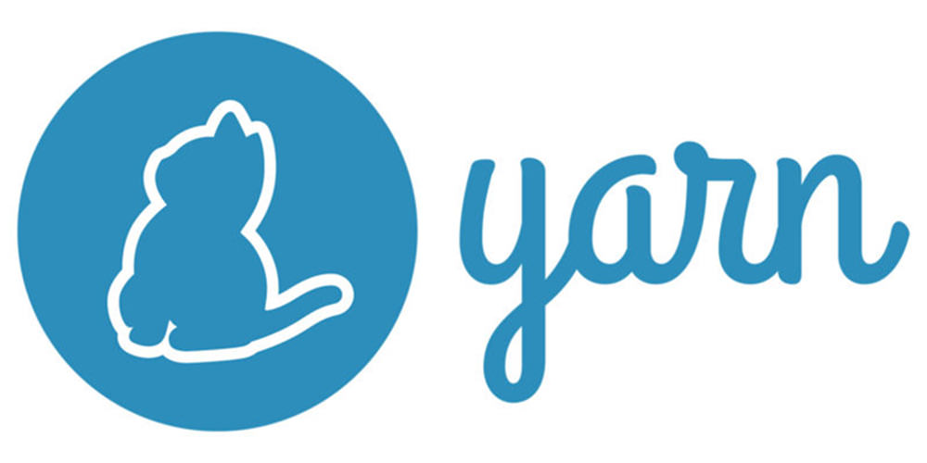


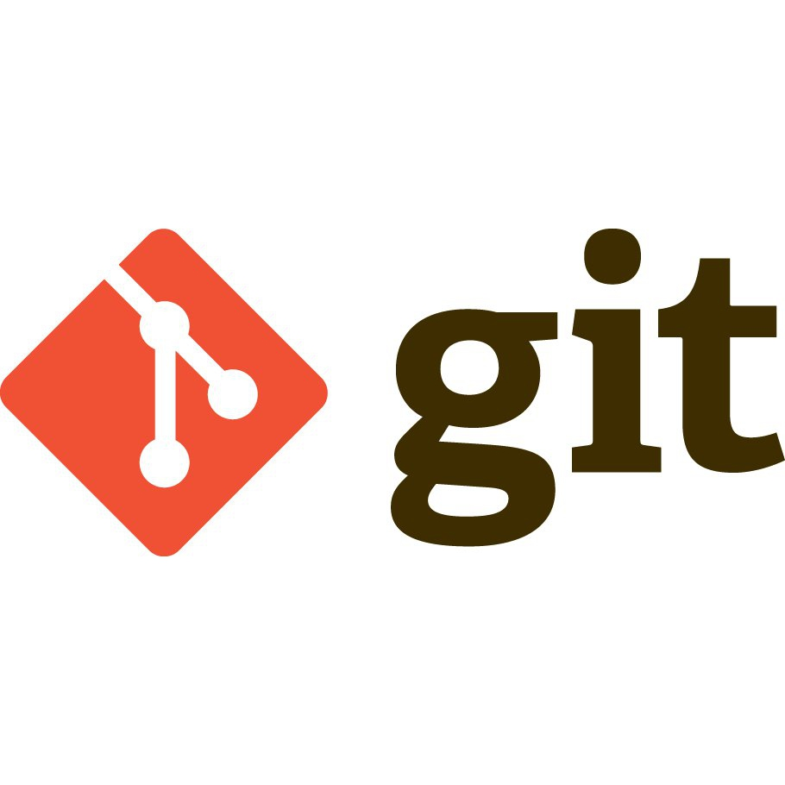

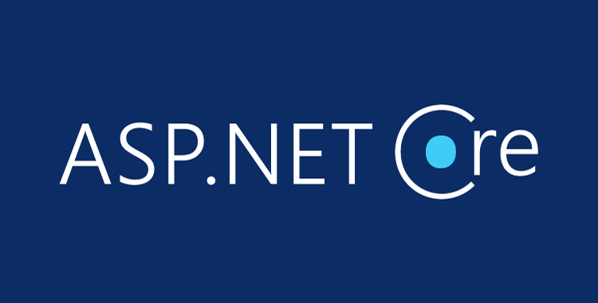

Package Managers

Slide 8
Demo Stack!

Slide 9
Why ?
Offline Mode If you've installed a package before, you can install it again without any internet connection.
Deterministic The same dependencies will be installed the same exact way across every machine regardless of install order.
Network Performance Yarn efficiently queues up requests and avoids request waterfalls in order to maximize network utilization.
Notes:
Offline Mode: If you've installed a package before, you can install it again without any internet connection.
Deterministic: The same dependencies will be installed the same exact way across every machine regardless of install order.
Network Performance: Yarn efficiently queues up requests and avoids request waterfalls in order to maximize network utilization.
Multiple Registries: Install any package from either npm or Bower and keep your package workflow the same.
Network Resilience: A single request failing won't cause an install to fail. Requests are retried upon failure.
Flat Mode: Resolve mismatching versions of dependencies to a single version to avoid creating duplicates.

Slide 10
Why ?
Multiple Registries Install any package from either npm or Bower and keep your package workflow the same.
Network Resilience A single request failing won't cause an install to fail. Requests are retried upon failure.
Flat Mode Resolve mismatching versions of dependencies to a single version to avoid creating duplicates.
Notes:
Offline Mode: If you've installed a package before, you can install it again without any internet connection.
Deterministic: The same dependencies will be installed the same exact way across every machine regardless of install order.
Network Performance: Yarn efficiently queues up requests and avoids request waterfalls in order to maximize network utilization.
Multiple Registries: Install any package from either npm or Bower and keep your package workflow the same.
Network Resilience: A single request failing won't cause an install to fail. Requests are retried upon failure.
Flat Mode: Resolve mismatching versions of dependencies to a single version to avoid creating duplicates.

Slide 11
Because … cats!

Slide 12
It’s demo time!
Install Node.js: https://nodejs.org/en/
Update npm: npm install npm@latest -g
Install Yarn: npm install --global yarn
Initialize a new Yarn project in project directory: yarn init
Add package to dependencies: yarn add {pkg}
Add js dependency to html: node_modules/{pkg}/dist/{pkg}.min.js"
Have fun!

Slide 13

Visual Studio Code Extension
Html5 Snippets https://marketplace.visualstudio.com/items?itemName=abusaidm.html-snippets
Yarn https://marketplace.visualstudio.com/items?itemName=gamunu.vscode-yarn

Slide 14

Links!!!
nodejs.org
www.npmjs.com
www.asp.net/core
www.asp.net
yarnpkg.com
bower.io
www.nuget.org

Slide 15
… moar Links!
https://code.facebook.com/posts/1840075619545360/yarn-a-new-package-manager-for-javascript/
http://www.infoworld.com/article/3172725/javascript/npm-or-yarn-nodejs-devs-pick-their-package-manager.html
http://alternativeto.net/software/npm/
https://www.akawebdesign.com/2016/03/25/thoughts-npm-fiasco/
http://stackoverflow.com/questions/40027819/when-to-use-yarn-over-npm-what-are-the-differences

Slide 16
Start coding!

