Slide 1

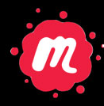

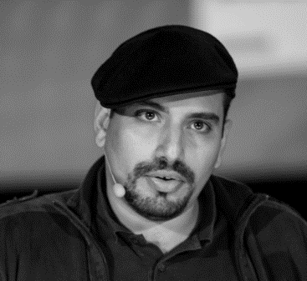
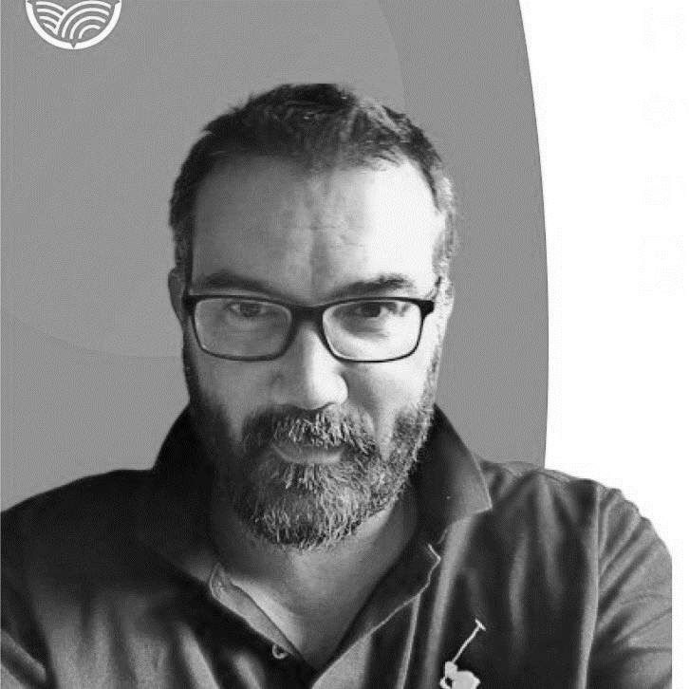

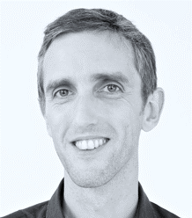
Context maps on the roof
Tuesday Sept 13th 2022
19h00
at
#DDDFR
( Lyon )
Julien Topçu (shodo)
Caroline Desplanques
Thomas PIERRAIN (agicap)
3 domains presented with Context Maps on the rooftop of a building
Jeremie Grodziski (redmind technology)

