Slide 1

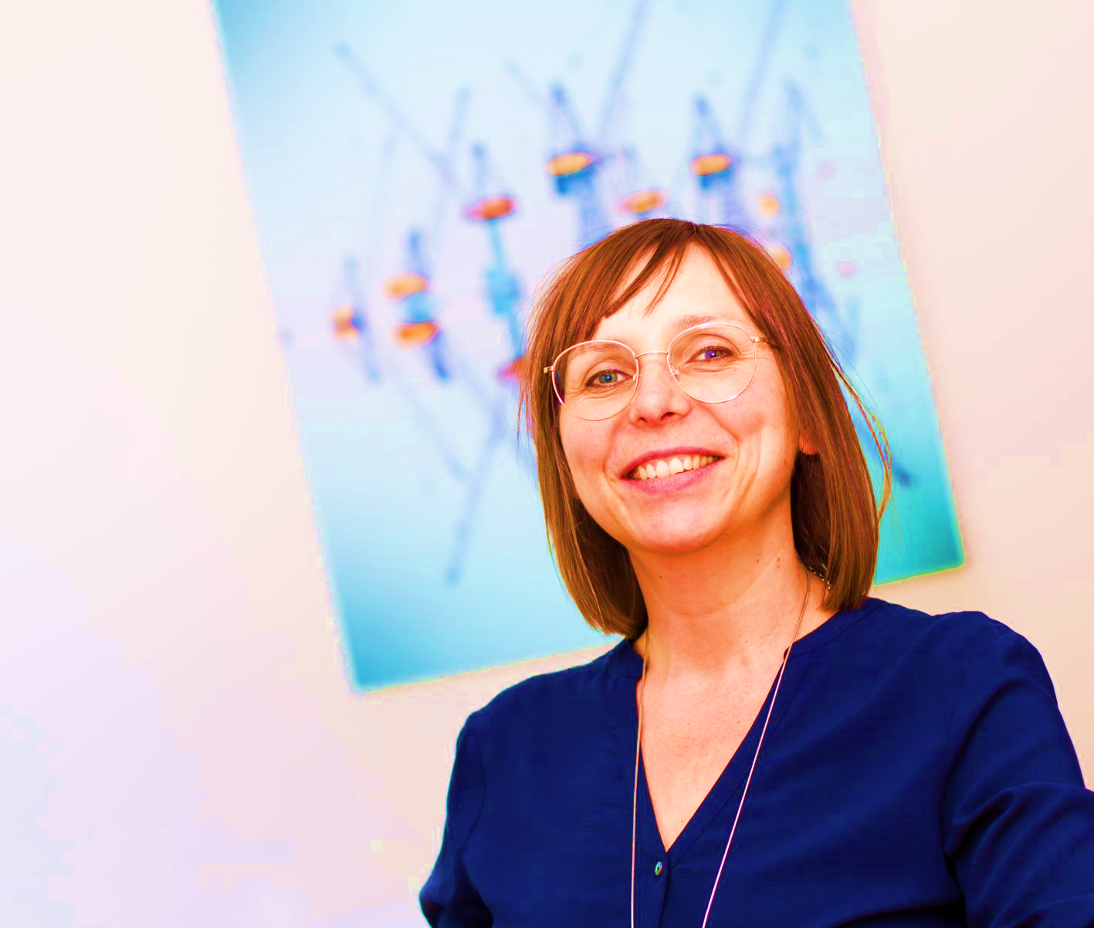

Building Adaptive Systems with Wardley Mapping, DDD, and Team Topologies
#Monday 27 Sept 2021
19h30
#DDDFR
Susanne Kaiser (Independent )

