Slide 1


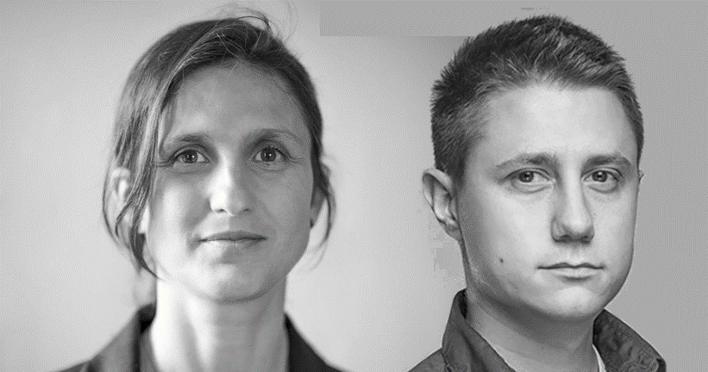
Do Distributed Systems they said It'll be fun they said
#Thursday 2nd Jun 2022
19h30
#DDDFR
Sara Pellegrini - Milan Savić (Axon IQ )

