Slide 1

OMI NLP in finance tutorial
Felix Drinkall, Dragos Gorduza

Slide 2
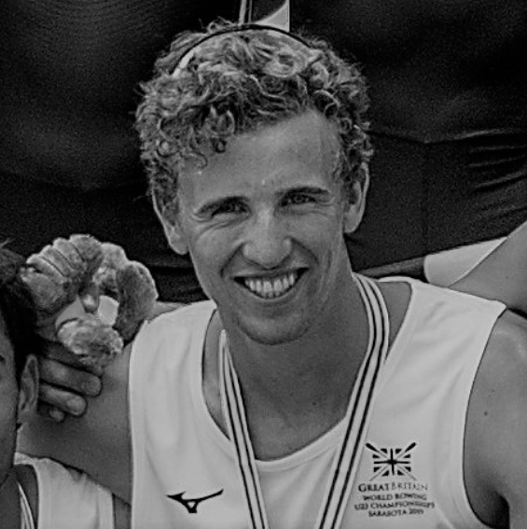
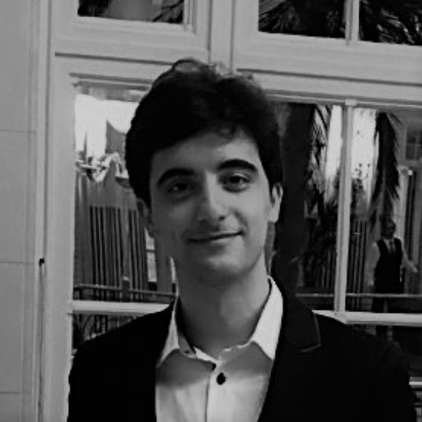
Introduction
Felix Drinkall
Blah blah blah
Dragos Gorduza
Blah blah blah

Slide 3
Schedule
9:15-10:15 – Motivation and traditional approaches
10:15-10:30 – Break
10:30-11:45 – Implementing the SOTA

Slide 4
Outline

Slide 5
Motivation

Slide 6
Thank you.

