Slide 1
Paper Review
April 12, 2019

Slide 2
Tracking Certificate Misissuance in wild https://www.youtube.com/watch?v=lNBoEDUbri0

Slide 3
Abstract
Certificate Authorities make errors in issuing certificates.
Used ‘Zlint’ to analyze those errors.
The errors drastically reduced since 2012 to 2017.
However, there remains the ‘longtail’ of small authorities that regularly issue non-conformant certificates.
By this analysis, looks for the best use lint data and ensure long-term health of the Web PKI(Public Key Infrastructure)

Slide 4
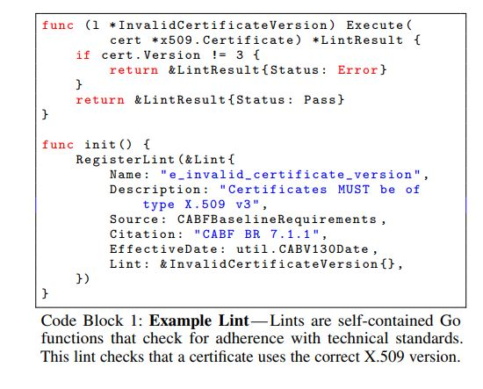
ZLINT: A CERTIFICATE LINTER
Linter: Checks Coding Convention and errors.
ZLint: A Linter that Checks a Certificate for Conformance with RFC 5280
https://www.rfc-editor.org/info/rfc5280
Severity Levels
NOTICE
WARNING
RFC SHOULD clause
ERROR
RFC MUST clause

Slide 5
ZLINT: A CERTIFICATE LINTER
Four Check-ups by using Zlint, not other certlints.
Since the paper used Zlint to grade authorities, it only includes lints that are directly based on a published standard
RFC 5280
CA/B Forum BRs
CA/B Forum is a voluntary consortium of certificate authorities, browsers and other PKI participants
Restricted lints to their effective periods
Zlint produces structured data for analysis
Zlint implemented as a standalone Go library.

Slide 6
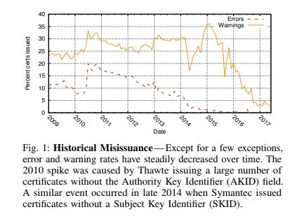
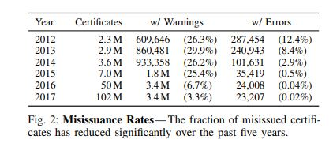
MISISSUANCE TODAY
A Long Tail of Misissuance
In 2017, only 0.02% of certificates contain errors, while 3.3% have warnings.
In 2012, more than 12% of certificates contained errors.

Slide 7
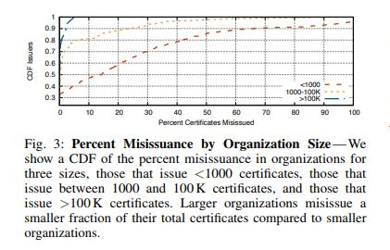
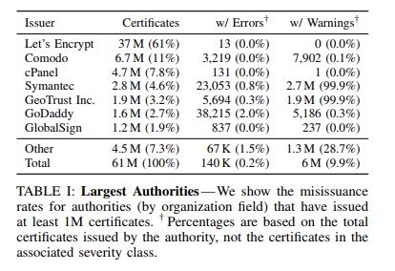
MISISSUANCE TODAY
A Long Tail of Misissuance(Cont’d)
The small amount of aggregate misissuance’s reason is that the large authorities well produces certificates.

Slide 8
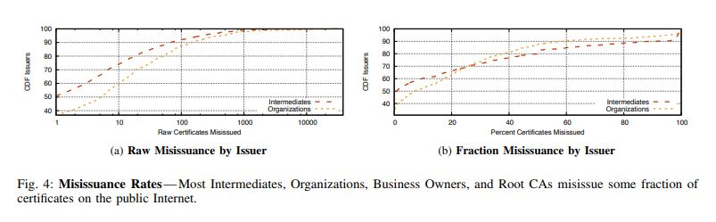
MISISSUANCE TODAY
A Long Tail of Misissuance(Cont’d)
On the flip side, nearly half of authorities misissue at least 10% of certificates.

Slide 9
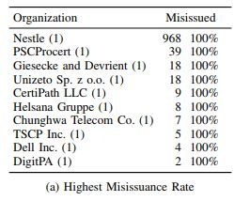
MISISSUANCE TODAY
A Long Tail of Misissuance(Cont’d)
The same errors are present on each certificates.
For example, the Nestle, which produced 100% of misissues, contains the same error: Failure to Include a Certificate Policy Statement (CPS).

Slide 10
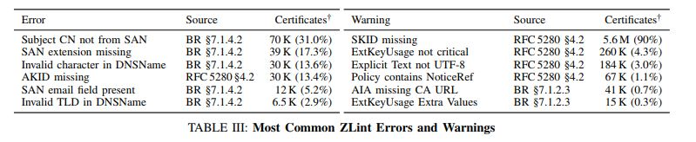
MISISSUANCE TODAY
What do Authorities Get Wrong?
The most common error is failing to correctly populate the Subject Alternate Names(SANs) extension.
https://en.wikipedia.org/wiki/Subject_Alternative_Name

Slide 11
MISISSUANCE TODAY
Warnings
Differ from errors, authorities often fail to adhere to recommendations in community standards. And that causes warnings.
There are handful of large players who do not follow community recommendations.
For example, Symantec, GeoTrust, and Thawate which owned by Symantec, triggers warnings for 99% of their certificates.
All of these fail to include the subject key identifier (SKID) extension in end-entity certificates.
https://www.ietf.org/rfc/rfc3280.txt (4.2.1.2 Subject Key Identifier)

Slide 12
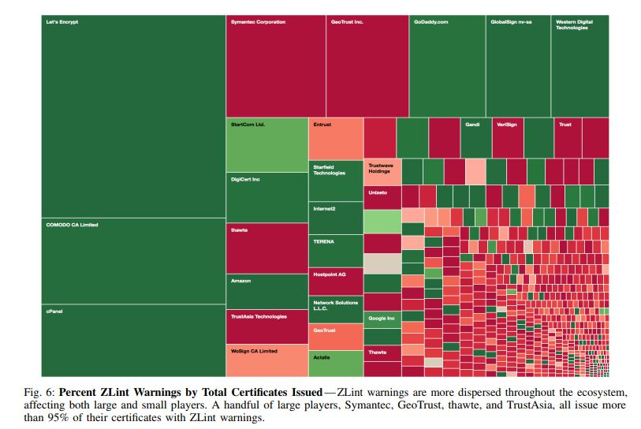
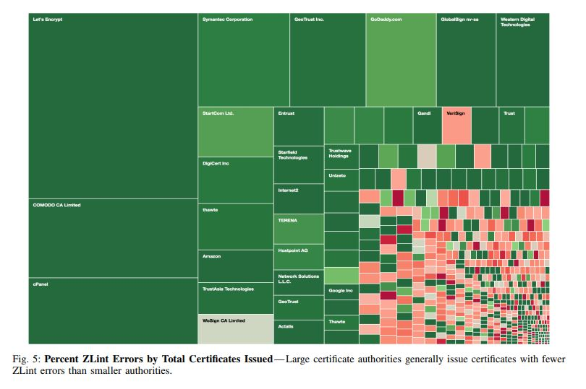

Slide 13
BEYOND INDIVIDUAL CERTIFICATES
Zlint can systematically identify problems, but there are many aspects of CA operation that cannot be verified in isolation.
Used two supporting services to see if they correlate with certificate misissuance
OCSP responders
CRL distribution points

Slide 14
BEYOND INDIVIDUAL CERTIFICATES
OCSP Responders
OCSP (Online Certificate Status Protocol)
Internet Protocol that allows authorities to revoke issued certificates.
1) Endpoint Availability
Certificate authorities must maintain an online OCSP responder
Checked for baseline responsiveness every hour during this period using a 60 second timeout.
2) Regular Updates
OCSP responders must update revocation periodically (every four days).
3) No Response for unknown Certificates
Authorities must not return a GOOD response for certificates they did not issue.

Slide 15
BEYOND INDIVIDUAL CERTIFICATES
OCSP Responders – Results
1) Endpoint Availability
75% : All online
9% : All offline
2) Regular Updates
10 responders did not refresh validity periods every four days.
3) No Response for unknown Certificates
25 responders incorrectly provided GOOD response for an unknown certificate.
CRL Maintenance
The result shows that smaller organization misissue a larger fractions of their certificate, which corresponds to earlier findings of the paper.

Slide 16
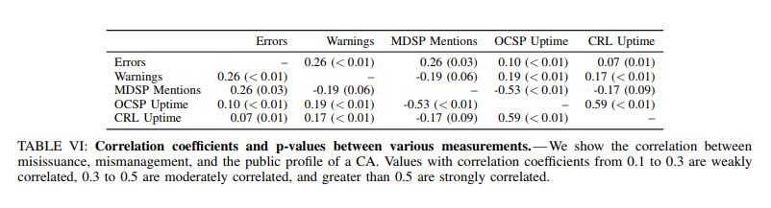
MISISSUANCE AS A PREDICTOR
The misissuance that Zlint detects can act as a predictor for more severe problems, like incorrectly validating domain ownership.
Can find correlation through several aspects.

Slide 17
MISISSUANCE AS A PREDICTOR
Community Discussion of Misissuance
Is the community aware of and addressing these authorities behavior (authorities with exceedingly high misissuance rates)?
Investigated the correlation between mismanagement and misissuance.
Referred from Mozilla Developer Security Policy (MDSP) mailing list.
The primary public forum for discussing web PKI issues and for reporting misissuance.

Slide 18
MISISSUANCE AS A PREDICTOR
Community Discussion of Misissuance(Cont’d)
Result
Surprisingly there was only a weak correlation.
However, this result is responsible for scale of organizations.
Large Organization’s misissues: Many talks or comments in MDSP
Small Organization’s misissues: Small talks
Community members only discuss misissued certificates when they are first logged in certificate transparency servers and many of the small authorities have only issued a handful of publicly-known certificates.

Slide 19
CONCLUSION
Zlint, a linter that checks certificates for conformance(적합성) with published technical standards.
Through the result from running the Zlint, the misissuance has drastically reduced over the past five years (2012-2017). Only 0.2% of certificates contain errors in 2017.
Still, there remains a long tail of authorities that continue to misissue certificates.
There is correlation in missuances, other types of mismanagement and in some cases, with browser action.
This lends credence to the idea that lint errors can help identify authorities with worrisome operational practices

