Slide 1
UART_top
tx_done
clk_sys
clk_sys
TX
clk_sys
RX
o_rx_data
out_data
rst_n
tx_done
rst_n
rst_n
parity_check
parity_check
in_valid
tx_valid
tx_data
uart_tx
uart_rx
rx_done
rx_done
in_data

Slide 2
clk_sys
clk_sys
…
…
…
…
center
sync_uart_rx
D0
D1
D2
baud_clk_cnt
…
…
baud_center_pulse

Slide 3
clk_sys
…
…
…
…
idle bit = 1
sync_uart_rx
start bit = 0
D0
reg [7:0] receive_start
1111_1111
…
1111_1110
1111_1100
1111_1000
0000_0000
0000_0000
baud_clk_cnt_valid

Slide 4
clk_sys
…
…
…
…
…
idle bit
stop bit
idle bit
sync_uart_rx
start bit
D0
D1
D2
D3
D4
D5
D6
D7
parity bit
baud_clk_cnt_valid == 1’b1
&&
baud_clk_cnt == BIT_CYCLE - 1
receive_bits_cnt == DATA_WIDTH
&&
baud_clk_cnt == BIT_CYCLE - 1
baud_clk_cnt == BIT_CYCLE - 1
IDLE
baud_clk_cnt_valid == 1’b1
&&
receive_bits_cnt == 4'd0
START
DATA
PARITY
STOP
baud_clk_cnt == BIT_CYCLE - 1

Slide 5
parity check
Odd parity check: data bits + parity bit, number of 1 is odd
PARITY_TYPE == 1
Even parity check: : data bits + parity bit, number of 1 is even
PARITY_TYPE == 0
D0
D1
D2
D3
D4
D5
D6
D7
parity bit
1
0
0
1
0
1
1
1
1
1
+
0
+
0
+
1
+
0
+
1
+
1
+
1
=
101
number_of_ones + sync_uart_rx == PARITY_TYPE
1
0
0
0
0
1
1
1
0
1
+
0
+
0
+
0
+
0
+
1
+
1
+
1
=
100
Odd parity: If the number of "1"s in the data bits is even, the parity bit is set to "1"; if the number of "1"s is odd, the parity bit is set to "0."
Even parity: If the number of "1"s in the data bits is even, the parity bit is set to "0"; if it is odd, the parity bit is set to "1."

Slide 8
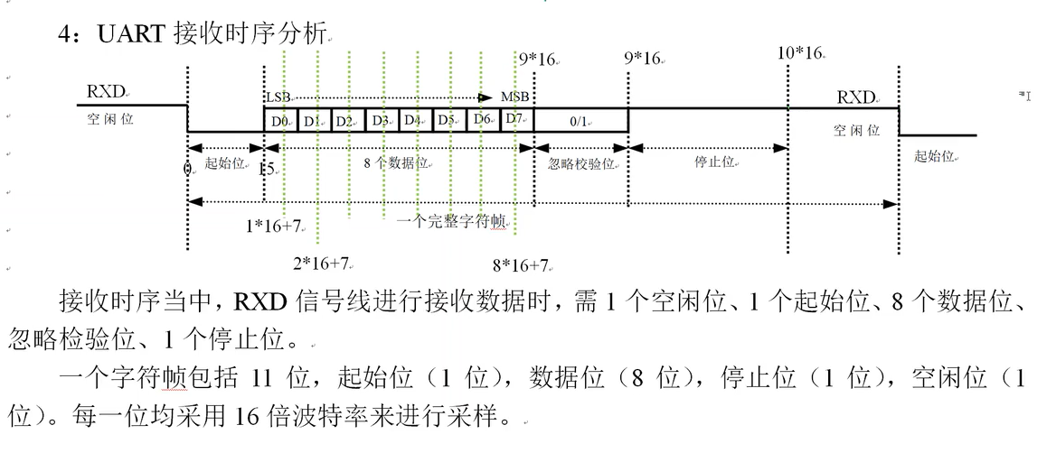

Slide 9
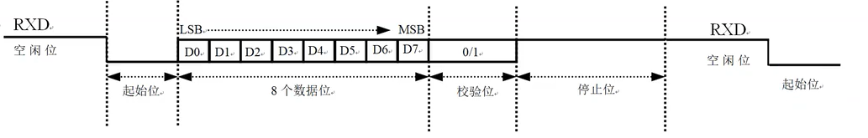
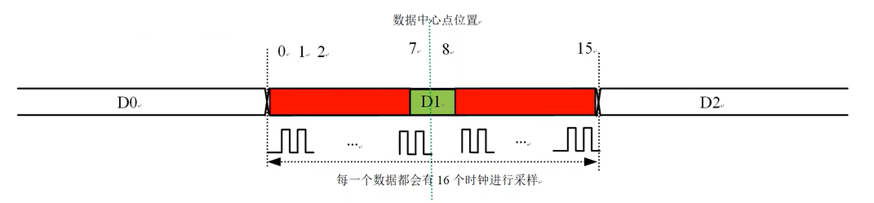

Slide 10
