Slide 1
Train data

Slide 2
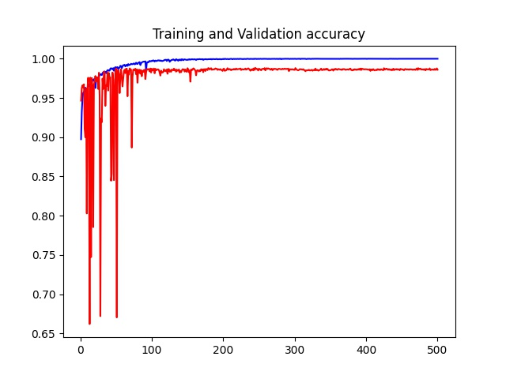
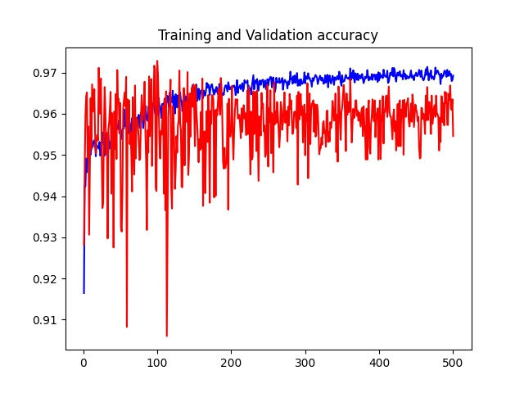
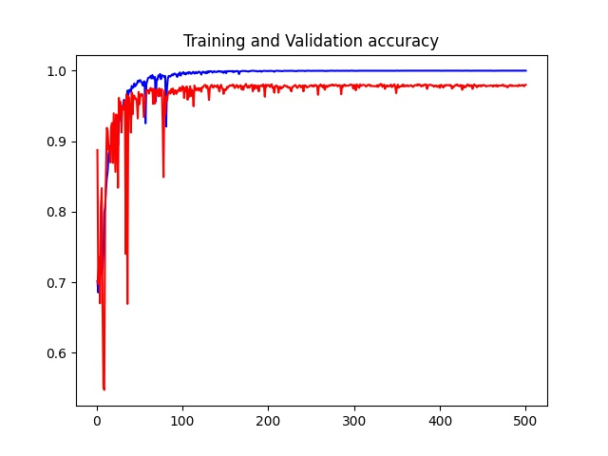
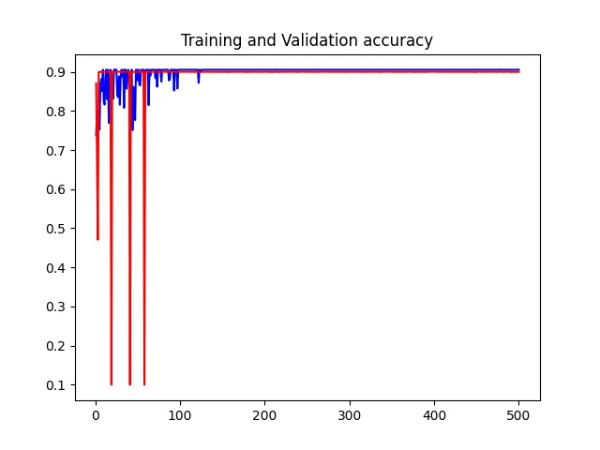
No mask
FALSE20Resnet18_Output
FALSE20Resnet101_Output
FALSE40Resnet18_Output
FALSE40Resnet101_Output

Slide 3
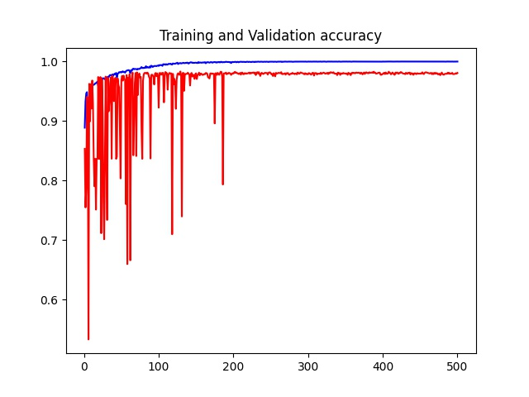
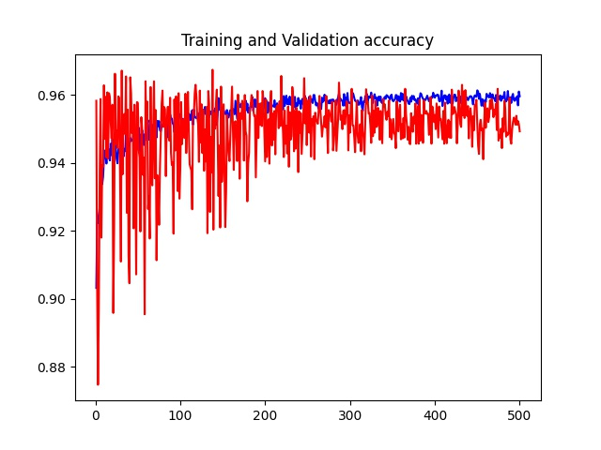
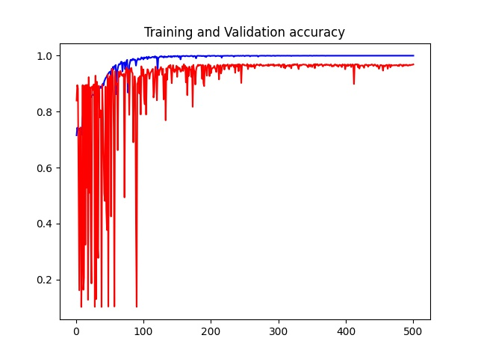
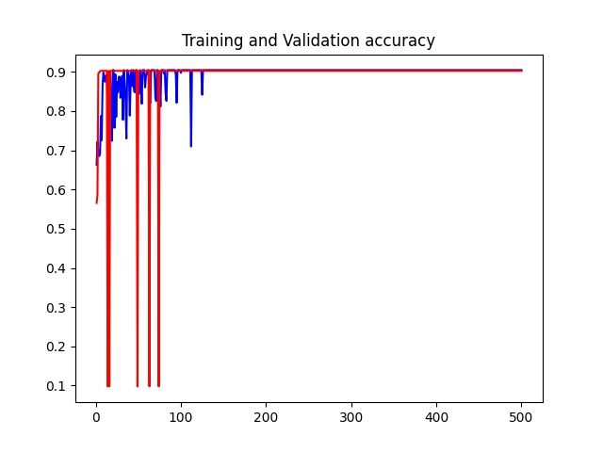
With mask
TRUE20Resnet18_Output
TRUE20Resnet101_Output
TRUE40Resnet18_Output
TRUE40Resnet101_Output

Slide 4
Test data

Slide 5
Test
Mask：False | Resnet18 | Resnet101
x20 | Loss: 0.165, Accuracy: 0.986 | Loss: 0.093, Accuracy: 0.961
x40 | Loss: 0.383, Accuracy: 0.980 | Loss: 0.693, Accuracy: 0.904
Mask：True | Resnet18 | Resnet101
x20 | Loss: 0.209, Accuracy: 0.983 | Loss: 0.152, Accuracy: 0.948
x40 | Loss: 2.293, Accuracy: 0.966 | Loss: 0.692, Accuracy: 0.904

