Slide 1
Model in each datasets

Slide 2
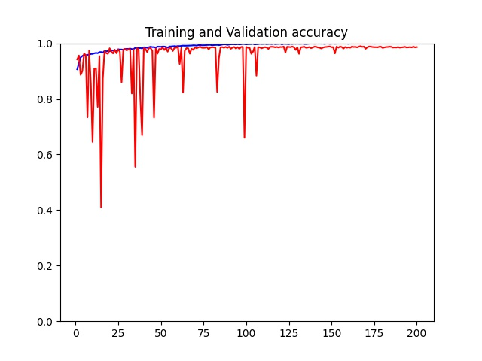
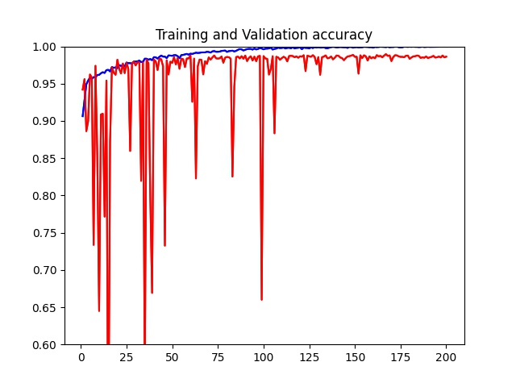
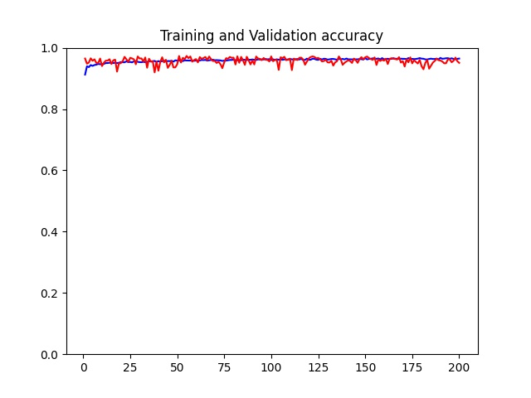
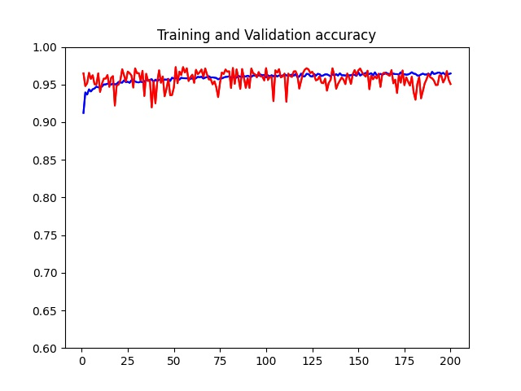
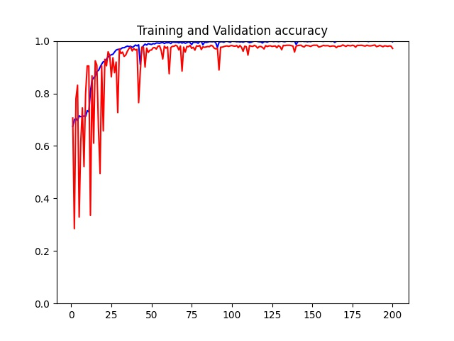
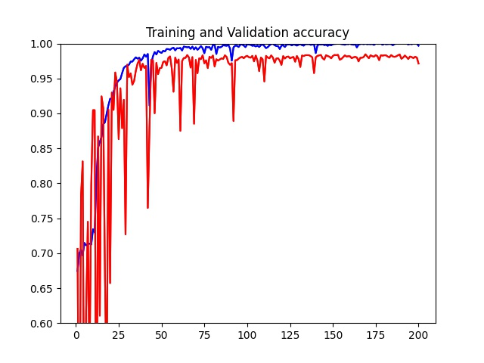
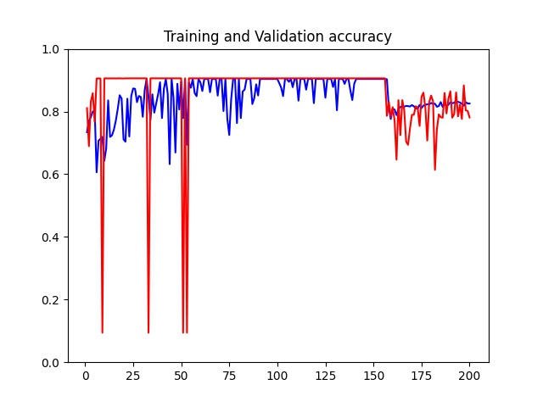
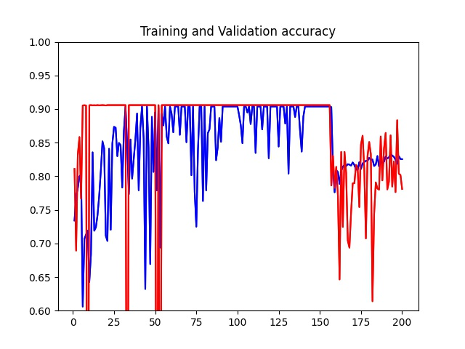
Train
No mask
FALSE20Resnet18_Output
FALSE20Resnet101_Output
FALSE40Resnet18_Output
FALSE40Resnet101_Output

Slide 3
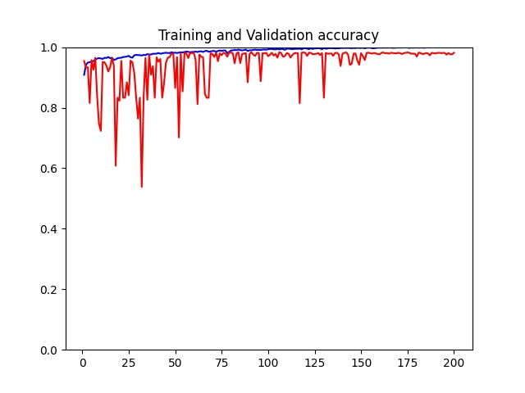
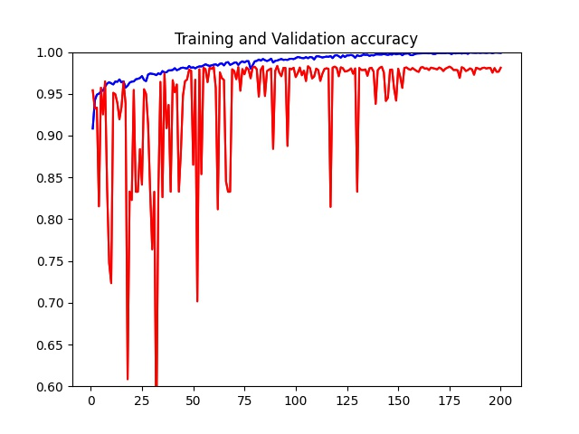
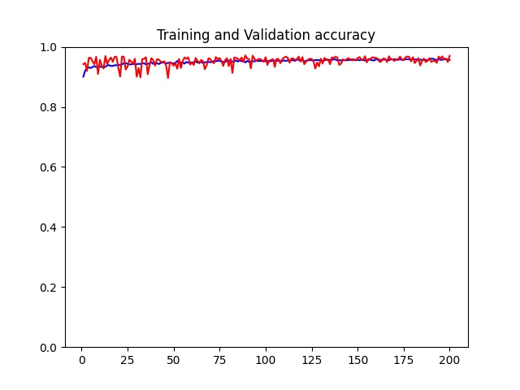
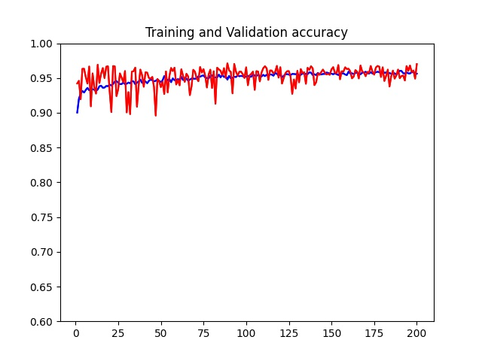
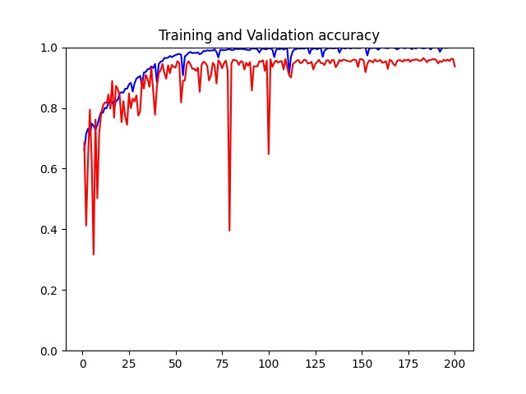
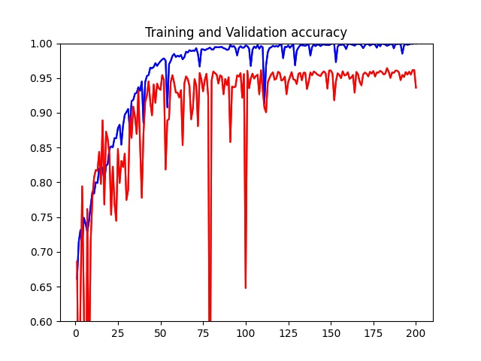
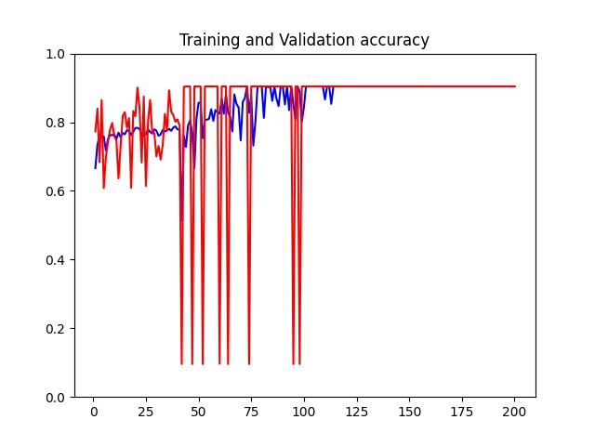
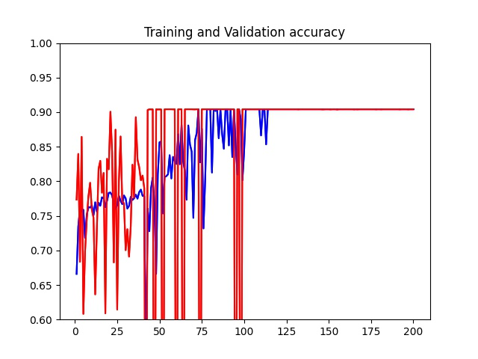
Train
With mask
TRUE20Resnet18_Output
TRUE20Resnet101_Output
TRUE40Resnet18_Output
TRUE40Resnet101_Output

Slide 4
Test
Mask：False | Resnet18 | Resnet101
x20 | Loss: 0.133, Accuracy: 0.986 | Loss: 0.427, Accuracy: 0.785
x40 | Loss: 0.223, Accuracy: 0.974 | Loss: 0.693, Accuracy: 0.904
Mask：True | Resnet18 | Resnet101
x20 | Loss: 0.161, Accuracy: 0.983 | Loss: 0.129, Accuracy: 0.966
x40 | Loss: 0.587, Accuracy: 0.938 | Loss: 0.692, Accuracy: 0.904

Slide 5

Model for all data

Slide 6
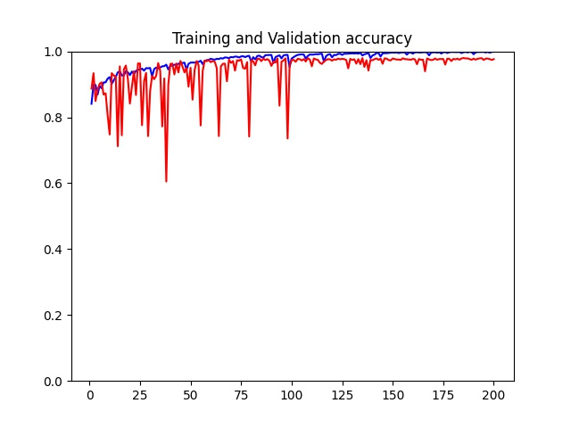
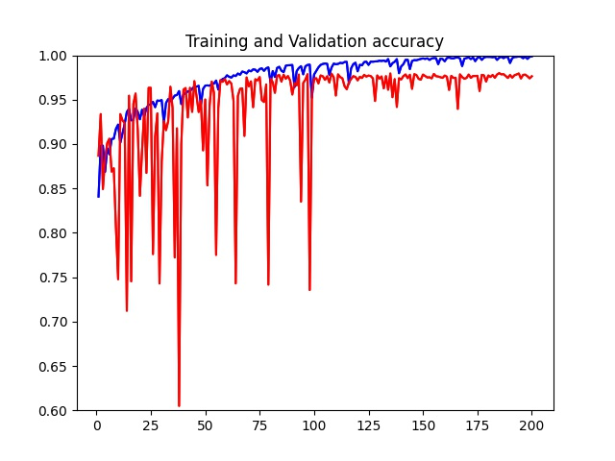
Train
no mask
Mode : resnet18
data: all 40 and 20
薬剤なし[:50000]
薬剤あり(13552,)

Slide 7
Test
Loss: 0.163, Accuracy: 0.976

Slide 8
Feature map

