Slide 1
Object Oriented Programming
Group 4 project presentation
TOPIC: MONOPOLY

Slide 2
TEAM MEMBERS
Lê Nguyễn Nguyên Thiêng - ITITIU21320
Nguyễn Trần Quốc Thái - ITITIU21307
Dương Minh Duy – ITDSIU21081

Slide 3
Table of contents
01
02
03
04
The details of the game
Introduction
UML class diagram
Evaluation
Notes:
Put the contribution at after team members?

Slide 4
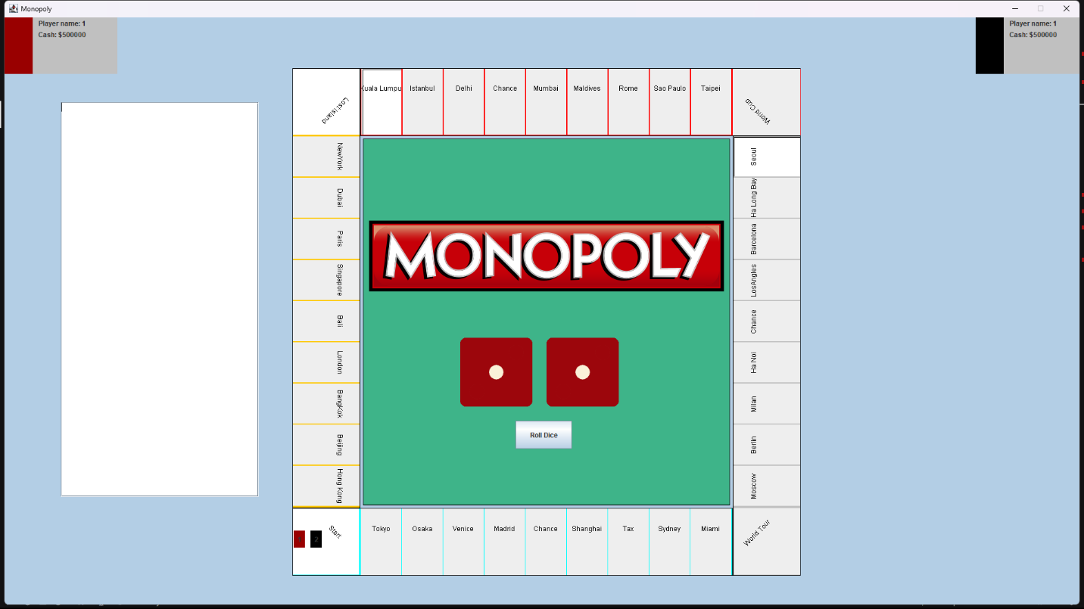
01: Introduction
• Project Overview: The project in the Object-Oriented Programming course demonstrates a comprehensive understanding of OOP concepts and incorporates advanced OOP principles for sophistication.
• Java Language: Java, a representative OOP language, is the only language used in this project, showcasing the application of OOP principles in a practical scenario.
• Graphical User Interface: The project's GUI is developed using Swing, enhancing user interaction and providing a visual representation of the application's functionality.

Slide 5
02: The details of the game
a). Flow of main game
• Start Menu: The game initiates with a Start Menu that allows players to begin the game, input their information, and access game settings before delving into the gameplay experience.
• Input Players Information: Players provide their names, choose colors/representative labels, and configure initial settings to personalize their gaming experience and set the stage for strategic gameplay interactions.
• Game GUI: The Game GUI showcases the virtual game board, player information, and interactive elements like dice rolling mechanics, property management, and gameplay progress tracking for an immersive gaming experience.
• Roll Dice Mechanism: Players engage in the game by rolling dice, moving their tokens on the board based on the dice result, and proceeding with property interactions, purchases, and strategic decisions for game advancement.
• Winner Declaration: The game determines the winner based on predefined conditions like ownership of four beaches and financial solvency, concluding the gameplay experience and highlighting successful strategic gameplay tactics.

Slide 6
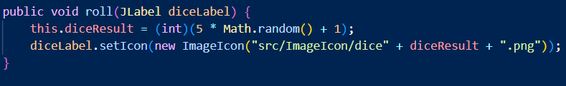
02: The details of the game
b). Class detail
Class Board:
The purpose of this class is to represent a game board, which includes a timer, a collection of squares, a collection of players, and a collection of cities related to events.
Class Dice:
Provide methods to initialize the dice images, set and get the dice result, and roll the dice.
dice1 to dice6: These are BufferedImage objects that store the images of the six faces of a dice (1 to 6).
The constructor initializes the dice1 to dice6 fields by reading the corresponding image files from the src/ImageIcon directory using ImageIO.read(). If any of the files cannot be read, an IOException is caught, and an error message is printed to the console.
The roll method generates a random number between 1 and 6 using Math.random() and set diceResult to this value.
The method also updates the diceLabel parameter, which is a JLabel component, by setting its icon to the corresponding dice image based on the diceResult value.

Slide 7
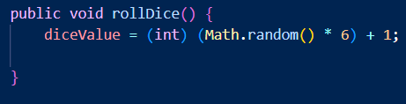
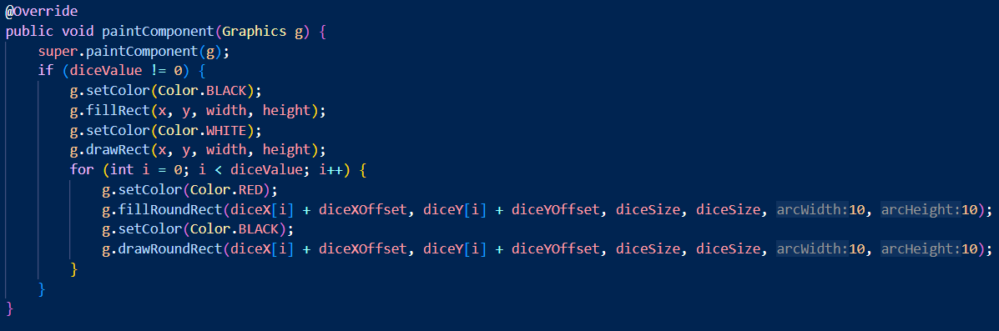
02: The details of the game
b). Class detail
Class DicePanel:
Create a custom panel for displaying a dice roll animation.
The rollDice method generates a random number between 1 and 6 and assigns it to the diceValue variable.
paintComponent method is overridden to customize the painting of the panel. It is called whenever the panel needs to be redrawn. Here's what it does:
If diceValue is not 0, it:
Fills the panel with a black rectangle (background)
Draws a white rectangle around the panel (border)
Loops through the diceValue number of times and:
Fills a red rounded rectangle (dice) at the calculated x and y coordinates
Draws a black rounded rectangle (dice border) around the red dice
The stopAnimation method sets diceValue to 0 and calls repaint to redraw the panel. This effectively stops the animation and clears the panel.

Slide 8
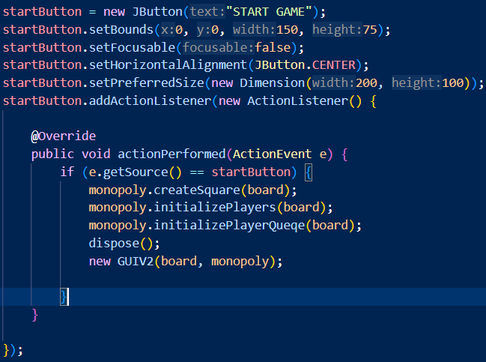
02: The details of the game
b). Class detail
Class ImgService:
The class imports necessary packages and classes for handling images and graphical user interfaces.
Class StartMenuGUI:
The UI is initialized with the Monopoly logo, a start button, and a message. When the start button is clicked, it triggers the game initialization and opens a new window with the game board and objects. The UI is also configured with a size, title, and icon image. It is set to be non-resizable and centered on the screen.
The UI consists of:
A JButton named startButton with the text "START GAME". When clicked, it initializes the game, creates squares on the board, and sets up players and their queues. It then disposes of the current window and opens a new window GUIV2 with the board and game objects.

Slide 9
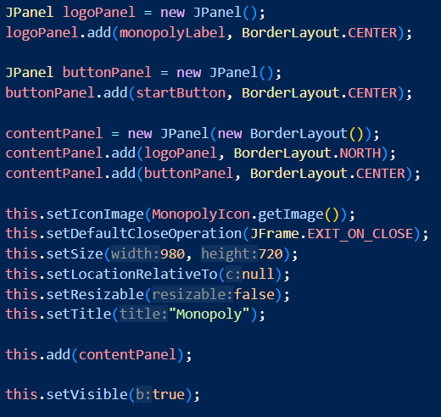
02: The details of the game
b). Class detail
A JLabel named monopolyLabel that displays the Monopoly logo and a message "This game is made by Group 4".
A JPanel named contentPanel that contains the monopolyLabel and startButton using a BorderLayout layout manager.

Slide 10
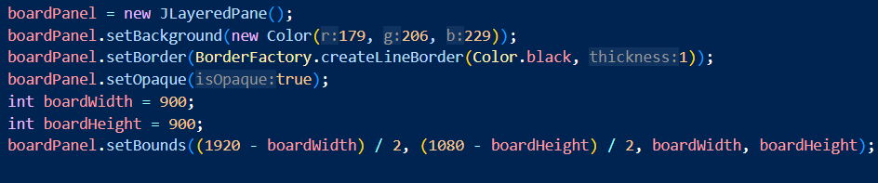
02: The details of the game
b). Class detail
Class GUIV2:
Create game GUI.
The GUI consists of several components:
Game Board: A JLayeredPane named boardPanel that represents the Monopoly board. It contains several panels and components, including:
North Panel: A JPanel that represents the top edge of the board, containing squares 11-20.
South Panel: A JPanel that represents the bottom edge of the board, containing squares 30-39.
East Panel: A JPanel that represents the right edge of the board, containing squares 21-30.
West Panel: A JPanel that represents the left edge of the board, containing squares 1-10.

Slide 11
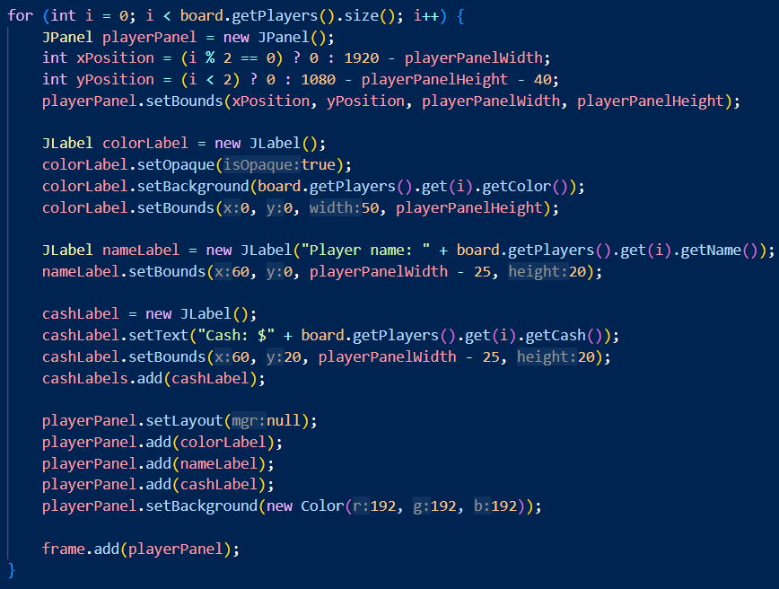
02: The details of the game
b). Class detail
Player Panels: Several JPanel instances that represent each player's information, including their name, cash, and color. These panels are added to the frame and updated dynamically.

Slide 12
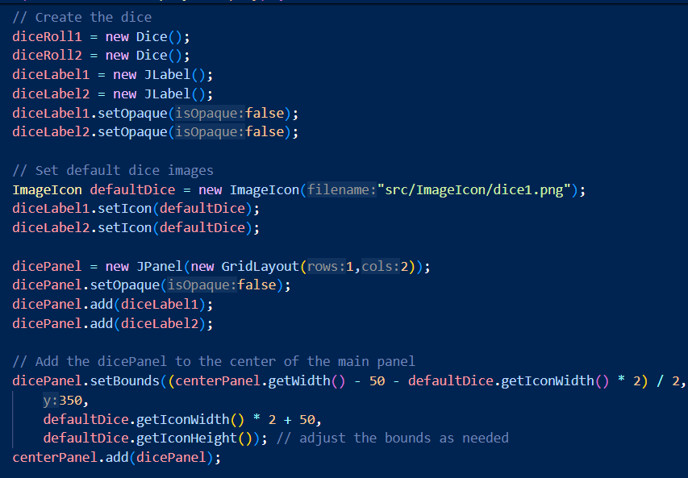
02: The details of the game
b). Class detail
Dice Panel: A JPanel that contains two JLabel instances that display the dice rolls.

Slide 13
02: The details of the game
b). Class detail
Roll Dice Button: A JButton that triggers the dice roll and game logic when clicked.
Text Area: A JTextArea that displays the game log and output.
Frame: A JFrame instance that contains all the GUI components and is responsible for displaying the game.
changePlayerPosition method updates a player's position on the board.
updatePlayerCash method updates a player's cash amount.
updatePlayerPosition method updates a player's position on the board and repaints the GUI.
removePlayerFromGUI method removes a player from the GUI when they are eliminated from the game.
getUserInputNumber method prompts the user to enter a number and returns the input.
getUserInputYesNo method prompts the user to choose YES or NO and returns the input.
setUserInput method sets the user input string.
The CustomOutputStream class is a custom output stream that appends text to a JTextArea and scrolls to the bottom to always show the latest output.

Slide 14
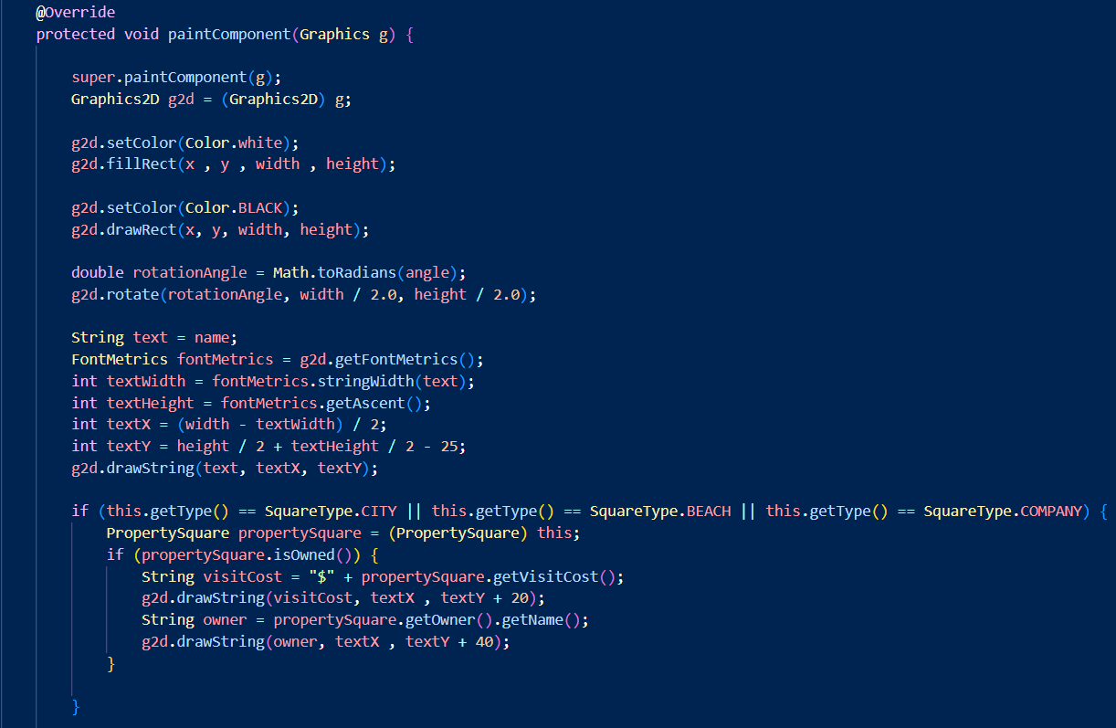
02: The details of the game
b). Class detail
Class Squares:
Create basic attributes, method of each square.
Create simple GUI for each square with paintComponent method.

Slide 15
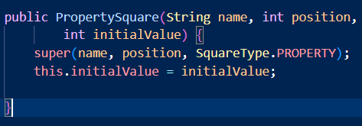
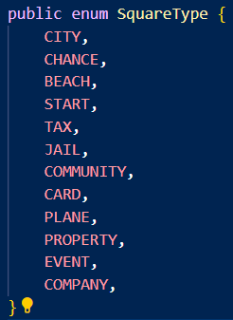
02: The details of the game
b). Class detail
Class PropertySquare:
Represent a property square and provides a template for creating different types of property squares, each with their own unique characteristics, such as property value, visit cost, and upgrade cost.
The constructor of the class initializes the Square with the type of PROPERTY.
resetAllAtribute method is used to reset level, property value and upgrade cost to initial value.
Class SquareType:
An enumeration (enum) is a value type that represents a set of named square constants.

Slide 16
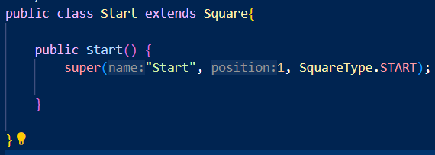
02: The details of the game
b). Class detail
Class Start:
The constructor of the class initializes the Square with the name " Start ", at position 1, and the type of START.
Class Event:
Create World Cup event square and handle the player’s city after event with setWorldCup method.
When a player step on this square, that player will have an option to choose a city by number from their properties, the player can check which city is valid in the text area by printCity method.
After that, the isValidChoice method will check if the input is a valid number, then check if that number is a city or not. If it is valid, it will set a world cup event on that city by increasing the visit cost and the event will remains until the next time a player step on this square.

Slide 17
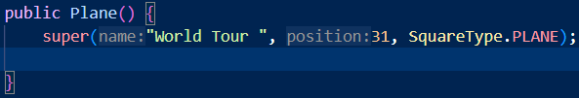
02: The details of the game
b). Class detail
Class Plane:
This class represents a plane square, provides methods for printing the list of available cities and moving the player to a chosen city.
Has an ArrayList of City objects called availableCities, which stores cities that the player can travel to.
The constructor of the class initializes the Square with the name "World Tour", at position 31, and the type of PLANE.
The printLocation method prints the list of cities that the player can travel to.
The travel method allows the player to choose a city from the availableCities list and move to that city. It first calls printLocation to display the list of available cities. It then gets user input and continues to ask for input until a valid number is entered. Once a valid number is entered, the method moves the player to the chosen city, and interact with the chosen city.

Slide 18
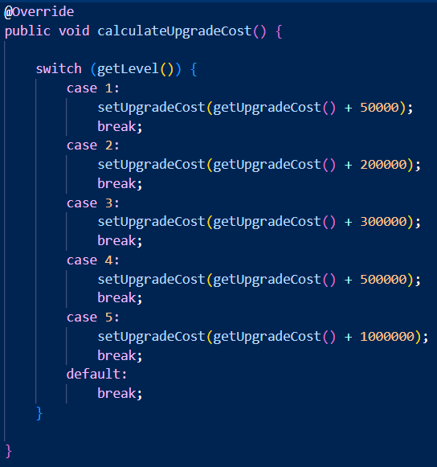
02: The details of the game
b). Class detail
Class City:
This class represents a city square, and it has methods to calculate its upgrade cost, property value, visit cost, and sell value based on its level and whether it's hosting a World Cup event or not.
The constructor of the class initializes the Square the type of CITY.
calculateUpgradeCost method to calculate the upgrade cost of the city based on its current level.

Slide 19
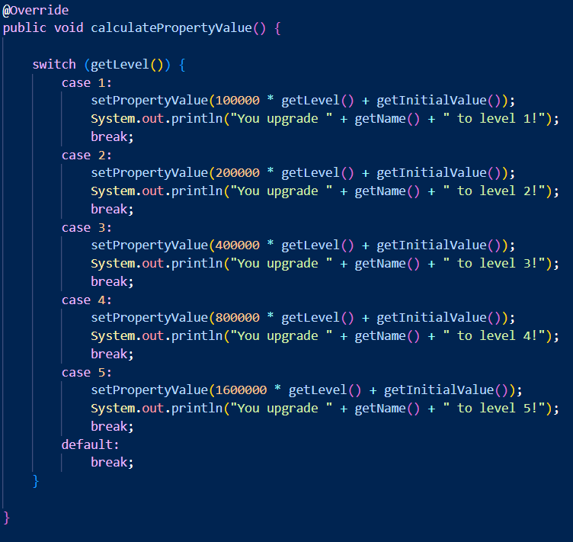
02: The details of the game
b). Class detail
calculatePropertyValue method to calculate the upgrade cost of the city based on its current level.
calculateVisitCost method to calculate the visit with condition. If the city is hosting a World Cup event, the visit cost is multiplied by 10. Otherwise, the visit cost is half of the property value.
calculateSellValue method to calculate the sell value by 70% of its property value.

Slide 20

02: The details of the game
b). Class detail
Class Jail:
Represents the jail square, and it has methods to handle the logic when a player lands on this square, including rolling a double to get out of jail and paying a fine if they can't get out after 3 turns.
The constructor of the class initializes the Square with the name " Jail ", at position 11, and the type of JAIL.
handlePlayerInJail method first prints a message indicating that the player is in jail, then checks if the player has rolled doubles by calling the rollDiceForJail method.
If the player has rolled doubles, they are released from jail and the jailTurn counter is reset to 0.
If the player hasn't rolled doubles, they are still in jail and the jailTurn counter is incremented. If the player has been in jail for more than 3 turns, they are forced to pay a fine of 50,000 to get out of jail by calling payJailFine.

Slide 21
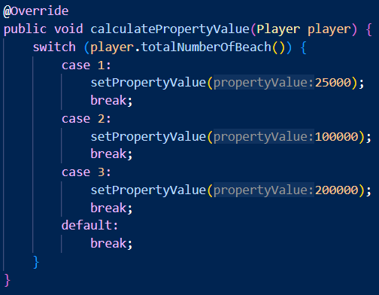
02: The details of the game
b). Class detail
Class Beach:
Represents a beach property in a board game, and it has methods to calculate its property value, visit cost, and sell value based on the number of beaches owned by the player.
The constructor of the class initializes the Square the type of BEACH.
calculatePropertyValue method calculates the property value of the beach based on the number of beaches owned by the player.
calculateVisitCost method calculates the visit cost equal to the property value.
calculateSellValue method fixes the sell value to 200,000.
calculateUpgradeCost fixes the upgrade cost to 0, indicating that beaches cannot be upgraded.

Slide 22
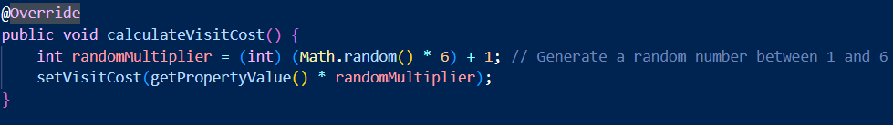
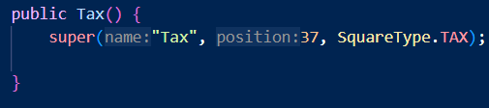
02: The details of the game
b). Class detail
Class Company:
Basically, the same as beach class. The difference is calculateVisitCost method.
The constructor of the class initializes the Square the type of COMPANY.
calculateVisitCost method calculates the visit cost by multiplying the property value with a random number from 1 to 6.
Class Tax:
Represents a tax square and it has methods to calculate the total tax amount based on the player's property and the game's progress.
The constructor of the class initializes the Square with the name " Tax ", at position 37, and the type of TAX.
calculateTotalTax method calculates the total tax amount based on the player's cash and total property value. The tax calculation changes depending on the elapsed time:
If the elapsed time is 5 minutes or less, the tax is 1% of the player's cash and total property value.
If the elapsed time is between 5 and 10 minutes, the tax is 5% of the player's cash and total property value.
If the elapsed time is 10 minutes or more, the tax is 10% of the player's cash plus 15% of the player's total property value.

Slide 23
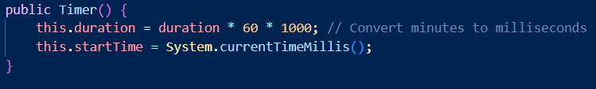
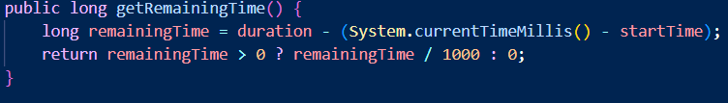

02: The details of the game
b). Class detail
Class Timer:
Create a timer and calculate the time left.
The constructor takes no parameters and initializes the startTime to the current time in milliseconds, and the duration to a default value.
getRemainingTime method returns the remaining time by subtracting the play time from the total duration in seconds.
getElapsedTime method returns the elapsed time in seconds by subtracting the start time from the current time.
start method starts the timer. It creates a new thread that runs in the background and updates the remaining time every second. When 10 minutes have passed, it executes the Runnable action set by setTenMinAction method. When the timer reaches 0, it prints "Time is up!".

Slide 24
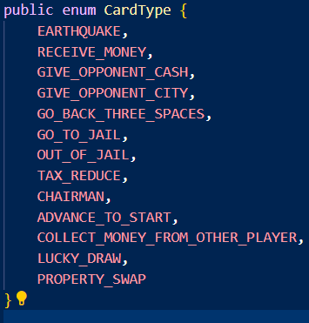
02: The details of the game
b). Class detail
Class CardType:
An enumeration (enum) is a value type that represents a set of named card constants.

Slide 25
02: The details of the game
b). Class detail
Class Card:
Represents a chance card and it has several methods that implement the effects of different cards.
EarthQuakeChanceCard method will destroy a random property owned by the player.
ReceiveMoneyChanceCard gives the player a certain amount of money.
GiveOpponentCashChanceCard allows the player to give a certain amount of money to another player.
GiveOpponentCityChanceCard allows the player to give a city to another player.
GoBackThreeSpaceChanceCard moves the player back three spaces on the board.
GoToJailChanceCard sends the player directly to jail.
GoOutOfJailChanceCard allows the player to get out of jail.
ReduceTaxChanceCard reduces the player's tax by 50%.
ChairManChanceCard allows the player to become the chairman and collect money from other players.
AdvanceToStartChanceCard moves the player to the start of the board and gives them a certain amount of money.
CollectMoneyFromOtherPlayerCommunityCard allows the player to collect money from other players.
LuckyDrawChanceCard gives the player a random amount of money.
PropertySwapChanceCard allows the player to swap one of their properties with another player's property.

Slide 26
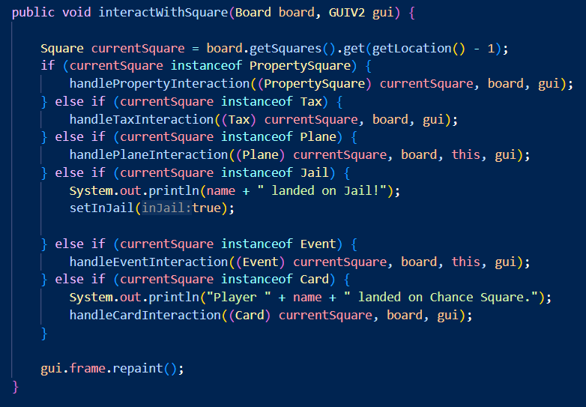
02: The details of the game
b). Class detail
Class Player:
Represents a player and it has methods for player interacts with a square, implementing the specific effects of each square type, rolling the dice, calculating the total number of beach and company properties, and total property value.
rollDice method rolls the dice and returns the total value of the dice rolls.
totalNumberOfBeach returns method the total number of beach properties owned by the player.
totalNumberOfCompanies method returns the total number of company properties owned by the player.
calculateTotalPropertyValue method calculates the total property value of the player.
interactWithSquare method interacts with the square that the player is currently on.

Slide 27
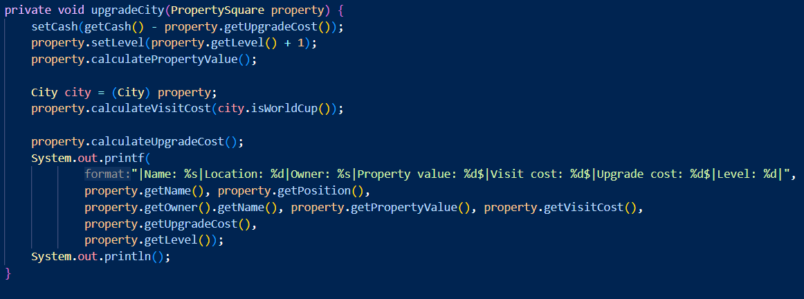
02: The details of the game
b). Class detail
handlePropertyInteraction method handles the interaction with a property square.
buyPropertyFromOtherPlayer method buys a property from another player.
sellPropertiesToCoverRent method sells properties to cover the rent amount.
buyProperty method buys a property.
upgradeCity method upgrades a city property.
handleTaxInteractionhandles method handle the interaction with a tax square.
handlePlaneInteraction method handles the interaction with a plane square.
handleJailInteraction method handles the interaction with a jail square.
handleEventInteraction method handles the interaction with an event square.
handleCardInteraction method handles the interaction with a card.

Slide 28
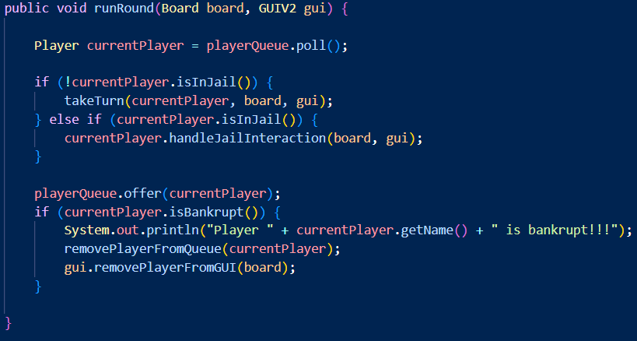
02: The details of the game
b). Class detail
Class Monopoly:
The Monopoly class contains the main method, which creates a new Board object and a new Monopoly object, and then initializes the game by calling the initializeGame method.
The Monopoly class also contains several methods for initializing the game, running the game, and printing the game result:
The runRound method runs a round of the game by taking the turn of each player in the player queue.

Slide 29
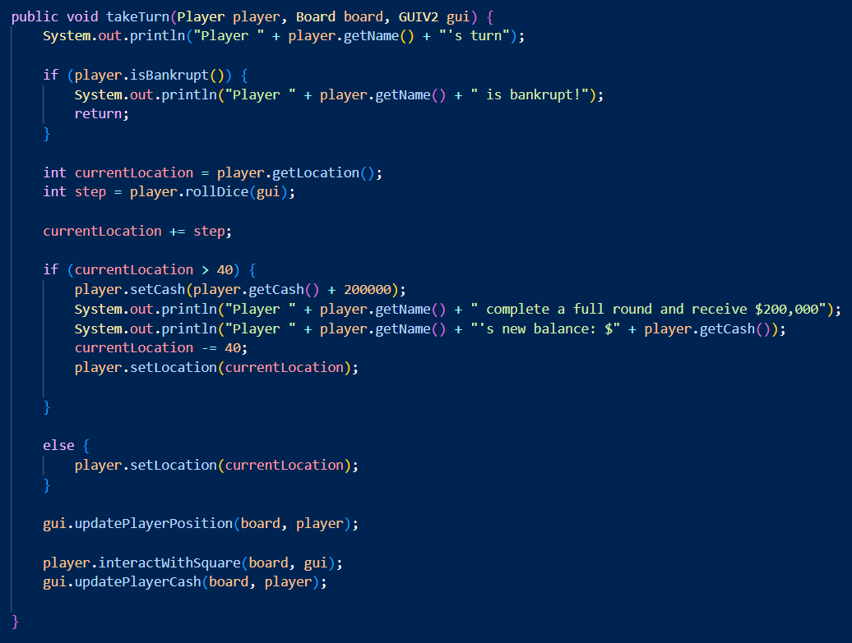
02: The details of the game
b). Class detail
The takeTurn method takes a turn of the game by rolling the dice, moving the player, and interacting with the square that the player lands on.
The createSquare method creates the squares on the board, such as Start, City, Beach, Jail, Event, and Company.
The printResult method prints the game result by displaying the final balance of each player. To control game structure.

Slide 30
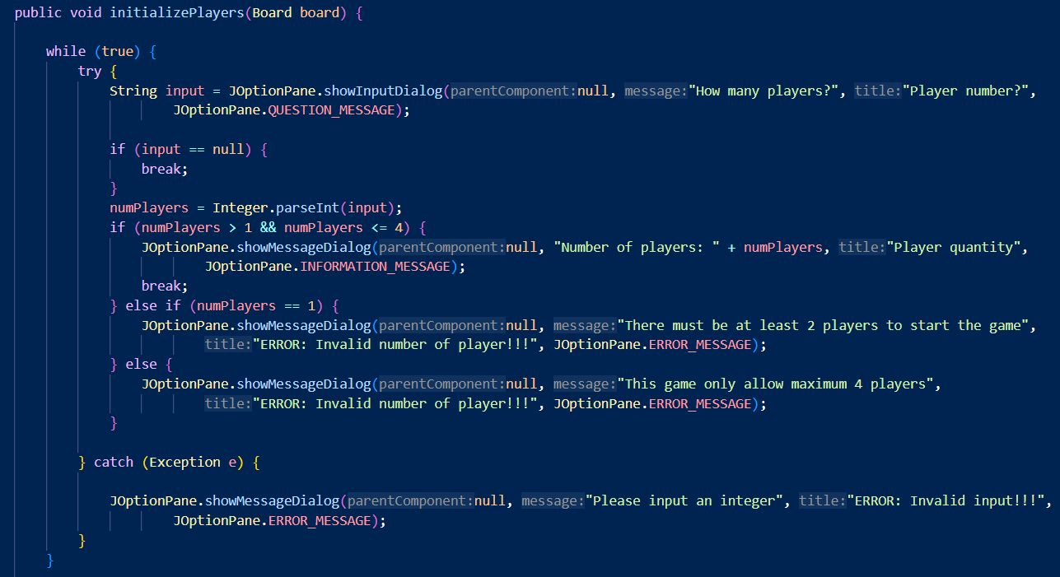
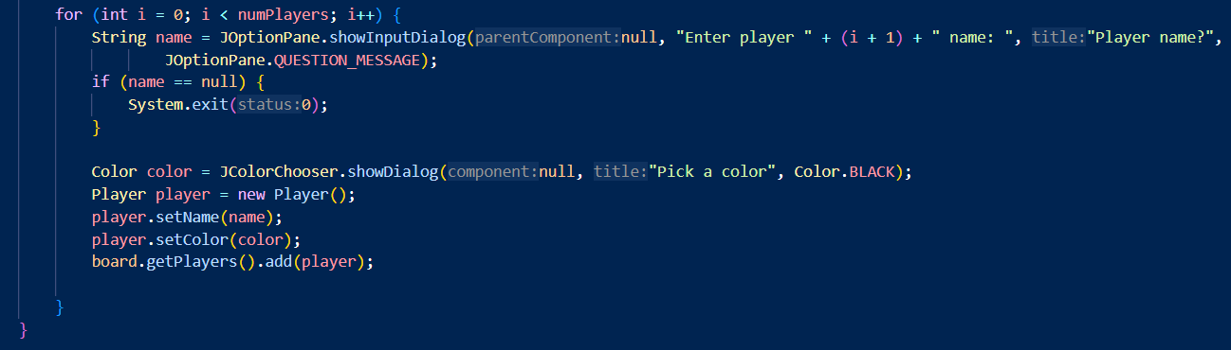
02: The details of the game
b). Class detail
The initializePlayers method initializes the players by prompting the user to enter the number of players and their names, and then creating a new Player object for each player.

Slide 31
02: The details of the game
b). Class detail
The initializePlayers method initializes the players by prompting the user to enter the number of players and their names, and then creating a new Player object for each player.

Slide 32
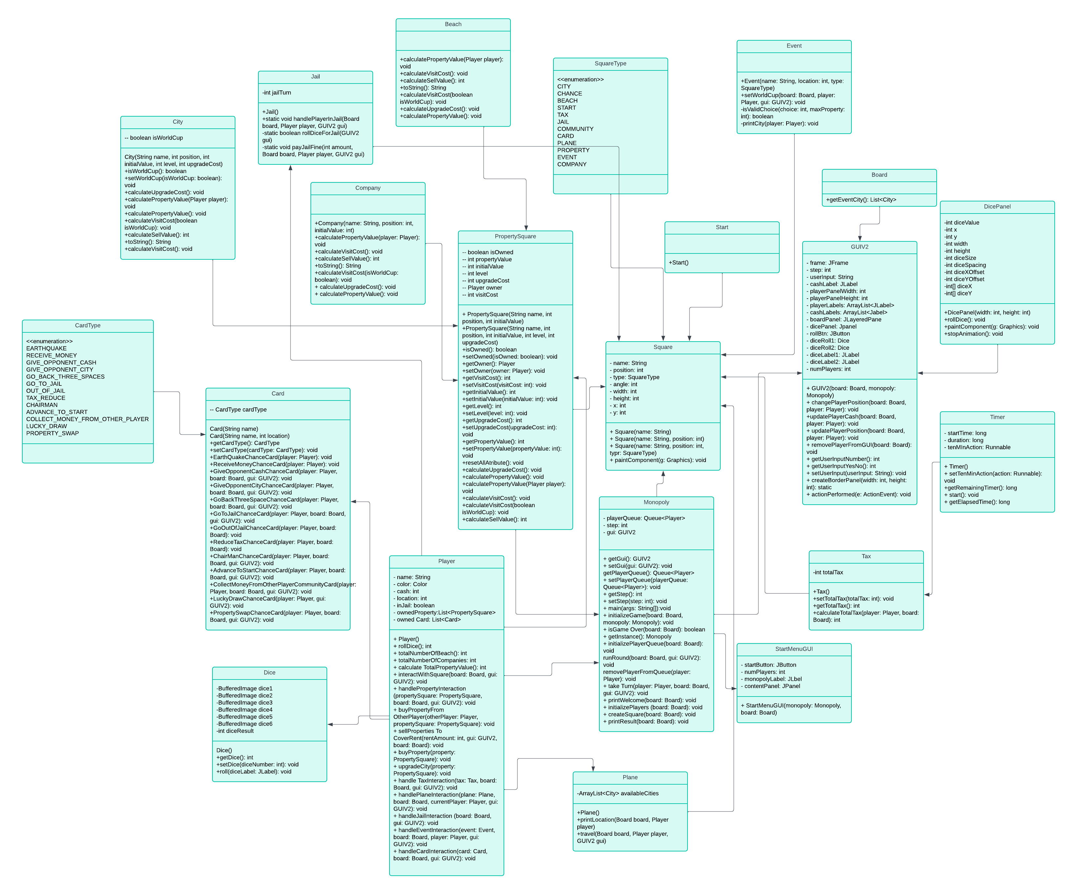
03: UML class diagram

Slide 33
04: Evaluation
• Design Flexibility: The game design allows for flexibility in future enhancements and modifications to accommodate evolving gameplay features and user feedback, ensuring adaptability and usability over time.
• Future Improvements: Opportunities for future improvements include adding more Chance cards, events, adjusting property costs, and introducing new features to enhance gameplay depth and engagement for players.
• Enhanced Features: Potential enhancements can enrich the gaming experience with advanced functionalities, additional game elements, and interactive components that add complexity and excitement to the gameplay dynamics.
• GUI Enhancement: Improving the GUI design can enhance user experience, visual appeal, and navigational ease, making the game interface more intuitive, engaging, and aesthetically pleasing for players of all ages.

Slide 34
Object Oriented Programming
Group 4 project presentation
TOPIC: MONOPOLY
Thank you for listening

