Slide 1
GANDHINAGAR INSTITUTE OF TECHNOLGY
Computer Engineering Department
Design Engineering-IB(3140005)
Automatic Solar Tracker
Presented By
Group ID: GIT_CE_DE1B_19_29
Dhruv S. Patel (180120107104)
Deep Patel (180120107100)
Dhruv M. Patel (180120107105)
Dhairya Patel (180120107102)
Guided By
Prof. Parita Shah

Slide 2
OUTLINE
Introduction of Domain
Overview of DE-1B work
Reverse Engineering
Empathy Canvas-Mind Mapping
Prior Art Search
Ideation Canvas
Product Development Canvas(PDC) – LNM
Rough Prototyping
Future Work
Advantages
References

Slide 3
INTRODUCTION
Extracting usable electricity from the sun was made possible by the discovery of the photoelectric effect. Subsequent development of the solar cell, which is a semi-conductive material that converts visible light into a direct current.
The solar tracker focuses on the optimization of the electric energy produced by photovoltaic cells through the development of a sun-tracking system which will result in more efficiency.

Slide 4
Overview of DE-1B Work
Interfacing between hardware and microcontroller
Inputs to microcontroller
Controlling constraints
Both automatic and manual

Slide 5
REVERSE ENGINEERING
At first, solar panels are used which were fixed at a certain place such that maximum solar energy can be obtained at a certain angle. But due to rotation of sun the solar panels won’t able to take advantage of maximum amount of solar energy.
So with the help of automatic solar tracker we can track the rotation of sun and which results in solar panels moving automatically facing towards the sun which results in capturing more sun rays and as an output we get high efficiency of electricity.

Slide 6
EMPATHY CANVAS
The selected users are government, public, industries. The stake holders of the topics are domestic, financier, landowners etc.
The users in empathy mapping had done many activities in the related of solar tracking system like: construction of the panel, employees working and maintenance, sweepers cleaning the solar panel, etc.

Slide 7
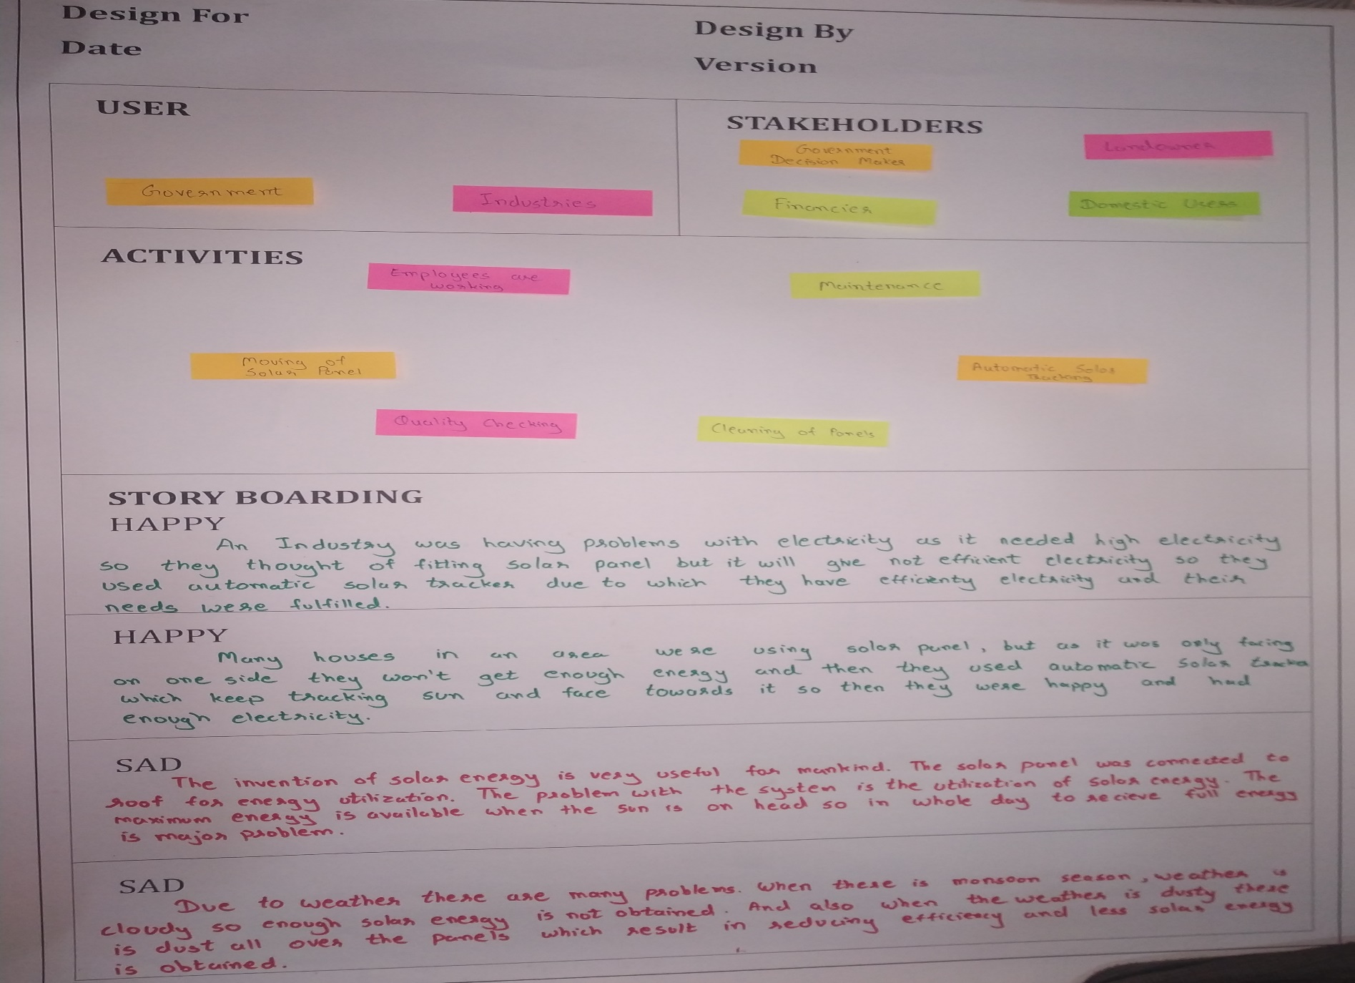
EMPATHY CANVAS

Slide 8
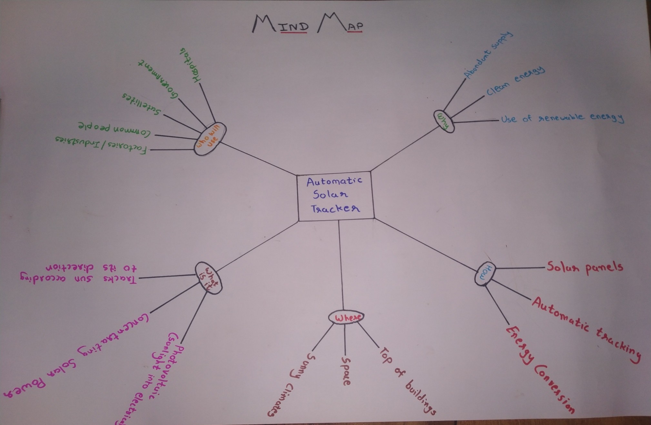
MIND MAPPING

Slide 9
PRIOR ART SEARCH
Background Early in the 21century, Nuwayhid et al. (2001) adopted the open-loop and closed-loop tracking methods into a parabolic concentrator attached to a polar tracking system.
In 2004, Abdallah and Nijmeh designed a two axis sun tracking system, a programmable logic controller (PLC) was used to calculate the solar vector and to control the sun tracker so that it follows the sun's trajectory. In addition, Shanmugam & Christraj (2005) presented a computer program written a Visual Basic that is capable of determining the sun's position and thus drive a paraboloidal dish concentrator (PDS) along the east-west axis or north-south axis for receiving maximum solar radiation.

Slide 10
PRIOR ART SEARCH
In 2007, Ali Al-Mohamad designed a Sun-tracking system, whereby the movement of a photovoltaic module programmable logic-controller (PLC) unit.
Also, Mohanad Alata, M.A. Al-Nimr and Yousef Qaroush demonstrated the design and simulation of time controlled step sun tracking systems. In Rajshahi University of engineering & Technology a project was done by Md. Rokunuzzaman whereby the movement of a photovoltaic module was controlled to follow the Sun's radiation using a CMOS logical circuit.

Slide 11
IDEATION CANVAS
The set of people mentioned in the ideation canvas are the workers, engineer, operators, owner, manager, employees.
The activities like employs are working their work, sweepers are cleaning the solar panel, engineer repair the solar panel etc...
Different situation/context/location mentioned in the ideation canvas is listed as sunny, clean, dusty, rainy etc.
The props/possible solutions are mentioned in the ideation canvas are solar panel , dc motor , microcontroller , dc motor driver , wires , stepper motor , etc.

Slide 12
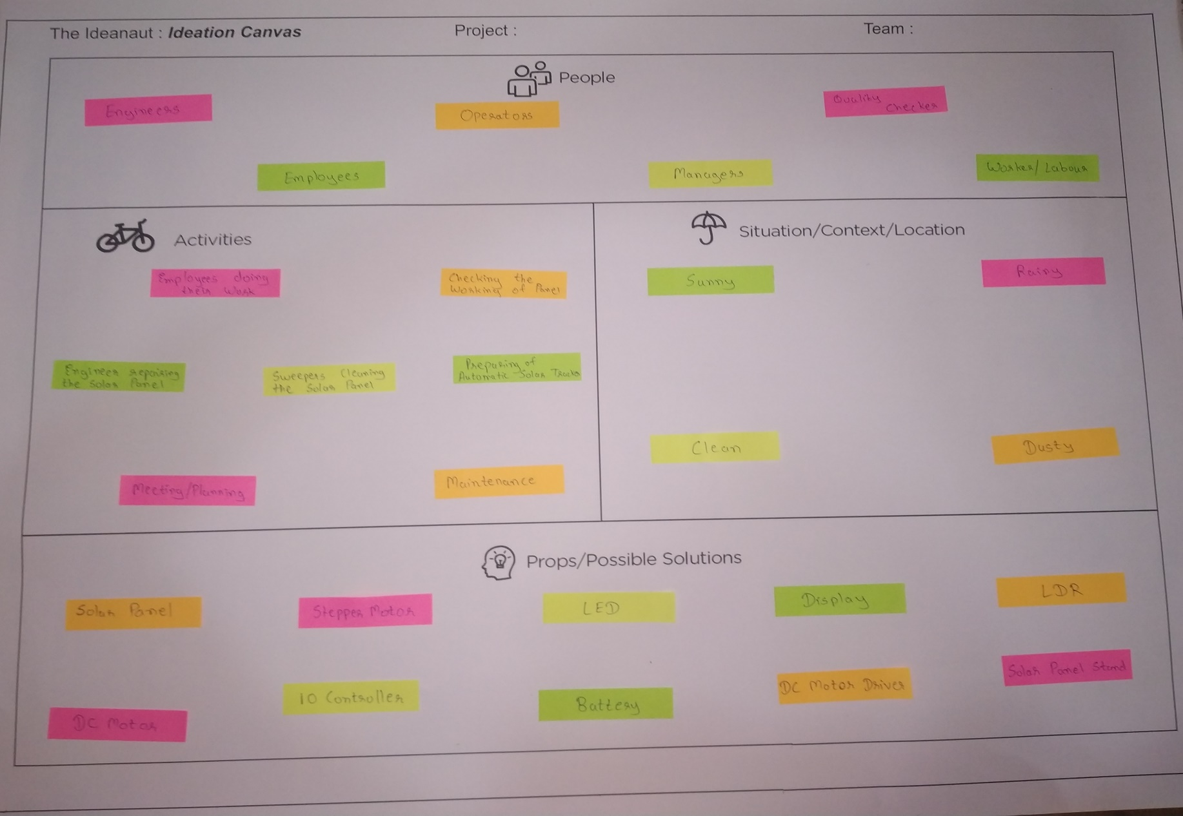
IDEATION CANVAS

Slide 13
PRODUCT DEVELOPMENT CANVAS
Purpose:-
The main purpose of solar tracking system is use of renewable energy and change the direction of solar panel to produce high electricity.
People:-
Public
Worker
Manager
Quality checker
Labour
Product Experience:-
The solar tracking system experience is this product is more efficient, easy operation, safe and energy improvement.

Slide 14
PRODUCT DEVELOPMENT CANVAS
Product Function:-
The product function is producing more electricity, easily working and less man power.
Product Feature:-
The Product feature is easy construction and high efficiency.
Components:-
Solar panel
Microcontroller
Dc motor
Battery
Stepper motor
Wires
Dc motor driver
LDR

Slide 15
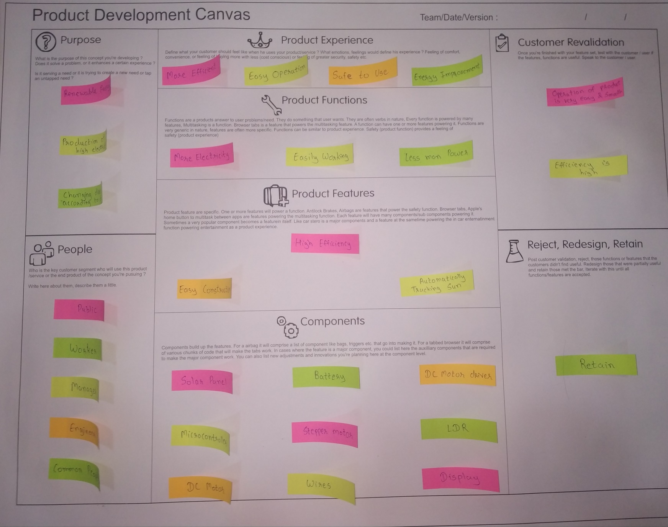

Slide 16
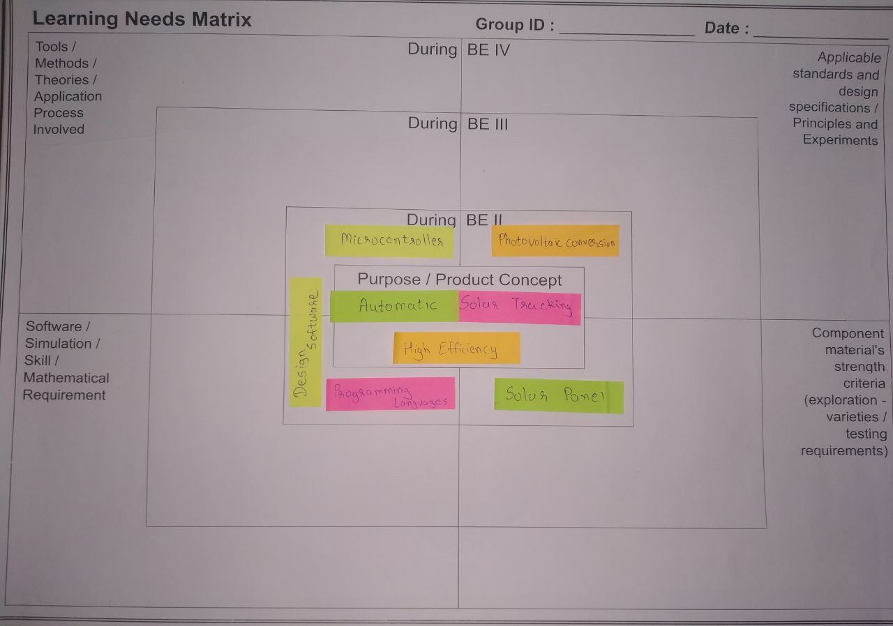
LEARNING NEEDS MATRIX

Slide 17
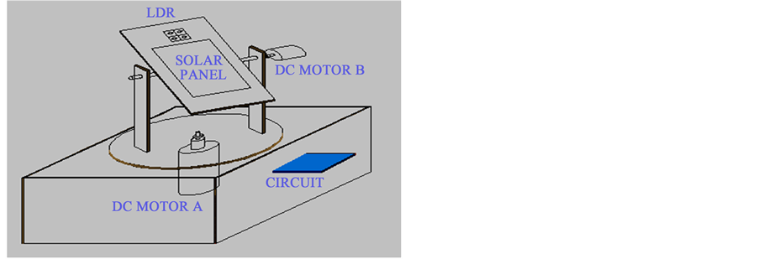
ROUGH PROTOTYPING

Slide 18
FUTURE WORK
In future with the help of artificial intelligence we can know if there is any part of solar panel is damaged due to any cause so that it can mention how much percentage of solar panel is working.
If there is too much dust on the solar panel with which efficiency of solar panel decreases than it cleans itself with automated machines.

Slide 19
ADVANTAGES
Solar tracking systems continually orient photovoltaic panels towards the sun and can help maximize your investment in your PV system.
One time investment, which provides higher efficiency & flexibility on dependency over other sources.
Tracking systems can help reducing emissions and can contribute against global warming.
Bulk implementations of tracking systems help reduced consumption of power by other sources.
It enhances the clean and emission free power production.

Slide 20
References
www.studymafia.org
www.wikipedia.com
www.google.com
www.electrical4u.com
www.tutorialspoint.com

Slide 21
Thank You

