Slide 1

Data Science for Health and Biomedical Sciences
Workshop 1

Slide 2
Learning outcomes for this course
Apply a range of specialised data science techniques to different medical and healthcare scenarios.
Analyse health and biomedical data with the use of the R programming language, including summarisation, visualisation and interpretation.
Critically examine the ethical, societal and regulatory principles and implications of data science in health.
Explain and critically discuss key concepts, principles and methods of data science in health.

Slide 3
Course focus
Programming: practice in working with data, choosing how best to gain insights from the available data, presenting these insights to others, knowing how to solve new problems, developing autonomy and independence
Theory: awareness of different types of data, awareness of data analysis techniques that are being used in our field, awareness of some of the ethnical and societal implications of working with health/biomedical data

Slide 4
Course format
10 weeks
Flipped classroom: videos to watch each week, and two 3h workshops
Most workshops will have at least a little bit of programming practice

Slide 5
Introductions

Slide 6
What are your expectations from this course?

Slide 7
What you’ll need
Laptop with R and RStudio installed
Access to the course on Learn

Slide 8


Pair programming:

Slide 9
Pair programming:
one person (driver) types while sharing their screen
other person (navigator) watches, asks questions and keeps the pair on track.

Slide 10
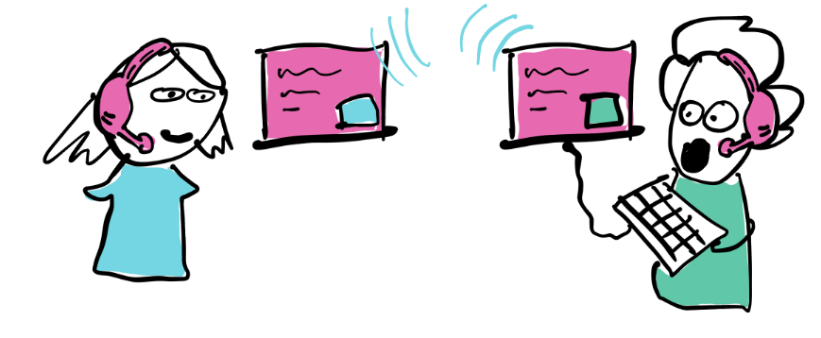
Switching the driver:
Every now and then they switch, so everyone has experience of both roles.
Why?
So that you can practice describing your code, and understanding other people's code

Slide 11
Why pair programming?
Science says it makes code better and people happier: “The authors found that for a development-time cost of about 15%, pair programming improves design quality, reduces defects, reduces staffing risk, enhances technical skills, improves team communications and is considered more enjoyable at statistically significant levels.” (Cockburn & Williams, 2000)
Standard practice in many tech companies

Slide 12
How to succeed at pair programming?
Put your heart into it
When disagreeing, talk in terms of benefit
When feeling ill at ease, say so
Bestow as many compliments as possible
Read more at https://www.rapid7.com/blog/post/2017/01/27/5-rules-of-pair-programming-etiquette/
https://tuple.app/pair-programming-guide/

Slide 13


Slide 14
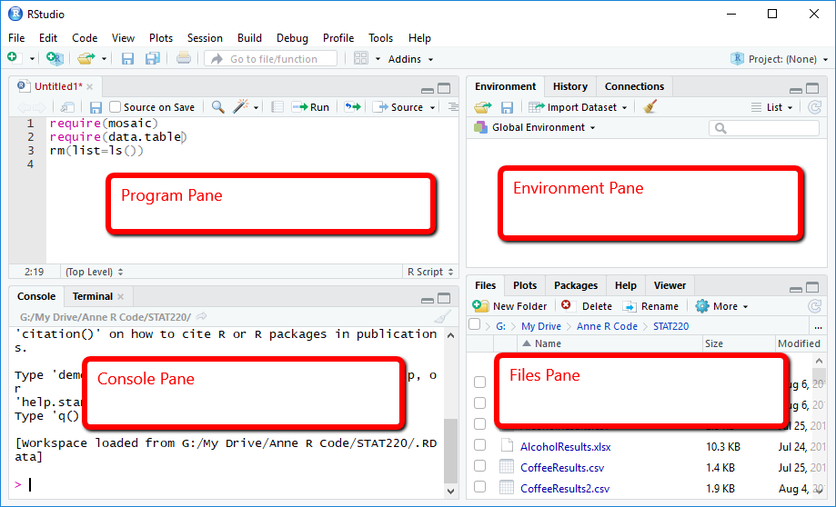
RStudio navigation

Slide 15
Let’s try it out!
Create a new directory for this course (if you haven’t got one)
Put file I sent you in that directory
Open RStudio
Create a new project in the new directory
Open the .Rmd file

Slide 16
Coming up tomorrow
Installing the most recent version of R and RStudio
Customising your RStudio environment
More cool functions

Slide 17
A bit of setup…

Slide 18
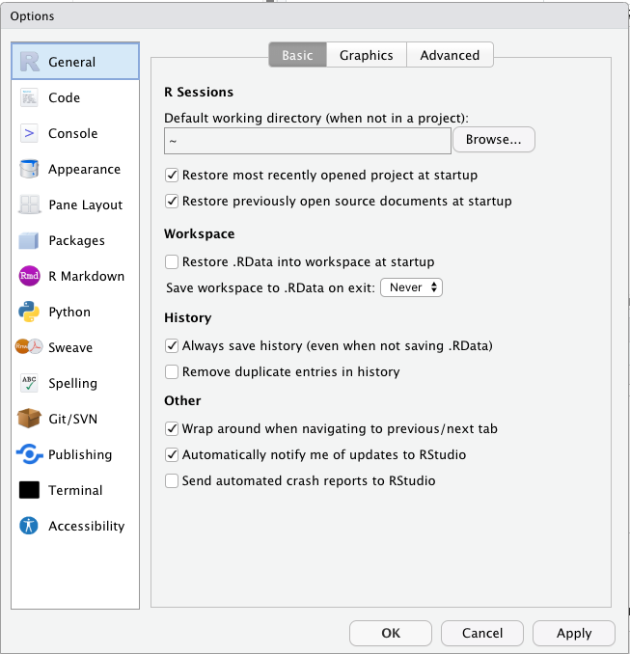
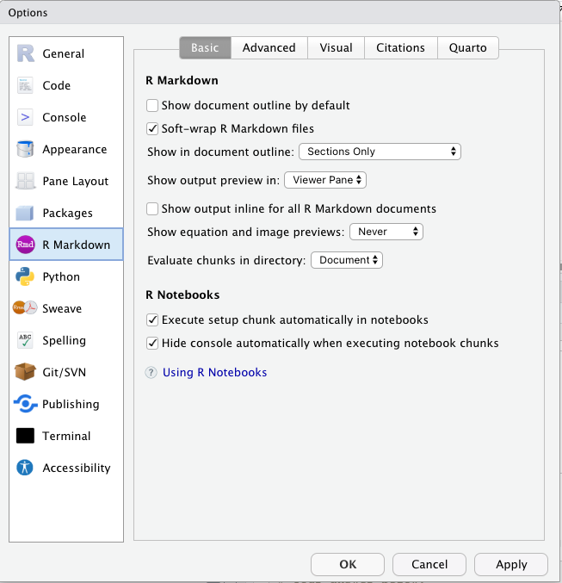
Tools > Global Options

Slide 19
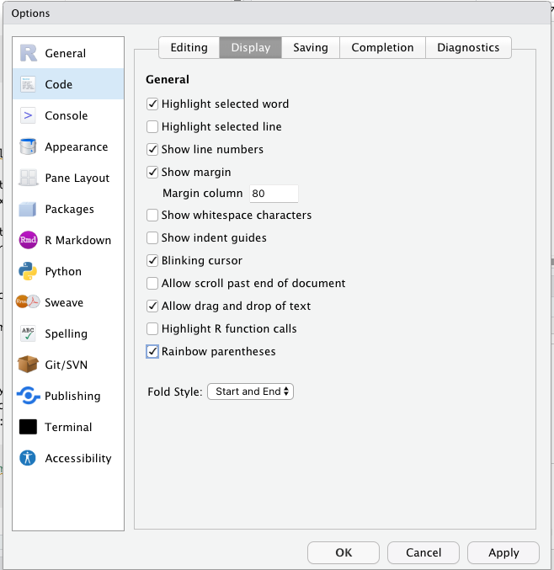
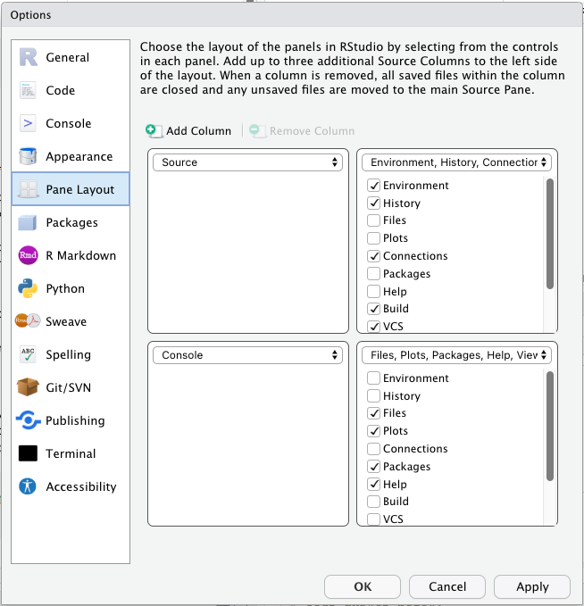
Tools > Global Options

