Slide 1

Topic 4: Correlation and/or causation?

Slide 2
Why do we need to think about causality?
In medicine we offer administer treatments to patients on the belief that it will improve the quality of their care and life.
But often we need to ask ourselves, given the patient in front of me, will this *actually* make them better?
This really is a question about whether something ‘causes’ another thing…but how do we actually know the evidence showing something will help is causation and not just correlation?

Slide 3
This topic…
Scatterplots and visualisation
Correlation testing
Thinking causally
Formalising visualisation skills in R
4.1 Scatterplots and visualisation

Slide 4
4.1 Scatterplots and visualisation

Slide 5
What do we mean by association?
Association describes how two variables change in relation to one another.
It does not imply that one variable causes the other… only that they tend to move together in some way.

Slide 6
Where do we see association in health and social care?
Health outcomes and risk factors
Social conditions and wellbeing
Behaviors and disease patterns
Many questions in health and social care are naturally about association:
Are healthier populations wealthier?
Is education linked to life expectancy?
Do behaviors cluster with outcomes?

Slide 7
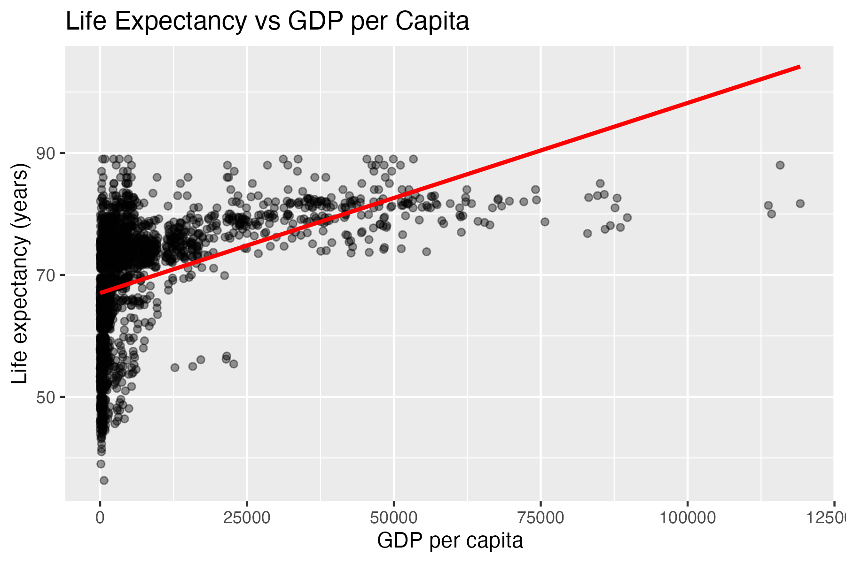
Visualising association: scatter plots
Each point in a scatter plot represents one observation (here, a country).
The position of the point reflects the values of both variables simultaneously.

Slide 8
Visualising association: scatter plots
Direction
positive or negative?
Strength
tight or diffuse?
Shape
linear or curved?
Outliers
unusual observations

Slide 9
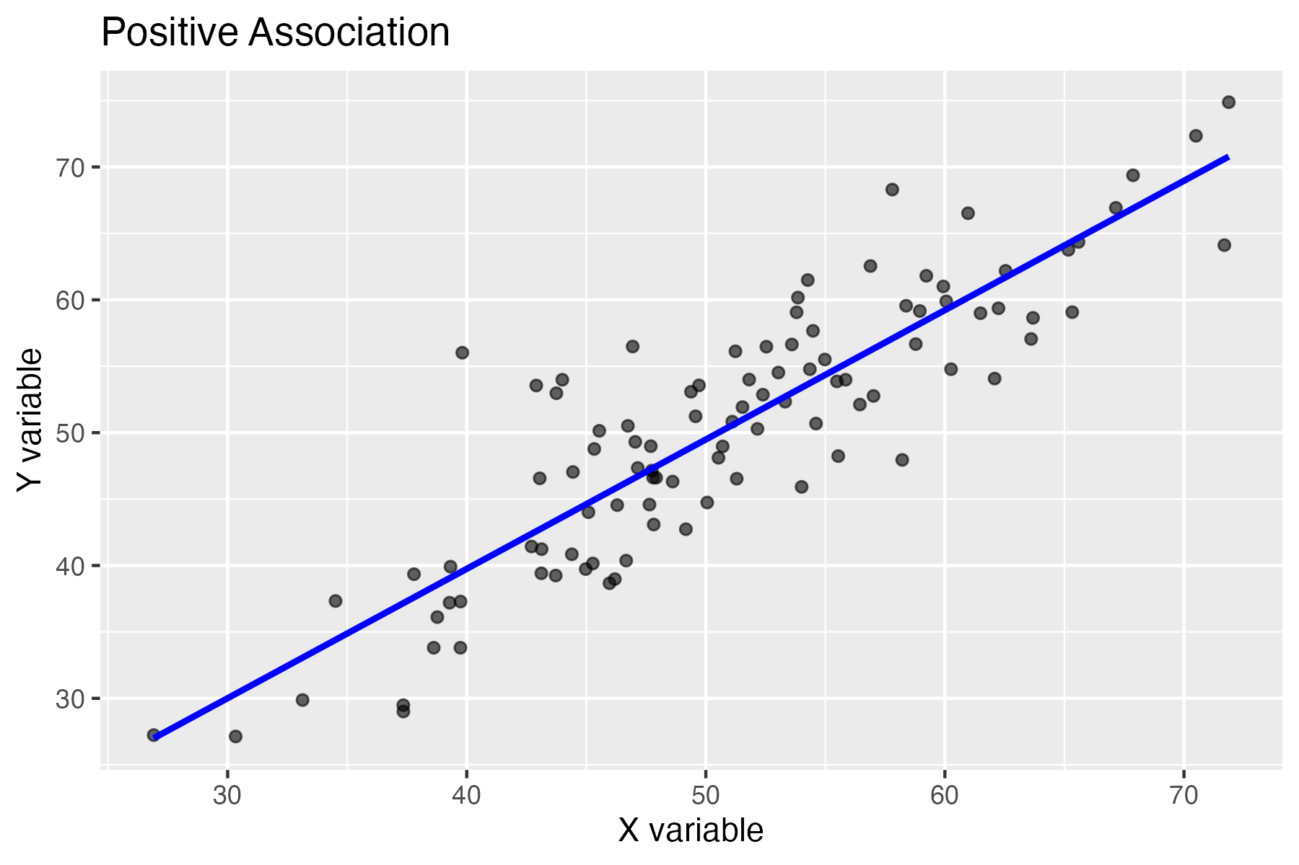
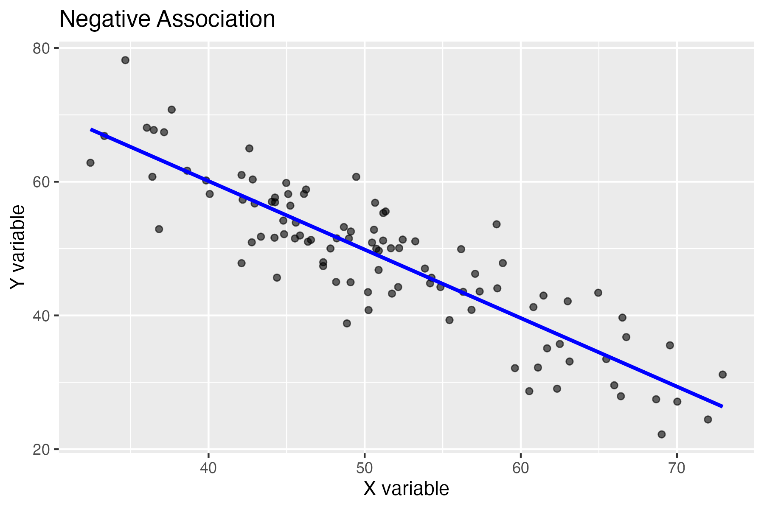
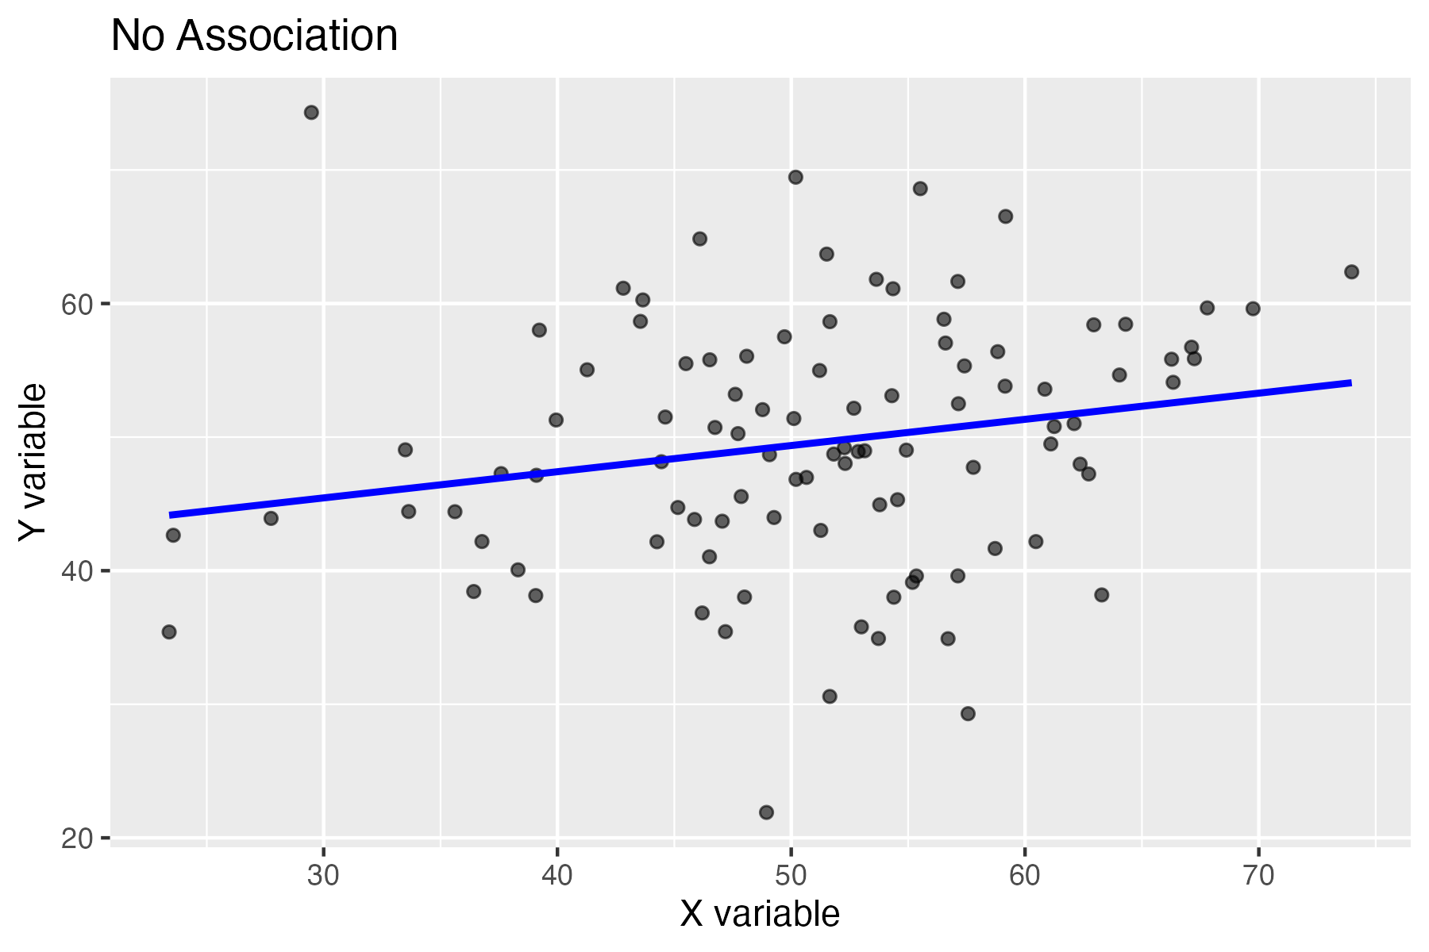
Describing direction

Slide 10
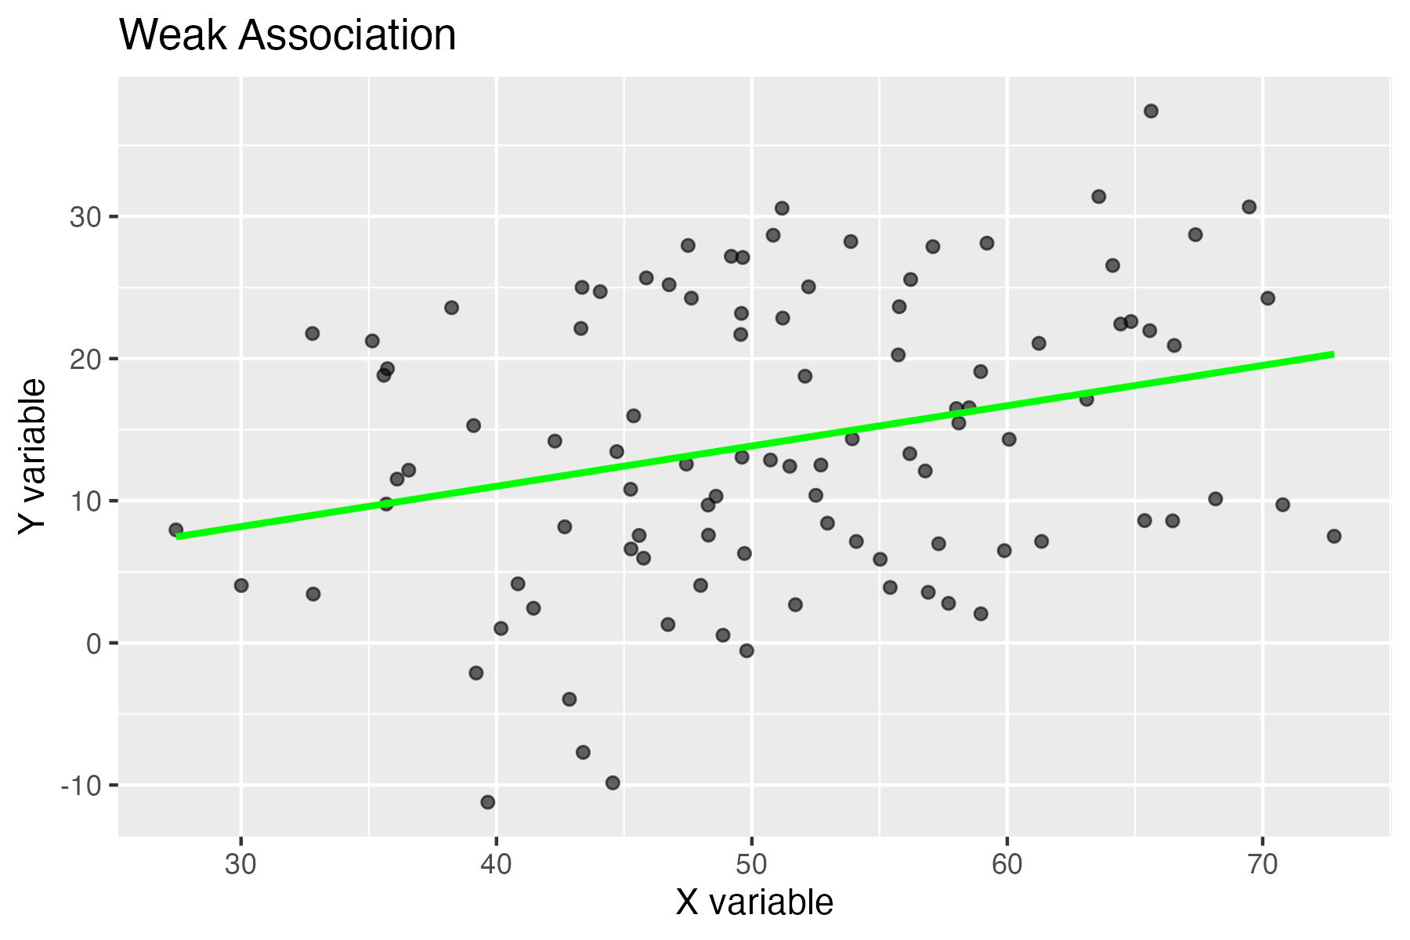
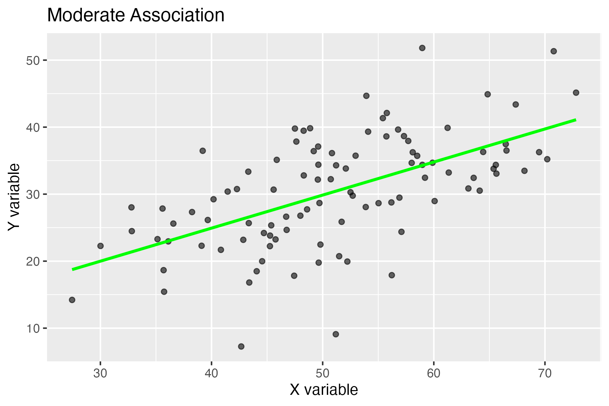
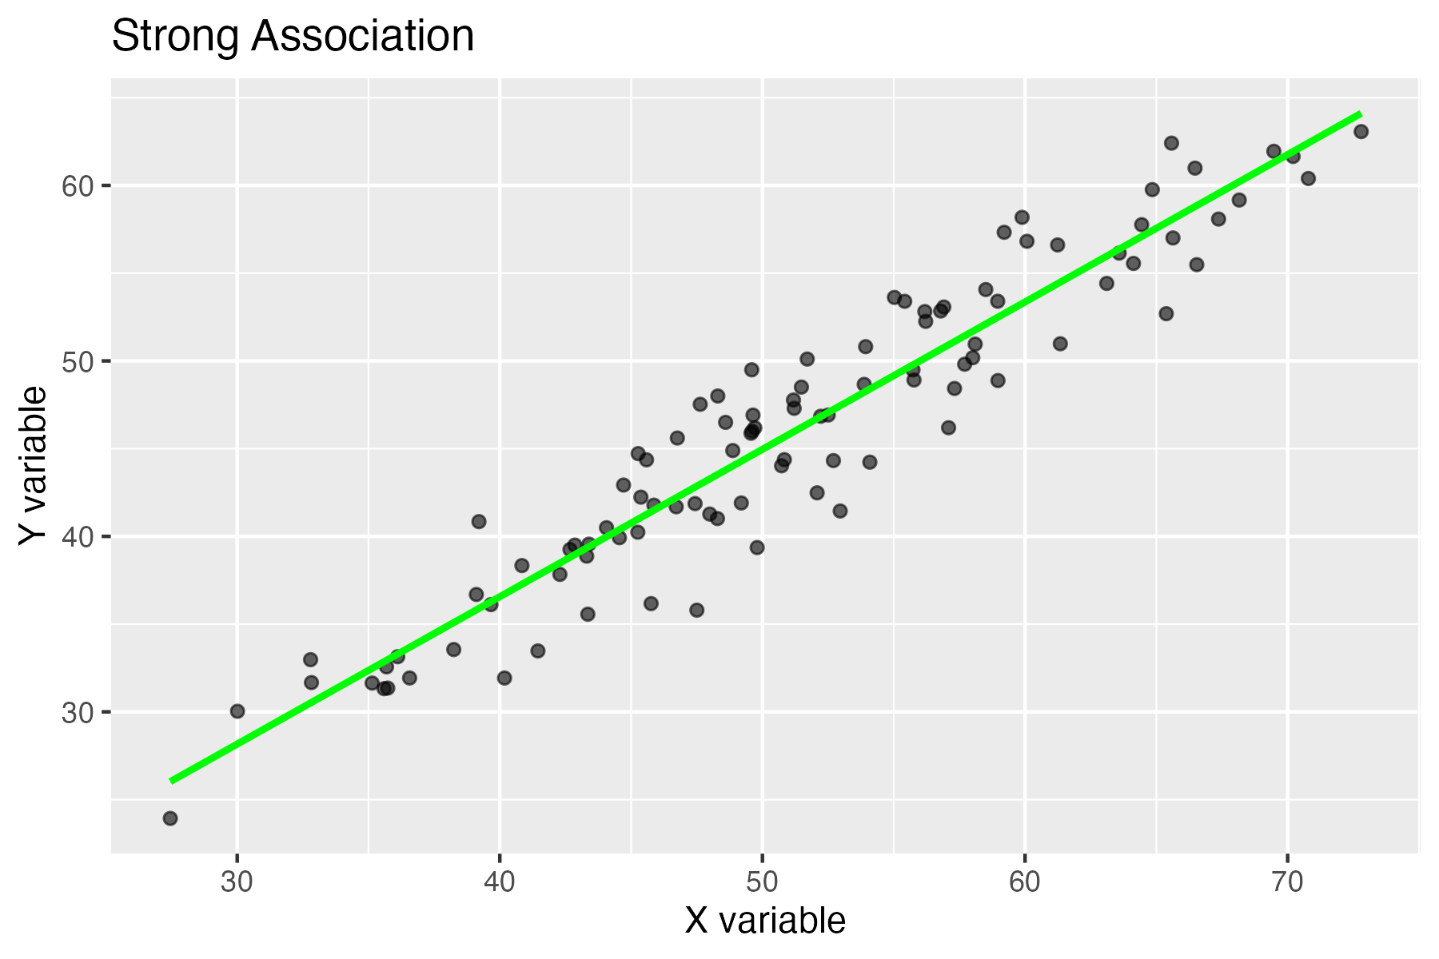
Describing strength

Slide 11
4.2 Correlation testing

Slide 12
Why do we need correlation?
Scatter plots are powerful, but they are subjective.
Correlation gives us a numerical summary of the strength and direction of association between two variables.

Slide 13
Pearson correlation coefficient
The most commonly used correlation measure is the Pearson correlation coefficient. It is appropriate when both variables are continuous and the relationship is approximately linear.
Correlation values always lie between −1 and +1:
+1: perfect positive association
−1: perfect negative association
0: no linear association

Slide 14
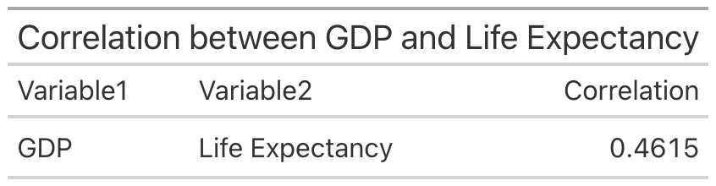
Pearson correlation coefficient
This value summarises the overall association across countries. However, it hides important details about the shape and structure of the data.
Pearson correlation measures linear association. If the relationship is curved or non-linear, correlation may underestimate or misrepresent the strength of association.

Slide 15
Alternatives when the relationship isn’t linear…
When the pattern between variables is monotonic but curved, a rank-based measure such as Spearman’s correlation can be more appropriate.
Cramer’s V gives a sense of the strength of in situations where one variable is continuous and the other is binary—such as comparing average recovery time between two treatment groups—differences

Slide 16
Two components of correlation analysis
Estimating: the strength of association from a sample
Testing: whether that association is likely to be more than random variation

Slide 17
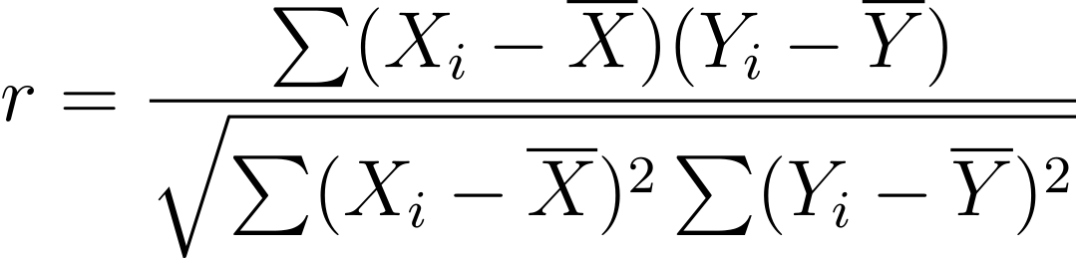
Estimating the Pearson correlation
You don’t need to memorise this formula, but it shows two important ideas:
Correlation is based on how variables vary together
It is centred around the means of both variables

Slide 18
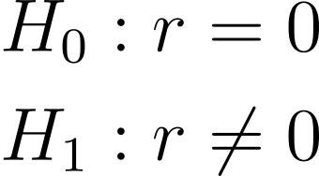
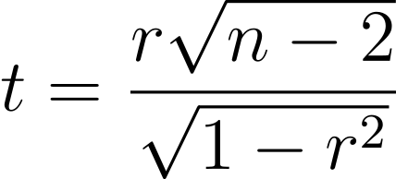
Hypotheses for correlation testing
The standard test evaluates whether the population correlation is zero. This corresponds to asking whether there is evidence of a linear association.
This test statistic follows a t-distribution with n - 2 degrees of freedom under the null hypothesis.

Slide 19
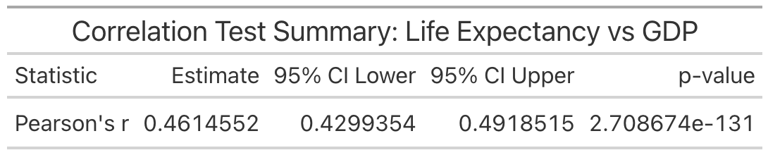
Hypotheses for correlation testing
As with other statistical testing, we look to the p-value to understand the chance of observing the correlation by chance.
The p-value is the probability of observing a test statistic as extreme as the one calculated, assuming the true population correlation is zero, not the strength of the relationship.

Slide 20
What assumptions are necessary?
For this the sample size ‘n’ matters a lot.
With large samples, very small correlations can be statistically significant.
With small samples, meaningful associations may fail to reach significance.
Always interpret p-values alongside effect size and context.

Slide 21
4.3 Thinking causally

Slide 22
Why this matters in health and social care
Evidence beyond association
Interventions and policy decisions
Even strong statistical relationships can arise without any causal link.
Relying on correlation alone risks incorrect conclusions about treatments, interventions, and policy.

Slide 23
Two broad reasons correlation fails
There are two main reasons correlation does not imply causation:
1. Different causal mechanisms can generate the same correlation
2. Correlations can arise from data structure rather than genuine relationships

Slide 24
Directed acyclic graphs
Variables
Arrows
Causal pathways
X
Y

Slide 25
Confounding
A confounder is a variable that influences both the exposure and the outcome. If not accounted for, it can induce a correlation even when no direct causal effect exists.
C
X
Y

Slide 26
Confounding
$$\text{X ←C →Y}$$
This structure creates a backdoor path between X and Y.
C
X
Y

Slide 27
Mediators
A mediator lies between the exposure and the outcome and transmits part or all of the causal effect.
M
X
Y

Slide 28
Mediators
$$\text{X →M →Y}$$
Here, the correlation between X and Y arises because changes in X influence Y through the mediator M.
M
X
Y

Slide 29
Colliders
A collider is a variable that is caused by two other variables. Unlike confounders, colliders do not create associations on their own.
S
X
Y

Slide 30
Colliders
$$\text{X →S ←Y}$$
This structure does not induce association unless we condition on the collider.
S
X
Y

Slide 31
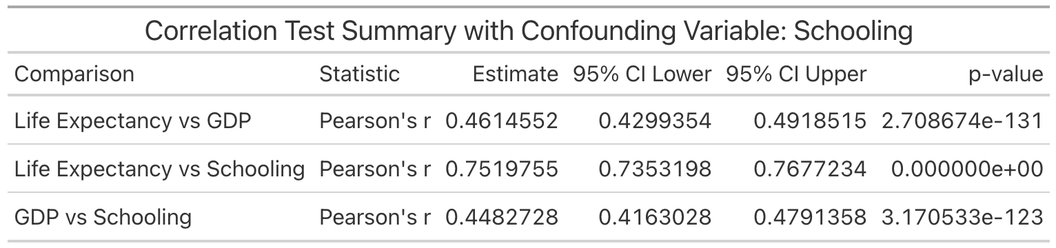
Applying this…
Schooling
This establishes Schooling as a potential confounder, mediator and collider, because it is associated with both the exposure and the outcome.
?
?
GDP
Life Expectancy

Slide 32
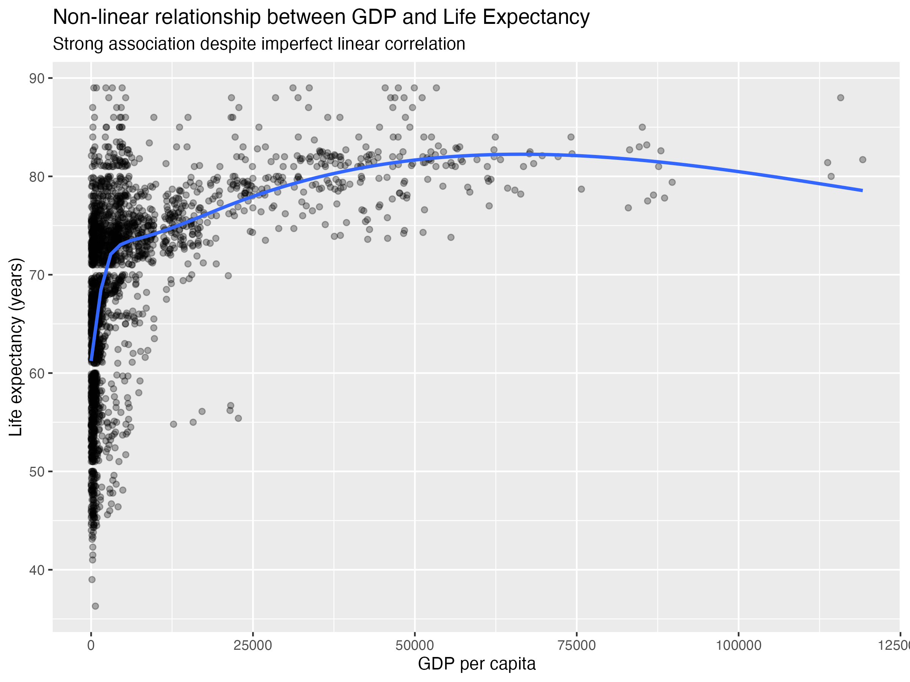
Non-linear relationships
Correlation measures only linear dependence. Strong curved or threshold relationships can exist even when correlation is close to zero.
Although life expectancy increases with GDP, the relationship is clearly non-linear. Pearson’s correlation measures only linear association, so it cannot fully capture this curved pattern. Visualisation is essential before interpreting correlation values.

Slide 33
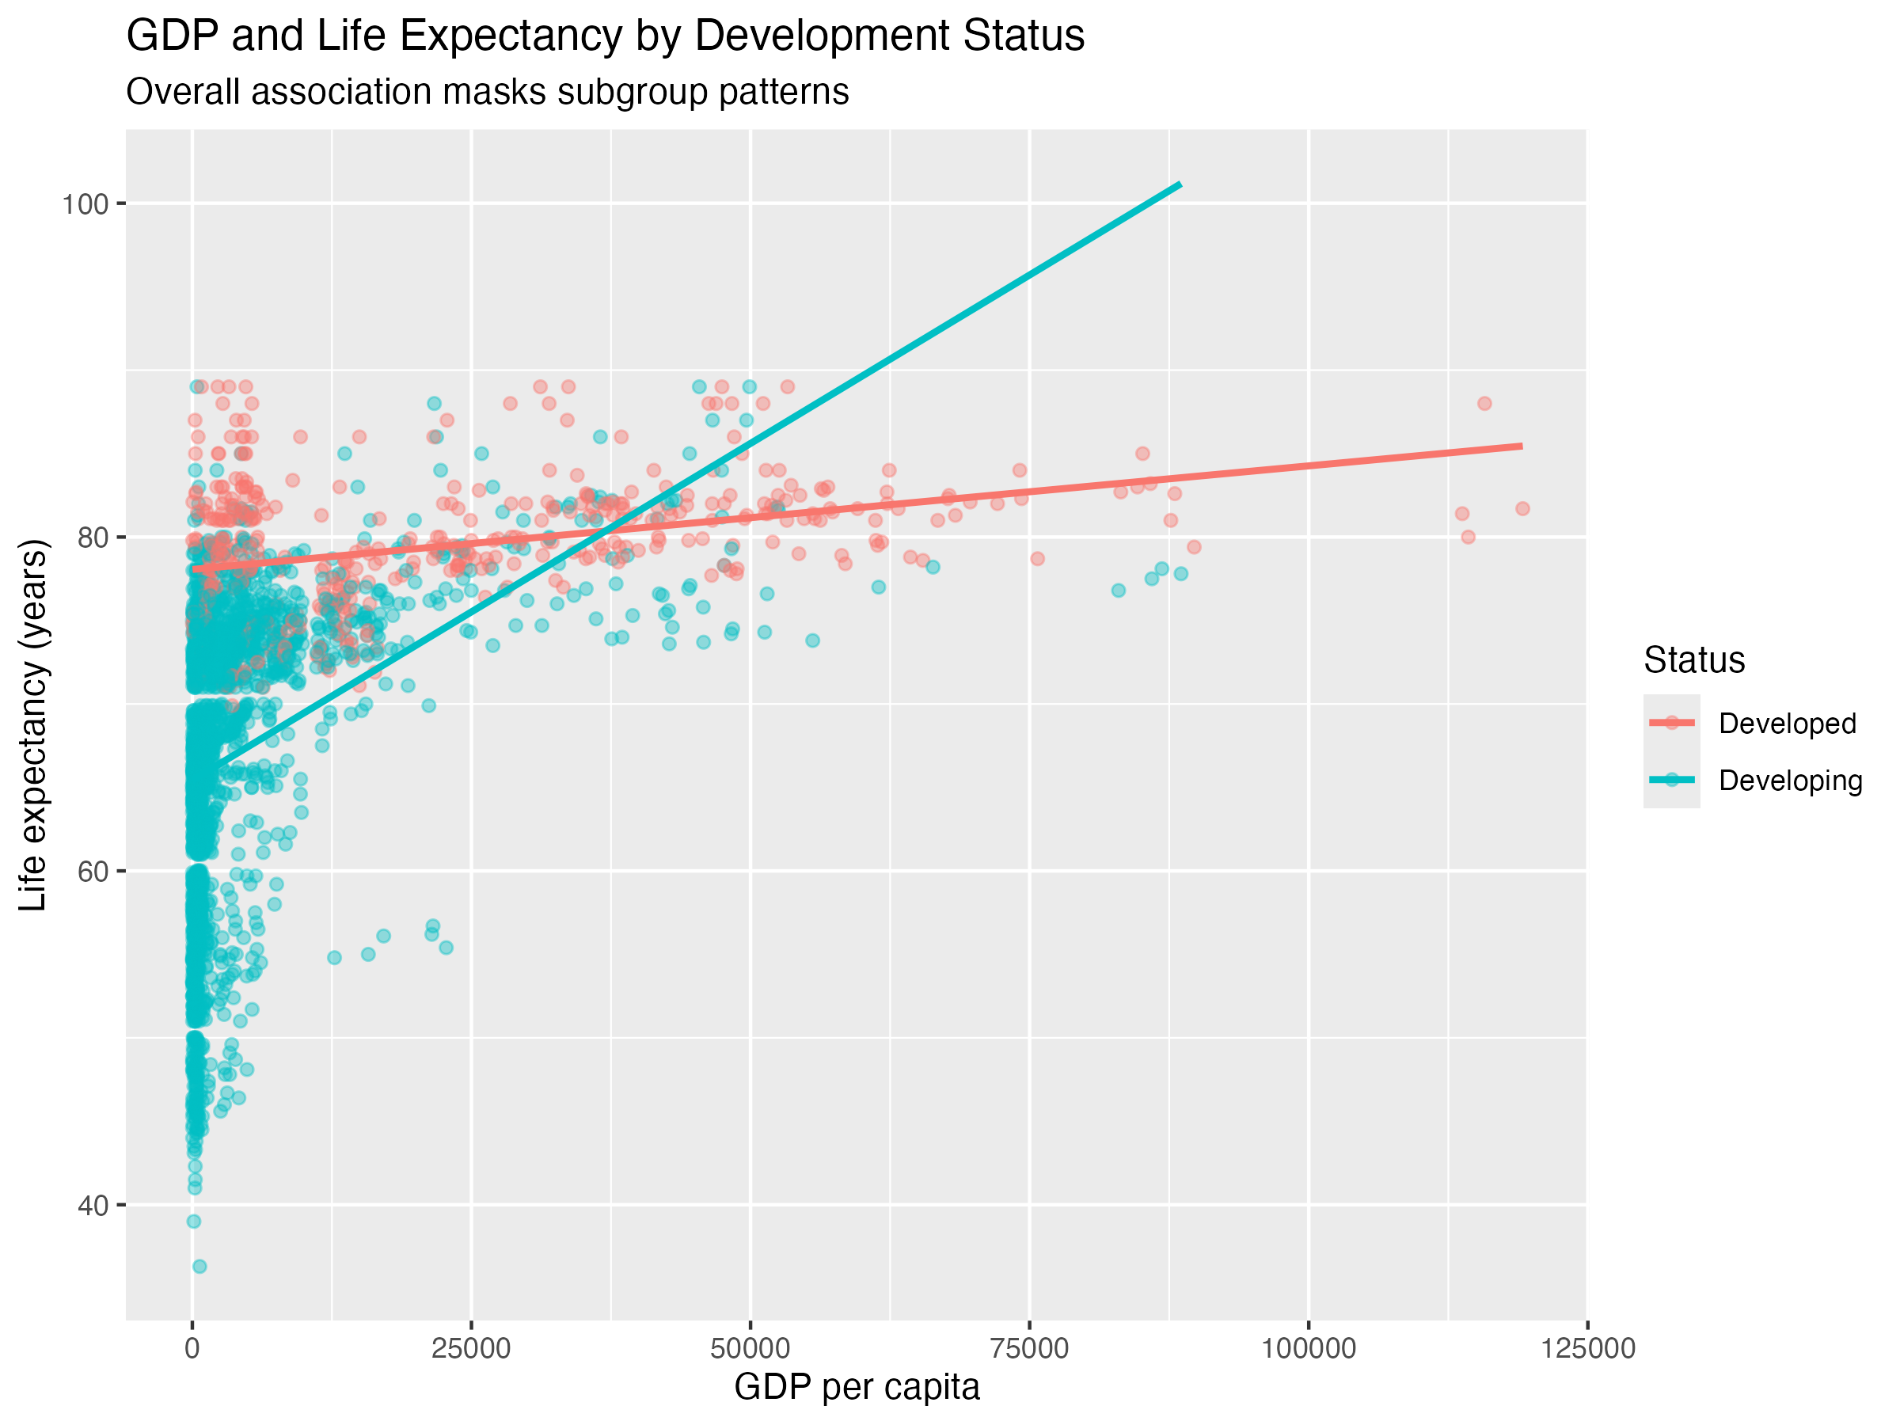
Heterogeneous subgroups & Simpson’s paradox
When data contain distinct subgroups, overall correlations can mask or even reverse subgroup-level patterns. The relationship between GDP and life expectancy differs by development status, illustrating how subgroup structure can distort interpretation — a key idea behind Simpson’s paradox.

Slide 34
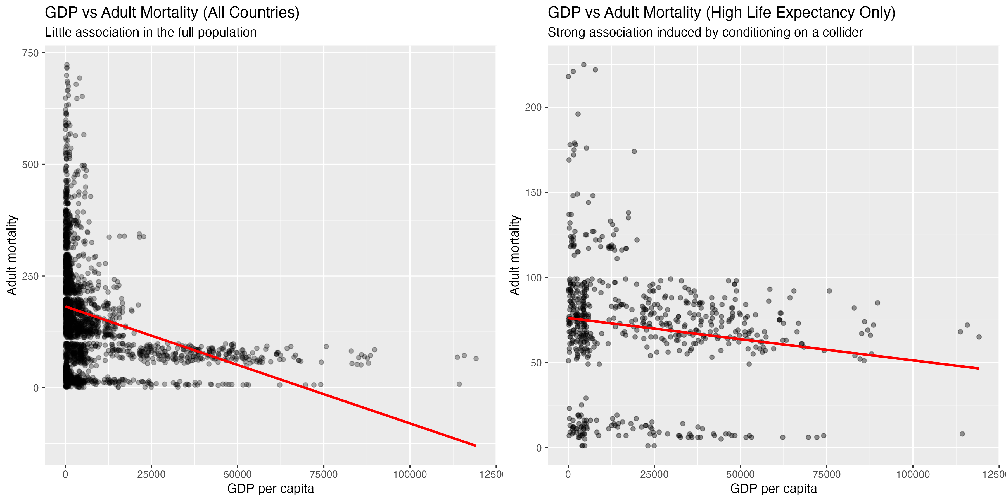
Selection mechanisms and colliders
Restricting analysis to selected groups can introduce spurious associations even when none exist in the population.

Slide 35
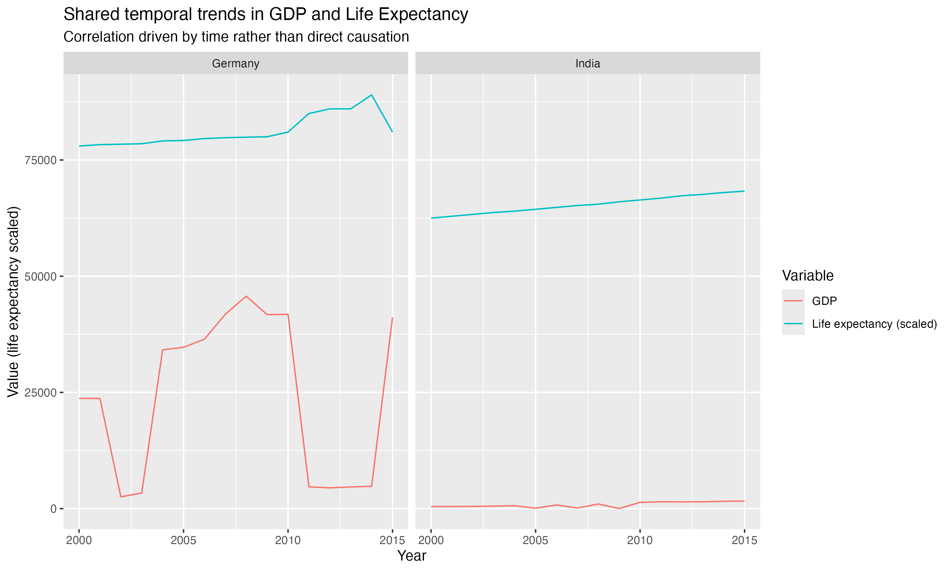
Temporal trends
In time-series data, variables may correlate simply because they share a common trend over time, not because one influences the other.
GDP and life expectancy both increase over time in many countries. This shared temporal structure can generate high correlations even when no direct causal relationship exists between short-term changes in the variables.

Slide 36
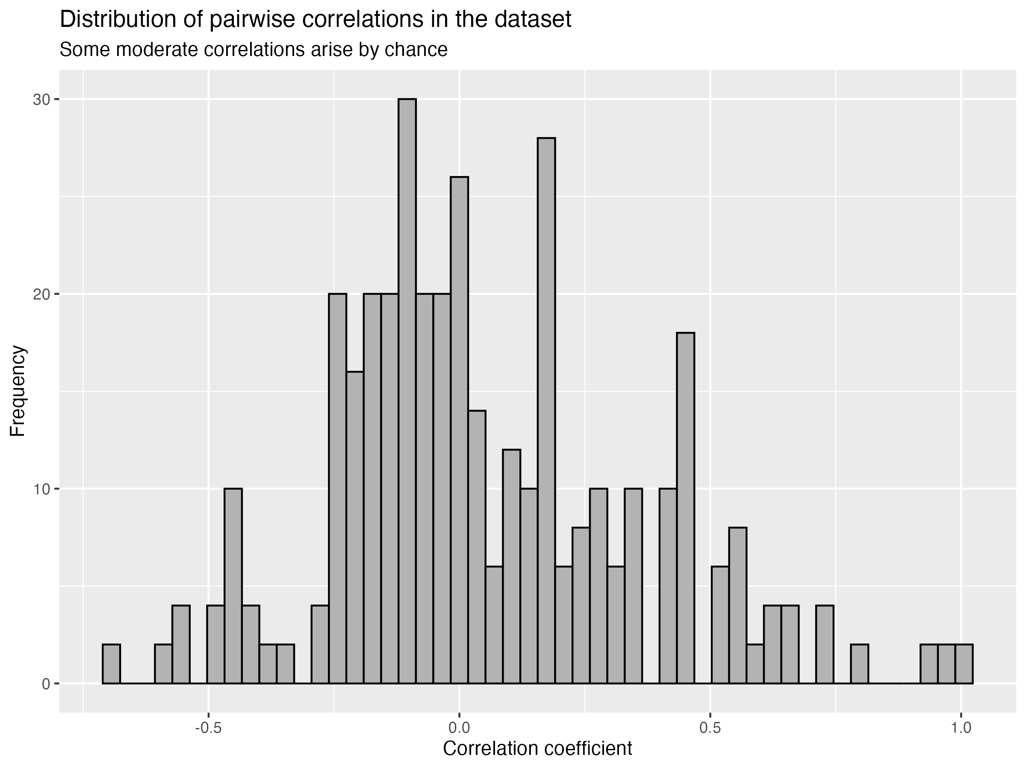
Chance correlations in large datasets
As the number of variables increases, the probability of observing strong correlations by chance alone also increases.

Slide 37
Key message
Correlation ≠ causation…
Correlation is a powerful descriptive tool, but it cannot establish causal relationships on its own.

Slide 38
4.4 Formalising visualisation skills in R

Slide 39
You have already used R to turn data into visual evidence…
First we did something like this to prepare the data.
analysis_data <- data |>
select(outcome, group) |>
filter(!is.na(outcome))
Then we may have done something like this…
ggplot(
analysis_data,
aes(x = group, y = outcome)) +
geom_boxplot()
…but what did it all mean?

Slide 40
ggplot2 uses a grammar to construct visualisations
A visualisation is not a single picture. It is a combination of components.
A visualisation =
data
+ aesthetic mappings
+ geometry
+ statistical transformations
+ scales
+ facets
+ labels and theme
In ggplot2(), these components are combined using +. This means that we can construct, understand and modify a visualisation one component at a time.

Slide 41
Every visualisation begins with data
analysis_data |>
ggplot()
Read this as:
“Take analysis_data and use it to begin a visualisation.”
At this stage, R knows which data to use—but not which variables to display or how to represent them.
The dataset should already have been selected, filtered and checked.

Slide 42
Aesthetic mappings connect variables to visual properties
analysis_data |>
ggplot(aes(x = gdp, y = life_expectancy))
gdp determines horizontal position
life_expectancy determines vertical position
aes() maps variables in the piped dataset to visual properties. Other possible aesthetics include:
colour size shape transparency

Slide 43
Geometries determine how observations appear
analysis_data |>
ggplot(aes(x = gdp, y = life_expectancy)) +
geom_point()
geom_point() represents every observation as a point.
Different questions require different geometries:
geom_histogram() Distribution of one numerical variable
geom_boxplot() Numerical outcome across groups
geom_point() Relationship between numerical variables
geom_line() Values ordered across time

Slide 44
Layers combine different representations of the same data
analysis_data |>
ggplot(aes(x = gdp, y = life_expectancy)) +
geom_point() +
geom_smooth()
The pipe passes the dataset into the visualisation.
The first graphical layer displays the observations.
The second graphical layer summarises the pattern between them.
data |> visualisation + points + trend

Slide 45
Statistical transformations add summaries and trends
analysis_data |>
ggplot(aes(x = gdp, y = life_expectancy)) +
geom_point() +
geom_smooth(method = "lm", se = TRUE)
geom_smooth() estimates a relationship between the mapped variables.
method = "lm" fits a straight regression line
se = TRUE displays uncertainty around the estimated line
A fitted line summarises an association. It does not demonstrate causation.

Slide 46
Scales control how data values are displayed
analysis_data |>
ggplot(aes(x = gdp, y = life_expectancy)) +
geom_point() +
scale_x_log10()
scale_x_log10() displays GDP using a logarithmic horizontal scale.
The observations have not changed. The scale changes how their values are positioned on the graph.
Scale choices can make patterns easier, or harder, to see so they should always be reported clearly.

Slide 47
Facets apply the same visualisation to different subgroups
analysis_data |>
ggplot(aes(x = gdp, y = life_expectancy)) +
geom_point() +
facet_wrap(~development_status)
Faceting divides the piped dataset into subgroups and constructs the same visualisation for each one.
This allows us to ask:
Does the overall relationship also appear within each subgroup?

Slide 48
Caution: sometimes the pipe isn’t your friend!
correlation_result <- cor.test(
analysis_data$gdp,
analysis_data$life_expectancy,
method = "pearson"
)
cor.test() returns several pieces of information and stores them together.
correlation_result$estimate
correlation_result$conf.int
correlation_result$p.value

Slide 49
Analysis results can be used in captions of figures
caption_text <- paste(
"Pearson r =",
round(correlation_result$estimate, 2))
Here:
$estimate retrieves the correlation coefficient
round() rounds it to two decimal places
paste() combines text and a value
analysis_data |>
ggplot(aes(x = gdp, y = life_expectancy)) +
geom_point() +
geom_smooth(method = "lm", se = TRUE) +
labs(x = "GDP per person",
y = "Life expectancy (years)",
caption = caption_text) +
theme_minimal()
Because the caption uses the saved result, it will update if the analysis changes.

Slide 50
What you need to do next…
We have discussed a lot this week about correlation and causation, and in particular correlation testing. We’re going to move onto implementing this in R and making good visualisations which help us think about these concepts.
To the code-along…

