Slide 1

Topic 6: Regression for fair comparison

Slide 2
What about confounding?
Last week, we compared the risk of disease between patients receiving treatment and those receiving usual care. But what if the groups were already different?
Patients receiving treatment might be:
Older
More severely unwell
More likely to have other health conditions
These characteristics could influence both:
Whether a patient receives treatment
Whether they develop the disease
The observed difference in disease risk may therefore reflect a mixture of the treatment and these pre-exisiting differences. Regression allows us to account for measured differences between patients and make a fairer comparison.

Slide 3
This topic…
Univariable regression
Assumptions of regression
Multivariable regression
Working with objects in R
6.1 Univariate regression

Slide 4
6.1 Univariable regression

Slide 5
Regression quantifies a relationship between variables
In health and social care, we often want to know:
How much does an outcome change when a predictor changes?
Regression allows us to:
Explicitly define explanatory variables (A) and outcomes (Y)
Estimate the direction and size of their association
Express the association using regression coefficients
Quantify the uncertainty around those estimates

Slide 6
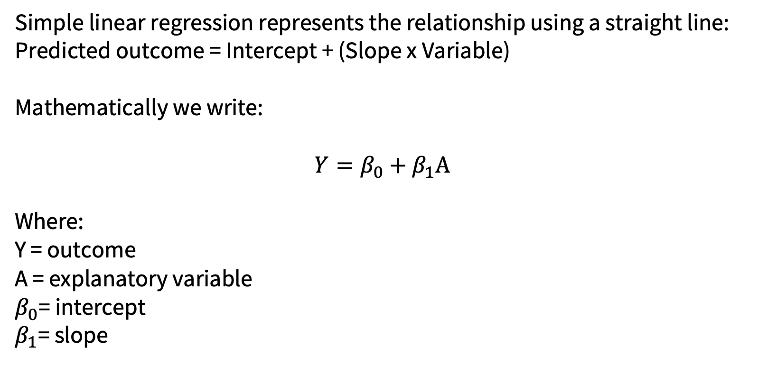
A regression line describes the average relationship
Simple linear regression represents the relationship using a straight line: Predicted outcome = Intercept + (Slope x Variable)
Mathematically we write:
$$Y=β_{0}+β_{1}A$$
Where:
Y = outcome
A = explanatory variable
$β_{0}$= intercept
$β_{1}$= slope

Slide 7
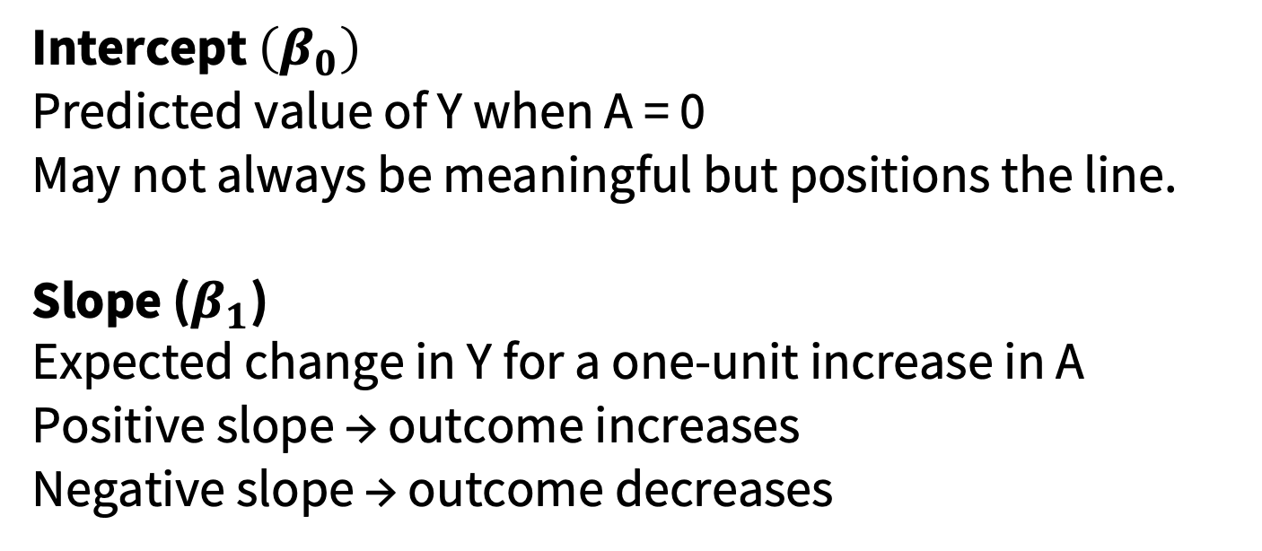
What are the intercepts and slope?
Intercept $\left(β_{0}\right)$
Predicted value of Y when A = 0
May not always be meaningful but positions the line.
Slope ($β_{1}$)
Expected change in Y for a one-unit increase in A
Positive slope → outcome increases
Negative slope → outcome decreases

Slide 8
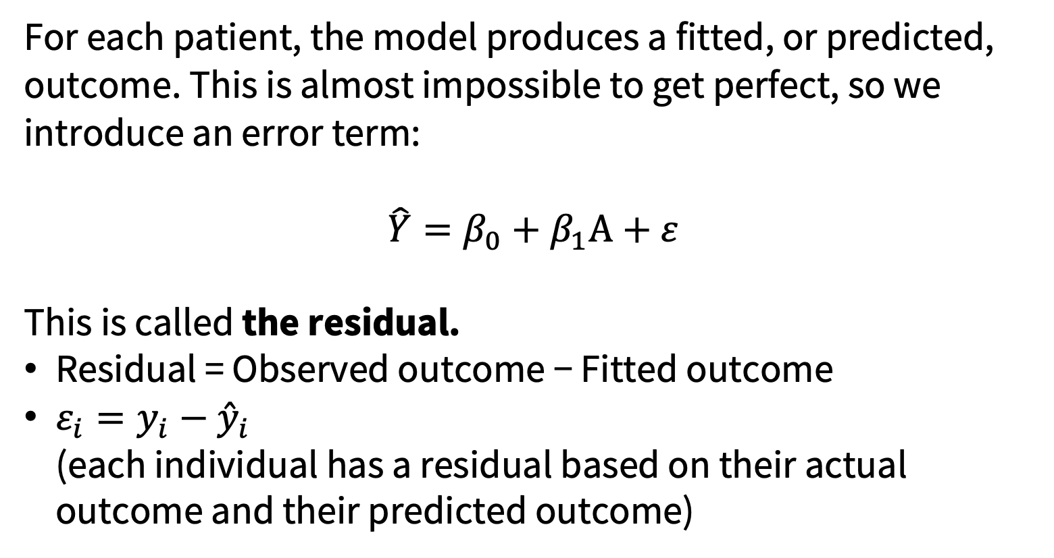
Observations rarely lie perfectly on the fitted line
For each patient, the model produces a fitted, or predicted, outcome. This is almost impossible to get perfect, so we introduce an error term:
$$\hat{Y}=β_{0}+β_{1}A+ε$$
This is called the residual.
Residual = Observed outcome − Fitted outcome
$ε_{i}=y_{i}−{\overset{ˆ}{y}}_{i}$ (each individual has a residual based on their actual outcome and their predicted outcome)

Slide 9
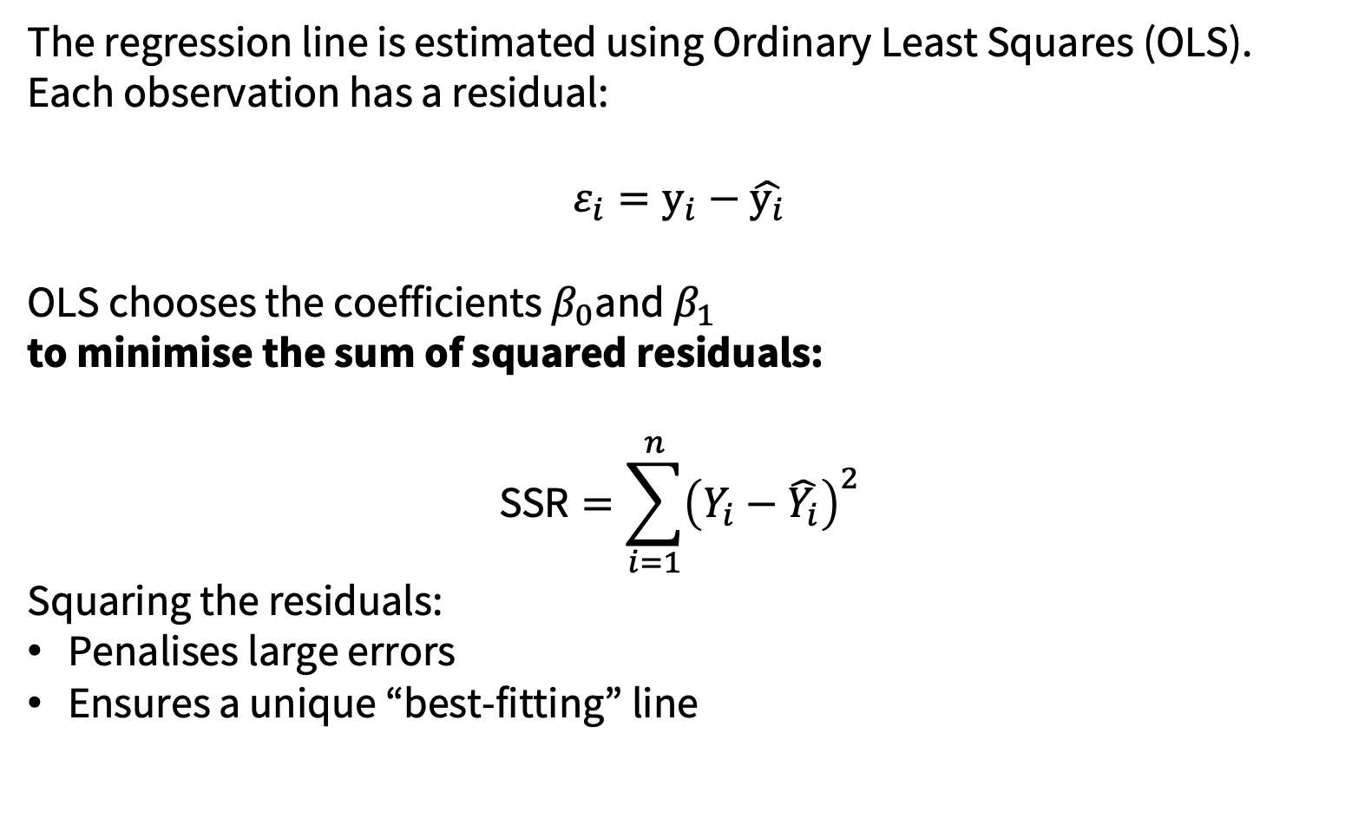
Some intuition on what is happening…
The regression line is estimated using Ordinary Least Squares (OLS).
Each observation has a residual:
$$ε_{i}=y_{i}−\hat{y_{i}}$$
OLS chooses the coefficients $β_{0}$and $β_{1}$ to minimise the sum of squared residuals:
$$\text{SSR}=\sum_{i=1}^{n}{{\left(Y_{i}−\hat{Y_{i}}\right)}^{2}}$$
Squaring the residuals:
Penalises large errors
Ensures a unique “best-fitting” line

Slide 10
R² describes how much variation the model explains
Patients of the same age will not all have the same blood pressure.
R² describes the proportion of observed variation in the outcome explained by the fitted model.
Values range from 0 to 1:
R² = 0 The model explains none of the variation
R² = 1 The model explains all the variation
Conceptually like variance explained in ANOVA

Slide 11
Binary clinical outcomes require a different model
Linear regression is designed for a continuous outcome such as:
Blood pressure
Recovery time
Symptom score
Some clinical outcomes have only two possibilities:
Disease or no disease
Readmitted or not readmitted
Recovered or not recovered
For a binary outcome, we want to estimate a probability between 0 and 1. A straight linear model can produce impossible predicted probabilities below 0 or above 1.

Slide 12
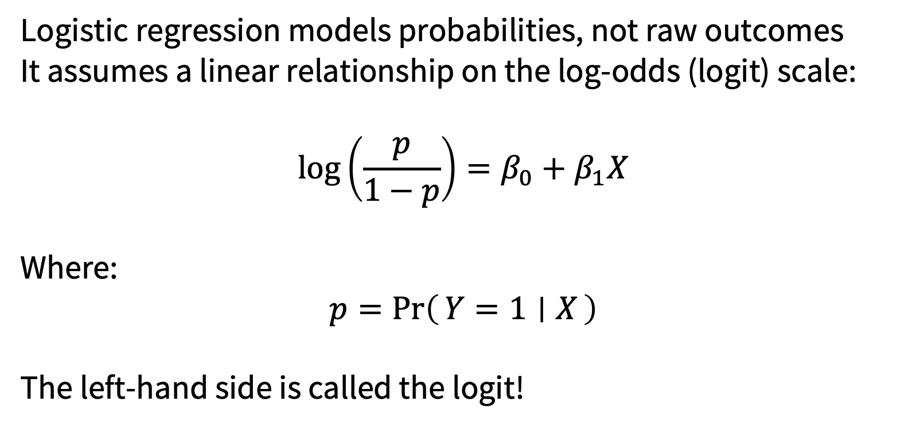
Logistic regression models the probability of an event
Logistic regression models probabilities, not raw outcomes
It assumes a linear relationship on the log-odds (logit) scale:
$$\log\left(\frac{p}{1−p}\right)=β_{0}+β_{1}X$$
Where:
$$p=\operatorname{Pr}\left(Y=1 ∣ X\right)$$
The left-hand side is called the logit!

Slide 13
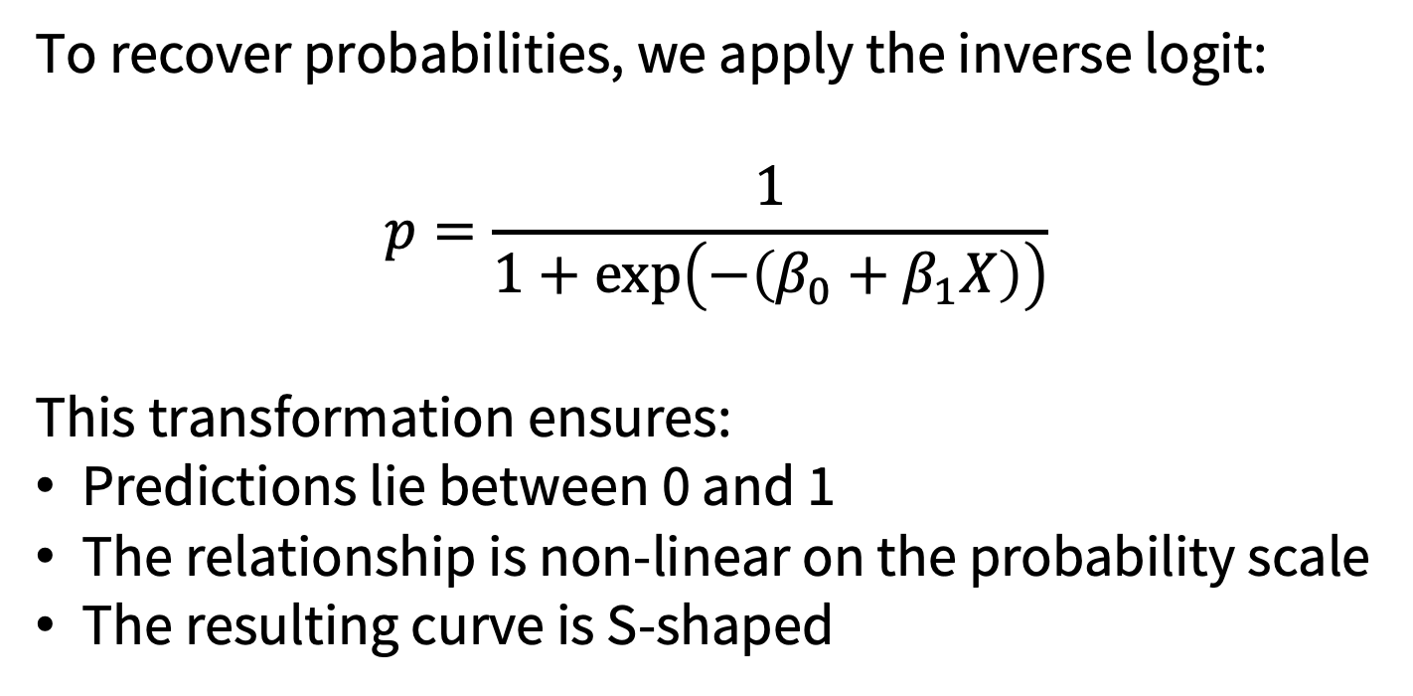
How do we interpret logistic regression?
To recover probabilities, we apply the inverse logit:
$$p=\frac{1}{1+\exp\left(−\left(β_{0}+β_{1}X\right)\right)}$$
This transformation ensures:
Predictions lie between 0 and 1
The relationship is non-linear on the probability scale
The resulting curve is S-shaped

Slide 14
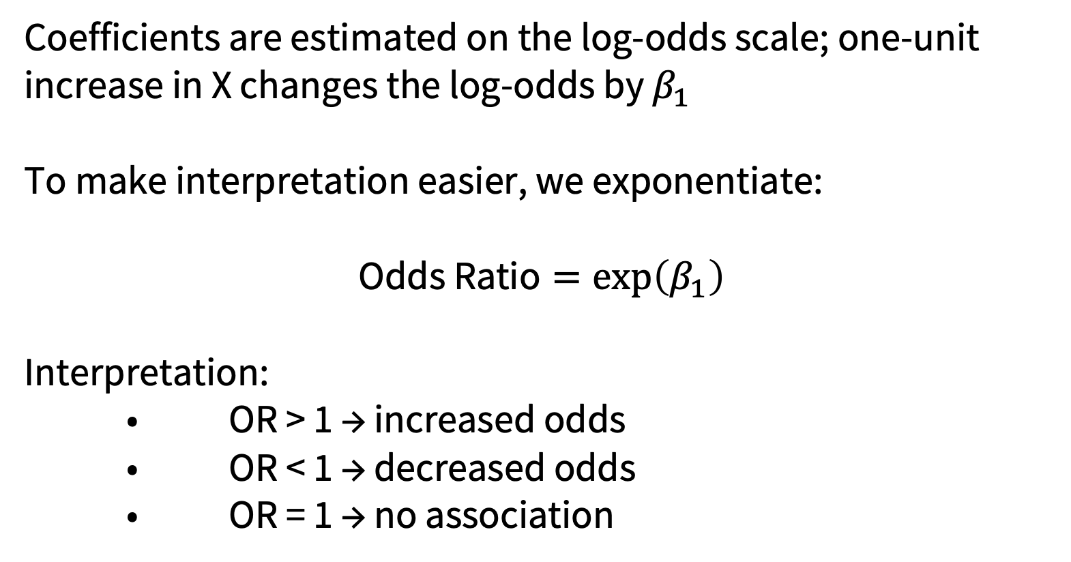
How do we interpret logistic regression?
Coefficients are estimated on the log-odds scale; one-unit increase in X changes the log-odds by $β_{1}$
To make interpretation easier, we exponentiate:
$$\text{Odds Ratio}=\exp\left(β_{1}\right)$$
Interpretation:
• OR > 1 → increased odds
• OR < 1 → decreased odds
• OR = 1 → no association

Slide 15
Linear and logistic regression follow the same framework
 | Linear regression | Logistic regression
Outcome | Continuous | Binary
Example | Blood pressure | Disease
Model estimates | Average outcome difference | Difference in log-odds
Common interpretation | Regression coefficient | Odds ratio
Fitted values | Any numerical value | Probability between 0 and 1
Both models:
Define an outcome and explanatory variable
Estimate regression coefficients
Produce fitted values and residuals
Rely on assumptions
Can be extended to include additional explanatory variables

Slide 16
6.2 Assumptions of regression

Slide 17
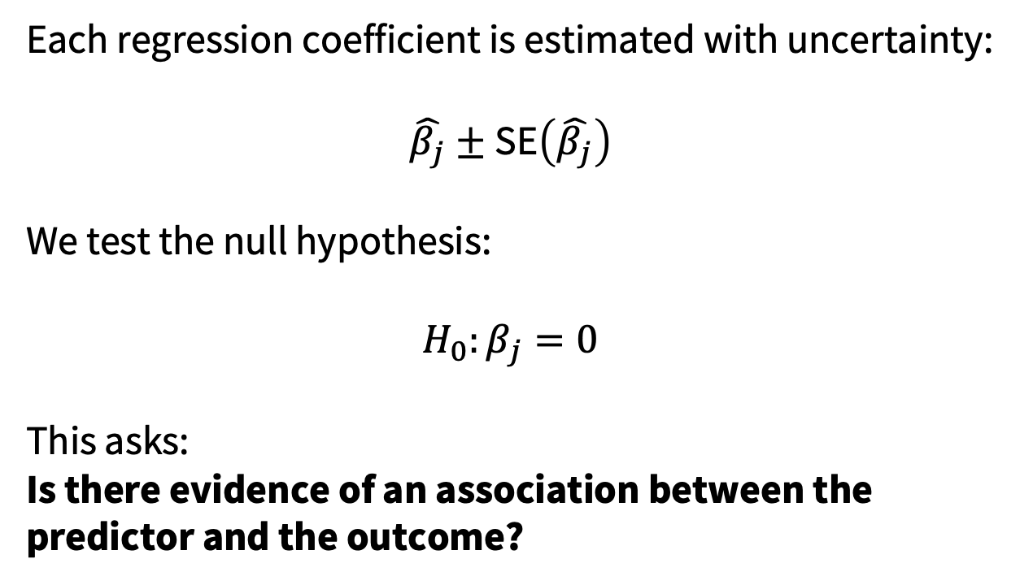
What can we test within a linear model?
Each regression coefficient is estimated with uncertainty:
$$\hat{β_{j}}±\text{SE}\left(\hat{β_{j}}\right)$$
We test the null hypothesis:
$$H_{0}:β_{j}=0$$
This asks:
Is there evidence of an association between the predictor and the outcome?

Slide 18
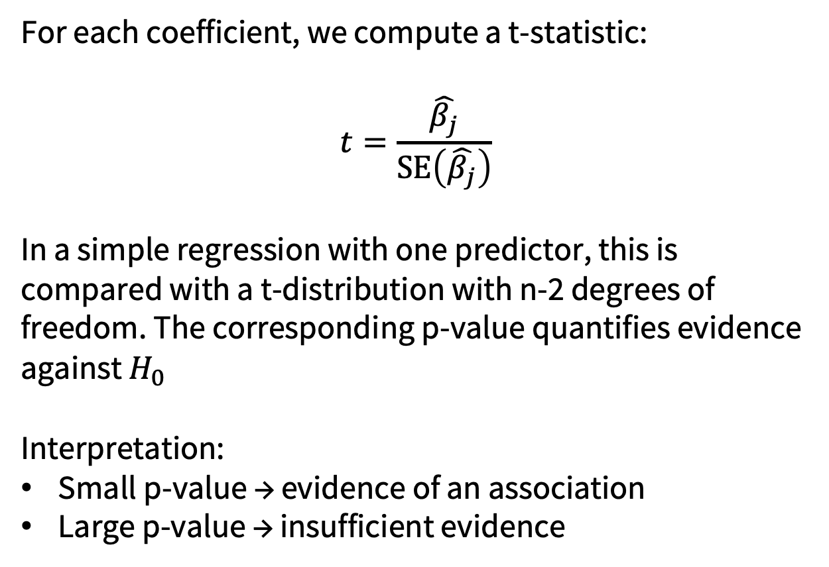
What can we test within a normal linear model?
For each coefficient, we compute a t-statistic:
$$t=\frac{\hat{β_{j}}}{\text{SE}\left(\hat{β_{j}}\right)}$$
In a simple regression with one predictor, this is compared with a t-distribution with n-2 degrees of freedom. The corresponding p-value quantifies evidence against $H_{0}$
Interpretation:
Small p-value → evidence of an association
Large p-value → insufficient evidence

Slide 19
Naturally, we have some assumptions…
Confidence intervals and p-values depend on assumptions about how the model relates to the data.
For a linear regression model, we consider:
Linearity
Constant residual variance
Independence
The distribution of the residuals
Unusual or influential observations
They are not ‘pass’ or ‘fail’. Assumptions require some subjective judgement.

Slide 20
The assumptions concern the residuals
A residual is the difference between an observed and predicted outcome:
Residual = observed outcome − predicted outcome
The residuals represent what the model has not explained. Many regression assumptions therefore concern the pattern and distribution of the residuals.
The explanatory variable and outcome themselves do not need to be normally distributed.

Slide 21
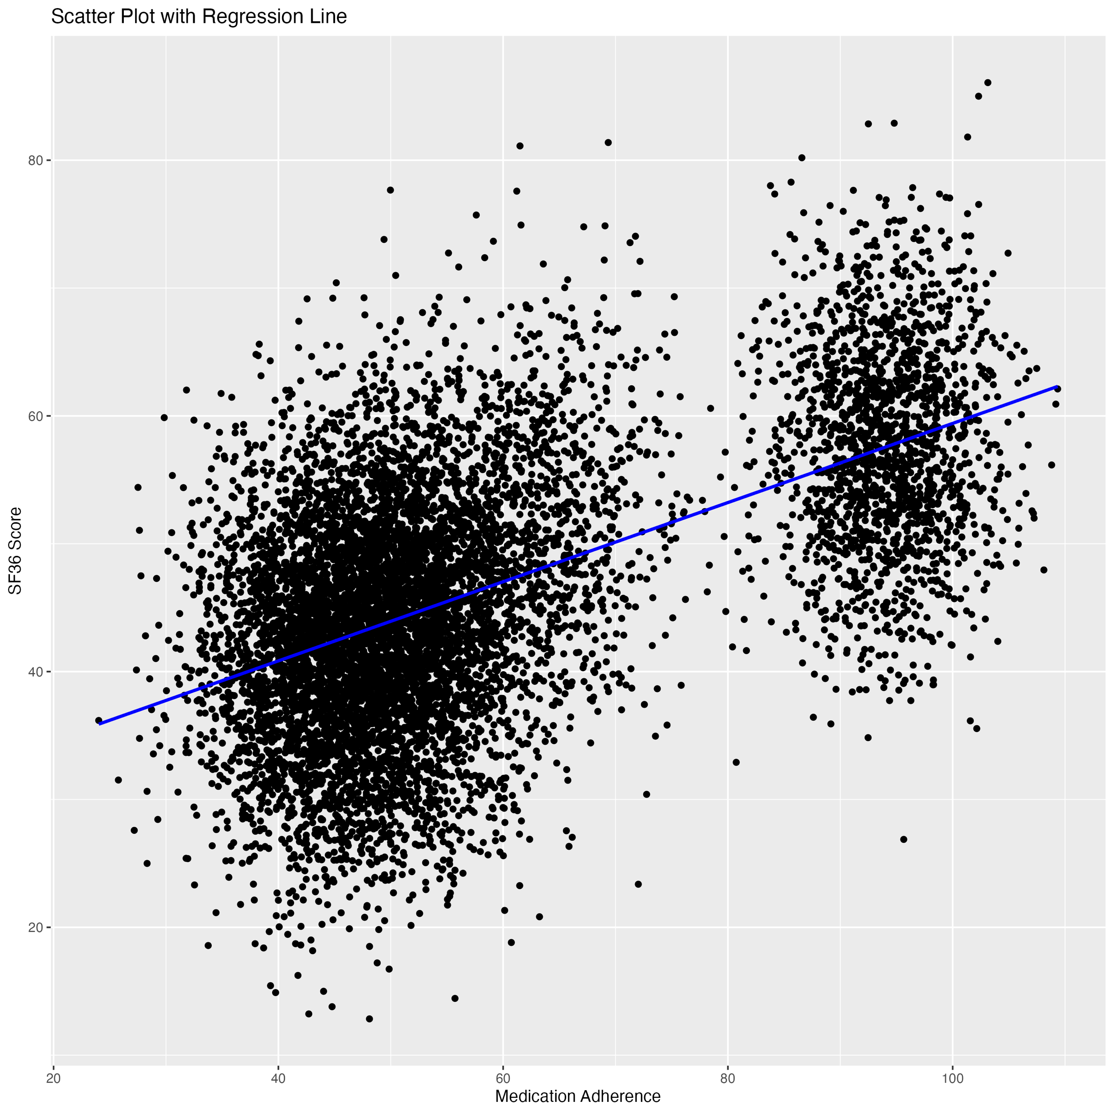
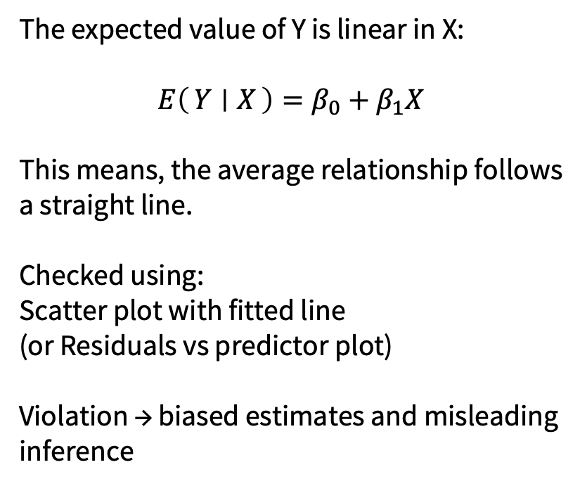
Linearity
The expected value of Y is linear in X:
$$E\left(Y ∣ X\right)=β_{0}+β_{1}X$$
This means, the average relationship follows a straight line.
Checked using:
Scatter plot with fitted line
(or Residuals vs predictor plot)
Violation → biased estimates and misleading inference

Slide 22
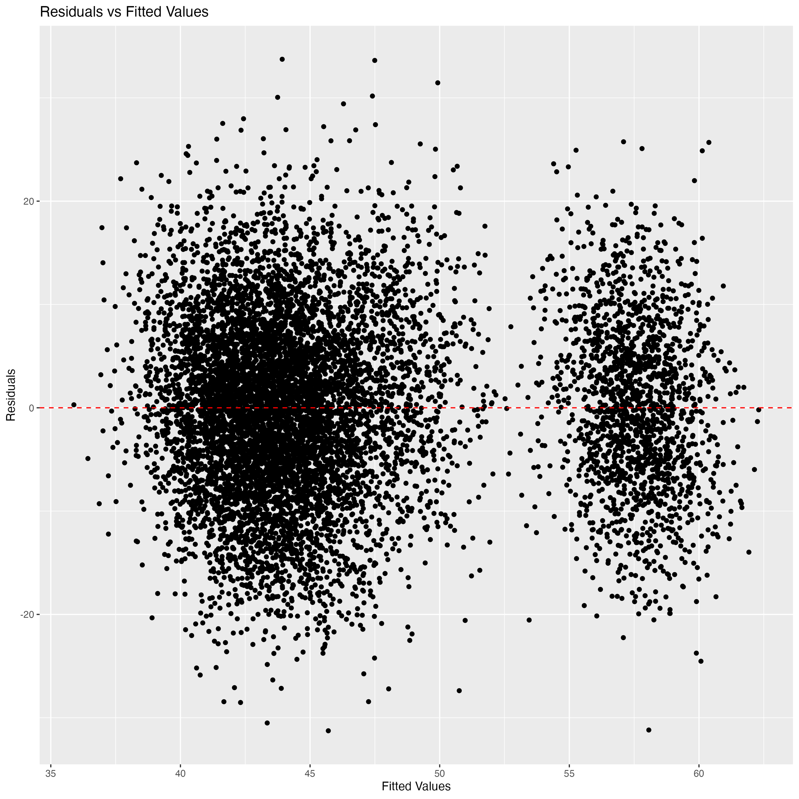
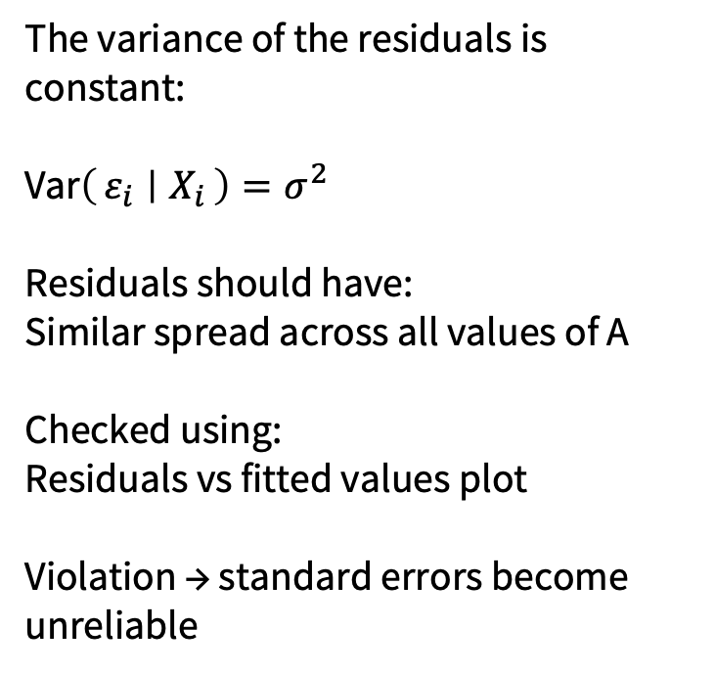
Constant Variability
The variance of the residuals is constant:
$\text{Var}\left(ε_{i} ∣ X_{i}\right)=σ^{2}$
Residuals should have:
Similar spread across all values of A
Checked using:
Residuals vs fitted values plot
Violation → standard errors become unreliable

Slide 23
Independence of Observations
Residuals are independent:
$\text{Cov}\left(ε_{i},ε_{j}\right)=0 \text{for }i≠j$
This is a study design assumption, not something we can “fix” statistically.
Violated by:
Repeated measurements
Time-series data
Clustered observations
Violation → invalid hypothesis tests

Slide 24
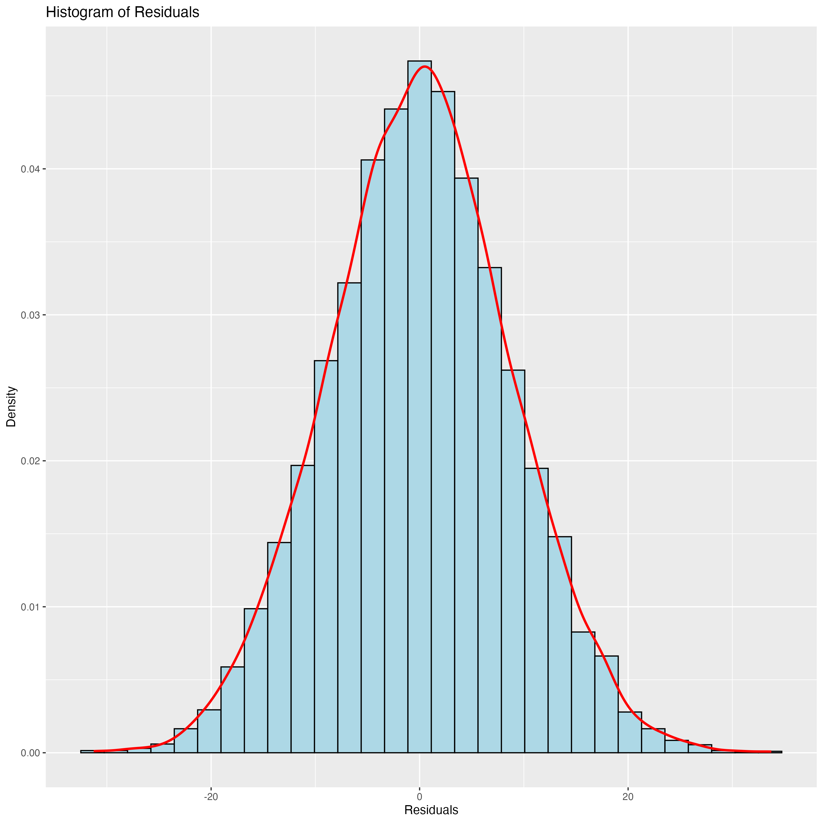
Normality of Residuals
Residuals are normally distributed:
$$ε_{i}∼𝒩\left(0,σ^{2}\right)$$
Normality is required for:
Valid t-tests
Confidence intervals
Checked using:
Histogram of residuals
Q–Q plot
Important:
Large samples reduce sensitivity to this assumption

Slide 25
Outliers
Outliers are observations with:
Large residuals
High leverage
They can distort $\hat{β_{1}}$ by either inflating or deflating significance.
Detected using:
Residual plots
Influence measures (e.g. Cook’s distance)
Outliers should be investigated, not automatically removed.

Slide 26
Reading diagnostic plots together
Check | Question
Residuals versus fitted values | Is there curvature or changing variability?
Normal Q–Q plot | Are the residuals approximately normally distributed?
Residuals versus leverage | Are any observations unusually influential?
Study design | Are the observations independent?
No single plot proves that a model is valid.
We build an overall judgement from the data, plots, study design and clinical context.

Slide 27
Inference in logistic regression
Logistic regression coefficients are estimated using maximum likelihood.
For each predictor, software commonly reports:
The estimated coefficient
Its standard error
A z-statistic
A p-value
A confidence interval
The coefficient is measured on the log-odds scale.

Slide 28
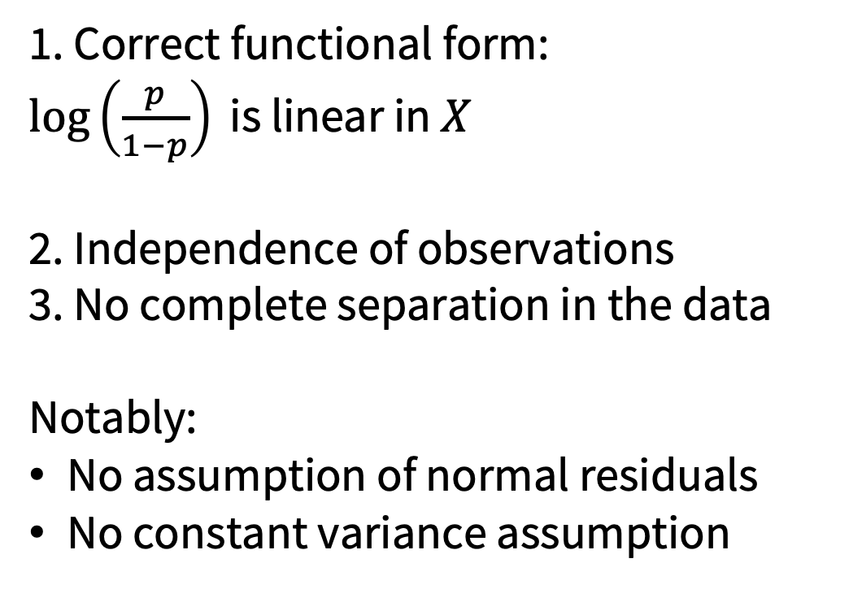
Logistic regression has different assumptions
1. Correct functional form:
$\log\left(\frac{p}{1−p}\right)\text{ is linear in }X$
2. Independence of observations
3. No complete separation in the data
Notably:
No assumption of normal residuals
No constant variance assumption

Slide 29
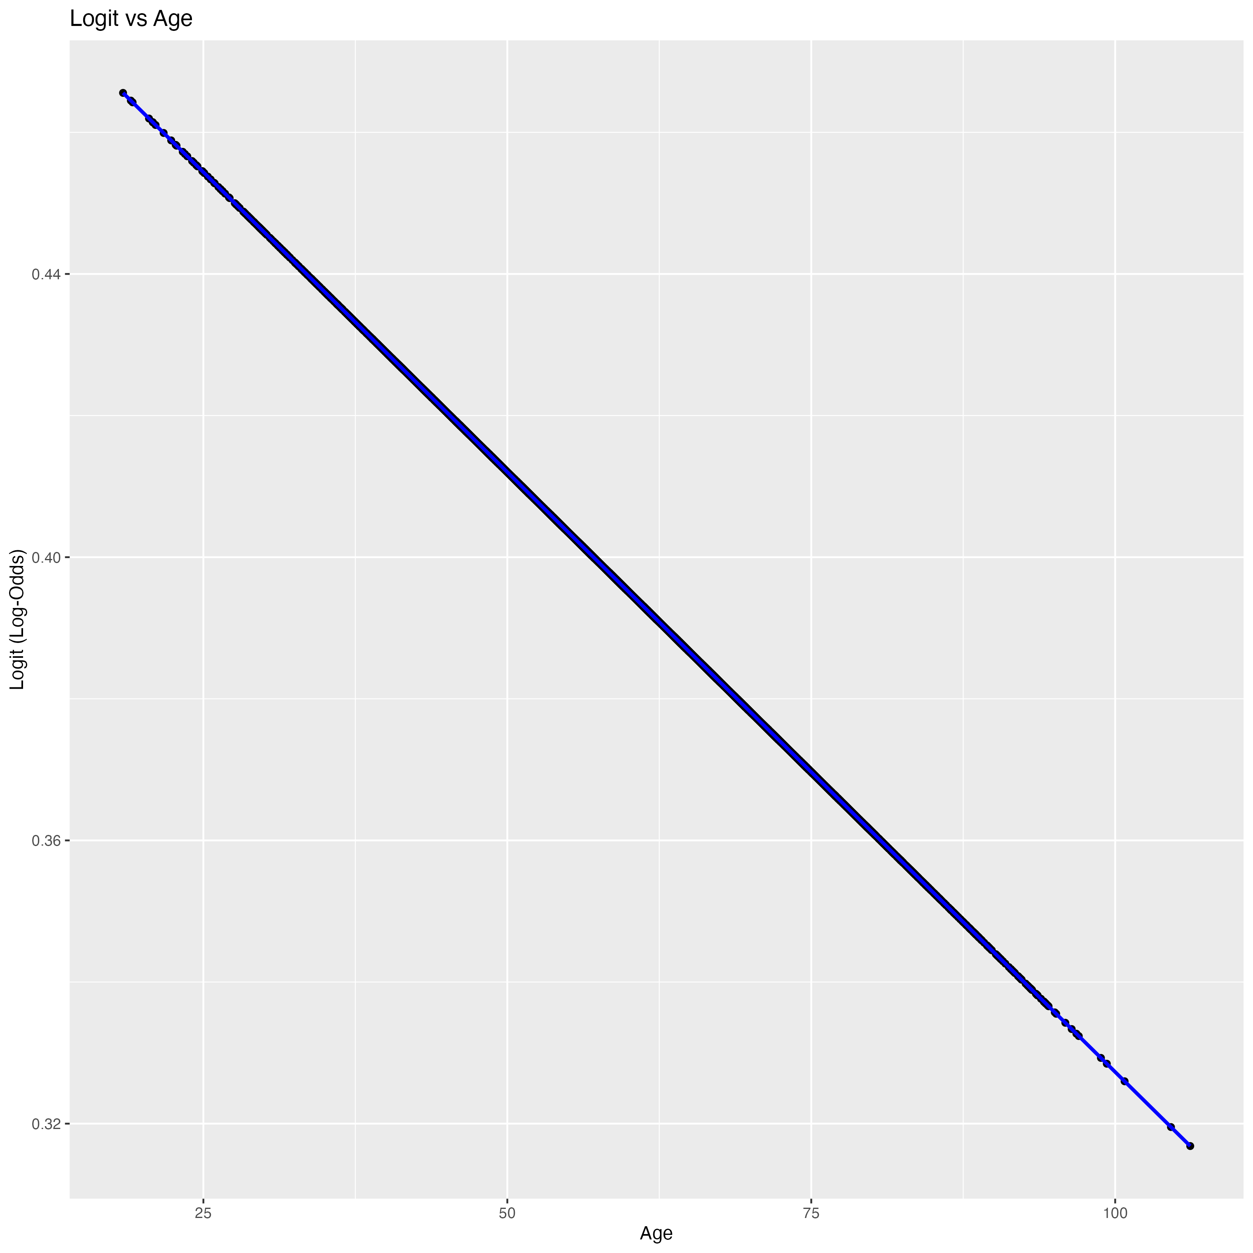
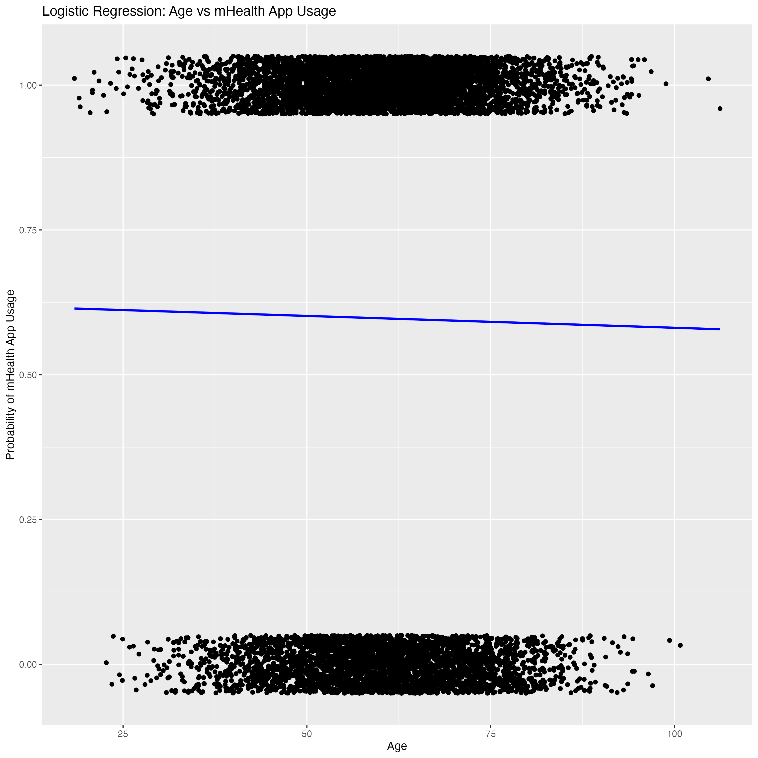
The assumptions of logistic regression.

Slide 30
What should we do when assumptions are questionable?
An assumption concern does not automatically mean that the analysis must be abandoned.
It may indicate that we should:
Check the data and coding
Reconsider the shape of the relationship
Investigate influential observations
Report the limitation clearly
Examine whether the conclusion is sensitive to different modelling choices
The appropriate response depends on the problem identified.

Slide 31
6.3 Multivariable regression

Slide 32
Sometimes (ie. always) things aren’t that simple…
A clinical outcome may be associated with several patient characteristics.
For example, blood pressure may be related to:
Age
Sex
Body mass index
Medication use
Smoking
Other health conditions
A model containing only one predictor may provide an incomplete account of these relationships.

Slide 33
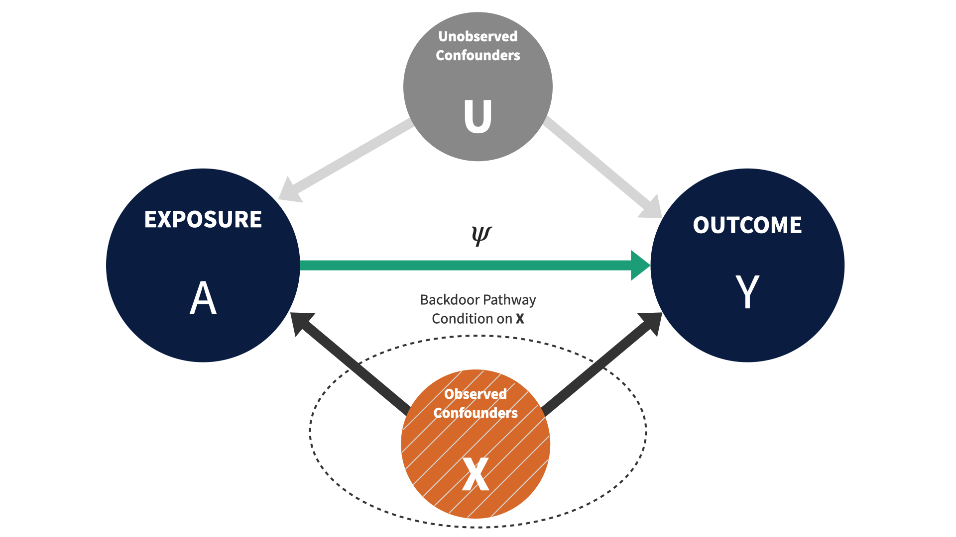
How do we ‘adjust’ for confounding in a model?

Slide 34
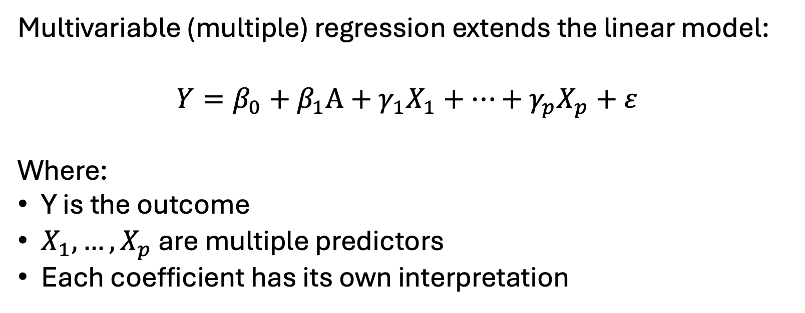
How does this look then?
Multivariable (multiple) regression extends the linear model:
$$Y=β_{0}+β_{1}A+γ_{1}X_{1}+…+γ_{p}X_{p}+ε$$
Where:
Y is the outcome
$X_{1},…,X_{p}$ are multiple predictors
Each coefficient has its own interpretation

Slide 35
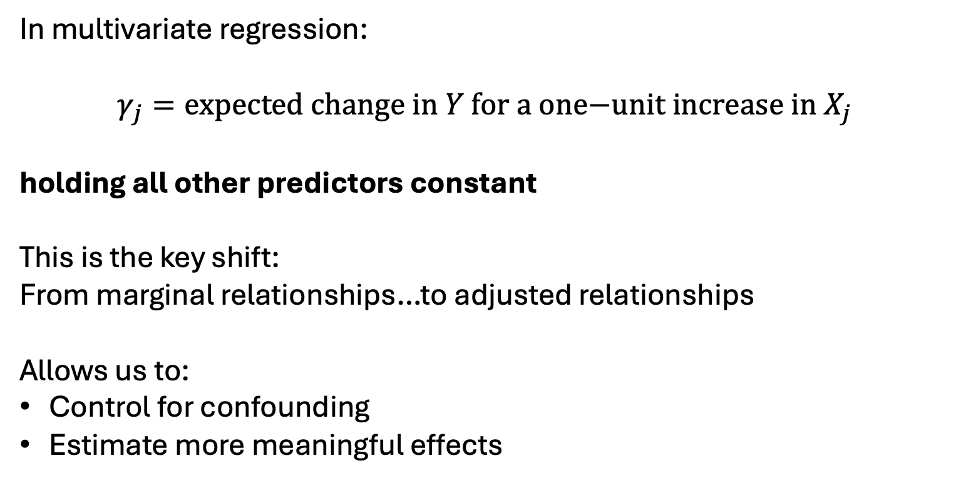
What is the important interpretation change?
In multivariate regression:
$$γ_{j}=\text{expected change in }Y\text{ for a one−unit increase in }X_{j}$$
holding all other predictors constant
This is the key shift:
From marginal relationships…to adjusted relationships
Allows us to:
Control for confounding
Estimate more meaningful effects

Slide 36
Why might the coefficient change?
Suppose we first model the association between physical activity and blood pressure:
Blood pressure ~ physical activity
We then account for age:
Blood pressure ~ physical activity + age
The physical-activity coefficient may change because age is related to:
Physical activity
Blood pressure
Part of the original association may therefore have reflected differences in age.

Slide 37
Adjustment does not solve everything
Regression can adjust only for characteristics that were:
Measured
Measured with reasonable accuracy
Represented appropriately in the model
An adjusted result may still be affected by:
Unmeasured confounding
Poor measurement
Missing data
Incorrect model specification
“Adjusted” does not mean “free from bias”.

Slide 38
So what is a regression model?
A regression model is a statistical representation of how an outcome varies with explanatory variables.
It combines:
Assumptions
Estimation
Interpretation
Regression is not just a test, it is a modelling framework for explanation and prediction

Slide 39
6.4 Working with objects in R

Slide 40
You have already created many objects
In previous weeks you created objects already!
analysis_data <- patient_data |>
select(age, treatment, outcome) |>
filter(!is.na(outcome))
Whether you were aware of it or not, maybe were told it by a tutor or figured it out yourself the ‘<-’ saves (or assigns) the result of the process on the right into an object, the thing named on the left.

Slide 41
Assignment stores the result of an instruction
mean_age <- mean(
patient_data$age,
na.rm = TRUE
)
R performs the instruction on the right.
<- assigns the result.
mean_age becomes the object’s name.
Typing the name retrieves the stored value.

Slide 42
Objects can contain different kinds of information
Object | What it contains
mean_age | One number
patient_data | A data frame
risk_table | A table of counts
correlation_result | Results from a statistical test
linear_model | A fitted statistical model

Slide 43
Complex objects contain named components
correlation_result <- cor.test(
patient_data$age,
patient_data$blood_pressure
)
names(correlation_result)
We can utilise the names() function to look what might be inside an object. In the example above, we’d expect to see…
estimate
p.value
conf.int
method
data.name

Slide 44
The $ operator retrieves one component of an object
object$component
This should be read as…
“From this object, retrieve this named component.”

Slide 45
The output of one function can become the input to another
Remember when we made a nice caption…
caption_text <- paste("Pearson r =",
round(correlation_result$estimate,2)
)
Here:
correlation_result stores the test.
$estimate retrieves one component.
round() formats the number.
paste() combines it with text.
The result is stored as caption_text.

Slide 46
A fitted regression model is a complex object
In order to fit the regression models we have to use the lm() command.
linear_model <- lm(
blood_pressure ~ treatment,
data = analysis_data
)
lm() does not simply print an answer. It creates a model object containing many related results.

Slide 47
The + symbol adds variables to the model
Within a model formula, + tells R to include another explanatory variable.
unadjusted_model <- lm(
blood_pressure ~ treatment,
data = analysis_data
)
adjusted_model <- lm(
blood_pressure ~ treatment + age + bmi,
data = analysis_data
)
It does not mean that R is adding the values of the variables together.

Slide 48
The outcome determines whether we use lm() or glm()
lm() models differences in the average value of a continuous outcome.
linear_model <- lm(
blood_pressure ~ treatment + age,
data = analysis_data
)
glm(..., family = binomial()) models the probability of a binary outcome.
logistic_model <- glm(
disease ~ treatment + age,
data = analysis_data,
family = binomial()
)

Slide 49
Helper functions retrieve useful model information
summary(linear_model) # Model overview
coef(linear_model) # Estimated coefficients
confint(linear_model) # Cis for coefficients
fitted(linear_model) # Fitted outcome values
residuals(linear_model) # Residual/errors per value
Rather than having to navigate every single internal component of an object, there are some other built in R functions which allow us to access the important things within a linear model.

Slide 50
Model output can be converted into a tidy dataset
model_results <- broom::tidy(
linear_model,
conf.int = TRUE
)
The tidy() function from the broom package converts model coefficients into a data frame.

Slide 51
What you need to do next…
We have explored how regression can be used to describe relationships and make fairer comparisons by accounting for differences between patients.
We have also considered: univariable and multivariable regression (linear and logistic), along with their assumptions; as well as how model results are stored and retrieved in R.
To the code-along…

