Slide 1

Topic 7: Estimation vs prediction

Slide 2
A model can answer two different clinical questions
Last week, we used regression to describe how an outcome varies with several explanatory variables and to make fairer comparisons between patients.
But a fitted model can be used for different purposes. We might ask:
Explanation/Estimation: Is treatment associated with the outcome after accounting for age and disease severity?
Prediction: Given this patient’s characteristics, how likely are they to experience the outcome?
These questions may use similar models, but they require different interpretations and different ways of judging whether the model is useful.

Slide 3
This topic…
Explanation, estimation and prediction
Evaluating prediction models
Machine learning and generalisation
Reproducibility in R
7.1 Explanation, estimation and prediction

Slide 4
7.1 Explanation, estimation and prediction

Slide 5
Explanation asks why or how variables are related (this is what we’ve done so far)
An explanatory question might ask:
Is treatment associated with hospital readmission after accounting for age and disease severity?
Here, we are interested in:
The direction of the association
The size of the association
Whether confounding has been addressed
Whether the association might be causal
The regression coefficients and their uncertainty are central to the interpretation.

Slide 6
Estimation quantifies a population parameter with uncertainty (we’ve done a bit of this too).
Estimation asks how large the relationship might be. An estimate uses sample data to quantify an unknown value in a wider population.
Among similar patients, how much lower are the odds of readmission with the treatment?
An estimate should usually be accompanied by:
A confidence interval
A clear reference group
The population to which it applies
An explanation of its clinical meaning
Estimation recognises that the exact population value remains uncertain.

Slide 7
Prediction estimates an unknown outcome for a new patient (we’ve not done this…yet!)
A predictive question might ask:
How likely is this patient to be readmitted within 30 days?
The model combines information about the patient, such as:
Age
Disease severity
Previous admissions
Comorbidities
Treatment received
It then produces a predicted outcome or probability.

Slide 8
The same regression model can support all three purposes.
Explanation
How and why is a predictor related to the outcome?
Estimation
How large is the relationship in the wider population?
Prediction
What outcome is likely for a new patient?
Before fitting a model, we should be clear about which question we are trying to answer.

Slide 9
A good explanatory model is not automatically a good predictive model.
Say a model gives us a predicted probability of readmission being 32%
A predicted probability is not a certain outcome. A predicted probability of 32% does not tell us what will happen to this patient.
The patient may be readmitted.
The patient may not be readmitted.
The prediction describes uncertainty using information available at the time.
Clinical outcomes are also affected by factors that may be:
Unknown
Unmeasured
Measured with error
Absent from the model

Slide 10
Population averages do not determine individual outcomes.
A model learns average patterns from groups of patients.
Patients with similar characteristics may still experience different outcomes.
For example, among 100 comparable patients assigned a predicted risk of approximately 30%, we might expect around 30 to experience the outcome.
However, the model cannot identify with certainty which 30 patients these will be.
Prediction estimates risk; it does not reveal an individual patient’s future.

Slide 11
Fitted values are predictions for observations already seen.
When we fit a regression model, it produces a fitted value for each observation in the data.
For a continuous outcome:
Fitted value = predicted value of the outcome
For a binary outcome:
Fitted value = predicted probability of the event
The residual represents the difference between the observed and predicted outcome.
We encountered these ideas when examining regression assumptions.

Slide 12
New-patient predictions require the same predictor information.
To make a prediction for a new patient, we must provide the predictor values required by the model.
A model developed using:
Age
Disease severity
Previous admissions
Treatment
cannot generate the intended prediction if these variables are unavailable, recorded differently or measured at a different time.
A clinically useful model must use information that is available when the prediction is needed.

Slide 13
Prediction supports clinical judgement; it does not replace it.
A prediction model should not be judged only by how well it describes the patients used to create it.
We need to ask:
How close are its predictions to the observed outcomes?
Can it distinguish higher-risk from lower-risk patients?
Do predicted probabilities correspond to observed frequencies?
Does it perform well for new patients?
Would its errors be acceptable in clinical practice?
This requires us to evaluate the prediction model.

Slide 14
7.2 Evaluating prediction models

Slide 15
Different prediction tasks require different evaluation metrics.
Continuous outcome
Example: predicted length of hospital stay
Common metrics:
Mean absolute error
Root mean squared error
R²
Binary classification
Example: predicted readmission or no readmission
Common metrics:
Sensitivity
Specificity
Accuracy
Binary outcome probability
Example: probability of 30-day readmission
Common metrics:
Calibration
Brier score
Discrimination or AUC

Slide 16
A threshold converts probabilities into classifications.
A prediction model initially produces probabilities, not clinical decisions. To evaluate how the model would classify patients, we can select a threshold.
For a threshold of 0.30:
Predicted readmission if: p ≥ 0.30
Predicted no readmission if: p < 0.30
A patient with p̂ = 0.35 would be classified as a predicted readmission. A patient with p̂ = 0.25 would be classified as a predicted non-readmission. The threshold is a decision rule, not a natural property of the model.

Slide 17
True positives, false positives, true negatives and false negatives.
 | Observed readmission | No observed readmission
Predicted readmission | True positive | False positive
Predicted no readmission | False negative | True negative
This resembles the Type I and Type II errors encountered in hypothesis testing. The ideas are similar, but not identical:
Type I and Type II errors concern conclusions from statistical hypothesis tests.
False positives and false negatives concern classifications made for patients.

Slide 18
Sensitivity: how often does the model identify patients who experience the outcome?
Sensitivity is the proportion of patients who experienced the outcome and were correctly identified.
Sensitivity = True positives / All observed positives
Sensitivity = TP / (TP + FN)
Suppose 40 patients were readmitted:
32 were correctly identified
8 were missed
Sensitivity = 32 / (32 + 8) = 0.80
The model identified 80% of patients who were readmitted.
Sensitivity is also called the true-positive rate.

Slide 19
Specificity: how often does it identify those who do not?
Specificity is the proportion of patients who did not experience the outcome and were correctly identified.
Specificity = True negatives / All observed negatives
Specificity = TN / (TN + FP)
Suppose 160 patients were not readmitted:
120 were correctly identified
40 were incorrectly classified as predicted readmissions
Specificity = 120 / (120 + 40) = 0.75
The model correctly identified 75% of patients who were not readmitted.

Slide 20
Changing the threshold changes the balance of errors.
Lowering the threshold classifies more patients as likely to experience the outcome.
This usually:
Increases sensitivity
Decreases specificity
Reduces false negatives
Increases false positives
Raising the threshold usually:
Decreases sensitivity
Increases specificity
Increases false negatives
Reduces false positives
Improving sensitivity will often reduce specificity, and vice versa.

Slide 21
The appropriate threshold depends on the clinical consequences.
There is no universally correct classification threshold. A lower threshold may be appropriate when missing the outcome would be particularly harmful.
For example:
Failing to identify a patient at risk of rapid deterioration. A higher threshold may be appropriate when the resulting intervention is costly, invasive or potentially harmful.
Threshold selection should consider:
The consequences of false negatives
The consequences of false positives
The effectiveness of the proposed intervention
Available clinical resources
The intended clinical use of the model
A threshold of 0.50 is not automatically clinically appropriate.

Slide 22
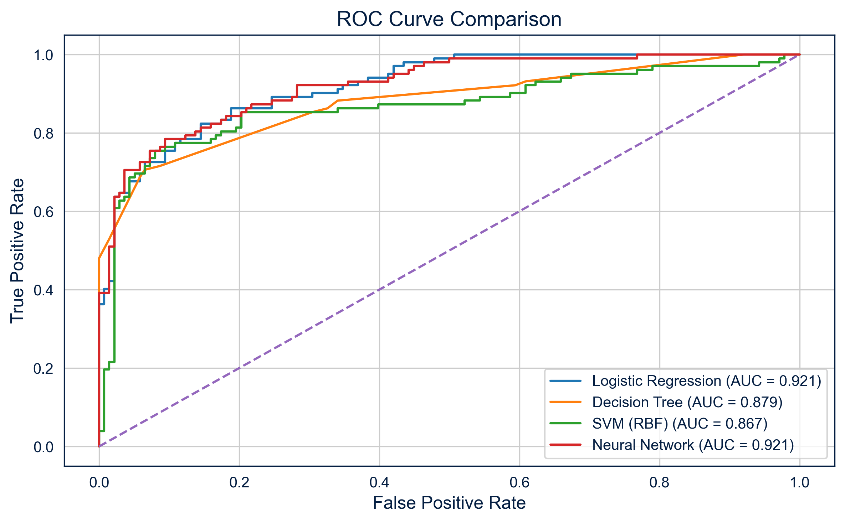
ROC curves summarise performance across thresholds.
A receiver operating characteristic (ROC) curve evaluates performance across every possible classification threshold.
Y-axis: Sensitivity
X-axis: 1 − Specificity
The quantity 1-specificity is also called the false-positive rate. Each point on the curve represents a different threshold. A model with no ability to distinguish between patients follows approximately the diagonal line.
A model with better discrimination produces a curve closer to the upper-left corner.

Slide 23
Discrimination asks whether higher-risk patients receive higher predictions.
A model discriminates well when patients who experience the outcome tend to receive higher predicted risks than patients who do not. Discrimination is commonly summarised using the area under the
ROC curve.
Values:
0.5 → random ranking
0.7 → acceptable discrimination
0.8 → good discrimination
0.9+ → strong discrimination
An AUC of, for example, 0.80 means:
If we randomly select one patient who was readmitted and one who was not, the model will assign the higher predicted risk to the readmitted patient approximately 80% of the time.
The AUC assesses ranking—not whether the predicted probabilities are accurate.

Slide 24
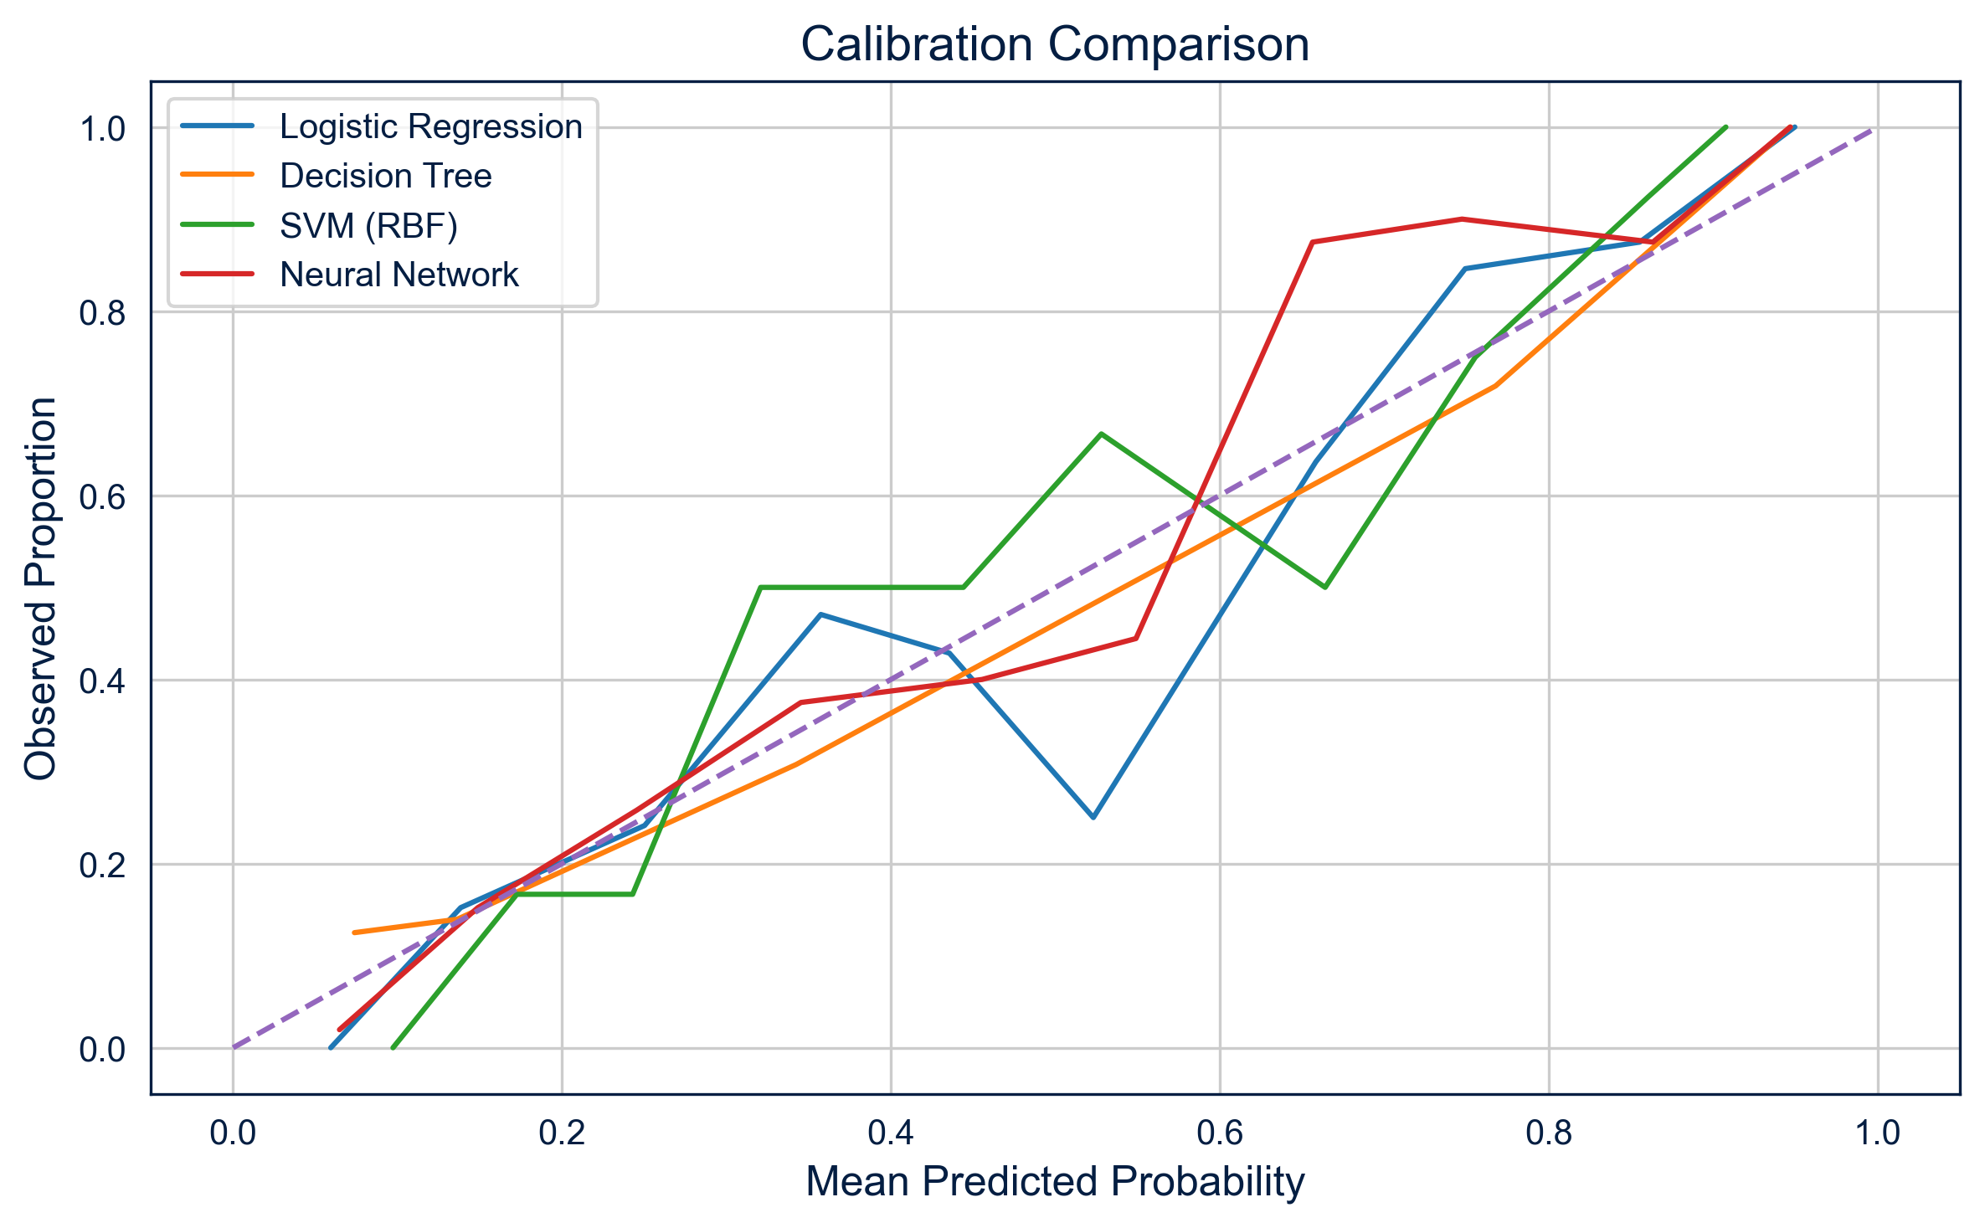
Calibration asks whether predicted risks agree with observed frequencies.
A model is well calibrated when its predicted probabilities correspond to observed outcome frequencies. Calibration asks, “Do the predicted numbers mean what they claim to mean?”
For example:
Among patients assigned a predicted risk of approximately 20%, around 20% should experience the outcome.
Calibration can be examined using a calibration plot:
X-axis: Mean predicted probability
Y-axis: Observed outcome frequency
Perfect calibration follows the 45-degree line.

Slide 25
A model can discriminate well but remain poorly calibrated.
Imagine a model that correctly ranks patients:
Patient A: lowest risk
Patient B: intermediate risk
Patient C: highest risk
Predicted Risk | Observed Risk
20% | 10%
40% | 20%
60% | 30%
The model separates lower-risk from higher-risk patients, but its predicted probabilities are too high.
Discrimination: Who is at greater risk?
Calibration: How accurate is the predicted risk?
Both matter when predictions will be communicated as probabilities.

Slide 26
Accuracy can be misleading when outcomes are uncommon.
Accuracy is the proportion of all classifications that are correct.
Accuracy = (TP + TN) / (TP + TN + FP + FN)
Imagine that only 5% of patients are readmitted. A model that predicts “no readmission” for every patient would be 95% accurate
However:
It would identify no readmissions
Its sensitivity would be 0%
It would provide no useful risk discrimination
High accuracy can therefore conceal poor performance when one outcome is much more common than the other. Accuracy should not be interpreted alone.

Slide 27
Clinical usefulness is not the same as statistical performance.
A model may have good discrimination and calibration but still provide little clinical benefit. We must also ask:
What decision will the prediction change?
Is an effective intervention available?
Would the model improve on existing clinical judgement?
What are the consequences of acting on a false positive?
What are the consequences of missing a true positive?
Can the health service act on the number of patients identified?
Statistical evaluation asks whether the model predicts well. Clinical evaluation asks whether using those predictions improves decisions or patient outcomes. A prediction model should support clinical judgement, not replace it.

Slide 28
7.3 Machine learning and generalisation

Slide 29
What makes something machine learning?
Traditional programming uses rules written explicitly by a person.
Rules + data → outputs
Machine learning uses examples with known outcomes to estimate the rules.
Data + known outcomes → learned model
The fitted model can then produce predictions for new patients. Machine learning does not mean that the model understands the clinical problem. It means that aspects of the prediction rule have been estimated from data.

Slide 30
A model learns a mapping from predictors to an outcome using examples.
A supervised machine-learning model learns a function: X → Y
where:
X represents the patient predictors.
Y represents the clinical outcome.
For example:
Age + disease severity + previous admissions → 30-day readmission
We can write this generally as:
ŷ = f(X)
The fitted function, f, takes a patient’s predictor values and produces a predicted outcome.

Slide 31
Regression is already a form of supervised machine learning.
In logistic regression, we use examples with known outcomes to estimate a relationship between predictors and a binary outcome. The fitted model then generates predicted probabilities for new patients.
This follows the supervised machine-learning framework:
Provide patient predictors
Provide the known outcomes
Estimate the relationship
Apply the fitted model to new patients
Machine learning is not a separate subject from statistics. Many familiar statistical models can be used for prediction.

Slide 32
Features are explanatory or predictor variables.
In machine learning, predictor variables are commonly called features.
For a model predicting 30-day readmission, features might include:
Age
Disease severity
Previous admissions
Comorbidities
Treatment received
Each patient is represented by a set of feature values.
The choice of features affects:
What patterns the model can learn
When the prediction can be made
Whether the model can be used in clinical practice
Features must be available at the time the prediction is required.

Slide 33
The label or target is the outcome.
In supervised machine learning, the outcome is often called the label or target.
For example:
Features: Age, disease severity and previous admissions
Target: Readmission within 30 days
For a binary outcome, the target might be coded as:
1 = Readmitted
0 = Not readmitted
The model uses examples where both the features and target are known. Poorly defined or incorrectly recorded targets will lead the model to learn the wrong task.

Slide 34
Training means estimating the model from known examples.
The data used to estimate the model are called the training data. During training, the model identifies values for its parameters that reduce prediction error.
For logistic regression, training estimates the regression coefficients. For each patient:
Features → Model → Predicted probability
The predicted probability is compared with the known outcome.
The model parameters are selected to make the observed training data reasonably likely.
Making predictions does not automatically update the model. It learns only when a training or retraining process is performed.

Slide 35
Performance on the training data can be misleading.
A model has already encountered every patient in its training data. Good training performance may therefore mean that the model has learned:
Genuine clinical patterns
Patterns specific to that dataset
Random variation
Measurement or recording quirks
Training performance tells us how well the model fits known examples. It does not tell us how well the model will perform for new patients.
Evaluating a model using the same data used to train it produces an overly optimistic result.

Slide 36
Overfitting
Underfitting
An overfitted model follows the training data too closely. It learns both:
Signal (the underlying pattern)
Noise (random variation specific to the training data)
An overfitted model may have:
Excellent training performance
Poor performance for new patients
Unstable predictions
Excessive sensitivity to small changes in the data
The model has memorised details that do not generalise.
An underfitted model is too simple to represent important relationships in the data. For example, it may:
Omit important predictors
Assume a linear relationship when the pattern is curved
Ignore interactions between predictors
Produce similar predictions for clinically different patients
An underfitted model usually performs poorly on the training data, and new patient data. Underfitting means that useful signal remains unexplained.

Slide 37
Split the data into training and test sets.
Training set
Used to estimate the model and learn its parameters.
Test set
Held aside and used to evaluate the final fitted model.
A common split might be:
80% training data
20% test data
The exact proportion depends on the size of the dataset and modelling process. The split should normally be performed randomly, unless the study design requires a temporal or geographical split.

Slide 38
Validation supports model development
Prediction modelling may use three separate datasets.
Training data
Used to estimate model parameters.
Validation data
Used to compare candidate models and make modelling decisions.
Test data
Used once to estimate the final model’s performance.
The process is:
Train → Validate → Test
When data are limited, cross-validation can repeatedly divide the training data into temporary training and validation portions. The final test set should remain untouched until model development is complete.

Slide 39
More complex does not automatically mean better.
A more complex model can represent more detailed relationships. This may improve training performance, but also increases the opportunity to learn noise.
Greater complexity can come from:
Including more features
Adding interactions
Modelling non-linear relationships
Using more flexible algorithms
The best model is not necessarily the one that fits the training data most closely. We want sufficient complexity to learn the signal without fitting unstable details. This is the balance between underfitting and overfitting.

Slide 40
A model may fail when patients or clinical practice differ from its training setting.
A model may fail when patients or clinical practice differ from its training setting. A numerical output does not guarantee that the prediction is reliable. A model learns patterns present in its training data. Its performance may change if it is used with:
A different patient population
A different hospital
Different diagnostic equipment
Different clinical definitions
Different treatment pathways
A later period of clinical practice
This is sometimes called dataset shift.

Slide 41
External validation is essential before clinical adoption.
Internal validation evaluates a model using data related to its development dataset.
External validation evaluates it using data from a different setting, location or period. External validation asks:
Does discrimination remain acceptable?
Are the predictions still calibrated?
Does performance differ between patient groups?
Is the model clinically useful in this setting?
A model should not be adopted simply because it performed well where it was developed. Before clinical use, it should be evaluated in patients who represent the population in which it will be applied.

Slide 42
7.4 Reproducibility in R

Slide 43
Reproducibility means another analyst can recreate the model and results.
A reproducible prediction analysis should make it possible to recreate:
The analysis dataset
The training and test split
The fitted model
The patient predictions
The evaluation results
This requires more than saving the final numbers. We must record the complete sequence of decisions that produced them.
Raw data → Prepared data → Model → Predictions → Evaluation

Slide 44
Set a random seed before a random data split.
A random data split will usually produce a different result each time the code is run. The set.seed() function makes random operations.
set.seed(2026)
If we use the same:
Random seed
Data
Code
Software environment
we should obtain the same random split.
The seed should be set immediately before the random operation it is intended to reproduce.

Slide 45
Divide observations into training and test data.
First, randomly select 80% of the row numbers:
set.seed(2026)
training_rows <- sample(
seq_len(nrow(analysis_data)),
size = 0.8 * nrow(analysis_data)
)
Then create the two datasets:
training_data <- analysis_data |>
slice(training_rows)
test_data <- analysis_data |>
slice(-training_rows)
Each patient should appear in only one dataset.
The test data are kept separate until the model has been developed.

Slide 46
Fit the model using the training data only.
readmission_model <- glm(
readmitted ~ age +
disease_severity +
previous_admissions,
data = training_data,
family = binomial()
)
Read this as:
“Model the probability of readmission using age, disease severity and previous admissions.”
The regression coefficients are estimated using only the training patients.

Slide 47
Use predict() to generate predictions.
The fitted model can generate predicted probabilities for the test patients:
predicted_risk <- predict(
readmission_model,
newdata = test_data,
type = "response"
)
Here:
readmission_model is the fitted model
newdata identifies the patients receiving predictions
type = "response" returns probabilities
For logistic regression, the predicted values will lie between 0 and 1.

Slide 48
Preserve patient identifiers alongside predictions.
test_predictions <- test_data |>
select(patient_id, readmitted) |>
mutate(
predicted_risk = predict(
readmission_model,
newdata = test_data,
type = "response"
)
)
Predictions should remain linked to the correct patients. The resulting dataset contains:
Patient identifier
Observed outcome
Predicted probability
Always check that the number and order of predictions match the patient records.

Slide 49
Compare predictions with observed test outcomes.
We can convert probabilities into classifications using a chosen threshold:
test_predictions <- test_predictions |>
mutate(predicted_readmission = predicted_risk >= 0.30)
We can then compare the predicted and observed classifications:
test_predictions |>
count(predicted_readmission, readmitted)
This produces the counts needed to identify:
True positives
False positives
False negatives
True negatives
The threshold should be selected for a clinical reason, not simply because it produces attractive results.

Slide 50
Store model objects and evaluation results.
model_predictions <- test_predictions
confusion_counts <- test_predictions |>
count(
predicted_readmission,
readmitted
)
We should also store the predictions and evaluation results as named objects. Named objects make the analysis easier to inspect, reproduce and report.

Slide 51
Record packages, versions and modelling decisions.
Reproducibility depends on more than the R code. Record:
The source and version of the data
Inclusion and exclusion criteria
How missing values were handled
The random seed
The training and test proportions
The predictors and outcome definition
The selected threshold
The R and package versions
R can report information about the current software environment.
sessionInfo()
A model result without its modelling decisions is not fully reproducible.

Slide 52
What you need to do next…
We have explored how the same statistical model can be used to explain relationships, estimate effects and predict outcomes for individual patients.
We have also considered how prediction models should be evaluated, why performance on new patients matters, and how machine learning builds on many of the modelling principles you have already encountered.
To the code-along…

