Slide 1

Topic 8: Clinical Decision Making

Slide 2
A prediction is not yet a decision
Last week, we explored how models can estimate the probability of an outcome for a new patient. A model might tell us that a patient has a 30% predicted risk of readmission. But that prediction does not tell us what to do. Should we:
continue usual care?
offer additional monitoring?
begin a preventative treatment?
gather more information first?
To move from a predicted risk to a clinical action, we must also consider:
the expected benefits and harms of each option;
the consequences of acting—or not acting;
uncertainty in the evidence;
the patient’s circumstances and preferences.
This changes the question from: What is likely to happen?
to: At what point does the expected benefit of acting outweigh its harms and burdens?

Slide 3
This topic…
From evidence to action
Thresholds and trade-offs
Making decision under uncertainty
Recording results and decisions in R
8.1 From evidence to action

Slide 4
8.1 From evidence to action

Slide 5
A clinical decision begins with a choice
Sam has a predicted 30% risk of hospital readmission during the next 30 days.
The clinical team could:
continue usual care;
arrange additional follow-up;
offer an intensive support programme;
gather more information before deciding.
We do not yet have enough information to make a defensible decision.

Slide 6
Evidence describes outcomes, it does not choose an action
A predicted risk tells us what might happen.
An effect estimate tells us how an intervention might change that outcome.
Neither tells us automatically which option is best.
Decision = evidence + available options
+ consequences + patient values
The statistical result is an input to the decision, not the decision itself.

Slide 7
Start by defining the available actions
Before comparing options, make sure all the options are visible.
Use BRAN:
B — Benefits: What might improve?
R — Risks: What harms or disadvantages are possible?
A — Alternatives: What else could we do?
N — Nothing new: What might happen if we continue current care?
“Do nothing” rarely means that nothing happens.

Slide 8
Population evidence must be translated to the individual
Imagine that, among 100 similar patients:
30 would be readmitted with usual care;
20 would be readmitted with additional support.
The programme may prevent approximately 10 readmissions per 100 patients.
But it cannot tell us:
whether Sam would otherwise be readmitted;
whether Sam would personally benefit;
whether Sam would experience a burden or harm.
Population evidence estimates possibilities, it does not reveal an individual future.

Slide 9
Baseline risk changes the expected benefit
Suppose an intervention reduces risk by approximately one-third.
Baseline risk | Risk with intervention | Absolute reduction
30% | 20% | 10 percentage points
9% | 6% | 3 percentage points
The relative effect is the same, but the expected absolute benefit is different.
Patients at higher baseline risk generally have more opportunity to benefit when the relative treatment effect remains constant.
Would the intervention look equally worthwhile in both groups?

Slide 10
Benefits, harms and burdens belong in the same comparison
For Sam, additional support might offer:
Possible benefit
lower chance of readmission;
earlier recognition of deterioration;
greater reassurance.
Possible harms or burdens
additional appointments;
travel and time commitments;
anxiety from increased monitoring;
opportunity costs for Sam and the service.
A decision can be clinically reasonable and still be burdensome.

Slide 11
The relevant outcomes depend on the decision
Different people may care about different consequences:
avoiding hospital admission;
living longer;
reducing symptoms;
remaining independent;
avoiding adverse effects;
spending less time attending healthcare;
reducing uncertainty.
The outcome easiest to measure is not always the outcome most important to the patient.

Slide 12
Patient values can change which action is preferred
Sam and Jo have the same predicted risk and face the same options.
Sam says:
“I want to avoid another admission, even if that means several extra appointments.”
Jo says:
“Appointments are exhausting. I would accept more risk to spend less time in hospital.”
Neither preference changes the evidence. The preferences change how the consequences are valued, and may change the preferred action.

Slide 13
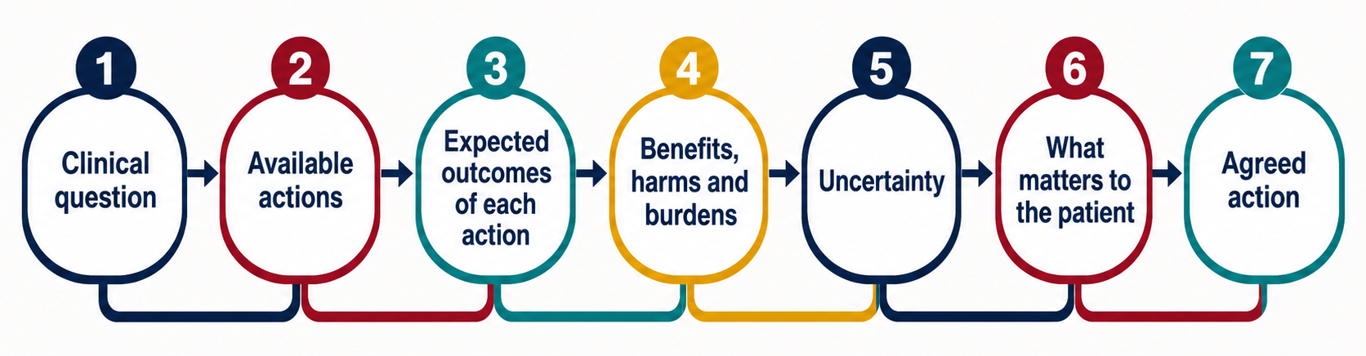
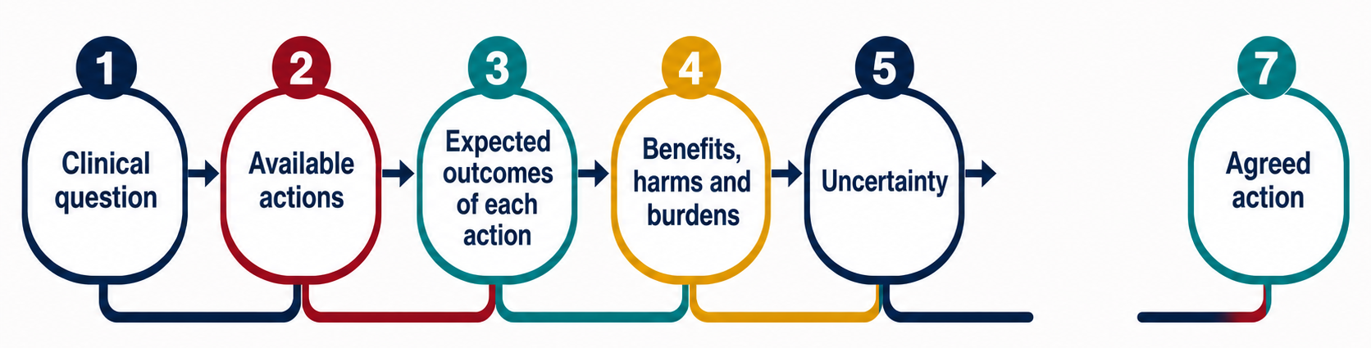
A good decision makes its reasoning visible
You must consider what goes wrong if you ignore one step of REBM informing decision making…

Slide 14
8.2 Thresholds and trade-offs

Slide 15
A decision threshold is the tipping point for action
Sam’s predicted risk of readmission is 30%.
At what predicted risk would you offer intensive follow-up?
Choose your threshold:
5% — 10% — 20% — 30% — 50%

Slide 16
Below the threshold, the expected harms outweigh the benefits
0% 100%
───────────────────────●──────────────────────────────────────────────────
Do not intervene Threshold Offer intervention
Below the threshold, the intervention is not expected to offer enough benefit to justify its harms and burdens.
Above the threshold, the expected benefit is judged sufficient to justify acting.
At the threshold, the options are finely balanced.
A threshold translates a continuous estimate into a choice.

Slide 17
Above the threshold, the expected benefits outweigh the harms
Imagine a simplified decision:
Giving the intervention to a patient who would be readmitted produces a benefit.
Giving it to a patient who would not be readmitted produces burden without that benefit.
Not giving it to a patient who is readmitted represents a missed opportunity.
The threshold asks:
How much intervention burden are we willing to accept to prevent one important outcome?

Slide 18
The threshold depends on the consequences of being wrong
Suppose intensive follow-up:
prevents readmission in some patients who would otherwise be readmitted;
requires several appointments for everyone who receives it;
occasionally causes distress or unnecessary investigation.
If intensive follow-up prevented 20 readmissions, would you offer it to all 100?
…what if it prevented 10?
…what if it prevented 5?
…what if it prevented only 1?
The point at which you change your answer reveals the trade-off you are willing to accept.

Slide 19
Lower thresholds identify more patients, but expose more to harm
Moving the threshold from 30% to 10% means more patients receive the intervention.
Potential advantage
more patients who would experience the outcome are offered help.
Potential disadvantage
more patients who would not experience the outcome receive an unnecessary intervention.

Slide 20
Higher thresholds reduce unnecessary treatment, but miss more benefit
Moving the threshold from 10% to 30% means fewer patients receive the intervention.
Potential advantage
fewer patients receive unnecessary or burdensome care.
Potential disadvantage
more patients who might have benefited are not offered the intervention.

Slide 21
The same risk can cross one threshold but not another
Sam has a 20% predicted risk.
Option A: A brief telephone call
low cost;
little inconvenience;
minimal risk of harm.
Likely threshold: relatively low
Option B: Admission for an invasive procedure
substantial burden;
meaningful risk of complications;
major use of time and resources.
Likely threshold: relatively high
The patient’s risk has not changed. What changed was the intervention, and therefore the amount of evidence needed to justify it.

Slide 22
Different consequences create different thresholds
Decision | Patient is readmitted | Patient is not readmitted
Offer intervention | Opportunity to benefit | Possibly unnecessary intervention
Do not offer intervention | Missed opportunity to benefit | Avoids unnecessary intervention
We have seen this structure before
Hypothesis testing: statistical conclusion versus the truth Type I error ≈ false positive; Type II error ≈ false negative.
Prediction: predicted outcome versus observed outcome False positive or false negative classification.
Clinical decisions: chosen action versus what would otherwise happen. Unnecessary intervention or missed opportunity to benefit.

Slide 23
Patient preferences can move the threshold
Sam and Jo both have a 20% predicted risk.
Sam
“Another admission would be devastating. I would accept several extra appointments to reduce the chance.”
Sam’s threshold may be lower.
Jo
“Healthcare appointments are extremely difficult for me. I would only choose this if the expected benefit were substantial.”
Jo’s threshold may be higher.
The evidence can be shared while the preferred action differs.

Slide 24
Thresholds are guides, not universal rules
A decision threshold may vary with:
the intervention being considered;
the severity of the outcome;
the size and certainty of the expected benefit;
adverse effects and treatment burden;
available alternatives;
feasibility and resources;
what matters to the patient.
So the clinical question is not simply:
“Is the risk above 20%?”
It is:
“Given this risk, this intervention and this patient, has the balance shifted towards action?”

Slide 25
8.3 Making decision under uncertainty

Slide 26
Every clinical decision contains uncertainty
Uncertainty can enter at several points:
The patient: Is the baseline risk estimate accurate?
The evidence: Is the estimated effect accurate?
The context: Does the research apply to this patient?
The future: What will actually happen?
The values: How will the patient experience each outcome?
Uncertainty is not a defect that can always be removed.

Slide 27
Confidence intervals describe a range of compatible effects
Suppose intensive follow-up is estimated to reduce readmissions by:
10 fewer readmissions per 100 patients
with a confidence interval from:
3 fewer to 16 fewer per 100
The evidence is compatible with:
a relatively small benefit;
the central estimate;
a substantially larger benefit.
The confidence interval does not tell us which value is the truth.

Slide 28
The key question is whether uncertainty could change the action
Imagine the threshold for offering intensive follow-up is an expected reduction of: 5 readmissions per 100 patients
Plausible effect | Decision
3 fewer per 100 | Do not offer routinely
10 fewer per 100 | Offer
16 fewer per 100 | Offer
The confidence interval includes values on both sides of the decision threshold.
The evidence does not point unambiguously to one action.

Slide 29
Consider what happens near both ends of the interval
Ask two questions:
If the true benefit were near the lower limit…
Would the intervention still be worthwhile?
If the true benefit were near the upper limit…
Would withholding the intervention still be reasonable?
If the preferred action changes, uncertainty is decision-relevant.
If the action remains the same, the decision may be robust.

Slide 30
Scenario analysis makes uncertainty decision-relevant
Scenario | Assumed benefit | Preferred action
Pessimistic | 3 fewer per 100 | Continue usual care
Central estimate | 10 fewer per 100 | Offer follow-up
Optimistic | 16 fewer per 100 | Offer follow-up
Scenario analysis does not predict three different futures.
It asks:
Would our decision survive reasonable changes in what we assume?

Slide 31
Some decisions are robust to uncertainty
Suppose the intervention threshold is 5 fewer readmissions per 100, and the confidence interval is:
8 to 18 fewer per 100
Every plausible effect remains on the same side of the threshold.
The exact benefit remains uncertain, but the preferred action does not change.
5 fewer 8 fewer 13 fewer 18 fewer
●────────────────────●──────────────●──────────────●
all favour action

Slide 32
Other decisions are sensitive to small changes
Now suppose the confidence interval is:
1 to 9 fewer readmissions per 100
and the threshold remains 5 fewer per 100.
1 fewer 5 fewer 9 fewer
●────────────────────────│──────────────────────●
do not offer threshold offer
Small changes in the assumed benefit can change the preferred action.
This is a decision-sensitive zone.

Slide 33
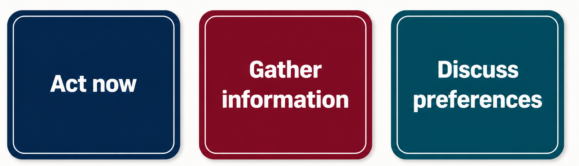
More information is useful only when it could change the decision
Additional information may be valuable when:
the decision is closely balanced;
the plausible effects support different actions;
the consequences are important;
the decision can safely wait; a practical test or further evidence could reduce uncertainty.
More information may add little when:
every plausible scenario supports the same action;
waiting would cause greater harm;
the new information is unlikely to resolve the uncertainty.

Slide 34
Uncertainty should be communicated, not hidden
Avoid:
“The intervention reduces readmissions by 10%.”
Prefer:
“Our best estimate is about 10 fewer readmissions per 100 patients, but the true benefit may plausibly be smaller or larger.”
Then explain:
what is known;
what remains uncertain;
whether the uncertainty could alter the choice;
what each option might mean for the patient.
A precise number can still describe an uncertain estimate.

Slide 35
Shared decisions combine evidence, uncertainty and patient values
A useful conversation asks:
What are the options?
What might happen with each option?
How certain are those estimates?
Which outcomes matter most to this patient?
Would reasonable uncertainty change the preferred choice?
Closing question for Sam:
If intensive follow-up offers a possible but uncertain reduction in readmission, what would Sam need to know before deciding?

Slide 36
8.4 Recording results and decisions in R

Slide 37
A reproducible result is not automatically a traceable decision
In Topic 07, we preserved:
the analysis dataset;
the model;
the predictions;
the evaluation results;
the random seed and software environment.
But a model object does not record:
which result informed the decision;
which threshold was used;
which assumptions were made;
why one action was preferred.
Reproducibility recreates the analysis. Traceability explains the decision.

Slide 38
Meaningful object names make the analysis easier to follow
Avoid storing important results under names such as x, answer or final.
predicted_risk <- 0.30
risk_lower <- 0.22
risk_upper <- 0.39
decision_threshold <- 0.20
agreed_action <- "Offer intensive follow-up"
Each object has one clear purpose. Typing an object name retrieves its stored value. Meaningful names make code easier to read, check and revisit.

Slide 39
Store estimates instead of copying them manually
A result can be used directly in a later calculation:
suggested_action <- if_else(
predicted_risk >= decision_threshold,
"Offer intensive follow-up",
"Continue usual care"
)
The action will update automatically if the risk or threshold changes.
Manual copying breaks the connection between result and decision.

Slide 40
Turn important results into a tidy table
decision_record <- tibble(
patient_id = "S001",
predicted_risk = predicted_risk,
risk_lower = risk_lower,
risk_upper = risk_upper,
threshold = decision_threshold,
suggested_action = suggested_action,
agreed_action = agreed_action
)
Read this as:
“Create one row containing the estimate, uncertainty, threshold and resulting actions.”

Slide 41
Keep assumptions alongside the results they produced
decision_record <- decision_record |>
mutate(
population = "Adults eligible for discharge",
outcome = "Readmission",
time_horizon = "30 days",
comparator = "Usual care",
intervention = "Intensive follow-up",
threshold_reason = "Locally agreed"
)
The decision record now states:
who the result concerns;
which outcome was estimated;
over what period;
which options were compared;
why the threshold was selected.
Important: Use non-identifiable study IDs and approved secure storage for real clinical data.

Slide 42
Select and arrange the results deliberately
A clean results table contains the information needed by its reader.
decision_summary <- decision_record |>
select(patient_id, population, outcome, time_horizon,
predicted_risk, risk_lower, risk_upper, threshold,
suggested_action, patient_priority, agreed_action,
decision_status
)
Selecting columns deliberately is safer than exporting every object in the workspace.

Slide 43
Export tables and save complete R objects
.csv files are easy to inspect and share appropriately.
.rds files preserve R-specific structures and data types.
Neither format replaces secure data handling or documentation.
Always reopen saved results and check that they contain what you expected.
write_csv(decision_summary, "decision_summary.csv")
saveRDS(decision_summary, "decision_summary.rds")

Slide 44
A decision record connects evidence to action
Before completing an analysis, ask:
Have the important results been stored?
Is uncertainty retained?
Is the threshold recorded?
Are assumptions visible?
Is the model suggestion distinguished from the agreed action?
Can the final table be recreated from the code?
Has identifiable information been handled appropriately?
The goal is not to record every object R creates.
The goal is to preserve enough information to answer:
What evidence informed this decision, and how did it lead to this action?

Slide 45
What you need to do next…
We have explored how clinical decisions move beyond statistical results by considering the available actions, expected benefits, harms and burdens, decision thresholds, uncertainty and what matters to the patient.
We have also seen how R can preserve the evidence, assumptions and reasoning that connect a result to an agreed action. In the code-along, we will create a decision record, explore how changing risks and thresholds affects the suggested action, and export the results in a clear and reproducible format.
To the code-along…

