Slide 1

Topic 01: Describing Data

Slide 2
What does it mean to describe data?
In medicine we often want to understand the make-up of some population, biological measurement, or the efficiency of some process.
This might be using…
Descriptive statistics
Data visualisation
Distributions
When we make any of the above, we have to use data. Typically lots of it…and the day of calculating/drawing things by hand is well gone!

Slide 3
This topic…
Variables, Measures of Central Tendency and Spread
Data Visulisation
Distributional Shapes
R Foundations and Principles
1.1 Variables, Measures of Central Tendency and Spread

Slide 4
1.1 Variables, Measures of Central Tendency and Spread

Slide 5
Data types
Ordinal
Categorical
“Numbers are labels or ranks”
Nominal
Variable X
Discrete
Quantitative
“Numbers measure amount”
Continuous

Slide 6
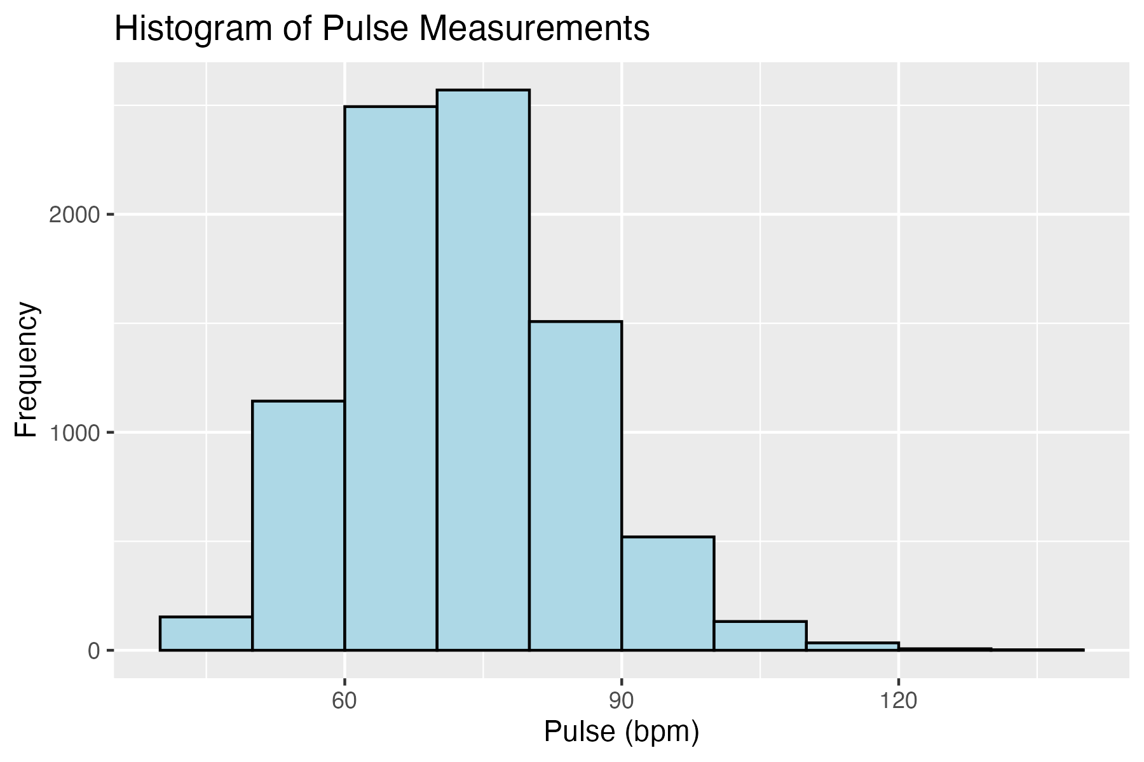
Measuring central tendency
We often have the (very natural) question which is…
What’s a ‘typical’ (or average) value in the sample (or population)?
Somewhere here?

Slide 7
The mean
The sample mean of a numerical variable is the sum of the values of all ‘n’ observations ($x_{1}, x_{2}, … , x_{n})$ divided by the number of observations:
$\overline{x}=\frac{x_{1}+x_{2}+…+x_{n}}{n}$ =$\frac{\sum_{i=1}^{n}{x_{i}}}{n}$
Note: x̄ is pronounced “x bar”

Slide 8
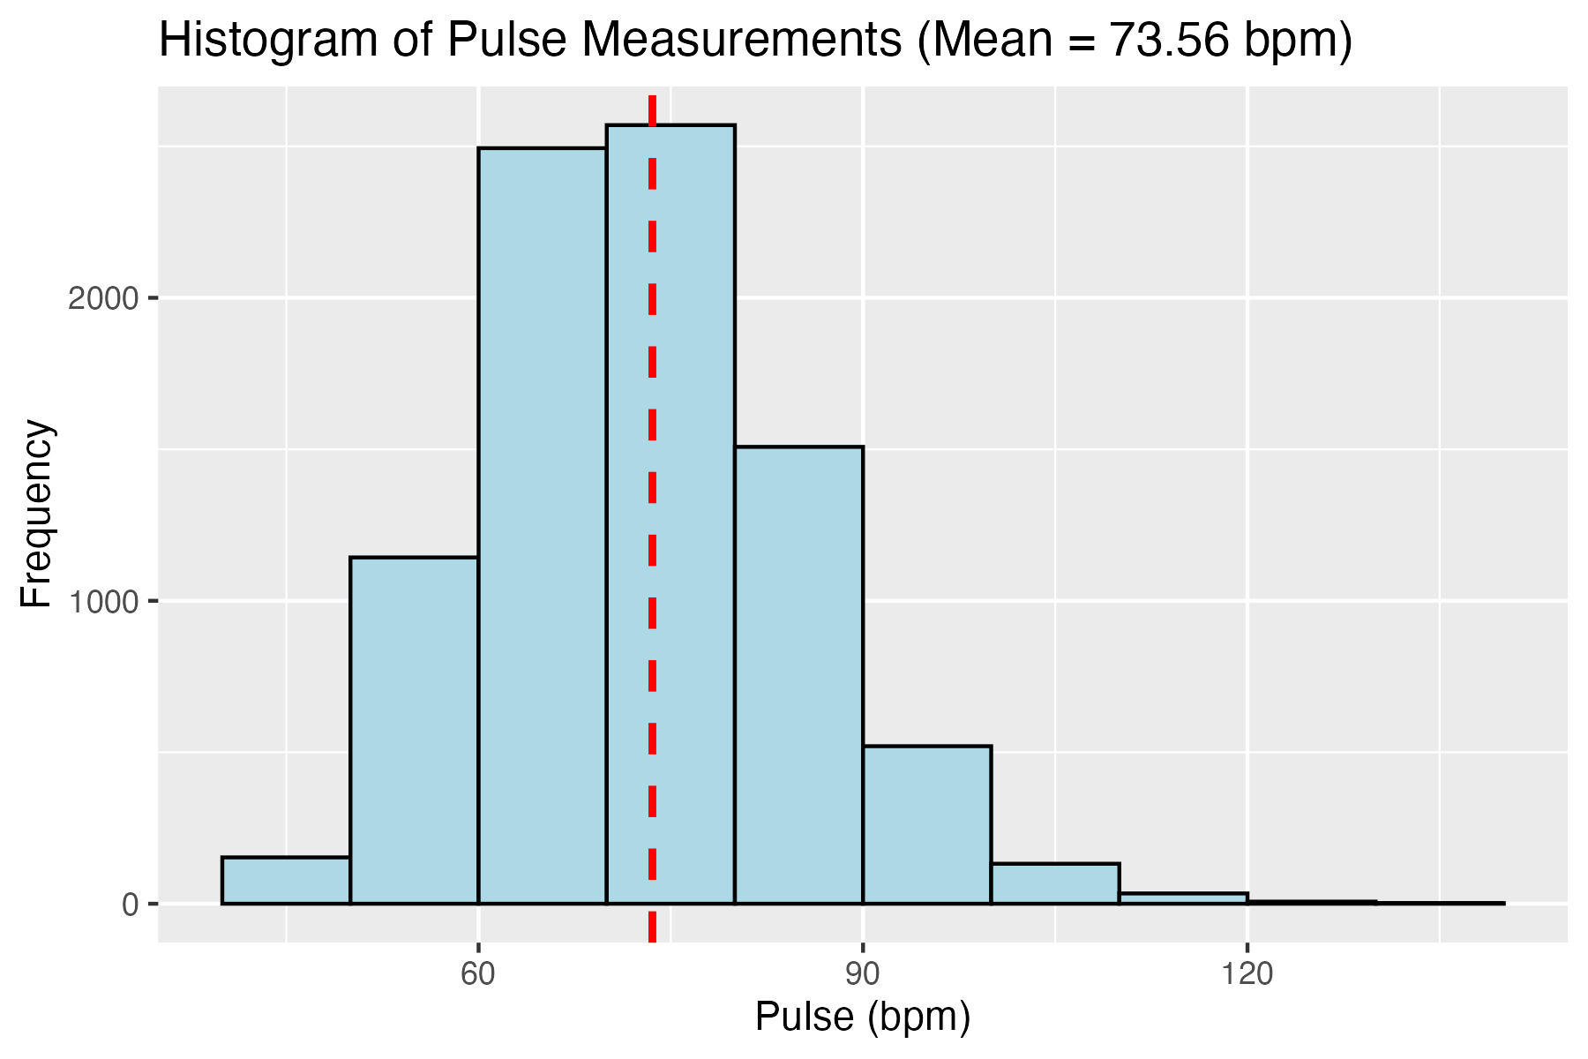
The mean

Slide 9
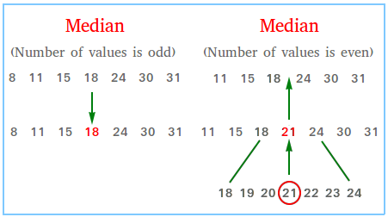
The median
The value of the middle data point.

Slide 10
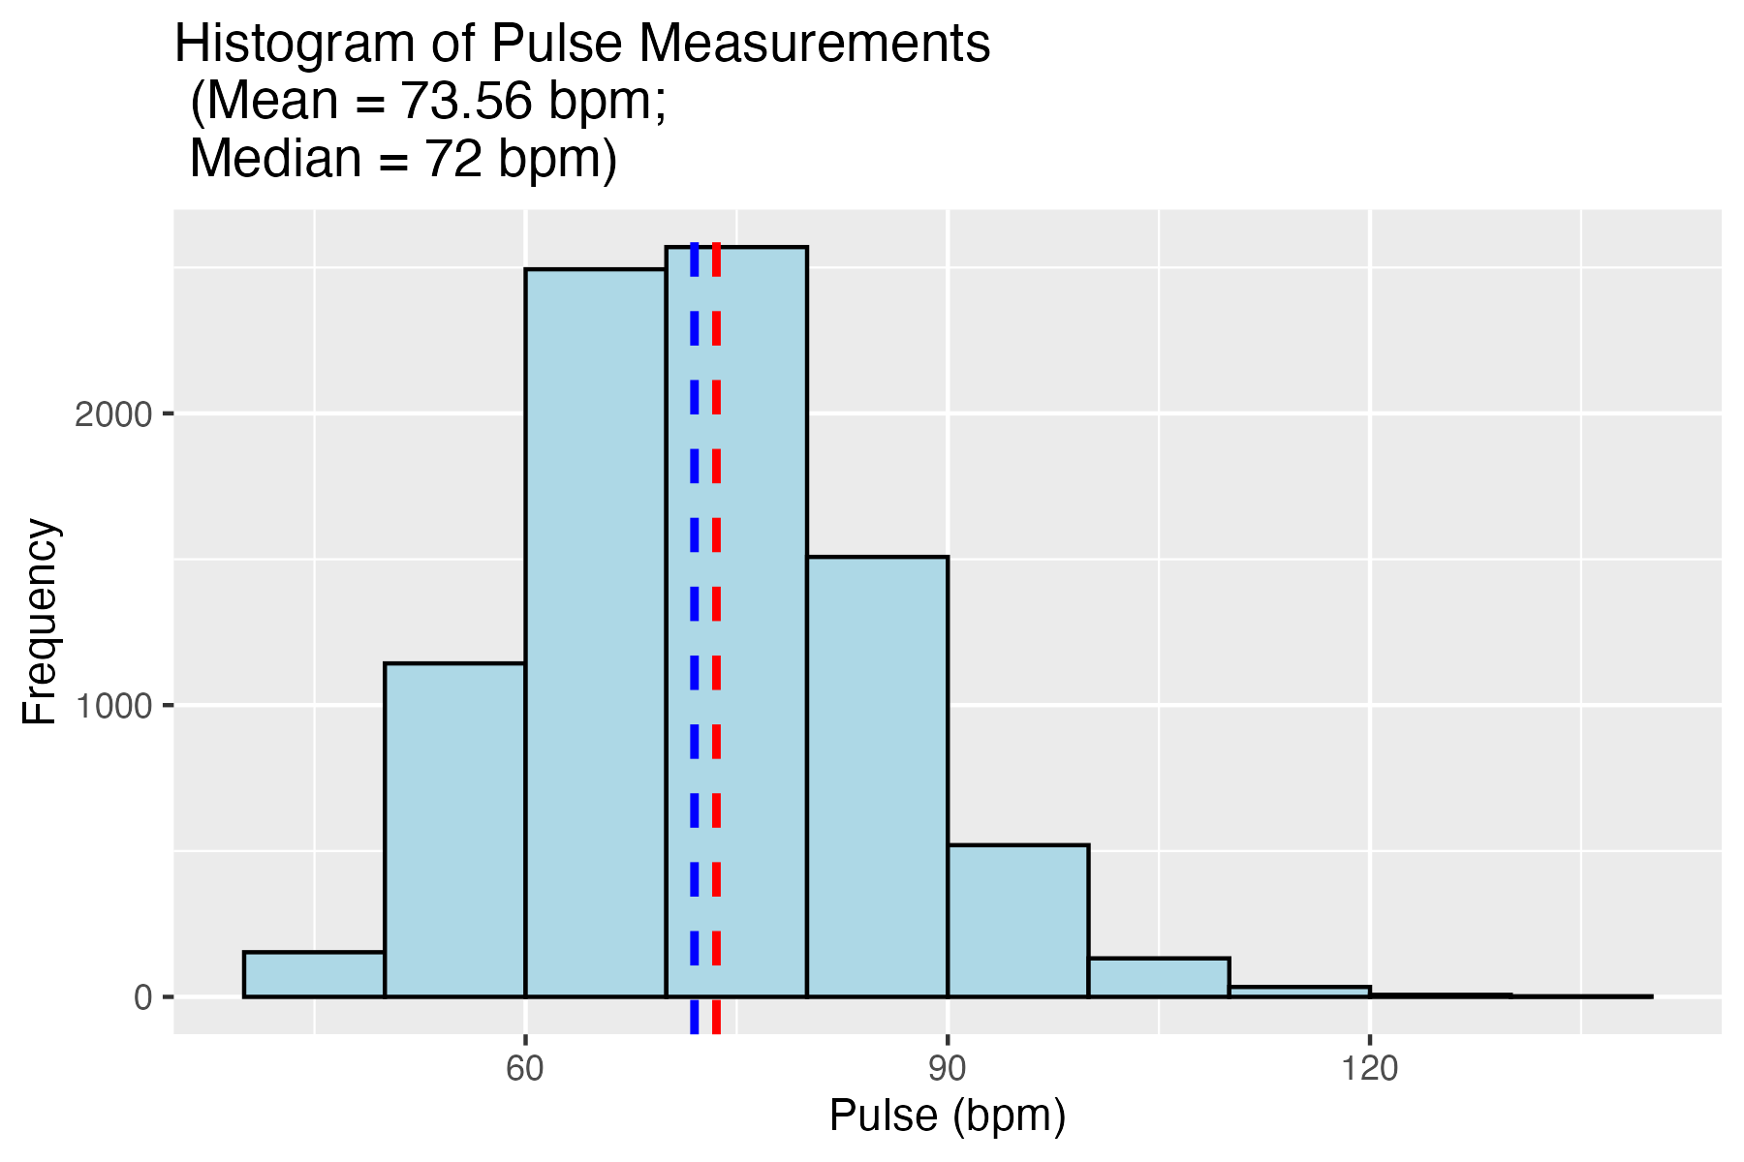
The median

Slide 11
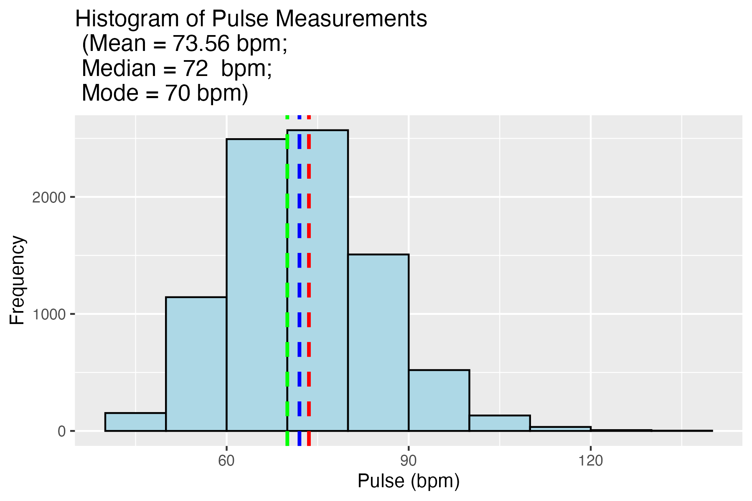
The mode
The most frequently occurring value.

Slide 12
Measuring the spread in the distribution
How similar or varied the values in the distribution are to each other
Are the values tightly clustered, or spread over a wide range?
Standard deviation (SD)
and
Variance
Range
and
Interquartile-range

Slide 13
Standard deviation (SD)
SD = the typical distance between an observation and the mean
We calculate it in 3 steps. Let’s illustrate looking at a sample of Pulse data from NHANES

Slide 14
Standard deviation (SD)
Sample data: 59 65 68 70 70 72 74 78 84 90 92 Mean = 74.7
Step 1: Calculate deviations
Deviation = the distance of a single observation from the mean
x₁ - x̄ = 59 - 74.7 = - 15.7
x₂ - x̄ = 65 - 74.7 = - 9.7
x₃ - x̄ = 68 - 74.7 = - 6.7 ...
x₁₁ - x̄ = 92 - 74.7 = 17.3

Slide 15
Standard deviation (SD)
Sample data: 59 65 68 70 70 72 74 78 84 90 92 Mean = 74.7
Step 1: Calculate deviations
x₁ - x̄ = 59 - 74.7 = - 15.7
x₂ - x̄ = 65 - 74.7 = - 9.7
x₃ - x̄ = 68 - 74.7 = - 6.7
...
x₁₁ - x̄ = 92 - 74.7 = 17.3
Step 2: Calculate variance
Variance (s²) is the average of squares of the deviations
s² = $\frac{{(−15.7)}^{2}+{(−9.7)}^{2}+ {(−6.7)}^{2}+ …+ {(17.3)}^{2}}{11 −1}$
s² = 106.8

Slide 16
Standard deviation (SD)
Step 3: Take the square root of variance to obtain the standard deviation
$s= √\text{106.8}$ = 10.3
Step 1: Calculate deviations
Step 2: Calculate variance
Variance (s²) is the average of squares of the deviations
s² = $\frac{{(−15.7)}^{2}+{(−9.7)}^{2}+ {(−6.7)}^{2}+ …+ {(17.3)}^{2}}{11 −1}$
s² = 106.8

Slide 17
Standard deviation (SD) generalisation
The sample standard deviation of a numerical variable is computed as the square root of the variance, which is the sum of the squared deviations divided by the number of observations – 1.
$$s=\sqrt{\frac{{\left(x_{1}−\overline{x}\right)}^{2}+{\left(x_{2}−\overline{x}\right)}^{2}+…+{\left(x_{n}−\overline{x}\right)}^{2}}{n−1}}$$

Slide 18
Why n-1?
$$s=\sqrt{\frac{{\left(x_{1}−\overline{x}\right)}^{2}+{\left(x_{2}−\overline{x}\right)}^{2}+…+{\left(x_{n}−\overline{x}\right)}^{2}}{n−1}}$$
When you take a sample, your sample mean ﻿$\overline{x}$ is itself an estimate of the (unknown) population mean. Because the sample mean is derived from the same data, it tends to “fit” your sample slightly better than the true population mean would. As a result, the calculation using﻿ $\overline{x}$ tends to underestimate the true variability in the data. This underestimation becomes especially noticeable for small samples.
Bessel’s correction (n-1 instead of n) mathematically offsets this tendency to underestimate variance, making your sample variance an unbiased estimator of the population variance (i.e. its expected value is the true variance).

Slide 19
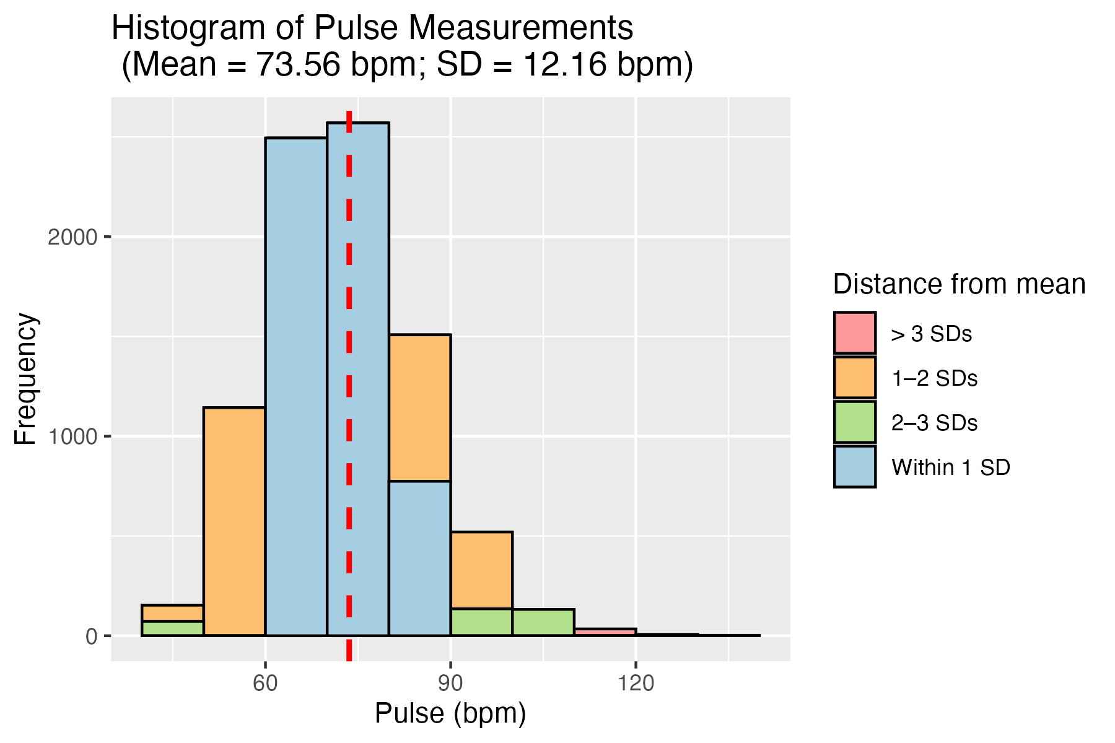
How does this look for the pulse data?

Slide 20
Range
The difference between the highest and lowest point. Helps us to understand the spread in the most general terms, and potentially spot things wrong with the data.
Interquartile range
With the data arranged in ascending order, and split into quarters (i.e. four sections), what is the difference between the value at the beginning of the third and the beginning of the first.
Interquartile range: 84 – 68 = 16
Sample data: 59 65 68 70 70 72 74 78 84 90 92
Q1
median
Q3

Slide 21
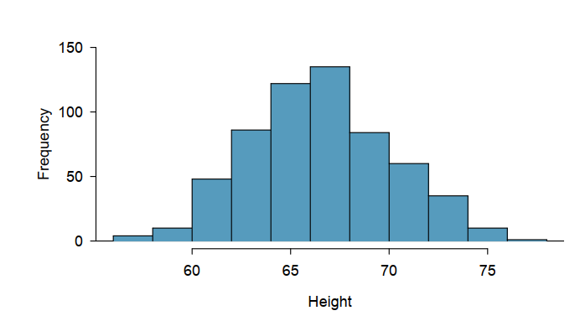
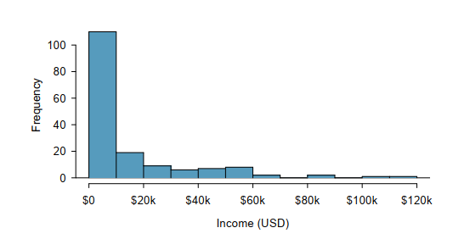
Tips for use
In general, the mean and standard deviation are used for normally distributed data, without any extreme values
The median and interquartile range are more robust, and can be used for skewed data, or data with extreme values

Slide 22
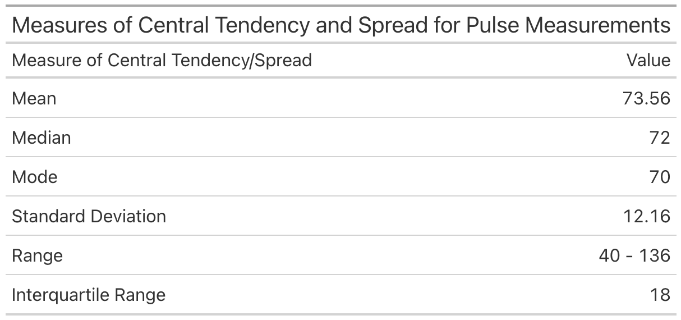
Tips for use
Presenting one ‘big’ table like below may seem intuitive, but without careful dialogue to aid it the mix of measurements can simply convolute/confuse the message.

Slide 23
1.2 Data Visulisation

Slide 24
How do we describe the distribution of a ordinal, nominal or discrete variable?
What are the outcomes in the sample, and how frequently do they occur?

Slide 25
How do we describe the distribution of a ordinal, nominal or discrete variable?
What are the outcomes in the sample, and how frequently do they occur?
Frequency table
Outcome
Heads | 6
Tails | 4

Slide 26
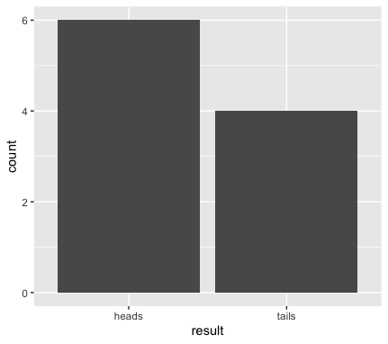
How do we describe the distribution of a ordinal, nominal or discrete variable?
What are the outcomes in the sample, and how frequently do they occur?
X-axis: outcome (heads and tails)
Y-axis: count of how many times the outcome occurred

Slide 27
How do we describe the distribution of a continuous variable?
We still ask: what are the outcomes in the sample, and how frequently do they occur? (sort of)

Slide 28
How do we describe the distribution of a continuous variable?
We still ask: what are the outcomes in the sample, and how frequently do they occur? (sort of)
Let’s look at pulse data from the NHANES data (US National Health and Nutrition Examination Study)
We’ll create a frequency table. Pulse is a continuous variable, so we’ll need to split the data into intervals, or ‘bins’

Slide 29
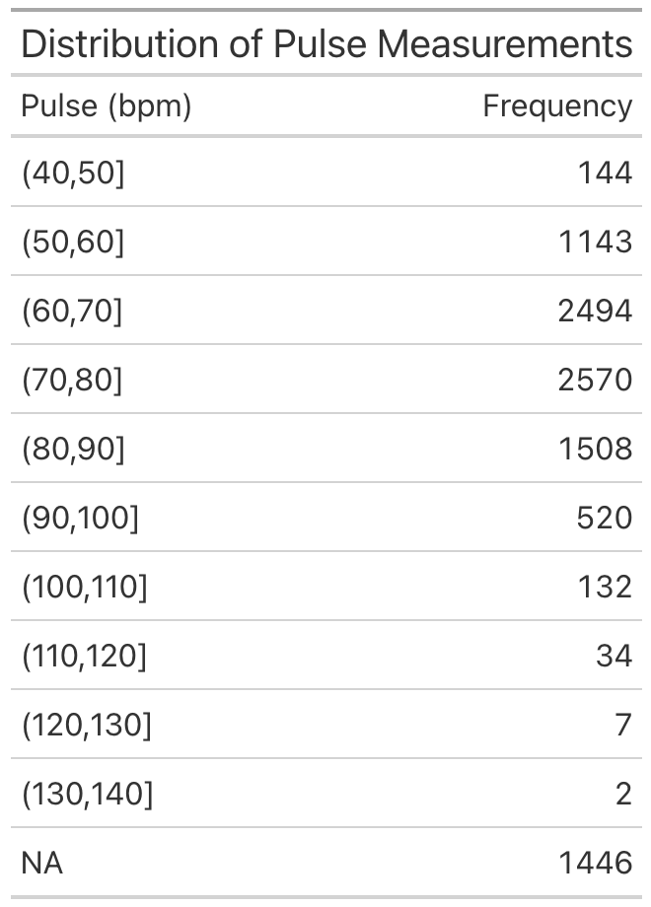

Slide 32
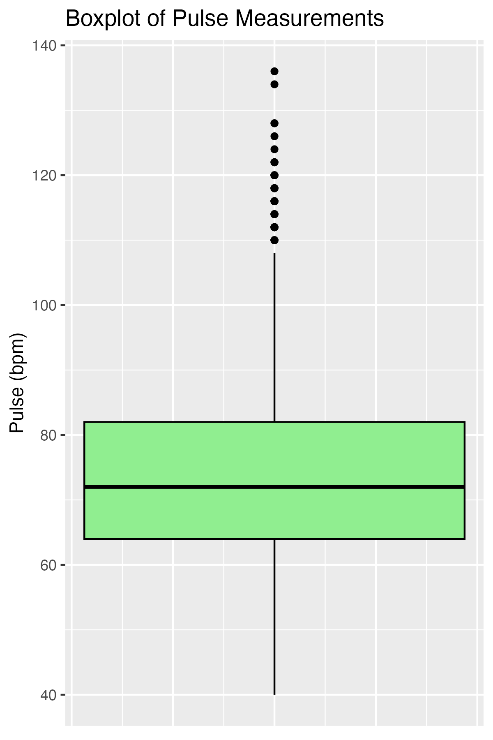
Outliers
Third quartile
Median
First quartile

Slide 33
So far we’ve described single variables…
Variable of Interest

Slide 34
How do we deal with underlying groups?
Underlying Grouping
Variable of Interest

Slide 35
How do I deal with underlying groups?
Vigorous Physical Activity
Pulse

Slide 36
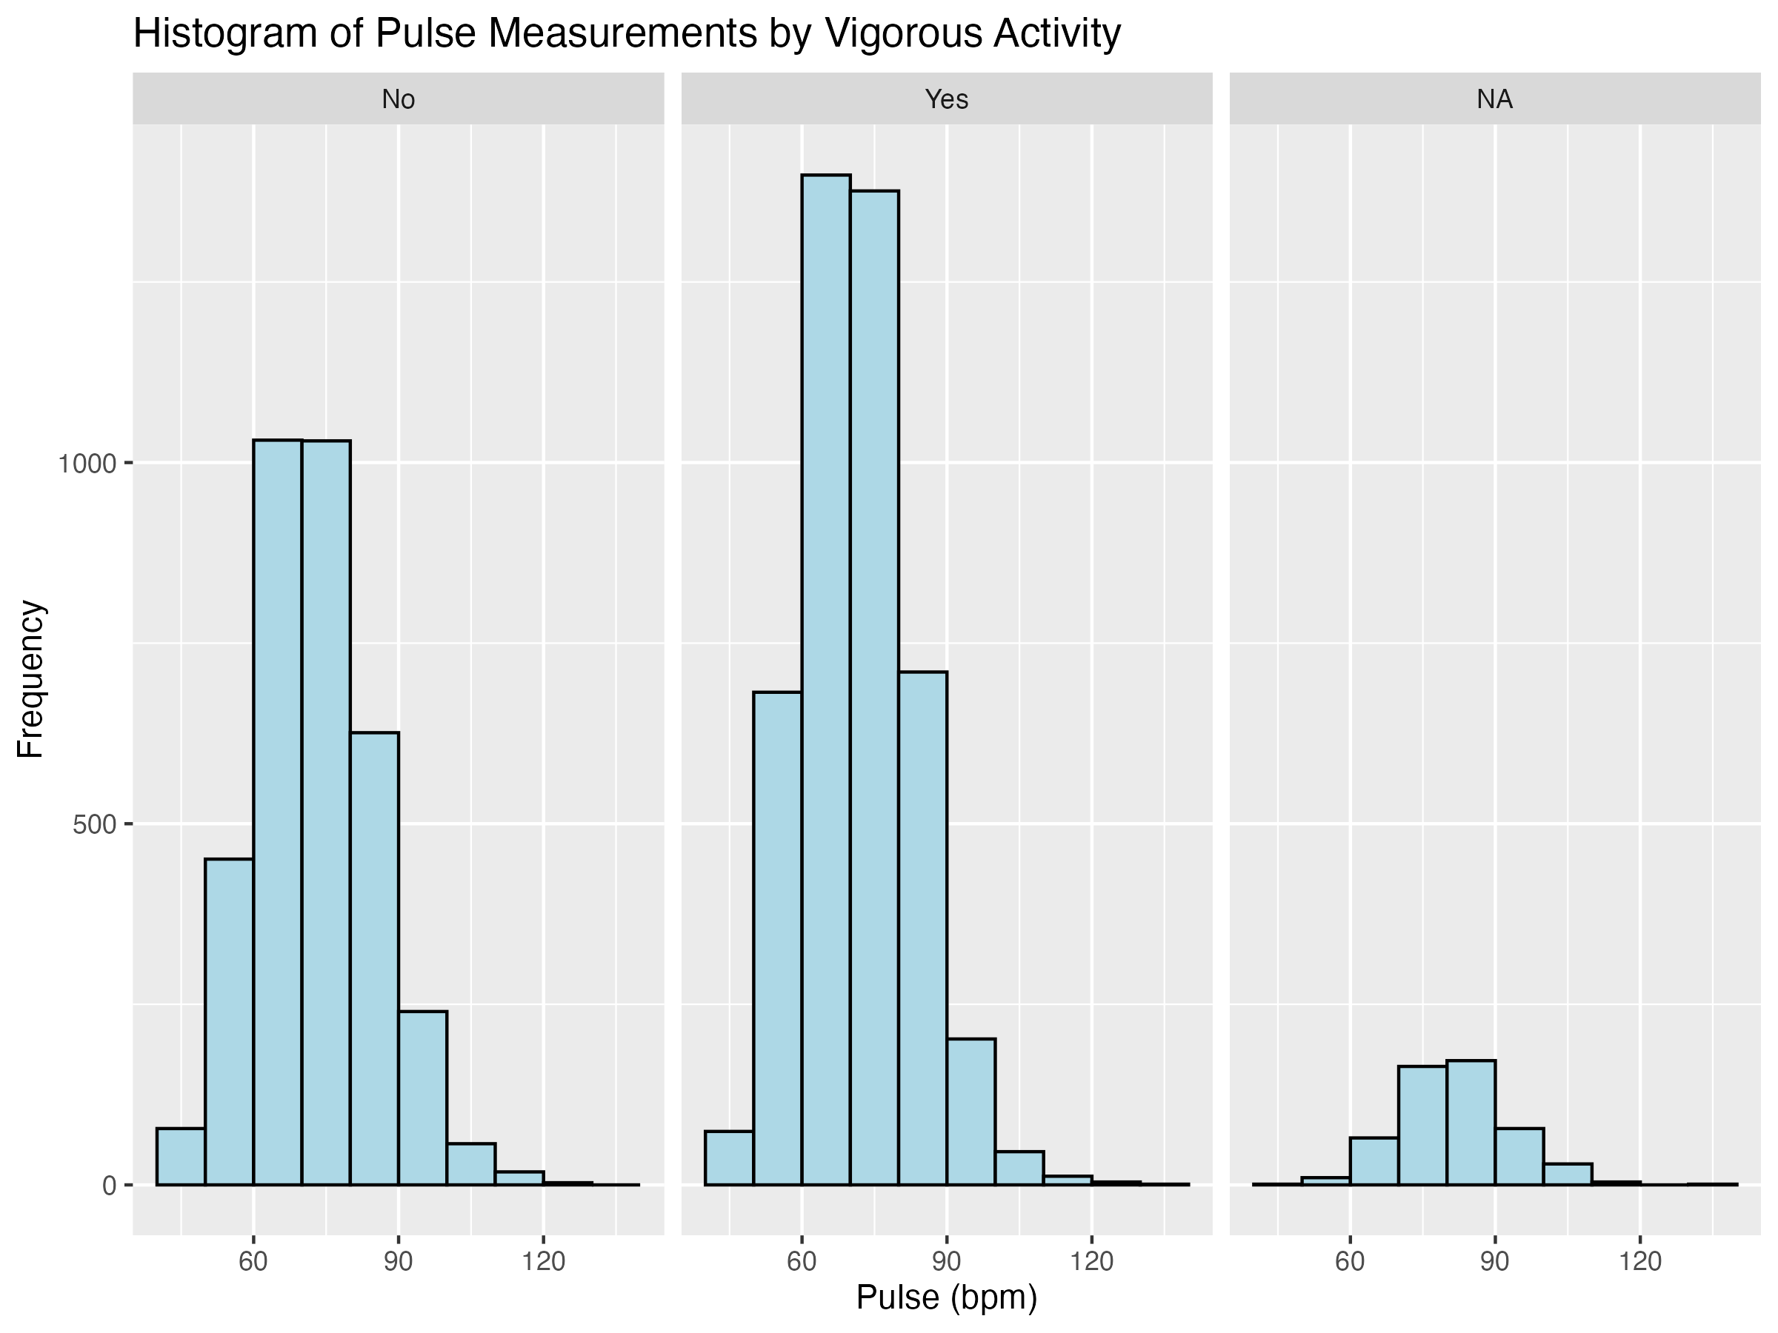
Can use a ‘faceted’ histogram…
Not great
Difficult to see what the central tendency is, and the height of bars depends on the size of the group.

Slide 37
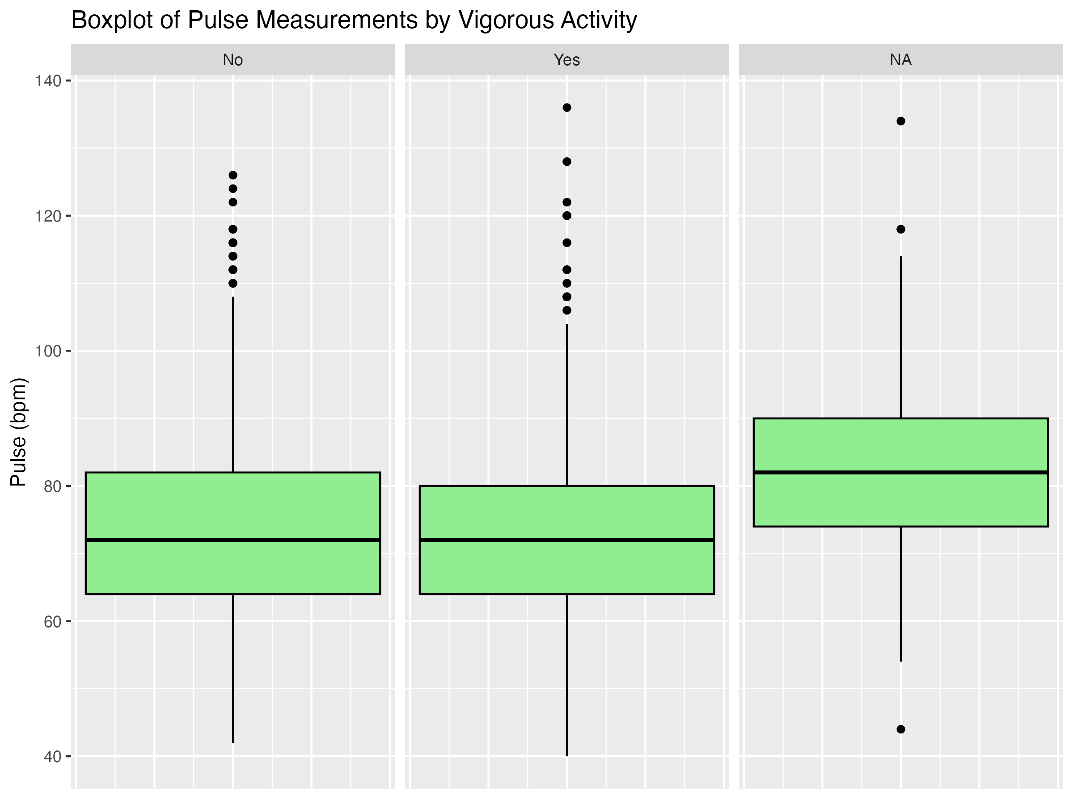
The ‘faceted’ boxplot…
Better!
Medians and interquartile ranges are easy to compare. Size of boxes does not depend on the group size.
We can start to make comments about the difference between the groups, although need ANOVA for that (which we’ll cover later in the course).

Slide 38
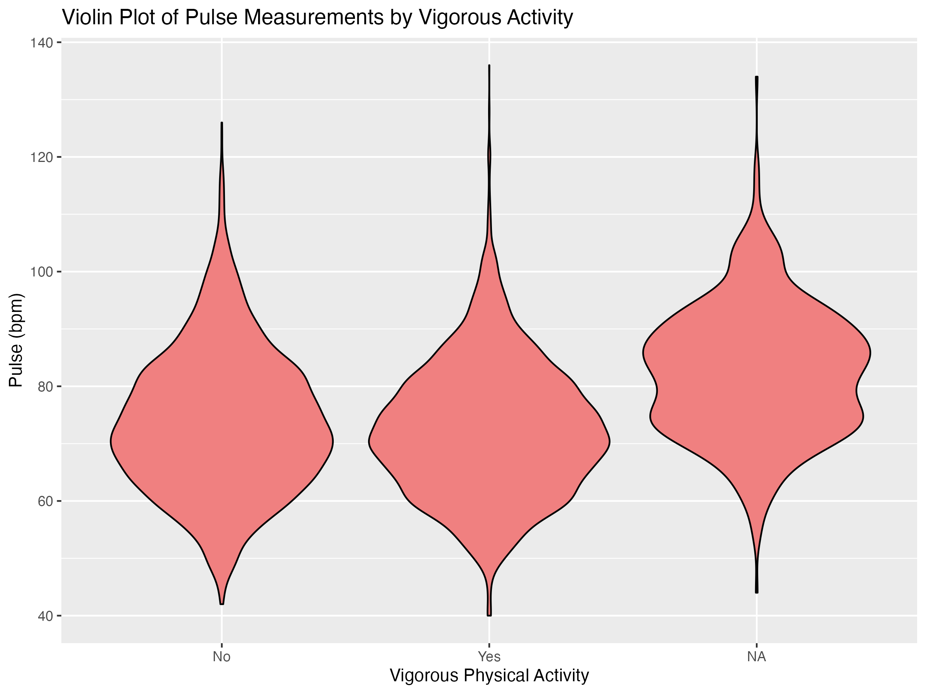
Introducing violin plots…
Allow for a holistic understanding of the distribution of the data. Loss of some definitive statistical descriptive measure but easier overview.

Slide 39
1.3 Distributional Shapes

Slide 40
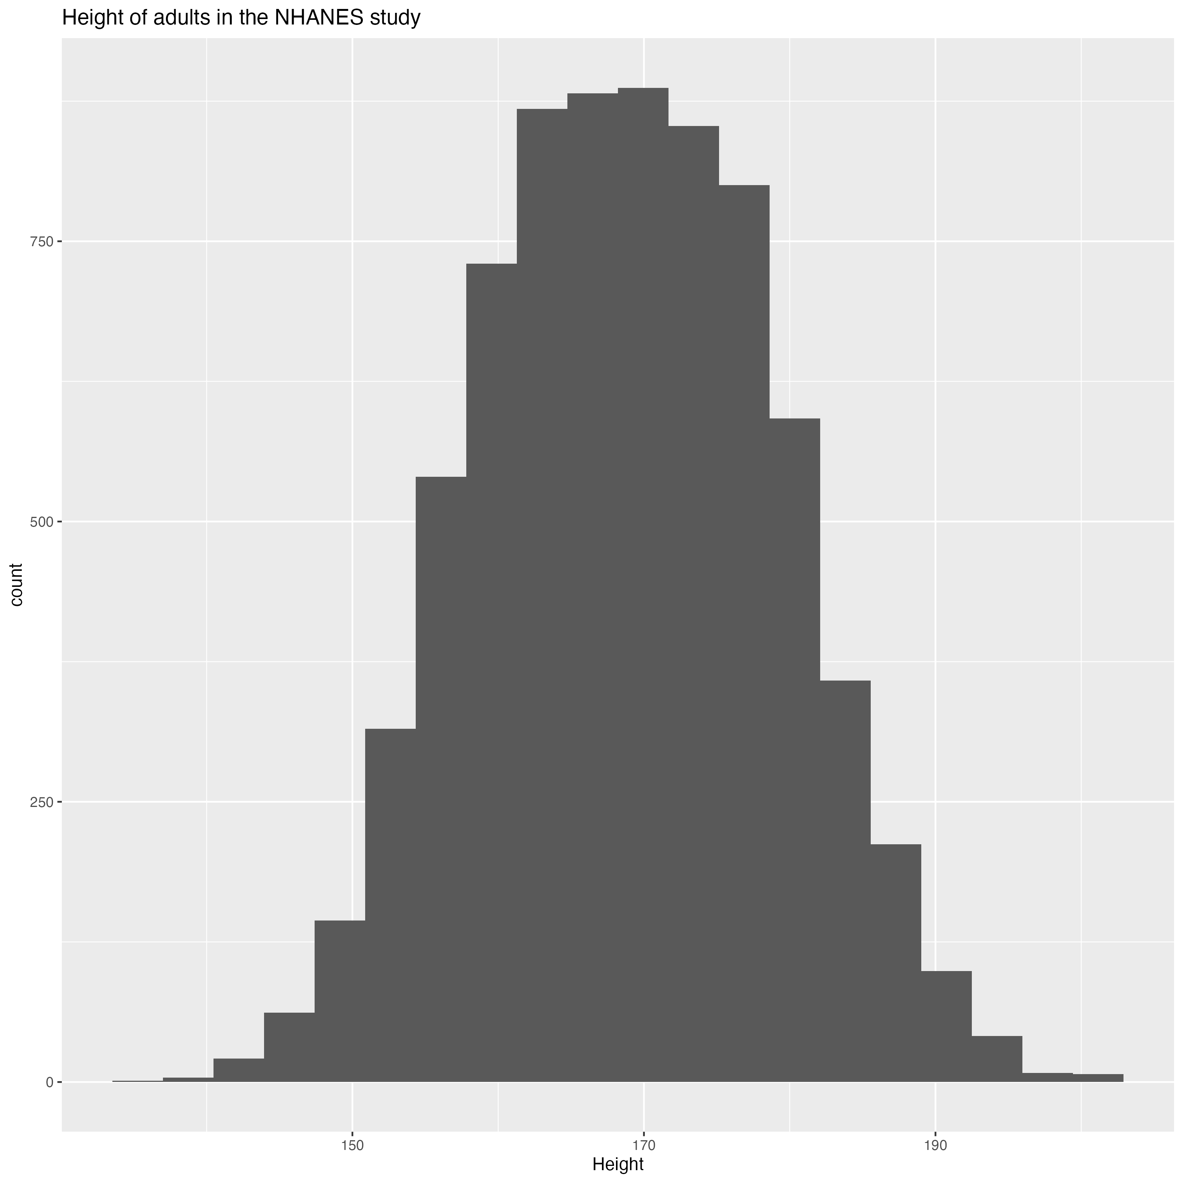
Let’s start with a histogram
We have an intuition that height is ‘normally’ distributed for adults, but what does that mean?

Slide 41

Scaling the histogram

Slide 42
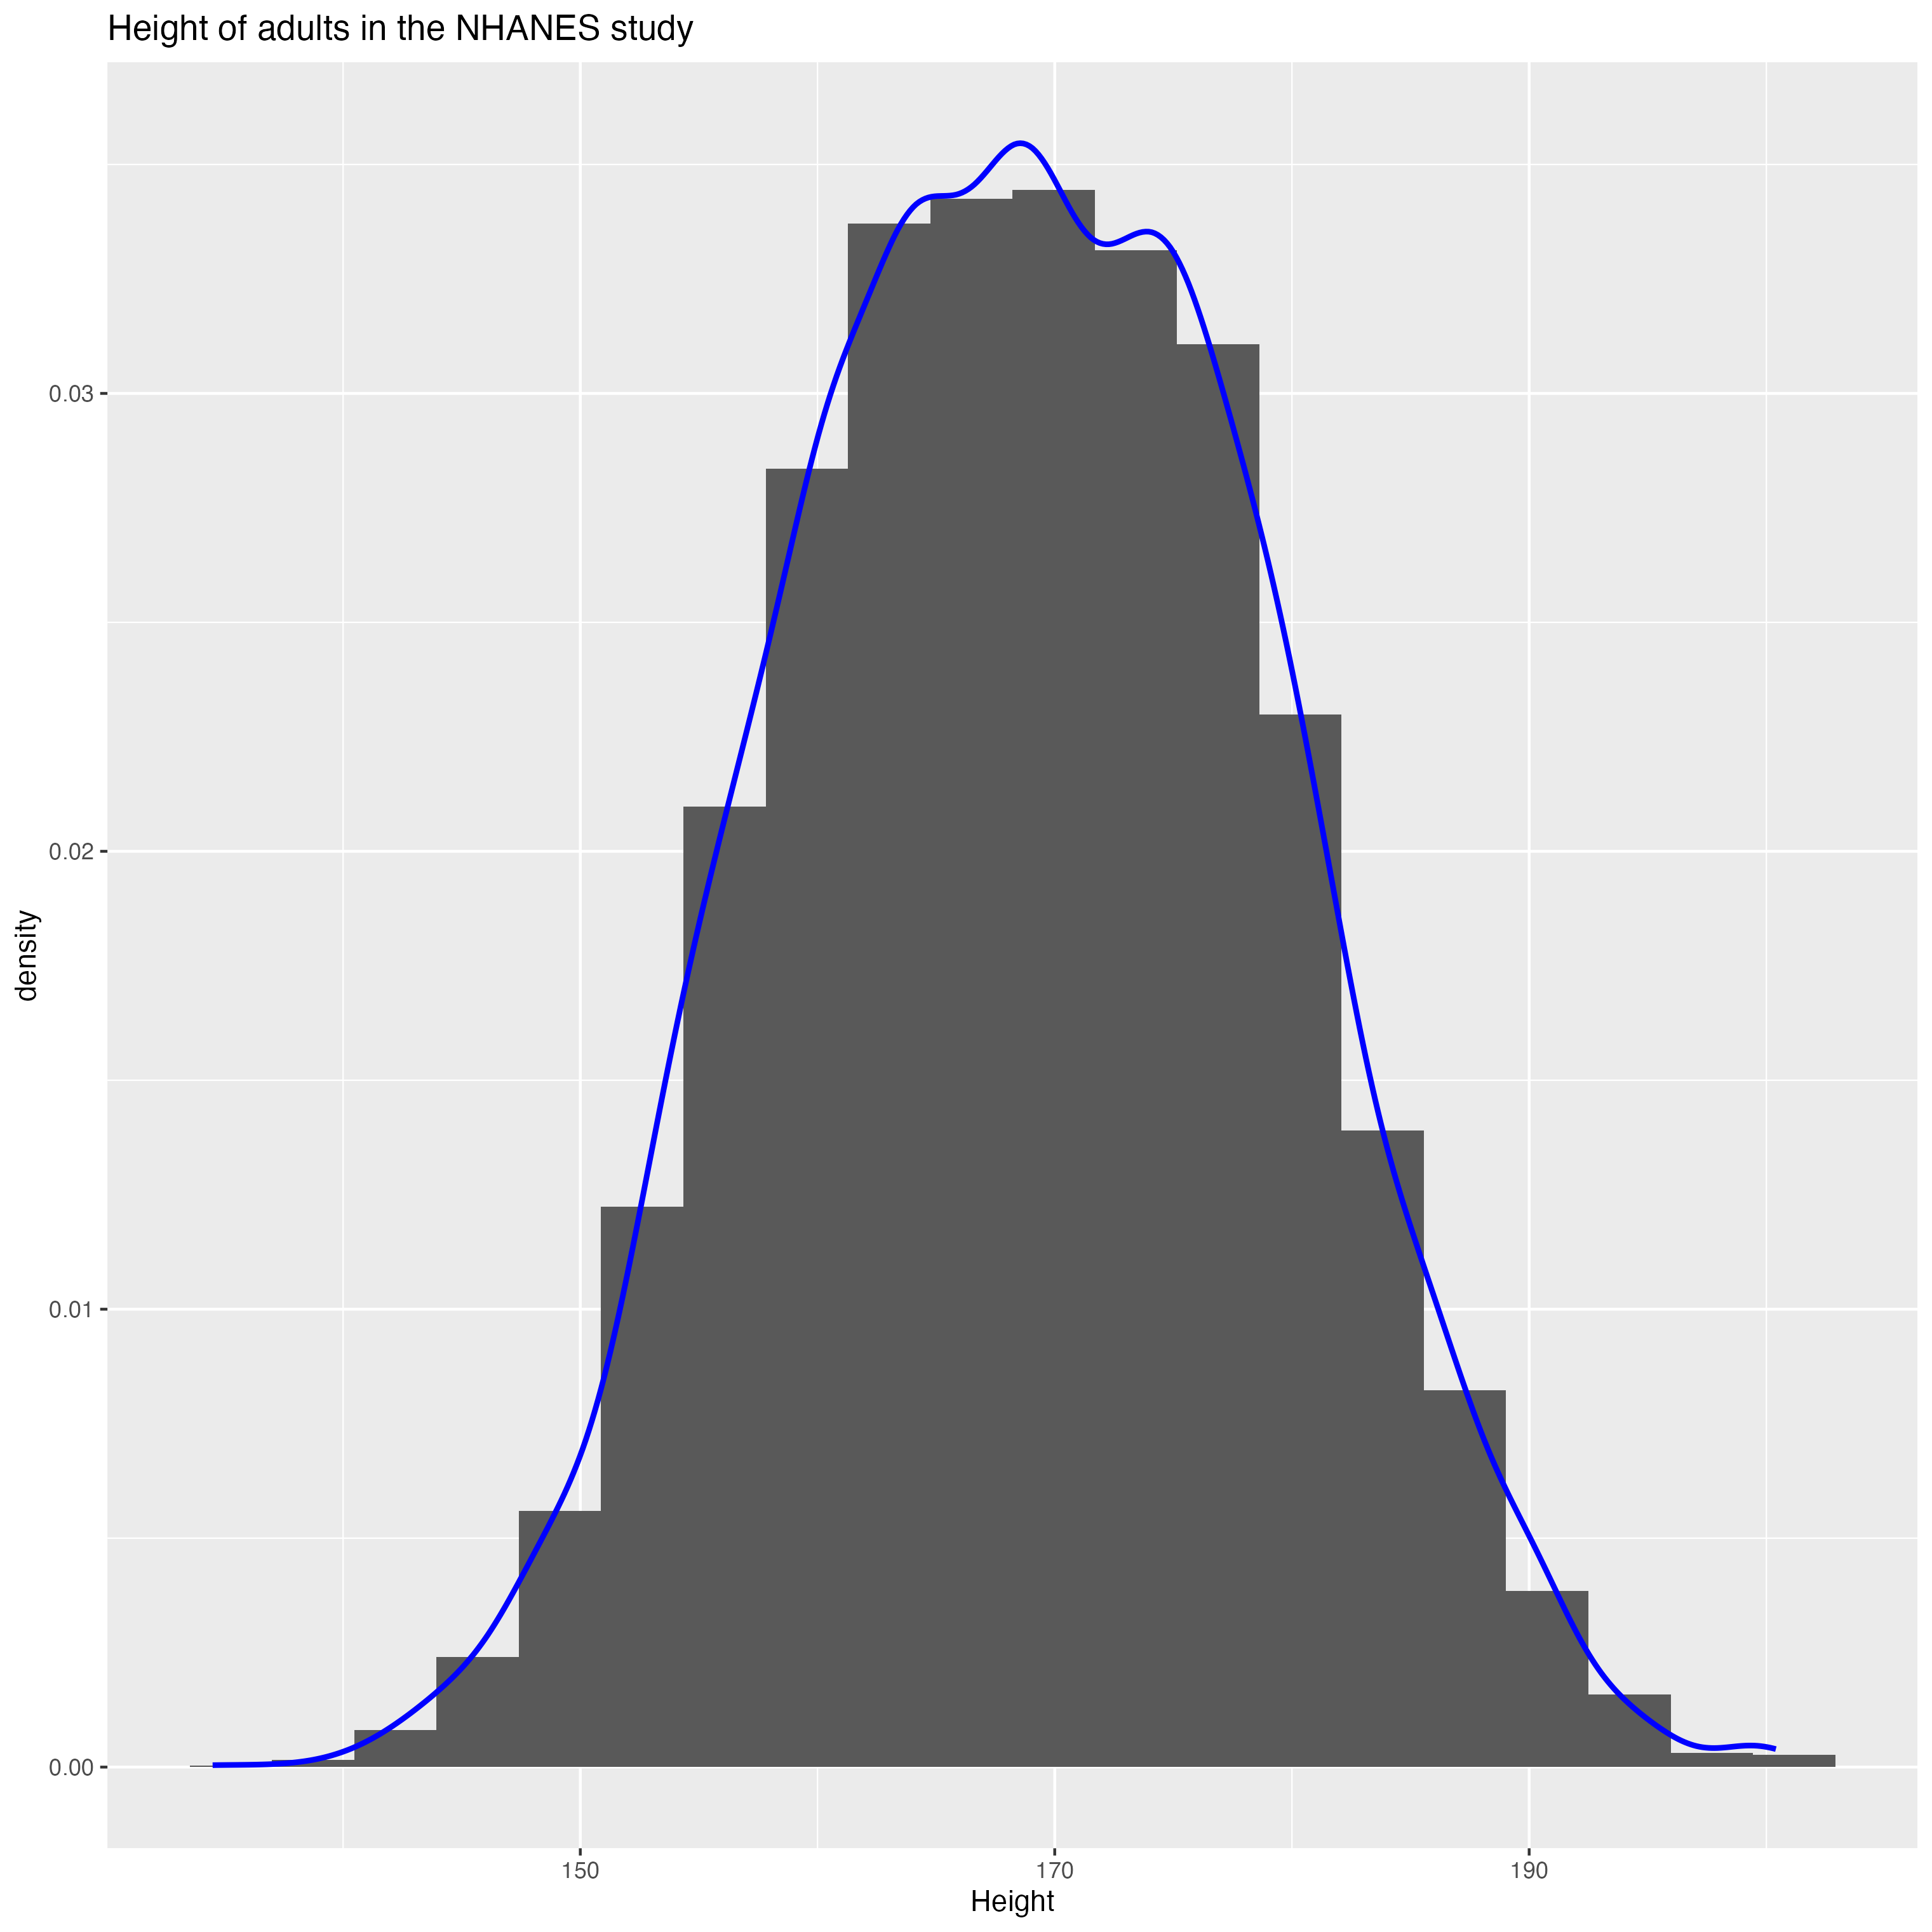
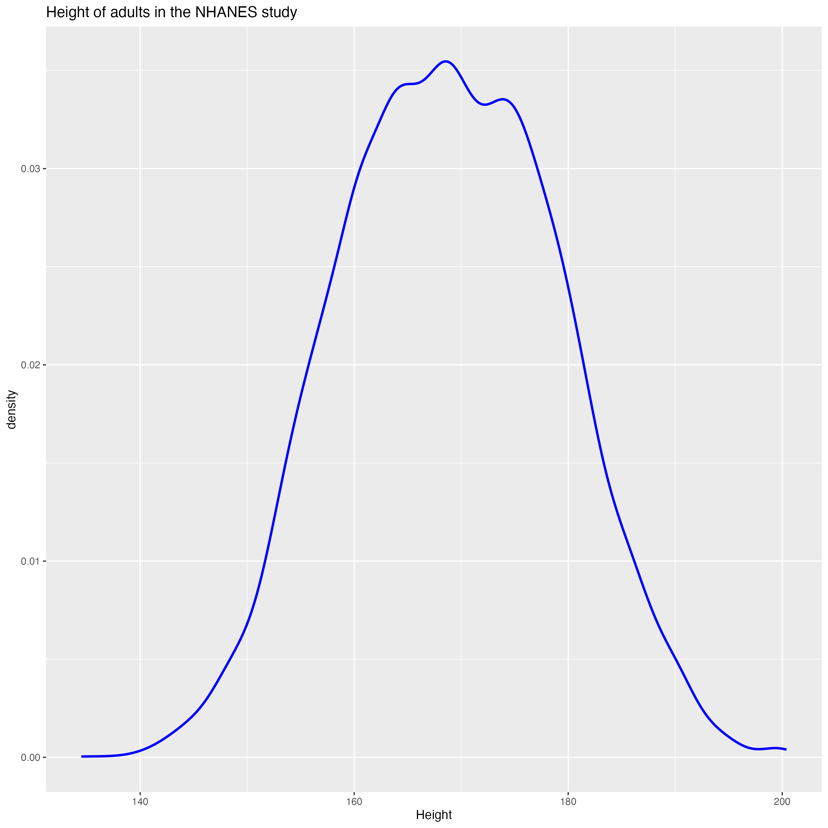
Probability density function

Slide 43
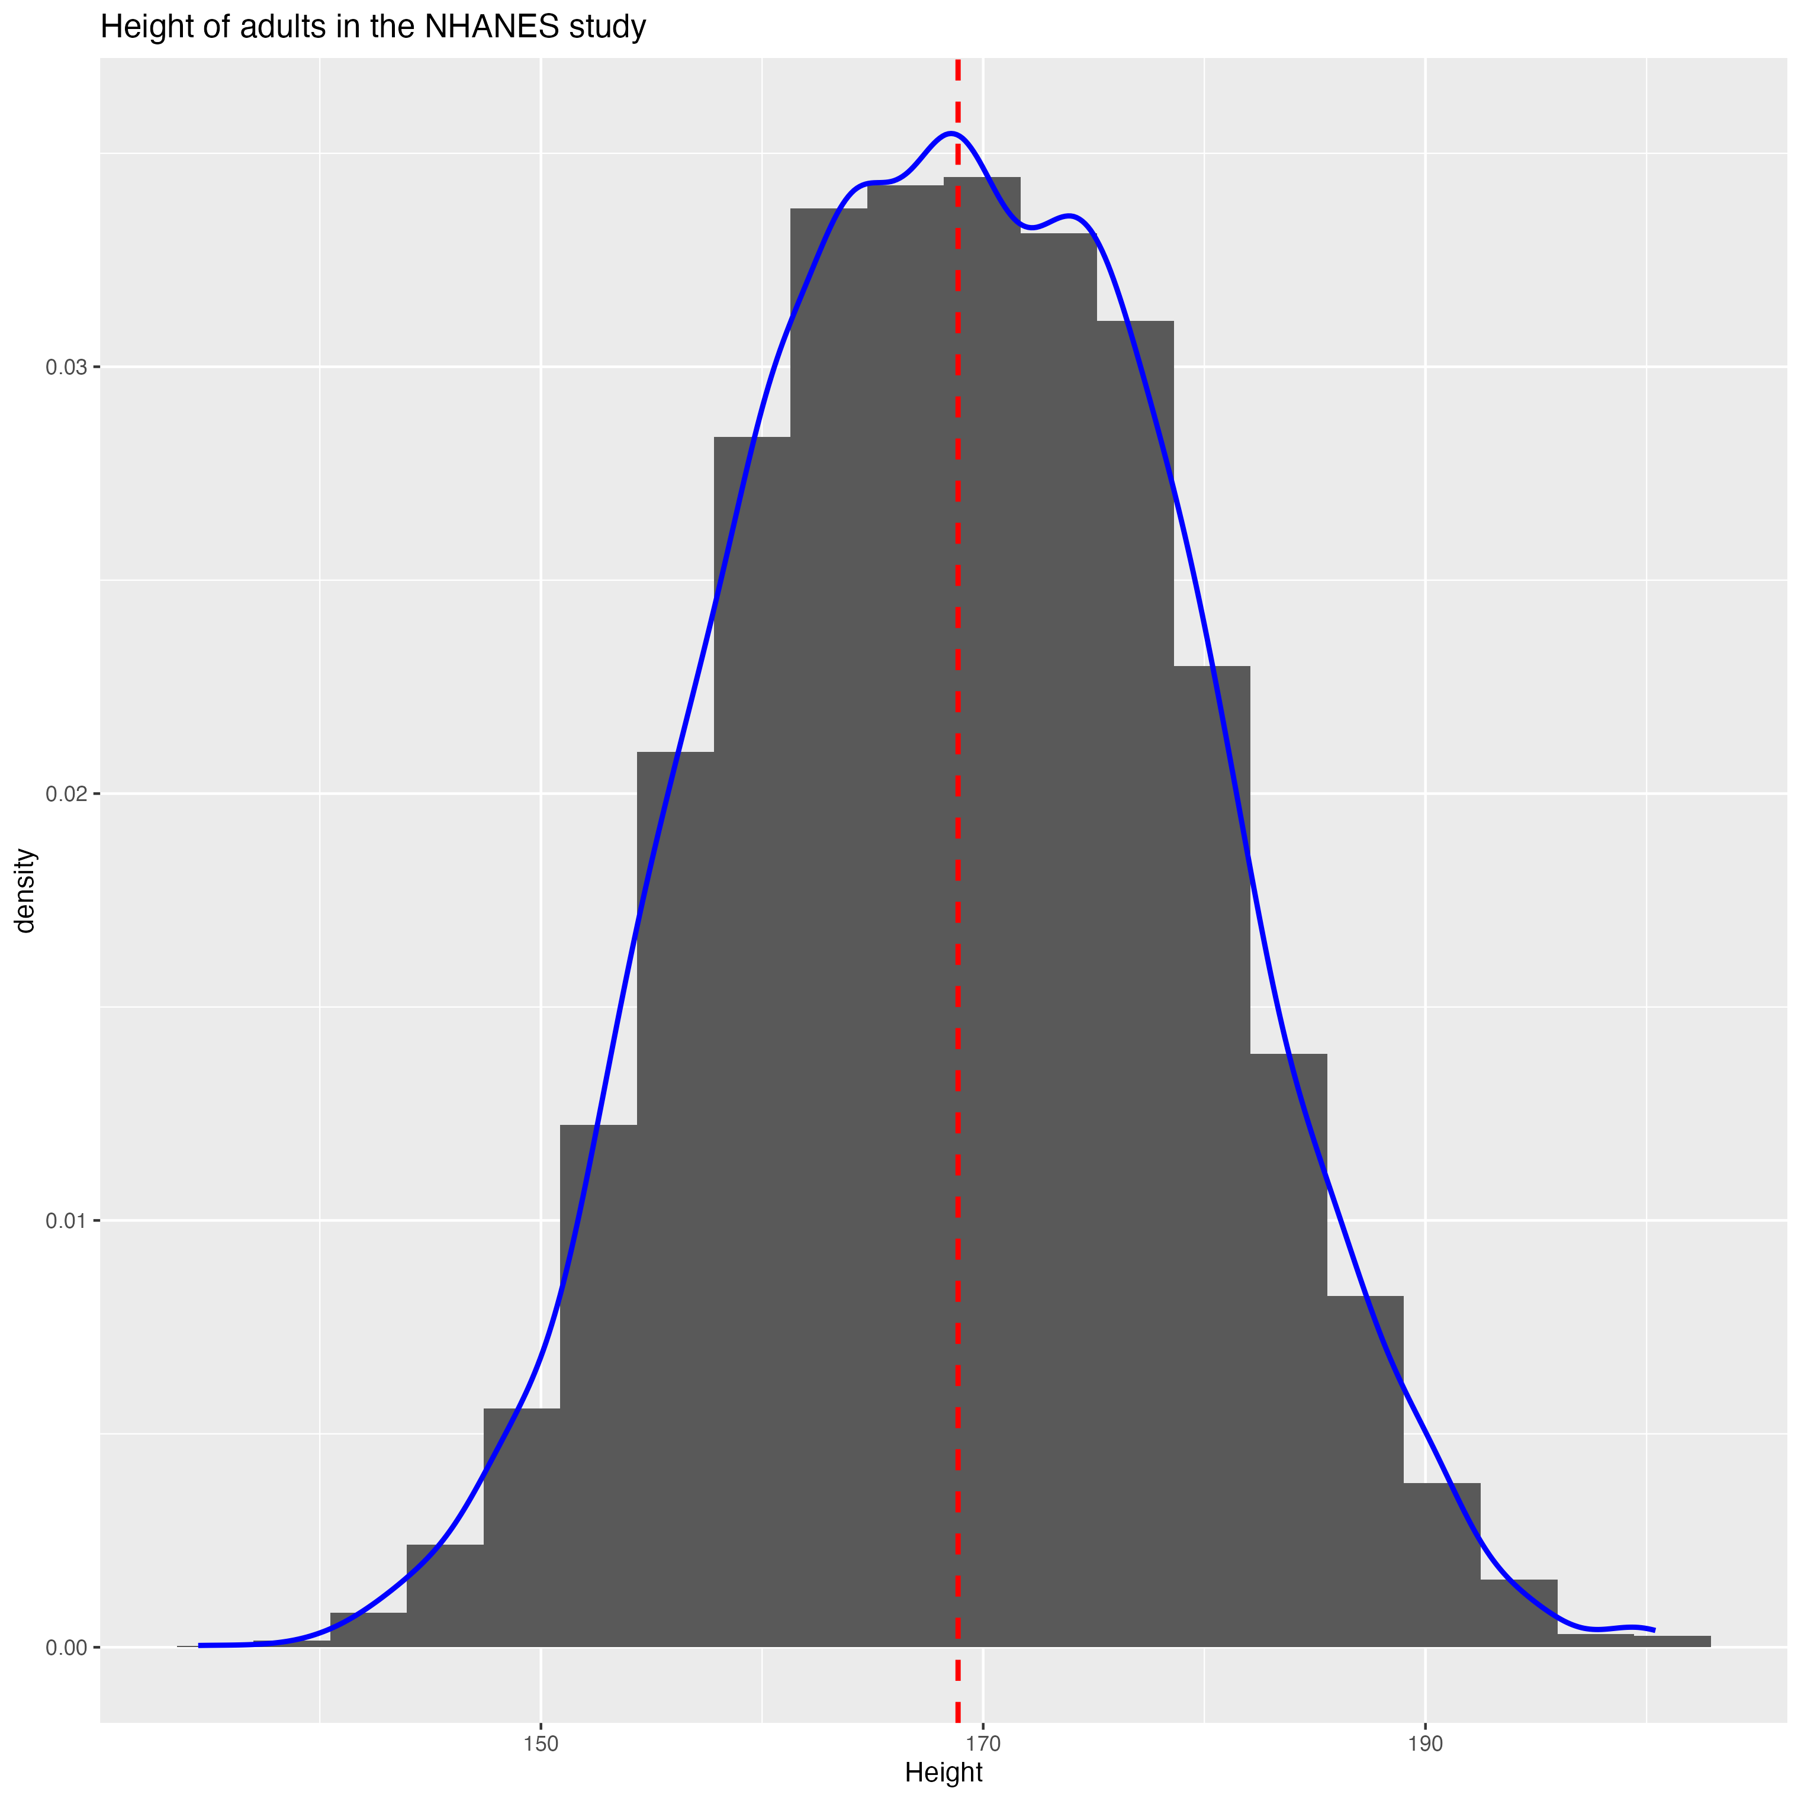
Is it ‘normally distributed?
If data is ‘normally distributed’ then we expect the density to be 50% either side of the mean.
50% of data points
50% of data points

Slide 44
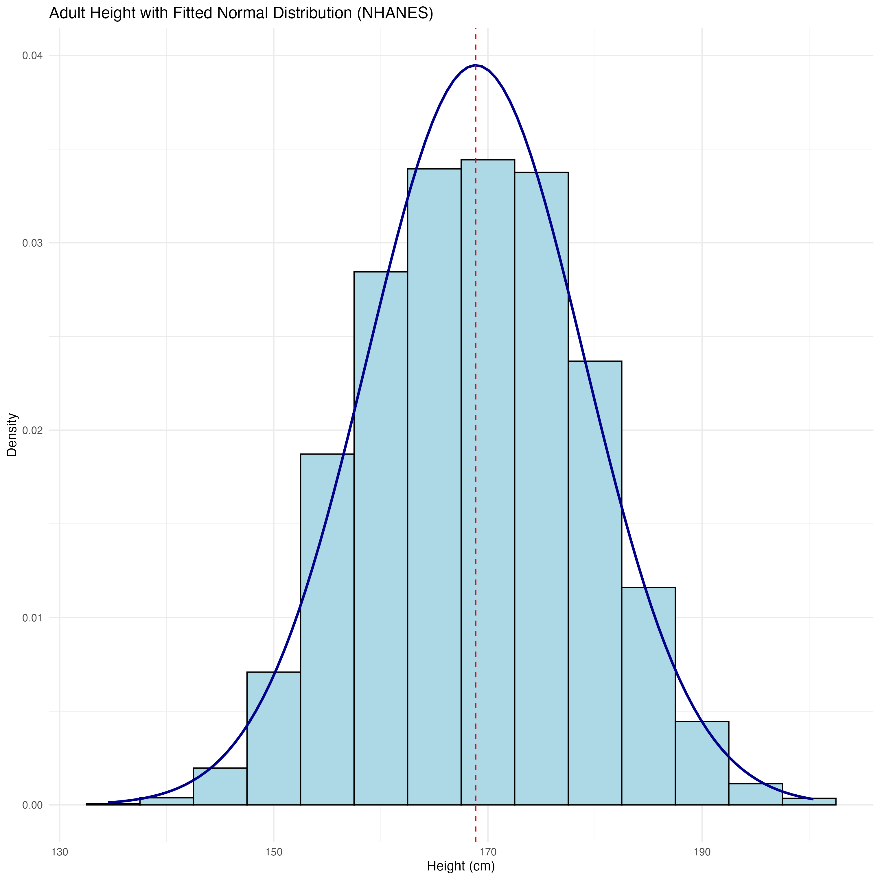
Why do we care?
If we knew the exact equation for the probability density function, we could calculate the probability of outcomes falling in a range For example, what proportion of people are between 180 and 190 cm tall?
Approximating to the normal is good enough.

Slide 45
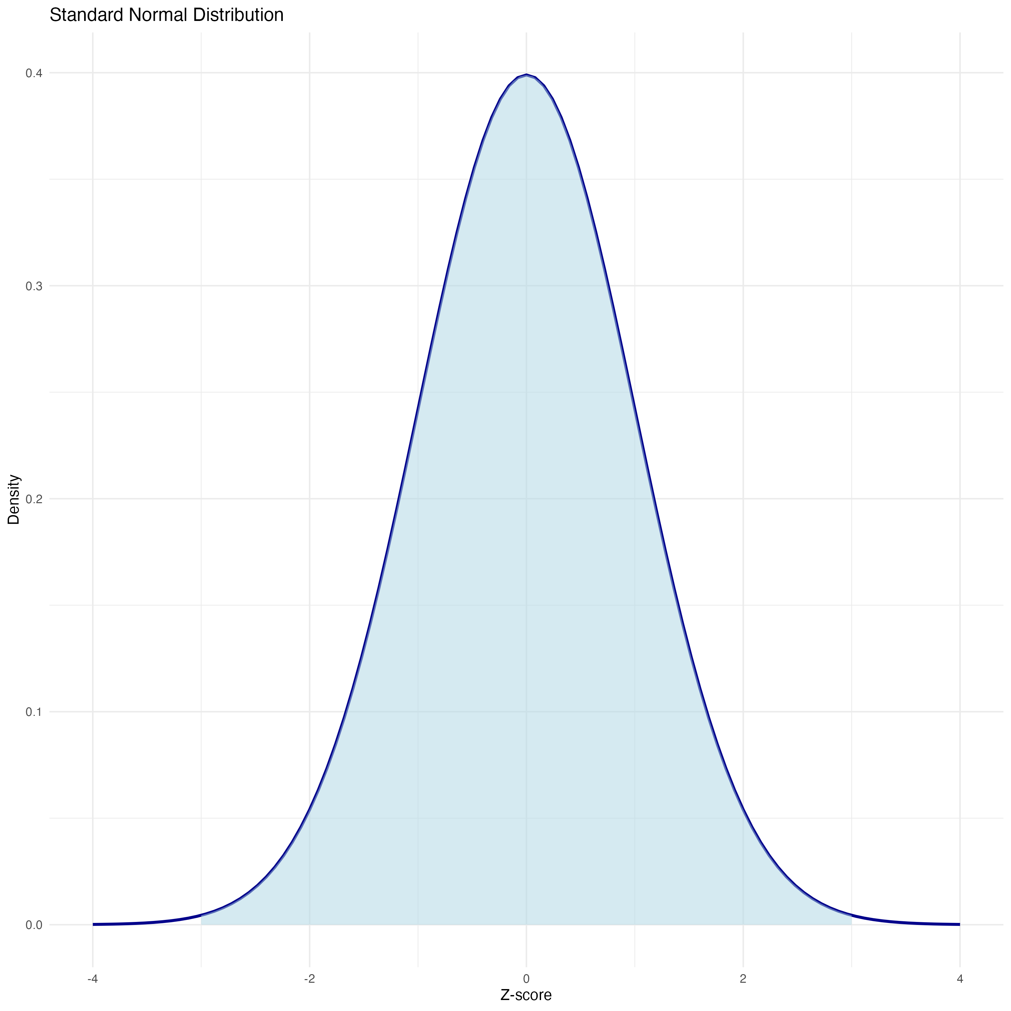
Normal distribution
Symmetric and Unimodal (one mode)
Mean, median and mode are the same value
Described by its mean and standard deviation: N(μ, σ) (here we see N(0, 1))
If we know the mean and standard deviation, we know the entire equation to draw this curve.

Slide 46
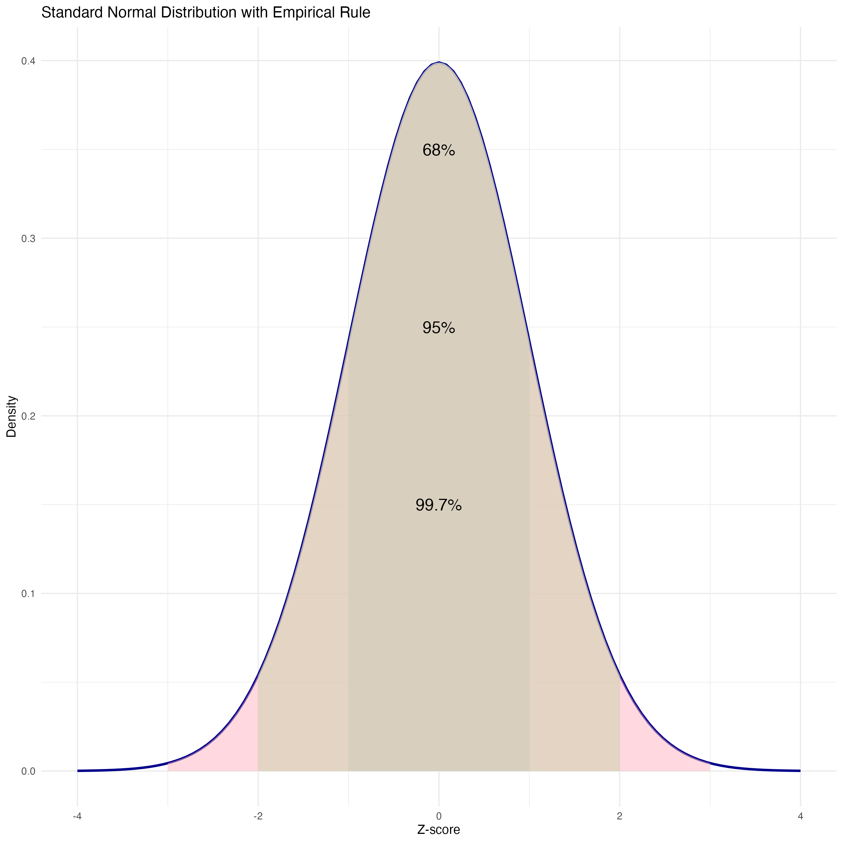
The empirical rule
The empirical rule for the normal distribution is that:
68% of data falls within 1 standard deviation of the mean.
95% of data falls within 2 standard deviations of the mean.
99.7% of data falls within 3 standard deviations of the mean.

Slide 47
The importance of the normal distribution
Often our data itself will not be normally distributed. Either because it follows some other distribution or because of sampling bias.
The normal distribution however is still important as we see later on in this course that even when the data itself isn’t normally distributed, under certain conditions values of central tendency are…

Slide 48
1.4 R Foundations and Principles

Slide 49
Why do we need to use programming?
Modern health datasets are far too large to analyse manually!
Instead we use programming to
automate repetitive analyses
*educe human error
analyse thousands (or millions) of observations
make analyses reproducible
share work with collaborators

Slide 50
Why are tools like R/Python preferable over Excel/SPSS?
Excel | SPSS | R
Good for small datasets | Menu driven | Programming language
Difficult to reproduce analyses | Expensive licence | Completely free
Limited graphics | Limited flexibility | Publication-quality graphics
Manual clicking | Manual clicking | Fully reproducible

Slide 51

So what exactly is R?
R was created in 1991 and released in 1993, and is quickly rising in the ranks as one of the most popular programming languages for data science.
R is an open-source domain-specific language designed for statistical analysis, data handling, and visualisation.
The primary objective that R was built for is data analysis and statistics. It is a highly extensible language that fosters an environment for statistical computing and graphics.

Slide 52
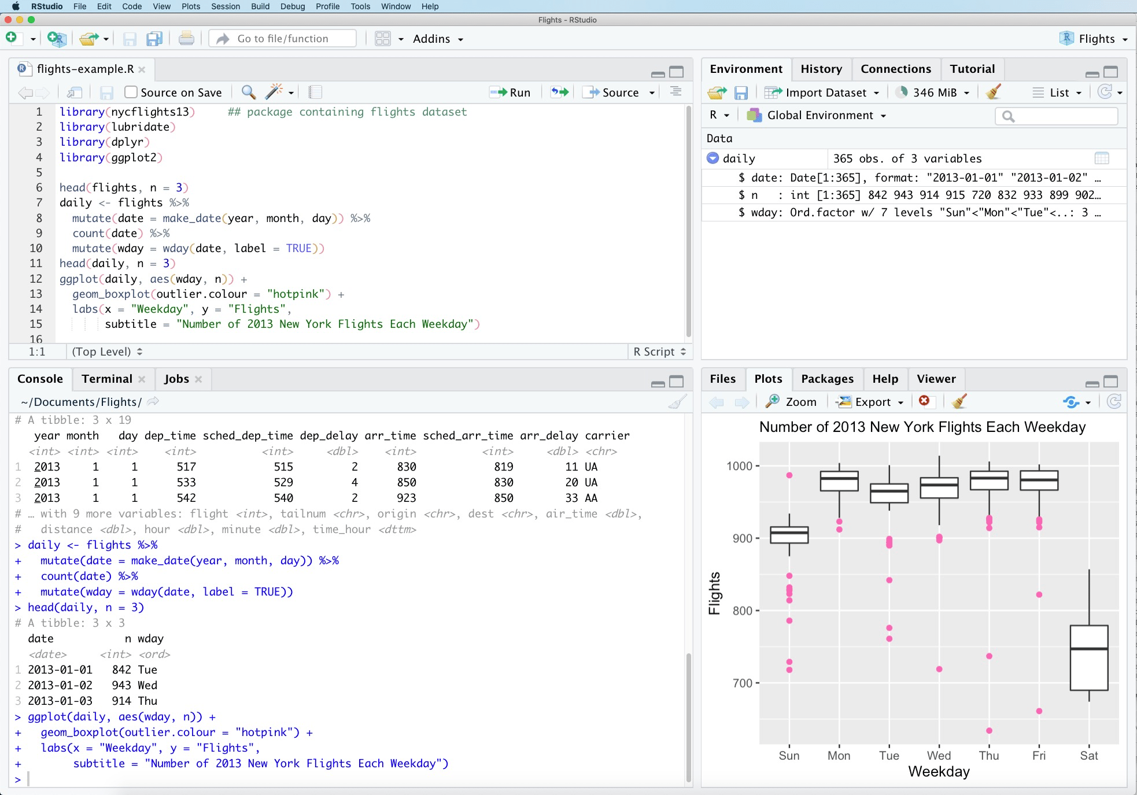
But hang on, what is R Studio then?
R Studio is not R. It is a Graphical User Interface (GUI).
It’s simply an application that makes writing and running R much easier.

Slide 53
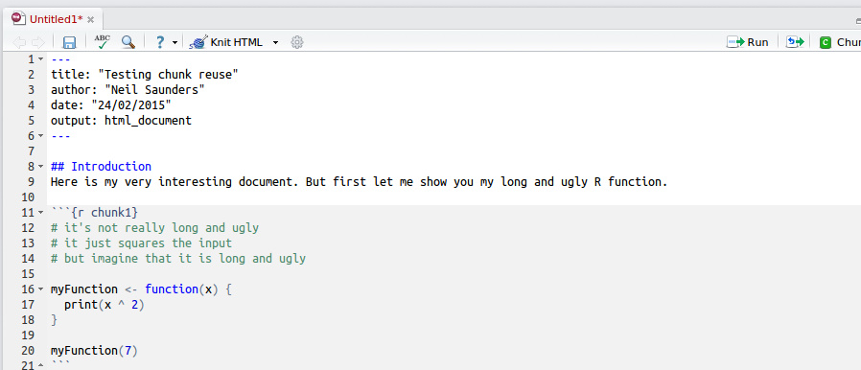


How are we going to use R Studio?
Code chunks separate out code from ‘normal’ text.
-> Easy to spot the grey and see code!
University service to access R Studio and R through the web-browser.
-> Doesn’t need a laptop!
Package to make nice reports and bring figures/text together.
-> Nice PDFs at the end!

Slide 54
.csv (Comma Separated Value) As it says on the tin. The dependable everyday workhorse of data science. Nearly everything can read it.
.tsv (Tab Separated Value) The sophisticated cousin of .csv. Favourite for larger or messier datasets where commas might already appear in the data.
What does data ‘come like’?
.xlsx (Comma Separated Value) Loves colours, formulas, multiple sheets and making everything look pretty…but can be a bit dramatic when you just want the raw data.
.Rdata
R’s memory box. Instead of saving just the data, it remembers almost everything you were working on so you can pick up exactly where you left off.

Slide 55

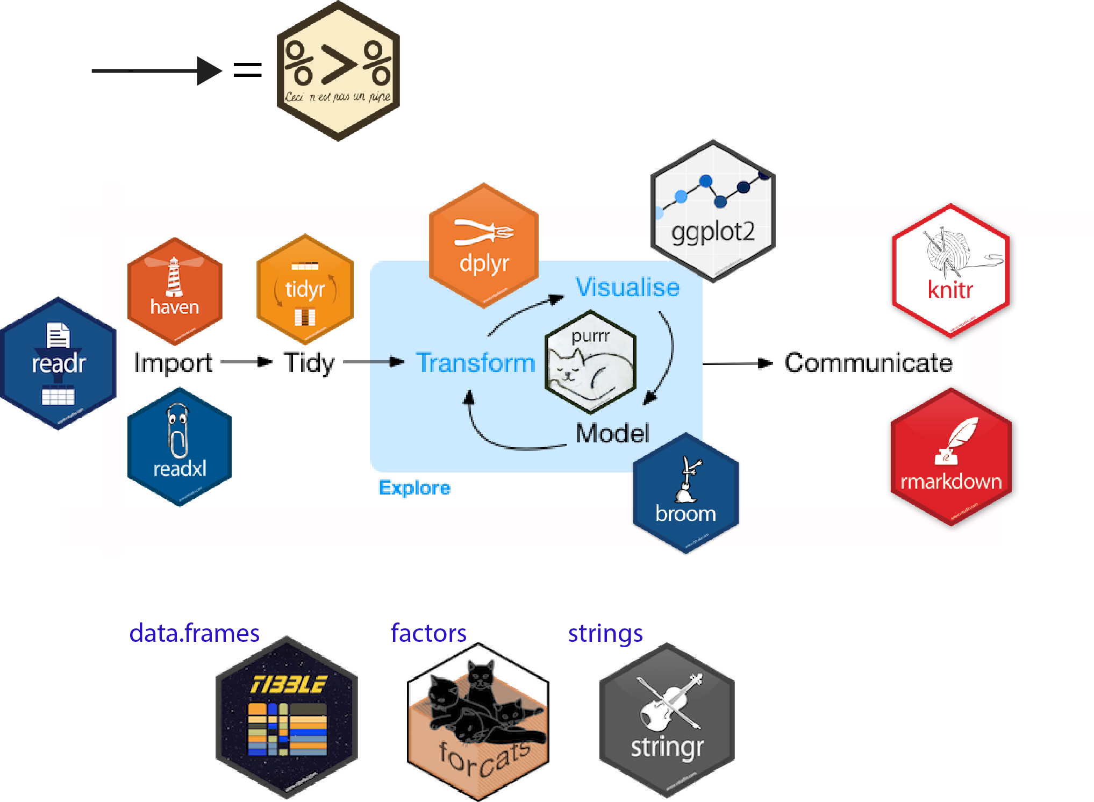
How do I load data in R?
The tidyverse is an extremely useful set of R packages that were created to make working with data faster, easier, and more fun.
We’ll gradually introduce these throughout the course, you do not need to memorise them today.

Slide 56
For now here’s some simple commands you’ll see…
library(tidyverse)
data <- read_csv("patients.csv")
In the code along we’ll meet some other short commands to put into practice the descriptive statistics and visualisations we’ve met this week.

Slide 57
How do I store data in R?
Object | Purpose
Vector | One variable
Data frame (tibble) | Entire dataset
Factor | Categorical variable

Slide 58
What you need to do next…
You’ve learnt all about descriptive statistics and how data can be visualised to represent this graphically. You’ve also learnt about what R and R Studio are, and how we use them (a bit).
Now it’s time to put this into practice!
To the code-along…

