Slide 1

Topic 02: Signal vs noise

Slide 2
How do we utilise a sample vs a population?
In medicine, we are rarely interested only in describing the data we have collected. Instead, we want to use data from a sample of individuals to learn something about a wider population.
This means asking questions such as…
Is this treatment actually effective?
Is this observed difference real or simply due to chance?
How much evidence do we need before drawing a conclusion?
However, every dataset contains both signal (the underlying pattern we are interested in) and noise (the random variation that can obscure it). The challenge of statistical inference is separating one from the other.

Slide 3
This topic…
From Samples to Populations
Deciding Whether an Effect is Real
Can We Trust Our Conclusions?
Using R for Statistical Inference
2.1 From Samples to Populations

Slide 4
2.1 From Samples to Populations

Slide 5
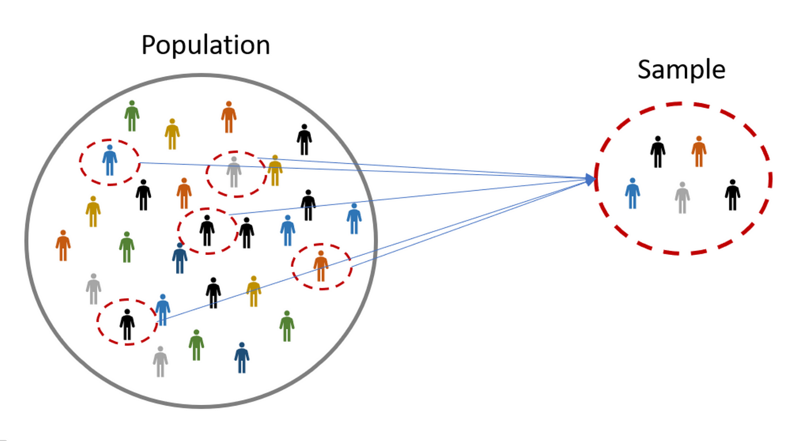
How do we ensure that the descriptive statistics of the sample from the population are representative?

Slide 6
Inferential statistics, aims to make predictions or draw conclusions about a population based on a sample of data, using probability theory and statistical inference techniques like hypothesis testing and confidence intervals.
Determine if a new treatment is more effective than a placebo.
Estimate the average recovery time for patients after a specific surgery.
Investigate whether there’s a relationship between patient age and treatment success rates.
Ascertain whether some social policy test has had a positive health effect.

Slide 7
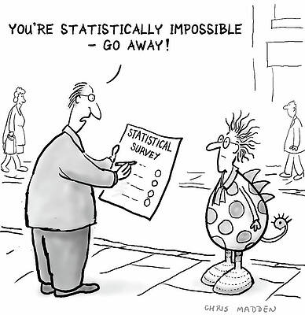
Some common misconceptions…
I can change the level of confidence in my estimate and report the one which `actually’ tells me something. P-HACKING
It is best to just keep performing tests until we find something interesting out. POOR SCIENCE
As long as I have 30 samples, my inference is great! NOT NECESSARILY!
If assumptions of my tests and experiment aren’t met then my results are rubbish and should be discarded. MAY STILL BE USEFUL

Slide 8
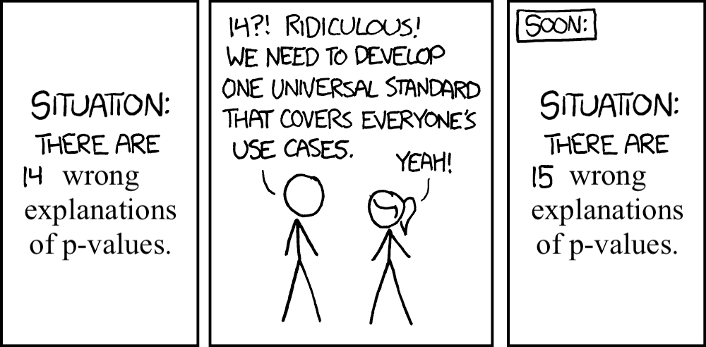
Some careful considerations…
Sometimes our sample size may just be too small to be able to find anything ‘significant’.
Misinterpreting p-values as absolute proof of an effect or as a measure of practical significance is dangerous territory.
Misinterpretations or selective reporting of statistical findings can influence policy decisions, medical practices, or resource allocation unfairly.
Statistical outputs, such as p-values or confidence intervals, can be difficult for non-statistical audiences to interpret.

Slide 9
2.2 Deciding Whether an Effect is Real

Slide 10
How do we decide whether an observed difference is real?
We must ask ourselves when we observe a difference is it:
Real biological/social effect?
OR
Random chance?
We typically form a research questions which looks to answer the above about a specific medical scenario.

Slide 11
The statistical inference pipeline
1. State a hypothesis
2. Pick an appropriate test and significance
3. Calculate a test statistic and p-value
4. Interpret findings
5. Check assumptions
5. Draw a conclusion

Slide 12
How do I formulate a hypothesis?
H0: The current status quo is this.
H1: I believe that it is this instead.
Our goal is not to prove H₁. Instead, we assess whether the observed data are compatible with H₀.

Slide 13
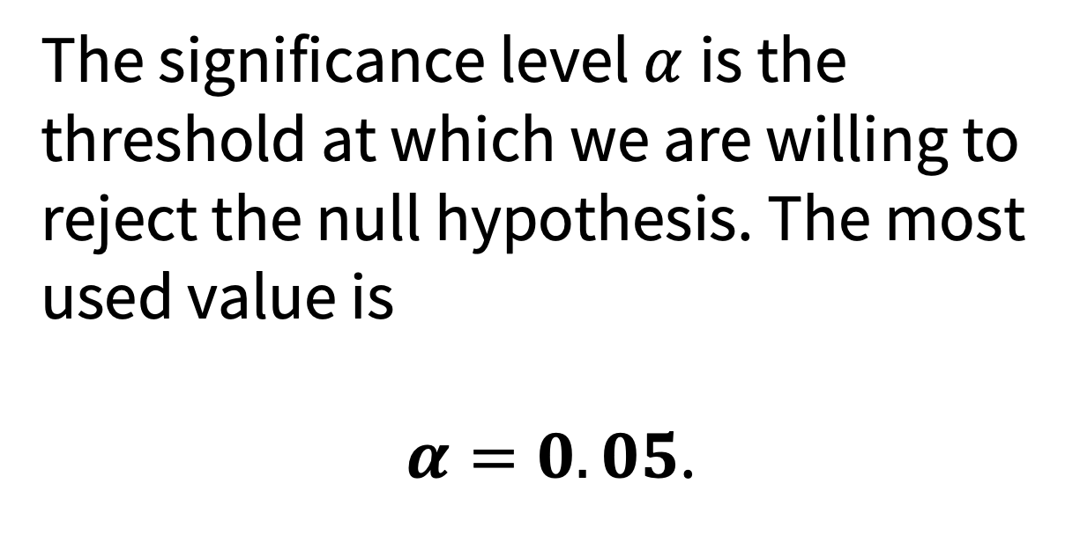
Choosing a significance level
The significance level $α$is the threshold at which we are willing to reject the null hypothesis. The most used value is
$α=0.05$.

Slide 14
Selecting an appropriate test and test statistic.
The type of test you select entirely depends on the data and the research question. We will explore types of tests through this course.

Slide 15
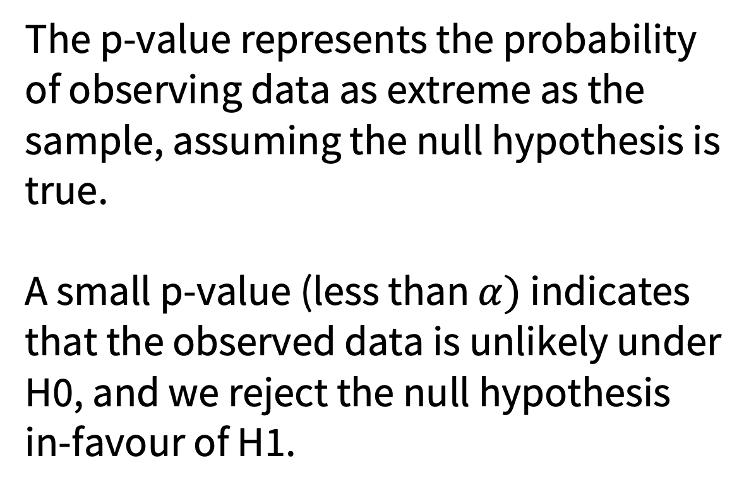
Determining a p-value
The p-value represents the probability of observing data as extreme as the sample, assuming the null hypothesis is true.
A small p-value (less than $α)$ indicates that the observed data is unlikely under H0, and we reject the null hypothesis in-favour of H1.

Slide 16
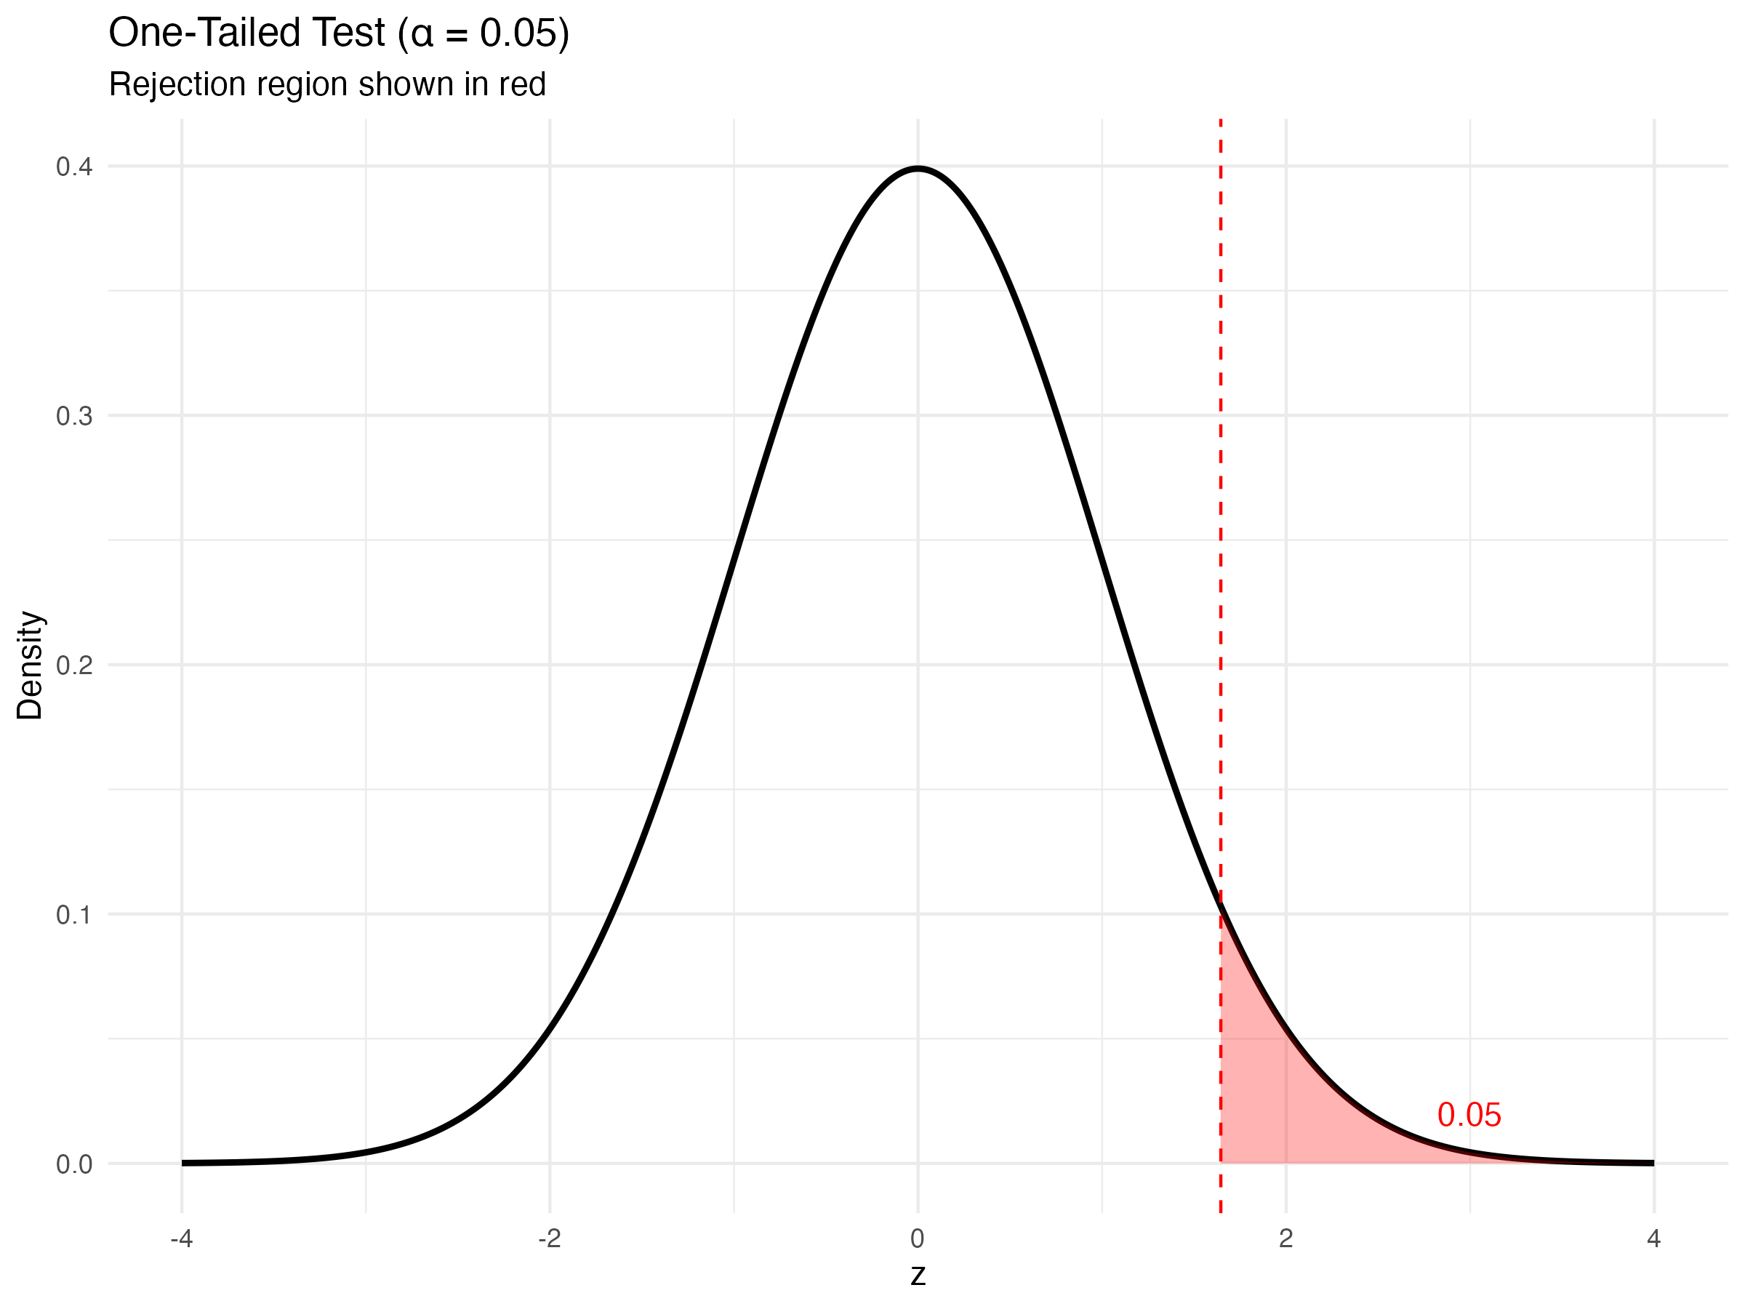

Slide 17
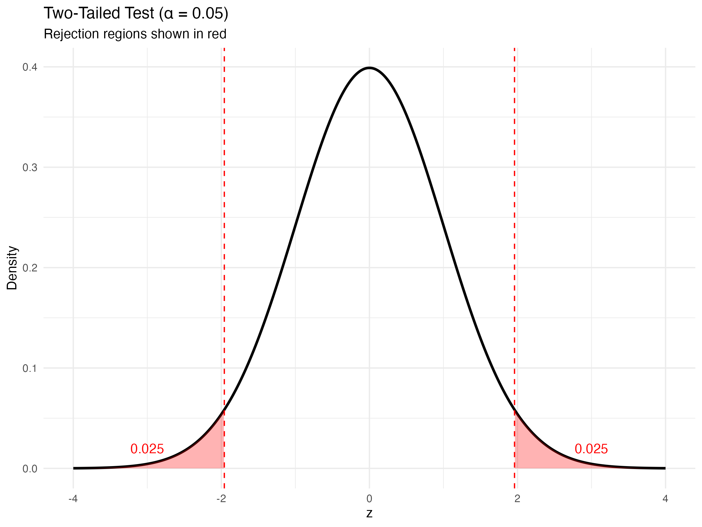

Slide 18
When we look at this, we can notice that the two-tailed test is going to be more ‘conservative’ in rejecting the null, since the density of the rejection region is split into the two separate regions.

Slide 19
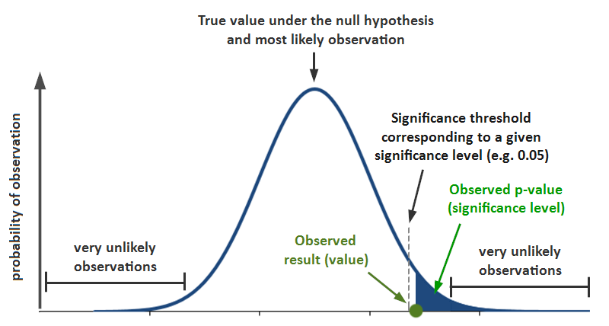
Going back to p-values

Slide 20
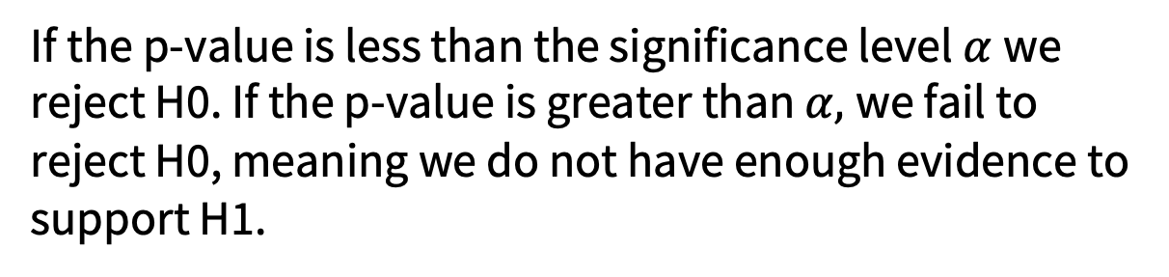
Interpreting a p-value
If the p-value is less than the significance level $α$we reject H0. If the p-value is greater than $α,$we fail to reject H0, meaning we do not have enough evidence to support H1.
REJECT the NULL if p < 0.05 or NOTHING

Slide 21
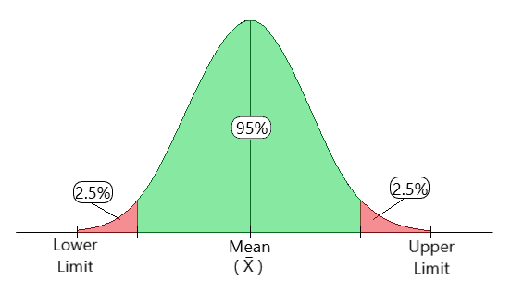
Confidence Intervals
Hypothesis tests answer
Is there evidence of an effect?
Confidence intervals answer
How large might that effect be?
A range of values likely to contain the true value.

Slide 22
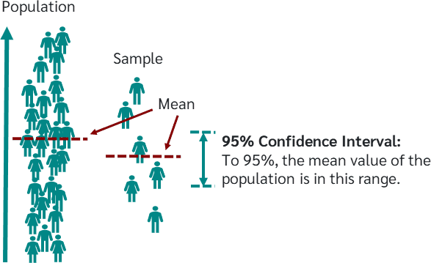

Slide 23
How to Interpret Confidence Intervals
95% CI for mean recovery time is [10.2, 12.8].
Interpretation: If we repeated the sampling, 95% of the intervals would contain the true mean.
Does not mean there’s a 95% probability the interval contains the true mean.

Slide 24
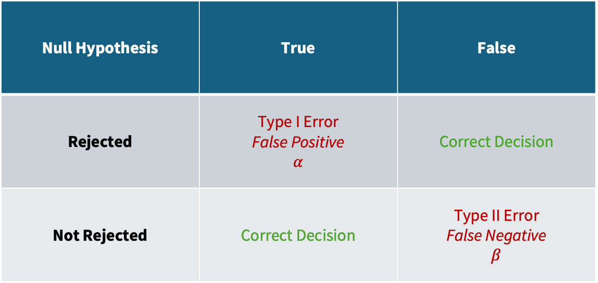
But what if it was all wrong?
Null Hypothesis | True | False
Rejected | Type I Error False Positive $$α$$ | Correct Decision
Not Rejected | Correct Decision | Type II Error False Negative $$β$$

Slide 25
Which one is worse?
False Positive
Doctor prescribes an ineffective treatment.
False Negative
Doctor misses an effective treatment.
The consequences of each error depend on the research question.
Researchers therefore carefully balance the risks of both types of error.

Slide 26
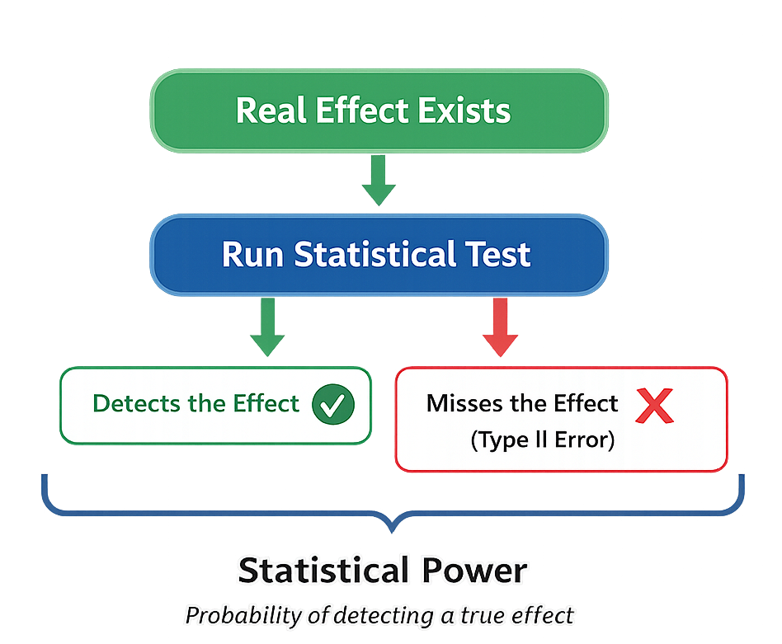
Statistical Power
Statistical power is the probability of correctly detecting a genuine effect when one exists. A study with high power is less likely to miss an important finding.
Low statistical power increases the chance of making a Type II Error.

Slide 27
What influences statistical power?
Larger true effect size.
Larger sample size.
Higher Statistical Power
Well-powered studies provide more reliable evidence and reduce the chance of missing important findings.
Less variability in data.

Slide 28
2.3 Assumptions in Statistical Inference

Slide 29
Why do assumptions matter?
Even a well-powered study can produce misleading conclusions if the assumptions of the statistical test are not met.
Statistical tests are mathematical models. Like all models, they make assumptions.
If those assumptions are badly violated, our conclusions may be unreliable.
Some assumptions include:
independence
equal variances
Normality

Slide 30
Why is normality particularly important?
Many tests we will be learning about assume that the sampling distribution follows a Normal distribution.
The central limit theorem tells us…
Regardless of population distribution, the sampling distribution of the sample mean approximates a normal distribution as the sample size increases.
Key Requirements:
Samples are independent.
Drawn from the same population.

Slide 31
For many situations, once the sample size is reasonably large (often around 30 or more), the sampling distribution of the sample mean becomes approximately Normal.

Slide 32
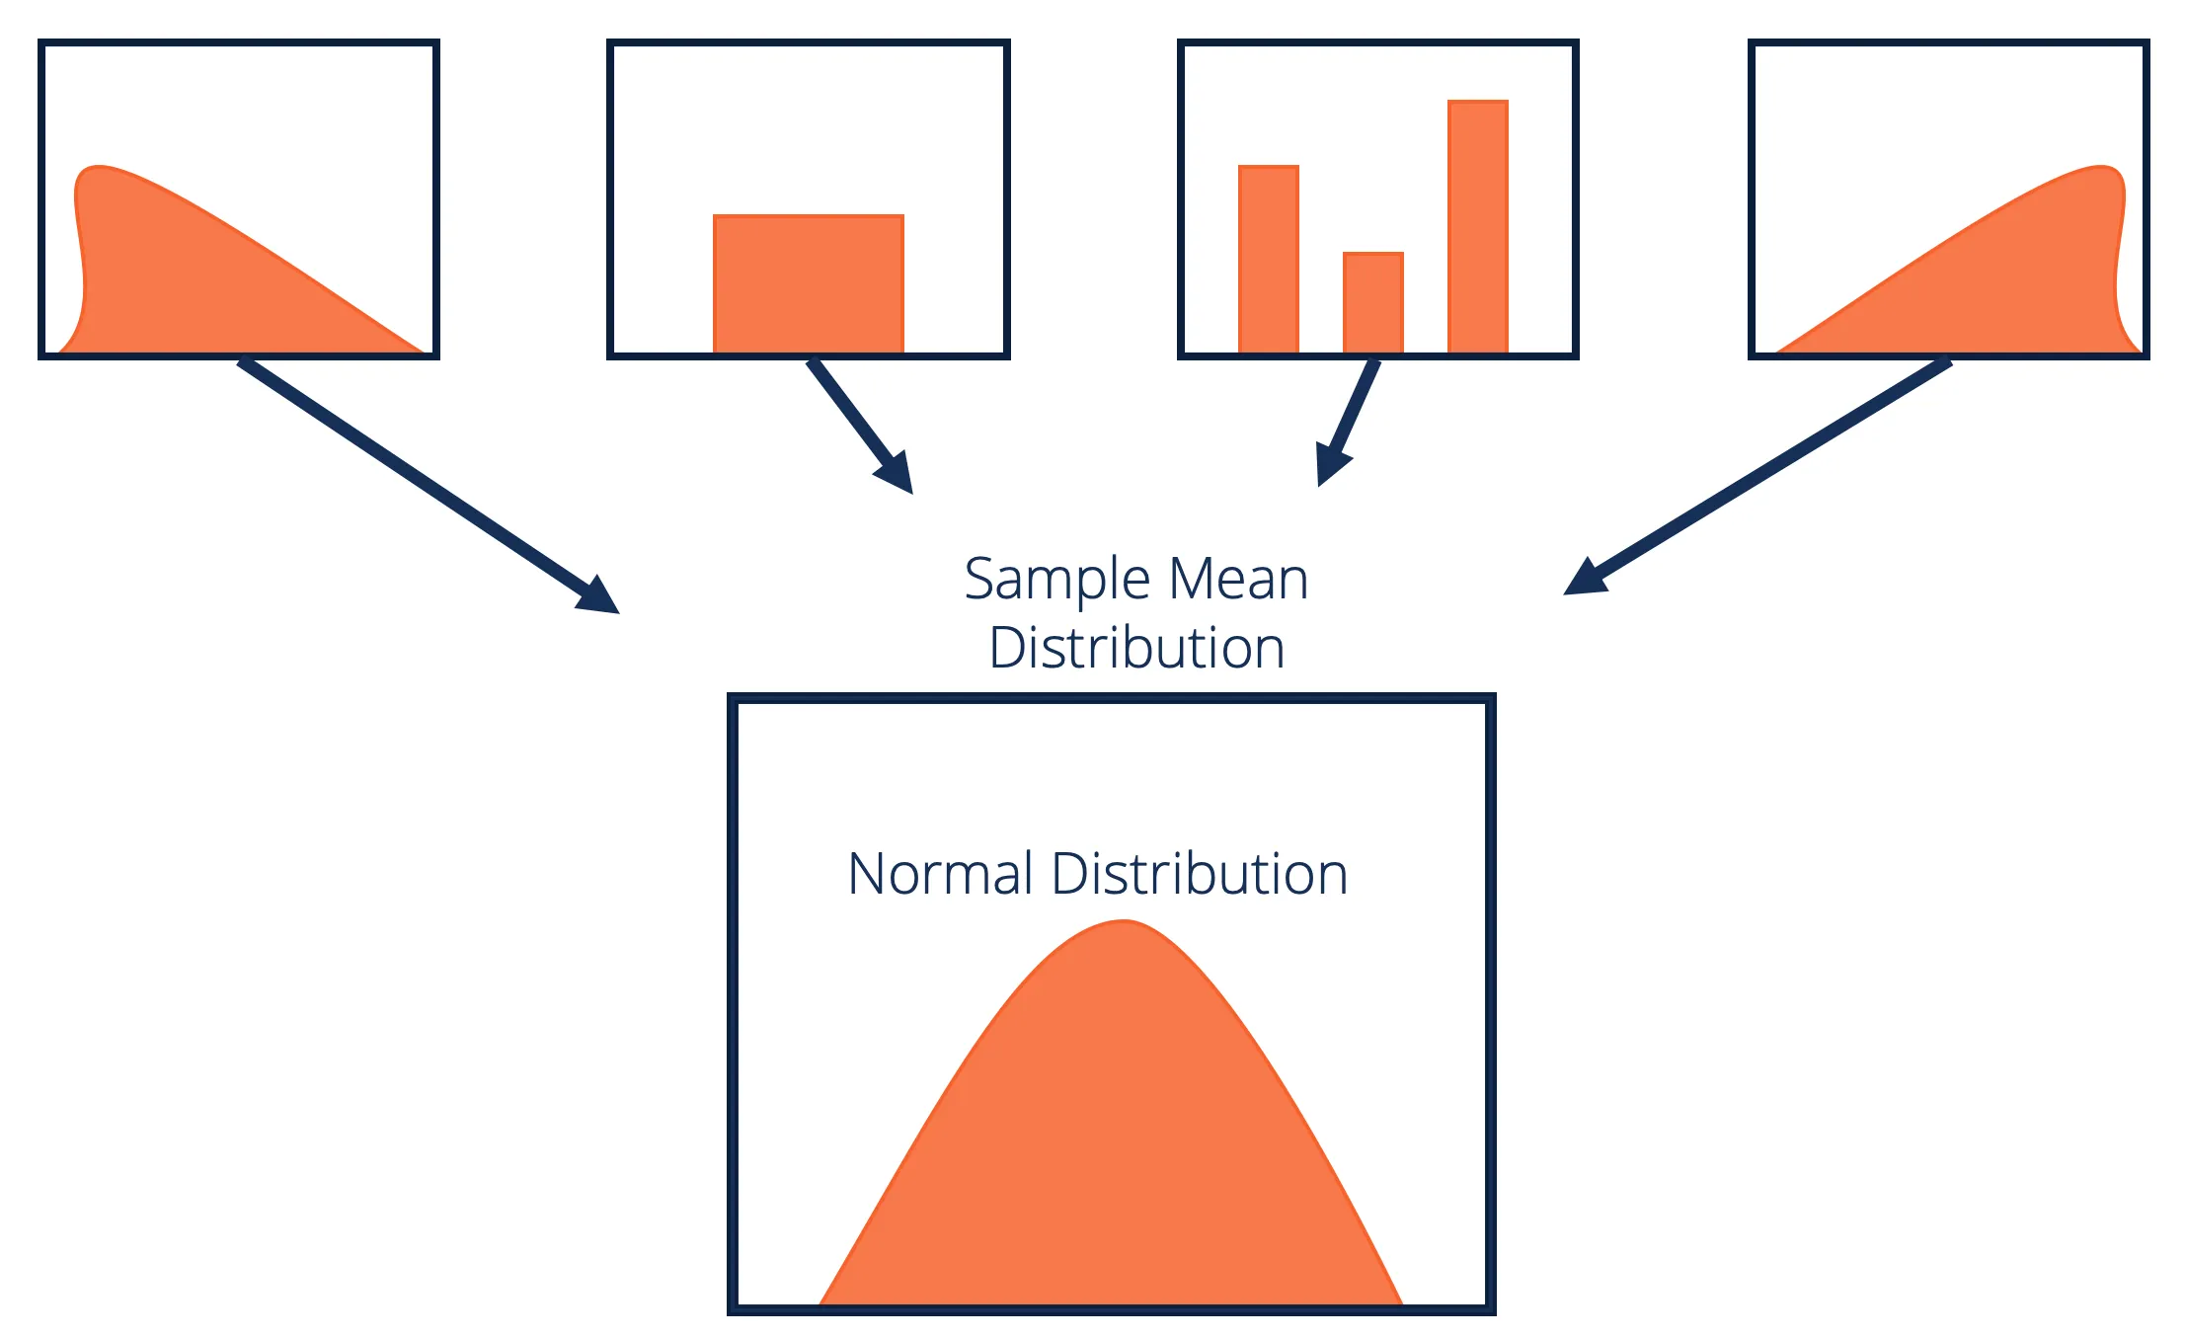

Slide 33
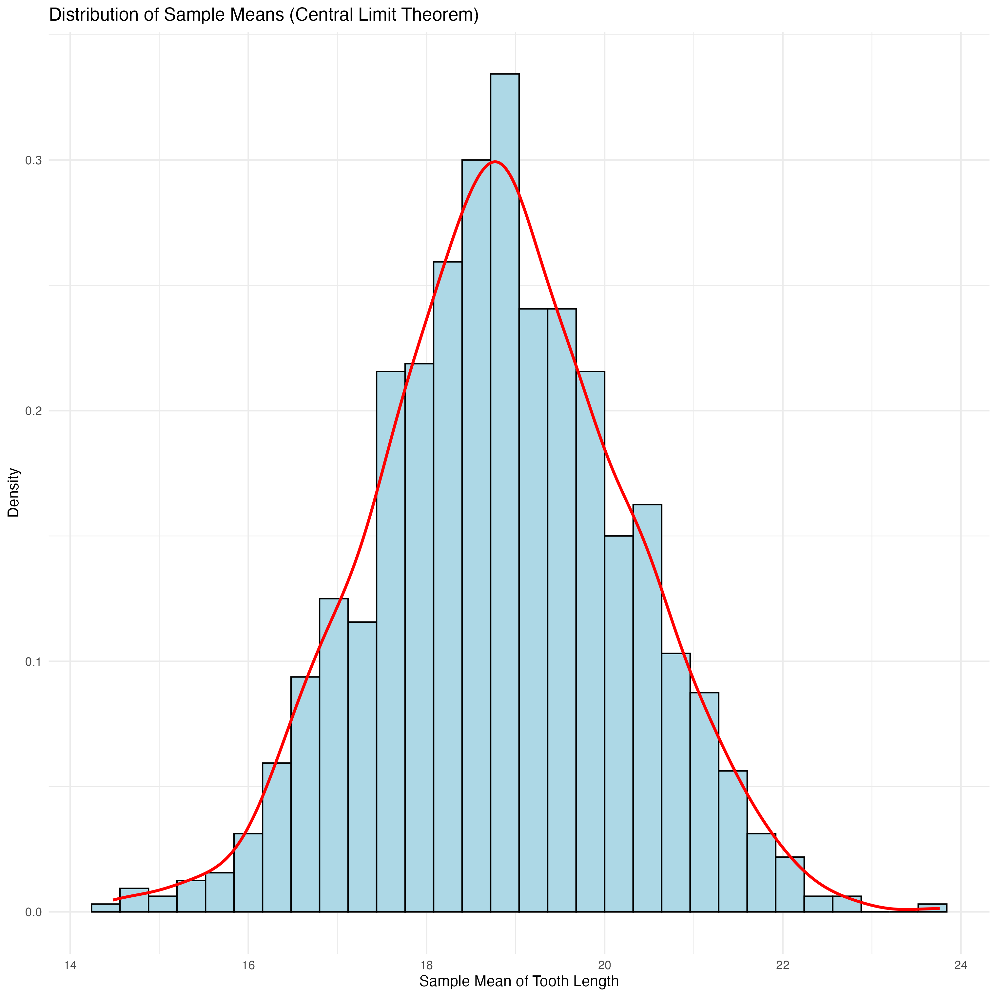

Slide 34
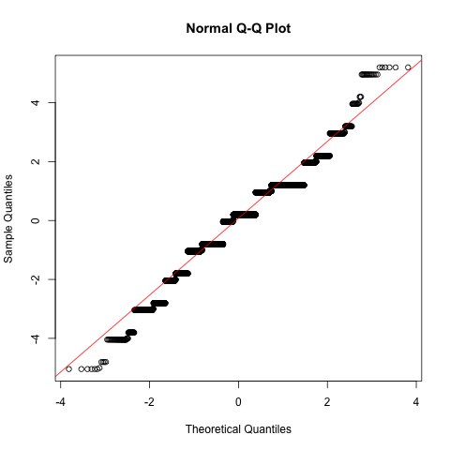
How do we assess normality?
Shapiro-Wilk Test
Kolmogorov-Smirnov Test
Visual Methods

Slide 35
Neither test is necessarily ‘better’
Different methods assess Normality in different ways. As a result, they may not always lead to the same conclusion. Possible reasons include:
• Different statistical power
• Different sensitivity to departures from Normality
• Sample size
• Outliers
Good statistical practice combines graphical evidence, statistical tests and subject knowledge before deciding whether an assumption has been adequately met.

Slide 36
2.4 Using Packages and Functions in R

Slide 37
Everything we do in R is built from functions.
Functions are small pieces of reusable code that perform a specific task.
mean()
median()
summary()
head()
Each function performs one job.
Rather than writing these calculations ourselves every time, we simply call the appropriate function.

Slide 38
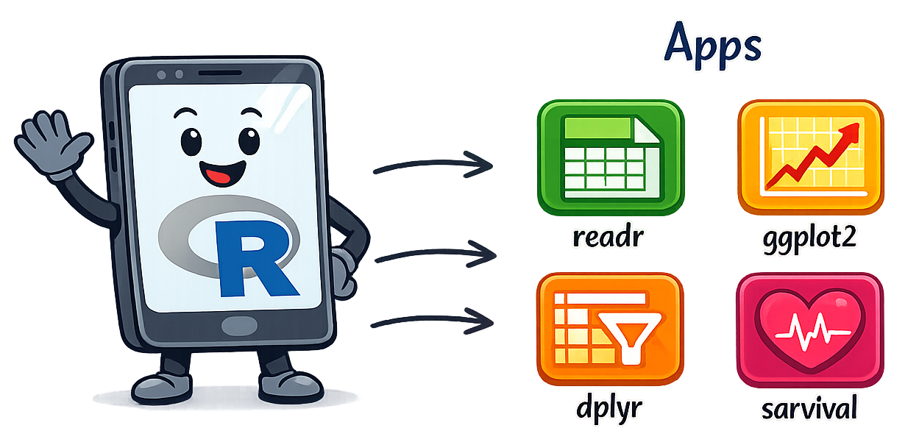
So wait what’s a package then again?
Packages are collections of related functions.

Slide 39
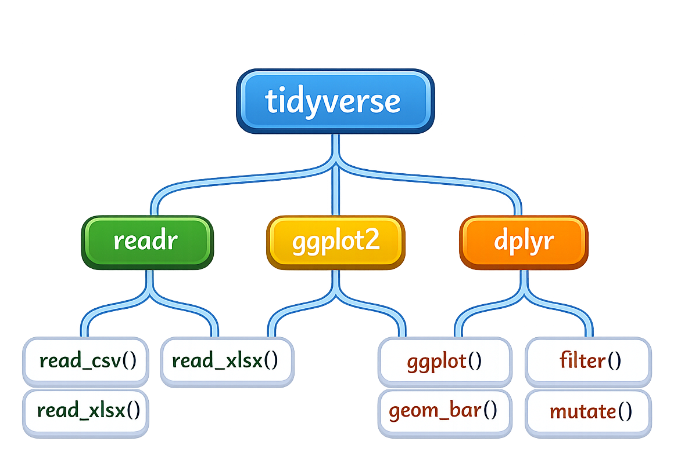
The Tidyverse
The tidyverse is a collection of packages designed to make data analysis easier. It provides functions for:
importing data
cleaning data
manipulating data
summarising data
creating graphics
Nearly every analysis we perform throughout this course will make use of the tidyverse.

Slide 40
Functions all follow a similar pattern
function_name(
input,
options
)
Every function has a name, brackets, something inside of the brackets.
mean(pulse)
summary(nhanes)
head(nhanes)
view(nhanes)

Slide 41
Using a package
library(package_name)
Library is a function. We use it to load packages with other functions in them. You must do this once at the start of each analysis.
install.packages(“package_name”)
Sometimes you might need to install a package. To do this the syntax looks a bit different. We won’t really need to do this in our course, but its worth knowing!

Slide 42
So what functions are we using this week?
📦 library() # Loads a package into R.
📊 qqnorm() # Creates a Normal Q–Q plot.
📈 qqline() # Adds the reference line to a Q–Q plot.
🧪 shapiro.test() # Performs the Shapiro–Wilk Normality test.
📋 ks.test() # Performs the Kolmogorov–Smirnov test.
We’ll use each of these functions in the upcoming code-along to assess whether data are approximately Normally distributed.

Slide 43
What you need to do next…
This week you’ve learn about the statistical inference pipeline and concepts about errors and power. It’s been very theory heavy right?
Let’s go ahead and look in the code-along at some normality testing to make it more grounded.
To the code-along…

