Slide 1

Topic 3: Comparing Groups

Slide 2
Why do we want to compare groups?
In medicine, we are often interested in whether an intervention, exposure, or characteristic is associated with a difference in an outcome.
Examples:
Blood pressure by treatment group
Depression score by therapy type
Recovery time by ward type
Here, we want to compare mean outcomes across groups, while accounting for natural variability between individuals.

Slide 3
This topic…
Comparing two groups
Comparing multiple groups
Comparing categorical variables
Exploring group differences in R
3.1 Comparing two groups

Slide 4
3.1 Comparing two groups

Slide 5
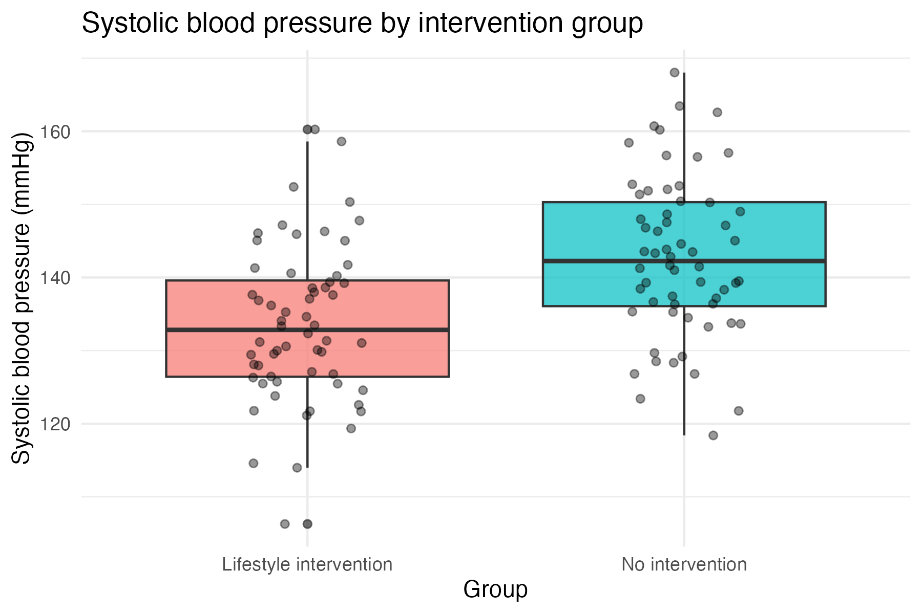
Lets think about blood pressure and lifestyle intervention.

Slide 6
What does “difference” really mean?
Differences always involve variability.
Visual differences ≠ statistical evidence.
When we compare groups, we almost always see some difference in averages.
But people vary naturally — even within the same group.
Is the observed difference larger than we would expect just by chance?

Slide 7
From description to inference
Describe → Compare → Test
Data → Evidence → Decision
We typically move through three stages:
Describe the data
Compare groups visually and numerically
Use statistical tests to make formal inferences

Slide 8
The Z-Test
$$Z=\frac{\overline{x}−μ_{0}}{σ/\sqrt{n}}$$
The z-test compares a sample mean to a known population mean when the population variance is known.
In health and social care, this situation is uncommon, but it helps illustrate the logic of hypothesis testing.
Suppose national surveillance data tells us:
Mean systolic BP in adults = 140 mmHg
Population SD = 15 mmHg
We may collect a small clinic sample to see if their mean differs from this, using the population SD are ground truth and doing a Z-Test

Slide 9
What happens when the population variance is unknown? (very likely)
In practice, we do not know the population variance.
Instead, we estimate it from the sample:
Adds uncertainty
Requires a different reference distribution
Leads to the t-distribution
The smaller the sample, the more important this adjustment becomes, which is common in health and social care studies.

Slide 10
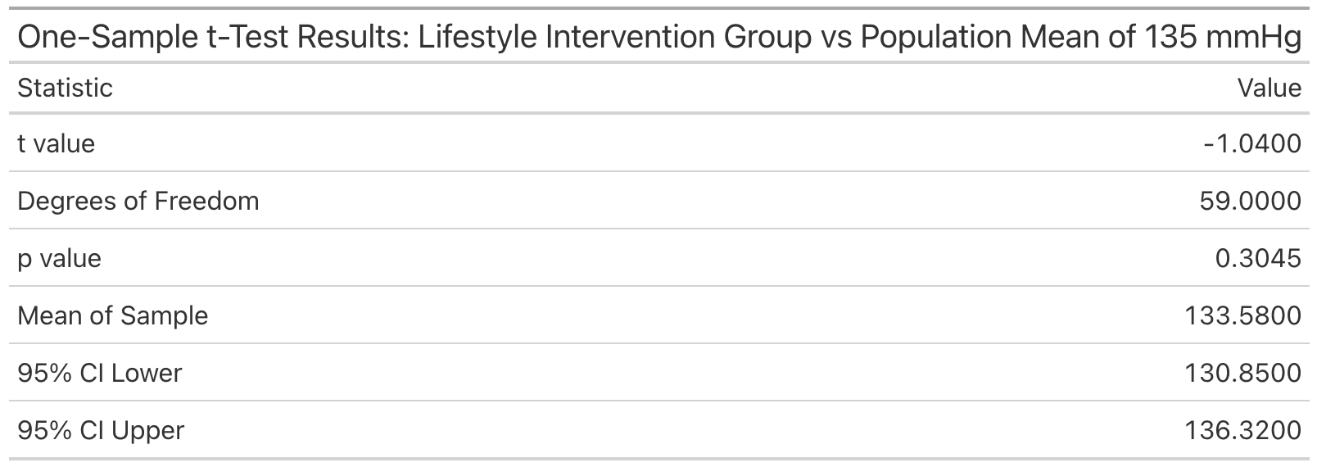
The one-sample t-test.
Used when comparing one sample mean to a known reference value.
In our example...
A guideline suggests systolic BP should average ≤ 135 mmHg after an intervention. We want to test whether our intervention group meets this target.
Hypotheses
H₀: μ = 135
H₁: μ ≠ 135
t$=\frac{\overline{x}−μ_{0}}{s/\sqrt{n}}$

Slide 11

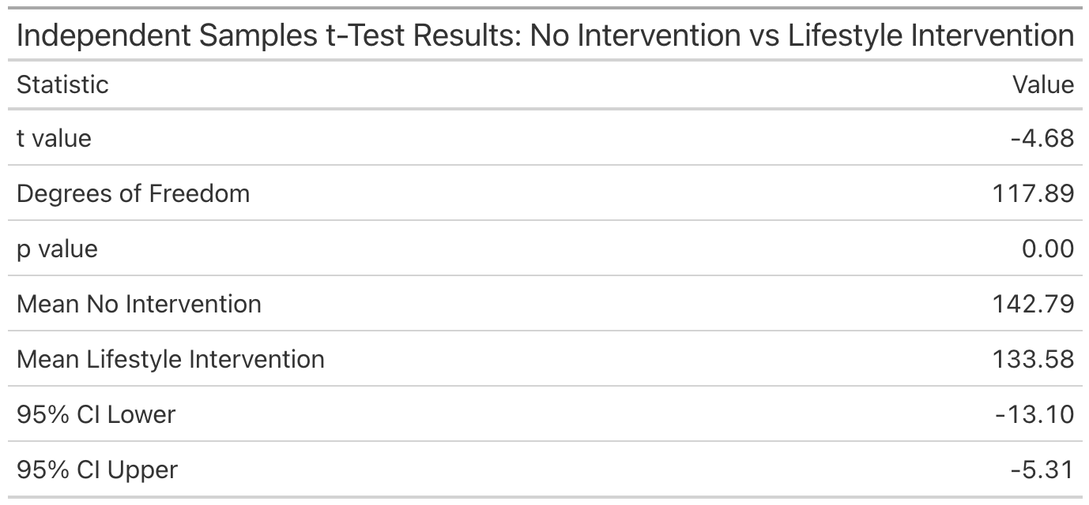
The independent samples t-test.
Used when comparing the means of two independent groups.
This is one of the most common tests in health and social care research.
In our example...
Do patients receiving a lifestyle intervention have lower systolic BP than those who do not?
Hypotheses
H₀: μ₁ = μ₂
H₁: μ₁ ≠ μ₂

Slide 12
The paired samples t-test.
Used when measurements are taken on the same individuals twice.
Typical health contexts:
Before vs after treatment
Admission vs discharge
Baseline vs follow-up scores
$${\text{d}}_{\text{i}}\text{ = }{\text{x}}_{\text{i}\text{,}\text{before}}\text{ − }{\text{x}}_{\text{i}\text{,}\text{after}}$$
$$\text{t}\text{ = }\frac{\overline{d}}{{\text{s}}_{\text{d}} \text{/} \sqrt{n}}$$

Slide 13
Assumptions of the z/t-tests.
In health and social care, assumptions matter because violations can affect conclusions.
Key assumptions
Independence: Each patient contributes one observation (unless paired)
2. The distribution of the sample mean is approximately normal: Guaranteed by the CLT for groups with n > 30.
3. Equal variances (for classical independent t-tests: Welch’s t-test relaxes this assumption

Slide 14
3.2 Comparing multiple groups

Slide 15
The Problem: Comparing more than two means.
In health and social care, we often want to compare outcomes across more than two groups.
In our latest running example, we are interested in whether average sleep duration differs by working status among adults:
Working full-time
Working part-time
Not working / retired / unable to work
Each group has its own mean sleep duration, and we want to know whether these differences are larger than we would expect by chance.

Slide 16
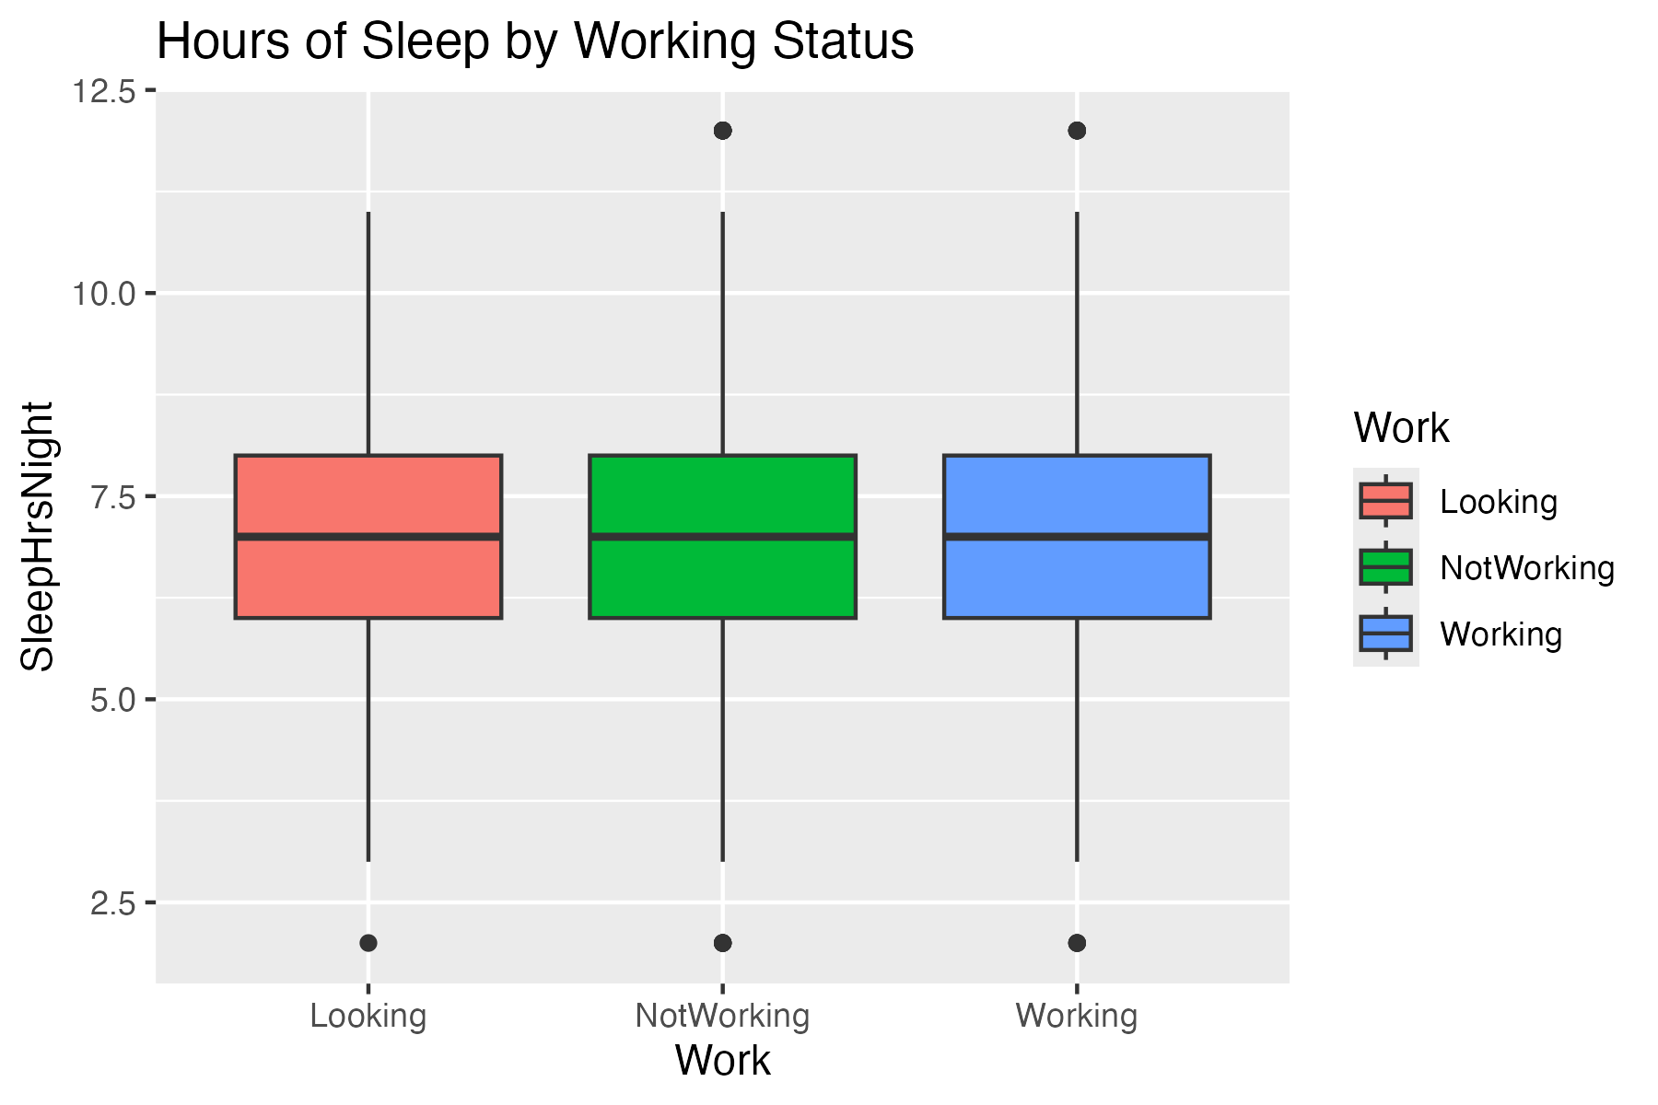
Motivating this in health and social care.
The boxplot produced visually shows:
Differences in central tendency
Overlap between groups
Within-group variability
This motivates the need for a formal statistical test.

Slide 17
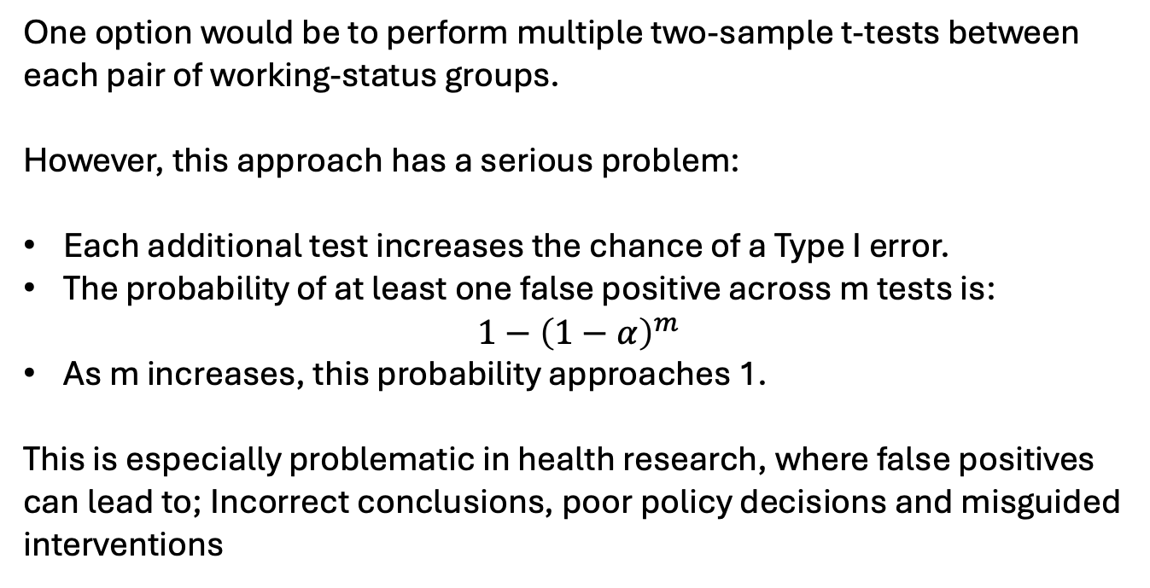
Why two-sample t-tests are not enough.
One option would be to perform multiple two-sample t-tests between each pair of working-status groups.
However, this approach has a serious problem:
Each additional test increases the chance of a Type I error.
The probability of at least one false positive across m tests is:
$$1−{\left(1−α\right)}^{m}$$
As m increases, this probability approaches 1.
This is especially problematic in health research, where false positives can lead to; Incorrect conclusions, poor policy decisions and misguided interventions

Slide 18
Type 1 error and multiple comparisons.
If we perform many hypothesis tests:
Each test has a probability α (often 0.05) of a false positive
The overall probability of at least one false positive increases rapidly
ANOVA solves this problem by:
Performing one global test
Controlling the Type I error rate at the chosen significance level

Slide 19
Between-group vs within-group variation.
ANOVA evaluates whether between-group variation is large relative to within-group variation:
Signal vs Noise
ANOVA assumes everyone in the same group shares the same mean. It then asks how far is their outcome from their group’s mean.
Observed value = actual outcome
Expected value = group mean
Residual = observed − expected

Slide 20
What is an ANOVA test?
ANOVA (Analysis of Variance) tests the hypothesis:
H₀: All group means are equal
H₁: At least one group mean differs
Importantly:
ANOVA does not tell us which groups differ
It only tells us whether any difference exists
The output shown later in the ANOVA table slide is the formal result of this global test.

Slide 21
What do we mean by “variation”?
ANOVA is built around the idea of variation in the outcome variable.
In our example:
Individuals differ in how many hours they sleep
Some of this variation is due to working status
Some is due to individual differences
ANOVA asks:
Is the variation between groups large relative to the variation within groups?

Slide 22
Total variation in the data.
The total variation represents how much individual sleep durations vary around the overall mean sleep duration.
Conceptually:
This is what we would see if we ignored working status entirely

Slide 23
Within-group variation.
Within-group variation measures:
How much sleep duration varies within each working-status group
This captures:
Natural biological variation
Lifestyle differences
Measurement noise
Large within-group variation makes it harder to detect real group differences.

Slide 24
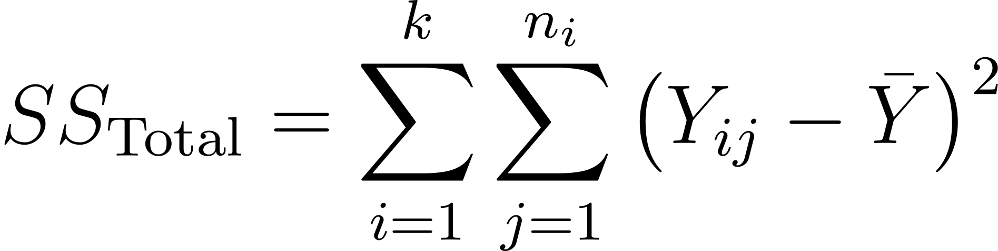
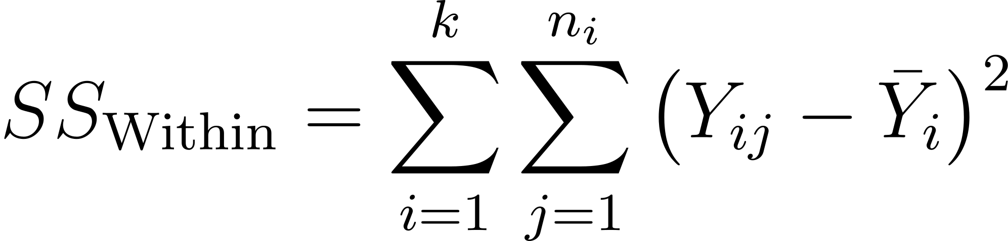
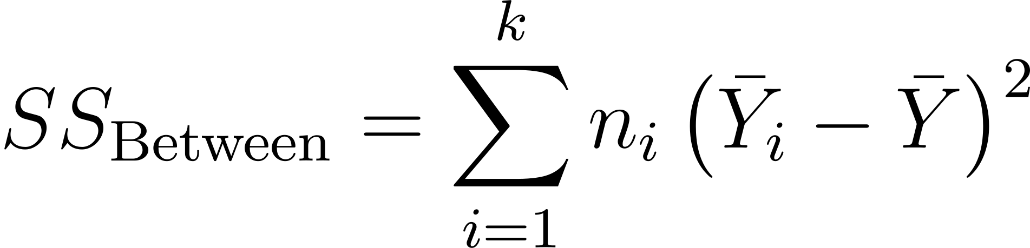
Decomposing variation: sum of squares.
This represents overall variability in the outcome.
This captures individual-level variability within groups.
Between-group sum of squares:

Slide 25
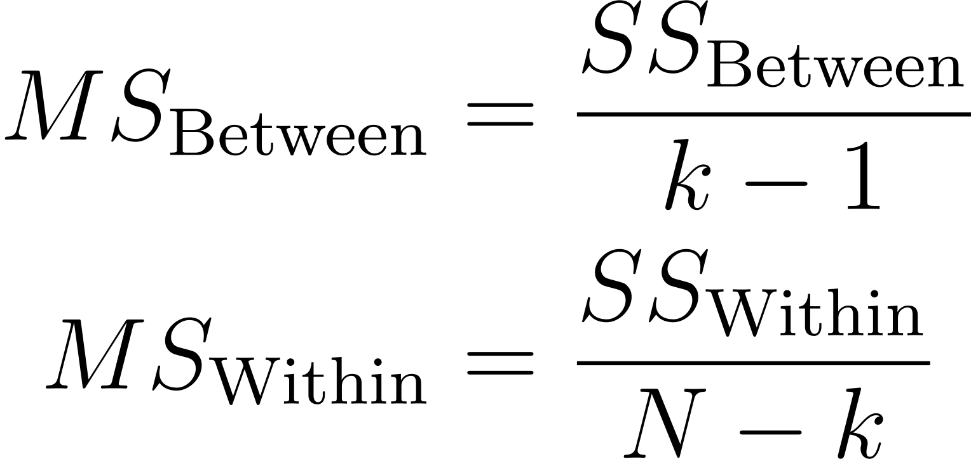
From sums of squares to mean squares.
Because sums of squares depend on sample size, ANOVA converts them into mean squares by dividing by degrees of freedom. This standardisation allows fair comparison between, between-group variation and within-group variation.

Slide 26
Degrees of freedom explained.
Degrees of freedom reflect the number of independent pieces of information available
In ANOVA:
Between-group df depends on the number of groups
Within-group df depends on total sample size
These values appear explicitly in the ANOVA table.

Slide 27
The F-ratio: comparing signal to noise.
The F-statistic is calculated as:
$$F=\frac{\text{Between}\text{−}\text{group} \text{mean} \text{square}}{\text{Within}\text{−}\text{group} \text{mean} \text{square}}$$
Interpretation:
Large F → group differences dominate random variation
Small F → differences are consistent with chance
The F-value and associated p-value are shown in the ANOVA table output.

Slide 28
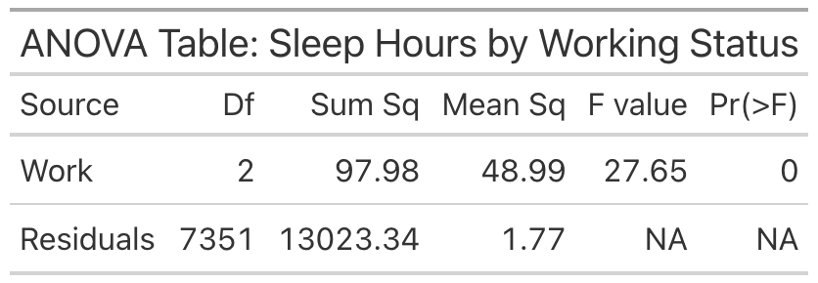
Interpreting the ANOVA table.
The p-value answers:
If all group means were truly equal, how likely would we be to observe an F-statistic this large?

Slide 29
What a significant F-test tells us (and what it doesn’t)
A significant F-test tells us:
There is evidence that not all group means are equal
It does not tell us:
Which groups differ
How large the differences are

Slide 30
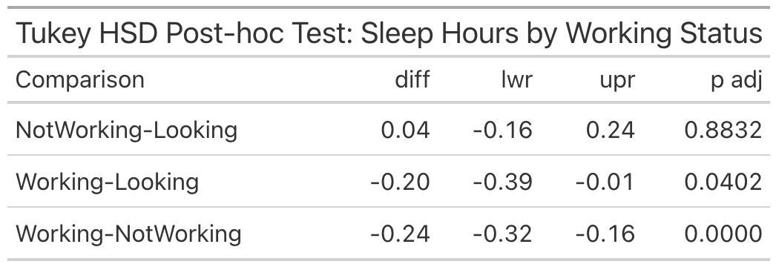
Why post-hoc tests are needed.
Once ANOVA indicates a difference exists, we perform controlled pairwise comparisons.
The Tukey HSD results show:
Mean differences between pairs of working-status groups
Confidence intervals
Adjusted p-values that control for multiple testing

Slide 31
Assumption 1: Independence
Observations must be independent:
Each NHANES participant contributes one sleep measurement
No clustering or repeated measures are present here
This assumption comes from the study design, not the data.

Slide 32
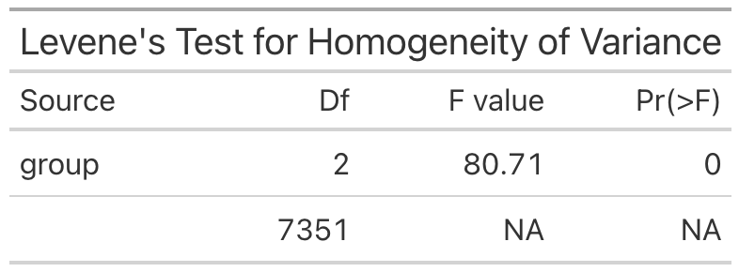
Assumption 2: Homogeneity of Variance
ANOVA assumes similar variance across groups.
Levene’s test formally assesses this.
Interpretation:
Non-significant result → assumption reasonable
Significant result → consider robust alternatives

Slide 33
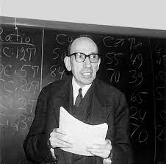
Levene’s test
Assess the equality of variances across multiple groups.
H₀ = the variances in different groups are equal
H₁ = the variances in different groups are different

Slide 34
Levene’s test
ANOVA
Mean
Rather than comparing variances directly, Levene’s test works by:
Measuring how far each observation is from its group’s centre
Taking the absolute size of these deviations
Comparing these deviations across groups using an ANOVA framework

Slide 35
Interpretation
Levene’s test produces a p-value. If the p-value is less than 0.05 (p < 0.05), this indicates that the variances are significantly different, and the assumption of equal variances is violated.
If the p-value is greater than or equal to 0.05 (p ≥ 0.05), the test suggests that the variances are equal, and the assumption holds.

Slide 36
Levene’s test is a key tool for ensuring the validity of parametric tests like ANOVA and t-tests.
By checking the equality of variances, we can ensure that our statistical tests are reliable and that we draw accurate conclusions from the data.
Always run Levene’s test before assuming equal variances in your analysis.

Slide 37
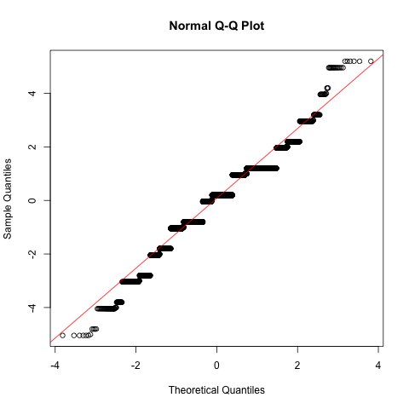
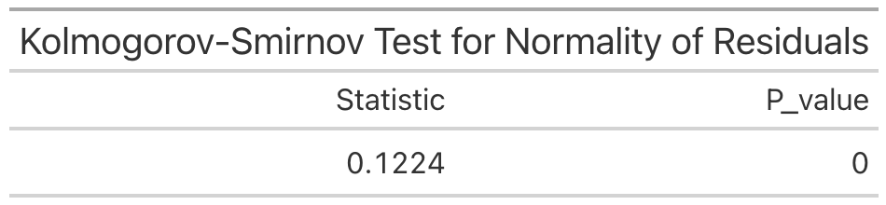
Assumption 3: Normality of Residuals
The normality assumption applies to the residuals, not the raw outcome.
We can check this using…
Kolmogorov–Smirnov test
Q–Q plot of residuals

Slide 38
Robustness and what to do when assumptions fail.
ANOVA is reasonably robust to:
Mild non-normality
Moderate variance differences (especially with balanced groups)
If assumptions are violated:
Use Welch’s ANOVA
Transform the outcome
Consider non-parametric alternatives

Slide 39
3.3 Comparing Categorical Variables

Slide 40

The χ² (Chi-square) test
Determines if there is an association between two categorical variables.

Slide 41


Types of χ² test
The χ² Test for independence
The χ² Goodness-of-Fit test

Slide 42
How the χ² test works
It compares the observed frequencies in each category to the expected frequencies.
The expected frequencies are calculated assuming there is no association between variables.

Slide 43

How the χ² test works
 | Lung disease | No lung disease | Total
Smoker | 40 | 20 | 60
Non-smoker | 10 | 30 | 40
Total | 50 | 50 | 100

Slide 44
Expected frequencies
The expected frequency for each cell in the contingency table is calculated using the formula:
Ε = Row Total x Column Total
Grand Total

Slide 45
Expected frequencies
E = Row Total x Column Total
Grand Total
Observed frequencies
 | Lung disease | No lung disease | Total
Smoker | 40 | 20 | 60
Non-smoker | 10 | 30 | 40
Total | 50 | 50 | 100
E = 60 x 50 = 30
100
Expected frequencies
 | Lung disease | No lung disease | Total
Smoker | 30
Non-smoker
Total

Slide 46
Chi-Square Statistic
$$x^{2}=\sum{\frac{{\left(O−E\right)}^{2}}{E}}$$
Where:
O is the observed frequency in each cell
E is the expected frequency in each cell

Slide 47
Degrees of freedom
The degrees of freedom ($ⅆf$) for a χ² test in a contingency table are calculated as:
$$ⅆf=\left(r−1\right)×\left(c−1\right)$$

Slide 48
Interpreting the results
If the p-value is less than the significance level (typically 0.05), we reject the null hypothesis and conclude that there is a significant association between the two variables.
If the p-value is greater than or equal to the significance level, we fail to reject the null hypothesis and conclude that there is no significant association between the variables.

Slide 49
Assumptions of the χ² test
The data must be in the form of counts or frequencies.
The categories must be mutually exclusive, meaning each observation falls into one and only one category.
The expected frequency for each cell should be at least 5 for the test to be valid. If this assumption is violated, other methods, such as combining groups, should be considered.

Slide 50
3.4 Exploring Group Differences in R

Slide 51
A research question must become an analysis dataset
Our research question determines which data we need.
Research question
Does sleep duration differ according to working status among adults aged 18–65?
What does R need?
Dataset: nhanes
Outcome: sleep_hours
Group: work_status
Inclusion criterion: age 18–65
We almost always need to create a smaller analysis dataset containing only the relevant variables and observations.

Slide 52
The pipe passes data from one function to the next
The pipe |> takes the result on its left and passes it into the function on its right:
nhanes |>
glimpse()
Read this as:
“Take the nhanes dataset, then inspect it using glimpse().”
Pipes allow several data-processing steps to be written in the order in which they happen.
Start with data |>
perform an action |>
perform another action

Slide 53
Select or filter?
select() → Which variables?
select() keeps the variables—or columns—that we need.
nhanes |>
select(age, sleep_hours, work_status)
filter() → Which observations?
filter() keeps observations—or rows—that meet specified conditions.
nhanes |>
filter(age >= 18)

Slide 54
Logical operators define which observations are retained
nhanes |>
filter(
work_status %in% c(
"Full-time",
"Part-time",
"Not working"
)
)
nhanes |>
filter(age >= 18, age <= 65)
Conditions inside filter() must evaluate to either TRUE or FALSE.
Both conditions must be true for an observation to be retained.
Equal to: ==
Not equal to: !=
Greater than: >
Less than: <
Greater/equal to: >=
Less/equal to: <=
One of several values: %in%
Text values require quotation marks. Several possible values can be combined using c().

Slide 55
Missing values must be identified and handled deliberately
is.na(nhanes$sleep_hours)
R represents a missing value as NA.
is.na() identifies missing values. Adding ! reverses the question:
!is.na(nhanes$sleep_hours)
This means:
“Sleep duration is not missing.”

Slide 56
We can retain complete observations using filter:
nhanes |>
filter(
!is.na(sleep_hours),
!is.na(work_status)
)
Removing missing observations can change the analysis sample, so it should always be done deliberately.

Slide 57
Several tidyverse functions can form one analysis pipeline
sleep_data <- nhanes |>
select(
age, sleep_hours, work_status) |>
filter(
age >= 18,
age <= 65,
work_status %in% c(
"Full-time",
"Part-time",
"Not working"
),
!is.na(sleep_hours),
!is.na(work_status)
)
Read this as:
“Start with nhanes, keep the variables we need, retain eligible observations, and save the result as sleep_data.”
<- assigns the result to a new object without changing the original dataset.

Slide 58
R uses different functions for different group comparisons
t.test(outcome ~ group, data = analysis_data)
t.test(after, before, paired = TRUE)
model <- aov(outcome ~ group, data=analysis_data)
summary(model)
TukeyHSD(model)
counts <- table(
analysis_data$variable_1,
analysis_data$variable_2
)
chisq.test(counts)

Slide 59
From research question to statistical conclusion
A reproducible comparison follows the same general workflow:
1. Define the research question
2. select() the relevant variables
3. filter() the appropriate observations
4. Check the analysis dataset
5. Choose the comparison function
6. Run and save the analysis
7. Interpret the result in context
R provides the statistical output—but we must translate that output back into an answer to the original research question.

Slide 60
What you need to do next…
We’ve discussed a lot about comparing groups of different sizes and data types. We’ve also discussed the way in which we need to filter data to select our groups…now let’s actually compare some groups in R.
To the code-along…

