Slide 1
STATIC ZONES OR
FREE SHUTTLE MOBILITY?
Z0
Z4
Z1
Z5
Characterizing isolation, locality, and coordination in scalable glass storage
Z2
Z6
Z3
Z7
Research discussion

Slide 2
Capacity Scales, Active Resources Do Not
More passive media increases transport work without adding service bandwidth.
CAPACITY
FIXED ACTIVE RESOURCES
8
8
SHUTTLES
READERS
Small
Medium
Large
Question: can fixed transport and read resources preserve performance as the library grows?

Slide 3
Initial Motivation: The Slowest Zone Sets the Tail
Static ownership creates independent queues that cannot share shuttle capacity.
Zone 0
Potential cost
Zone 1
Zone 2
Queued requests remain in one zone
Other shuttles finish early
Idle capacity cannot help the tail
Zone 3
Zone 4
Zone 5
Zone 6
Stranded service capacity
Zone 7
BATCH
COMPLETES

Slide 4
What Did We Want to Test?
Does shared mobility convert idle capacity into lower tail latency?
HYPOTHESIS 1
HYPOTHESIS 2
No-Zone reduces
idle shuttle capacity.
Lower idle capacity
reduces tail latency.
All shuttles draw work from a shared pool.
More active shuttles should drain work sooner.

Slide 5
Two Baselines
The comparison isolates fixed ownership versus shared movement.
STATIC ZONE
GREEDY NO-ZONE
Fixed owner
Fixed reader
Local movement
Conflict-free abstraction
Shared work pool
Zone 0 → Shuttle 0
Oldest task
Freedom is useful only when scheduling converts it into productive work.
Zone 1 → Shuttle 1
Nearest idle shuttle
Zone 2 → Shuttle 2
Nearest reader
Zone 3 → Shuttle 3
Reserve route

Slide 6
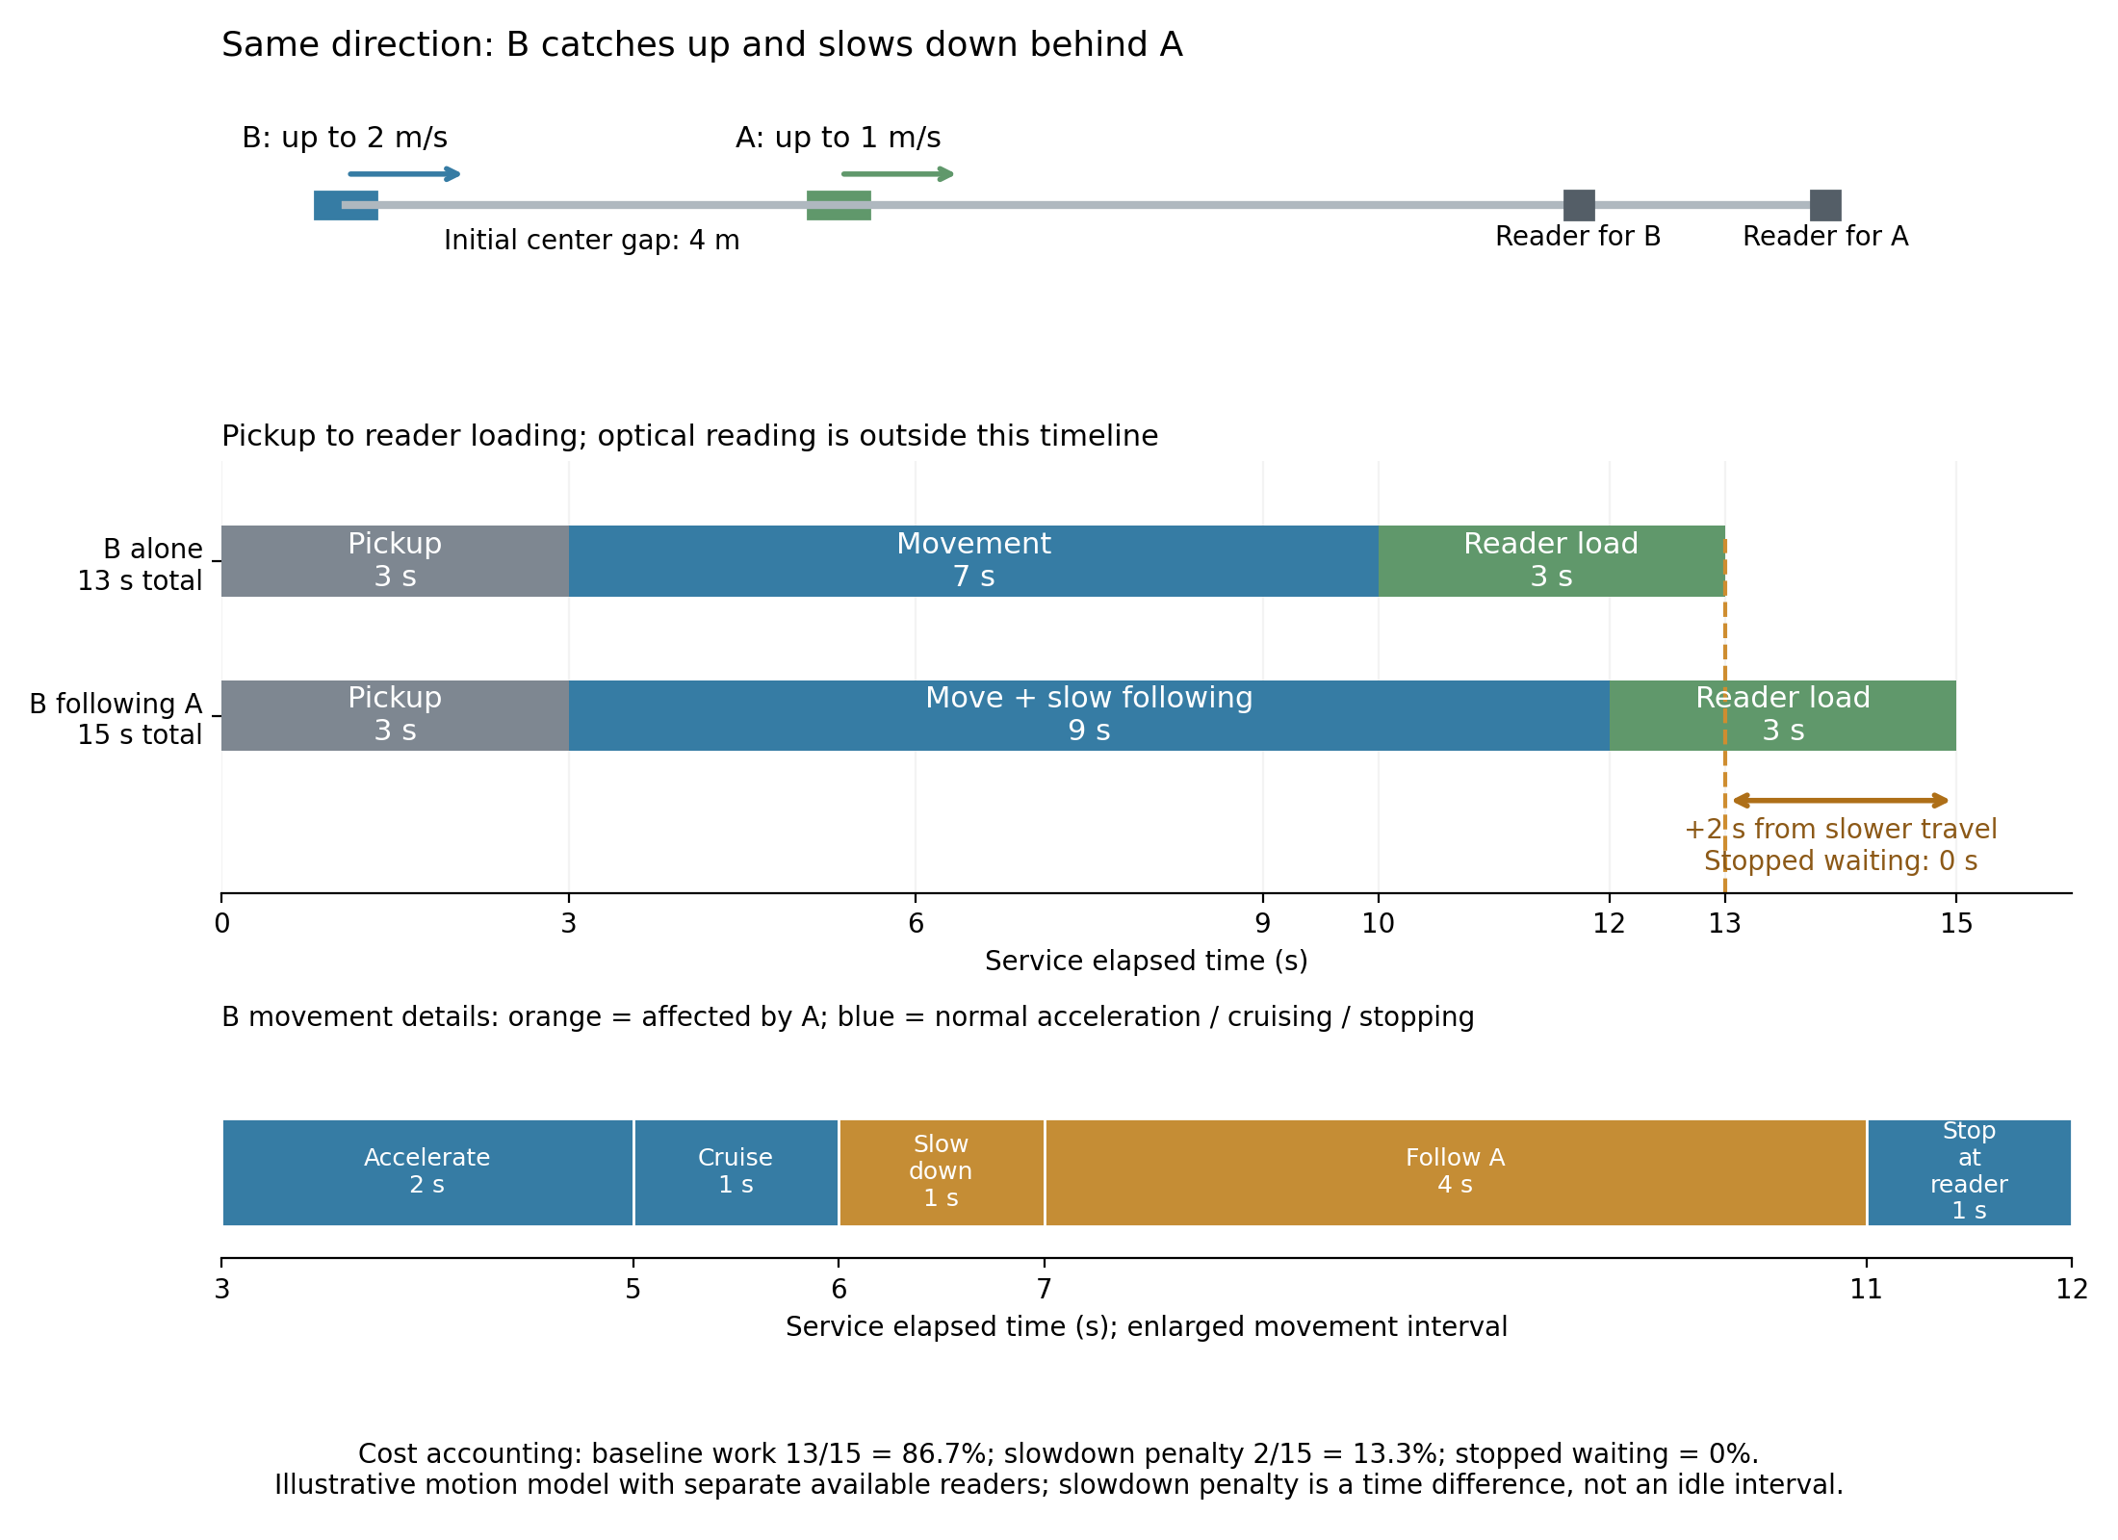
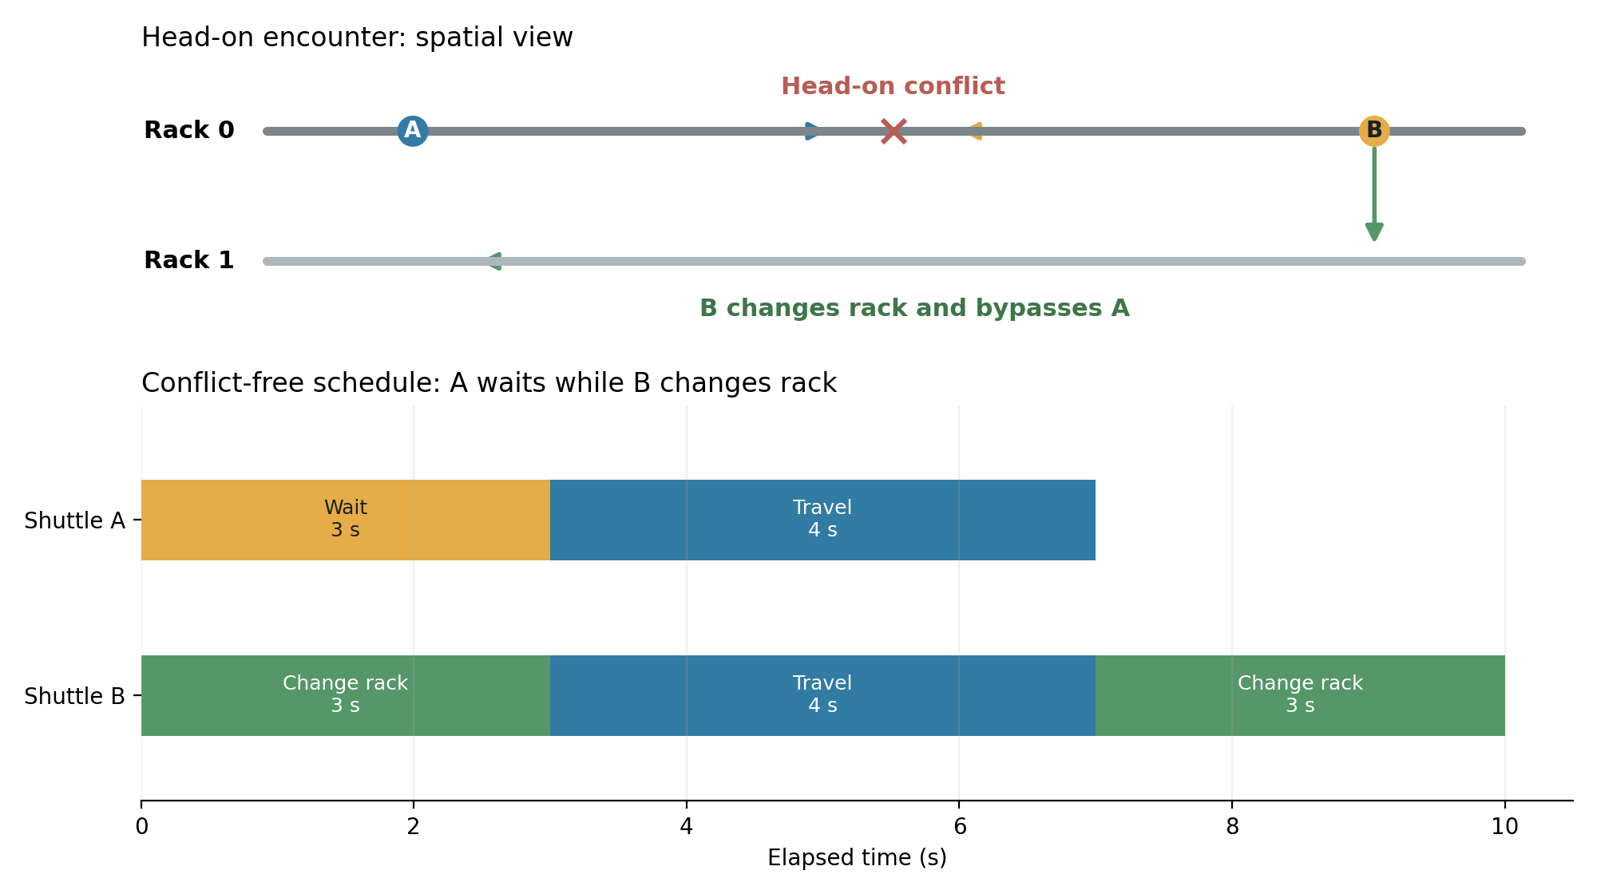
How Greedy No-Zone Handles Conflicts
Direct routes are delayed or detoured when shuttle trajectories overlap.
HEAD-ON ENCOUNTER
SAME-DIRECTION CATCH-UP
B changes rack; A waits until the original rack is clear.
The following shuttle slows or waits to preserve clearance.

Slide 7
Trace-Driven Experiment
Both policies receive the same requests and physical placement.
100,000
640
PANEL-SIDE LENGTH
Azure blob requests
Virtual platters
4 m
8 m
16 m
32 m
64 m
8 + 8
10
Preserved from the raw trace
Shuttles and readers
Paired placement seeds
Arrival time · request order · object identity · bytes
Physical glass locations are seeded synthetic mappings shared by both policies.

Slide 8
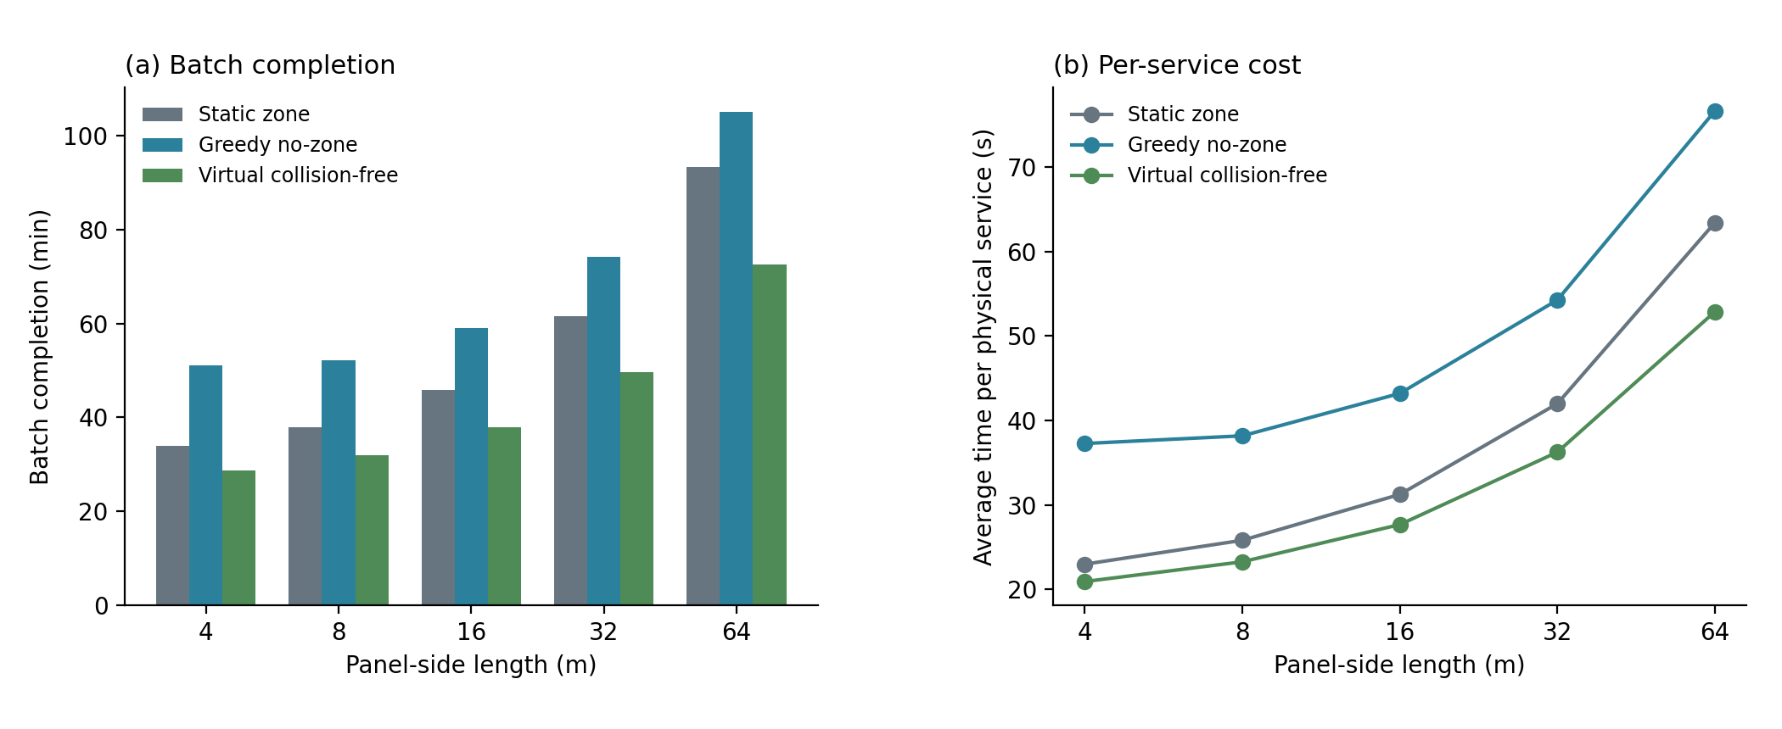
Unexpected Result: Greedy No-Zone Is Slower
Shared mobility lowers idle capacity, but p99 request latency remains higher.

Slide 9
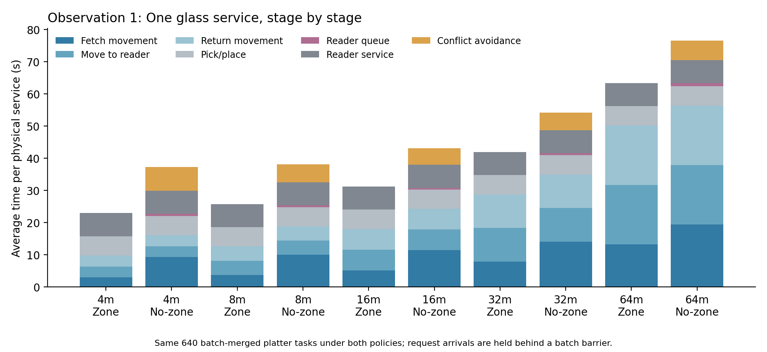
Why Is Greedy No-Zone Slower?
Each physical glass service becomes less efficient.

Slide 10
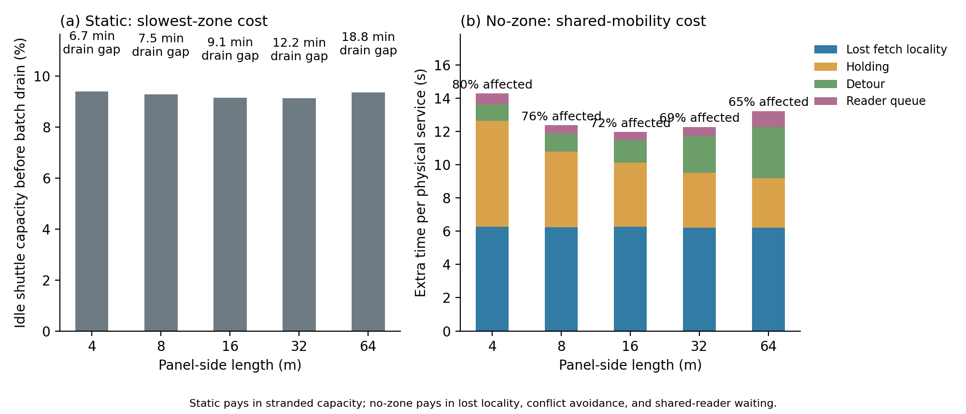
The Real Trade-off
Static pays in stranded capacity; No-Zone pays per service.
Higher shuttle utilization does not imply higher productive throughput.

Slide 12
Tail Latency

Slide 13
Tail Latency

Slide 14
REFINED RESEARCH MOTIVATION
Recover stranded capacity without sacrificing locality and traffic isolation.
1
2
3
4
Fair baseline
Locality-aware assignment
Bounded coordination
Feeder buffering
Allow the flexible scheduler to emulate Static Zone.
Choose task, shuttle, and reader by expected completion.
Plan only interacting shuttle paths in a short horizon.
Overlap platter transport with reader service when starvation dominates.
Zone provides more than collision avoidance: it also preserves movement locality.

