Slide 1
CAPACITY SCALABILITY IN GLASS STORAGE
DISK SCALE-OUT
More glass does not mean
more service bandwidth
capacity + I/O
capacity + I/O
capacity + I/O
Passive capacity can grow while readers and shuttles remain fixed.
GLASS SCALE-OUT
R
more media
same active service
Old intuition: capacity ↑ ⇒ throughput ↑
Glass reality: capacity ↑, service resources unchanged
Opening claim: glass decouples passive capacity from active service resources.
01
Notes:
這一頁不要重新介紹 Glass Library，而是直接推翻舊直覺。傳統 disk scale-out 雖然不一定線性成長，但新增裝置通常會帶來新的 I/O endpoint。Glass platter 是 passive media，新增容量不會自動增加 reader 或 shuttle。接下來要問的是：這種 capacity-service decoupling 會造成什麼效能結果？

Slide 2
RESEARCH SCOPE
Scale passive capacity; hold active hardware fixed
WHAT SCALES
WHAT REMAINS FIXED
1× → 32×
8 readers + 8 shuttles
Glass platters and storage slots
Reader throughput
Storage-rack footprint
Logical and physical work
Physical access range
Hardware provisioning
We do not optimize the reader/shuttle ratio in this study.
Goal: characterize performance degradation before proposing a movement-management design.
02
Notes:
研究範圍先固定 active hardware。我們不是要找最佳 reader/shuttle 配比，也不是用增加硬體解決問題。唯一擴充的是 passive capacity、slots 與 physical range。這能讓後續 throughput degradation 明確歸因到容量擴張下的服務成本。

Slide 3
CAUSAL MECHANISM
Capacity affects performance only when accesses span the enlarged library
1
2
3
4
More capacity
Longer reach
More movement
Lower throughput
More available
storage locations
Requested platters
can be farther away
Fetch and return
cycles get longer
The same batch
drains later
The pilot studies capacity-proportional physical access, not every possible placement or workload.
03
Notes:
這一頁把 capacity 和 throughput 的因果條件講清楚。不是 platter count 本身讓 throughput 下降，而是 request 所觸及的 physical range 隨容量擴張。若新增容量完全是 cold data，結果可能不同。這個限制應該主動說明，避免把條件式 observation 說成普遍定律。

Slide 4
CONTROLLED EXPERIMENT
The pilot changes capacity while preserving the work
Readers / shuttles
8 / 8
FIXED
Model boundary
Physical platter tasks
640
FIXED
Direct fetch–read–return cycle
Request size
64 MiB
FIXED
No prefetch or reader staging
Random seeds
10 paired runs
FIXED
No multi-shuttle collision model
Capacity scale
1×, 2×, 4×, 8×, 16×, 32×
SCALED
Paired normalized locations
Use this as mechanism evidence, not a production forecast.
All capacity points use the same logical and physical work.
04
Notes:
這頁是教授最容易檢查實驗是否公平的地方。所有 capacity points 都使用同樣的 640 個 tasks、相同 request size、相同 active resources 與 paired seeds。也要清楚說明目前沒有 prefetch、staging 與 collision，因此結果是 mechanism pilot，不代表真實 production Silica 的精確數字。

Slide 5
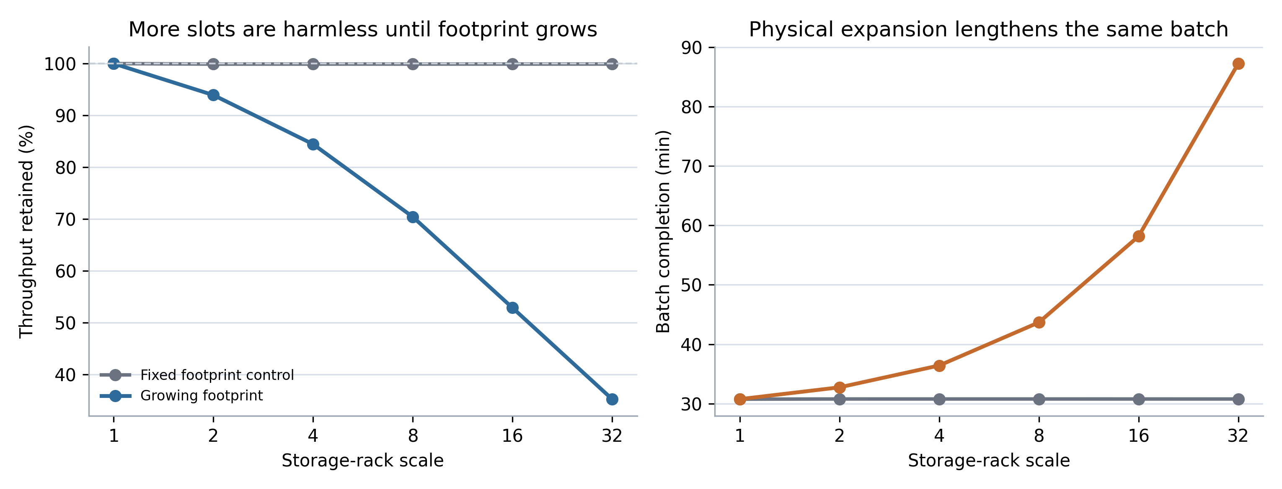
OBSERVATION 1
The same batch loses throughput as the access range expands
35.3%
throughput retained at 32×
Request count and bytes are unchanged
Reader and shuttle counts are unchanged
Batch completion increases from 30.8 to 87.2 min
Source: GLINT capacity-scalability pilot, 10 paired seeds.
Result: capacity-proportional access turns the same work into a longer batch.
05
Notes:
這一頁只講現象，不急著談 zone。相同 batch 在 32× capacity 只保留約 35.3% throughput。因為 requests 和硬體都固定，所以 throughput loss 必須來自每次 service cycle 的時間增加。下一頁再分解原因。

Slide 6
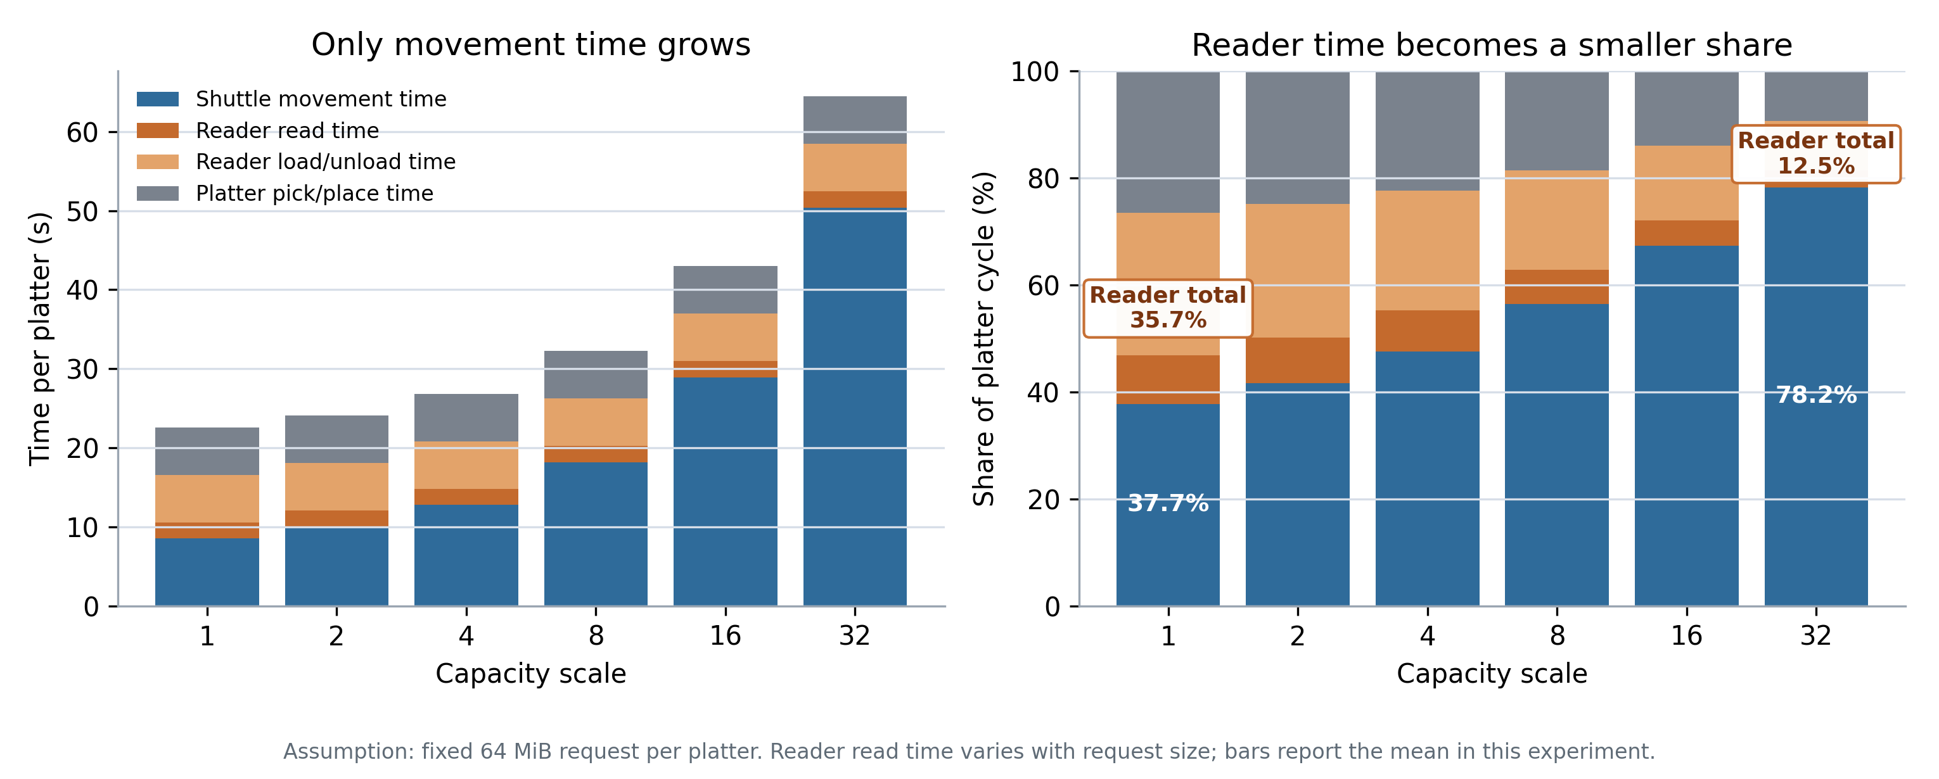
OBSERVATION 2
Movement—not reader work—is the growing component
1× → 32×
Movement
8.53 → 50.39 s
Reader total
35.7% → 12.5%
The reader is not slower. More of every cycle is spent moving media.
Assumption: fixed 64 MiB request; read time varies with request size.
Movement grows from 37.7% to 78.2% of the platter cycle.
06
Notes:
這張圖解釋 throughput loss。Reader read、load/unload 和 platter pick/place 都固定，只有 shuttle movement 從 8.53 秒增加到 50.39 秒。系統不是 reader 變慢，而是每個 cycle 花在 reader 的比例越來越低。這一步只帶出 movement management 重要，還不能直接推論 zone 必要。

Slide 7
LOGICAL CHECKPOINT
Long movement does not automatically imply that zoning is needed
LONG BUT CONFLICT-FREE
OVERLAPPING PATHS
!
Movement latency
Traffic congestion
One shuttle can travel far without blocking another shuttle.
Zoning addresses shuttle interactions—not physical distance by itself.
Next question: does scaling create enough shuttle interaction to justify spatial isolation?
07
Notes:
這一頁防止邏輯跳躍。長距離 movement 只代表 latency 增加，不代表一定發生 congestion。Zone 解決的是多 shuttle 互相阻擋與 traffic-management complexity，而不是距離本身。因此下一步必須建立 collision-free traffic model，才能判斷 zone 是否真正有價值。

Slide 8
ZONE-BENEFICIAL SCENARIO
Zoning is effective when traffic is dense and work is balanced
ZONE-FRIENDLY CONDITIONS
Many shuttles move concurrently
Paths compete for shared rails or readers
Post-merge work is spatially balanced
Predictable tail latency matters
Expected benefit
less blocking + simpler traffic control
Independent traffic domains
Prior evidence: Project Silica, SOSP 2023, §7.5.
Zone benefit comes from avoiding congestion while keeping all partitions useful.
08
Notes:
Zone 最適合的場景是 traffic 很密集，同時 workload 又能平均落在各區。這時 spatial isolation 能減少 blocking，且不會留下大量 idle resources。這是我們預期的 zone-beneficial region，但在目前 simulator 尚未有 collision model，所以先標成 hypothesis。

Slide 9
ZONE-HARMFUL SCENARIO
Static zoning becomes costly when demand and boundaries diverge
POST-MERGE WORK BY ZONE
one owner remains busy
ZONE-UNFRIENDLY CONDITIONS
Shuttle traffic is naturally sparse
Requests concentrate in a few zones
Hot regions move over time
seven owners become idle
Idle resources cannot help busy owners
Expected cost: stranded capacity and a longer batch tail
Z0
Z1
Z2
Z3
Z4
Z5
Z6
Z7
Static ownership is useful only when its traffic benefit exceeds its resource-fragmentation cost.
09
Notes:
Static zone 的代價是 ownership fragmentation。只要 request 分布和 boundary 不一致，一個 owner 可能持續忙碌，其他資源卻無法幫忙。這頁不要宣稱某一個 skew threshold 已經確定，只呈現我們已經理解的 causal mechanism，下一步再找 crossover。

Slide 10
UNRESOLVED RELATIONSHIP
Capacity growth can make zoning less necessary—or more necessary
SPATIAL DILUTION
LONGER ROUTE OCCUPANCY
Larger area
Longer trips
↓
↓
Lower shuttle density
Paths remain active longer
Zone may matter less
Zone may matter more
Which effect dominates under fixed readers and shuttles?
Capacity is an amplifier; traffic concurrency and spatial demand determine the zoning outcome.
10
Notes:
這是 capacity 和 zone 的真正橋接。固定 shuttle 數量下，面積變大會降低空間密度，可能減少 encounters；但更長的 trips 也讓 rails 被占用更久，reader 入口的共同瓶頸仍存在。因此 capacity 越大到底越需要 zone 或越不需要，不能先假設，必須實驗量測。

Slide 11
POSSIBLE RESEARCH DIRECTION
Prevent interaction—or coordinate it?
STATIC ZONING
CONTROLLER COORDINATION
Prevent interaction
Coordinate interaction
✓
Allow movement when paths do not conflict
Simple and predictable
but idle resources cannot cross boundaries
More flexible
but online scheduling has a cost
Can we keep movement conflict-free without permanent shuttle ownership?
Research direction: preserve conflict avoidance while recovering resource flexibility.
11
Notes:
這一頁提出一個新的研究方向。Static zone 是用永久限制移動來避免 shuttle interaction，優點是簡單、可預測，缺點是空閒資源不能跨區幫忙。另一個方向是讓 controller 只在路徑真正衝突時進行協調，沒有衝突時仍允許跨區服務。這不代表 controller 一定更好，因為即時 scheduling 也有計算與 traffic overhead。我們真正要問的是：能否在維持 conflict-free movement 的同時，避免 permanent ownership restriction？

