Slide 1
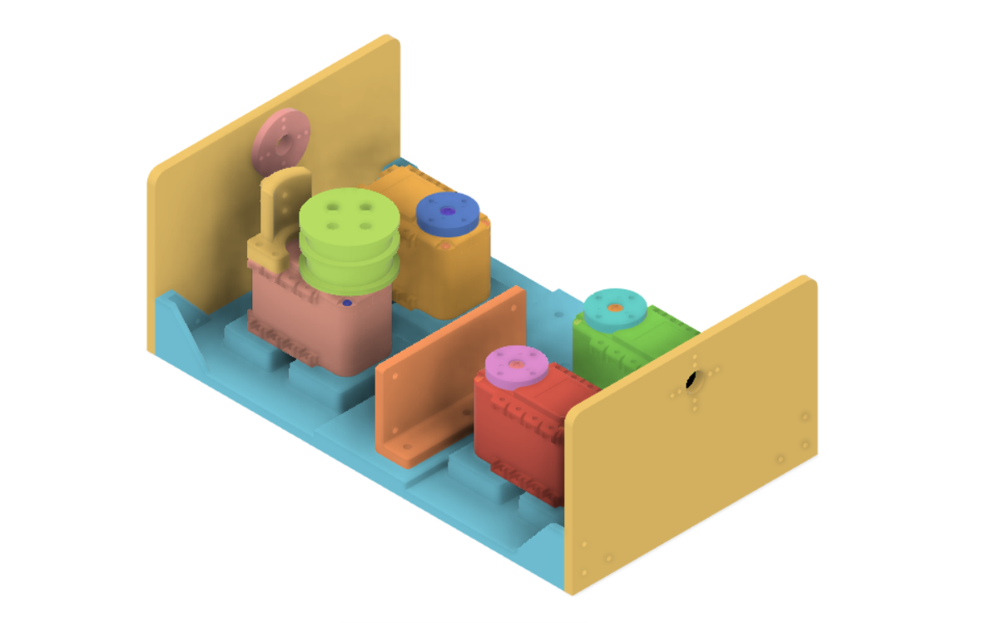
Spacer
Wire path fixer 1
Wire path fixer 2
AX_12 motor
Bottom panel
Side panel
Raspberry Pi supporter

