Slide 1
Updates to RODAN Gamera Interactive Classifier
Minh Anh Nguyen
DDMAL
McGill University
Montreal, Canada
SIMSSA Workshop XIV
May 28, 2018

Slide 2
History
Originally a part of Gamera, a framework for document analysis applications by Karl MacMillan, Michael Droettboom, and Ichiro Fujinaga
Gamera classifier is a standalone application
Implemented as a RODAN job in 2014 by Andrew Fogarty and extended by Sacha Perry-Fagant and Alex Daigle in 2017
Tested and used by SIMSSA project co-investigator Jennifer Bain and collaborator Inga Behrendt
Michael Droettboom, Ichiro Fujinaga, Karl MacMillan, G. Sayeed Choudhury, Tim DiLauro, Mark Patton and Teal Anderson. “Using the Gamera framework for the recognition of cultural heritage materials.” JCDL (2002)
Notes:
Gamera functionalities imported as Rodan jobs
Still in progress
Users provide valuable feedback: issues, enhancements

Slide 3
Interactive Classifier
A tool for classifying symbols
Two-part classification
Manual correction
Automatic correction
Notes:
Any symbols: numbers, letters, music notation
In our case: neumes from medieval music

Slide 4


Interactive Classifier in OMR
Document Analysis
Interactive Classifier
Pitch
Finding
Notes:
Pixel: neume layer -> connected components
Classify -> pitch finding, rendering

Slide 5
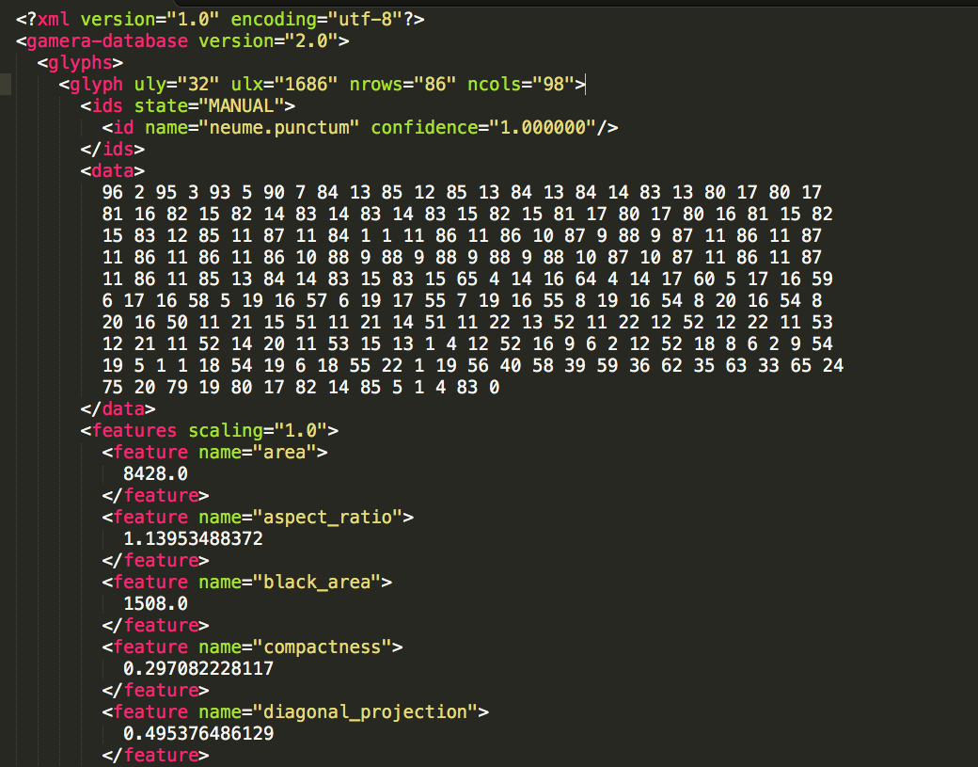
GameraXML
Notes:
data: image
state, name, confidence
features: used for automatic classification

Slide 6
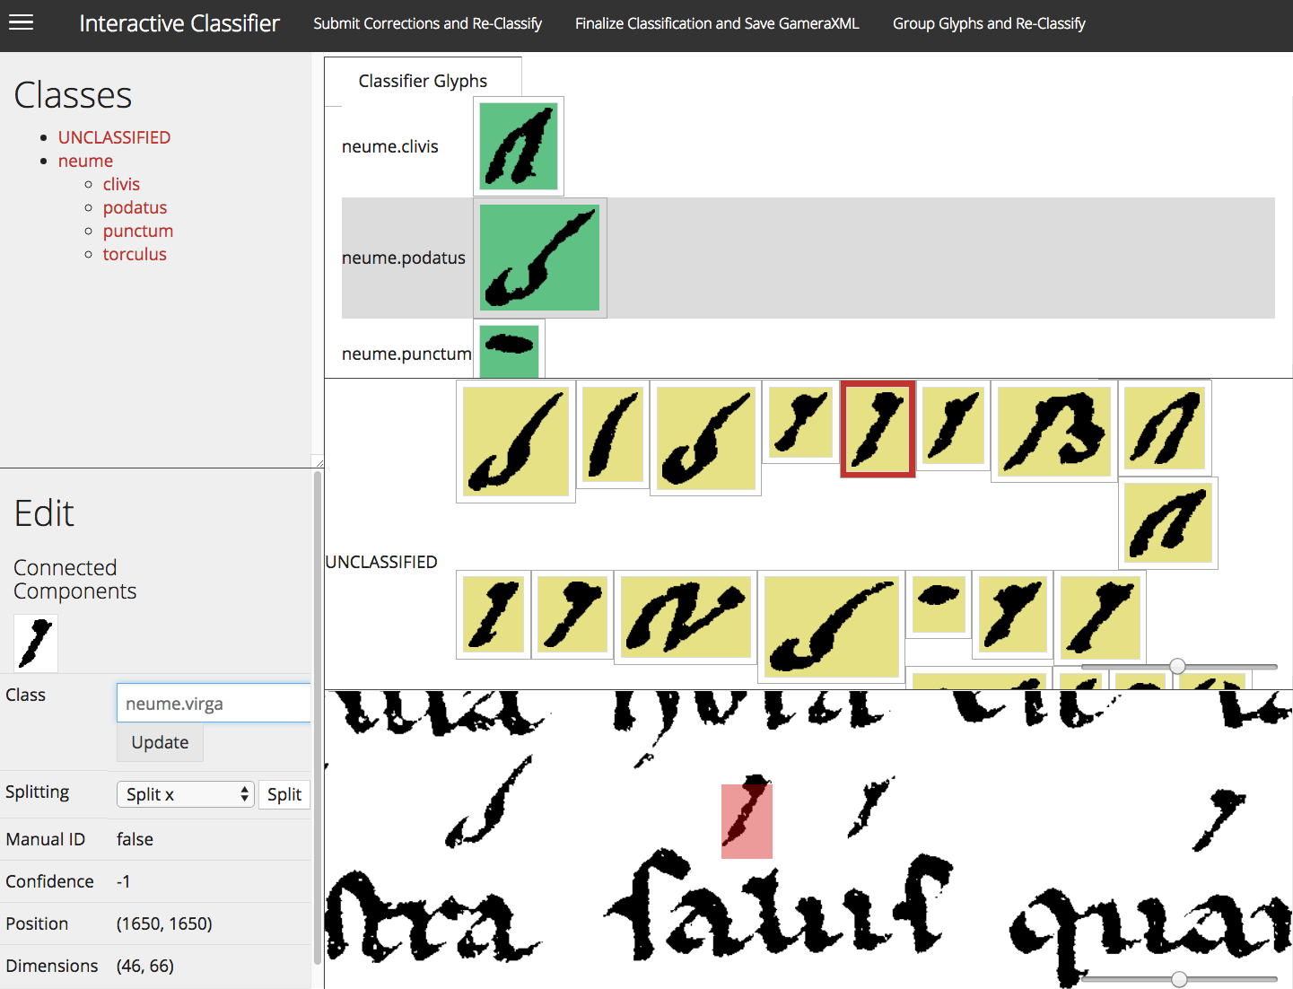
Manual Correction
Assign classes
Delete classes
Rename classes
Group glyphs
Split glyphs
Notes:
Launches a browser window for user
confidence: 1

Slide 7
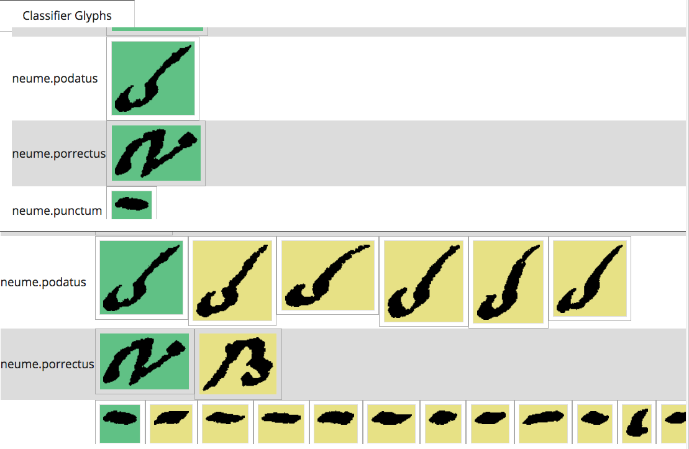
Automatic Correction
Uses the k-nearest neighbors algorithm
Match each glyph to the model with the most similar features
Each matching has a confidence rating
Notes:
Given classifier models, attempt to classify the rest

Slide 8
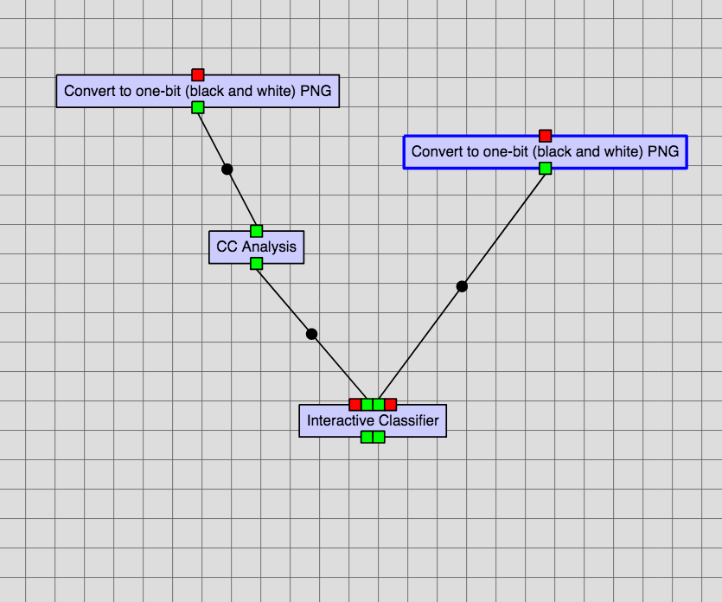
Interactive Classifier in a RODAN workflow
Inputs:
Connected components
Preview image
Training data
Feature selection
Outputs
Classified glyphs
Training data
Notes:
Connected components: 1-bit PNG, all glyphs to be classified from Pixel
Preview image: color PNG
Training data: manually classified models from prev job
Feature selection: features and weights
Classified glyphs: GameraXML all classified glyphs
Training data: to chain multiple IC jobs

Slide 9
Advantages Over a Complete Manual Classification
Faster than solely manual classification
User can switch between automatic correction and manual correction
User can control the number of iterations
Can classify all types of symbols
Notes:
only need to give 1 or 2 models
all symbols: neumes

Slide 10
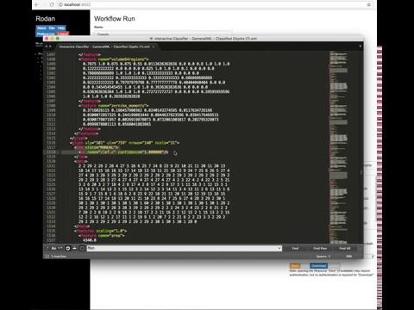
Demo

Slide 11
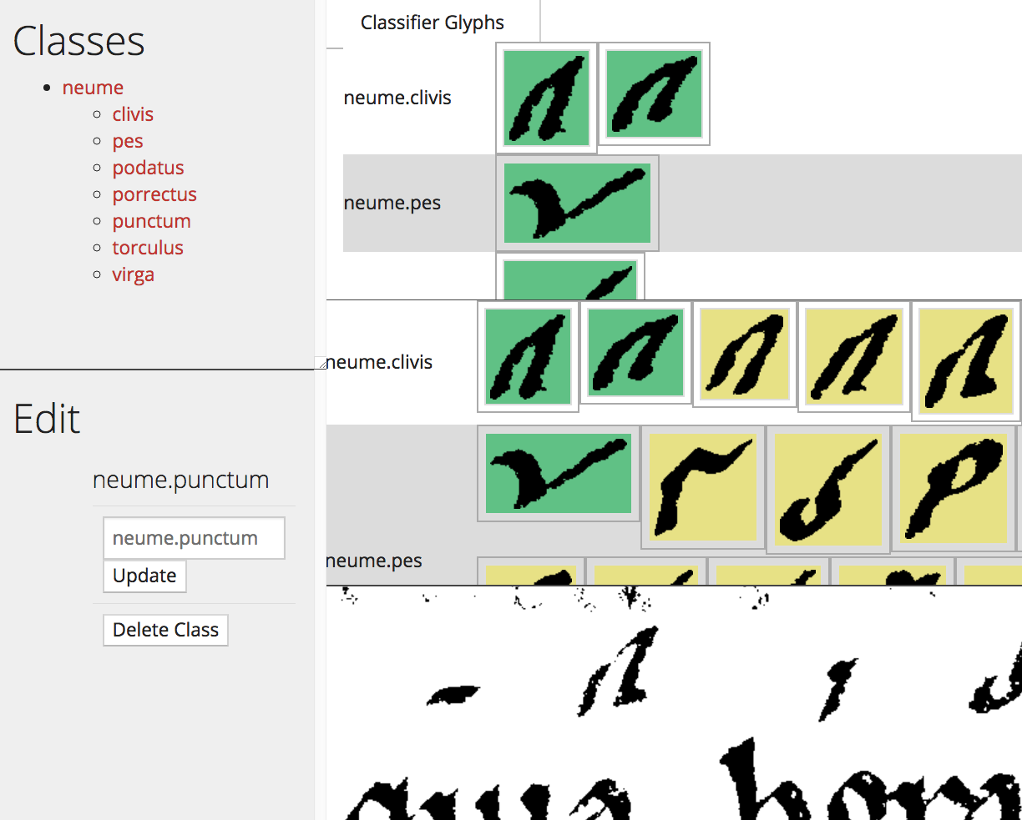
Current Work
Sanitize class names
Fix logical errors
Ability to delete a class
Ability to rename a class
Notes:
No empty or Unclassified class names
Reset the view after events
Delete & rename requested by musicologists

Slide 12
Future Enhancements
Ability to import and save classes and subclasses
Ability to delete glyphs
Ability to display colour preview images
Implement the classifier optimization as a RODAN job
Fix issues suggested by users
Notes:
Issue: saving grouped components

Slide 13

Thank you

