Slide 1
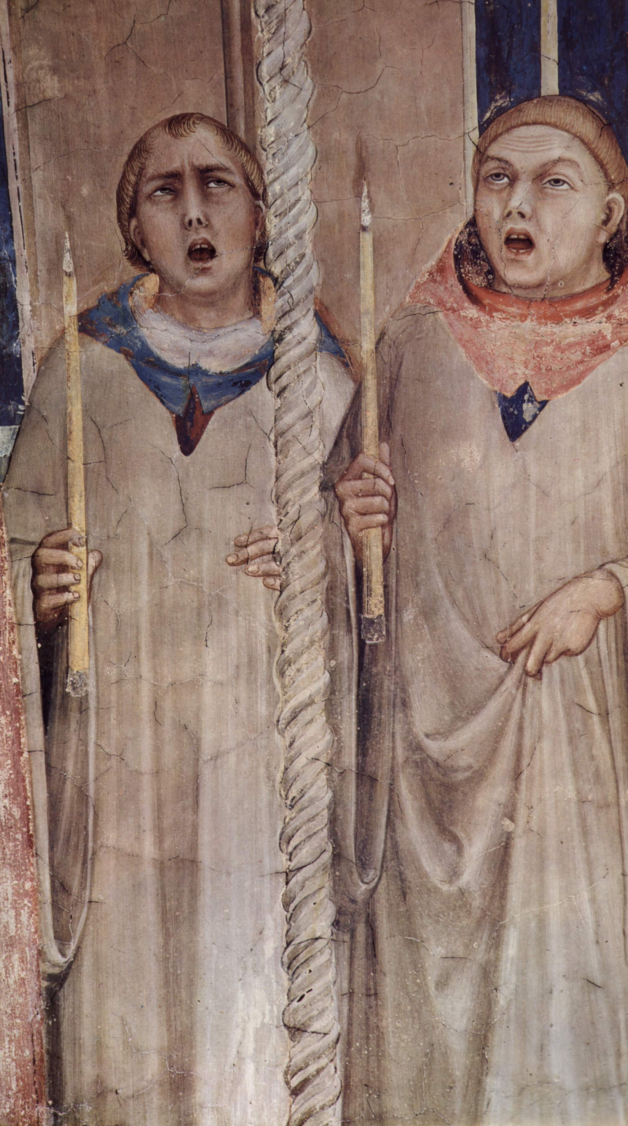
Whose Line is it Anyway?
Assessing melodic features of mode in polyphony
Claire Arthur, Julie Cumming, Peter Schubert
CIRMMT Workshop on Digital Musicology
April 27th, 2018
McGill University

Slide 2
À La Mode
Debates on the nature of mode in polyphonic music are as popular now as they were in the 16th century:
Did composers deliberately compose “in the modes?”
Which musical features best create a sense of mode?
Does the plagal-authentic distinction apply to polyphonic works?
If so, which voice or melodic “line” carries the role of P/A “identifier?”
Notes:
Mode is a term or concept that is inherently linked to melody and has its origins in chant (which is of course a monophonic tradition).
Common questions include…

Slide 3
A Computational Approach
Corpus investigation of a set of polyphonic duos
44 Renaissance duos with “secure” modal labels:
Pieces used as illustrations in treatises or taken from (labeled) didactic collections.
Lasso (1577/1995), Zarlino (1558), Pontio (1588) deliberately composed new duos to illustrate modes.
Glarean (1547) used pre-composed or commissioned works to illustrate modes.
Notes:
The pieces were used in the treatises as illustrative of mode or else were taken from didactic collections…

Slide 4
Corpus of Duos
Collection | Zarlino | Lasso | Pontio | Glareanus
Number of duos | 8 | 12 | 9 | 15
Mode | 1 | 2 | 3 | 4 | 5 | 6 | 7 | 8
Number of duos | 7 | 8 | 5 | 2 | 5 | 6 | 5 | 6
Notes:
Mode Families: 15 7 11 11
*

Slide 5
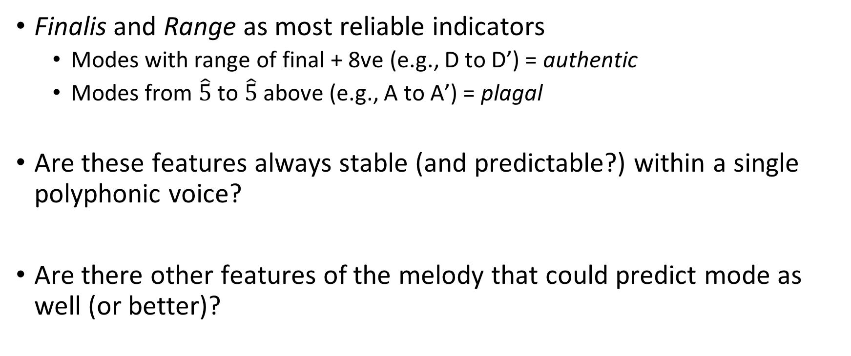
What Determines Mode?
Finalis and Range as most reliable indicators
Modes with range of final + 8ve (e.g., D to D’) = authentic
Modes from $\hat{5}$ to $\hat{5}$ above (e.g., A to A’) = plagal
Are these features always stable (and predictable?) within a single polyphonic voice?
Are there other features of the melody that could predict mode as well (or better)?
Notes:
Re: info about criteria for plagal and authentic:
“These criteria were well established by the beginning of the eleventh century” (Cohen 2002).
+

Slide 6
The Modal Features of a Line
Marchetto of Padua (ca. 1317) illustrates the importance of highlighting bounding notes of a species through melodic leaps and outlines:
The first mode according to Marchetto. We add brackets to show leaps (below) and outlines (above).
Notes:
Music theorists have often claimed, however, that it is not solely the finalis and range that determines mode, but that leaps within a melody and “turning points” (outlines) are largely responsible for establishing the mode by highlighting the boundary pitches of the principal interval species (species of 4ths and 5ths; in other words the location of the semitone)
[define leaps and outlines & mention the contention of leap as 3rd or 4th and that you’ll come back to it.]
Notice that an outline can also be a leap**
Most of the leaps(below) and outlines (above) in Example 1 are between D and A, but there is one outline between G3 and D4 that contradicts the basic principle (shown in red).
*

Slide 7
The Hypothesis
Notes forming melodic leaps and outlines function as “structural tones”
salient features of musical surface; carry modal significance
Tallies of pitches forming leaps/outlines can be used to predict mode.

Slide 8
Methodology
Pieces reduced to set of tables containing pitch contents of leaps and outlines.
Two “rounds” of guessing mode of each piece: Information about interval size, leap/outline direction, and register/range is either…
Eliminated (focus on pitch class content.) Study 1
Retained Study 2
Two methods to evaluate hypotheses:
Regression modeling
Behavioral experiments (i.e., “expert guesses”)
Notes:
IMPORTANT (FROM PAPER):
“Note that the theorists suggest that one ought to compose in such a way that focuses on
leaps and outlines of fourths and fifths, particularly emphasizing notes that form the
boundary tones of the appropriate interval species (or mode). While we could simply count
only leaps or outlines of fourths and fifths, this fails to evaluate the underlying assumption
that composers did compose in this way. That is, by only counting such leaps and outlines
we might find that those notes do align with the theoretical prediction, but it could also be
the case, for instance, that there are just as many leaps and outlines of thirds, sixths and
sevenths. How, then, could we argue that fourths and fifths are privileged? If leaps and
outlines are meant to be used in a way that highlights the mode, then it would be prudent
to investigate all leaps and outlines. This is the approach we take here.”

Slide 9
Methodology
Example table from Study 1:
 |  | A | B | C | D | E | F | G
Upper Voice | Leap Endpoint | 8 |  | 3 | 9 | 4 | 5 | 3
 | Outline | 8 |  | 5 | 6 | 5 | 1 | 3
Lower Voice | Leap Endpoint | 6 | 3 | 6 | 11 | 4 | 4 | 3
 | Outline | 8 | 3 | 2 | 6 | 9 | 2 | 4
 | Total | 30 | 6 | 16 | 32 | 22 | 12 | 13
Notes:
Explain the methodology:
2 Experts were given the complete set of tables, and challenged to guess a single mode (1 through 8) for each table.
The set of tables was used in a multinomial regression model > each row tested independently; counts used as predictor variables; possible interactions were limited based on theoretical predictions to avoid over-fitting the models to our small data set. Train and test procedure: randomly selects piece from each mode family and puts aside for testing, remainder goes to training the models. This is repeated 100x and the results are an average of the performance across all iterations.

Slide 10
Results: Study 1
Expert Guesses:
Chance accuracy at mode* = 12.5%; Chance accuracy at mode family = 25%
Expert mode accuracy = 35%; Expert mode family accuracy 65%
Overall expert agreement = 86%
Notes:
Remind: there are 8 modes, there are 4 mode “families” (modes that share a final.)
“Notice that with a 65% accuracy rate for
correctly predicting the mode family, and a subsequent guess of the mode (authentic or
plagal) having a 50/50 probability, that an overall accuracy level based on simply guessing
authentic/plagal after identifying mode family would be approximately 32.5 (or half of 65),
which closely approximates our experts’ accuracy at exact mode prediction.”

Slide 11
Results: Study 1
Regression Models:
Baseline accuracy at mode* = 18%; Baseline accuracy at mode family* = 34%
Model mode accuracy = 30-36%; Model mode family accuracy 62-67%
Notes:
There was no single voice or musical feature (leaps or outlines) that best predicted mode family. (Best models all used rows of “totals” data) However, best models all used the data that classified leaps as a fourth-or-greater

Slide 12
Results: Study 1
Summary:
Regression models and experts perform with roughly equal accuracy
Classifying mode & mode family with better-than-chance accuracy using only tallies of leaps and outlines.
However, distinguishing plagal vs. authentic may require additional information…
Notes forming leaps/outlines are very poor predictors of mode*
Notes:
Although there are 8 modes, there are 4 mode “families” (modes that share a final.) [should this go earlier?]
“Notice that with a 65% accuracy rate for
correctly predicting the mode family, and a subsequent guess of the mode (authentic or
plagal) having a 50/50 probability, that an overall accuracy level based on simply guessing
authentic/plagal after identifying mode family would be approximately 32.5 (or half of 65),
which closely approximates our experts’ accuracy at exact mode prediction.”
*Based on our particular measure, which was as simple tallies of pcs*

Slide 13
Methodology
Example table from Study 2:
From/To | C3 | D3 | E3 | F3 | G3 | A3 | B3 | C4 | D4 | E4 | F4 | G4 | A4
C3 | X |  | 1 | 1
D3 |  | X |  | 2 | 2 | 2 |  |  | 1
E3 |  |  | X |  | 3 | 3 |  | 1
F3 |  | 5 |  | X |  |  |  |  |  |  | 1
G3 |  | 1 | 6 |  | X |  |  | 3
A3 |  |  |  | 3 |  | X |  | 4 | 4
B3 |  |  |  |  |  |  | X |  | 1 | 1
C4 |  |  |  |  |  | 6 |  | X |  | 1
D4 |  |  |  |  |  | 1 | 2 |  | X |  | 2 | 1 | 2
E4 |  |  |  |  |  | 1 |  | 1 |  | X
F4 |  |  |  |  |  |  |  |  | 3 |  | X
G4 |  |  |  |  |  |  |  |  |  | 3 |  | X
A4 |  |  |  |  |  |  |  |  | 1 | 1 |  |  | X
Total |  | 6 | 7 | 6 | 5 | 13 | 2 | 9 | 10 | 6 | 3 | 1 | 2
Notes:
Marchetto points out the role of the pitches, species, size, and direction of the interval, as well as the range in which the leap or outline occurs. Our hypothesis was that if this additional information aligned …Since direction and size of intervals, and range, are missing from our first set of tables (Study 1), we sought to evaluate the predictive power of a set of tables that would retain this information. with the theoretical predictions, it would dramatically improve our experts’ modal predictions.

Slide 14
Results: Study 2
No regression modelling (too many parameters for too little data)
Experts’ overall ability no better than in Study 1!
Expert Guesses:
Expert mode accuracy = 39%; Expert mode family accuracy 61%
Overall expert agreement = 70%*
Summary: having additional melodic information doesn’t help ID mode family; marginally helpful for distinguishing plagal/authentic (i.e. mode)
Notes:
e.g., We have pitch instead of pitch class in study 2.
*Each expert got a different set of tables (1) based on leaps as >= minor third (2) >= P4. Since they performed with such similarity the first time around, we felt it was safe to give them different data and see if one resulted in better performance… it didn’t.

Slide 15
Summary Evaluation
Leaps/outlines are poor predictors of mode; decent predictor of mode family?
Compared with WHAT?
Pitch classes do not appear with equal frequency (e.g., Temperley, 2007), therefore, “chance” not really appropriate comparison.
Accordingly…
Notes:
As with any empirical investigation, an important question is: against what are we comparing the evidence? In our studies, we first evaluated the success (or failure) of our experts and our models based on greater-than-chance accuracy. This is a common approach..the fact that our experts (and models) were still able to use this to deduce the mode with a rate of accuracy greater than we would expect by chance, might seem to provide evidence in support of our hypothesis.
*

Slide 16
Comparison Sets
Regression results from Study 1 compared against predictive power of two alternative “comparison” data sets:
Comparison set #1: Only melodic motion by step (i.e., “remainder”)
Comparison set #2: Complete counts of all pcs (i.e., pc distribution)
Notes:
Study 1: instead of assuming that some notes are privileged, we looked at the predictive power of (a) the notes we initially left out (which is all stepwise motion) and then (b) ALL notes.
Study 3: instead of assuming that some intervals are privileged, we looked at the predictive power of (a) the consonant intervals we initially left out (dissonances are likely treated differently) and then (b) ALL intervals built above any note which amounts to the equivalent of the PC distribution of the lower voice.)

Slide 17
Summary
Melodic Data: Studies 1 and 2
Regression model | Mode | Mode family
test data: leaps and outlines | 36% | 67%
comparison set 1: remainder notes | 39% | 68%
comparison set 2: pc distributions | 45% | 71%
Experiment w/ experts
experiment 1: pc tallies | 35% | 65%
experiment 2: pitch, interval size & direction | 39% | 61%
Full score experiment | 67.5% | 100%

Slide 18
Conclusions
We suggest the authentic/plagal distinction is not clearly marked in polyphonic music
Subsequent analyses show the traditional “measures” of range not used predictably (e.g. only 11/44 duos have both voices with same range).
Our findings did not align with the theory about the significance of leaps and outlines…but…

Slide 19
Word(s) of Caution
Our data set was very small! (Only 44 duos)
The proportion of commixture is unknown

Slide 20
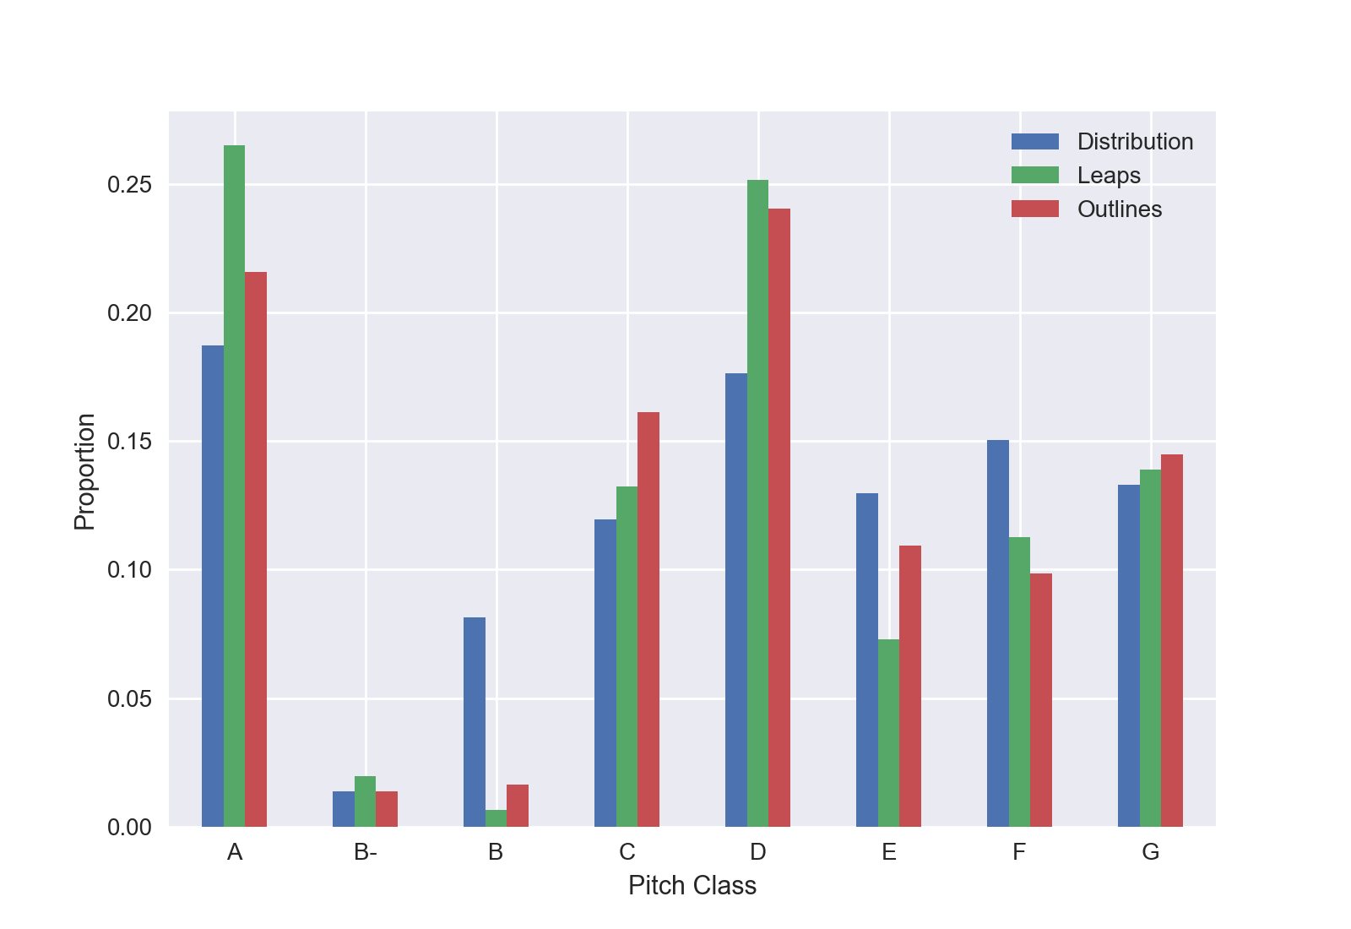
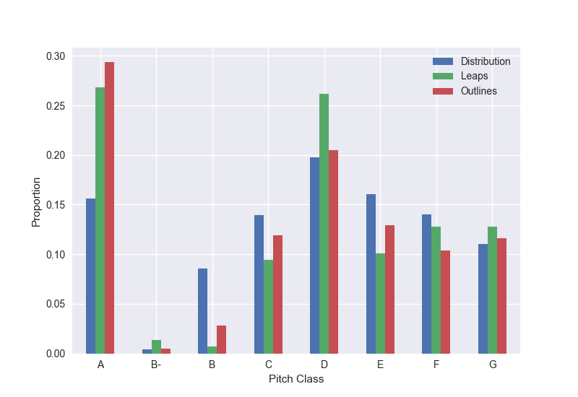
Mode 1 (Dorian)
Mode 2 (Hypodorian)
Notes:
That this pattern emerges from “Example 5”, yet fails to prove useful in our
regression model, suggests that these patterns may not be as strong throughout the
remaining mode families; or, it may simply be that these graphs aggregate all the pieces
together into a single collection, whereas our model evaluates the pieces individually.

Slide 21
Conclusions
Leaps and outlines may still indicate mode family (more work needed!)
Consistent with notion that plagal-authentic distinction had no clear definition in 16th century polyphony.
Notes:
*even in pieces CHOSEN or COMPOSED to illustrate the modes!
This notion (of an imaginary distinction), was, in fact admitted by a select few theorists (e.g. Sebald Heyden, 1540)
CUT:
Of our three test sets, harmonic intervals proved greatest predictors
(though pc distributions still proved equally predictive overall)

Slide 22





Thank You!

Slide 23
How to Measure Optimal Performance?
“Baseline” performance can be calculated for regression…
Experts should perform with “optimal” accuracy at task if given complete score…
100% mode family accuracy; 67% mode accuracy!
Notes:
While “baseline” performance can be calculated for regression, we can’t really calculate an “optimal” performance.
However, we can assume that for our experts, they would perform with “optimal” accuracy at this task if they had access to the complete score.
(This “optimal performance” experiment demonstrated just how difficult this task is, even when experts have access to the full score where the full set of information is available.)

Slide 24
The Modal Features of a Line
Marchetto of Padua (ca. 1317) illustrates the importance of highlighting bounding notes of a species through melodic leaps and outlines:
The eighth mode according to Marchetto. We add brackets to show leaps (below) and outlines (above).
Notes:
the eighth mode is expressed by the emphasis on C4 descending to G3. However, outlines in red contradict the basic principle, while outlines in orange show that ascending G3 to C4 is just as common (However, in two cases here, our brackets do not align with slur-markings from Marchetto
This is of course, originally for CHANT (and was transcribed in chant notation.)
[of course, we use Marchetto here only as an illustration. We don’t actually include Marchetto (or any monophonic examples) in our corpus, but as will be discussed, phrase boundaries are taken into consideration in our corpus.]
our study aims to find out to what extent composers adhered to “correct” modal behavior ***

Slide 25
Results: Study 1
Regression Models:
Baseline accuracy at mode* = 18%; Baseline accuracy at mode family* = 34%
Model mode accuracy = 30-36%; Model mode family accuracy 62-67%
Consistent model features predicting
mode:
Leaps ≥ P4
Consistent model features predicting
mode family:
Leaps ≥ m3
Outlines in upper voice
Notes:
There was no single voice or musical feature (leaps or outlines) that best predicted mode family. (Best models all used rows of “totals” data) However, best models all used the data that classified leaps as a fourth-or-greater

Slide 26
…One More Study…
Vertical intervals!
Ramis de Pareia (1482), and Tinctoris (1444) comment on significance of perfect vertical intervals
From Ramis: Dorian organization of the upper line according to Ramis
Notes:
-this goes beyond the scope of the title, but it was an integral part of our study, so I’m going to tell you about it.
-Peter Schubert thought this was important too, so we wanted to test it.
He shows two examples of noteagainst-
note counterpoint above a Dorian cantus firmus. He comments that the second one (shown here)
exhibits the “organization” of the Dorian mode (Ramis 1482, 128). We can see in this
example, that it contains three vertical D octaves and two fifths below D. Thus the
added line emphasizes D4 and is implicated in five perfect intervals involving D.

Slide 27
The Modal Features of a Line
Marchetto’s examples are monophonic but theory later applied to polyphonic pieces:
Followers in this tradition include: Tinctoris (1476), Aron (1525), Glarean (1547), Zarlino (1558), and Aiguino (1581).

Slide 28
…One More Study…
Hypothesis: Tallies of pitch classes forming perfect intervals can be used to predict mode.
Evaluation: Regression modeling; Experiment with experts
Example Table:
Vertical Intervals | A | B | C | D | E | F | G
P1 | 1 |  |  |  |  |  | 1
P5 | 1 |  | 4 | 8 | 5 | 3 | 12
P8 | 2 | 1 | 3 | 5 | 3 | 2 | 2
Total | 4 | 1 | 7 | 13 | 8 | 5 | 15
Notes:
Example table shows the number of perfect intervals built on (or forming the bottom of) the given PC that formed either unisons, fifths or octaves. So, for instance, there is a single instance of a P5 on A in this piece while there are 12 built on G (or, alternatively, that have D as the upper note.)

Slide 29
Results: Study 3
Regression Models:
Mode accuracy = 38-41%; Mode family accuracy 63-70%
Expert Guesses:
Mode accuracy = 40%; Mode family accuracy 70%
Agreement: 80%
Notes:
There was no single voice or musical feature (leaps or outlines) that best predicted mode family. (Best models all used rows of “totals” data) However, best models all used the data that classified leaps as a fourth-or-greater

Slide 30
Comparison Sets
Regression results from Study 1 and 3 compared against predictive power of two alternative “comparison” data sets:
Study 1
Comparison set #1: Only melodic motion by step (i.e., “remainder”)
Comparison set #2: Complete counts of all pcs (i.e., pc distribution)
Study 3
Comparison set #1: Imperfect consonances (i.e., “remainder” consonance)
Comparison set #2: PC count from lower voice (i.e., all intervals)
Notes:
Study 1: instead of assuming that some notes are privileged, we looked at the predictive power of (a) the notes we initially left out (which is all stepwise motion) and then (b) ALL notes.
Study 3: instead of assuming that some intervals are privileged, we looked at the predictive power of (a) the consonant intervals we initially left out (dissonances are likely treated differently) and then (b) ALL intervals built above any note which amounts to the equivalent of the PC distribution of the lower voice.)

Slide 31
Some Known Problems
Commixture
Notes:
This slide should come later

