Slide 1
The Power of Rodan
Full Optical Music Recognition Workflow with Rodan
Alex Daigle
Notes:
Where we will explore the full end to end OMR workflow in Rodan.

Slide 2
Index
What is Rodan?
The OMR Workflow
Demo

Slide 3
What is Rodan?
Workflow Engine
In the Browser
Open Source
Notes:
Rodan is a tool that allows us to identify information on images, it helps us perform image recognition tasks. Rodan can wrap together the jobs we talked about today and have the workflow act upon resources we upload. A workflow can be one or many jobs connected together.
It's standing on the shoulders of Gamera, jobs in rodan have been built using the Gamera toolkit.
You do not need to install anything, it's in the browser for you, and it gets updated nightly for you.
It’s open source, if you have any ideas you can look at the code and let us know.

Slide 4
Upload Resources
Notes:
Fast Collaboration of resources

Slide 5
View Resources
Notes:
It uses the Diva viewer for viewing all almost image formats

Slide 6
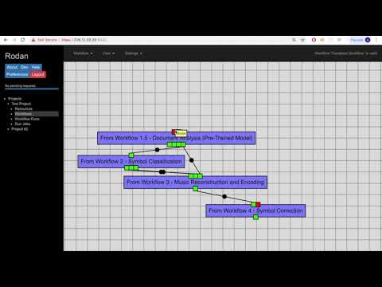

Slide 7
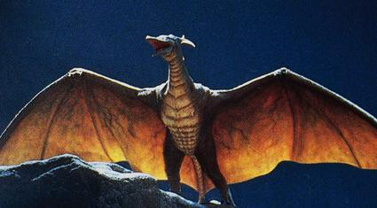

Thank You
Alastair Porter
Alex Daigle
Andrew Hankinson
Andrew Horwitz
Anton Khelou
Brian Stern
Deepanjay Roy
Gabriel Vigliensoni
Ling-Xiao Yang
Matan Gover
Nicky Mirfallah
Peter Henderson
Rajarshi Rivu Khoda
Ruth Berkow
Ryan Bannon
Wei Gao
Wendy Liu
YiHong Luo

