Slide 1
PatternFinder:
Symbolic Music Retrieval
David Garfinkle
McGill University
SIMSSA Workshop XVII: Infrastructure for music discovery
Montreal, Saturday December 1st 2018
Notes:
Hi I’m david, I’ll be presenting PatternFinder, a software tool I built for symbolic music retrieval
I think my presentation builds on the previous one in that a graphical query language precisely defines the musical passage that we’re interested in, that we want to find in a larger corpus of digitally encoded sheet music
My project is about implementing a system that will find occurrences of that query and return a set of results

Slide 2
Symbolic Content-Based Music Retrieval
Search music by its content: Given a musical passage, find all of its occurrences (and/or similar occurrences) in a corpus of digitized music scores.
PatternFinder is software for symbolic music retrieval
Python package using music21: https://github.com/ELVIS-project/patternfinder
You can use PatternFinder’s web application at https://patternfinder.elvisproject.ca
Notes:
The technical term for this is “symbolic music retrival” and the idea is
Patternfinder is software that I built for this task
In this presentation I will explain how to use the Patternfinder web application and what kind of searching it can do for you

Slide 3
PatternFinder Web Application: https://patternfinder.elvisproject.ca
Query: written in the digital music representation “**kern”
Search: An algorithm to find occurrences of our musical passage
Filters: to expand or narrow search results
Notes:
So, the web application has three components
Search: an algorithm that will actually do the search through a database of digitally encoded sheet music

Slide 4
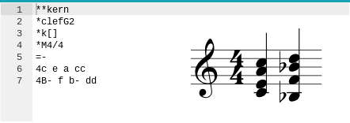
Entering Your Query
Clef
Key Signature
Time Signature
Notes:
The first thing we’ll do is show you how to input your query.
The query is input using a music encoding format called kern. Kern data sort of looks like a music score turned on its side. Rather than time passing vertically, now each row represents a simultaneous moment in time. So write chords, we write notes in a row as shown in blue. To move onto the next beat, we create a new row as shown in blue. So, a chord corresponds to a row, and a voice ccorresponds to a column. Repeated letters and Capital letters are used to specify high and low registers respectively.

Slide 5
PatternFinder Web Application: https://patternfinder.elvisproject.ca
Query: written in the digital music representation “**kern”
Search: An algorithm to find occurrences of our musical passage
Filters: to expand or narrow search results
Notes:
Ok so, now we’ve written a query in the web application. How will the computer look for it? There are a multitude of methods for searching a large corpus by its musical content. One of the major challenges in content-based music retrieval is finding occurrences in a corpus of specifically polyphonic music, so for now we have implemented one of the few search methods capable of doing this. The method we chose was developed at the University of Helsinki in 2011; it is flexible because it will find all the transpositions of your query, partial matches such as just a subset of the notes you were looking for, and rhythmically scaled occurrences (that is, in any note values--we entered our query in quarter notes, but it will find minims, semibreves, and breves)

Slide 6
Algorithm to Find Polyphonic Occurrences
Developed at the University of Helsinki in 2011
Searches through polyphonic texture for exact voice leading
Transpositions
Partial matching
Rhythmically altered occurrences
K. Lemström and M. Laitinen. Transposition and time-warp invariant geometric music retrieval algorithms. In Proc. ADMIRE’11, Third International Workshop on Advances in Music Information Research, Barcelona, 2011
Notes:
Ok so, now we’ve written a query in the web application. How will the computer look for it? There are a multitude of methods for searching a large corpus by its musical content. One of the major challenges in content-based music retrieval is finding occurrences in a corpus of specifically polyphonic music, so for now we have implemented one of the few search methods capable of doing this. The method we chose was developed at the University of Helsinki in 2011; it is flexible because it will find all the transpositions of your query, partial matches such as just a subset of the notes you were looking for, and rhythmically altered occurrences
scaled occurrences (that is, in any note values--we entered our query in quarter notes, but it will find minims, semibreves, and breves)
Since the algorithm’s true strength is the second point, finding your query in a polyphonic texture, I would like to show you an example of this

Slide 7
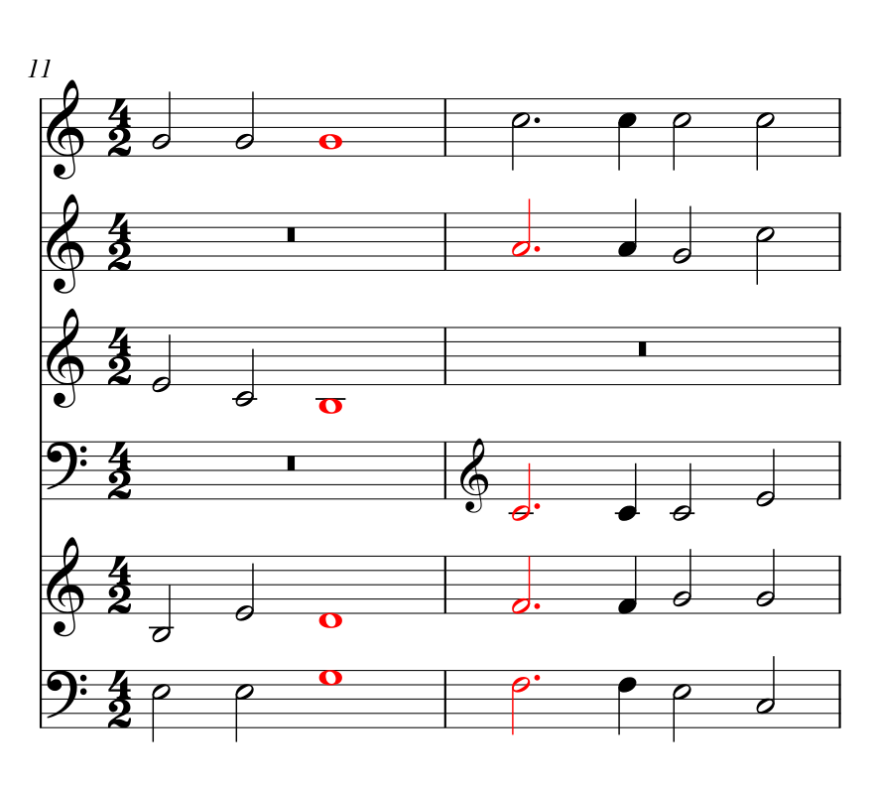
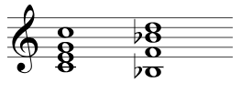
Credo movement of Missa Veni creator spiritus à 6
Query:
Notes:
Consider the following query written on the right hand side:
We look for it in the entirety of palestrina’s masses
First we notice that this is a transposed occurrence: the C major chord has been transposed up a fifth to correspond to the G major chord, colored in red on the left. The algorithm is capable of finding the query when all the pitch content is there, but actual connections between the voices are not made. This is an important distinction
The algorithm is not searching voice by voice but rather, it searches for your query within the entire polyphonic texture as a whole

Slide 8
PatternFinder Web Application: https://patternfinder.elvisproject.ca
Query: written in the digital music representation “**kern”
Search: An algorithm to find occurrences of our musical passage
Filters: to expand or narrow search results
Notes:
This can lead to a lot of freedom in how the algorithm will return occurrences of your query, we provide filters to expand or narrow the search results

Slide 9
Filters
Partial matches
Transpositions
Intervening notes
Notes:
Partial matches: how many notes of the query does the algorithm need to find? All, or some percentage?
Intervening notes: given an occurrence of our query, how thick is the polyphonic texture which obscures it?
first we define exactly what we mean by “intervening notes.” This can be thought of some measure for the polyphonic texture. The idea is, as we increase the tolerance of intervening notes, we allow extra contrapuntal or harmonic behaviour to occur in between notes found in the score that belong to our query.

Slide 10
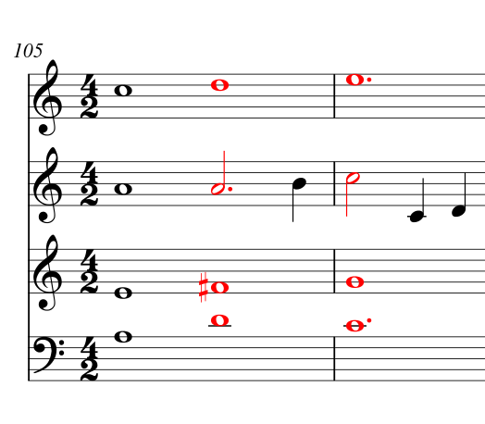
Gloria movement of In te domine speravi à 4: one intervening note
Query:
Notes:
For example, consider measure 105 of the Gloria movement in Missa In te Domine speravi (sper-ah-vee). Here we see our familiar two root-position major chords descending by whole step. In this example, the major chords walk through our two-chord progression with a passing note in the Alto voice. This occurrence of our query has one intervening note, namely, the passing B in the Alto voice. The filter would ignore this occurrence if it was set to 0 intervening notes.
But how do we count “intervening notes”? As examples get more complicated, we might have another intervening note in the Soprano, or two in the Bass.

Slide 11
Gloria movement of In te domine speravi à 4: one intervening note
Query:
4
9
3
5
8
2
7
1
6
Notes:
So to standardize the way we count “intervening notes” in a polyphonic context, the search method in Patternfinder orders notes in the score from beginning to end, and from low pitch to high pitch. In other words, each rhythmic attack gets ordered from left to right, and then for every particular rhythmic attack we order the notes from bottom to top.
each note in an individual rhythmic attack gets a unique number ordered bottom to top. The filter then ignores any occurrence which has two notes that are too far apart in the ordering. Returning to our example, the Soprano in the final beat of measure 1 is number four in the ordering. The passing B in the alto voice is numbered five, as it occurs to the right, and the bass at the first beat in measure 2 is number six, as it occurs to the right and is the lowest. So the bass and the soprano from one measure to the next are one intervening note away from each other.

Slide 12
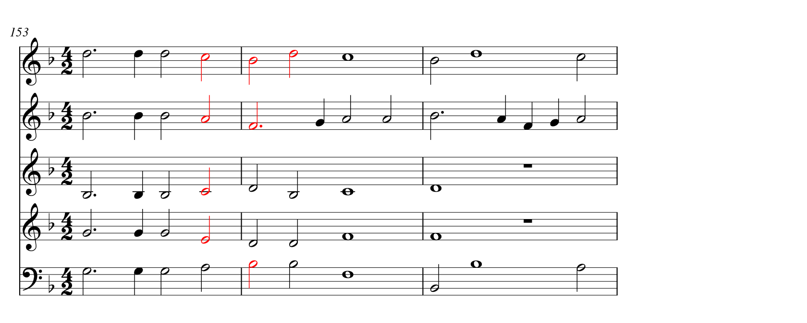

Credo Movement of Missa Memor esto à 5:
three intervening notes
Query:
4
13
9
3
8
2
7
12
1
6
11
5
10
Order: E, C, A, C, B, (intervening D, D), F, Bb, (intervening Bb, D, Bb), D
Notes:
As it happens, by increasing our tolerance for intervening notes, we can find many interesting cases. In measure 153 of the Credo movement in Missa Memor esto, the two-chord progression occurs with a very peculiar resolution of voices. We see similar broken voice-leading as in the Credo of Missa Veni creator (cray ah tor) spiritus: the middle voice leads down to the bass, the tenor to the alto, the alto to the soprano. But this time, the soprano line is actually fulfilled by arpeggiation.
When using the web application to find this occurrence, you would need to allow for three intervening notes, since the bottom three voices on beat 2 of measure 2 are ordered separating the two notes of the soprano line in m.154.

Slide 13
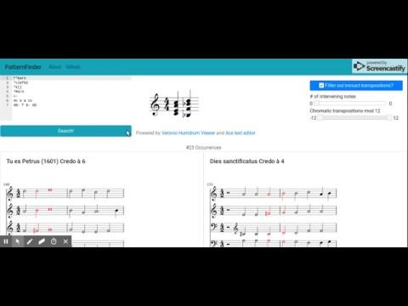
Demo

Slide 14
Future Work
Better indexing methods for faster search
Experiment with ranking system
Query interface
Index data directly from SIMSSA DB

Slide 15
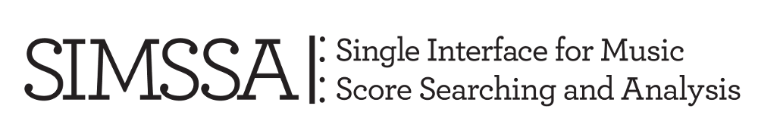


Slide 16
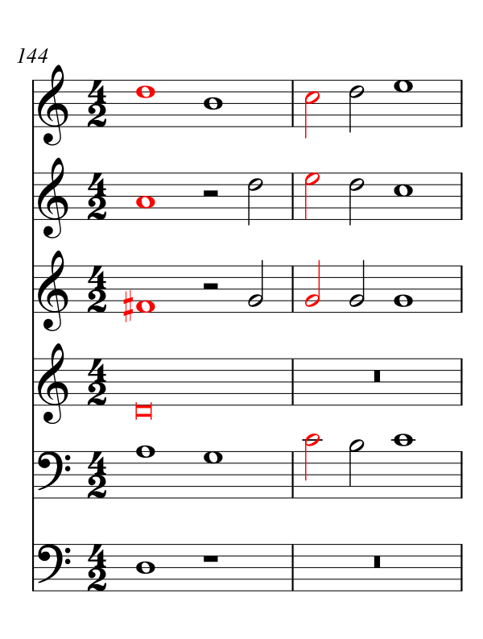
Credo Movement of Missa Tu es Petrus à 6:
four intervening notes
Query:
Notes:
As we continue to increase the size of the filter beyond the number of voices in the mass, we begin to see passing chords appear. We found that, when we searched for root position major chords descending by whole step, the intervening chord that appeared the most had a root a fifth below the first chord, creating what we might call a “V I IV” progression. This is illustrated in measure 144 of the Credo in Missa Tu es petrus, where between a D major chord and a C major chord we find an intervening G major chord.

Slide 17
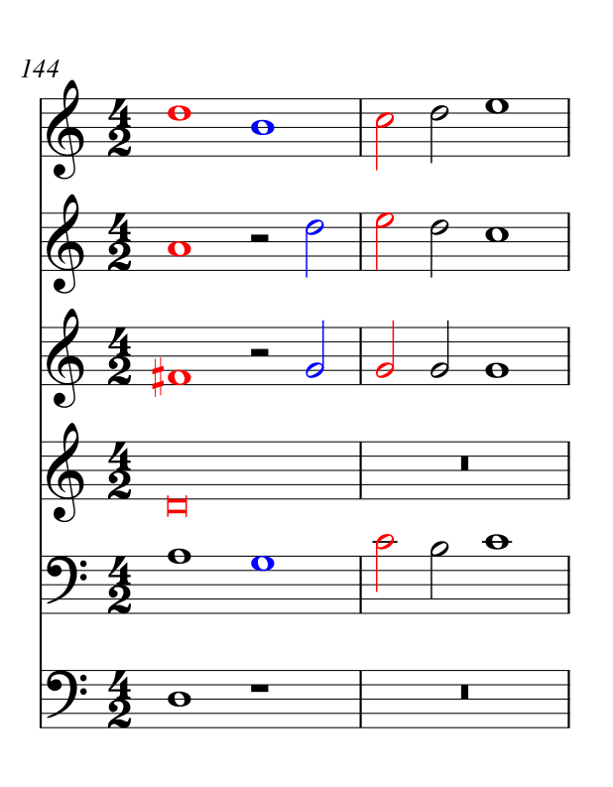
Credo Movement of Missa Tu es Petrus à 6:
four intervening notes
Query:
Notes:
As we continue to increase the size of the filter beyond the number of voices in the mass, we begin to see passing chords appear. We found that, when we searched for root position major chords descending by whole step, the intervening chord that appeared the most had a root a fifth below the first chord, creating what we might call a “V I IV” progression. This is illustrated in measure 144 of the Credo in Missa Tu es petrus, where between a D major chord and a C major chord we find an intervening G major chord.

Slide 18
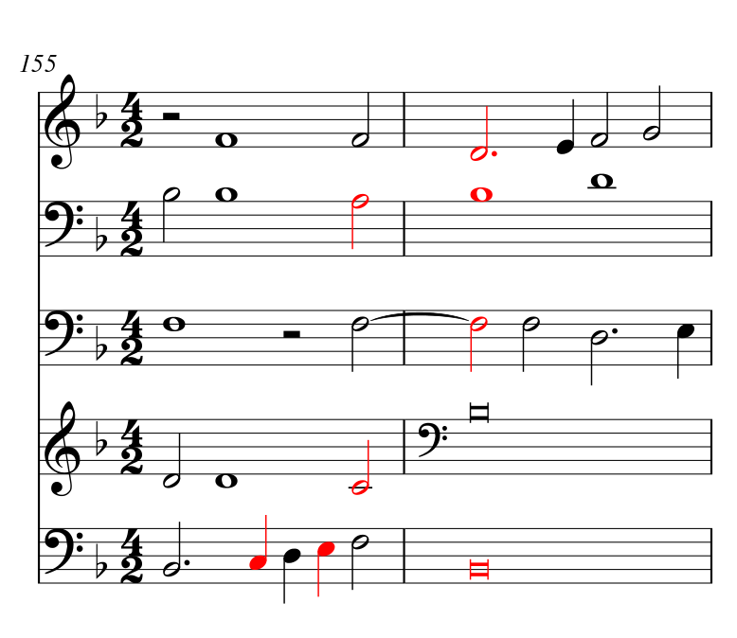
Credo movement of In semiduplicibus majoribus à 5
(only one intervening note, but still noise)
Query:
Notes:
You can imagine that, as we go further, we are met with lots of noisy examples. By “noisy” I mean filled with irrelevant information. However, we can also find noisy examples with small filter sizes. This final example of the Willaert progression supposedly found in Missa In semiduplicibus (du PLEE-chi bus) majoribus (my Oar ee boos), shows how our program is fooled by the pitch content and ignores crucial rhythmic information, such as arpeggiating notes on weak beats in the bass.

Slide 19
PatternFinder Web Application: https://patternfinder.elvisproject.ca
Query: written in the digital music representation “**kern”
Search: An algorithm to find occurrences of our musical passage
Filters: to expand or narrow search results

Slide 20
Filters
Partial matches
Transpositions
Intervening notes

Slide 21
Where does it fit in?
Solr
Index
(metadata)
SMR
Index
(content)
SIMSSA
Database
OMR process
Notes:
We’re aware from the previous presentations of an OMR process that populates a central SIMSSA database with music encoding files

Slide 22
Symbolic music retrieval: desirable traits
A music query should be found even when embedded in a larger context
e.g. solo cello suite melody vs bass
e.g. orchestral piano reduction
Notes:
And this an important point to make because there exist other symbolic music retrieval systems, however they do not support finding queries embedded in larger contexts
We could imagine a solo cello suite with both a melody and a bass played by only one voice. We’d expect that if we searched for the melody, we should find it as it is obscured and interrupted by the bass

Slide 23
Symbolic music retrieval: desirable traits
A music query should be found even when embedded in a larger context
Notions of similarity: not just verbatim statements of the query, but also “similar” ones
Notes:
A second desirable trait could be a notion of similarity. Now this goes beyond our previous example of being embedded in a larger context; here we imply finding musical transformations of our query

Slide 24
Notions of similarity
Transpositions
Rhythmic variations
Partial matches of a query
Notes:
Or many other creative ways to measure the distance between two sets of notes; all these notions of similarity can help inform our retrieval system

Slide 25
Symbolic music retrieval: desirable traits
A music query should be found even when embedded in a larger context
Notions of similarity: not just verbatim statements of the query, but also “similar” ones
Ranked comparison between occurrences
Highlighted excerpt of the content
Notes:
With a similar

Slide 26
What do we have now?
Experimental search service at patternfinder.elvisproject.ca
Three corpora: Palestrina masses, Bach fugues, Mozart/Beethoven Themes & Variations
Simple ranked comparison between occurrences
Size of partial matching
Highlighted excerpt of the content
Api for serving excerpts
Similarity:
Transpositions, rhythmic variation
Notes:
There can be many notions of similarity which may be useful for symbolic music retrieval; these are the ones we’ve focused on so far

Slide 27
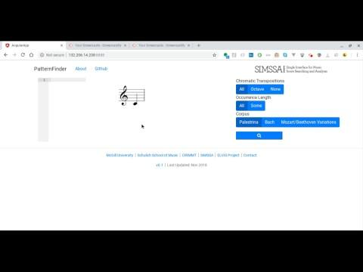
Patternfinder demo
Notes:
There can be many notions of similarity which may be useful for symbolic music retrieval; these are the ones we’ve focused on so far

Slide 28
Future work
Better indexing methods for faster search
Experiment with ranking system
Query interface
Index data directly from SIMSSA DB
Notes:
There can be many notions of similarity which may be useful for symbolic music retrieval; these are the ones we’ve focused on so far

Slide 30
Embedded in a larger context
Query:
4
13
9
3
8
2
7
12
1
6
11
5
10
Order: E, C, A, C, B, (intervening D, D), F, Bb, (intervening Bb, D, Bb), D
Notes:
There can be many notions of similarity which may be useful for symbolic music retrieval; these are the ones we’ve focused on so far

Slide 31
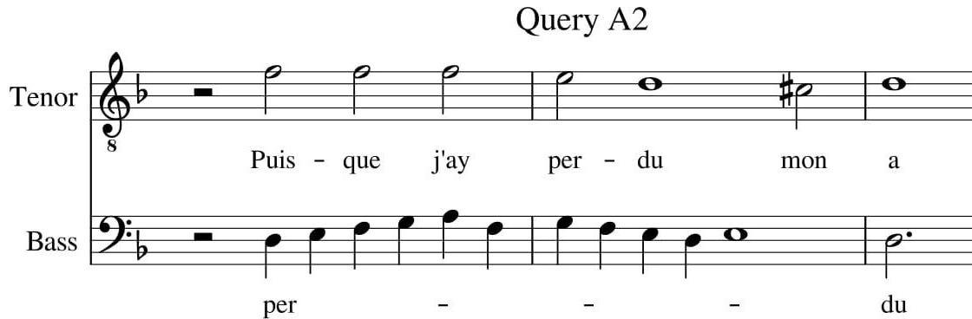
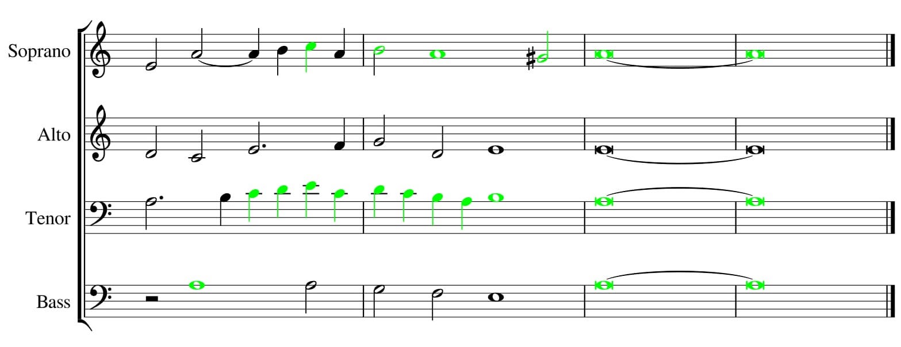
Query A2 in Spem in alium

Slide 32
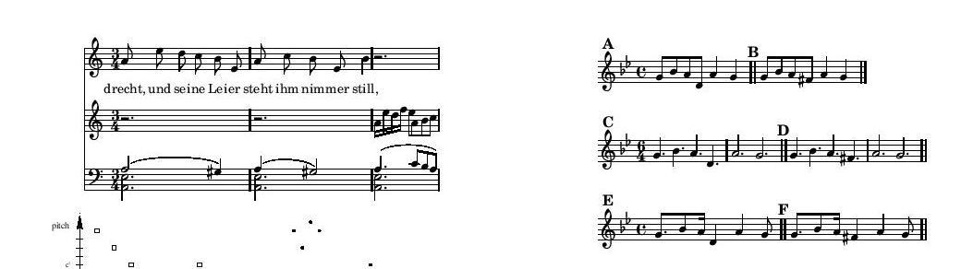
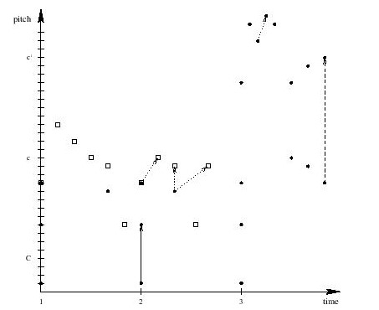
Point-set Representation
Excerpt from Schubert’s Der Leiermann
K. Lemström and M. Laitinen. Transposition and time-warp invariant geometric music retrieval algorithms. In Proc. ADMIRE’11, Third International Workshop on Advances in Music Information Research, Barcelona, 201
Notes:
Query finds point-set intersections in the database

Slide 33
Unscaled similarity: queries A and B
All notes
One missing
Unscaled
Excerpt from Schubert’s Der Leiermann
Transposition invariance : the results of our query should not change based on the key of our query
Notes:
A few desirable qualities of similarity. On the right are a few queries a musicologist may look for and would expect to find in an excerpt of schubert’s song

Slide 34
Unscaled similarity: queries A and B
All notes
One missing
Unscaled
P5 --------> m3
Excerpt from Schubert’s Der Leiermann
Transposition invariance : the results of our query should not change based on the key of our query
Notes:
B query

Slide 35
Scaled similarity: queries C and D
All notes
One missing
Unscaled
Scaled
Excerpt from Schubert’s Der Leiermann
Transposition invariance : the results of our query should not change based on the key of our query
Time-scaling invariance: augmentation and diminution
Notes:
A few desirable qualities of similarity. On the right are a few queries a musicologist may look for and would expect to find in an excerpt of schubert’s song

Slide 36
Warped similarity: queries E and F
All notes
One missing
Unscaled
Scaled
Excerpt from Schubert’s Der Leiermann
Warped
Transposition invariance : the results of our query should not change based on the key of our query
Time-scaling invariance: augmentation and diminution
Time-warping invariance: arbitrary rhythmic warping of individual notes
Notes:
A few desirable qualities of similarity. On the right are a few queries a musicologist may look for and would expect to find in an excerpt of schubert’s song

Slide 37
Warped similarity: queries E and F
All notes
One missing
Unscaled
Scaled
Excerpt from Schubert’s Der Leiermann
Warped
Transposition invariance : the results of our query should not change based on the key of our query
Time-scaling invariance: augmentation and diminution
Time-warping invariance: arbitrary rhythmic warping of individual notes
Notes:
A few desirable qualities of similarity. On the right are a few queries a musicologist may look for and would expect to find in an excerpt of schubert’s song
UI: sliders for selecting what kind of similarity you’d like

Slide 38
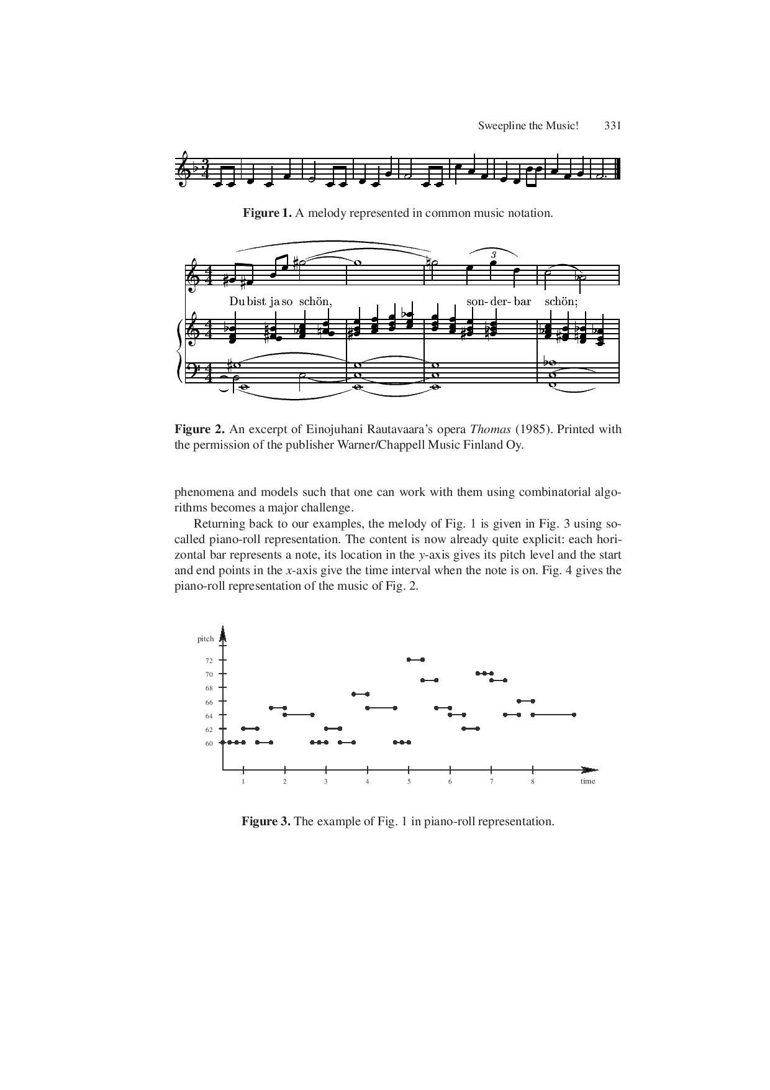
Piano-roll Representation
Ukkonen, E., Lemström, K., & Makinen, V. (2003). Sweepline the Music! Lecture Notes in Computer Science, 2598, 330-342.
Notes:
Two dimensional point-set representation (or

Slide 39
Threshold
Excerpt from Schubert’s Der Leiermann
Queries B, D, and F require a threshold of at least 5 (or 85%) Queries A, C, and E require a threshold of at least 6 (or 100%)

Slide 40
Scale
Time-scaling liberties taken by the algorithm to find a match
Pure: rhythmically identical occurrences
Scaled: finds augmentation and diminution
Warped: rhythmic values are ignored

Slide 41
Scale
Excerpt from Schubert’s Der Leiermann
Queries A and B require a scale of 1 Queries C and D require a scale of 3/2 Queries E and F require ‘warped’

Slide 42
Window
Number of intervening notes allowed between two matched notes
Pattern window
Source window

Slide 43
Window
All queries would require a source window of 4 Queries B, D, F need a pattern window of at least 2

