Slide 1
The SIMSSA DB Data Model
Presented by Emily Hopkins
SIMSSA DB team: Cory McKay, Gustavo Polins Pedro, Yaolong Ju,
Ichiro Fujinaga, and Julie Cumming
SIMSSA Workshop XVII: Infrastructure for Music Discovery
CIRMMT, McGill University, Montreal QC, 1 Dec. 2018
Notes:
Hello again! In addition to serving as project manager, I’m also part of a team working on the SIMSSA Database.
Cory McKay is actually the one who led the development of the first version of this data model, but he couldn’t be here this weekend so I’m presenting instead.
The SIMSSA Database is the successor of an older database created as part of Julie’s Digging into Data grant, and it was designed to gather symbolic music files in one place to do computer-aided counterpoint analysis. Since then it’s evolved into part of the SIMSSA Project.
I’m going to give you some background on what goes into the conceptual model for this database, and then Yaolong and Gustavo will take you through the implementation and user interface after.

Slide 2
How do we model music?
How do we track provenance?
Notes:
First, two big questions: How do we model music and how do we track provenance?
In modelling music, it’s important to consider who is using these materials and what they might expect.

Slide 3
Digital musicologists want to study abstract works.
Notes:
So – digital musicologists want to study abstract works!
This is definitely a bit of a generalization. But for computational musicology looking at musical content, we mostly want to be able to study large numbers of pieces of music at the same time, organized by composer or time period or key or instrument.

Slide 4
Digital musicologists want to study abstract works.
e.g. “Beethoven’s Third Symphony”
Notes:
So an example of this kind of “abstract work” would be a Beethoven symphony. This doesn’t refer to a particular score or edition, it’s just the abstract idea of a combination of musical elements that make up Beethoven’s third.
To be clear -- Beethoven didn’t actually sit down to write “Beethoven’s Third Symphony-the-abstract-work”; he wrote a piece of music on particular pieces of paper. This idea of a work existing outside material reality is an abstraction we use to organize things.

Slide 5
Digital musicologists want to study abstract works.
e.g. “Beethoven’s Third Symphony”
Libraries and databases deal with describing and storing items.
Notes:
On the other hand libraries and databases, deal with describing and storing particular items.

Slide 6
Digital musicologists want to study abstract works.
e.g. “Beethoven’s Third Symphony”
Libraries and databases deal with describing and storing items.
e.g. “IMSLP46066-PMLP02581-Op.55.pdf”
Notes:
We have to store Beethoven’s third as manifested in Breitkopf & Härtel’s 1862 edition as made available to us in a file from IMSLP.
It’s tempting to imagine that we can just digitize the abstract notion of Beethoven’s third symphony – but we can’t. We have to digitize a particular edition, using a particular kind of software, making various decisions as we go about how to represent this work.

Slide 7
IFLA-LRM
(Inernational Federation of Library Associations and Institutions -- Library Reference Model)
Work: Beethoven Symphony No. 3
Expression: piano reduction, study score
Manifestation: particular edition (e.g., Breitkopf & Härtel, 1862)
Item: specific object (the file as it exists stored on IMSLP)
Notes:
In working out how to translate this to a database, we’ve made some attempt to refer to the IFLA-LRM and other library-based conceptual models.
IFLA = International Federation of Library Associations and Institutions, LRM = Library Reference Model
In the IFLA-LRM work is “the intellectual or artistic content of a distinct creation” – NOT a material object
Expression: “a distinct combination of signs conveying intellectual or artistic content” (translation, piano reduction)
Manifestation: a particular edition, by a particular publisher –for example Breitkopf and Härtel in 1862.
Item: specific object -- not just a particular edition of a novel, but an actual copy of it; here the file on IMSLP.

Slide 8
IFLA-LRM
SIMSSA DB Data Model
Work: Beethoven Symphony No. 3
Expression: piano reduction, study score
Manifestation: particular edition (e.g., Breitkopf & Härtel, 1862)
Item: specific object (the file as it exists stored on IMSLP)
Work: Beethoven Symphony No. 3
Related work: piano reduction
Source: particular edition (e.g., Breitkopf & Härtel, 1862)
File: specific object (the file as it exists stored on IMSLP)
Notes:
Now here is our model on the right.
Essentially we have collapsed work and expression, instead expressing that dynamic through relating works to other works. We have prioritized musical content equivalence over other aspects – so a piano reduction would be a related work, because the music is different, whereas a study score would be equivalent.
Source maps quite closely on to manifestation.
File then maps on to “item” – because in the end we are primarily storing and describing individual files.
Now that we’ve established this basic framework, we can start building our database!

Slide 9
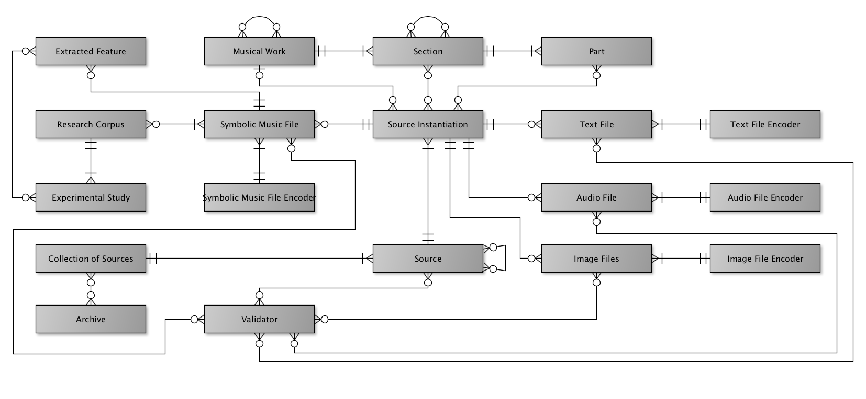
Entity-Relationship Diagram
Notes:
Enter the SIMSSA DB entity-relationship diagram. This is a type of diagram often used for building databases. Everything in a box is an entity – such as a musical work, a source, or an audio file, and the arrows in between define the relationships between the entities.
All the lines, circles, and little chicken feet indicate constraints on these relationships. A line is one, a circle is zero, and the chicken feet represents “many”. FOR EXAMPLE, a section relates to one and only one musical work, but a single musical work can have multiple sections.
I won’t take you through every relationship in detail, but I will give you an overview of some of the key features and how they work.

Slide 10
Symbolic Music Files
Notes:
This here is the symbolic music file: the heart of the SIMSSA database.
Here you can see we keep track of how it is encoded, what musical works it links to (via the source instantiation), and what research projects it belongs to.

Slide 11
Support for different file types
Notes:
Of course, we want other file types too. Text files allow us to include lyrics to songs, audio files may connect with automated audio transcription in the future, and image files are a key part of connecting this to the OMR process you’ve heard about today.

Slide 12
Modelling Musical Works
Notes:
A Musical work is a complete, abstract work. Musical works can be related to other musical works – for example, a symphony could be made available in a piano reduction. The musical content is different but still clearly related.
A musical work can be divided into sections – for example, an opera aria, or a movement in a symphony. We made it possible to relate sections to other sections as well – for example if musical material is reused in different masses, or an opera aria is also available with a piano part as a separate publication.
Parts are single voices or instruments – we relate them back to sections as they can vary between movements, for example, but it’s a tricky thing to model well on the user end and we’re still working on it. Most of the files we’ve encountered so far are full scores, not parts, but we do want it to be possible.

Slide 13
Beethoven Symphony No. 3
Movement 3: Allegro vivace
Oboe I
BeethovenSymphony3-III-allegrovivace.xml
Notes:
Here is how we might model the third movement of Beethoven 3 on the actual diagram so far.
We have our abstract work, we have its section, the third movement, the corresponding symbolic music file, and a first oboe part.
But wait -- which edition did we use to get our notes from? Where did we get our file? This brings us to the next big question.

Slide 14
How do we track provenance?
Notes:
Provenance is really important for reusability. How does someone know if something is trustworthy if they don’t know where we got it from, or what we did to get it into the database?

Slide 15
Tracking Provenance
Notes:
First we need to track sources.
Source instantiation and source are basically the same thing; the separate abstraction allows us to be more specific about which files our sections come from. Together they represent the source -- the particular edition or manuscript you got your notes from. You can also relate sources to other sources – so your edition that you consulted could be based on an earlier manuscript, for example.
Collection of sources could be something like a hymnal or a fake book – multiple different works gathered together.
An archive on the other hand is a repository of documents – so not a published collection, but either a physical library or institution, or an online database where music is stored.

Slide 16
Tracking Provenance
Notes:
Another part of provenance is keeping track of who did what when. We have entities for tracking how different file types are encoded, as well as validation which can track verifying the quality of files and can include details about workflow or reliability.

Slide 17
Beethoven Symphony No. 3
Movement 3: Allegro vivace
Oboe I
BeethovenSymphony3-III-allegrovivace.xml
Beethoven Symphony No. 5,
pp. 24-56 of specific edition
(movement 3)
Encoded in Musescore
Collected symphonies
Beethoven Symphony No. 5 score published by Breitkopf & Härtel in 1862
IMSLP
Notes:
Here is how we might model the third movement of Beethoven 3 on the actual diagram at this point. You can see we’ve added that the symbolic file was encoded using musescore, and we have added the pages we got our notes from, and the edition, and then maybe it’s actually part of a published collection of all of Beethoven’s symphonies, and we found the file on IMSLP.

Slide 18
Research corpora & content-based search
Notes:
In addition to being able to track where pieces come from and how we generated files, we can also group them within the database. Users can define a research corpus of files they want to work with as a group – sort of like a music playlist, a piece can belong to many collections simultaneously.
In addition, every piece in the database automatically has extracted jSymbolic features.
These features can be used for content-based music search, which Gustavo and Yaolong will highlight later. Users can search for music by metadata and by musical content!
This research corpus dimension allows allows us to preserve which features were used for a particular study, such as the madrigal study Julie told you about earlier. We can keep datasets together with the features involved in a particular study.

Slide 19


Archiving and re-using datasets
GitHub
SIMSSA DB
Notes:
It takes a lot of time to build a research corpus and ensure that everything is high quality, so we want to be sure we get to keep it! For our own records, so that someone else could reproduce our experiments, or so that others could use our dataset for new research.
Long-term digital preservation is actually quite a tricky problem, which for now we’ve planned to approach in three ways.
While datasets are being worked on, they go in GitHub. This allows us to track changes and collaborate really easily, and prevents things from getting lost in Google Drive.
SIMSSA DB is great for finished corpus, storing related features, making it discoverable, BUT
For citation purposes we need something even more robust, so we have plans to try using Zenodo for “release quality” datasets to cite in papers. Zenodo is an open-access respository run by the folks responsible for CERN and allows us to generate a DOI for a stable, citeable dataset.

Slide 20
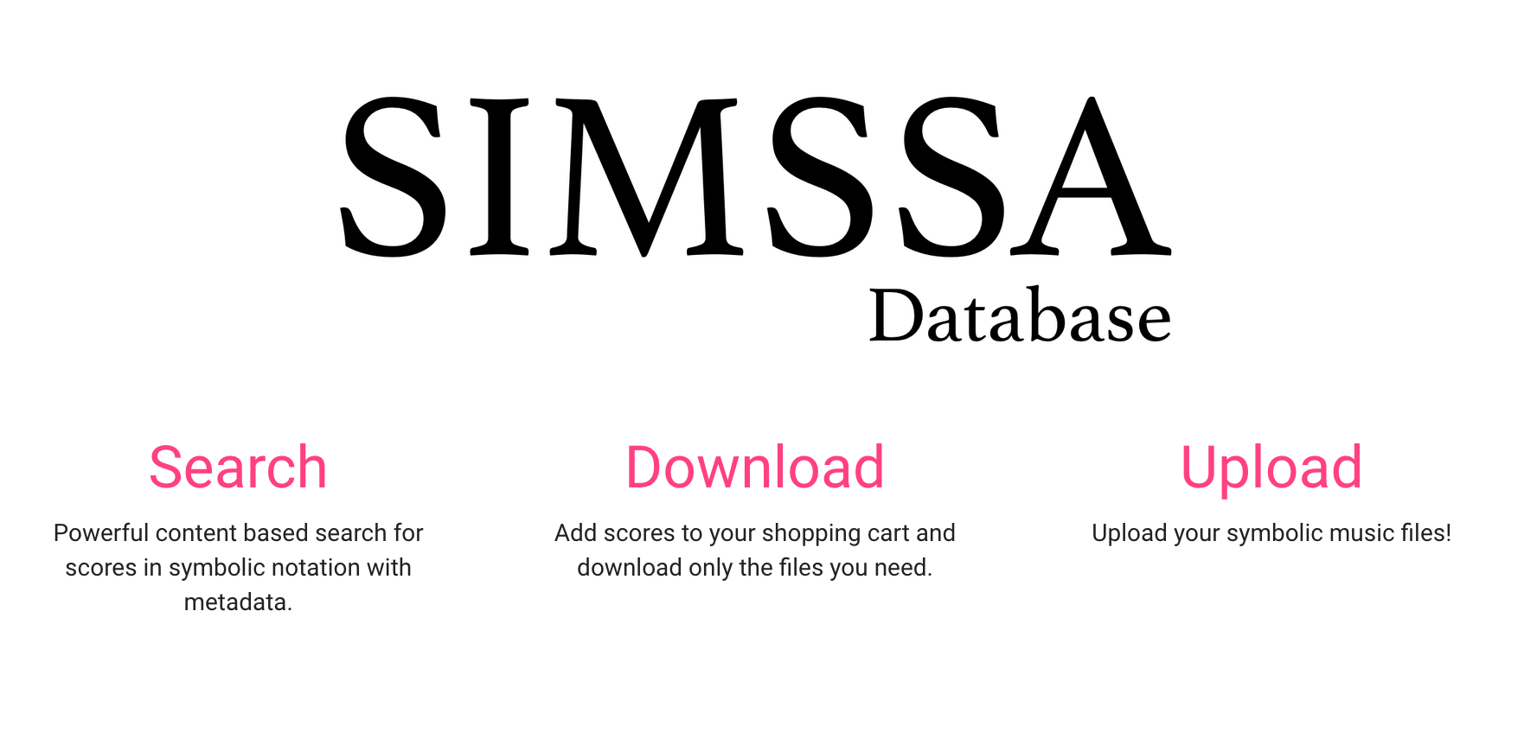
Towards the interface
Notes:
Now, on to the database itself!
Creating a user interface requires taking a step back from the model I just presented and trying to come up with useful and friendly abstractions that will be intuitive to music researchers.
Just because we need a particular field or entity in the backend doesn’t mean the user needs to know!
Up next you’ll hear from Gustavo and Yaolong who have been the primary developers of the actual SIMSSA Database.

Slide 21


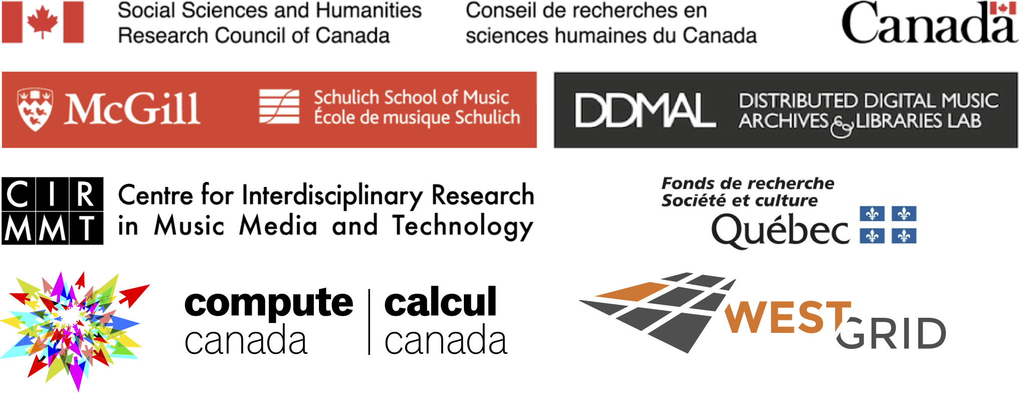
https://github.com/ELVIS-Project/simssadb @simssaproject emily.hopkins@mcgill.ca
Thank you!

