Slide 1

Discographic Metadata as a Research Resource
for Studying the Development of Popular Music Genres and Cultures
Jada Watson, University of ottawa
SIMSSA Workshop XVII: Infrastructure for music discovery

Slide 2
Theory & Methodology
Prosopography – distant reading

Slide 3
Prosopography influenced by Katherine Keats-Rohan (2000) and Averil Cameron (2003)
Prosopography is “about what the analysis of the sum of data about many individuals can tell us about the different types of connection between them, and hence about how they operated within and upon the institutions – social, political, legal, economic, intellectual – of their time” (Keats-Rohan 2000).
As a methodology, prosopography “gathers and digest information about the individual persons who are attested in a particular historical period; as well as uncovering specific careers and relationships, it may also provide a tool for the broader detection of historical trends” (Cameron 2003).

Slide 4
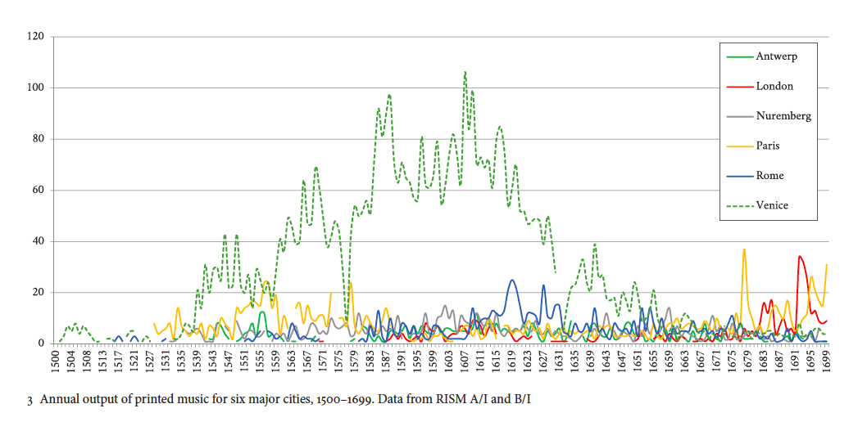
BDHM 1
Distant reading of music data
“Writing a Big Data History of Music” in Early Music XLIII, no. 4 (2015) by Stephen Rose, Sandra Tuppen, Loukia Drosopoulou.

Slide 5
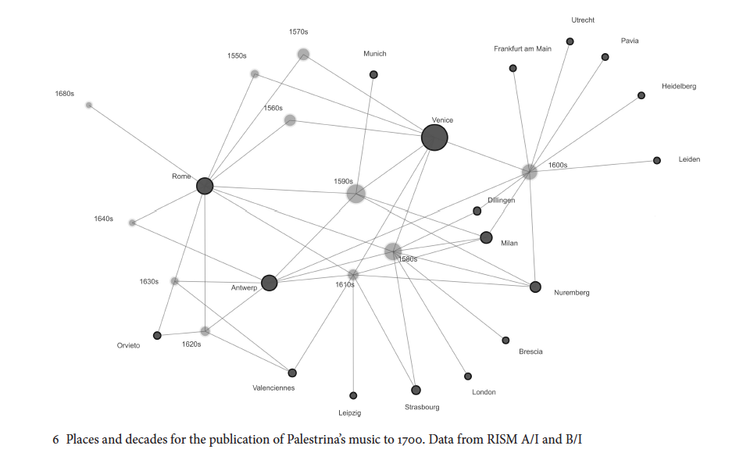
BDHM 1
Distant reading of music data
“Writing a Big Data History of Music” in Early Music XLIII, no. 4 (2015) by Stephen Rose, Sandra Tuppen, Loukia Drosopoulou.
Notes:
This is a network diagram showing the places and decades where Palestrina’s music was published in the 16th and 17th centuries. It includes single-composer editions of Palestrina (as listed in RISM A/I) and anthologies containing works by Palestrina (as listed in RISM B/I). The diagram clarifies which locations were central or peripheral to the dissemination of his music, and shows some of the patterns in the posthumous publication of his music. The size of the nodes shows that the most important locations for the publication of Palestrina’s music (in terms of numbers of books) were Venice and Rome.

Slide 6
Data Curation & modeling
Billboard Hot Country Songs, 1944-2016

Slide 7
Discography:
19,844 singles (including covers, re-releases, etc.)
Biography:
4,127 Performers (solo artists and members of ensembles)
8,193 songwriters
~1,500 producers
Industry:
~1,187 labels and partnerships
There is overlap here: some artists in this dataset perform more than one function – and often are all three (performers, songwriters and producers.
Dataset: Hot Country Songs, 1944-2016

Slide 8
1
Discography → three main phases
Augmented dataset to include names of songwriters and label catalogue numbers for each record → DONE
Added all records charting between 1944 and 1958 (not included in core Billboard dataset) → DONE
Adding all corresponding album details (title, release date, producer) → in progress
Biography → three main phases
Created a dataset with all of the biographic details for every charting performer (solo and ensemble)→ DONE
Create a subset with the biographic details for all songwriters → in progress
Create a subset with the biographic details for all producers → in progress
Industry → one phase
Dataset with the labels producing these singles → in progress
2
3
Curation phases

Slide 9
Discography → BGSU MARC Records, WorldCat and Wikipedia
BGSU Bill Schurk Sound Archives → ~15,000 country album MARC records from collection
Cascading Search in WorldCat → using ISBN and/or album titles
Search API → Wikipedia to pull discographic data from album pages
Biography → Library of Congress, WorldCat and Wikipedia
MARC Edit → to pull URI records for Name Authority files from the Library of Congress
Virtual International Authority File (VIAF) → to pull URI records for Name Authority files from WorldCat
Search API → Wikipedia to pull biographic details for songwriters / producers with Wikipedia pages
1
2
Overcoming challenges

Slide 10
[2] PERSON [Composer]
[1] WORK
[Composition]
[2] PERSON
[performer(s)]
[1] EXPRESSION
[recorded work]
[2] PERSON
[producer(s)]
[1] MANIFESTATION
[album]
[2] CORPORATE BODY
[Orchestra, Country, Founding date of orchestra]
Entity-relation model for Variations3 influenced by FRBR (Riley, Hunter, Colvard, Berry, Indiana University; 2007)

Slide 11
[2] PERSON
[performers]
First NAME
Last NAME
Birth DATE
Death DATE
Birth CITY
Birth STATE
Birth COUNTRY
Race / Sex
[2] PERSON
[songwriter(s)]
First NAME
Last NAME
Birth DATE
Death DATE
Birth CITY
Birth STATE
Birth COUNTRY
Race / Sex
[2] BAND
[performers]
Bane name
Members (performers)
Dates active
[1] WORK
[song]
Title
Songwriter
Instrumentation
[1] EXPRESSION
[recorded work]
Title
Songwriter
Performer
Producer
Billboard Peak Position
Billboard Weeks on chart
Musical Style
[2] PERSON
[producer(s)]
First NAME
Last NAME
Birth DATE
Death DATE
Birth CITY
Birth STATE
Birth COUNTRY
Race / Sex
[2] CORPORATE BODY
[studio/label(s)]
Label Name
City
State
Est. Date
Def. Date
[1] MANIFESTATION
[album]
Album title
Performer
Format
Place : Corporate Body date
Album catalogue no.
Conceptual Model – Adapted to SongData
influenced by FRBR and Variations3 catalogue at Indiana University (Riley, Hunter, Colvard, Berry 2007)

Slide 12
[2] PERSON
[performers]
First NAME
Last NAME
Birth DATE
Death DATE
Birth CITY
Birth STATE
Birth COUNTRY
Race / Sex
[2] PERSON
[songwriter(s)]
First NAME
Last NAME
Birth DATE
Death DATE
Birth CITY
Birth STATE
Birth COUNTRY
Race / Sex
[2] BAND
[performers]
Band name
Members (performers)
Dates active
[1] WORK
[song]
Title
Songwriter
Instrumentation
[1] EXPRESSION
[recorded work]
Title
Songwriter
Performer
Producer
Billboard Peak Position
Billboard Weeks on chart
Musical Style
[2] PERSON
[producer(s)]
First NAME
Last NAME
Birth DATE
Death DATE
Birth CITY
Birth STATE
Birth COUNTRY
Race / Sex
[2] CORPORATE BODY
[studio/label(s)]
Label Name
City
State
Est. Date
Def. Date
[1] MANIFESTATION
[album]
Album title
Performer
Format
Place : Corporate Body date
Album catalogue no.
Conceptual Model – Adapted to SongData

Slide 13
PERSON
(performer)
Dolly Parton
January 19, 1946
N/A
Sevierville
Tennessee
USA
Female
PERSON
(songwriter)
Dolly Parton
January 19, 1946
N/A
Sevierville
Tennessee
USA
Female
[2] BAND
[performers]
Name
Members
Dates active
WORK
Jolene
Dolly Parton
Voice, guitar
EXPRESSION
Jolene
Dolly Parton
Bob Ferguson
Recorded in RCA Studio B
May 22, 1973
Billboard: Number 1
Country; Bluegrass
PERSON
(producer)
Bob Ferguson
December 30, 1927
July 22, 2001
Willow Springs
Missouri
USA
Male
MANIFESTATION
Jolene
Dolly Parton
Bob Ferguson
Long playing record
Nashville: RCA Victor 1973
APL1-0473
CORPORATE BODY
RCA Victor
Nashville, Tennessee
June 23, 1901
Conceptual Model – Dolly Parton’s “Jolene”

Slide 14
PERSON
[songwriter]
Maren Morris
April 10, 1990
N/A
Arlington
Texas
USA
Female
WORK
[song]
My Church
Maren Morris;
Michael James Ryan Busbee
Voice, guitars , drums
PERSON
[performer]
Maren Morris
April 10, 1990
N/A
Arlington
Texas
USA
Female
[2] BAND
[performers]
Name
Members
Dates active
PERSON
[producer]
Maren Morris
April 10, 1990
N/A
Arlington
Texas
USA
Female
EXPRESSION
[recorded work]
My Church
Maren Morris
Michael James Ryan Busbee
Number 8
Country; R&B
PERSON
[songwriter]
Michael James Ryan Busbee
N/D
N/A
San Francisco
California
USA
Male
PERSON
[producer]
Michael James Ryan Busbee
N/D
N/A
San Francisco
California
USA
Male
CORPORATE BODY [label]
Columbia Nashville
Nashville
Tennessee
2007
Def. Date
MANIFESTATION
[album]
Hero
Maren Morris
CD + Booklet
Nashville; Columbia Nashville; Sony Music Entertainment, 2016
88875-16885-2
Conceptual Model – Maren Morris’s “My Church”

Slide 15
PERSON
[songwriter]
Hillary Scott
PERSON
[performer]
Hillary Scott
WORK
[song]
Wanted You More
Voice, guitars, drums
BAND
Lady Antebellum
Hillary Scott; Charles Kelley; Dave Haywood
2006 - present
PERSON
[songwriter]
Charles Kelley
PERSON
[performer]
Charles Kelley
PERSON
[producer]
Hillary Scott
PERSON
[songwriter]
Dave Haywood
PERSON
[performer]
Dave Haywood
PERSON
[producer]
Charles Kelley
EXPRESSION
[recorded work]
Wanted You More
Number 20
Country
PERSON
[songwriter]
Matt Billingslea
PERSON
[producer]
Dave Haywood
PERSON
[songwriter]
Dennis Edwards
PERSON
[producer]
Paul Worley
CORPORATE BODY
[label]
Capitol Nashville
Nashville
Tennessee
1950
Def. Date
PERSON
[songwriter]
Jonathan Long
MANIFESTATION
[album]
Own the Night
CD + Booklet
Nashville; Capitol, 2011
509990 94431 2 9
PERSON
[songwriter]
Jason ”Slim” Gambill
Conceptual Model – Lady Antebellum’s “Wanted You More”

Slide 16
Gender representation in the country music industry, 1996-2016
Pilot study
Recently published in Journal of Popular Music and Society (43, no. 1).

Slide 17
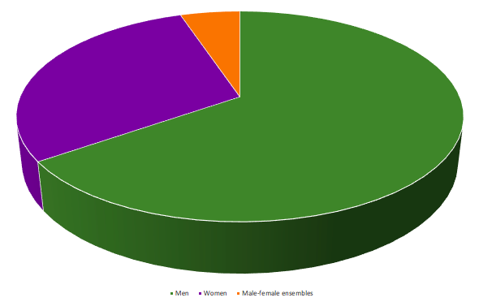
Total number of debuting songs:
Total number of songs peaking at #1:
Total number of artists active:
Men:
Women:
Male-female ensembles:
4,276
432
718
469
212
37
M-F ensembles: 5%
Women: 30%
Men: 65%
Active artists between 1996-2016
Hot Country Songs, 1996-2016

Slide 18
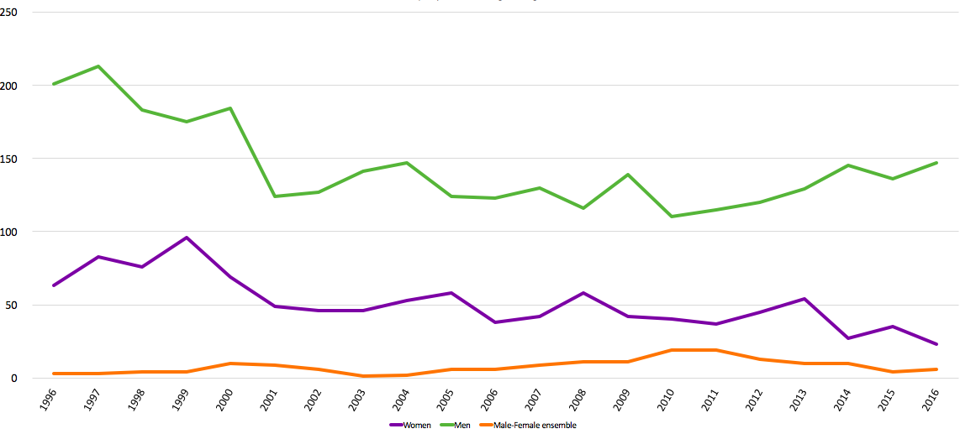
Activity (no. of songs entering chart) by both men and women decline, while that of male-female ensembles increase.
Men outperform women in every year of this two-decade period.

Slide 19
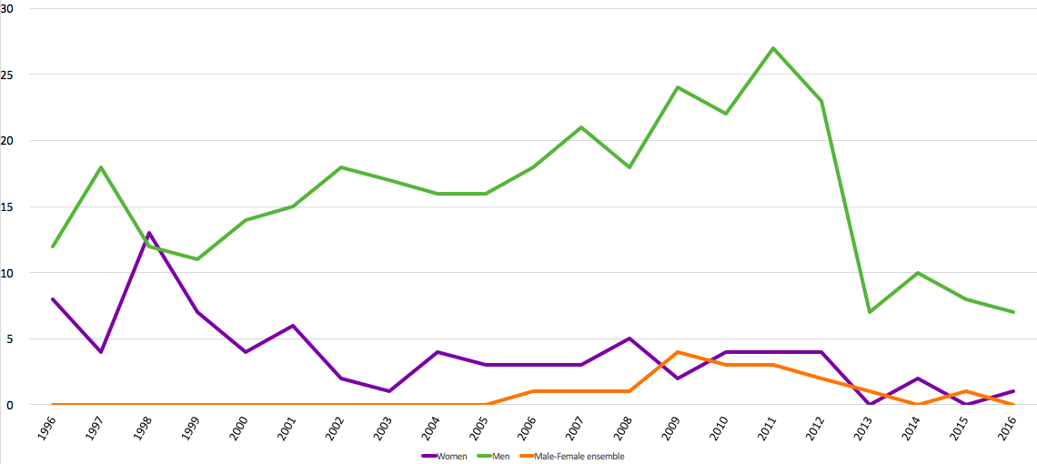
Activity (no. of songs at No. 1) by women declines, while the trend line for men remains fairly stable and then out perform women every year but 1998. Male-female ensembles increase.

Slide 20
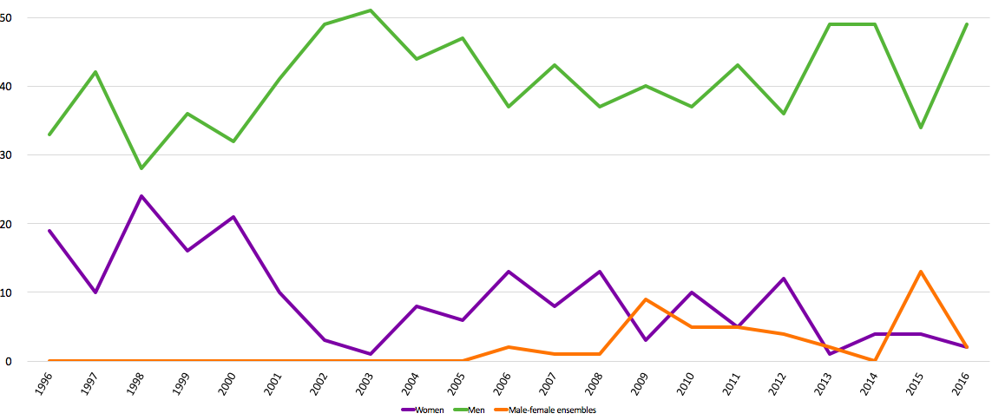
There is a significant disparity between men and women when focusing on weeks spent at No. 1. The trend lines are mirror opposites: with men increasing and women decreasing.

Slide 21
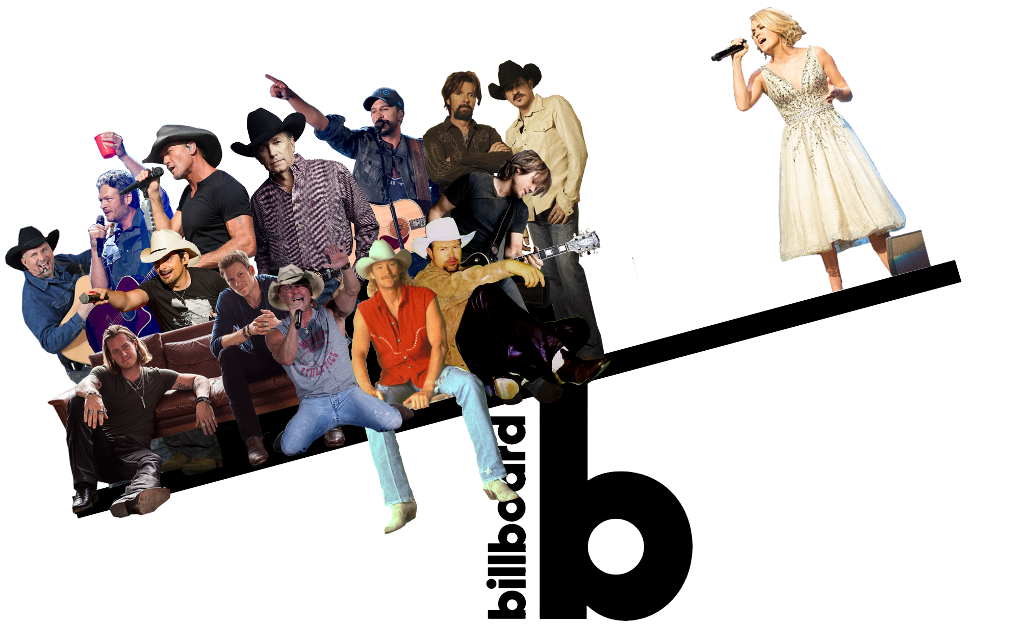

Slide 22
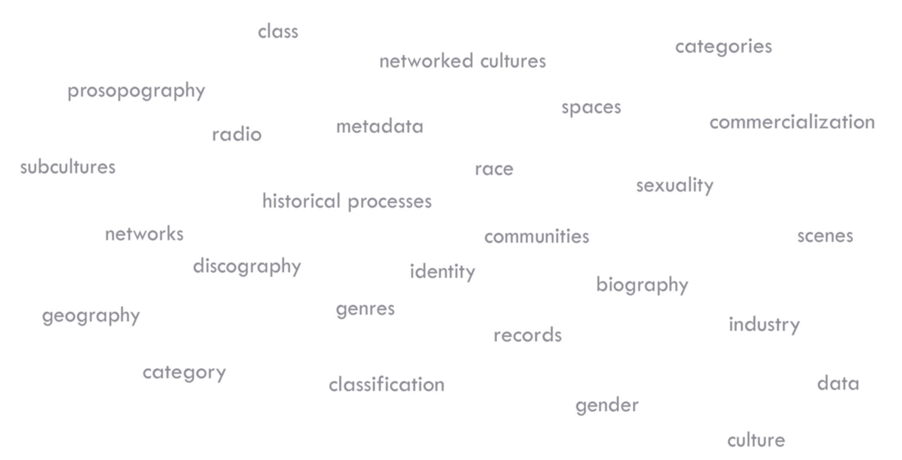


Slide 23
Discographic Metadata as a Research Resource
for Studying the Development of Popular Music Genres and Cultures
Jada Watson, University of ottawa
Website: www.SongData.ca
Contact: jada.watson@uottawa.ca

