Slide 1
Licensing Hackathon!
Emily Hopkins, DDMAL, McGill University, 24 July 2020

Slide 2
Guiding questions:
Who has copyright claims on this stuff?
Another way to ensure you get credit for your work!
Under what license am I able to use those works?
Making sure other people can use your work and you can use theirs
Bonus: Can someone who is trying to use my materials in good faith figure out how to do it?

Slide 3
Which licenses should I use?
For software: MIT or GPL 3.0 are the most common ones on our existing repos
It’s up to you as long as it’s an open source license
License picker from GitHub: https://choosealicense.com/
More about what makes something open source: https://opensource.org/osd
More about what makes something free software: https://www.gnu.org/philosophy/free-sw.en.html
For software documentation: CC-BY-SA 4.0
For symbolic scores: CC BY 4.0
Unless you are working with e.g. scores from the JRP or other scores with a more restrictive license, in which case you will need to follow that license’s restrictions
Keeping the license as close to public domain as possible while still getting credit

Slide 4
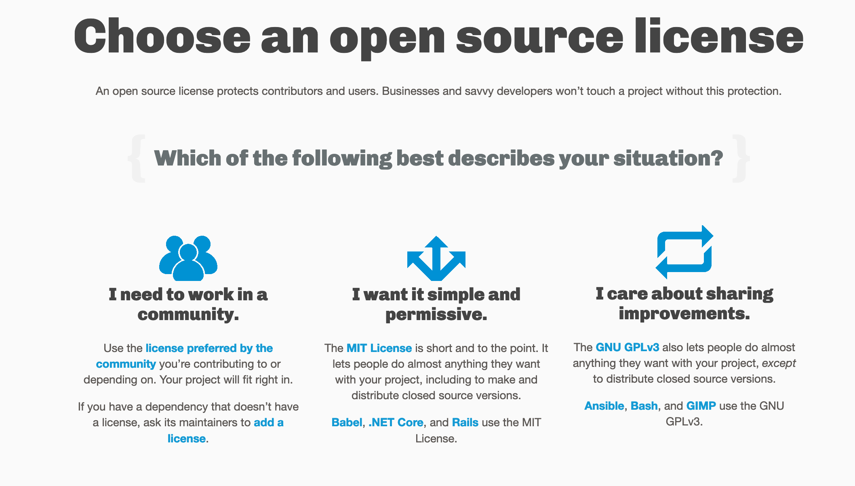
https://choosealicense.com/

Slide 5
Get Creative Commons license text (and buttons!)
Link to license text (include this in your repo):
https://creativecommons.org/licenses/by/4.0/
Link to buttons! Optional:
https://creativecommons.org/choose/results-one?license_code=by&amp;jurisdiction=&amp;version=4.0&amp;lang=en

Slide 6



CC-BY 4.0
“Creative Commons”
“By Attribution”

Slide 7
Important note about the “non-commercial” option…
The open source definition excludes non-commercial style licenses
There are Creative Commons options that include it, but…
All we really need is attribution & we want to keep this material close to public domain so that we are adding back to a commons of music resources for everyone
Some examples of commercial scenarios we don’t want to prevent: someone wants to develop training material, use as examples in a text book, performers
BUT ALSO! These are public domain pieces, we shouldn’t restrict them more than absolutely necessary

Slide 8
Do I need to separate my scores and my code into different repos?
This works better for things that are their own “Organization” e.g. Measuring Polyphony
Since all our stuff is in the “DDMAL” organization, you are probably going to need to use multiple licenses in one repo instead
IMPORTANT! If you are using any kind of noncommercial Creative Commons licensed scores (“NC”) then you definitely can’t just throw everything in one repo with only an MIT license
FOSS licenses are incompatible with Non-Commercial restrictions

Slide 9
Example repo:
https://github.com/DDMAL/SIMSSA-HR-Intro-and-licensing
Repo-level license (GitHub metadata) = software license
Repo-level README: explains all licenses for different types of content
E.g. MIT for software, CC BY SA for documentation, CC BY for symbolic scores
Individual files should have appropriate rights metadata (especially important for your scores)
Like having your name on every page of a paper exam…
Can use GitHub file structure to have a folder for symbolic files so it’s easy to identify scores vs. what’s code

Slide 10
Also…
Creative Commons licenses are written with content like scores in mind. Software licenses are written with software in mind.
No one is really “coming to get us” if we don’t do this right. There is no GitHub automatic takedown for not-clearly-licensed scores
But it may prevent people from using your work (NO CITATIONS FOR YOU!)
AND people can use our repos as good examples of what to do
Separating out the scores in a folder makes them easier to find for people who aren't necessarily there for the code

Slide 11
How do I add a license to my GitHub repository?
Click “Create New File”
Type LICENSE or LICENSE.md
It will let you choose a license from their list
Make sure you change the copyright name if you’re using MIT – GitHub default is wrong
Can be a long list of names (should not be “DDMAL”)
You can follow this tutorial here: https://help.github.com/en/enterprise/2.16/user/articles/adding-a-license-to-a-repository

Slide 12
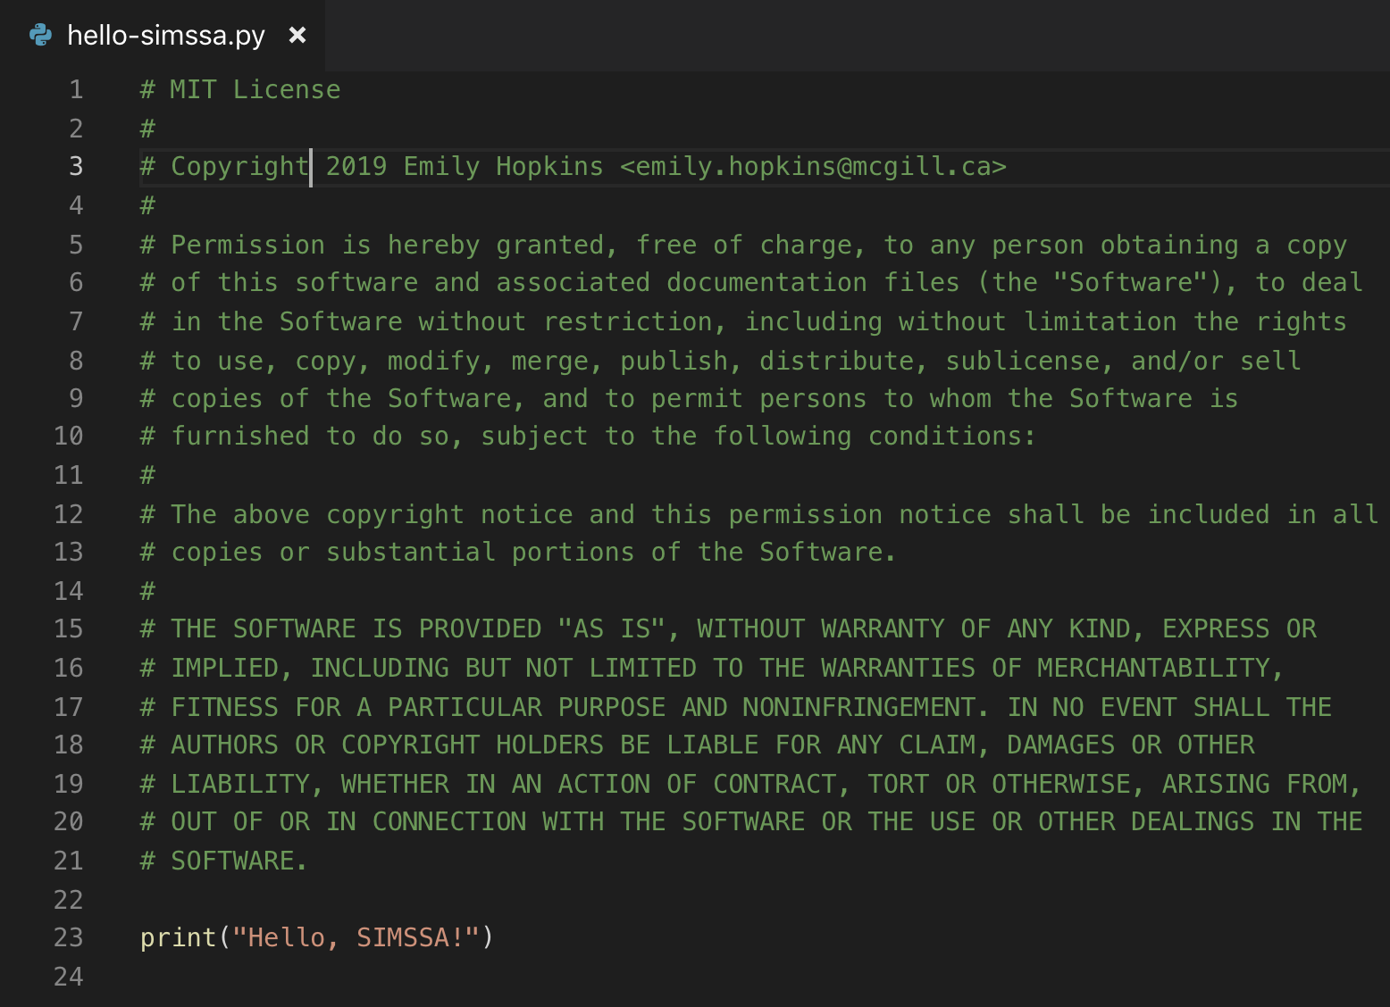

Slide 13
Measuring Polyphony: example with multiple repos
https://github.com/MeasuringPolyphony
Music files: https://github.com/MeasuringPolyphony/mp-music-files
Website: https://github.com/MeasuringPolyphony/measuring_polyphony_jekyll
Project has several different repos

Slide 14
License on the score repo for Measuring Polyphony
License
The content of this project itself is licensed under the Creative Commons Attribution 3.0 license. Any further use of this project's music transcriptions must be attributed correctly to the project and the project's editor according to the terms of this license.
The underlying source code used to format and display that content is licensed under the MIT license.

Slide 15
XML rights metadata
<rights>Attribution 3.0 United States (CC BY 3.0 US) https://creativecommons.org/licenses/by/3.0/us/</rights>

Slide 16
What if my repo has no license but I’m not the only contributor, or the other contributors haven’t worked for DDMAL for years?
Make an issue and tag in all the contributors
Propose a license change and a deadline for them to object by
Since they signed a contract saying the software they make at DDMAL has to be open source, I don’t think this is too shady! We are just making sure it’s actually open source.
Once the deadline passes and no one has objected, change the license!
Néstor has done this before, I will add a link if I find it…

