Slide 1
Software and Public Domain Policy
SIMSSA is funded by a SSHRC Partnership grant and follows SSHRC policies for availability of research. SSHRC is committed to the principle that the various forms of research results and data collected with public funds belong in the public domain. Accordingly, SSHRC has adopted a policy to facilitate making research results and data that has been collected with the help of SSHRC funds available to other researchers. All software written while working at DDMAL falls into this category, and must be open sourced.
Notes:
Creative Commons: set of copyright licenses to encourage sharing and re-use of creative work, e.g. CC BY-SA 4.0
Open source: making source code available
Public domain: no longer in copyright -- scores in the public domain can be hosted on Musiclibs (need better definition to match with SSHRC)
Open access: scholarly publishing movement

Slide 2
What do all the following have in common? How are they different?
Creative Commons
Open source
Public domain
Open access

Slide 3


Slide 4
Does putting your code on GitHub make it open source?

Slide 5
No! Making something available online doesn’t make it open source or public domain. It’s still all rights reserved to its creators.

Slide 6
What is open source software?
Open Source Initiative definition:
Open source software is made by many people and distributed under an OSD-compliant license which grants all the rights to use, study, change, and share the software in modified and unmodified form.
Software freedom is essential to enabling community development of open source software.
Notes:
Debian, Free Software Foundation – collaboration on definition

Slide 7
In order for our code to be open source, we need a license!

Slide 8
Which license to use?
1) Working on an existing project? Use its current license
2) Are there external libraries you need to consider? Make sure the license is compatible
3) Starting a new project? It’s up to you!

Slide 9
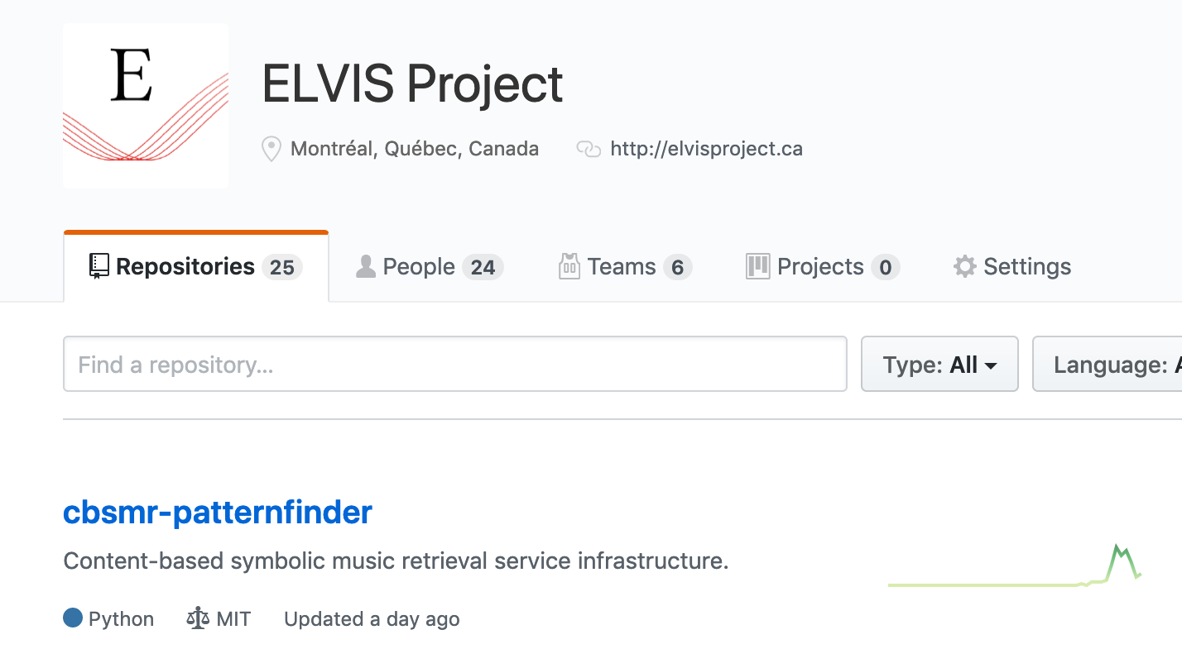
Example 1: Find existing license

Slide 10
Sometimes you need to hunt…
LICENSE or COPYING file in root directory
Use GitHub to search for “license” in the repository

Slide 11
Sometimes there is no license!
We are still catching up on getting things standardized across the lab, and still need to get in touch with some past students as well

Slide 12
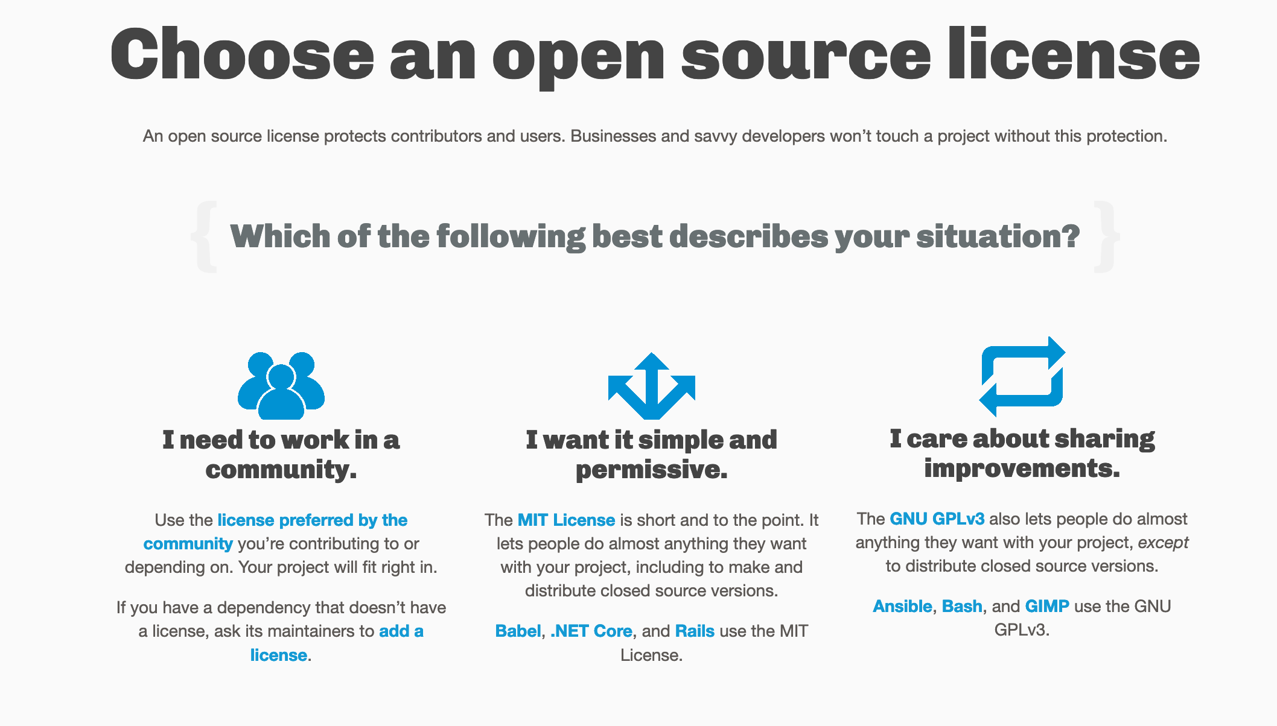
https://choosealicense.com/

Slide 13
Permissive vs. Copyleft open source licenses
e.g. MIT vs. GPL
MIT: Permissive license allows future users to do whatever, including use it as part of proprietary software
GPL: Copyleft license ensures openness/freedom is passed on to future users

Slide 14
How do I add a license to my repository?
Click “Create New File”
Type LICENSE or LICENSE.md
It will let you choose a license from their list
You can follow this tutorial here: https://help.github.com/en/enterprise/2.16/user/articles/adding-a-license-to-a-repository

Slide 15
How do I add this license to my code?
Example repo at DDMAL/SIMSSA-HR-Intro-and-licensing
I’ll add the slides from today
Also has a small example code file with the MIT license boilerplate
Make sure you change the name if you’re using MIT – GitHub default is wrong

Slide 16
