Slide 1
Welcome to the DDMAL Lab!

Slide 2

How do I get paid?

Slide 3
AMURE
Casual Research Assistant
Collective agreement is online here: http://www.aerum-amure.ca/wp-content/uploads/2019/03/AMURE-2018-06-18.pdf
Notes:
We are in the process of ratifying the new collective agreement and I will keep you posted as to what changes in there affect you as well as the voting process.

Slide 4
Timesheets
Submitted every two weeks
Paid via direct deposit in Minerva
Submit to folder in the lab by the door
Track your own hours too!
https://github.com/matangover/timesheets

Slide 5
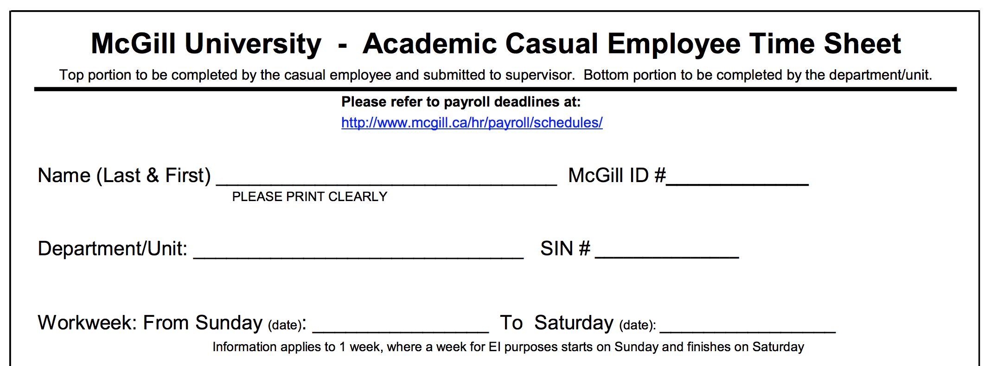
Music Research
Don’t fill this in!
Get these dates from your handbook

Slide 6
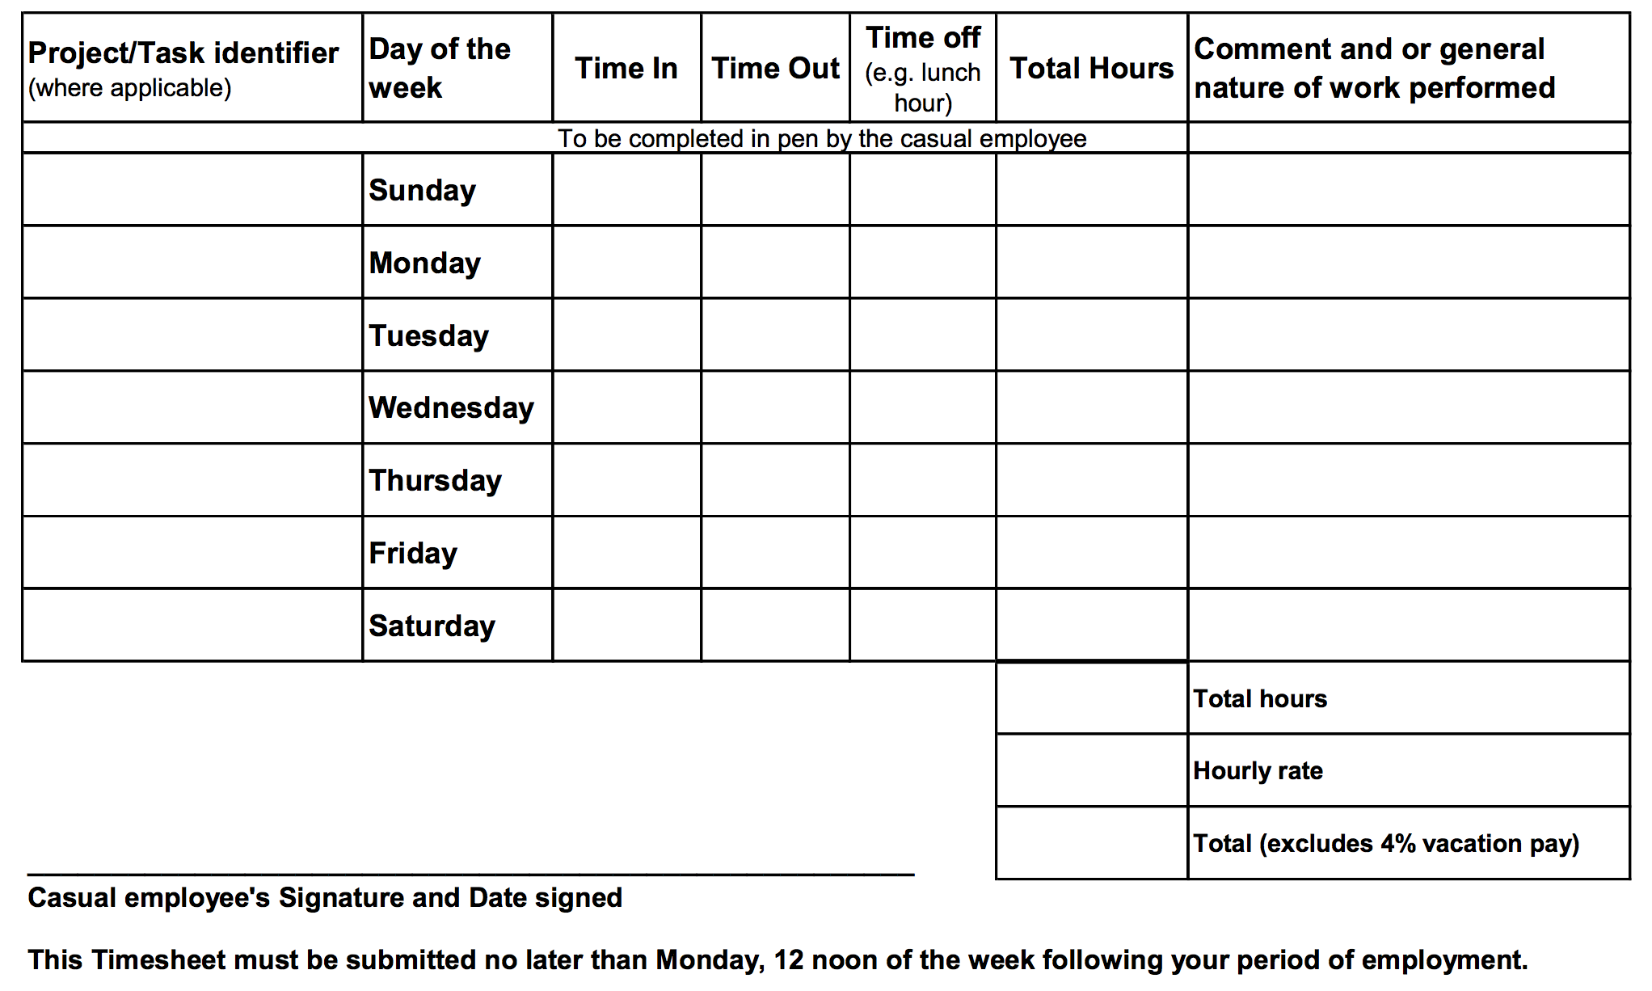
Programming
9
5
1
7
Programming
9
5
1
7
Programming
9
5
1
7
Programming
9
5
1
7
Programming
9
5
1
7
35
$16.00
$560.00

Slide 7
What is my hourly take-home pay?
(This is a rough example; please check your pay stub in Minerva for exact deductions)
 | Percentage | Amounts
Hourly rate | 16 | $ 16.00
stat holiday indemnity | 3.6 | $ 0.58
vacation indemnity | 6 | $ 0.96
EI deduction | 1.25 | $ (0.20)
QPIP deduction | 0.526 | $ (0.08)
QPP deduction | 5.55 | $ (0.89)
 |  | $ 16.36

Slide 8
Statutory Holidays
You get paid a fixed percentage of your hourly wage (3.6%) in lieu of being paid for holidays (same with paid vacations, 6%)
Statutory Holidays this summer:
Victoria Day/Fête de Dollard: Monday 21 May
La Fête Nationale: taken on Monday 25 June
Canada Day/Moving Day: taken on Monday 2 July

Slide 9
What if I get sick?
Email to let us know you won’t be coming in
You are eligible for paid sick days after 3 months uninterrupted service
Paid at 1/20th of the last four weeks of your work
FYI this is not in the Collective Agreement (part of Pay Equity Act)

Slide 10
What if I get sick before August?
We can still give you extra unpaid time off if needed
You can make up the time if you are able to come in early/stay late/come in on the weekend, etc.
You are only paid for hours you submit timesheets for; there is no requirement to make up the hours

Slide 11
Unpaid days off
You can take these 10 days any time after training is done
Can take larger chunks or individual days
Please add to DDMAL Family Calendar (send me your gmail address)

Slide 12
Keys to the lab
You should already be authorized (if your key card is working, you have permission to pick up a key)
Go to E222 in the Strathcona music building (10am-12pm, 2pm-4pm) to pick up

Slide 13
McGill’s Policy Against Sexual Violence and Policy on Harassment and Discrimination Prohibited by Law
Can be found here: https://www.mcgill.ca/how-to-report/
Applies to you as students and applies to our workplace as well
There are formal reporting procedures; you are also welcome to talk to me or Gabriel for help with a situation

Slide 14
Discrimination
Any action, behaviour, or decision which results in the exclusion or preference of an individual or group within the University community based on:
race, colour, sex (including gender identity), pregnancy, sexual orientation, civil status, age (except as provided by law), religion, political conviction, language, ethnic or national origin, social condition, or disability

Slide 15
Sexual violence
Definition: sexual act or acts targeting
Sexuality
gender identity
gender expression
They are committed, threatened, or attempted against a person without the person’s Consent. May occur by any means of communication, including:
in person
in writing
by phone
online and social media

Slide 16
Continuing in the Fall
If all goes well this summer, many people continue into the Fall (max. 10h/week, school comes first!) and some even come back for a second summer
Please save the date: morning of Saturday Sept. 21 we will be doing a SIMSSA Workshop and you can present on your work done over the summer

Slide 17
Communicate early & often!
You are also welcome to talk to me (Emily Hopkins) or Gabriel
We can get ergonomic chairs/keyboards/etc.
Thank you for choosing to work with us this summer! ☺

Slide 18
Notes:
Haymarket Massacre in 1886, police fired on workers striking for 8-hour day

