Slide 1
Licensing 101
Emily Hopkins
Summer training, 4 May 2021
McGill University

Slide 2
What do all the following have in common? How are they different?
Creative Commons
Open source
Public domain
Open access

Slide 3
Open Access
Familiar with concept from publishing
Key idea: we’ve already been paid
About access, not copyright

Slide 4
Public domain
Public domain: no longer in copyright -- scores in the public domain can be hosted on Musiclibs (need better definition to match with SSHRC)
Example of British Museum

Slide 5
Software and Public Domain Policy
SIMSSA is funded by a SSHRC Partnership grant and follows SSHRC policies for availability of research. SSHRC is committed to the principle that the various forms of research results and data collected with public funds belong in the public domain. Accordingly, SSHRC has adopted a policy to facilitate making research results and data that has been collected with the help of SSHRC funds available to other researchers. All software written while working at DDMAL falls into this category, and must be open sourced.
Notes:
Open source: making source code available
Open access: scholarly publishing movement

Slide 6
Creative commons
Creative Commons: set of copyright licenses to encourage sharing and re-use of creative work, e.g. CC BY-SA 4.0

Slide 7
Turning public domain music into data sets
Extending from open access principle -- we’ve already been paid
But! We still need to get credit
We might also want to have some control over other people making data we’ve worked hard to make accessible no longer accessible

Slide 8
Recommended CC license
Josquin Research Project uses ___________
This is obviously better than no license!
However, strong case to be made for trying to keep this as close to “public domain” as possible, while still getting credit for our work

Slide 9

Does putting your code on GitHub make it open source?

Slide 10
No! Making something available online doesn’t make it open source or public domain. It’s still all rights reserved to its creators. (see Berne convention for more on this)

Slide 11
What is open source software?
Open Source Initiative definition:
Open source software is made by many people and distributed under an OSD-compliant license which grants all the rights to use, study, change, and share the software in modified and unmodified form.
Software freedom is essential to enabling community development of open source software.
Notes:
Debian, Free Software Foundation – collaboration on definition

Slide 12
In order for our code to be open source, we need a license!

Slide 13
Which license to use?
1) Working on an existing project? Use its current license
2) Are there external libraries you need to consider? Make sure the license is compatible
3) Starting a new project? It’s up to you! Most of our projects use GPL or MIT

Slide 14
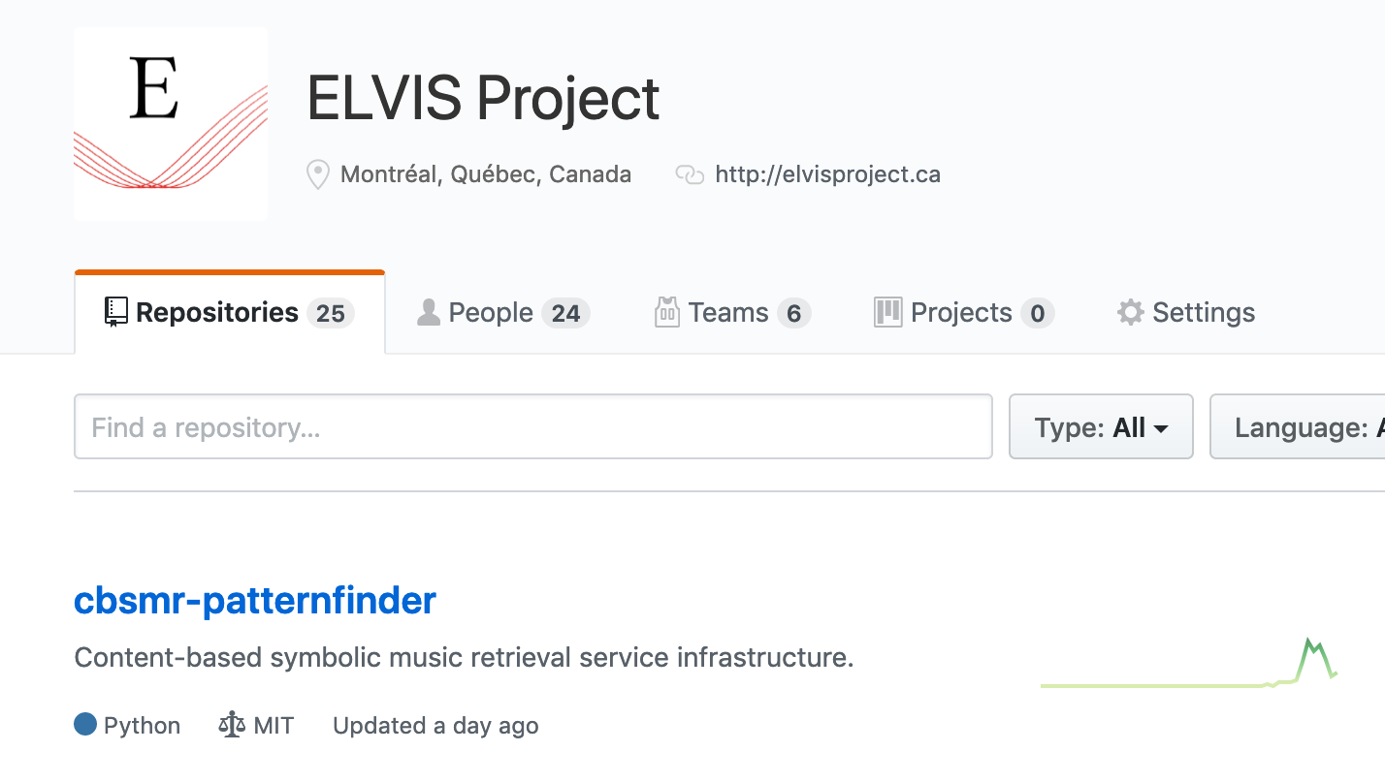
Example 1: Find existing license

Slide 15
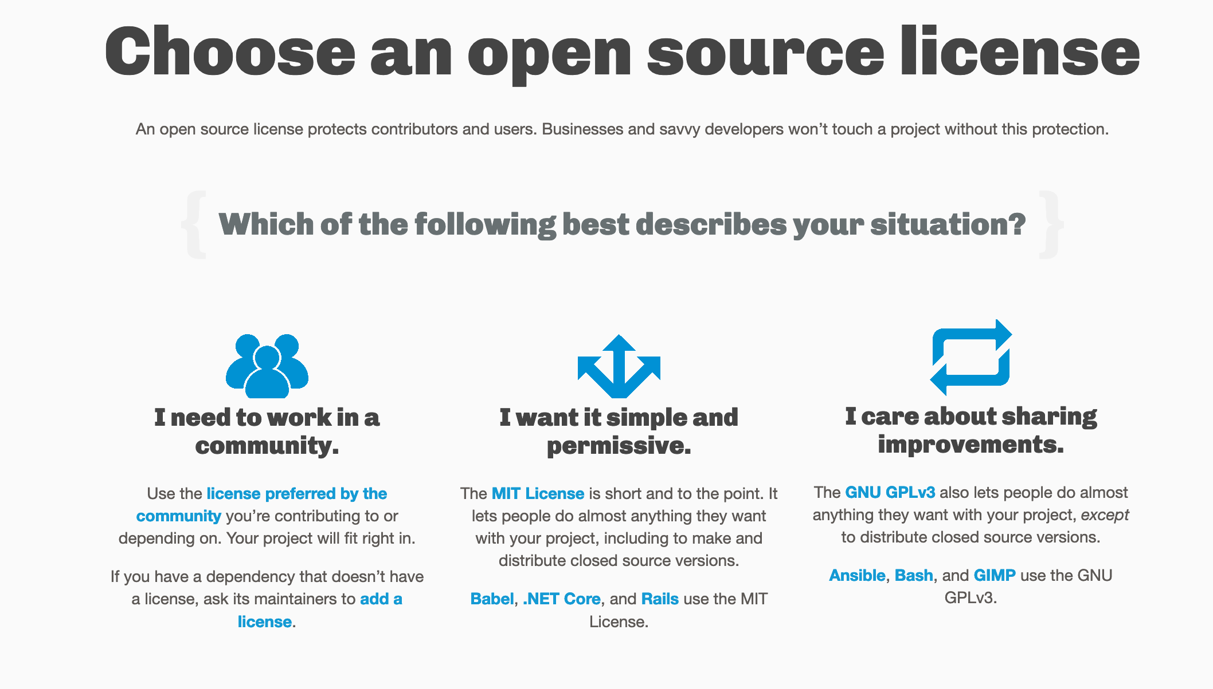
https://choosealicense.com/

Slide 16

Choose a Creative Commons license
https://creativecommons.org/choose/
Useful for scores (recommend CC-BY) or documentation (recommend CC-BY-SA)

Slide 17
Permissive vs. Copyleft open source licenses
e.g. MIT vs. GPL
MIT: Permissive license allows future users to do whatever, including use it as part of proprietary software
GPL: Copyleft license ensures openness/freedom is passed on to future users

Slide 18
How do I add a license to my repository?
Click “Create New File”
Type LICENSE or LICENSE.md
It will let you choose a license from their list
You can follow this tutorial here: https://help.github.com/en/enterprise/2.16/user/articles/adding-a-license-to-a-repository

Slide 19
How do I add this license to my code?
Example repo at DDMAL/SIMSSA-HR-Intro-and-licensing
Also has a small example code file with the MIT license boilerplate
Make sure you change the names if you’re using MIT – GitHub default is wrong

Slide 20
