Slide 1
Welcome to the DDMAL Lab!

Slide 2

How do I get paid?

Slide 3
Positions & Collective Agreements
Stipend
AMURE Casual Research Assistant
http://www.aerum-amure.ca/wp-content/uploads/2019/03/AMURE-2018-06-18.pdf
AMUSE IT Assistant C
https://static1.squarespace.com/static/5f3d763912202f427092d1af/t/5fc54c145147b14804e0e432/1606765594390/amuse_casuals_collective_agreement_2017-2020.pdf
Notes:
We are in the process of ratifying the new collective agreement and I will keep you posted as to what changes in there affect you as well as the voting process.

Slide 4
Submitting your hours in Workday
Please log in to Workday now to make sure you can!
Track your own hours too! There are often issues with Workday so we really do need you to have backup documentation for when we get audited.
Pay attention to your pay stubs and report any issues to me ASAP
Keep your banking info up to date
Notes:
Emphasize that it is likely that there will be problems

Slide 5
Statutory Holidays
You get paid a fixed percentage of your hourly wage (3.6%) in lieu of being paid for holidays (same with paid vacations, 6%)
Statutory Holidays this summer:
Victoria Day/Fête de Dollard: Monday 24 May
La Fête Nationale: Thursday 24 June
Canada Day/Moving Day: Thursday 1 July

Slide 6
What if I get sick?
Email to let us know you won’t be coming in
Officially you are eligible for paid sick days after 3 months uninterrupted service
Paid at 1/20th of the last four weeks of your work
FYI this is not in the Collective Agreement (part of provincial Pay Equity Act)

Slide 7
What if I get sick before August?
We can still give you extra unpaid time off if needed
You can make up the time if you are able to
You are only paid for hours you submit timesheets for; there is no requirement to make up the hours

Slide 8
Unpaid days off
You can take these 10 days any time after training is done
Can take larger chunks or individual days
Please add to DDMAL Calendar (send me your gmail address)

Slide 9
McGill’s Policy Against Sexual Violence and Policy on Harassment and Discrimination Prohibited by Law
Can be found here: https://www.mcgill.ca/how-to-report/
Applies to you as students and applies to our workplace as well
There is a mandatory training that is part of your onboarding in Workday (“It Takes All of Us learning module on sexual violence”)
There are formal reporting procedures; you are also welcome to talk to me, Ich, or one of the PhD students for help with a situation

Slide 10
Discrimination
Any action, behaviour, or decision which results in the exclusion or preference of an individual or group within the University community based on:
race, colour, sex (including gender identity), pregnancy, sexual orientation, civil status, age (except as provided by law), religion, political conviction, language, ethnic or national origin, social condition, or disability

Slide 11
Sexual violence
Definition: sexual act or acts targeting
Sexuality
gender identity
gender expression
They are committed, threatened, or attempted against a person without the person’s Consent. May occur by any means of communication, including:
in person
in writing
by phone
online and social media

Slide 12
Continuing in the Fall
If all goes well this summer, many people continue into the Fall (max. 10h/week, school comes first!) and some even come back for a second summer
In September we will be doing a SIMSSA/MIRAI Workshop and you can present on your work done over the summer (date TBD)

Slide 13
Communicate early & often!
Get in touch with me on Slack or email (emily.Hopkins@mcgill.ca)
Thank you for choosing to work with us this summer! ☺

Slide 14
What is my hourly take-home pay?
(This is a rough example; please check your pay stub in Minerva for exact deductions)
 | Percentage | Amounts
Hourly rate | 16 | $ 16.00
stat holiday indemnity | 3.6 | $ 0.58
vacation indemnity | 6 | $ 0.96
EI deduction | 1.25 | $ (0.20)
QPIP deduction | 0.526 | $ (0.08)
QPP deduction | 5.55 | $ (0.89)
 |  | $ 16.36

Slide 15
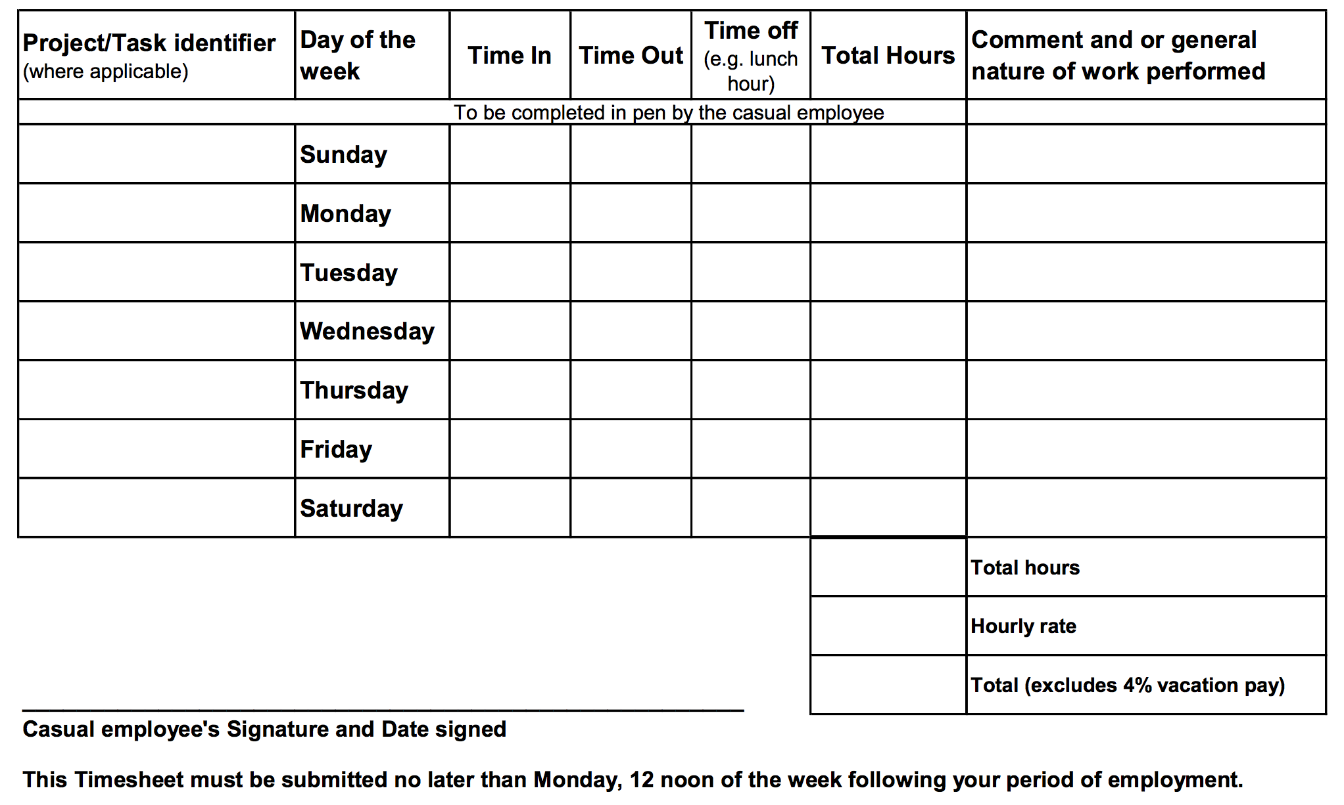
Programming
9
5
1
7
Programming
9
5
1
7
Programming
9
5
1
7
Programming
9
5
1
7
Programming
9
5
1
7
35
$16.00
$560.00

Slide 16
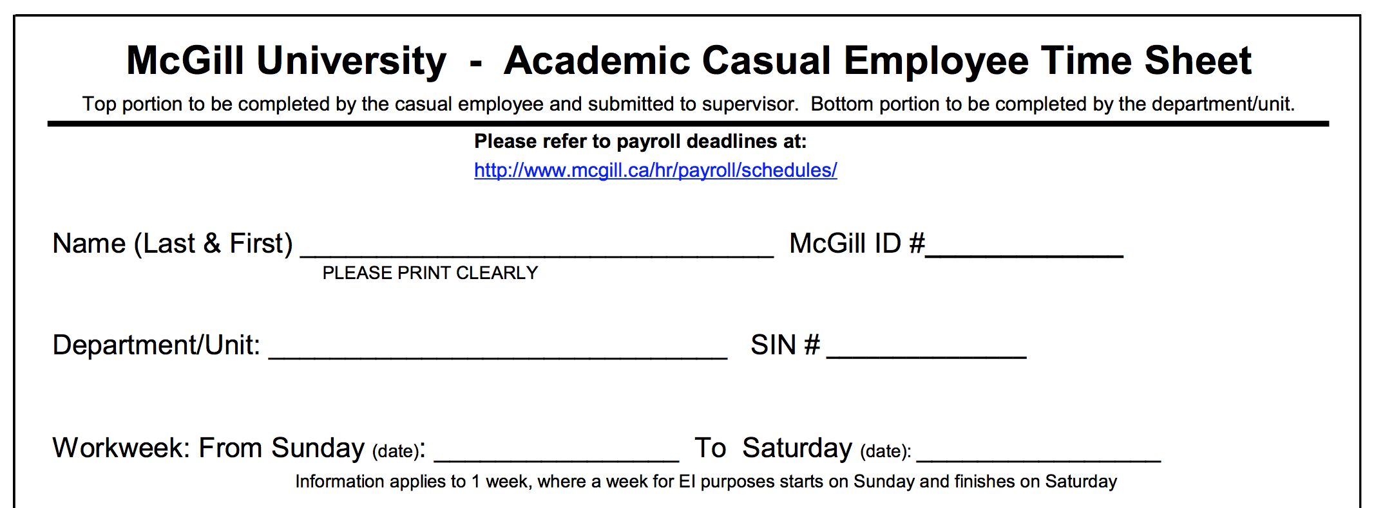
Music Research
Don’t fill this in!
Get these dates from your handbook

Slide 17
Keys to the lab
You should already be authorized (if your key card is working, you have permission to pick up a key)
Go to E222 in the Strathcona music building (10am-12pm, 2pm-4pm) to pick up

Slide 18
Notes:
Haymarket Massacre in 1886, police fired on workers striking for 8-hour day

