Slide 1
LinkedMusic Queries
Review and Handover
Junjun Cao
alienmusedh@gmail.com
There are corresponding hyperlinks in the following slides, pointing to specific documents or resources.
Notes:
I was previously a postdoctoral researcher here, supervising the application of linked data technologies for our LinkedMusic Project.
My presentation is structured around three main issues that provide a coherent throughline.

Slide 2
Query across Different Graphs
SPARQL-linked data query <- Subject+Predicate+Object’s triples
e.g.: Wikidata SPARQL endpoint: https://query.wikidata.org/
Query across different “graphs”(Federal Query):
LinkedMusic 2024 Oct. annual meeting: NLQ2SPARQL
The Session: (1) contrast with webpage (2) function beyond webpage
The Session + Wikidata
The Session + Wikidata +MusicBrainz
RISM: <-XML for elaborate metadata
see https://github.com/DDMAL/linkedmusic-queries/issues/61
the basic principle of
new challenge:
(1) difficult for data reconciliation
(2) difficult for schema-based NLQ2SPARQL
Notes:
The basic principle is mapping S-P-O patterns in RDF data and NLQ
comparison between webpage query and SPARQL query
RISM: It can be inferred that RISM’s RDF is converted from XML which contains lots of nested structures. Therefore it brought about new challenges for both data reconciliation and queries

Slide 3
NLQ2SPARQL
Question A: What is the “best context”? (refer to discussion 27)
The more concise, the better: try to leverage the pretrained knowledge of LLMs <- reconciliation with Wikidata
Query based on different context/prompt: (1) RDF snippets (2) Example pairs of NLQ & SPARQL (3)“schema”
——Literature Review: “for those database without schema”…
prompt types | database type | NO. of shots | technology feature
RDF snippets | oversized, unknown schema | 1-shot or few-shots | algorithm & computing-strength-oriented
NLQ&SPARQL | e.g. XML-featured | 1-most similar shot | similarity calculation between...
“Schema” | with schema or latent schema | 0-shot | knowledge-representation-oriented
Notes:
LLMs know lots of entities and properties of Wikidata
for the complex ones beyond the simple S-P-O structure,->
shots represent samples

Slide 4
NLQ2SPARQL
Graph Database: schema-free & flexibile & extensible
What if we can obtain a ready-made“nominal” schema?
All the 14 databases must have schemas;
after the conversion, will the schema disappear?
CSV2RDF/RDB2RDF within Virtuoso: ontology can be automatically generated via mapping with schema
e.g., Taking CantusDB as an example for RDB2RDF into Virtuoso)
Tutorial: https://github.com/DDMAL/linkedmusic-datalake/tree/main/doc/rdb2rdf
as a schema of RDF
Notes:
revist graph database. A graph data base can have a schema. For the sake of rigor, we call nominal schema
reproduce the schema

Slide 5
NLQ2SPARQL
Schema:
(1) ontology (open world hypothesis)
(2) shapes (close world hypothesis)
Ontology: RDFs -> OWL
(1) RDFs:
rdfs:domain - what is the class for the subject of the predicate
rdfs:range - what is the class for the object of the predicate
(2) OWL: ObjectProperty; DataProperty; owl:inverseOf...
Which is better, can we rely on only one?
OP: When the property value is another node
DP: When the property value is
purely data such as literals, strings, integer, dates, boolean...
Notes:
delve into schema in the context of linked data
up to now, we can rely on only one type of schema

Slide 6
NLQ2SPARQL
Question-B: LLMs can not concertrate when the ontology is too large
Experiment and solution:
E.g., Chinese Traditional Music Culture Knowledge Base (CTM or ESEA)
which has a complicated existing ontology
which can also support “knowledge reasoning”which may relieve LLMs
which has visualization facilities
whose vocabularies would like to be shared with LinkedMusic eg:instru...
Notes:
in previous experiments, we provided only small ontology snippets to specific questions
the straight way is to provide LLMs with the entire OWL

Slide 7
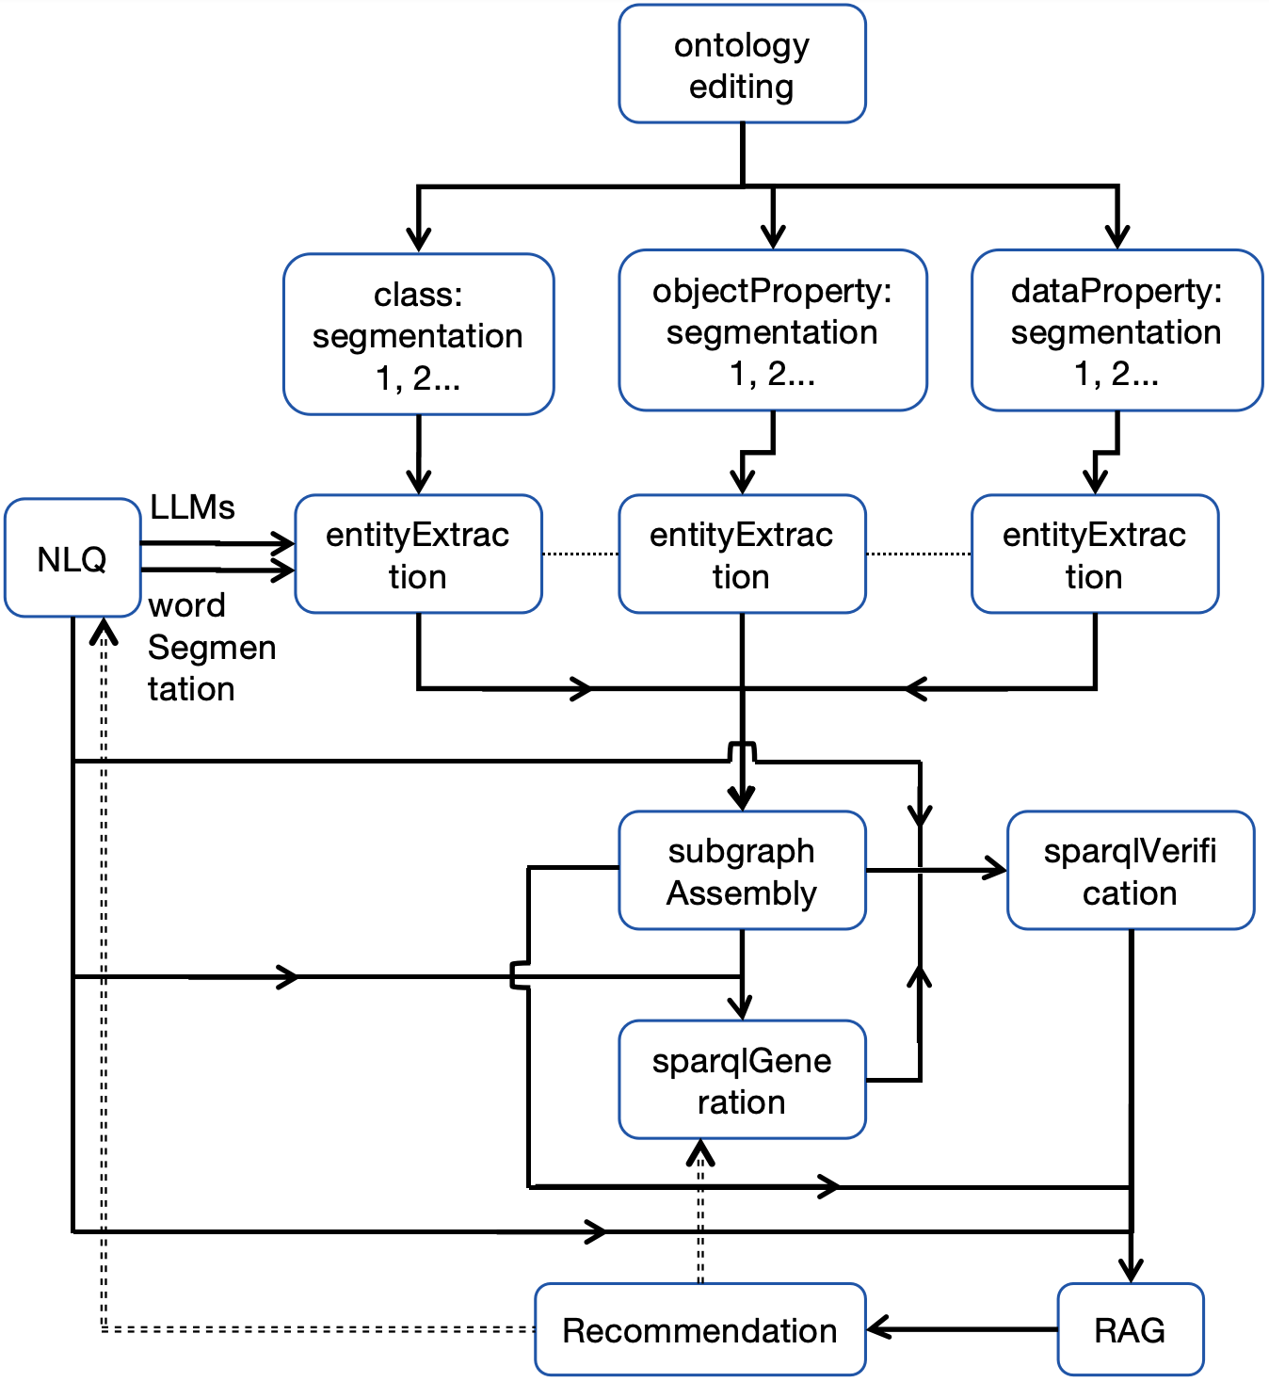

Python Script Workflow
Script:
1_entitiesExtractionFromNLQ_basedOnOntology.py
2_subGraphAssemblyFromOntology_3_SPARQLgeneration.py
Workflow:
1. Specific Ontology Editing
--Protege
(1) Clarification and Enrichment of ...
(2) Semantic reinforcement. Eg:inverse
use ontology to replace shapes
(3) Simplification
Notes:
schematic diagram

Slide 8
Python Script Workflow
2. Ontology Segmentation：into 3 parts
3. Entity Extraction from the Ontology Segments
LLMs are prompted to extract (isolated) entities from an NLQ by mapping them with all segments of the ontology. Hereby, the “entities” also include class, property, or instance.
——key point！It decides whether this approach is robust enough
4. (Ontology) Subgraph Re-Assembly
Ontology is also a special graph! The nodes represent classes,
Ambiguity of NLQ->Over-generalization->base for recommendation
and edges properties

Slide 9
Python Script Workflow
5. SPARQL Generation and Verification Based on Subgraph
(1)claude 4 (2) reflection: ontology for validation instead of shapes
6. Retrieval Augmented Generation(RAG) and Recommendation
Illustration on the retrieval result in respect to 3 contexts...
2 scenarios of the rusults:
(1) If the result is too large or complicated, e.g.: issues 60
(2) If the result is too small or even empty:
the retrieval scope is broadened by relaxing query conditions/constraints in the SPARQL query, and other possible query patterns can be recommended

Slide 10
Python Script Workflow
6. Retrieval Augmented Generation(RAG) and Recommendation
2 scenarios of the rusults:
(2) If the result is small or empty -> Recommendation Based on:
A. Relaxing SPARQL Constraint
B. the neighborhood within the Ontology Subgraph
The aforementioned (including literature review) can be found in the paper: ESEA (East-and-Southeast-Asian) Traditional Music Knowledge Base and its Ontology-subgraph-driven NLQ2SPARQL Intelligent Question-Answering System Research
--DDMAL/linkedmusic-queries

Slide 11
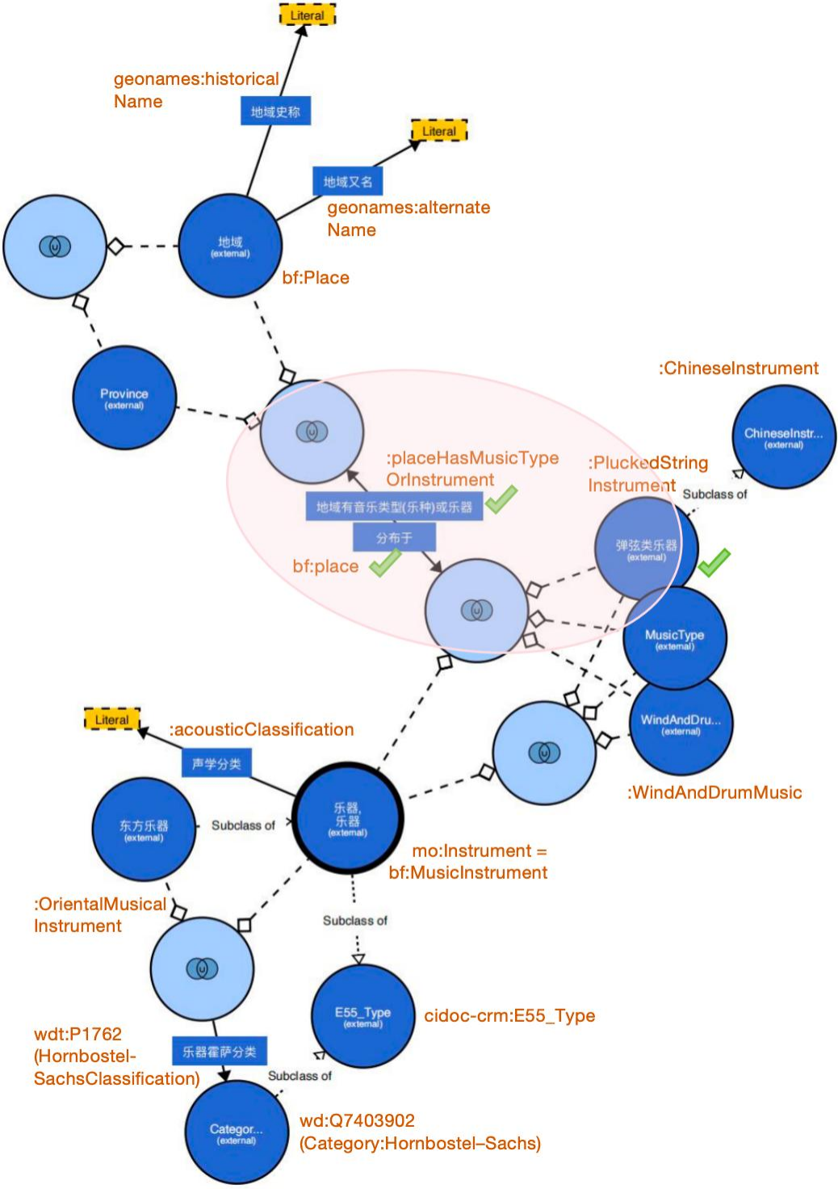
Python Script Workflow
NLQ: Where is the "dongbula" (dombra, 东不拉) distributed, and what other plucked string instruments are distributed in the same regions/places? -> Light Red Area
The Recommended pairs of NLQ & SPARQLs are based on the neighbourhood of the subgraph
Reflection：
(1) The Ambiguity of NLQ necessiates recommendation
(2) Limitation of the approach: SPO-triples-question
Notes:
prioritizes comprehensiveness than precision
Use LLMs to inversely create new NLQs along with SPARQL

Slide 12
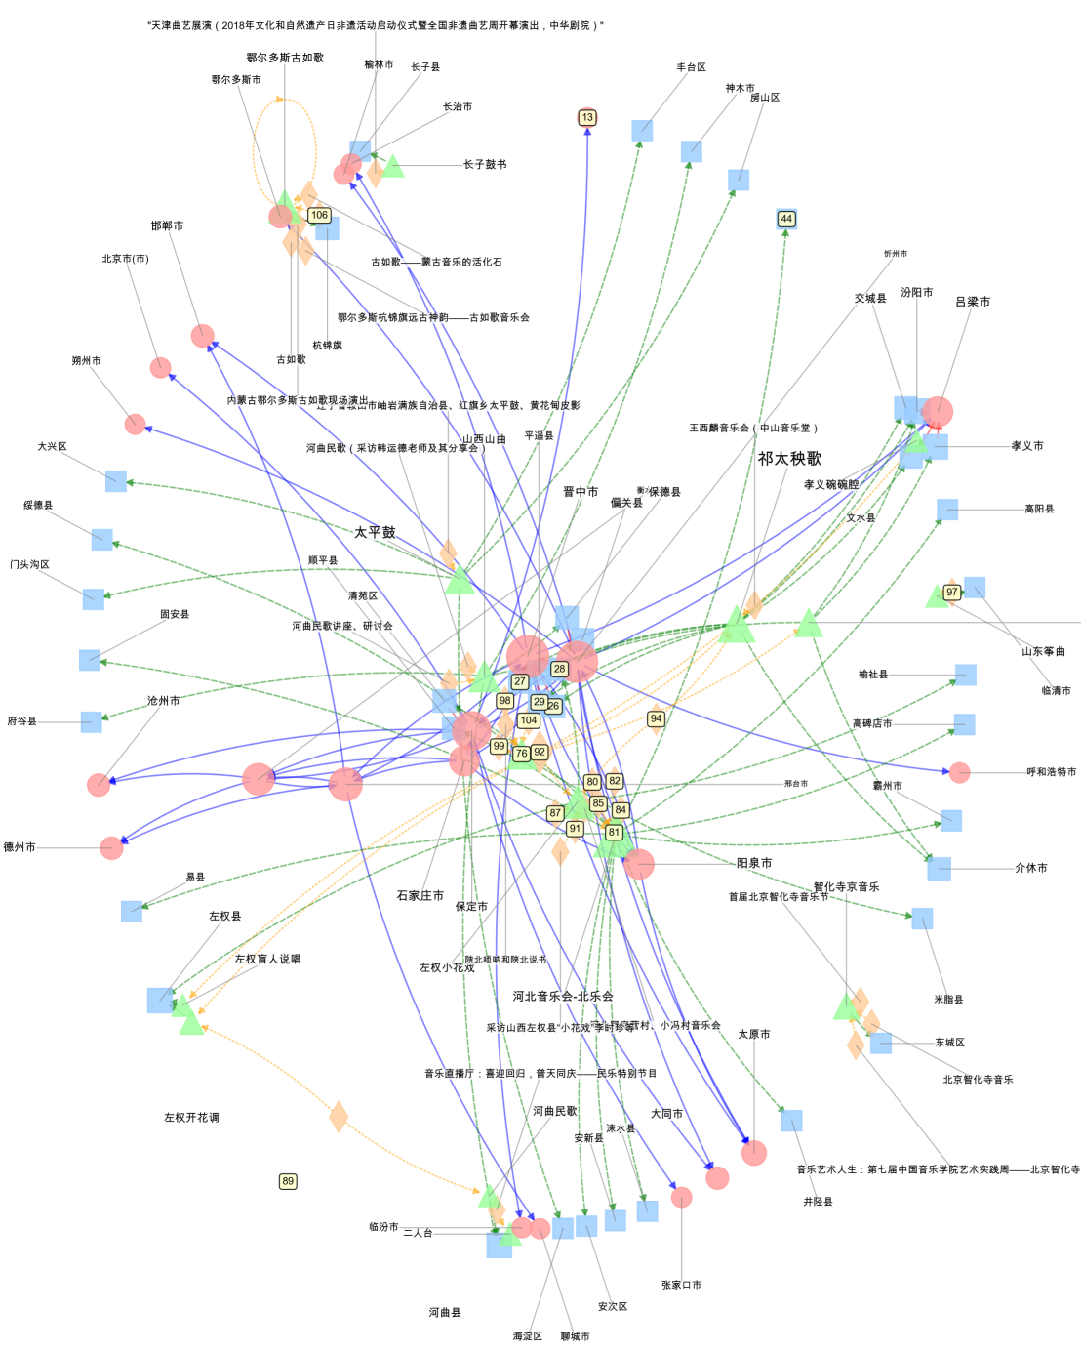
Advance
7* examples (storage)/ vector databases
e.g.: (1) nested structure such as that
in RISM (2) special functions queries e.g.
(3) granularized questions
8* NLQ2SPARQL2NetworkAnalysis
(1) Obtain data for heterogeneous network
analysis: generating“typed edge list” data
(2) Visualization
Notes:
time or geographical functions

Slide 13
Advance
Future Work:
Other NLQ examples beyond the scope of previous ... Modular workflow & Agent Development, 扣子 (e.g., coze developing platform)
--to faciliate live interaction between users and LLMs
Retrospection on:
2 orientations for NLQ2SPARQL
Question-C
How to obtain ontology from existing RDF data graph?
VOID (Vocabulary of Interlinked Datasets)：
https://github.com/DDMAL/void-generator
It's almost impossible to always generate the corect or expected SPARQL <-
ambiguity of NLQ
itself

Slide 14
Advance
Future Work:
Question-C: How to extract ontologies from... graphs in data lake?
(1) For CSV2RDF, e.g. TheSession, MusicBrainz...
VOID generator
e.g.: Generate the ontology for TheSession
(2) For RDB2RDF, e.g. CantusDB, SimmsaDB...
The internal process of RDB2RDF in Open Link Virtuoso
e.g.: https://github.com/DDMAL/linkedmusic-datalake/tree/main/doc/rdb2rdf
Notes:
VoID can be used to describe multiple named graphs within a Virtuoso data lake, especially by capturing their shared use of ontology vocabularies, which supports semantic integration.

Slide 15
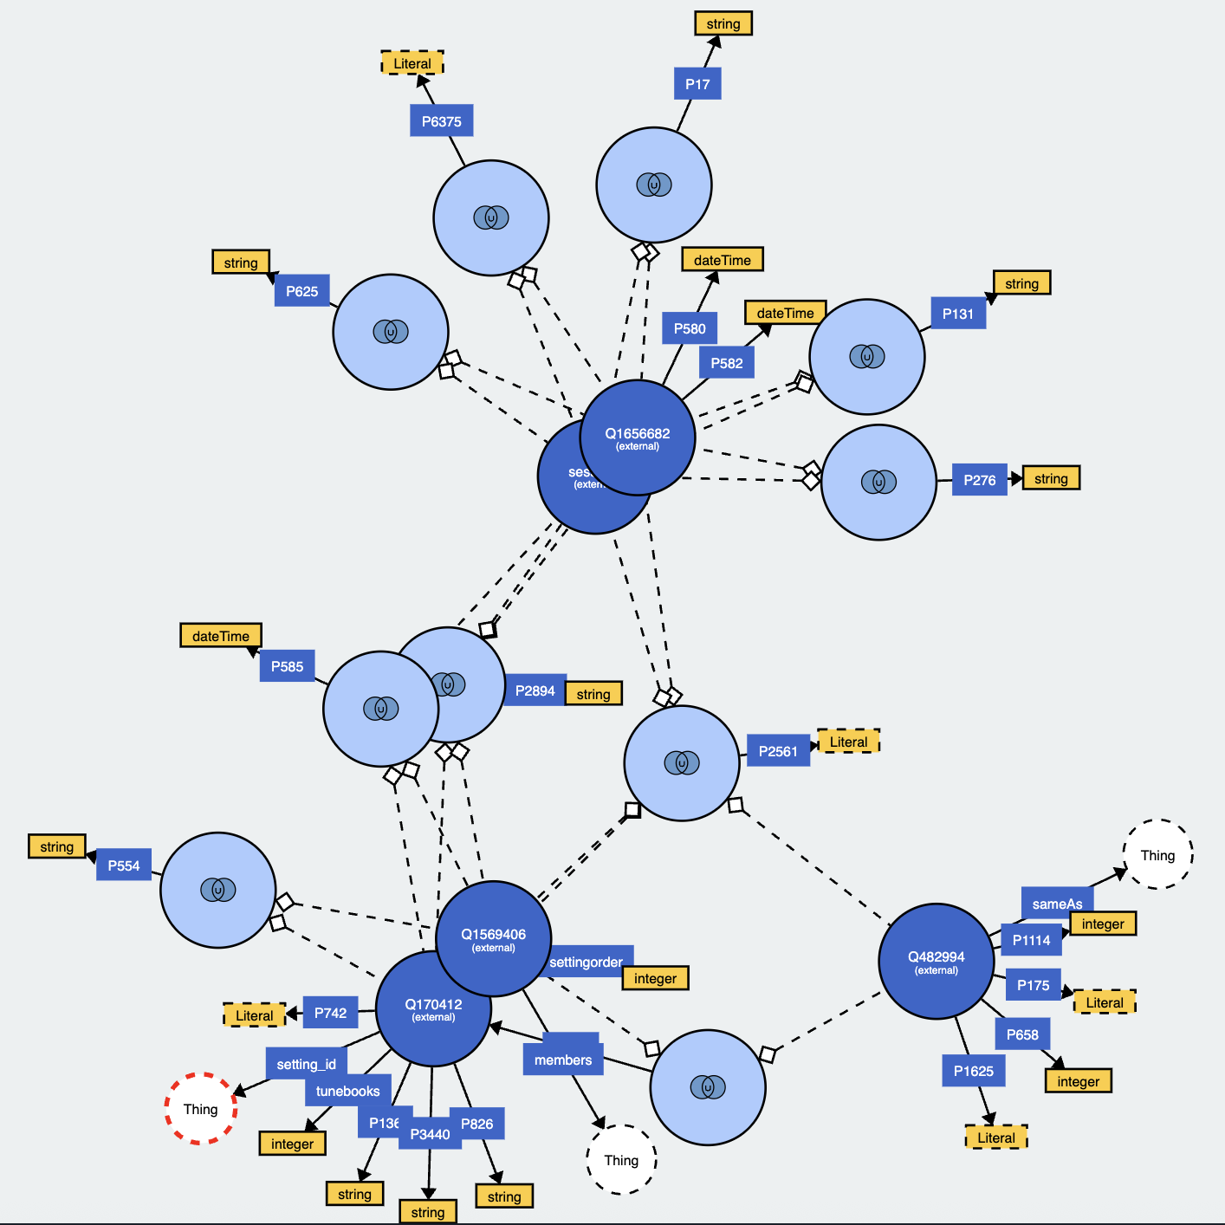
Advance
-> TheOntologyFor TheSession
unionOf classes
light blue circles with “U”
owl:objectProperty
between 2 nodes
owl:dataProperty
yellow squares
owl:Thing

Slide 16
Addition/Reflection on Data Reconciliation and RDF Conversion
Different scenarios and ways of None-graph-DBs to RDF
https://github.com/DDMAL/linkedmusic-datalake/tree/main/doc/CSV2RDFInVirtuoso
A summary of data reconciliations:
Guidelines or suggestions for data reconciliation (updated from time to time; collecting advice from everyone)
Logs & Archives for reconciliations: (1)Properties in ...mapping.json file (2) Archived Excels
The co-existence of unreconciled data and reconciled data
To what extent will the reconciliation be conducted? -> for queries
preparation for ontology; balance between ObjectProperty and DataProperty
Blank nodes and Named Graph
Bulk Loader
Notes:
（1）Any instance in the RDF dataset should be specified with a rdf:type.
（2）We may not reconcile all of them even if we can, because some information can be viewed as dataProperty instead of objectProperty.
100% reconciliation strategy is just like regarding all the properties as object property, which may cause a lot of tough work or burderns on the data structure. The keypoint is like a trade-off between OP and DP. The suggestion is, to respect the original schema of RDB

Slide 17
Thank you!
Junjun Cao
alienmusedh@gmail.com

