Slide 1
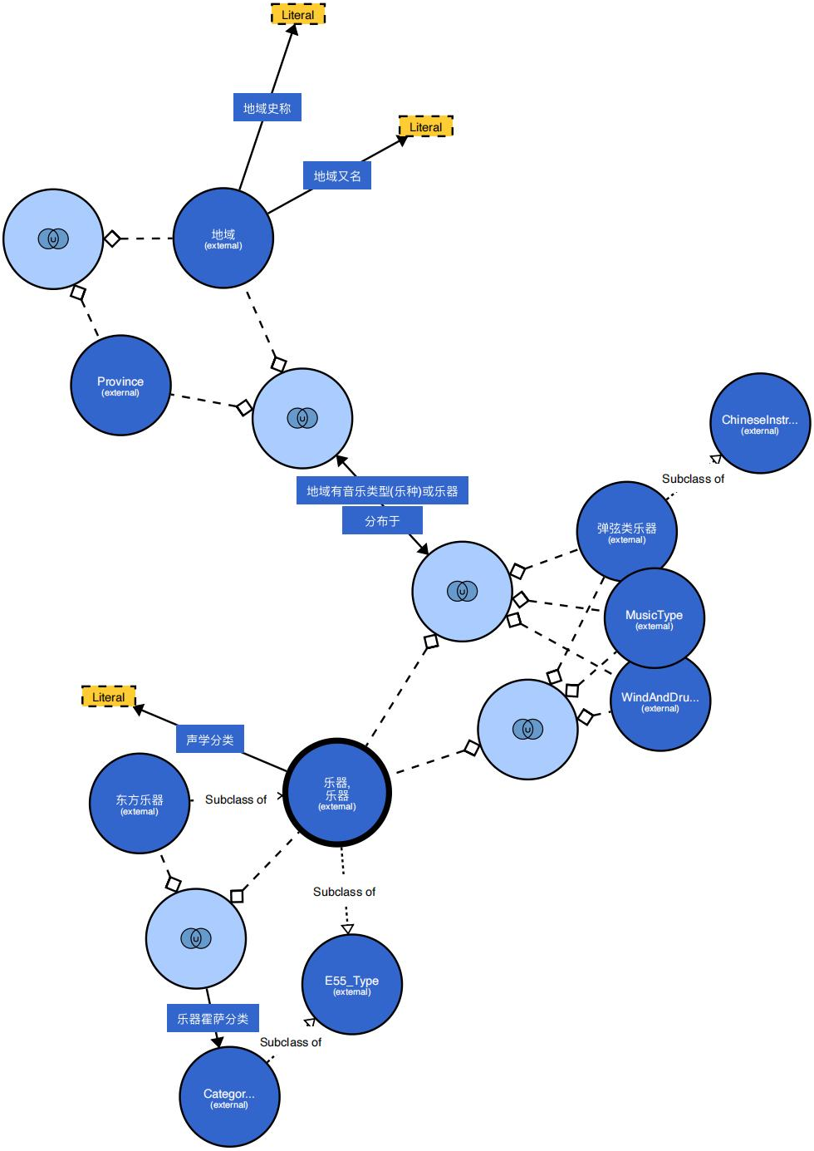
geonames:historicalName
geonames:alternateName
bf:Place
:ChineseInstrument
:placeHasMusicTypeOrInstrument
:PluckedStringInstrument
bf:place
:acousticClassification
:WindAndDrumMusic
mo:Instrument = bf:MusicInstrument
:OrientalMusicalInstrument
wdt:P1762
(Hornbostel-
SachsClassification)
cidoc-crm:E55_Type
wd:Q7403902 (Category:Hornbostel–Sachs)

