Slide 1
LinkedMusic Queries
Review and Handover

Slide 2
Query across Different Graphs
SPARQL-linked data query
Wikidata SPARQL endpoint: https://query.wikidata.org/
Query across different “graphs”:
LinkedMusic 2024 Oct. yearly meeting: NLQ2SPARQL
The Session
The Session + Wikidata
The Session + Wikidata +MusicBrainz
RISM: <-XML

Slide 3
NLQ2SPARQL
What is the “best context”?
The more concise, the better: try to leverage the pretrained knowledge of LLMs<-reconciliation with Wikidata
Query based on different context/prompt: (1) RDF snippets (2) Example queries (3)“schema”
——Literature Review: “for those database without schema”…
Graph Database: schema-free & flexibile & extensible
What if we can obtain a ready-made“nominal” schema?
CSV2RDF/RDB2RDF within Virtuoso: ontology can be automatically generated

Slide 4
NLQ2SPARQL
Schema:
(1) ontology (open world hypothesis)
(2) shapes (close world hypothesis)
Ontology: RDFs, OWL
(1) RDFs:
rdfs:domain
rdfs:range
(2) OWL: object property; data property; inverseOf...

Slide 5
NLQ2SPARQL
Issue-1: LLMs can not concertrate when the ontology is too large
(why)
Experiment and solution:
Chinese Traditional Music Culture Knowledge Base (CTM)
which has a complicated existing ontology
which can also support “knowledge reasoning”which may relieve LLMs
which has visualization facilities
which aims at joining in LinkedMusic

Slide 6
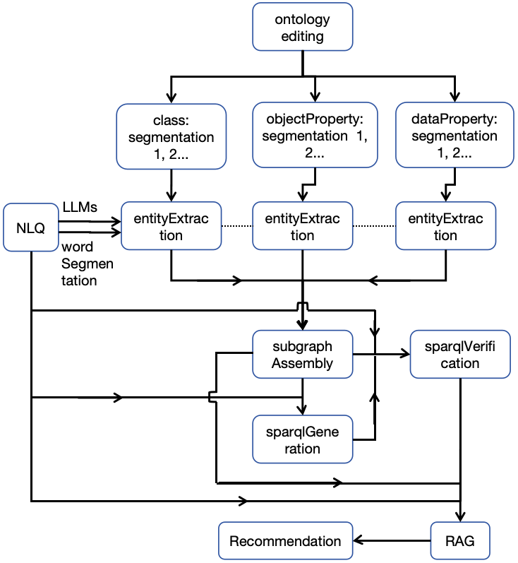
Python Script Workflow
Script:
1_entitiesExtractionFromNLQ_basedOnOntology.py
2_subGraphAssemblyFromOntology_3_SPARQLgeneration.py
Workflow:
1. Specific Ontology Editing
--Protege
(1) Clarification and Enrichment of ...
(2) Semantic reinforcement. Eg:inverse
use ontology to replace shapes
(3) Simplification

Slide 7
Python Script Workflow
2. Ontology Segmentation：into 3 parts
3. Entity Extraction from the Ontology Segments
LLMs are prompted to extract entities from an NLQ by mapping them with all segments of the ontology. Hereby, the “entities” also include class, property, or instance.
——key point！
4. (Ontology) Subgraph Assembly
Ontology is also a special graph!
Overgeneralization->base for recommendation

Slide 8
Python Script Workflow
5. SPARQL Generation and Verification Based on Subgraph
(1)claude 3.7 (2) reflection: using ontology for validation
6. Retrieval Augmented Generation(RAG) and Recommendation
Illustration on the retrieval result in respect to 3 contexts...
2 scenarios of the rusults:
(1) If the result is too large
(2) If the result is too small or even empty:
the retrieval scope is broadened by loosening query conditions/constraints in the SPARQL query, and other possible query patterns can be recommended

Slide 9
Advance
7* examples (storage)/ vector databases
8* SPARQL2NetworkAnalysis
(1)Obtain data for h...network typed edge list data
(2)Visualization

Slide 10
Advance
Other NLQ examples beyond the scope of previous ... Agent Development
--interaction
How to generate ontology from existing RDF data graph?
VOID
Retrospection on”:
(1) Data Reconciliation and CSV/JSON/RDB2SPARQL
(2) 2 directions for NLQ2SPARQL
Future Work:
How to generate ontologies from... graphs in data lake?

