Slide 1
Model-fitting
ABC + DL
CNN/LAN/NLE

Slide 2
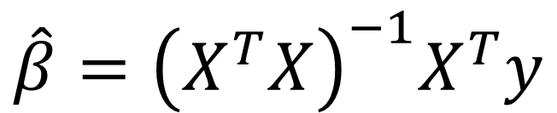
Model-fitting:
Models with analytical solutions:
T-test , Linear regression(Gaussian distribution)...
$$\hat{β}={\left(X^{T}X\right)}^{−1}X^{T}y$$

Slide 3
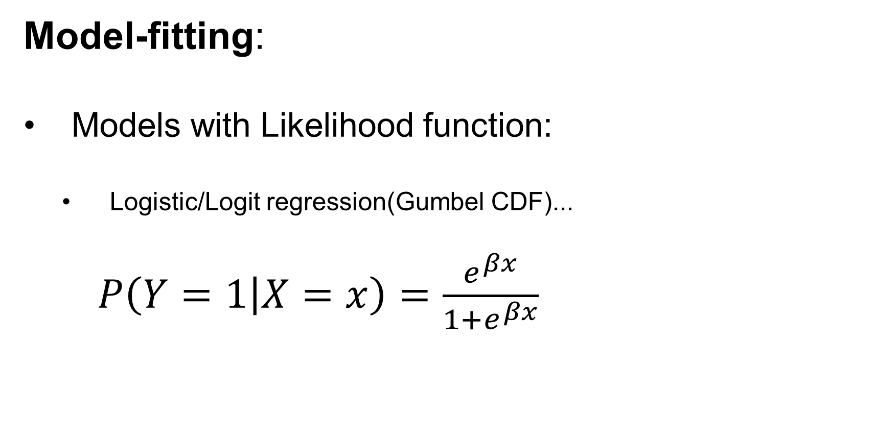
Model-fitting:
Models with Likelihood function:
Logistic/Logit regression(Gumbel CDF)...
$P\left(Y=1 | X=x\right)=\frac{e^{βx}}{1+e^{βx}}$

Slide 4
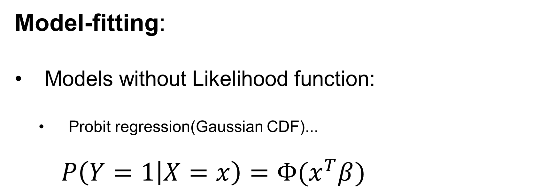
Model-fitting:
Models without Likelihood function:
Probit regression(Gaussian CDF)...
$P\left(Y=1 | X=x\right)=Φ(x^{T}β)$

Slide 5
Model-fitting:
Models have the likelihood function $L(θ|D)$
Models we can simulate

Slide 6
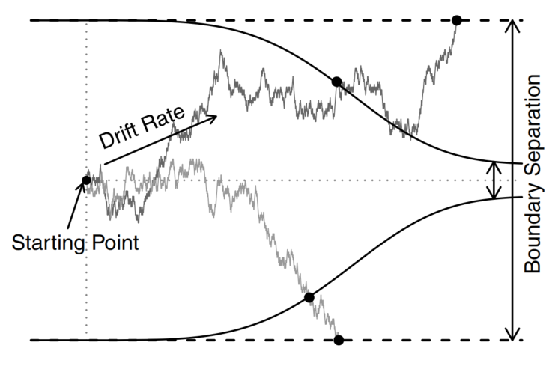
Model-fitting:
Most SSMs have no likelihood function…
Hawkins et al., 2015

Slide 7
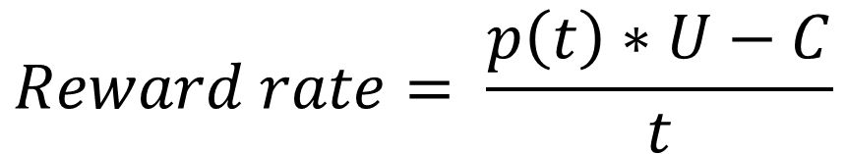
Model-fitting:
Most SSMs have no likelihood function…
$$Reward rate= \frac{p\left(t\right)∗U−C}{t}$$
Hawkins et al., 2015

Slide 8
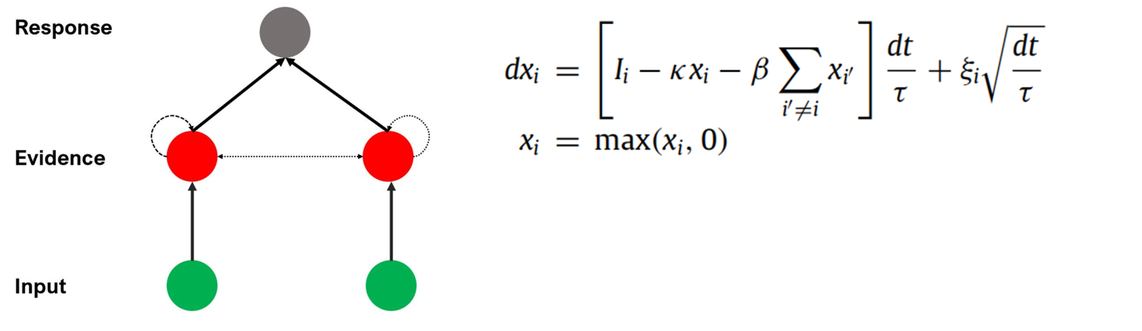
Model-fitting:
Most SSMs have no likelihood function…
Usher & McClelland, 2001

Slide 9
Model-fitting:
Fitting SSMs without likelihood function
Simulation methods:
Step1:Define a summary statistics(Chi/G-square/K-S test/WLS)
Step2:Use black-box optimization algorithm(DE-optim/Simplex) to minimize the summary statistics.

Slide 10
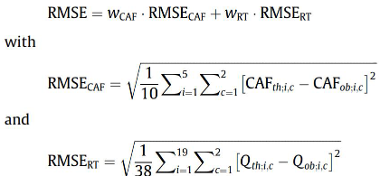

Model-fitting:
Fitting SSMs without likelihood function
Simulation methods:
Step1:Define a summary statistics(Chi/G-square/K-S test/WLS)
Step2:Use black-box optimization algorithm(DE-optim/Simplex) to minimize the summary statistics.

Slide 11
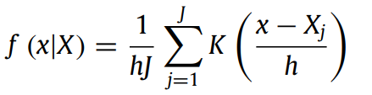
Model-fitting:
Fitting SSMs without likelihood function
Simulation methods:
A special case:
PDA+MLE/Bayesian (Turner&Sederberg,2014) :

Slide 12
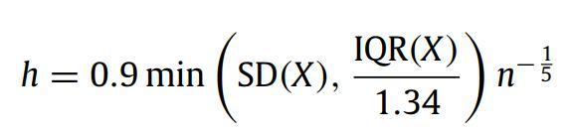
Model-fitting:
Fitting SSMs without likelihood function
Simulation methods:
A special case:
PDA+MLE/Bayesian (Turner&Sederberg,2014) :

Slide 13
Model-fitting:
Fitting SSMs without likelihood function
Simulation methods:
Cons:
Summary statistics may not have the sufficiency to capture the needed information.
The time cost of simulation is extremely high.
Impossible to use gradient-based optimization/sampling algorithm.

Slide 14
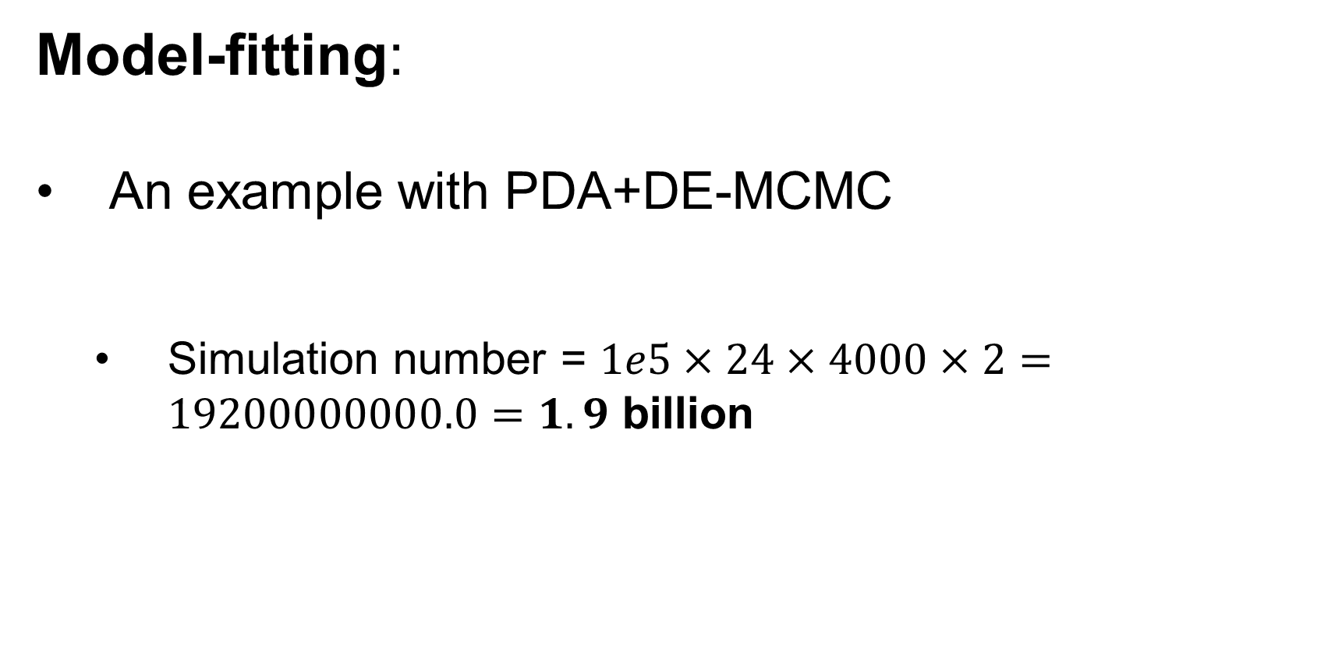
Model-fitting:
An example with PDA+DE-MCMC
Simulation number = $1e5×24×4000×2=19200000000.0=1.9$ billion

Slide 15
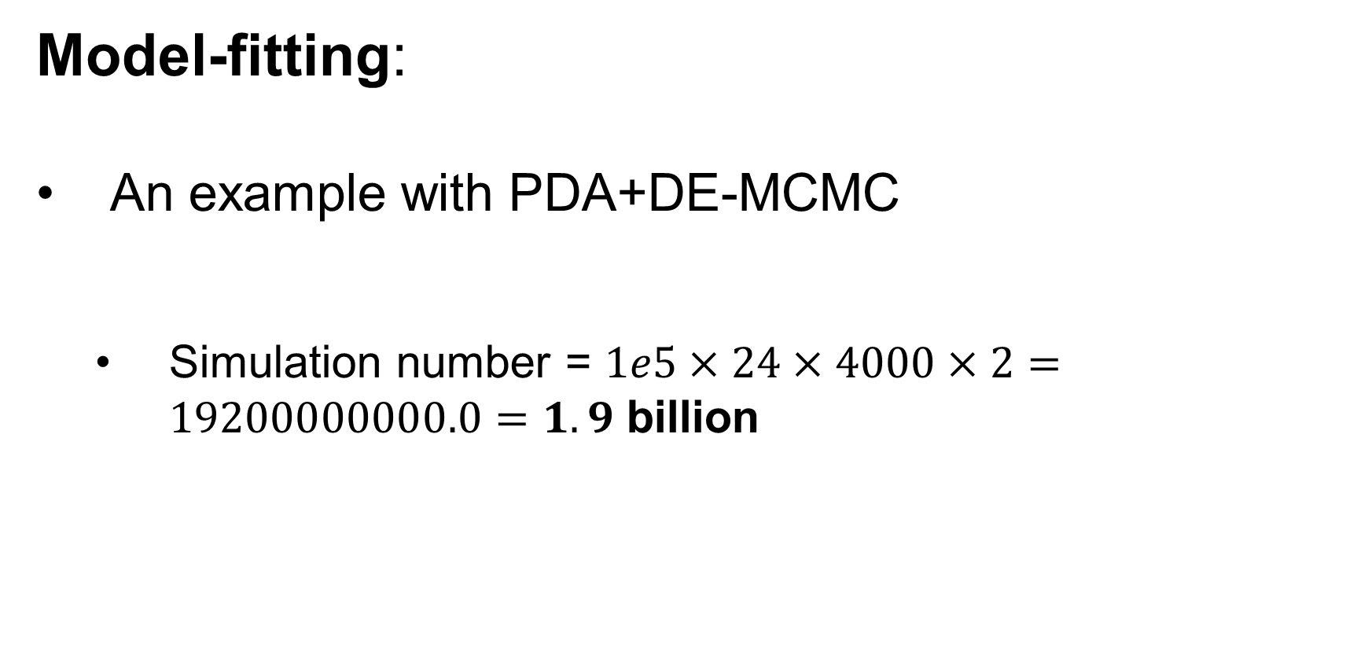
Model-fitting:
An example with PDA+DE-MCMC
Simulation number = $1e5×24×4000×2=19200000000.0$ $=1.9$ billion
Chain
Iteration
Likelihood ratio

Slide 16
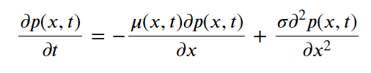
Model-fitting:
Fitting SSM without likelihood function
Numerically solving the Fokker-Planck equation:

Slide 17
Model-fitting:
Fitting SSM without likelihood function
Numerically solving the Fokker-Planck equation:
Cons:
Almost impossible to apply gradient-based optimization/sampling algorithm.

Slide 18
Model-fitting:
Fitting SSM without likelihood function
Numerically solving the Fokker-Planck equation:
Cons:
Still requires lots of computation time.

Slide 19
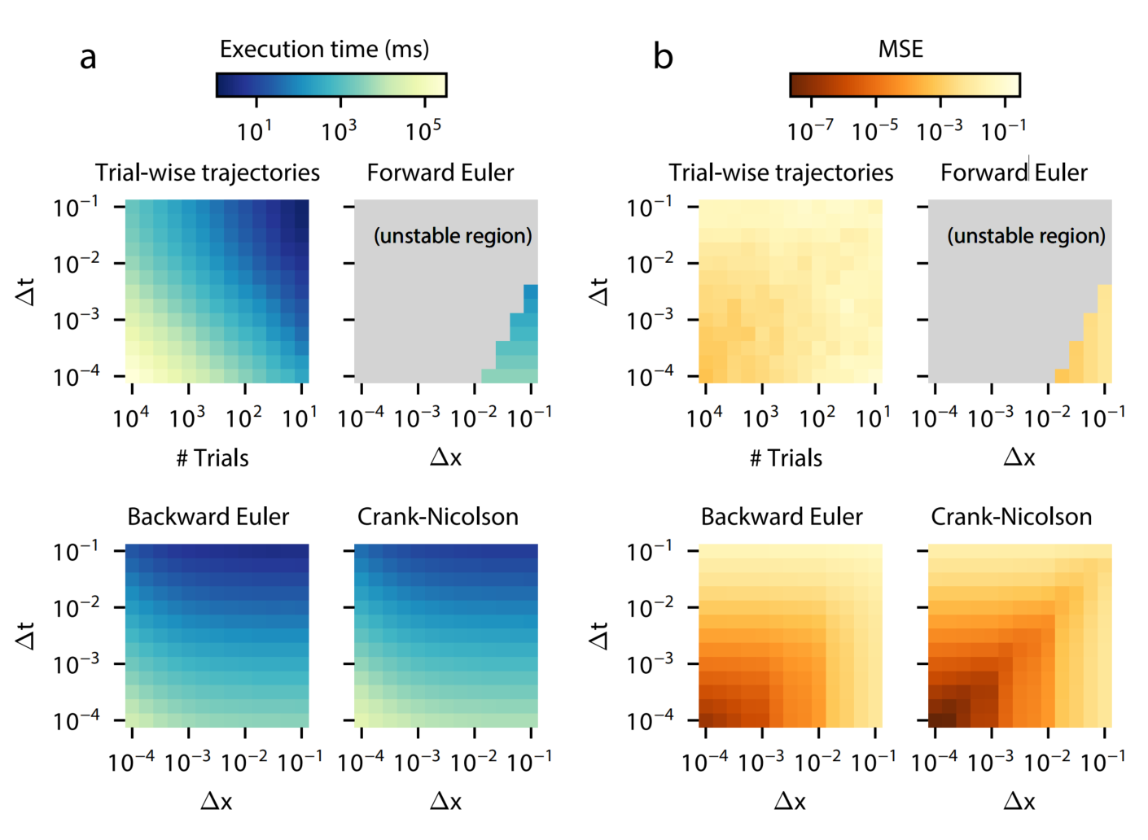
Model-fitting:
Fitting SSM without likelihood function
Numerical solving Fokker-Planck equation:
Shinn et al., 2020

Slide 20
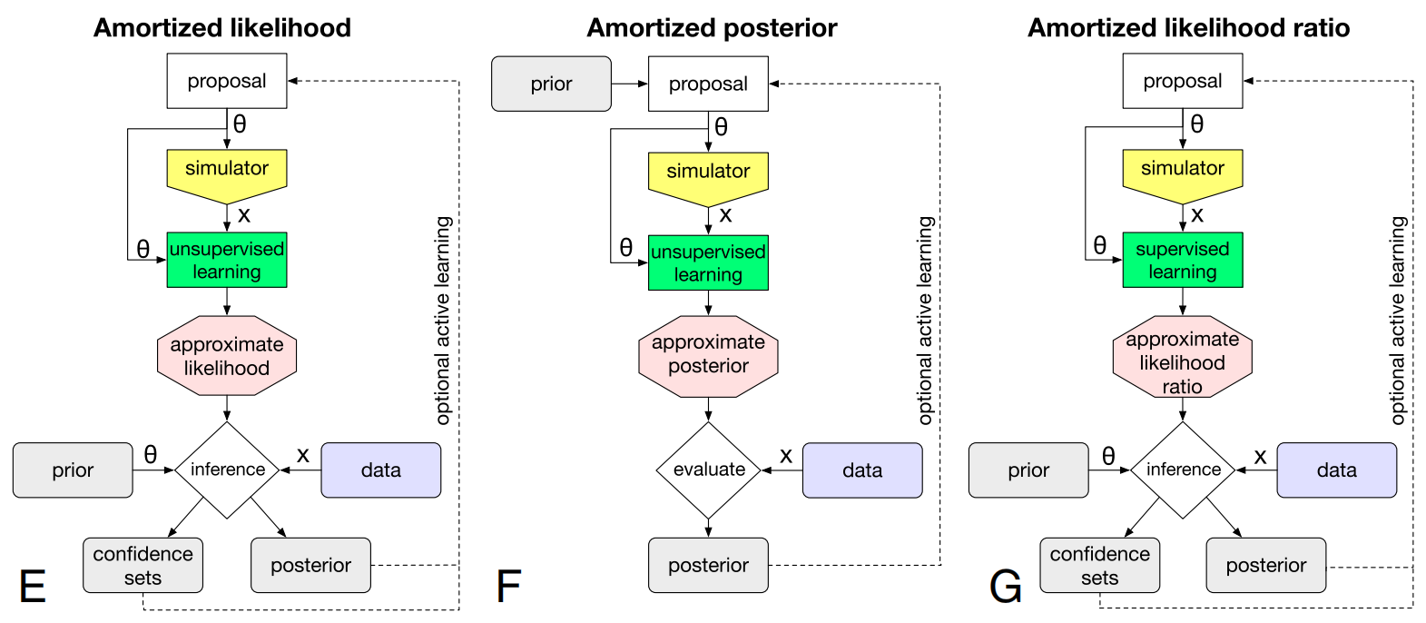

Approximate Bayesian Computation:
Possible solution: Combine DL with ABC
Cranmer et al., 2020

Slide 21
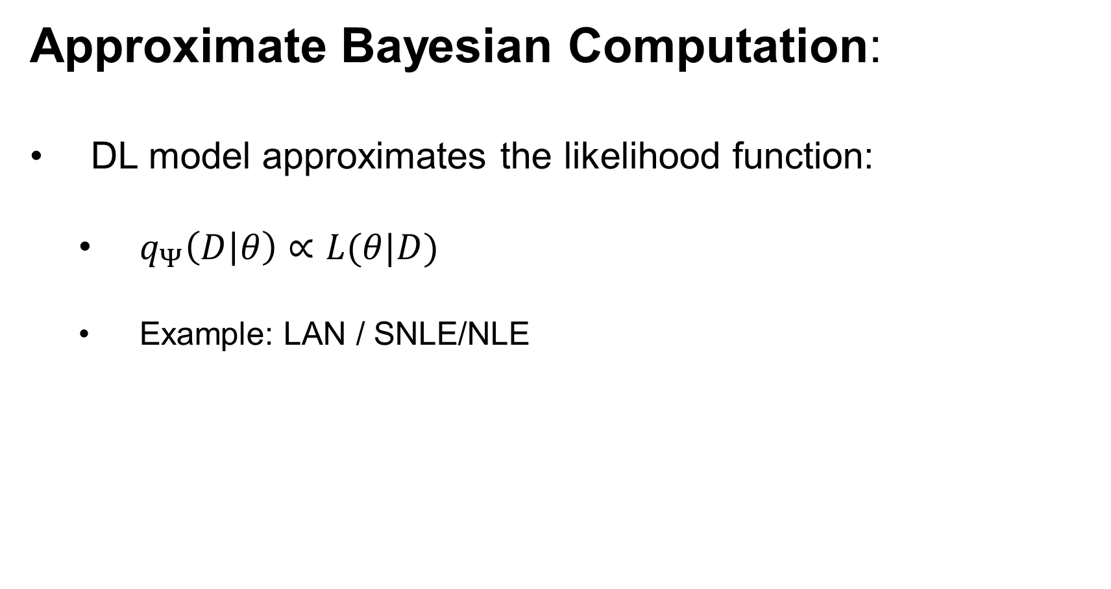
Approximate Bayesian Computation:
DL model approximates the likelihood function:
$q_{Ψ}\left(D | θ\right)∝L(θ|D)$
Example: LAN / SNLE/NLE

Slide 22
Approximate Bayesian Computation:
Confusion of names:
NLE: Neural likelihood estimation.
SNLE: Sequential neural likelihood estimation.
MNLE: Mixture neural likelihood estimation.

Slide 23
Approximate Bayesian Computation:
DL model approximates the likelihood function:
Pros:
More flexible(arbitrary prior distribution).
Can be easily adapted to the hierarchical model.
Much faster than traditional ABC.

Slide 24
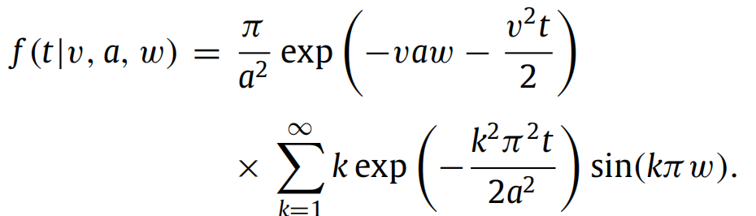
Approximate Bayesian Computation:
DL model approximates the likelihood function:
Pros:
More flexible(arbitrary prior distribution).
Can be easily adapted to the hierarchical model.
Much faster than traditional ABC(sometimes even faster than analytical solution).

Slide 25
Approximate Bayesian Computation:
DL model approximates the likelihood function:
Cons:
Inference stage is slower than the latter two methods.

Slide 26
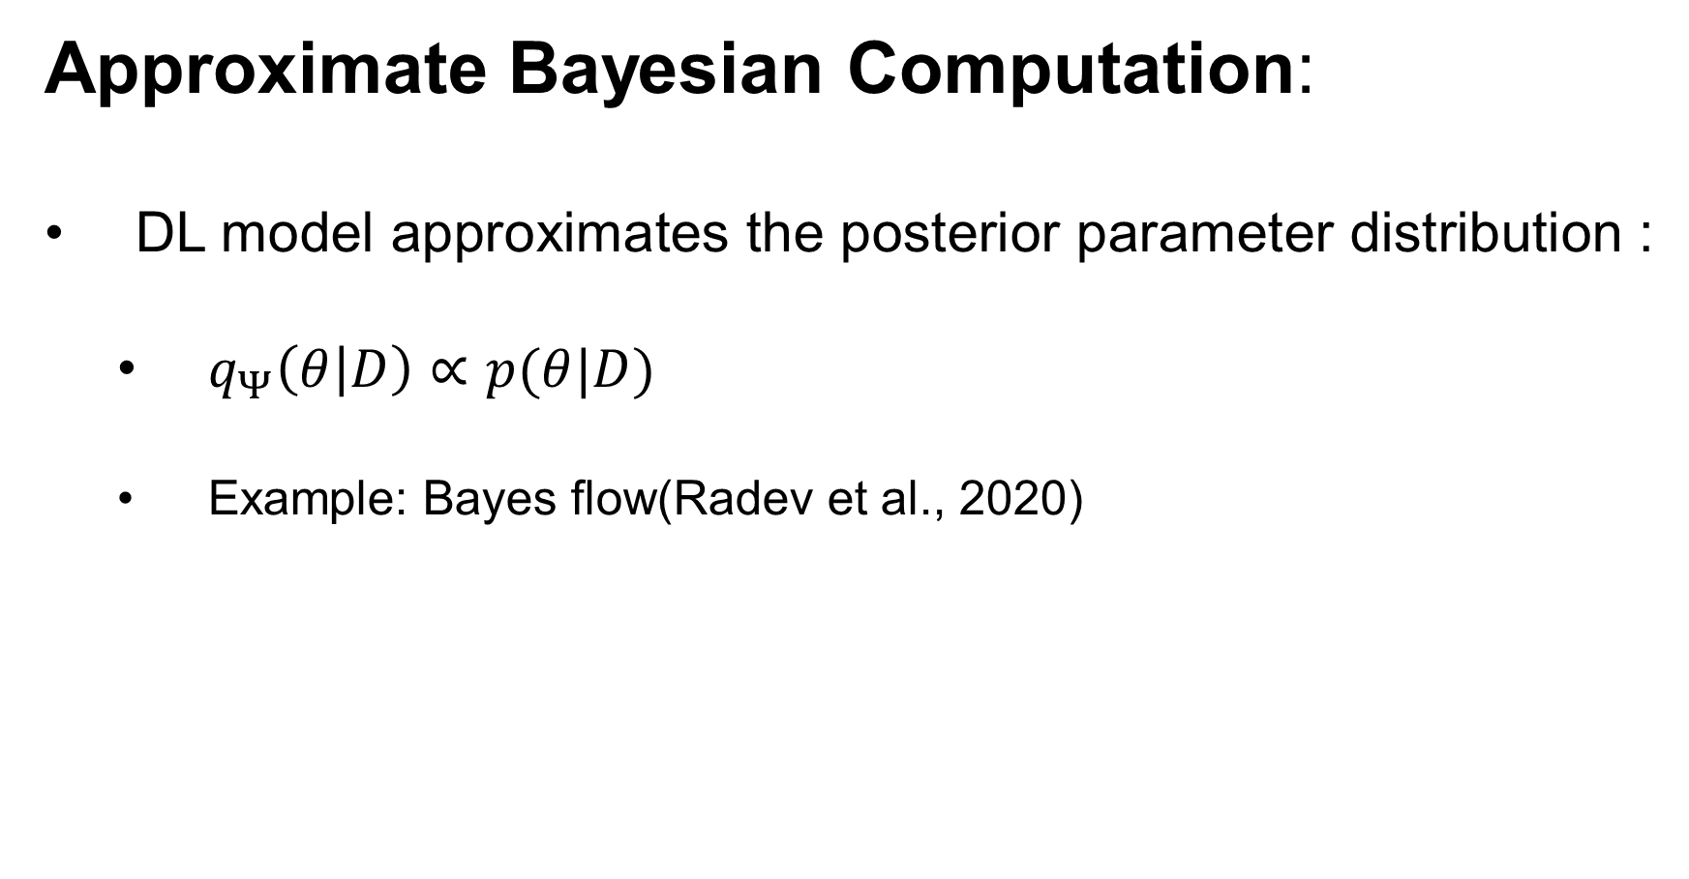
Approximate Bayesian Computation:
DL model approximates the posterior parameter distribution :
$q_{Ψ}\left(θ | D\right)∝p(θ|D)$
Example: Bayes flow(Radev et al., 2020)

Slide 27
Approximate Bayesian Computation:
DL model approximates the posterior parameter distribution:
Pros:
Inference stage needs very little time(Super fast).
Provides full posterior parameter distribution.

Slide 28
Approximate Bayesian Computation:
DL model approximates the posterior parameter distribution:
Cons:
Hard to apply to the hierarchical model.
Cannot adjust prior distribution after the DL model is trained.

Slide 29
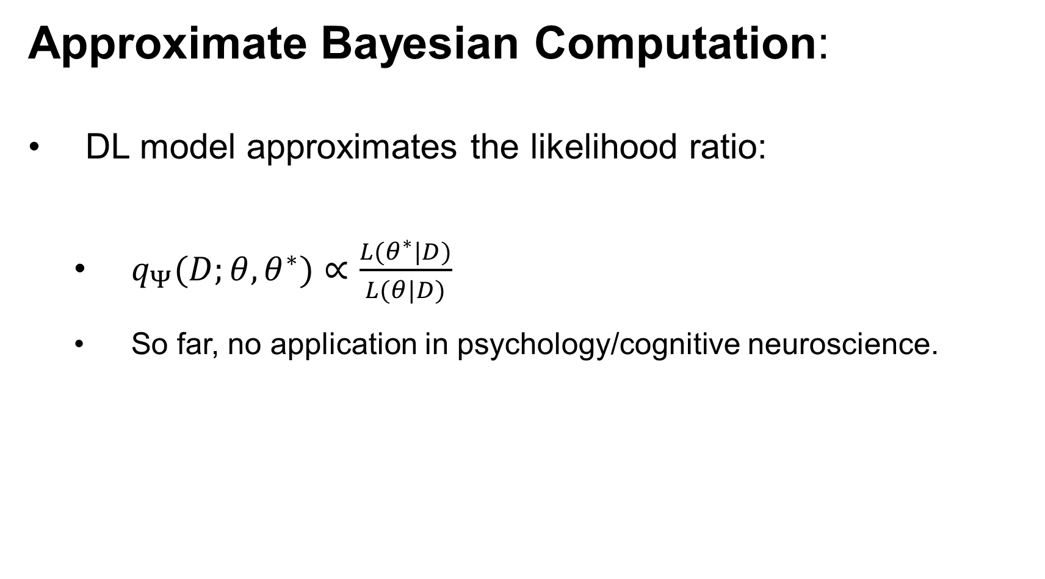
Approximate Bayesian Computation:
DL model approximates the likelihood ratio:
$q_{Ψ}(D;θ,θ^{∗})∝\frac{L(θ^{∗}|D)}{L(θ|D)}$
So far, no application in psychology/cognitive neuroscience.

Slide 30
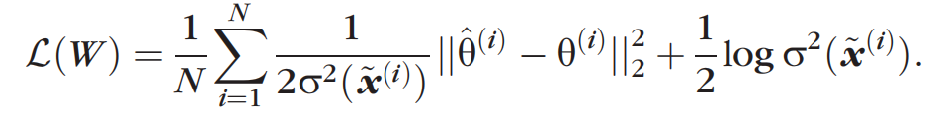
CNN-ABC:
CNN + Heteroscedastic loss:
Loss function:

Slide 31
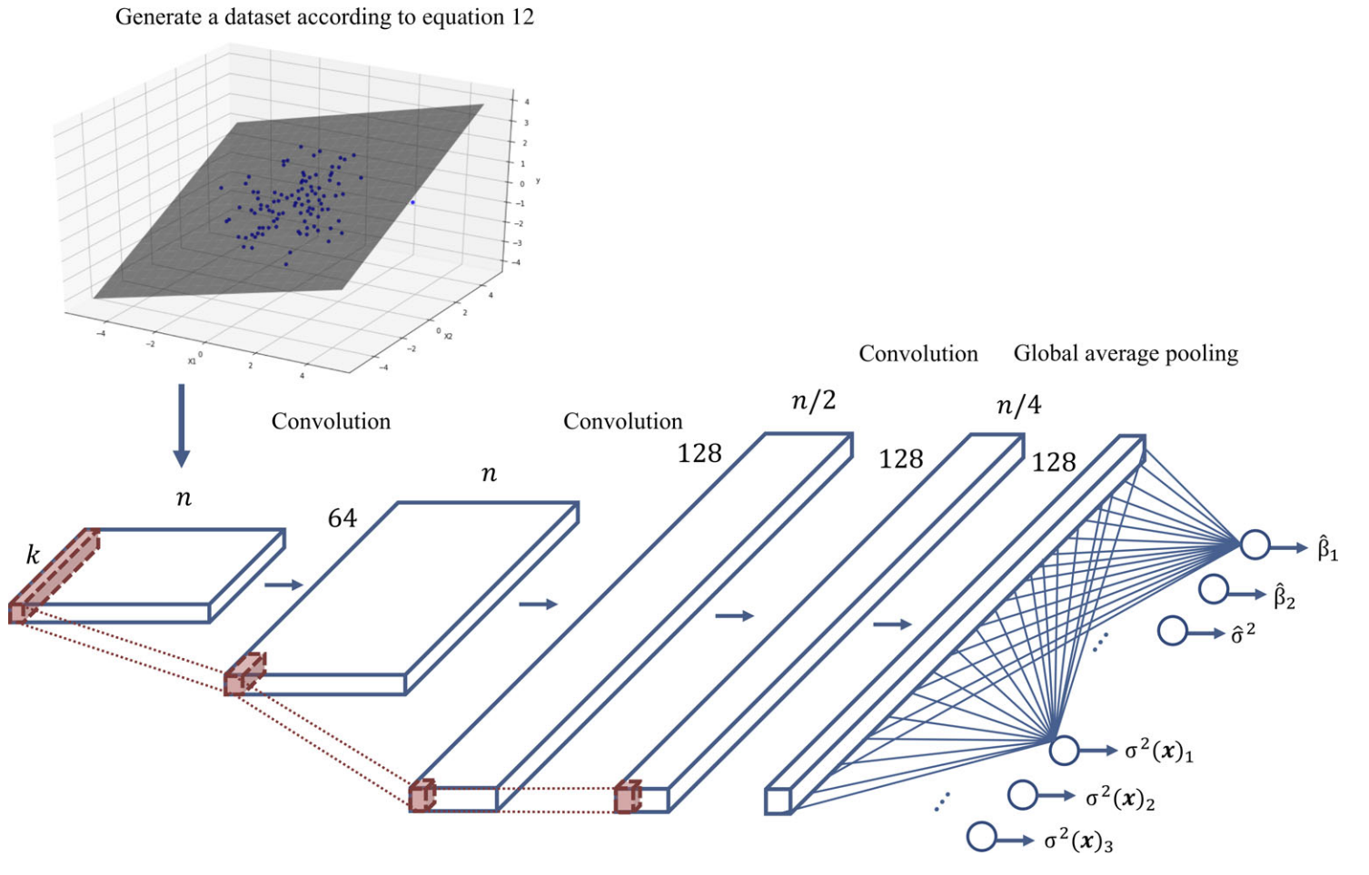
CNN-ABC

Slide 32
CNN-ABC
Stride=1
Stride=2

Slide 33
CNN-ABC
Kernel=1
Kernel =3

Slide 34
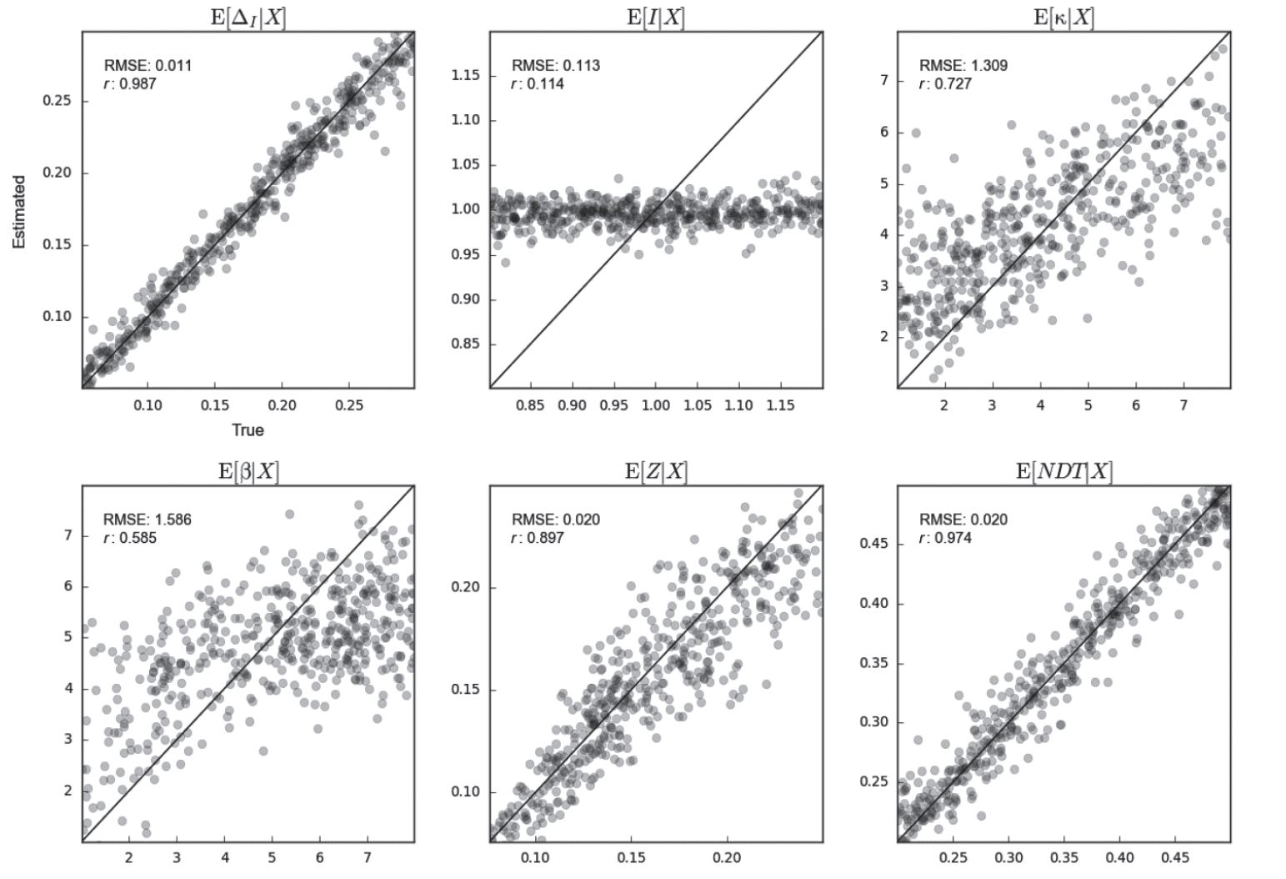
CNN-ABC
Parameter recovery for LCA:

Slide 35
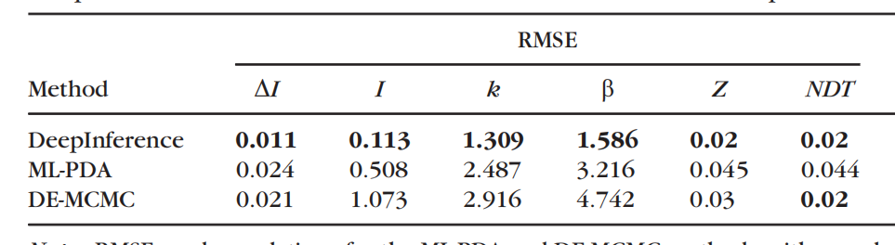
CNN-ABC
Parameter recovery for LCA:
Comparison between PDA+MLE, PDA+DE-MCMC and CNN-ABC

Slide 36
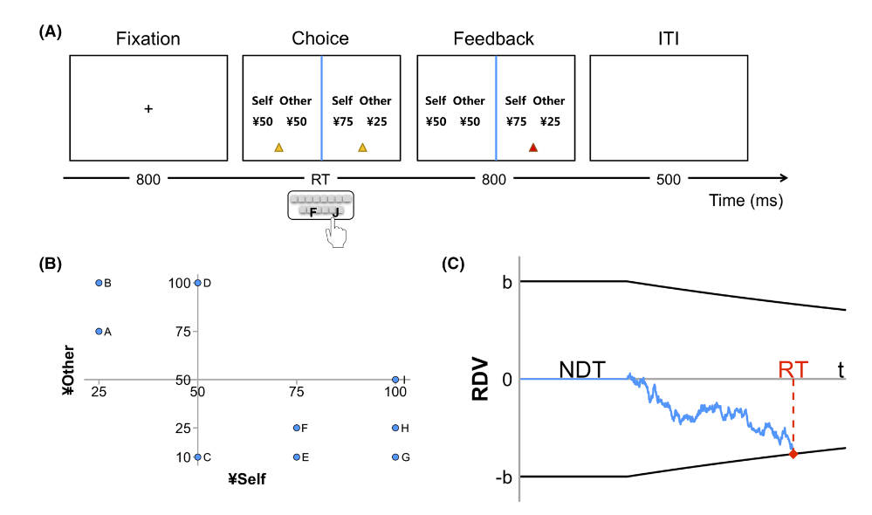
CNN-ABC
Parameter recovery for collapse boundary model:
Li, Zhang, Yuan & Rao, 2022

Slide 37
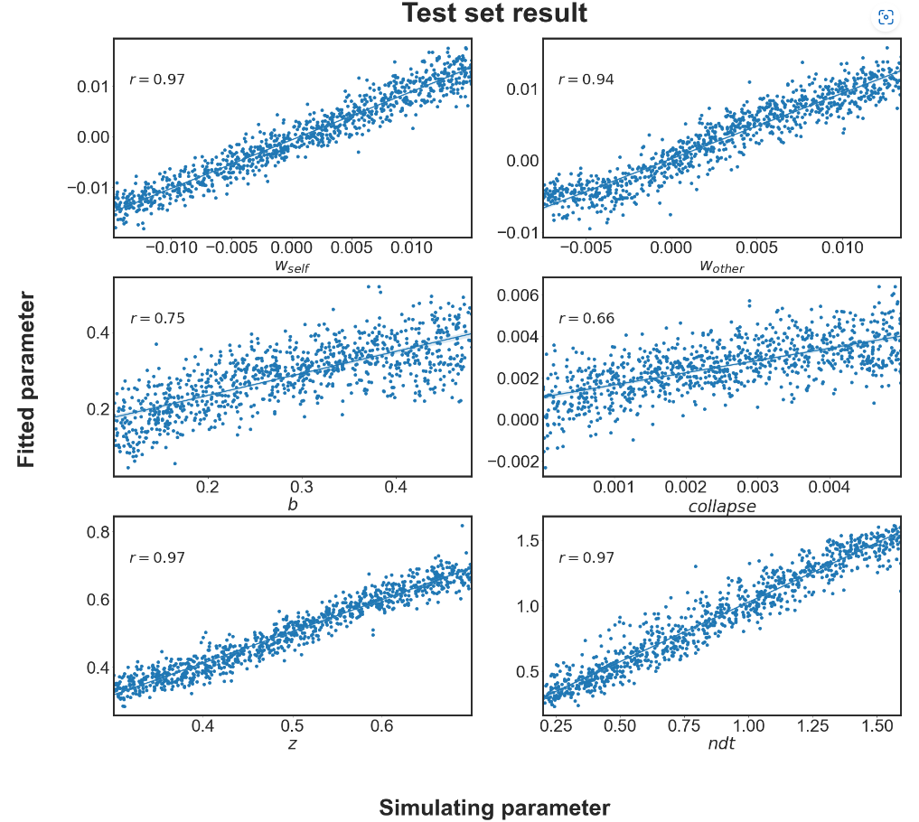
CNN-ABC
Parameter recovery for collapse boundary model:

Slide 38
CNN-ABC
Summary:
Pros:
Easy to implement.
Fast training.
Good parameter recovery.

Slide 39
CNN-ABC
Summary:
Cons:
Only return the expected value and variance of the parameter(assuming gaussian distribution).
Hard to apply to the hierarchical model.

Slide 40
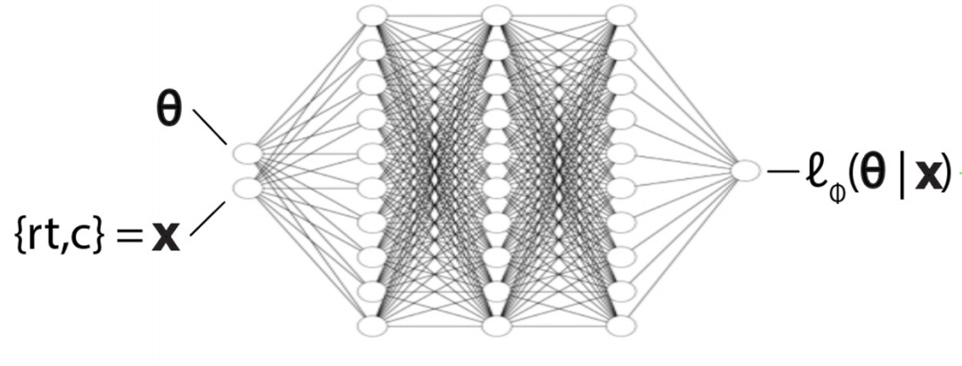
LAN
Network structure:
Fully connected MLP + KDE:
Generated by KDE

Slide 41

LAN
Network structure:
Fully connected MLP + KDE:
Three hidden layers: $[100, 120, 100]$
Approximate $2e5$ parameter number.

Slide 42
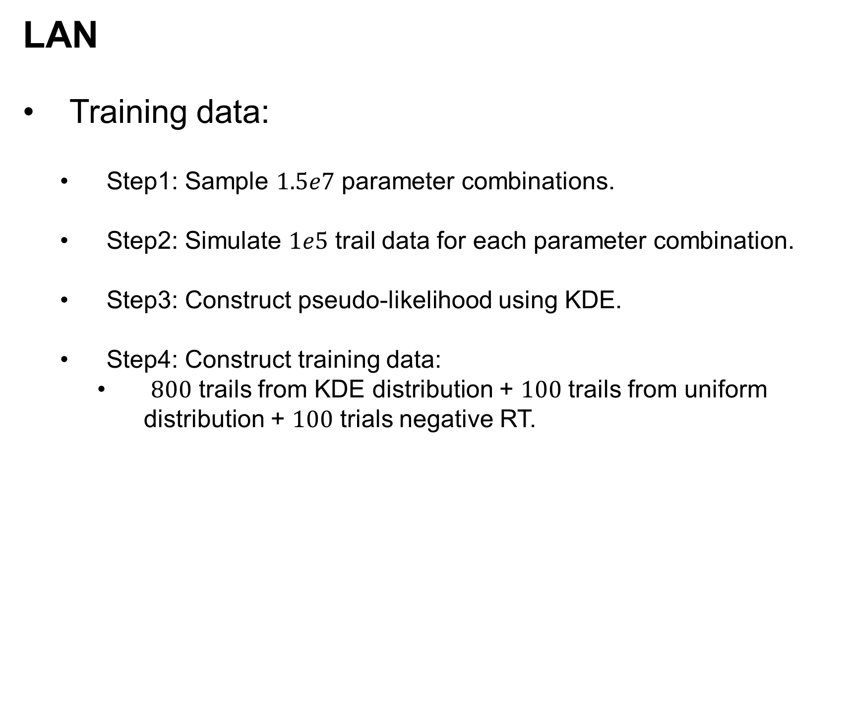
LAN
Training data:
Step1: Sample $1.5e7$ parameter combinations.
Step2: Simulate $1e5$ trail data for each parameter combination.
Step3: Construct pseudo-likelihood using KDE.
Step4: Construct training data:
$800$ trails from KDE distribution + $100$ trails from uniform distribution + $100$ trials negative RT.

Slide 43

LAN
Bottleneck:
Large simulation number: $1.5$ million $× 1e5$.
Training time is longer than MNLE/Bayes flow(Due to large training data($1.5$ million $×$ $1000$)).
KDE provides a biased approximation of likelihood.

Slide 44

LAN
My own trying:
Model: 4 parameter Pure DDM
Simulation number: $1.5e6$ $× 1e5$.
Simulation + KDE: 6 hours on TR2990WX.
Training time: Huber loss: 2.5 hours for one epoch.
MSE loss: 30 minutes for one epoch.

Slide 45
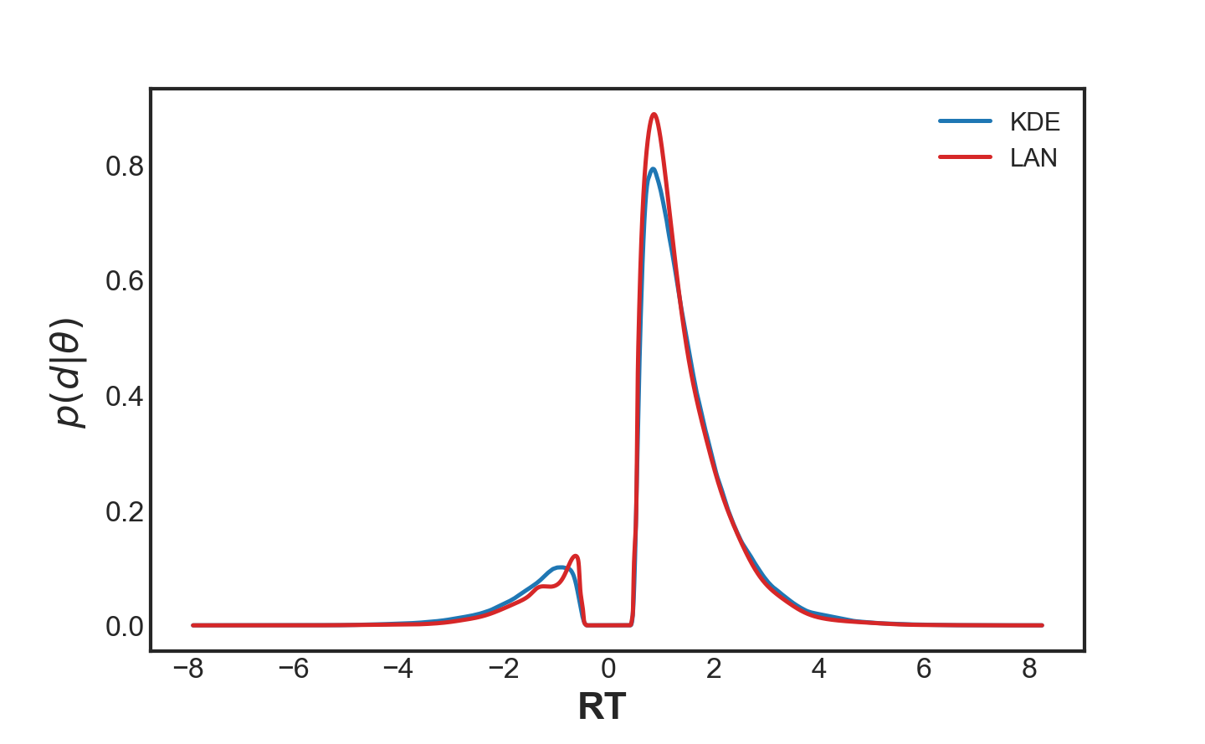
LAN
My own trying:
3 epoch result:

Slide 46
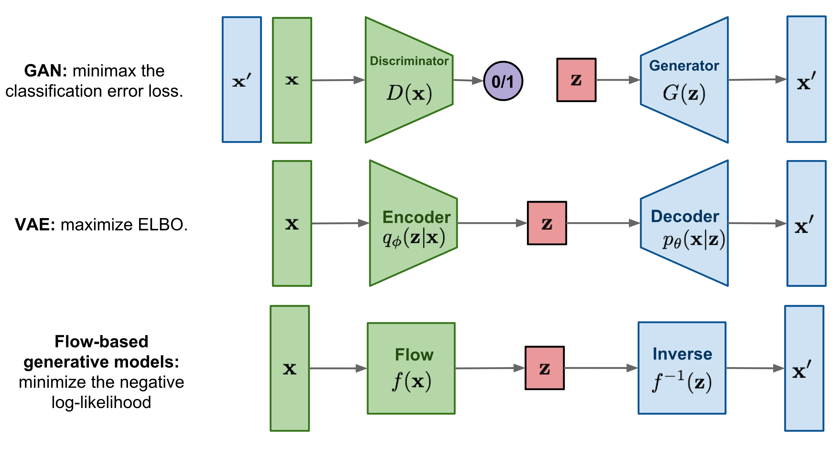
MNLE (Boelts et al., 2022)
Flow-based model:

Slide 47
MNLE
Flow-based model:
Change of variables

Slide 48
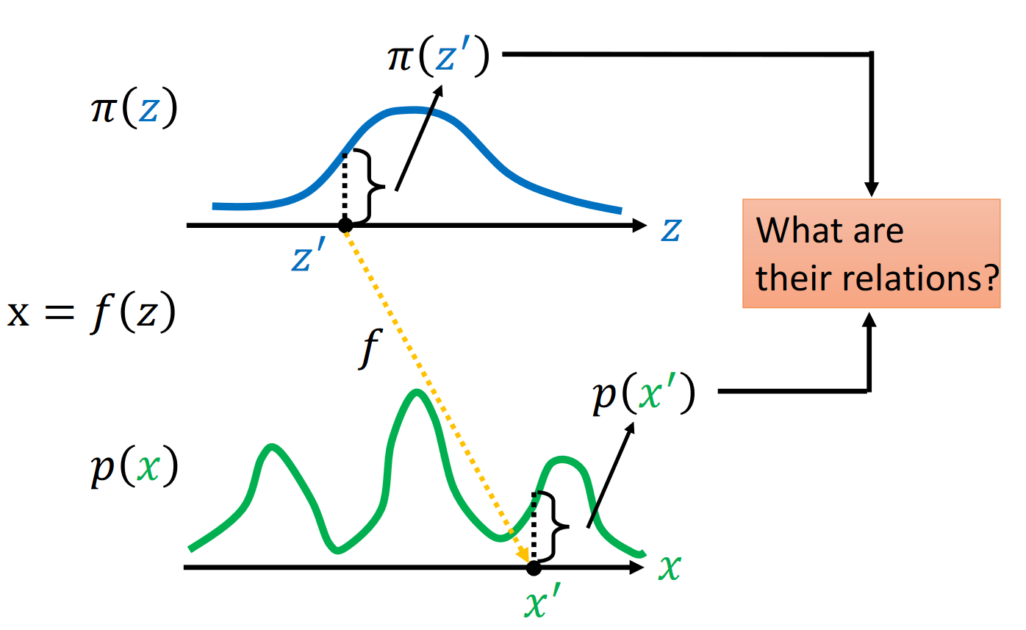
MNLE
Change of variables
李宏毅老师的随堂PPT

Slide 49
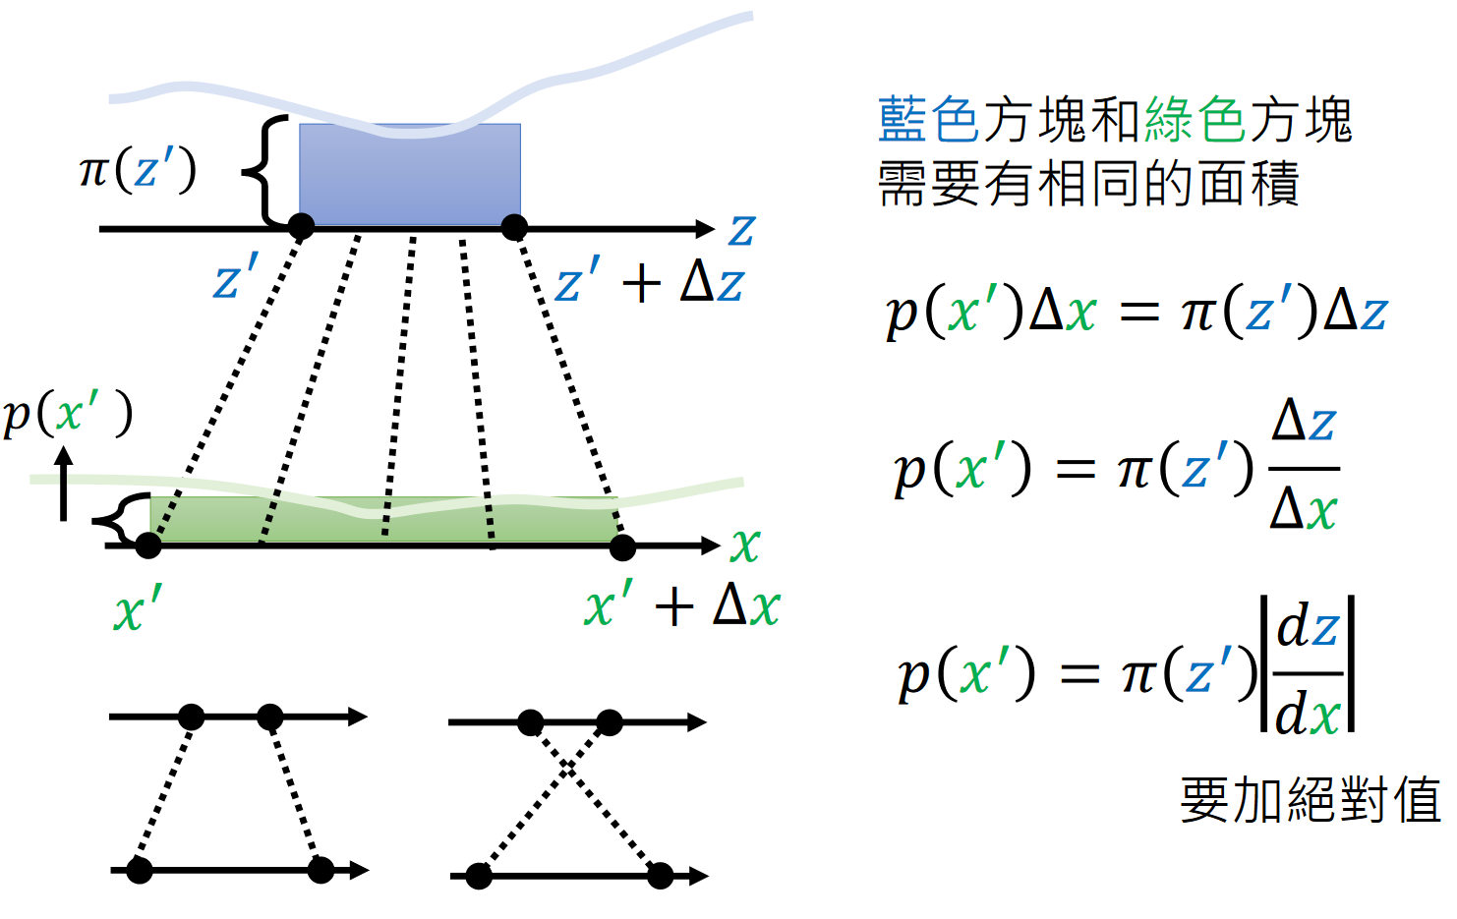
MNLE
Change of variables

Slide 50
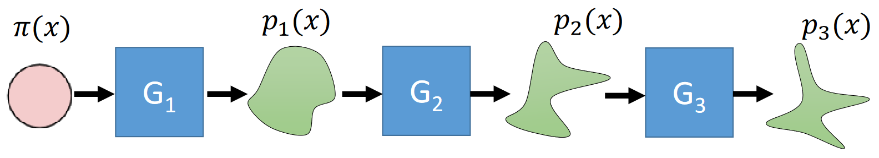
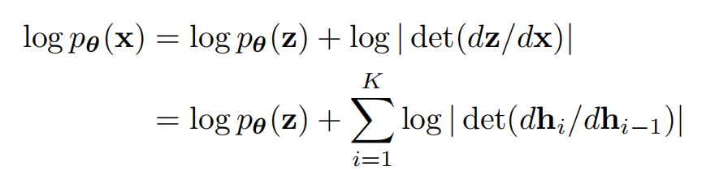
MNLE
Change of variables
MLE

Slide 51

MNLE
Two usages of flow-based model:
Simulate: sample $z$, then generate faked data $\hat{x}$ through the invertible network.
Calculate likelihood function.

Slide 52
MNLE
Commonly used invertible network:
Requirement:
Invertible
Easy to calculate the determinant.

Slide 53

MNLE
Commonly used invertible network:
Coupling network(Nice/Real NVP/GLOW):
Affine transformation:
$x_{d:D}=a_{d:D}⊗z_{d:D}+b_{d:D}$
$z_{d:D}=\frac{x_{d:D}−b_{d:D}}{a_{d:D}}$

Slide 54
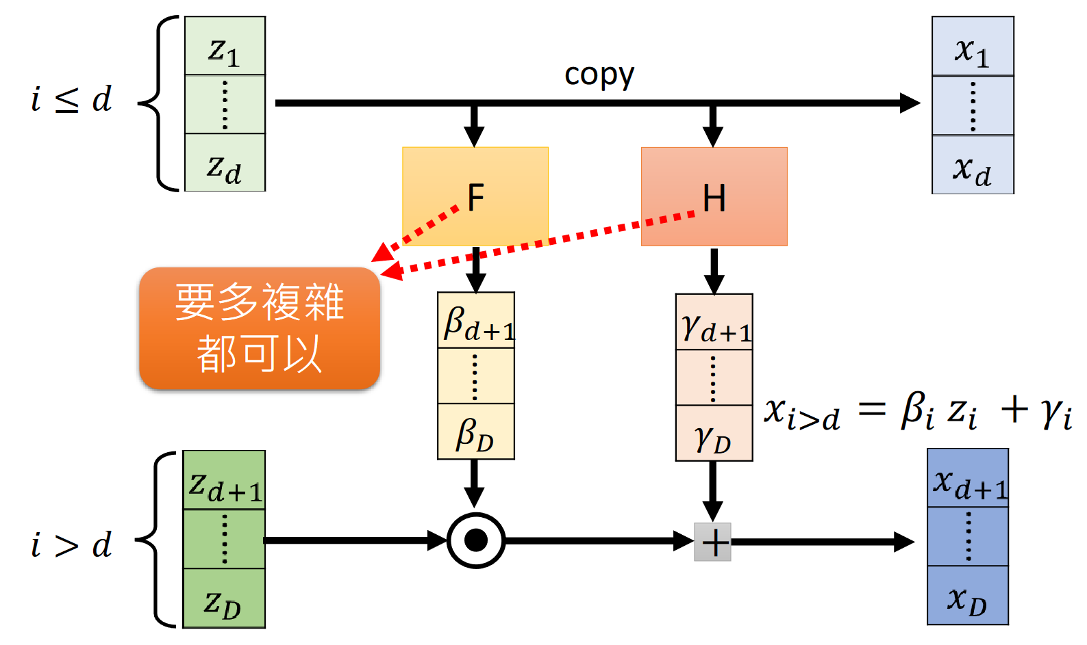
MNLE
Commonly used invertible network:
Coupling network(Nice/Real NVP/GLOW):

Slide 55
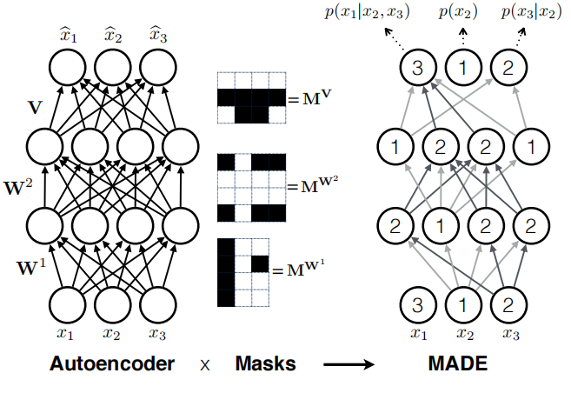

MNLE
Commonly used invertible network:
Autoregressive model:
$p\left(x_{i}\right)=N\left(μ_{i−1} | σ\right)$
$x_{i}=μ_{i−1 }+σ×z$
$z\sim N(0,1)$
$μ=f_{μ_{ψ}}\left(x_{1:i−1 }\right), σ=f_{σ_{psi}}(x_{1:i−1})$

Slide 56
MNLE
Commonly used invertible network:
Coupling model and auto-regressive model:
Auto-regressive model is more flexible; however, its sampling speed is slower.
Coupling model can be regarded as a special case of the auto-regressive model.

Slide 57

MNLE
Go back to Bayes flow:
Step1: Sample parameter $θ$ from the prior distribution.
Step2: Simulate data and then fit the data into an auto-encoder model.
Step3: Extract the summary statistics from the encoder-decoder model.
Step4: Construct flow model:
Input: simulate parameter.

Slide 58
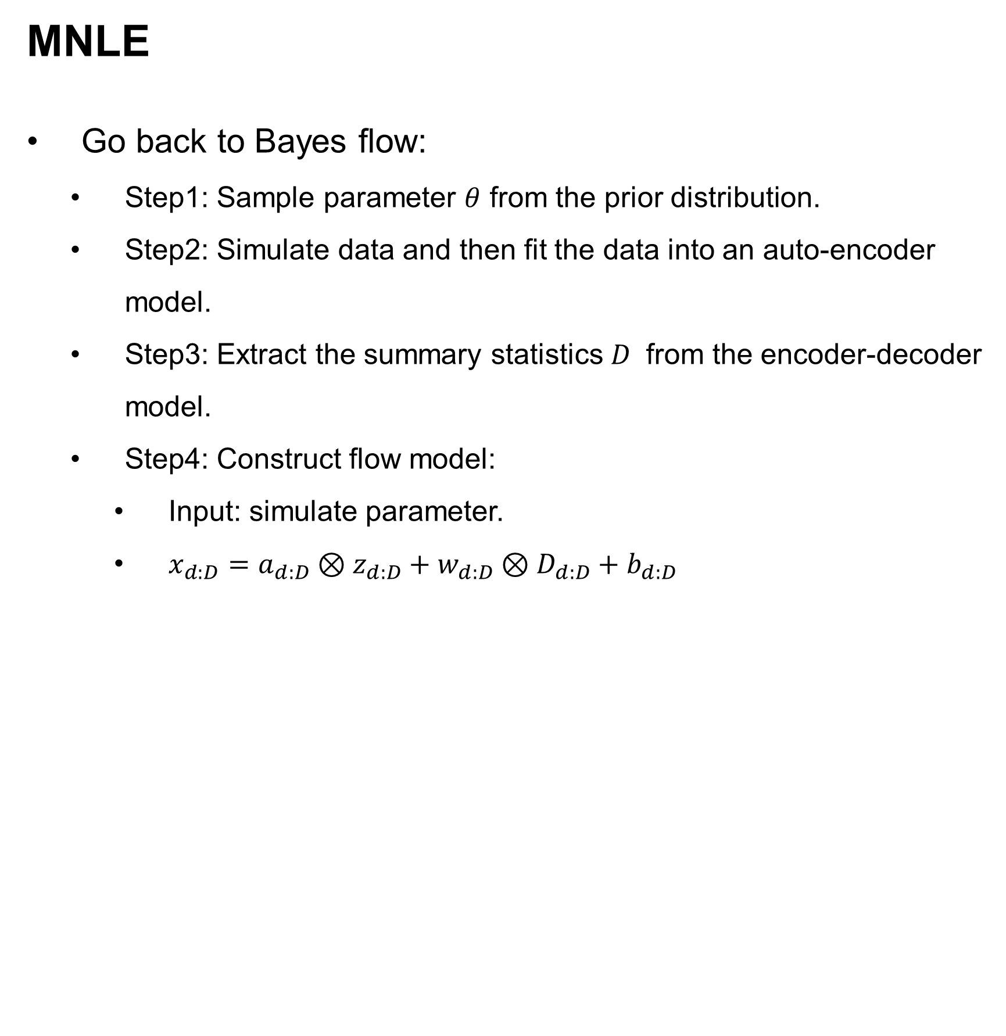
MNLE
Go back to Bayes flow:
Step1: Sample parameter $θ$ from the prior distribution.
Step2: Simulate data and then fit the data into an auto-encoder model.
Step3: Extract the summary statistics $D$ from the encoder-decoder model.
Step4: Construct flow model:
Input: simulate parameter.
$x_{d:D}=a_{d:D}⊗z_{d:D}+w_{d:D}⊗D_{d:D}+b_{d:D}$

Slide 59
MNLE
Go back to Bayes flow:
One advantage of Bayes flow
Naturally suitable for joint modelling.

Slide 60

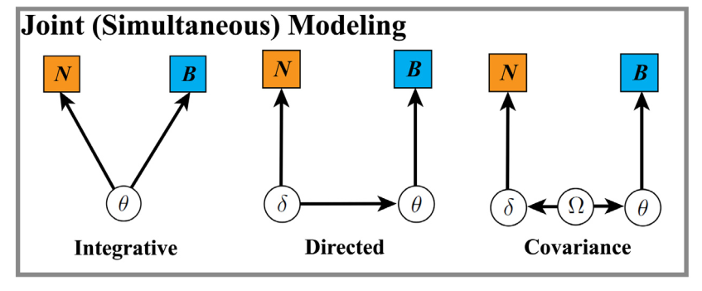
MNLE
Go back to Bayes flow:
Joint modeling
Turner et al.,2017

Slide 61

MNLE
Go back to Bayes flow:
One advantage of Bayes flow
Naturally suitable for joint modelling.
$x_{d:D}=a_{d:D}⊗z_{d:D}+w_{d:D}⊗B_{d:D}+β_{d:D}⊗N_{d:D}+b_{d:D}$

Slide 62
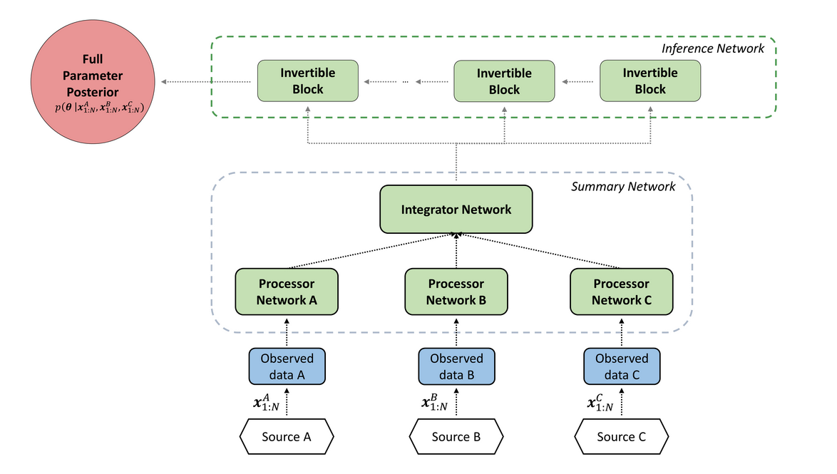

MNLE
Go back to Bayes flow:
One advantage of Bayes flow
More suitable for joint modeling.
$x_{d:D}=a_{d:D}⊗z_{d:D}+w_{d:D}⊗B_{d:D}+β_{d:D}⊗N_{d:D}+b_{d:D}$

Slide 63
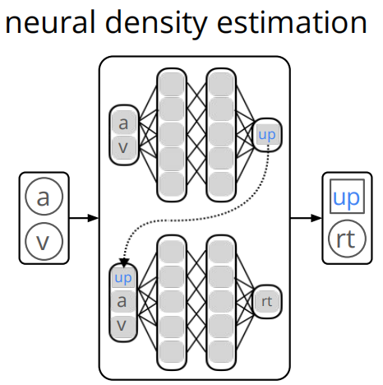

MNLE
Network structure:
Fully connected MLP + Spline Flow model

Slide 64

MNLE vs. LAN:
Simulation number:
LAN11:$1e\text{6}×1e5$(smaller than the original LAN paper’s claim)
LAN8: $1e\text{4}×1e4$
LAN5: $1e\text{2}×1e3$
MNLE: $1e\text{3}×1e2$

Slide 65
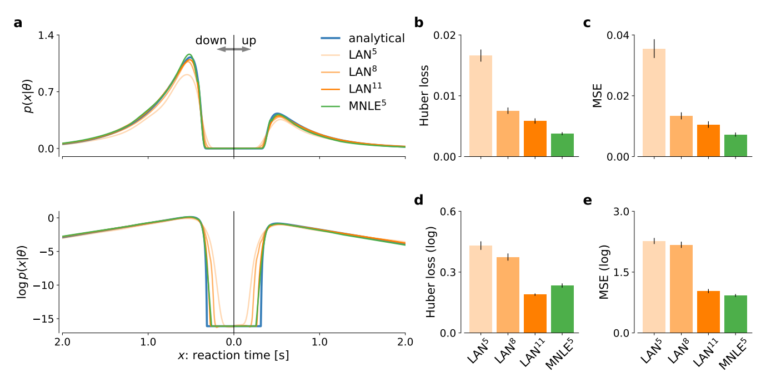
MNLE vs. LAN:
Fixed boundary DDM:
Likelihood comparison:

Slide 66
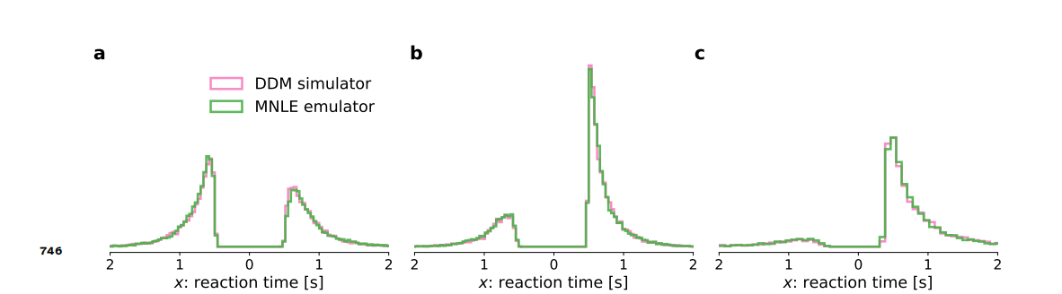
MNLE vs. LAN:
Fixed boundary DDM:
Simulation comparison:

Slide 67
MNLE vs. LAN:
Fixed boundary DDM:
Parameter estimation comparison:
100 observed trails, 100 simulated agents

Slide 68

MNLE vs. LAN:
Fixed boundary DDM:
Parameter estimation comparison:

Slide 69

MNLE vs. LAN:
Fixed boundary DDM:
Parameter estimation comparison:

Slide 70

MNLE vs. LAN:
Fixed boundary DDM:
Parameter estimation comparison:

Slide 71

MNLE vs. LAN:
Fixed boundary DDM:
Parameter estimation comparison:

Slide 72

MNLE vs. LAN:
Fixed boundary DDM:
Computation time:
LAN: $1.02±0.03 ms$
MNLE: $4.14±0.04 ms$(MNLE needs to calculate determinant).

Slide 73

MNLE vs. LAN:
SBC(Simulation-based calibration):

Slide 74

MNLE vs. LAN:
SBC:

Slide 75

MNLE vs. LAN:
Collapse boundary DDM:

Slide 76
Discussion:
MNLE has less bias compared to the previous likelihood approximation methods.
MNLE provides maximal flexibility compared to NRE and NPE(NRE is almost identical to NLE…).
MNLE can be applied to high dimension models, whereas LAN cannot(The biggest advantage).

