Slide 1

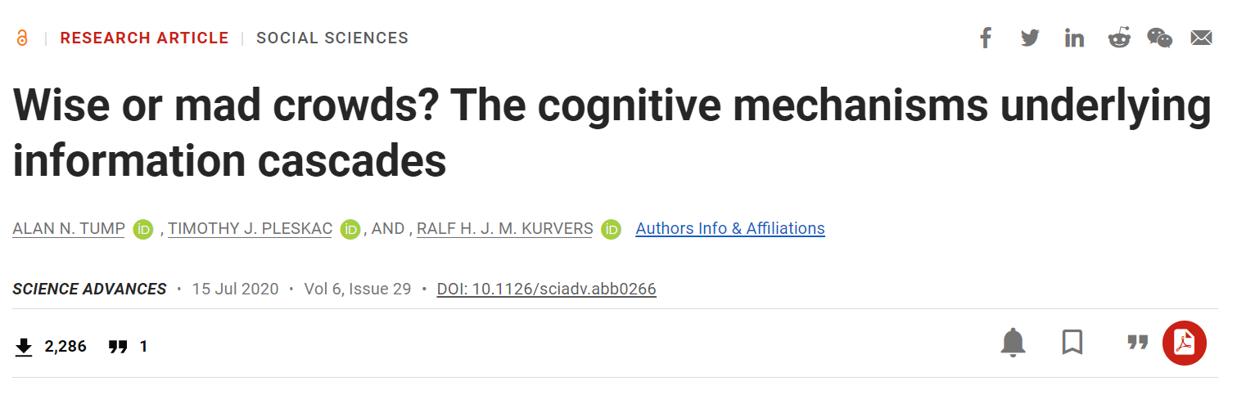
潘晚坷(上海师范大学)
邮箱：panwanke@163.com
2022.09.06

Slide 2
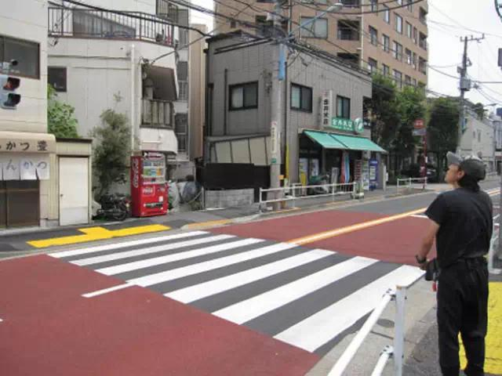
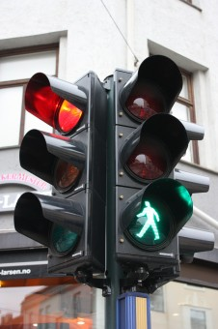
Information cascade
An information cascade is when an individual changes their behavior based on inferences they make by observing other people.
2
Notes:
信息瀑布，羊群效应。

Slide 3

Question
How does the majority influence the decisions of others?
What is the cognitive mechanism behind it? How do individuals balance their own beliefs with the performance of others?
The role of personal confidence and sensitivity to cascading information.
The role of group size and group consistency.
3
Notes:
信息瀑布，羊群效应。

Slide 4
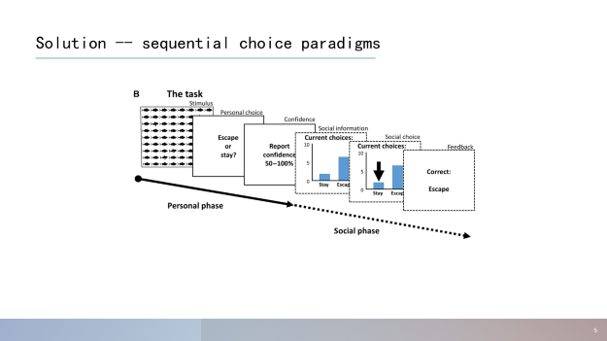
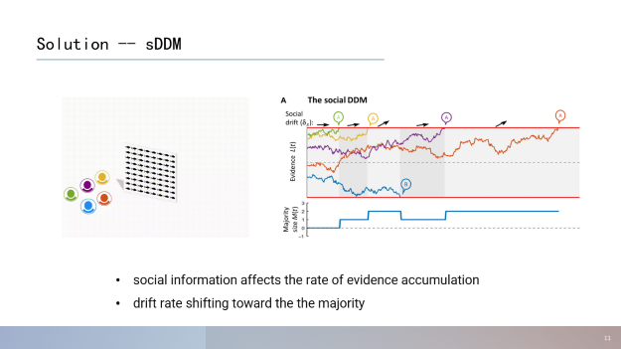
Solution
4
Notes:
信息瀑布，羊群效应。

Slide 5
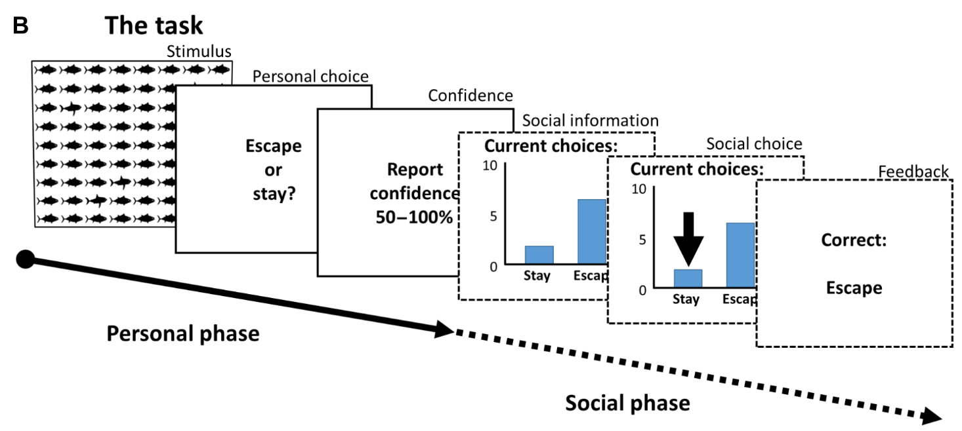
Solution -- sequential choice paradigms
5
Notes:
信息瀑布，羊群效应。

Slide 6
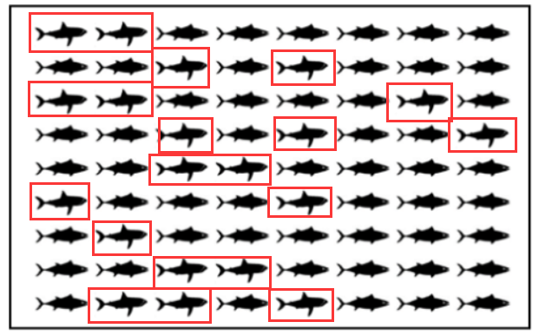
Phase1：visual search task
binary decision task:
observed 72 stylized fish (for 2 s)
“escape” if there were five or more sharks
“stay” if there were four or fewer
number of sharks: 3,4,5,7,
each number was repeated 10 times (40 trials in total)
6
Notes:
信息瀑布，羊群效应。

Slide 7
Phase2：personal choice and confidence
5s to report their personal decision;
5s to report their confidence in their personal decision.
7
Notes:
信息瀑布，羊群效应。

Slide 8
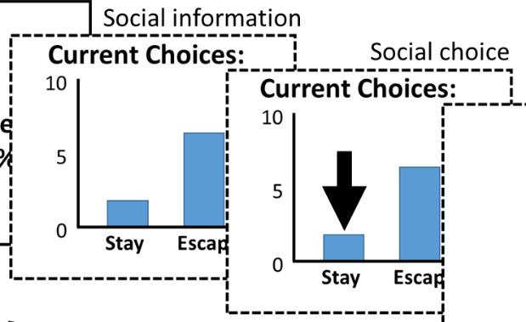
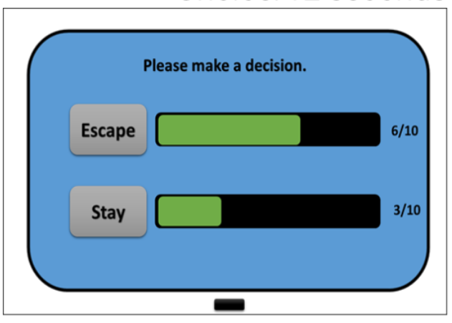
Phase3：social choice phase
the social phase lasted 20 s
social information was first updated after 3 s
then iteratively every 2 s (i.e., at 3, 5, 7, 9,...,19 s).
participants made a second decision on the same image.
8
Notes:
信息瀑布，羊群效应。

Slide 9
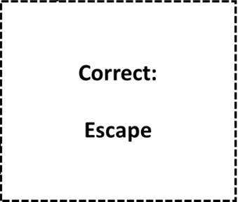
Phase4：feedback
feedback on the correct choice
received 0 points for an incorrect decision and 100 points for a correct decision.
9
Notes:
信息瀑布，羊群效应。

Slide 10
Solution -- sequential choice paradigms
Participants：141 students (divided into 16 groups)
Three group size：
“small”: 3 individuals, 5 groups
“medium”: n = 7 to 10 individuals, 6 groups
“large”: 15 to 17 individuals, 5 groups
10
Notes:
信息瀑布，羊群效应。

Slide 11
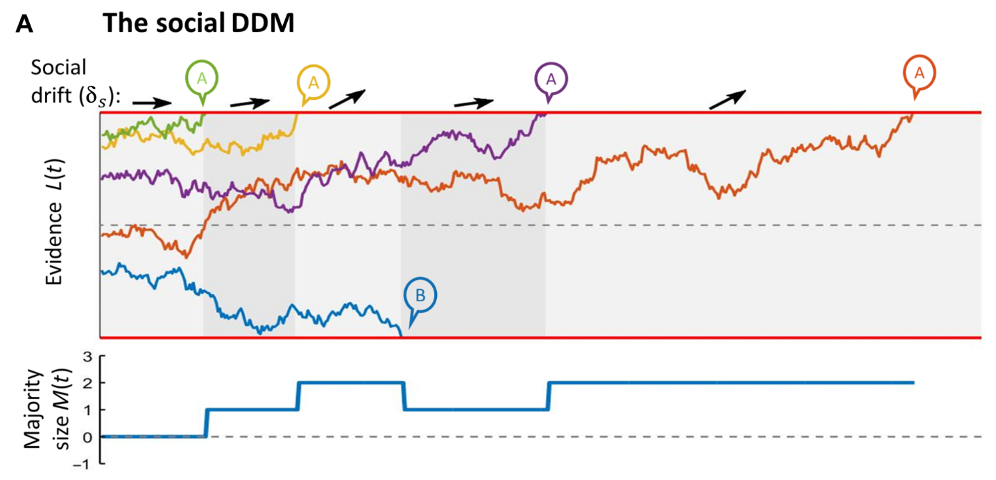
Solution -- sDDM
social information affects the rate of evidence accumulation
drift rate shifting toward the the majority
11
Notes:
信息瀑布，羊群效应。

Slide 12
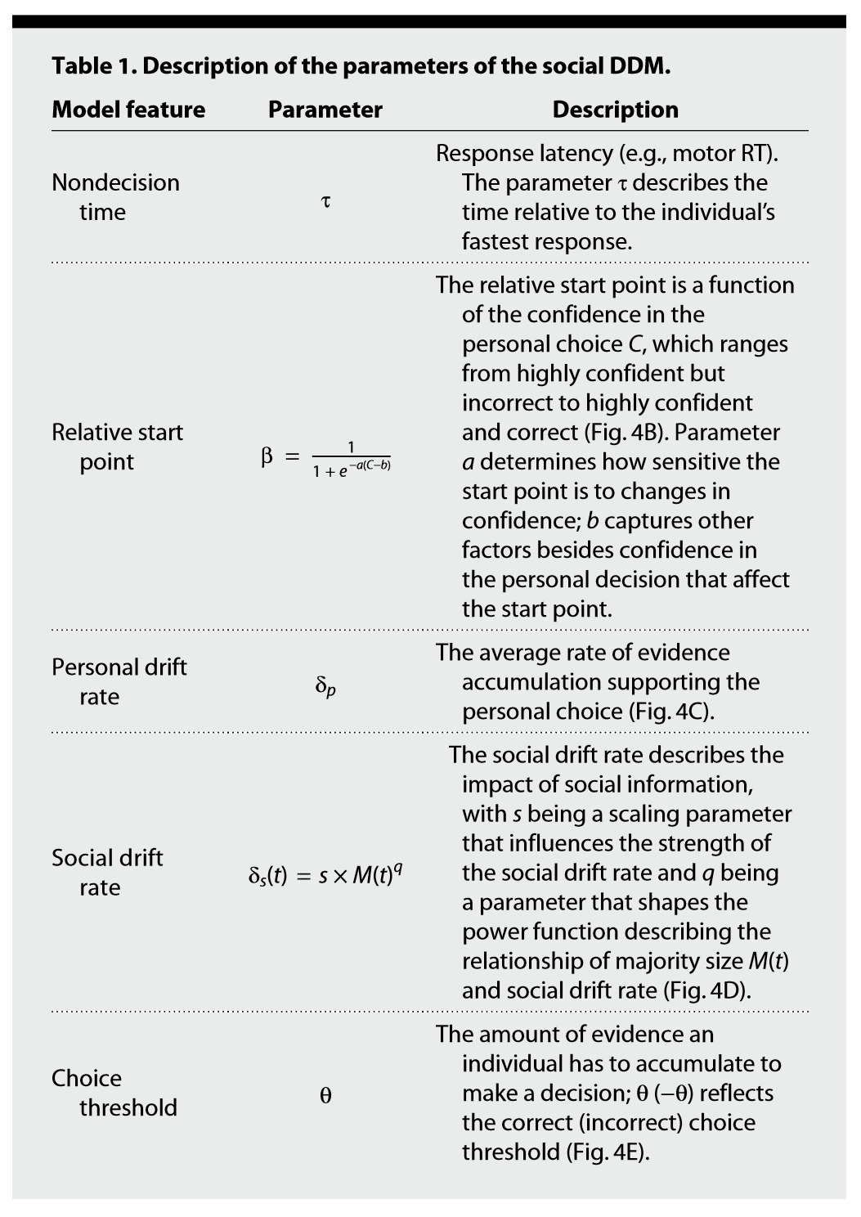
Solution -- sDDM
12
Notes:
信息瀑布，羊群效应。

Slide 13
Solution -- sDDM
13
Notes:
信息瀑布，羊群效应。

Slide 14
Solution -- sDDM
14
Notes:
信息瀑布，羊群效应。

Slide 15
Solution -- sDDM
15
Notes:
信息瀑布，羊群效应。

Slide 16

Solution -- sDDM
16
Notes:
信息瀑布，羊群效应。

Slide 17
Solution -- sDDM
17
Notes:
信息瀑布，羊群效应。

Slide 18
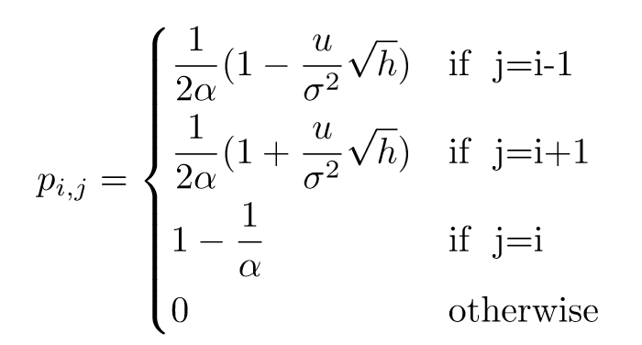
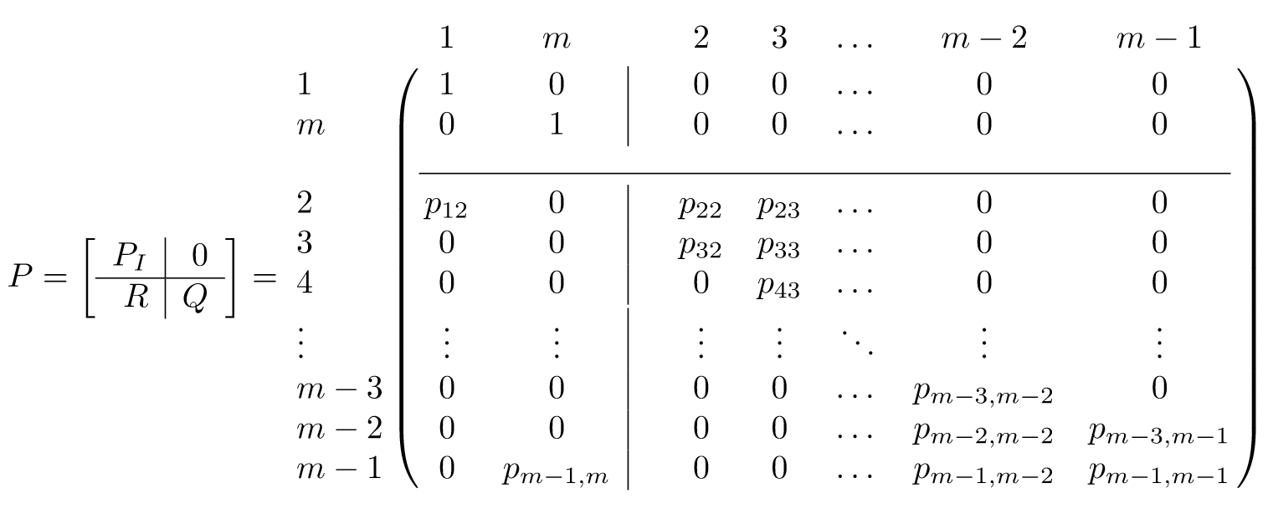
sDDM – algorithm ＆ code
18
Notes:
信息瀑布，羊群效应。

Slide 19
Solution
19
Notes:
信息瀑布，羊群效应。

Slide 20
Hypotheses
How individuals simultaneously combine personal and social information?
How they time their decision in groups?
The amplification of cascade information to positive or negative?
20
Notes:
信息瀑布，羊群效应。

Slide 21
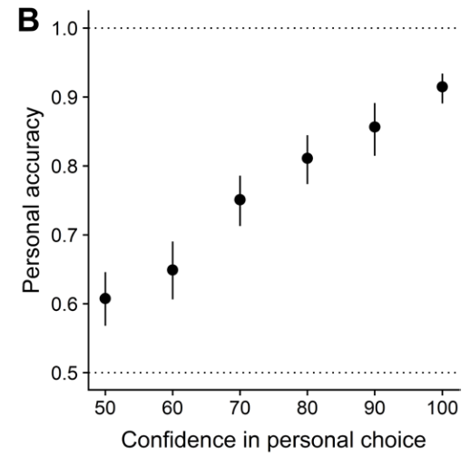
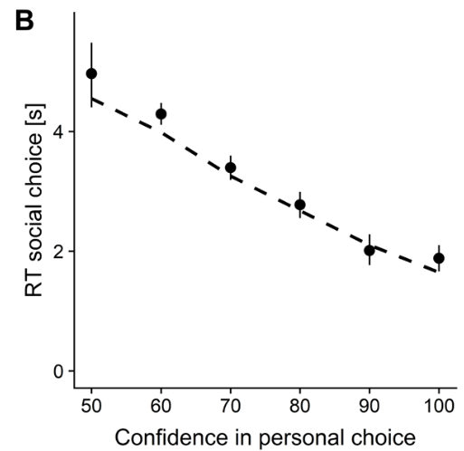
Results—personal confidence
increase personal accuracy
decrease rt
personal confidence
21
Notes:
self-organization: 即confidence增加acc or 减少rt

Slide 22
Results—personal confidence
Self-organization
increase personal accuracy
decrease rt
personal confidence
22
Notes:
self-organization: 即confidence增加acc or 减少rt。with confident and accurate participants deciding early, thereby organizing themself to provide high-quality information

Slide 23
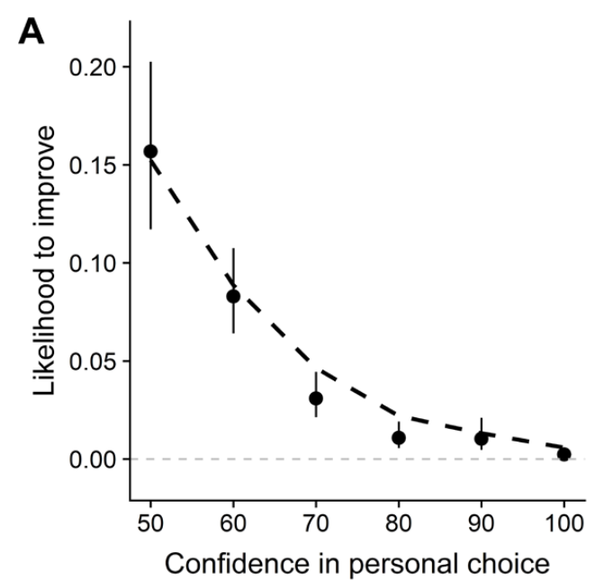
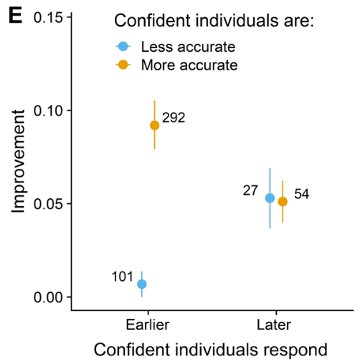
Results — social choice
decrease improvement
increase improvement
Self-organization
Accuracy↑
Rt↓
confidence
23
Notes:
First, their response with higher confidence is less likely to change so that attain little improvement.
Second, relying on the coefficients of confidence with rt and acc, we find that those who provide high quality information improve more.
“positive confidence-accuracy correlation” + “negative accuracy-RT correlation”

Slide 24
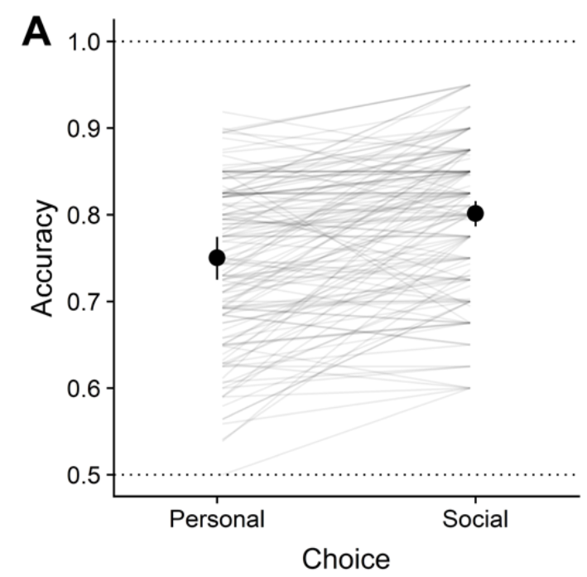
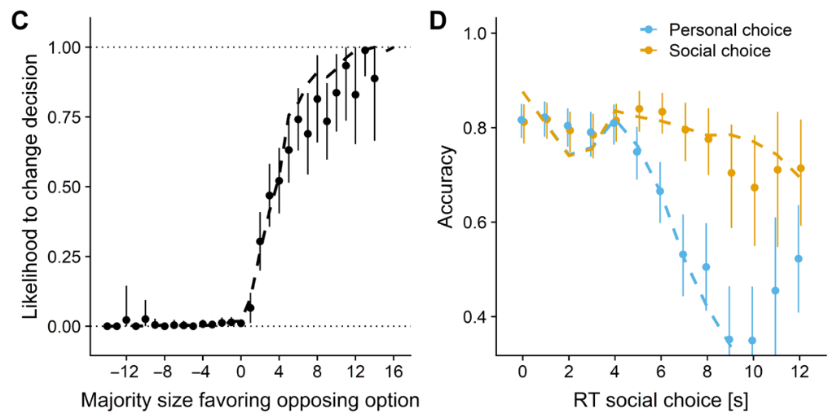
Results — social choice
increase accuracy
increase change
Wait for increasing accuracy
Information cascade
24

Slide 25
Results — behavior implication
The preliminary conclusion
Personal confidence leads to optimal decision
The social group decision-making leads to optimal decision
Individual depends on the self-organization to help group decision-making
Information cascade seems to bring more positive effect
25

Slide 26
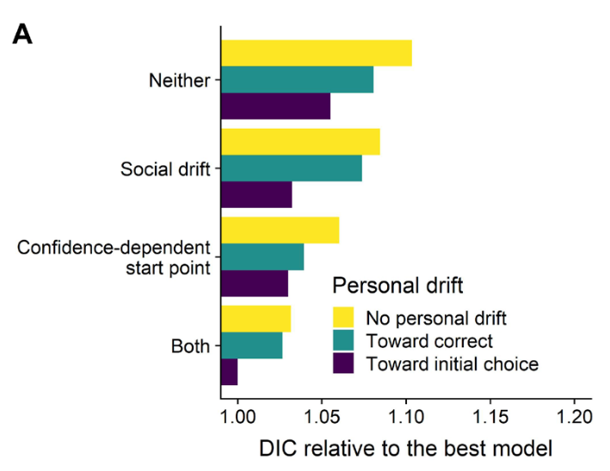
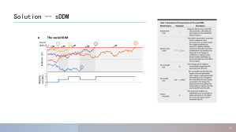
Results -- sDDM
Model comparison
start point on confidence
drift toward the correct option or initially chosen option
drift toward the option favored by the majority
fitted the parameters separately for each group size
26

Slide 27
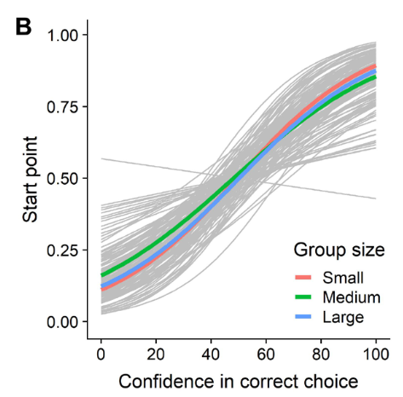
Results -- sDDM with confidence
Individuals who reported higher confidence in the (in)correct option started closer to the threshold of the (in)correct option
27
Notes:
Individuals who reported higher confidence in the (in)correct option started closer to the threshold of the (in)correct option

Slide 28
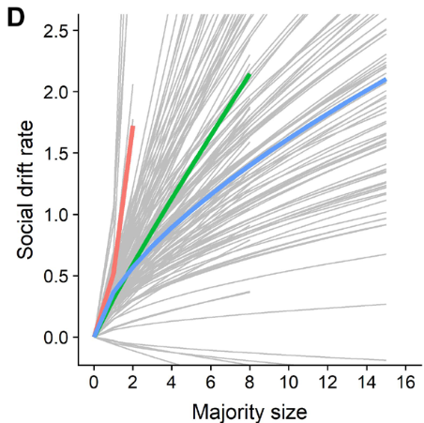
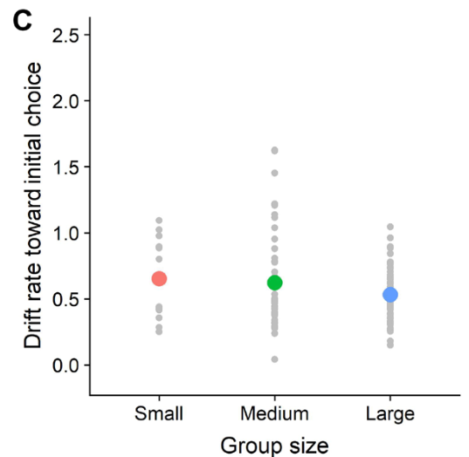
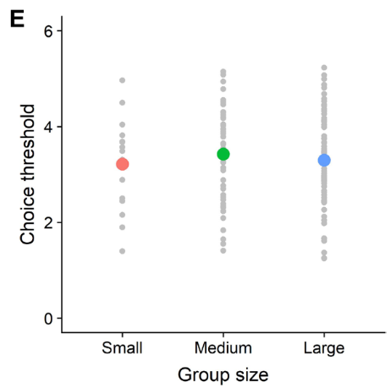
Results -- sDDM with group size
The larger the majority favoring an option, the more strongly participants drifted toward that option.
Threshold did not differ between group sizes.
28
Notes:
Accordingly, the influence of a single individual was larger in small groups than in large groups
Majority of approximately four participants is required to induce a 50% likelihood of changing a participant’s decision in favor of the opposing option.
“participants’ tendency to give personal information more weight than social information”

Slide 29
Wait… Can we emulate and predict group behavior?
We could use ABS (Agent-Based Simulation) methods to predict group behavior.
ABS could explore the interactions (cascade information) between agents and their impact on their surroundings.
ABS could render some unprecedent results.
29
Notes:
信息瀑布，羊群效应。

Slide 30
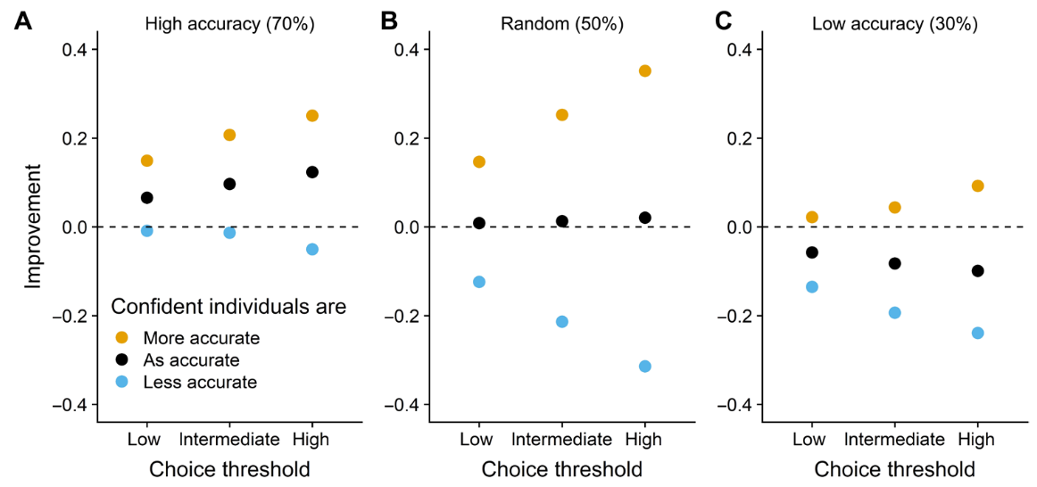
Results -- sDDM with simulation
Agent-based simulation
simulated a group of 10 agents
agents’ behavior was parameterized using the mean posterior estimates of medium-sized groups
three key features
self-organization
agents’ personal accuracy by assigning 30, 50, or 70%
low, intermediate, or high choice threshold
30
Notes:
1. “varied the confidence-accuracy relationship by assigning either higher, similar, or lower confidence to agents”
2. “varied the willingness to wait for social information by assigning a low, intermediate, or high choice threshold”

Slide 31
Results -- sDDM with simulation
Waiting more time get higher improvement.
31

Slide 32
Results -- sDDM with simulation
Waiting more time get higher improvement.
Those who judge with more uncertainty get higher improvement.
32

Slide 33
Results -- sDDM with simulation
Self-organization prompt improvement.
33

Slide 34
Results -- sDDM with simulation
Self-organization prompt improvement.
At the same time, self-organization lead to negative information cascades.
34

Slide 35
Discussion
belief reinforcement
power law
willingness to wait for social information
Future
delay between personal choice and provision of social information
quorum responses
interrelationships between the different parameters and idiosyncrasy
quality of information cascades
how individuals adjust their start point depending on their confidence
agent-based simulations
schooling fish(poel2022)
Poel, W., Daniels, B. C., Sosna, M. M. G., Twomey, C. R., Leblanc, S. P., Couzin, I. D., & Romanczuk, P. (2022). Subcritical escape waves in schooling fish. Science Advances, 8(25), eabm6385. https://doi.org/10.1126/sciadv.abm6385
35

Slide 36
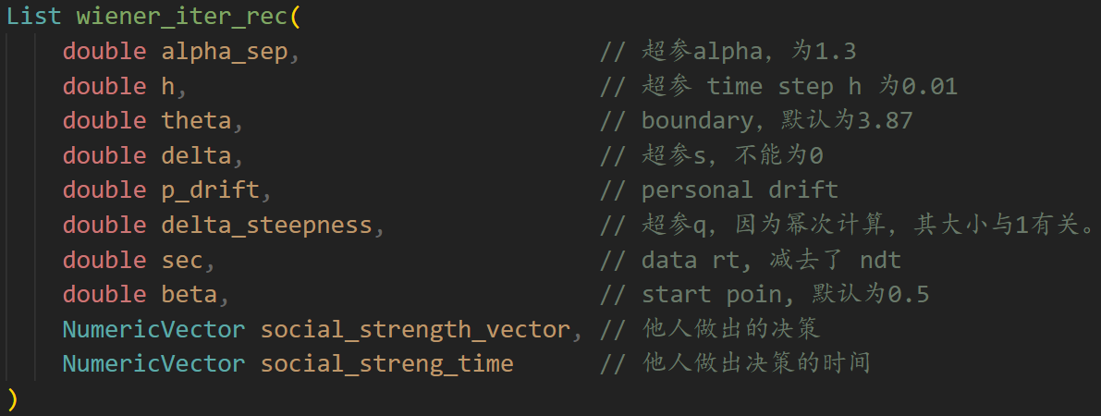
sDDM – algorithm & code
36

Slide 37

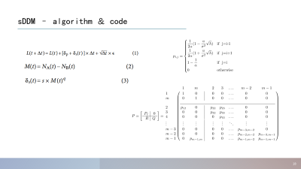
sDDM – algorithm & code
37

Slide 38
sDDM – algorithm & code
38

Slide 39
sDDM – algorithm & code
39

Slide 40


sDDM – algorithm & code
40

Slide 41
sDDM – algorithm & code
41

Slide 42
sDDM – algorithm & code
42

Slide 43
sDDM – algorithm & code
PI containing the two absorbing states
R containing the transition probabilities to an absorbing state
Q with all the remaining transition probabilities
Vector Z is probabilities of the initial evidence states
43

Slide 44
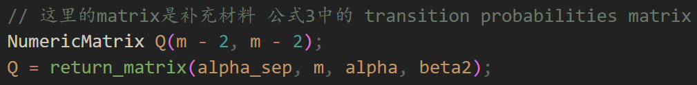
sDDM – algorithm & code
PI containing the two absorbing states
R containing the transition probabilities to an absorbing state
Q with all the remaining transition probabilities
Vector Z is probabilities of the initial evidence states
44

Slide 45
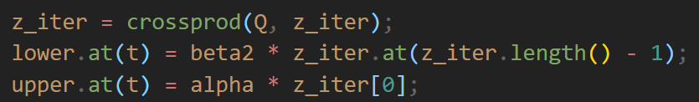
sDDM – algorithm & code
45

Slide 46
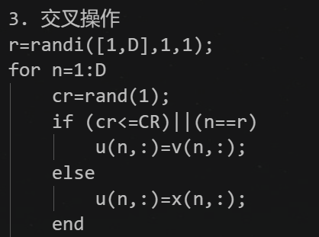
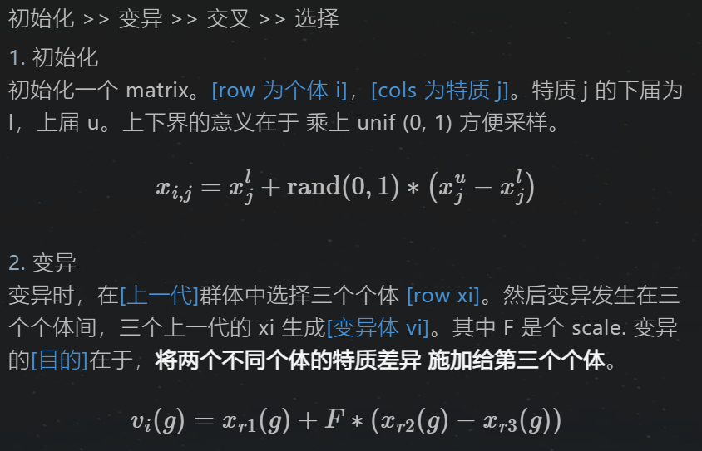
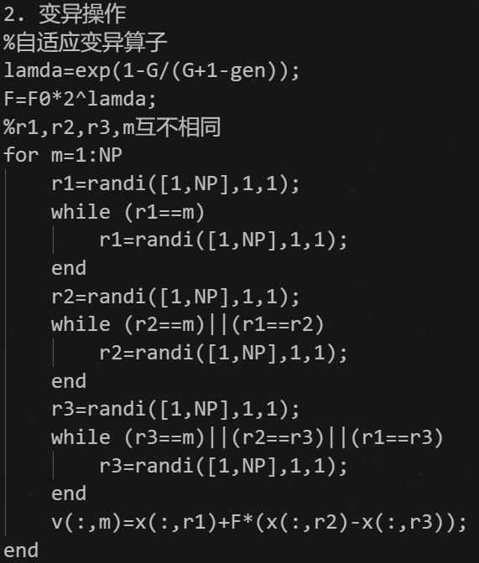
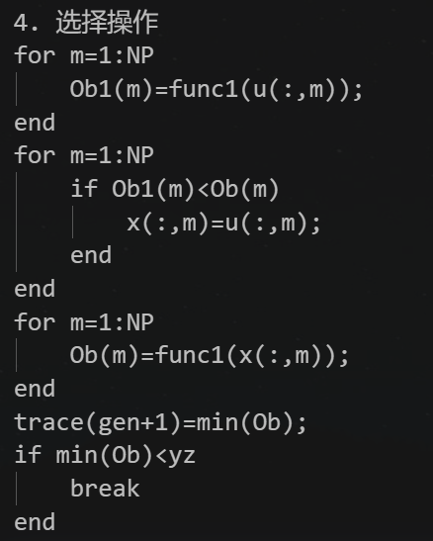
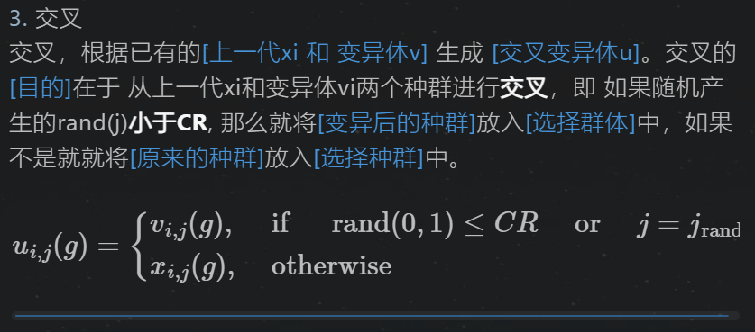
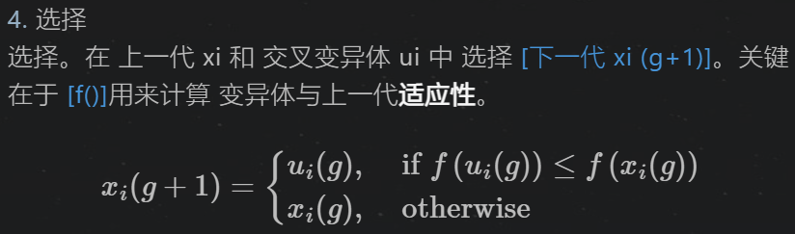
sDDM – DE MCMC
46

Slide 47
sDDM – algorithm & code
47

Slide 48
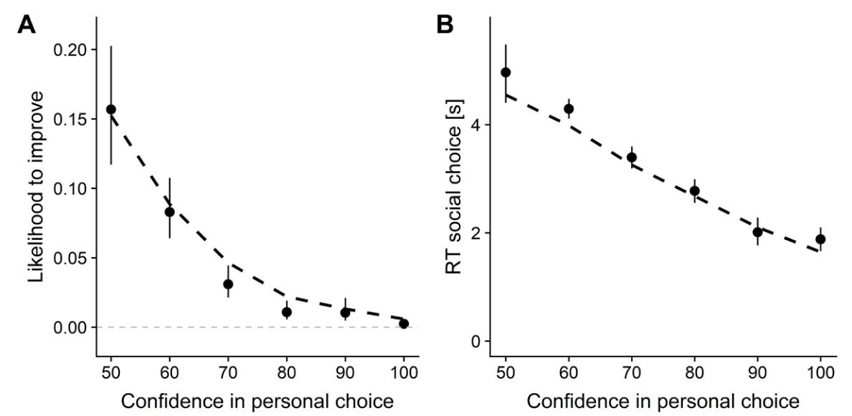
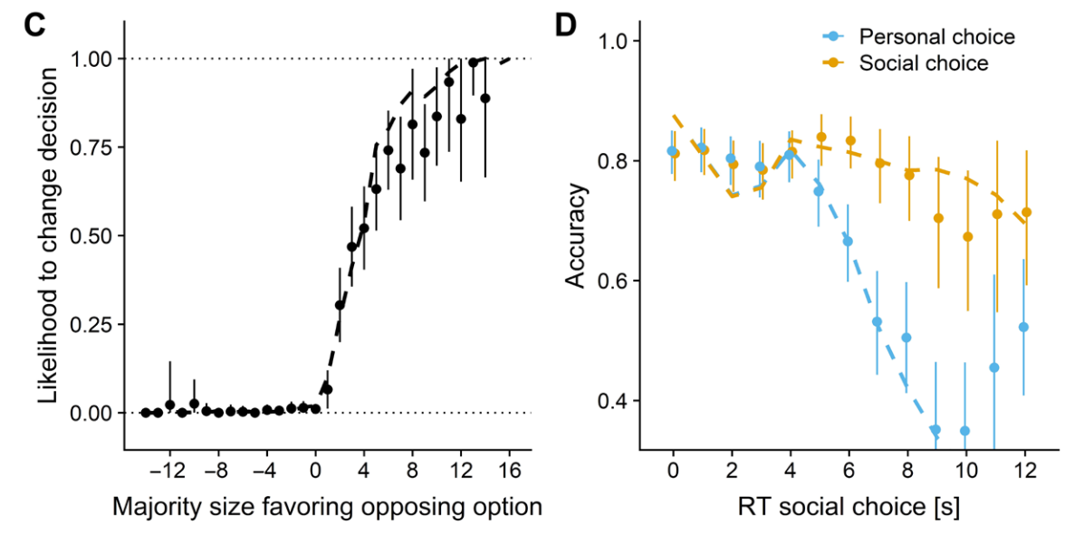
Validation -- ppc
48

Slide 49
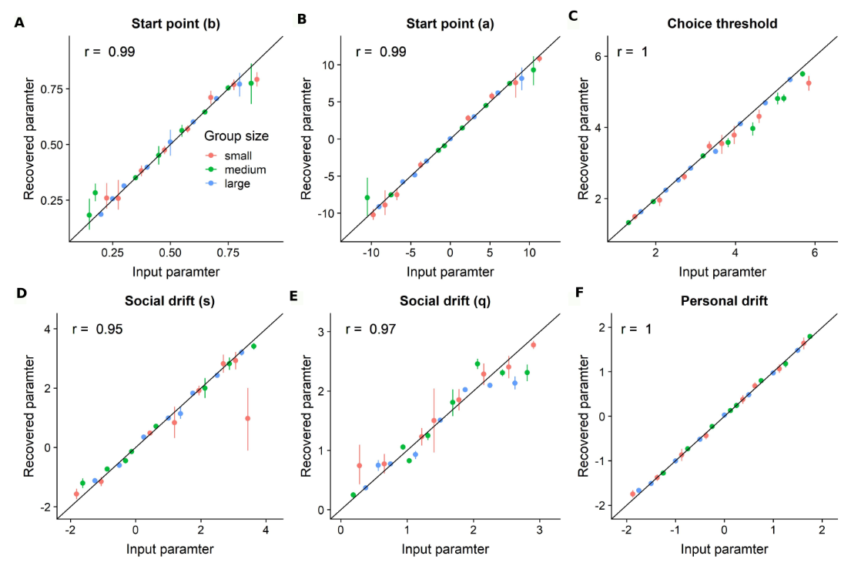
Validation -- recovery
49

