Slide 1
GM47283
DEG
GO enrichment (BP & MF)

Slide 2
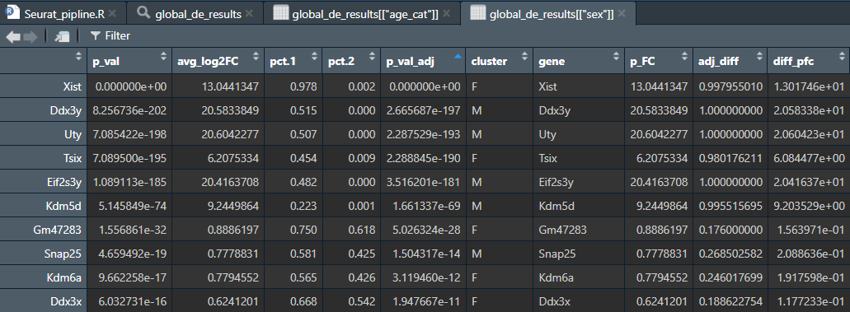
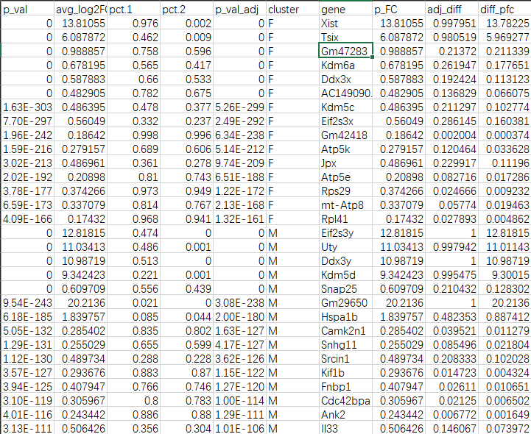
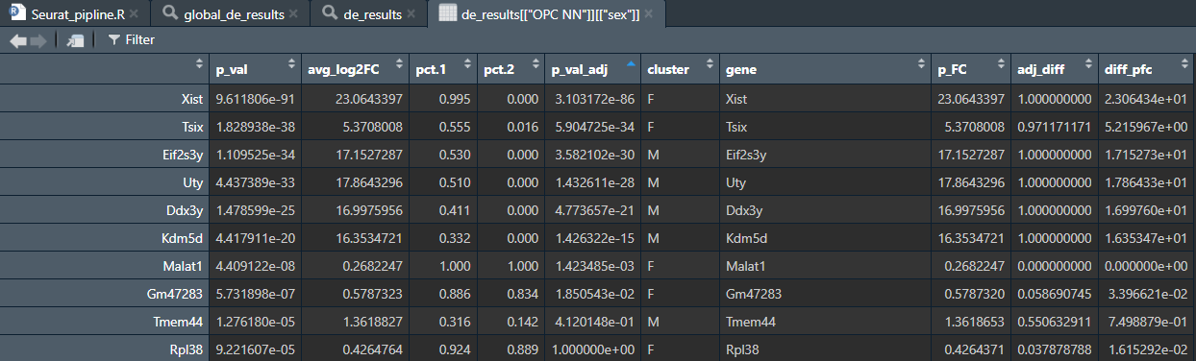
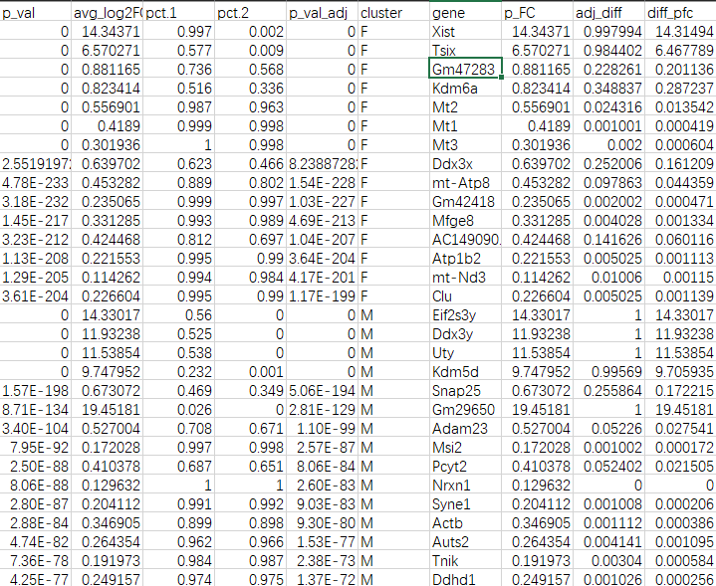
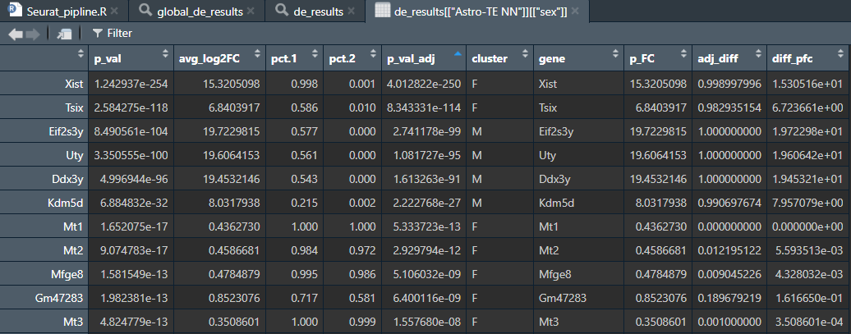
3K subset
All glia
GM47283 upregulated in female in Global, ABC, Astro, BAM, endothelial, Microglia, Oligo, OPC, SMC, VLMC, perithelial

Slide 3
GM47283 Synteny
chrY: 897,790~946,316 Kdm5d
chrY: 1,010,543~1,028,594 Eif2s3y
chrY: 1,097,144~1,245,718 Uty
chrY: 1,260,771~1,286,629 Ddx3y
chrY: 90,785,501~90,816,464 Gm47283
Reference: UCSC Genome Browser (https://doi-org.myaccess.library.utoronto.ca/10.1093/nar/gkaf1250)

Slide 4
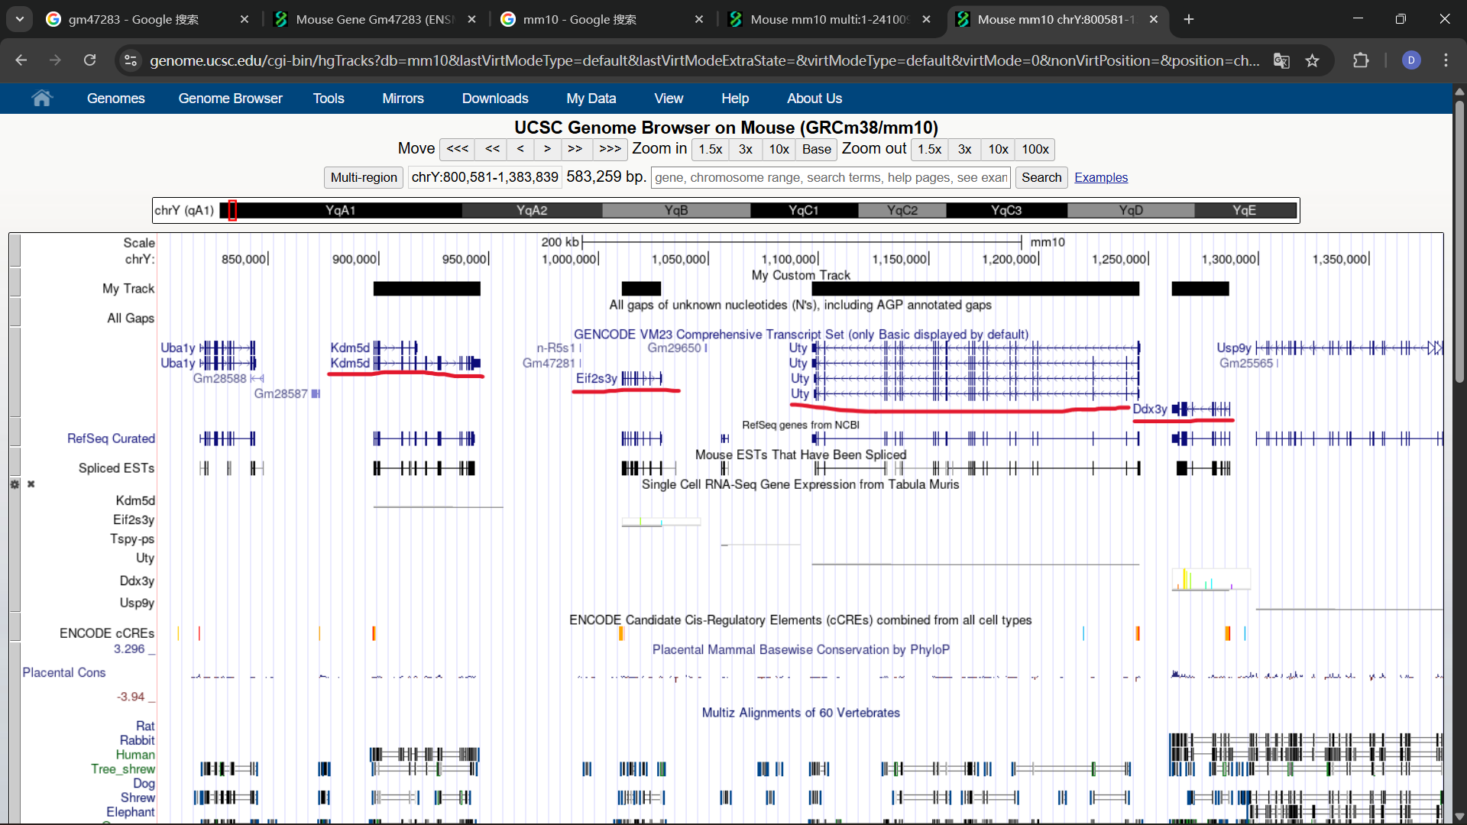

Slide 5
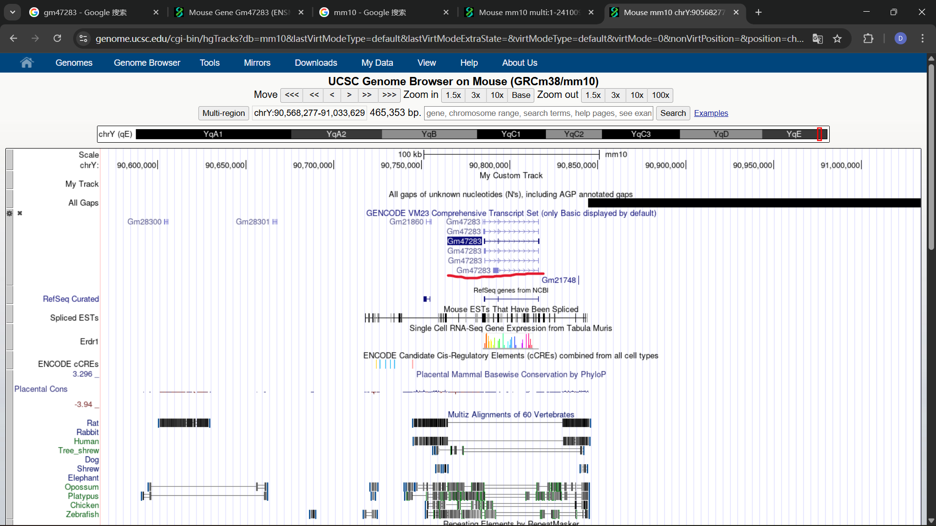

Slide 6
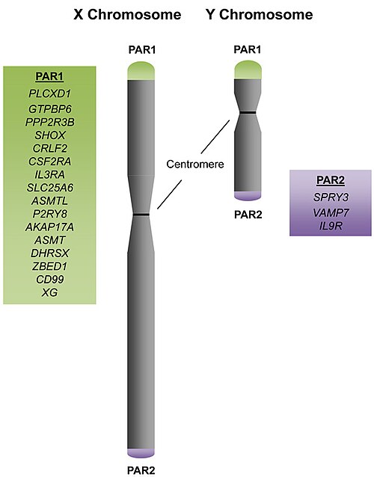
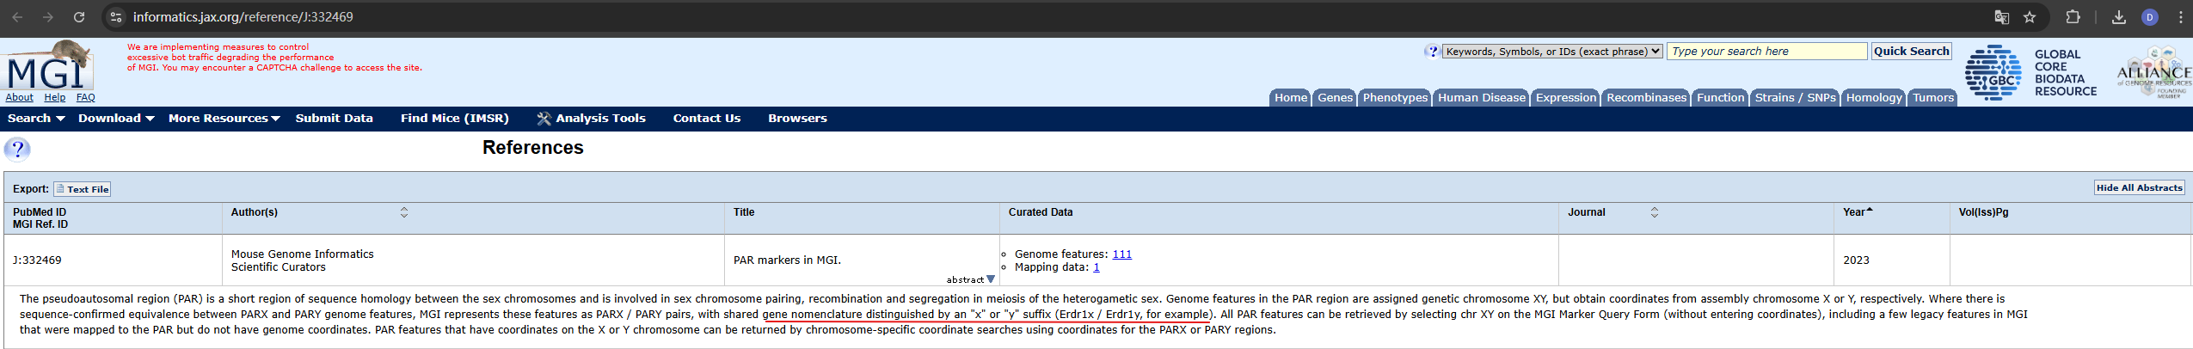
Pseudoautosomal region

Slide 7
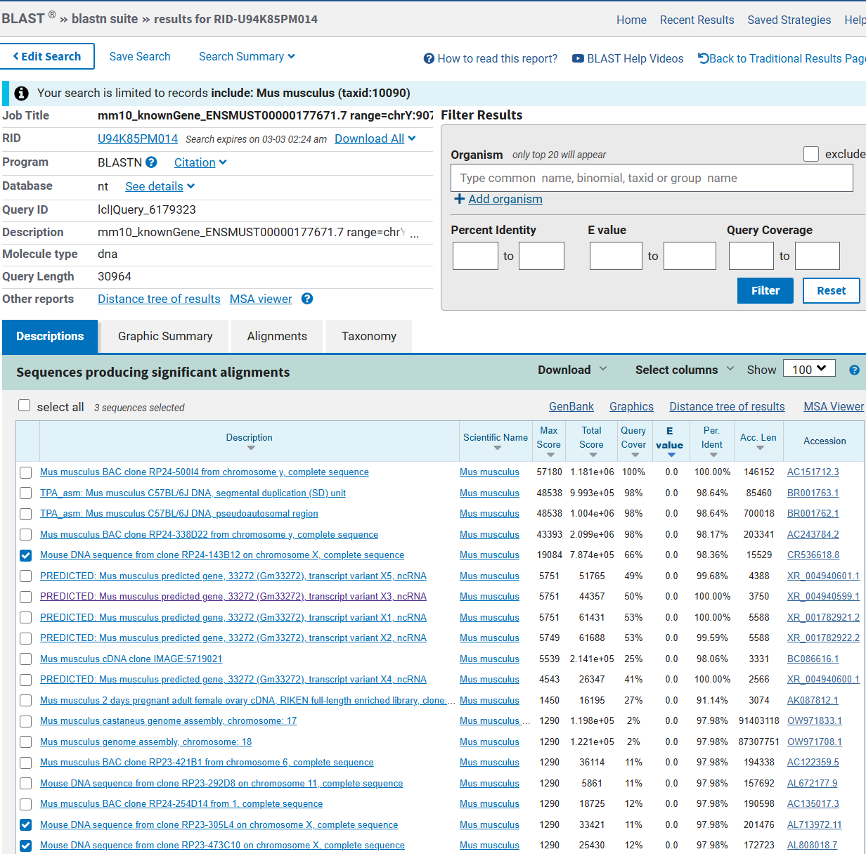
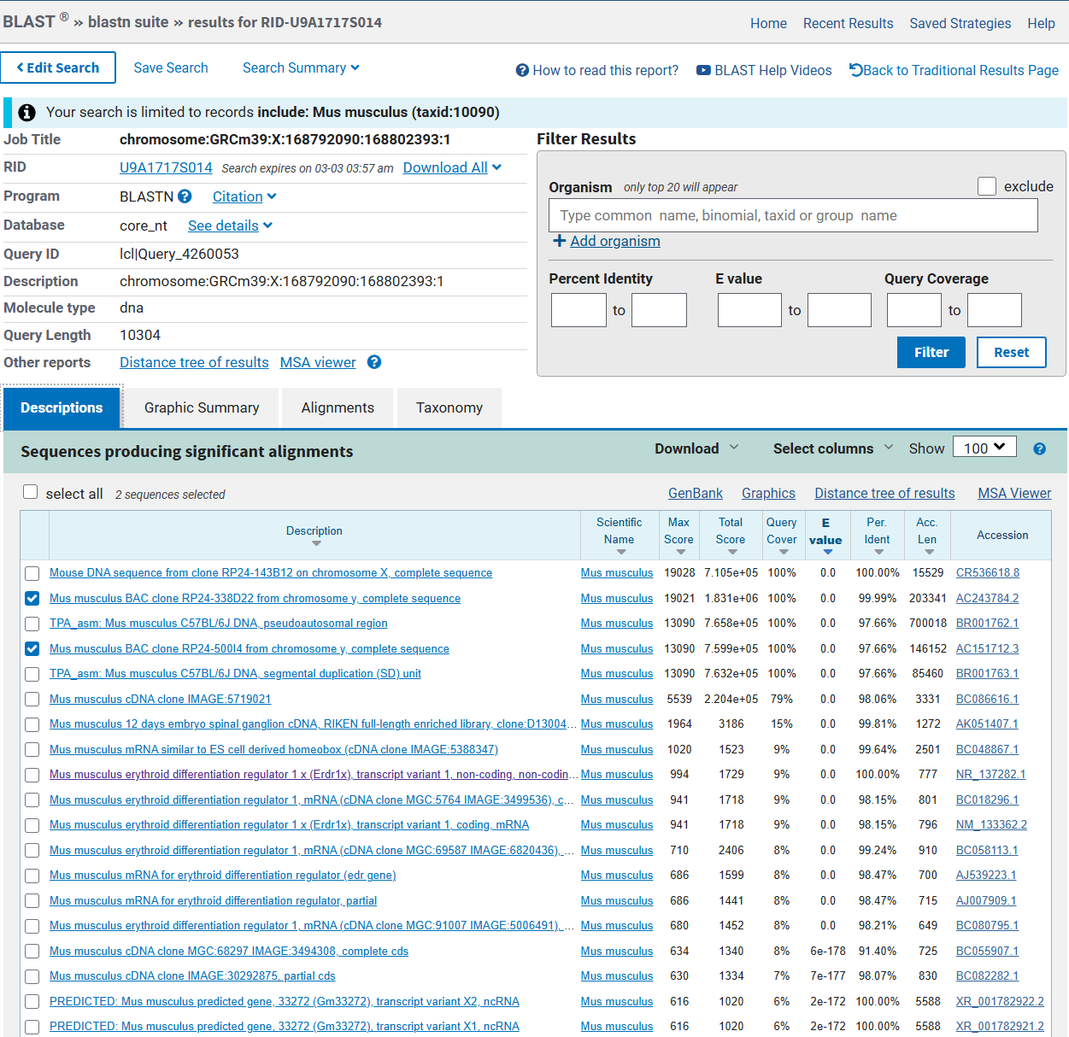
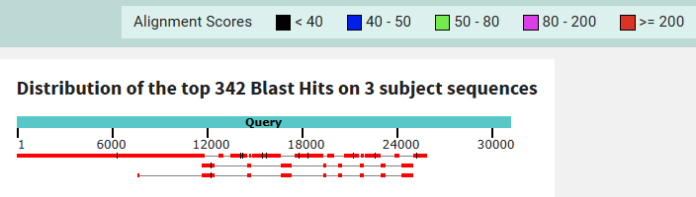
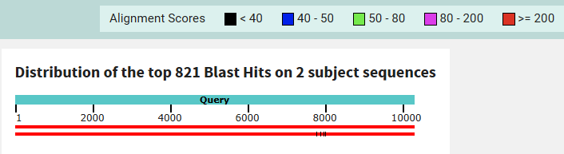
Y -> X
X -> Y

Slide 8
Y -> X
X -> Y
Y allele: 32 RNA isoform
X allele: 7 RNA isoform

Slide 9
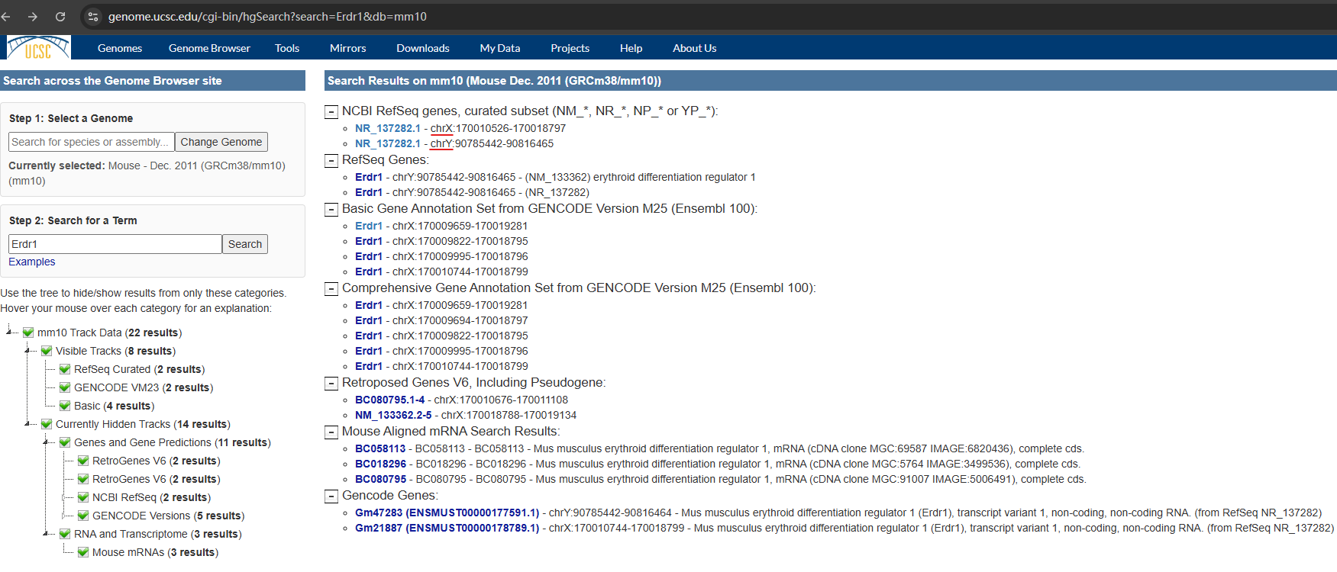

Slide 10
Park et al, 2020
(https://doi.org/10.3390/ijms21072603)
Wang, 2024
(https://doi-org.myaccess.library.utoronto.ca/10.4049/immunohorizons.2400004)
Dörmer et al, 2004 (https://doi.org/10.1016/j.cyto.2004.02.005)
Abo et al, 2020
(https://doi.org/10.1038/s41467-019-14258-z)
Shu, 2020
(https://doi-org.myaccess.library.utoronto.ca/10.1016/j.heliyon.2025.e42085)

Slide 11
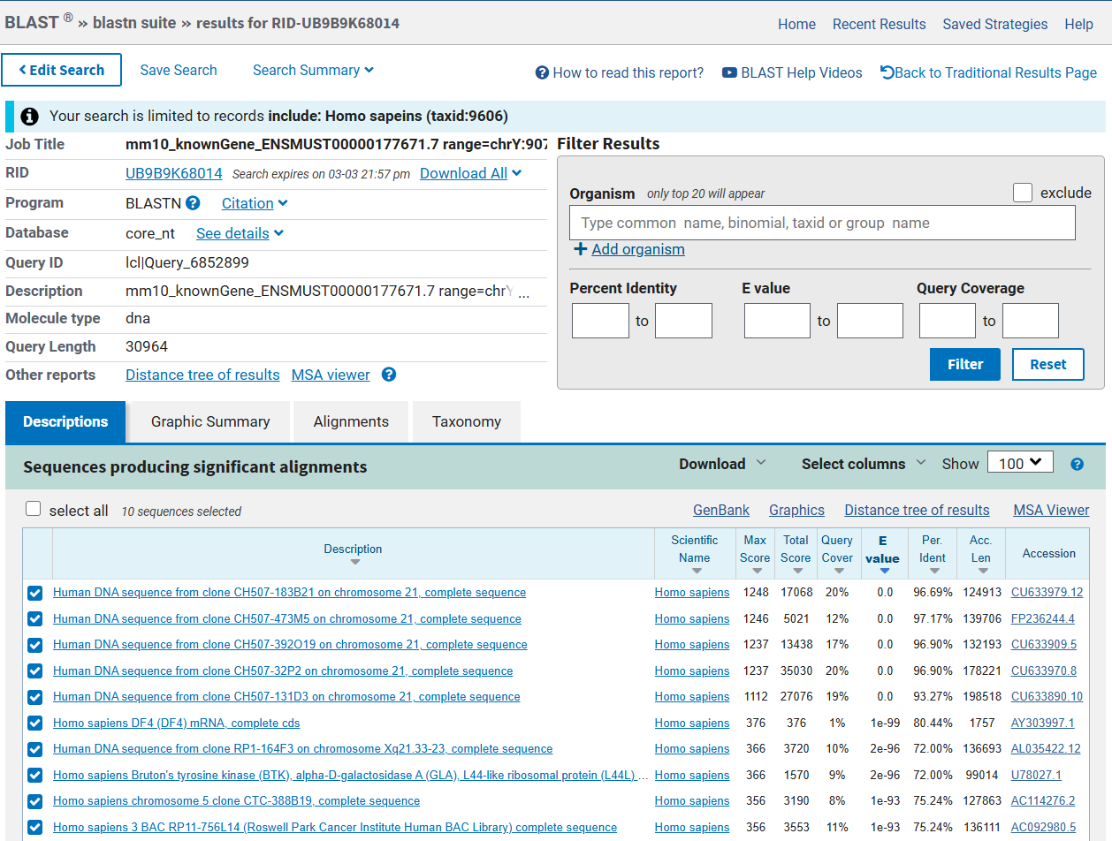
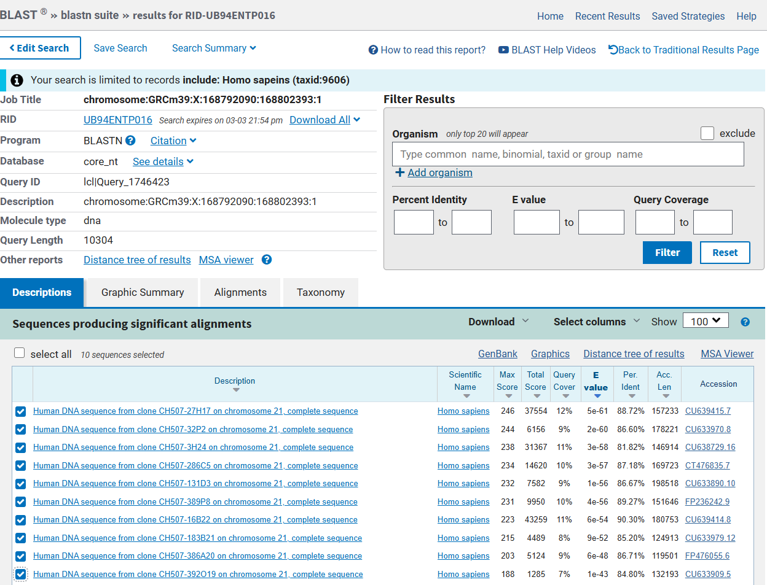
Erdr1y -> Human
Erdr1x -> Human

Slide 12
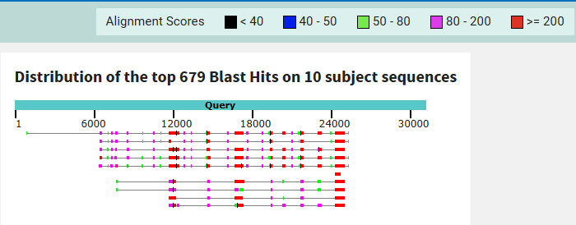
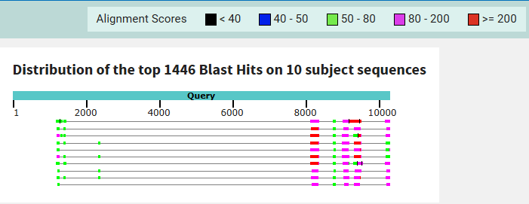
Erdr1y -> Human
Erdr1x -> Human

Slide 13
GM47283 Summery
Sex-linked gene upregulated in various glia subclass in female
Misaligned Erdr1x during reads mapping because of pseudoautosomal region homology
Exist a human paralog, but no ortholog
Both mRNA and lncRNA evidence exist
Immunoregulatory and apoptosis role

Slide 14
DEG

Slide 15
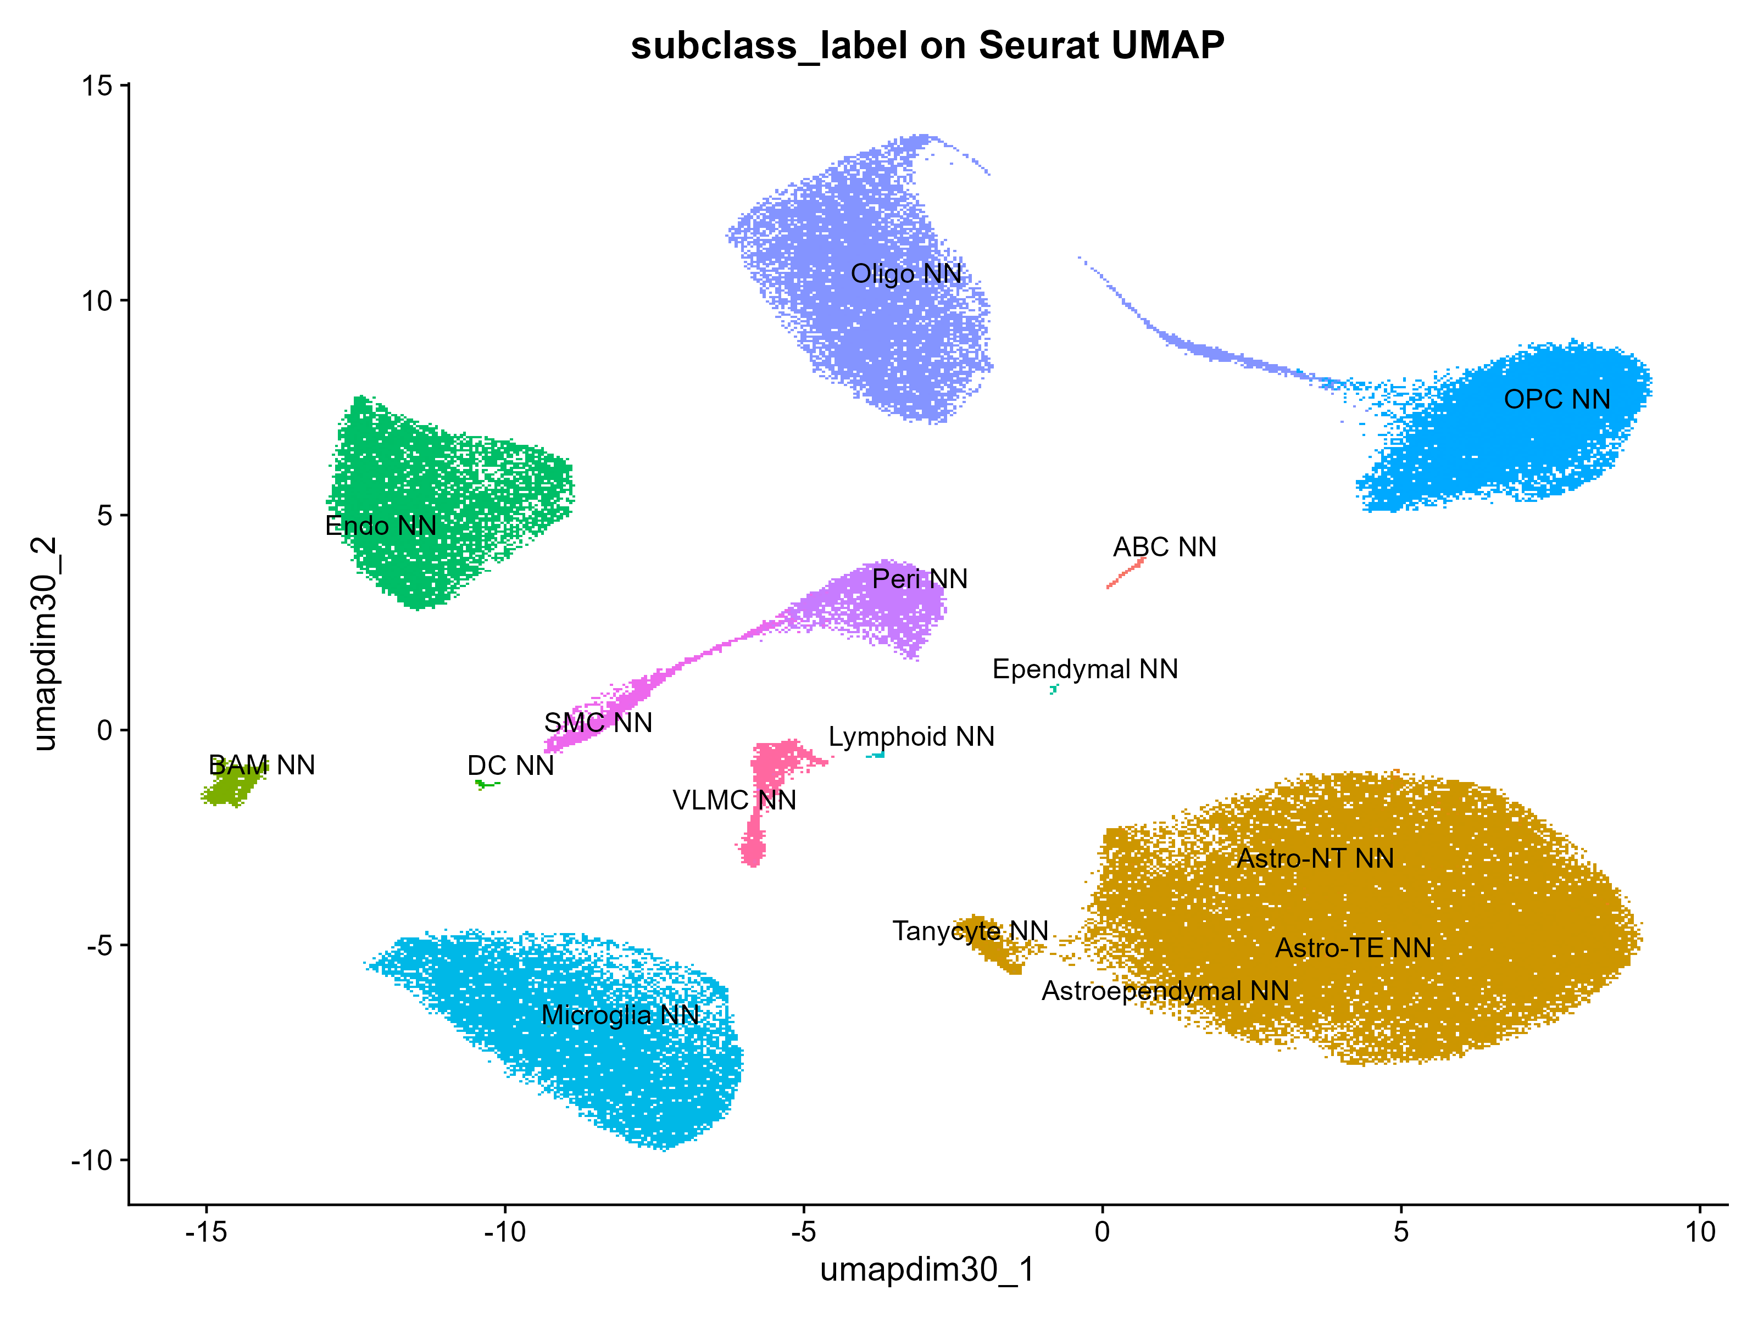
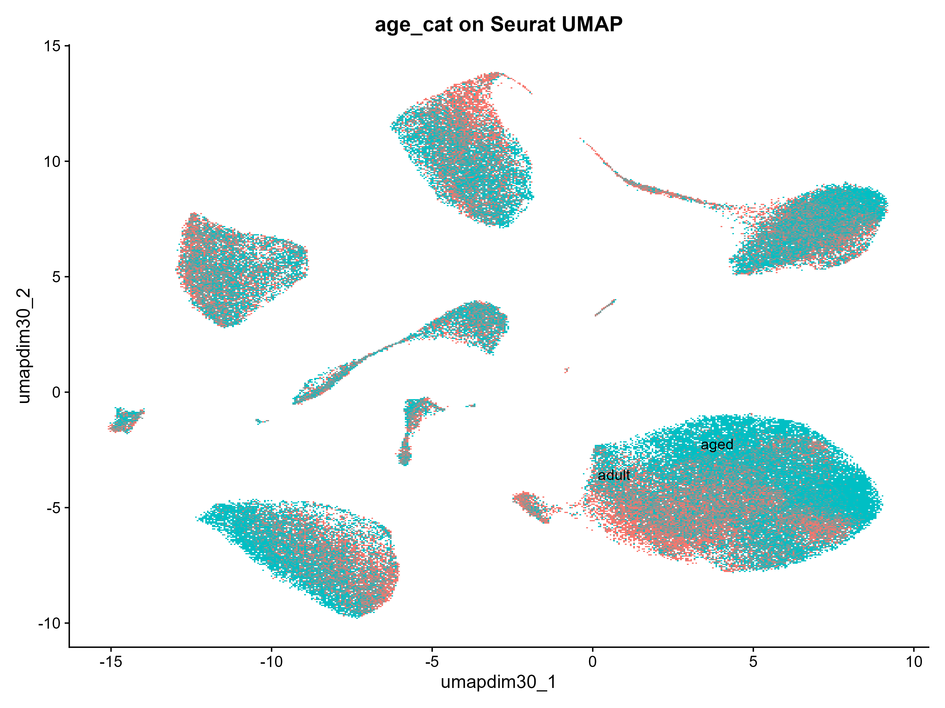
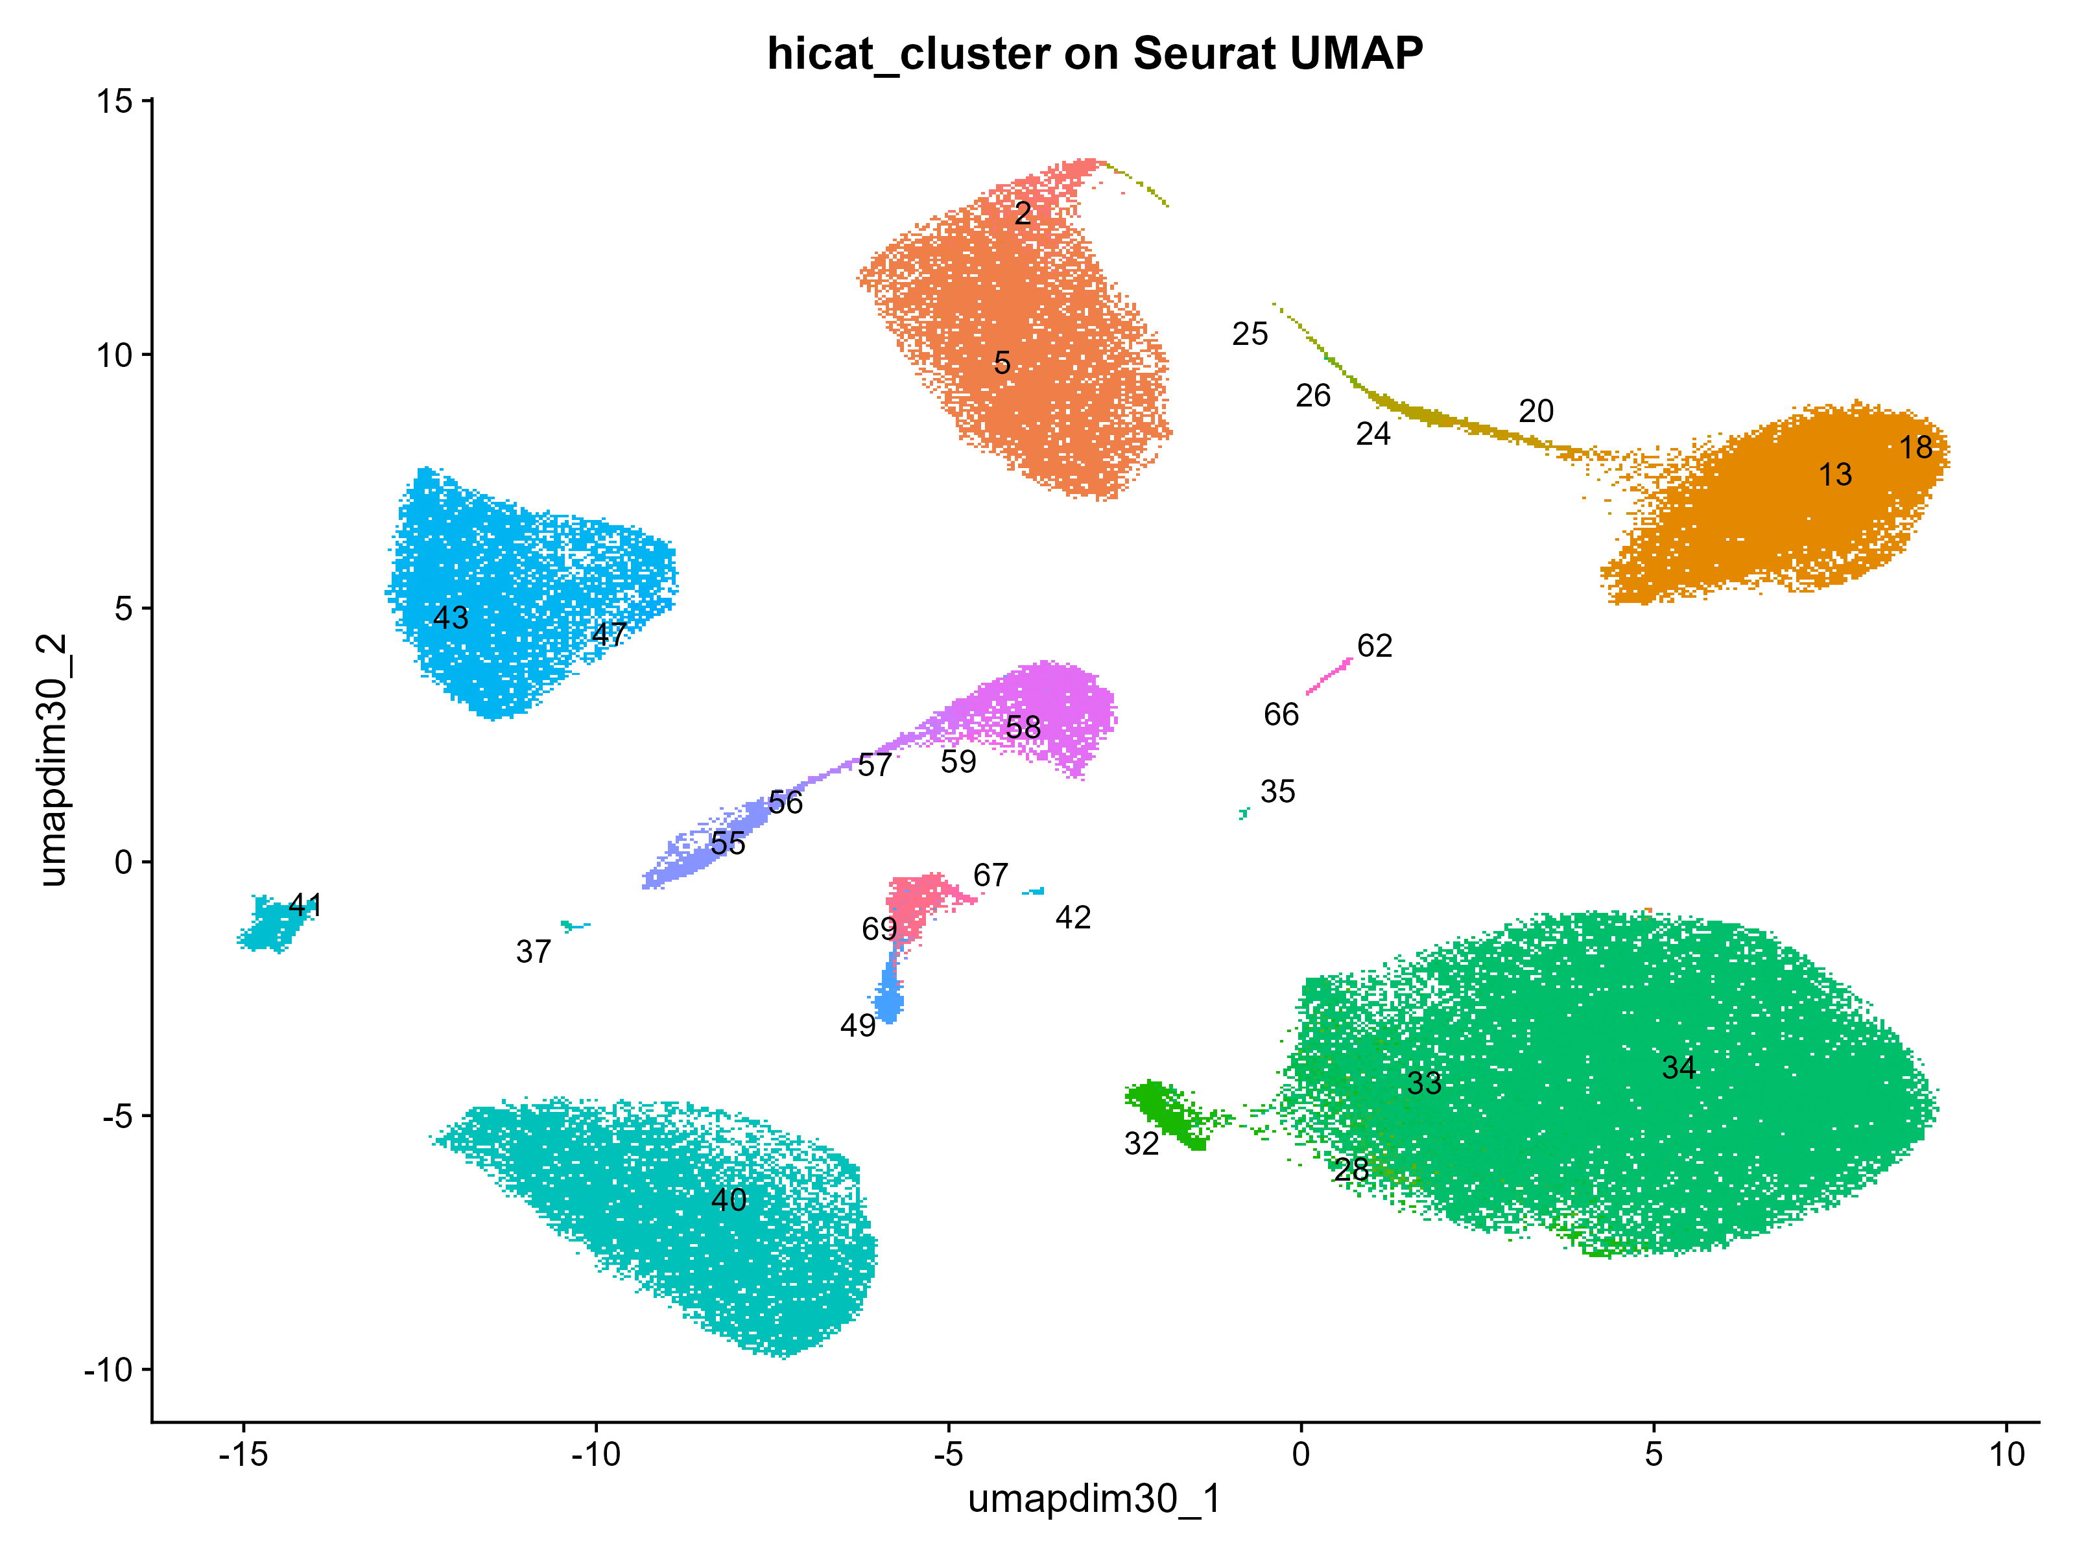
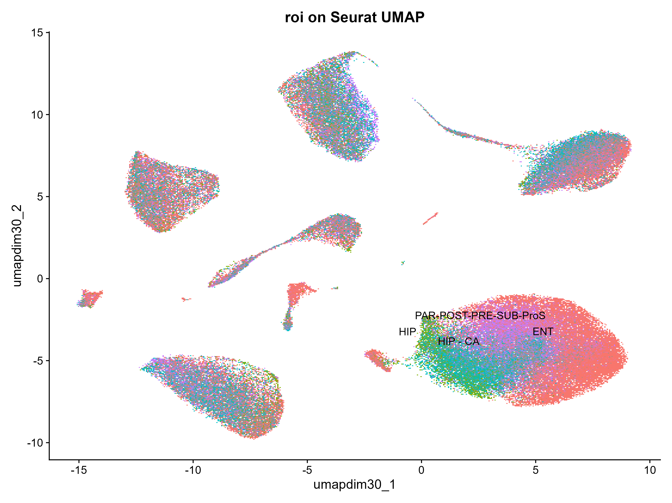
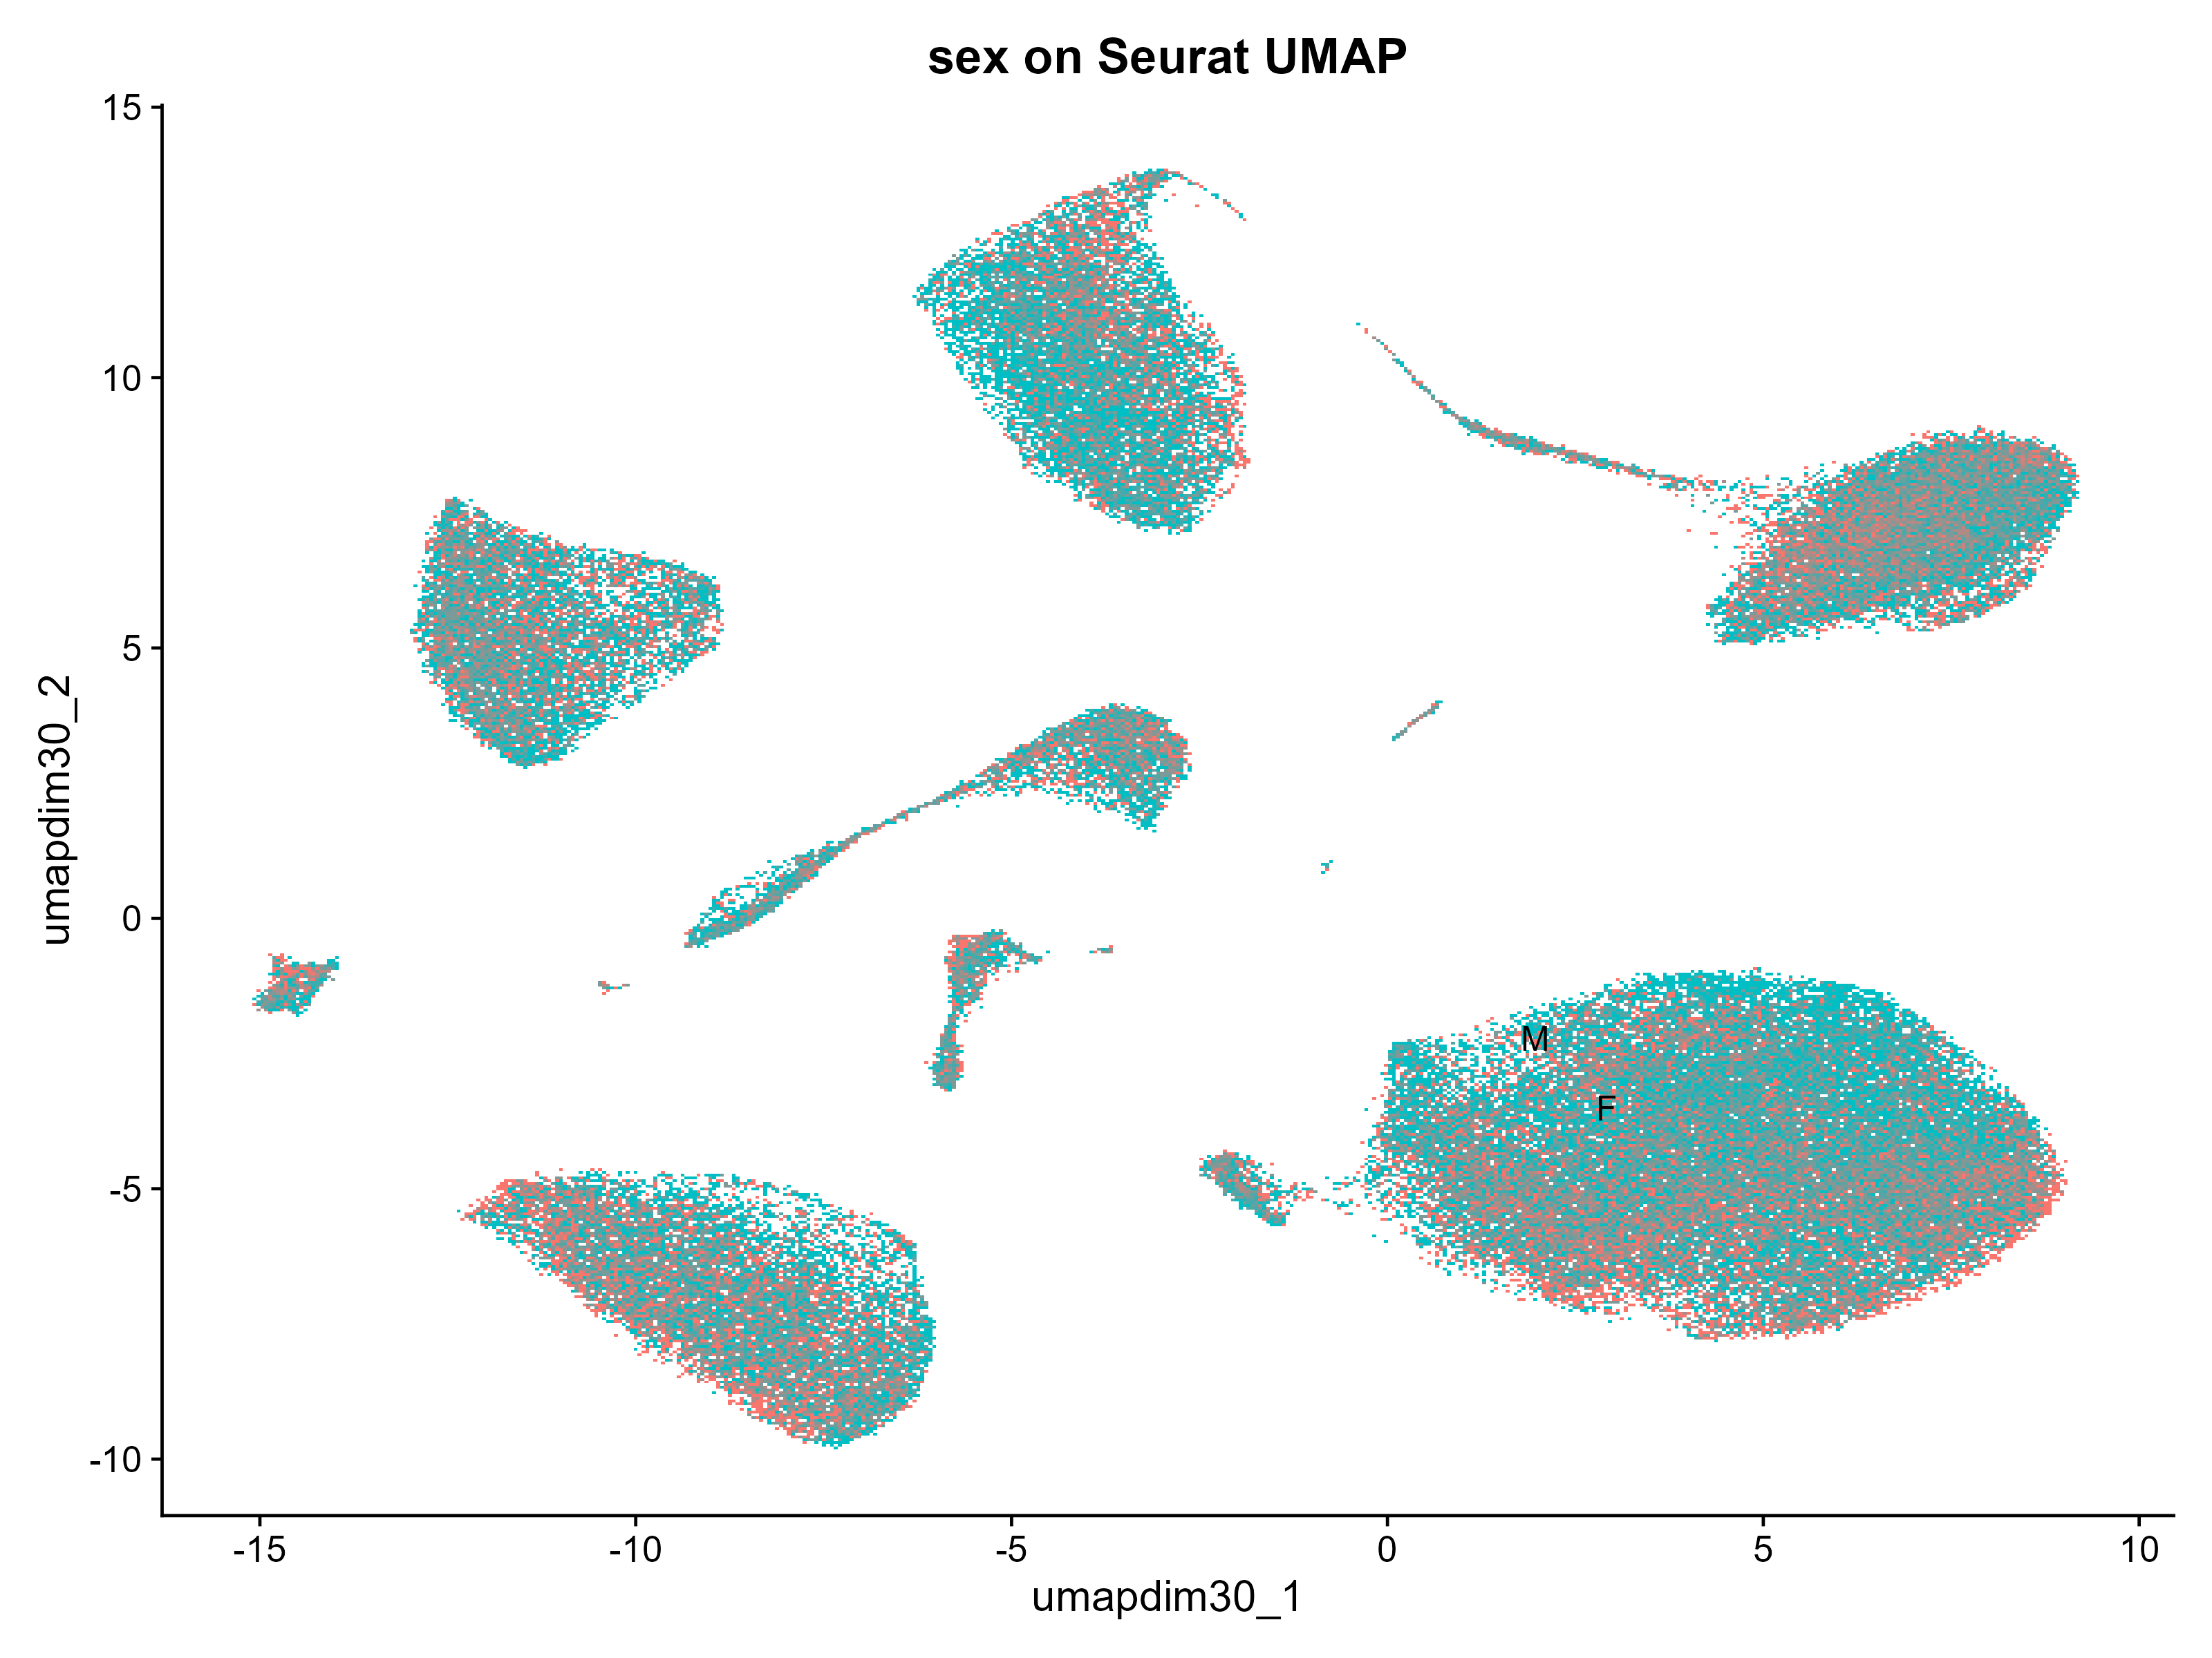

Slide 16
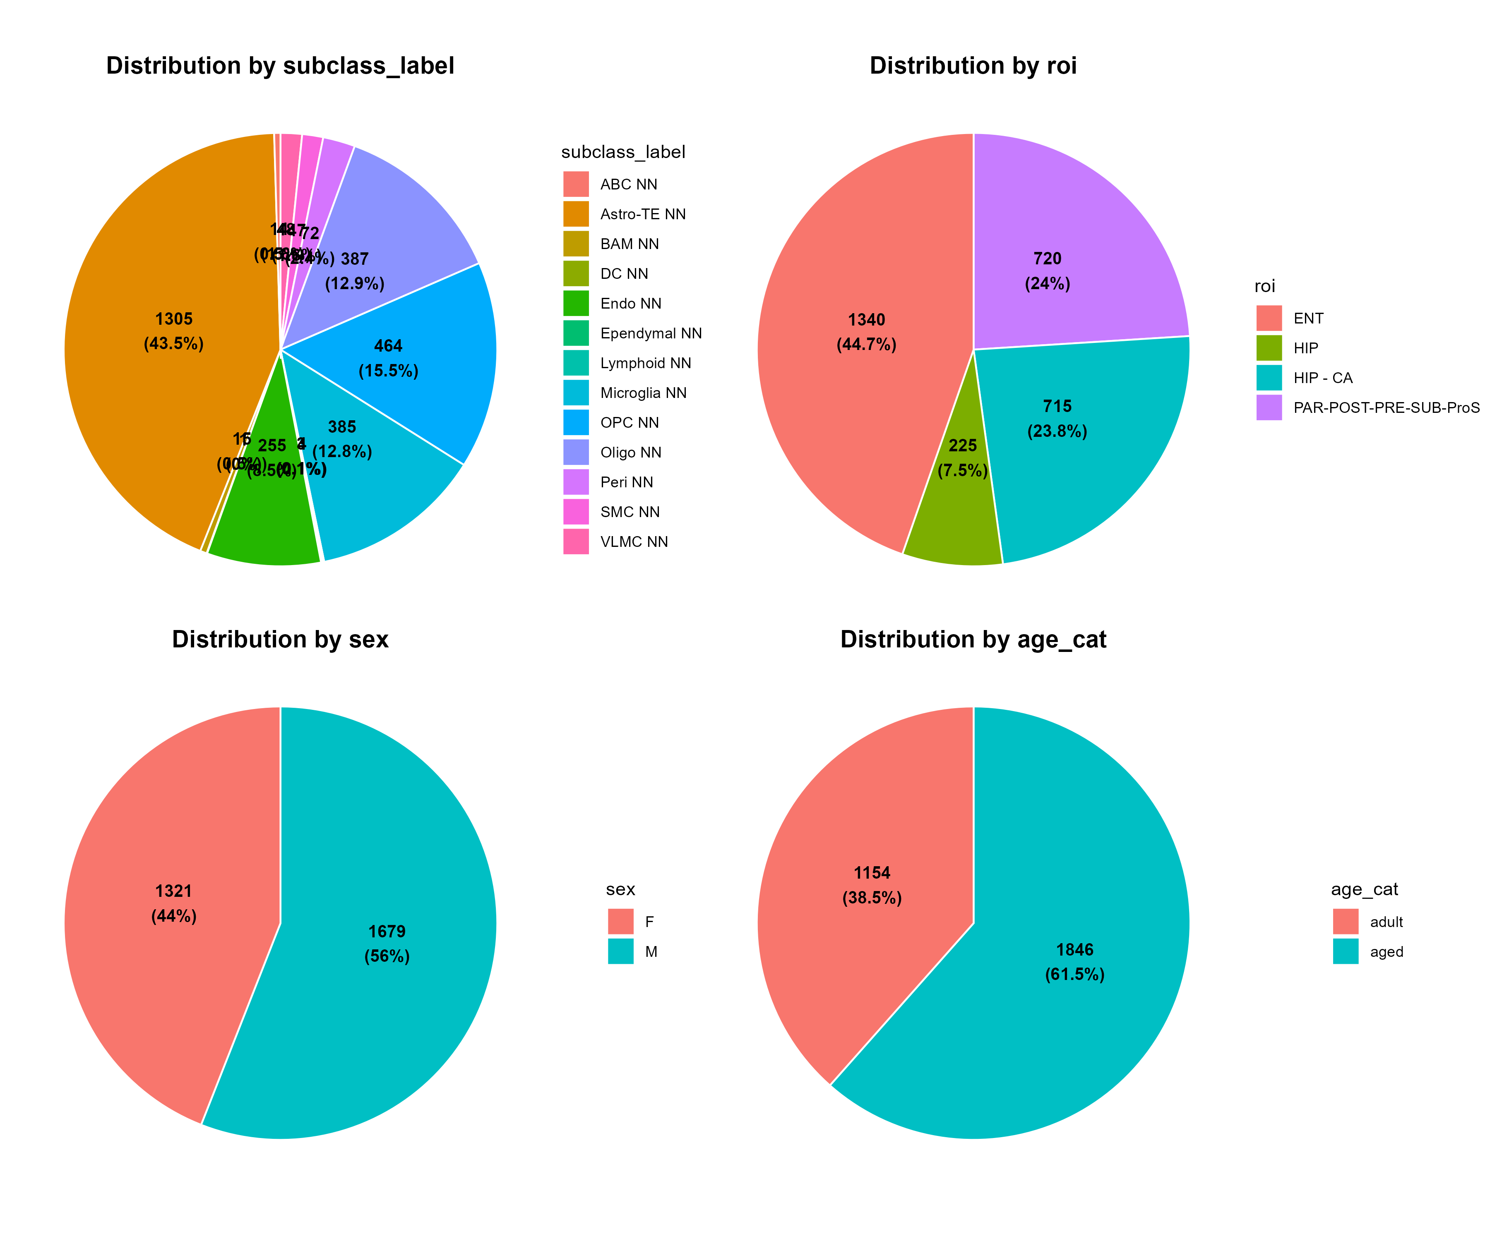
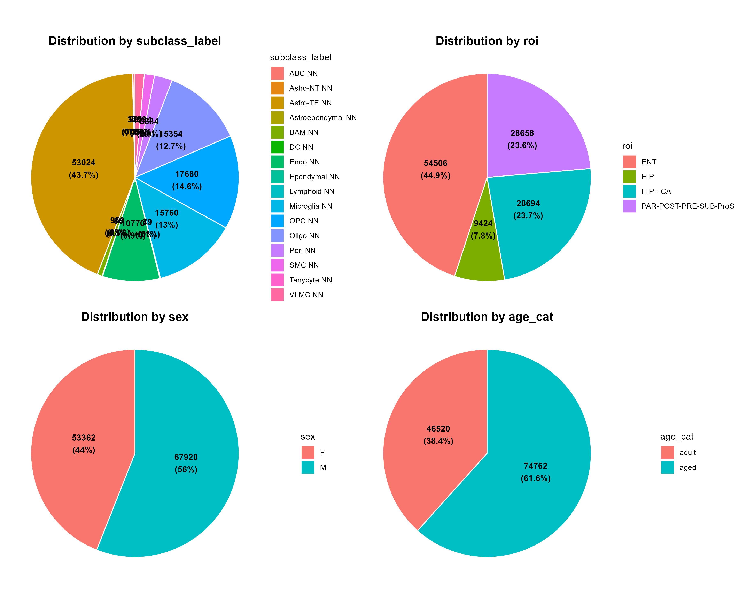
3k subset
Whole glia

Slide 17
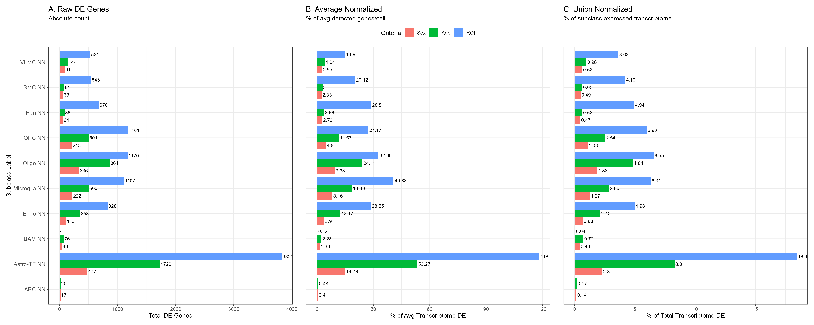
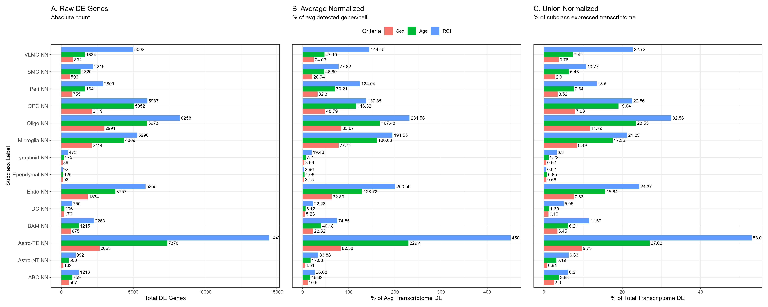
3k Subset
Whole Glia

Slide 18
GO enrichment (BP & MF)
clusterProfiler package (Yu, 2024 https://doi.org/10.1016/j.xinn.2024.100722)
Gene Ontology (Thomas et al, 2022 https://doi.org/10.1002%2Fpro.4218)

Slide 19
Global age difference
3k
Whole glia
Mitochondrial respiration ↑ adult
GTPases mediated transduction ↑ adult
Gliogenesis ↑ adult
Synapse regulation ↑ adult

Slide 20
Global sex difference
3k
Whole glia
Sex chromosome dosage compensation↑ Female
Histone modification ↑ Female
Immune response & activation ↑ Female

Slide 21
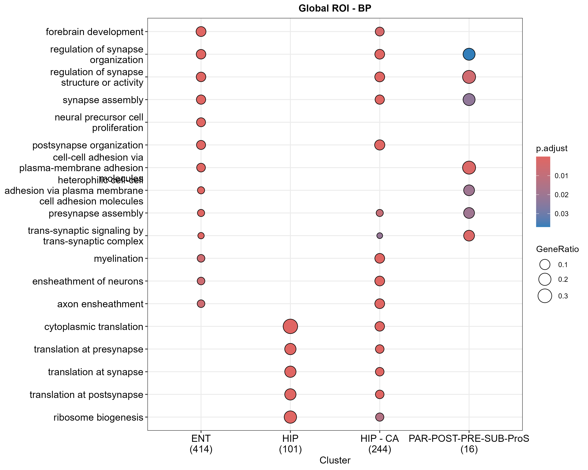
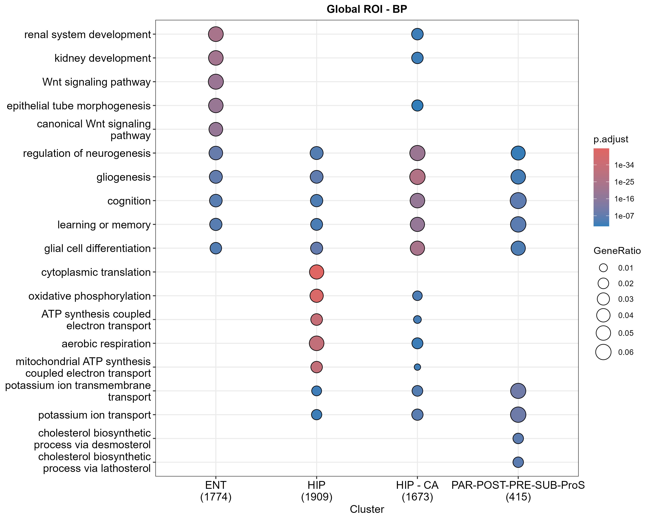
Global roi difference
3k
Whole glia

