Slide 1
Contaminant source identification with neural network surrogates
Zitong Zhou, 03/05/21

Slide 2
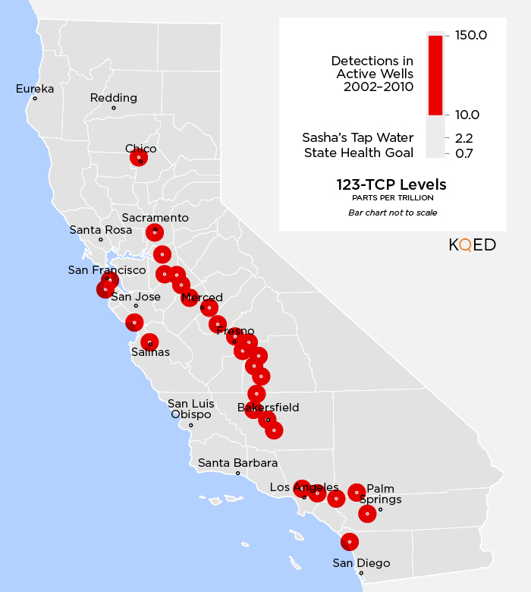
Problem Background
Organic contaminants such as Trichloropropane (TCP, used in industrial solvent production) enters drinking water[1].
TCP is on the list of cancer causes[2].
TCP is banned from use in soil fumigants now, but breakdown of it in the soil is slow.
Source identification is needed for further removal of TCP!
1: https://www.cleanwateraction.org/features/tcp-californias-drinking-water
2: https://oehha.ca.gov/proposition-65/crnr/chemical-listed-effective-december-4-2015-known-state-california-cause
3: SOURCE: CALIFORNIA STATE WATER RESOURCES CONTROL BOARD, MAP: Teodros Hailye, KQED Science

Slide 3
Forward Problem Formulation
1. In general:
Advection-diffusion-reaction transport equation:
The reaction terms represent sorption and first-order rate reaction:
2. In our study:
single specie, Freundlich sorption, no degradation:
Sorption constants: 0.1, 0.9

Slide 4
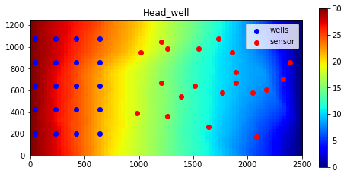
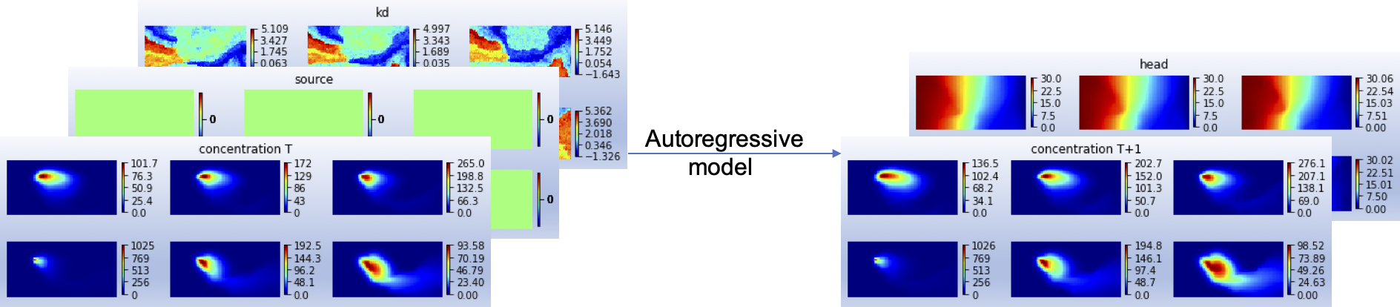
Forward 3D model visualization
Discretization: 300m*1250m*2500m; 6*41*81 grids
Source term: release from 1 of the wells
Releasing time: 5 periods, 4 years each, with different concentration
Hydraulic conductivity: channelized, shown below
Time step: 4 years
Hydraulic head profile; releasing well in the 4th layer

Slide 5
Problem description
Measurements on x_i locations: concentration and hydraulic head
Unknowns: injecting concentration and hydraulic conductivity field
1 location && 5 release concentration && 6*41*81 hk ~ 19932 parameters
Uncertainty quantification:
distribution of the unknow parameters
Challenge: parameterization of the 3D conductivity field

Slide 6
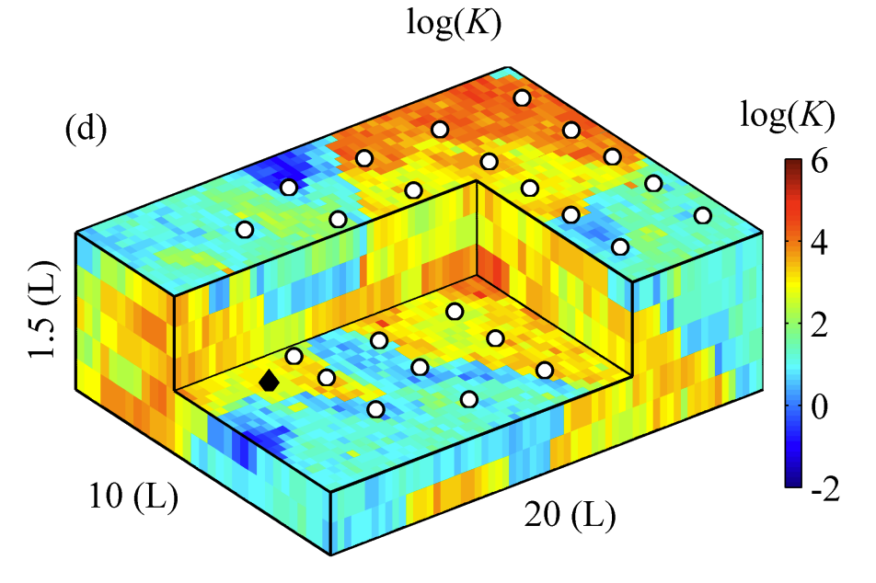
Parameterization of the conductivity field: Convolutional adversarial autoencoder(CAAE)
encoder
decoder
Conductivity field: 6*41*81
Latent var
z: 924*1
Conductivity field: 6*41*81
x: the conductivity field. p_data(x): the data distribution, high dimensional, with complicated spatial correlation
D: discriminator, computes if the sample x is from p_data(x);
G: generator, the decoder in the above image.

Slide 7
Bayesian Surrogate neural network
Dataset:
A deterministic neural network:
Obtain of the parameters:
Bayesian neural network:
Obtain of the distribution of parameters:
🤔🤔🤔🤔🤔🤔

Slide 8
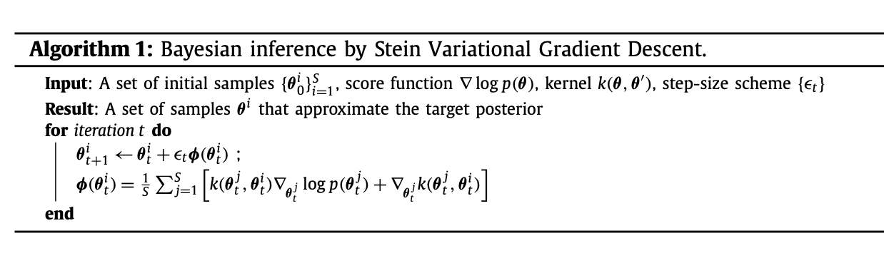
Bayesian Surrogate neural network
Only if an ensemble of samples could be obtained
Bayesian Inference:
Unnormalized posterior of w

Slide 9
Bayesian Surrogate neural network
With ~20 samples obtained for the parameters:

Slide 10
Putting things together
Represent hydraulic conductivity field with low dimensional latent variable z, from standard normal distribution.
Build Bayesian forward surrogate model, ~20 neural networks as an ensemble.
Inverse process: sample from the posterior distribution

Slide 11
Numerical experiments(NN part)
Surrogate forward model Dataset:
Conductivity fields from a big image
Source, through well injection in the first 20 years
Hydraulic head fixed on x=0, L
Simulation time, 40 years in total
Injection happened in 1 of the 20 wells

Slide 12
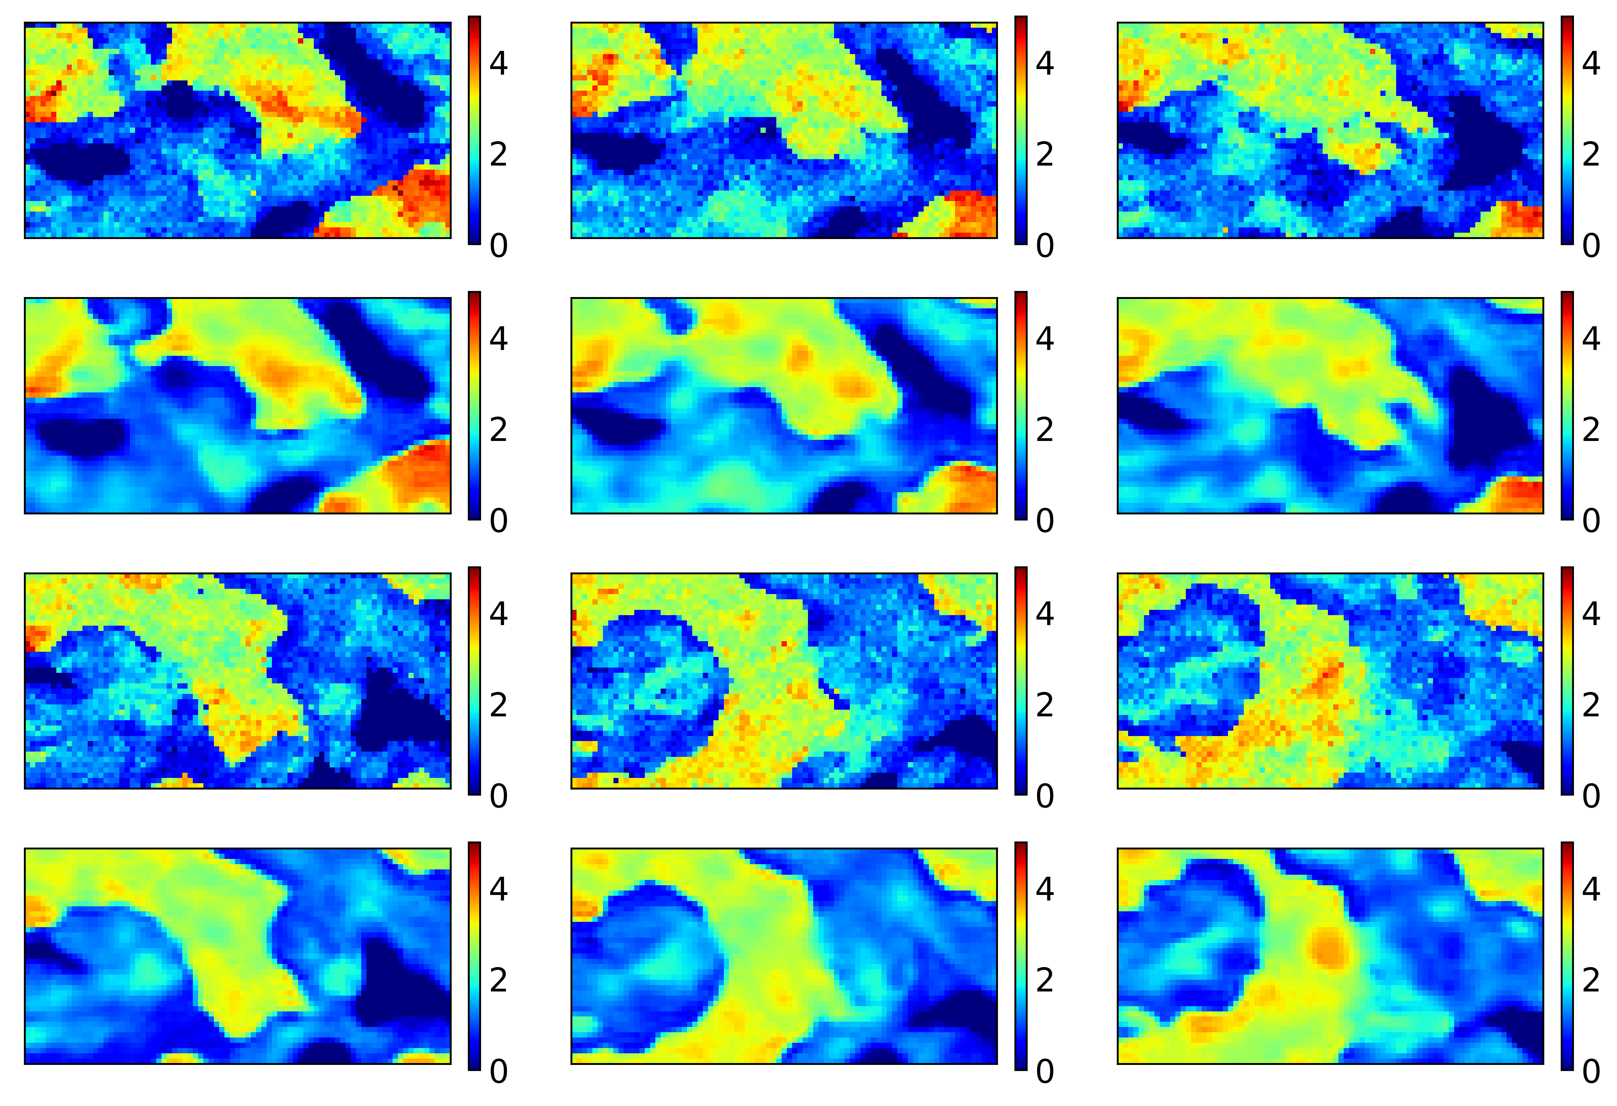
Numerical experiments(NN part)
CAAE for the hk field:
1 forward surrogate model:

