Slide 2
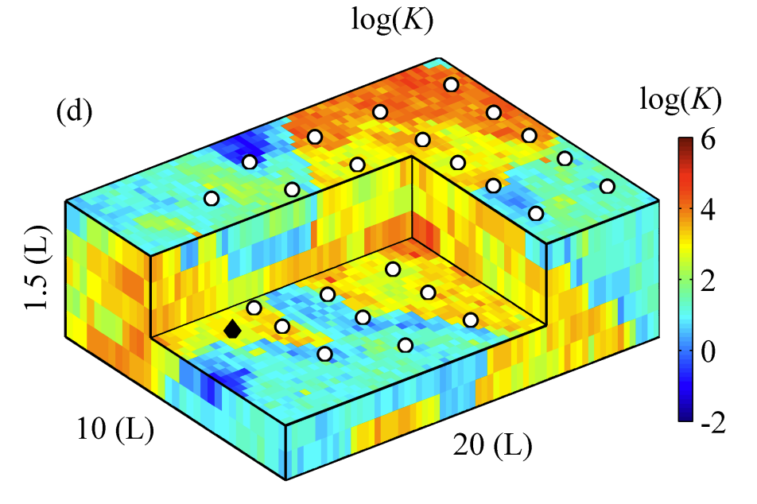
Parameterization of the conductivity field: Convolutional adversarial autoencoder(CAAE)
encoder
decoder
Conductivity field: 6*32*64
Conductivity field: 6*32*64
Latent var z: 512*1

Slide 3
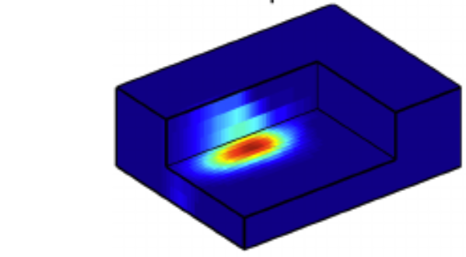
Bayesian Surrogate neural network

