Slide 1
Nilo
Networked Intelligent Lab Orchestrator
People and AI working together
on real hardware
Proof of concept
Notes:
Nilo is a project I am developing to connect people, AI agents and real electronics equipment. The purpose is to make AI assistance useful at the hardware bench, whether an engineer works alone or a team shares a test setup. This presentation describes the proof of concept and the workflows I want it to enable as more integrations become available.
Source: user-supplied product vision and use cases, September 2026. Current project responsibilities: D:/ProjectsDDP/2026_Networked_Intelligent_Lab_Orchestrator/.agentic/context/project.md

Slide 2
The gap at the hardware bench
AI can help with software.
Hardware work also needs
a connection to the bench.
People move between equipment, software and scattered logs.
An agent needs access to what it can observe and operate.
2
Notes:
I started with an observation: AI support feels much easier to use in software than in electronics development and testing. A hardware investigation often moves between a board, its software, measurement tools and logs. To contribute to that work, an AI agent needs a way to obtain observations and use connected tools. Nilo addresses that connection.
This is the developer’s observation and product motivation, not a measured claim about industry adoption. Source: user-supplied framing.

Slide 3
A shared connection to the bench
People
Choose the task and review the findings.
AI agents
Use available tools and investigate the evidence.
Nilo
Connect the equipment and record its activity.
3
Notes:
The intended workflow is simple. The engineer asks a question or defines a test. The AI agent uses the tools that Nilo exposes, collects observations and helps interpret the evidence. Nilo provides access to equipment and records activity. The reasoning and research belong to the agent. People can use a browser or command line, and agents can connect through the command line or MCP.
Source: D:/ProjectsDDP/2026_Networked_Intelligent_Lab_Orchestrator/.agentic/context/project.md. The investigation workflow is the user’s product vision.

Slide 4
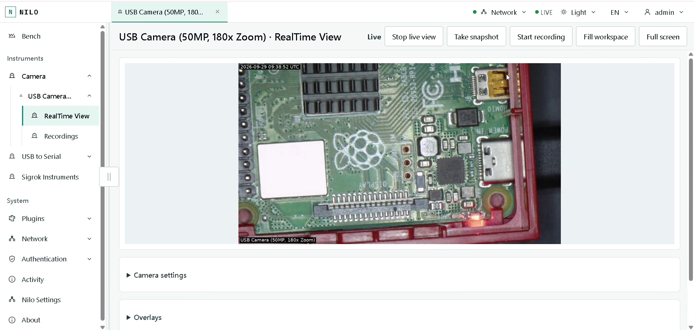
Eyes and hands for AI
Eyes on the bench
Cameras give an agent
visual context.
Hands through tools
Each new integration
adds supported actions.
Current camera workspace
Watch the app preview
4
Notes:
The camera is a concrete example of giving an agent eyes on the bench. Nilo can manage multiple cameras, and its camera tools are available through MCP. An agent can obtain snapshots and use supported camera controls. The “hands” are supported operations through integrations, with more device capabilities planned. The image is an actual frame from the supplied recording, showing the Raspberry Pi running Nilo.
Optional demo: play D:/ProjectsDDP/2026_Networked_Intelligent_Lab_Orchestrator/09_Others/Nilo_preview_HR.mp4. The slide hyperlink points to Nilo_preview_HR.mp4 beside the final deck.
Sources: D:/ProjectsDDP/2026_Networked_Intelligent_Lab_Orchestrator/06_SoftwareDocu/Camera_Integration.md; D:/ProjectsDDP/2026_Networked_Intelligent_Lab_Orchestrator/.agentic/context/project.md. Image: D:/ProjectsDDP/2026_Networked_Intelligent_Lab_Orchestrator/09_Others/Nilo_preview1.mp4, frame at 05:17.

Slide 5

Shared test
benches
A team testing the next
software release.
Driver displays, control
units and connected
systems.
Concept illustration
5
Notes:
One use case is a team testing new releases on a shared electronics bench. The setup may contain a driver display, electronic control units and communication gateways. Today, people can spend substantial effort repeating checks and searching through results. The vision is for an AI agent to assist with those tasks through the equipment and software connections provided by Nilo, then bring findings back to the team. No customer or company names are implied.
Use case source: user-provided examples. Visual: AI-generated concept illustration using the built-in image generation tool. Prompt: generic automotive electronics test bench with two engineers, driver display, control modules, gateway, camera and instruments; left-side negative space; warm off-white and teal; no brands, logos or readable text. This is not a photograph of a customer deployment.

Slide 6
A release test with an AI agent
“Test this release.
Show me what changed.”
1
Run the agreed checks on connected equipment.
2
Capture device behavior and communication.
3
Compare logs and research unexpected results.
4
Draft a report with evidence for the team.
Envisioned workflow as integrations expand
6
Notes:
Imagine asking an agent to test a new release and show what changed. It could run the team’s agreed checks through available integrations, capture behavior and communication, compare logs, and search documentation to investigate an unexpected result. It would draft a report with the evidence attached for the team to review. These complete workflows are the intended direction of the proof of concept as the relevant integrations become available.
User-supplied scenario: release testing for driver interfaces, ECUs and gateways, including messaging clients such as MQTT. Nilo exposes tools; the agent performs analysis and research.

Slide 7
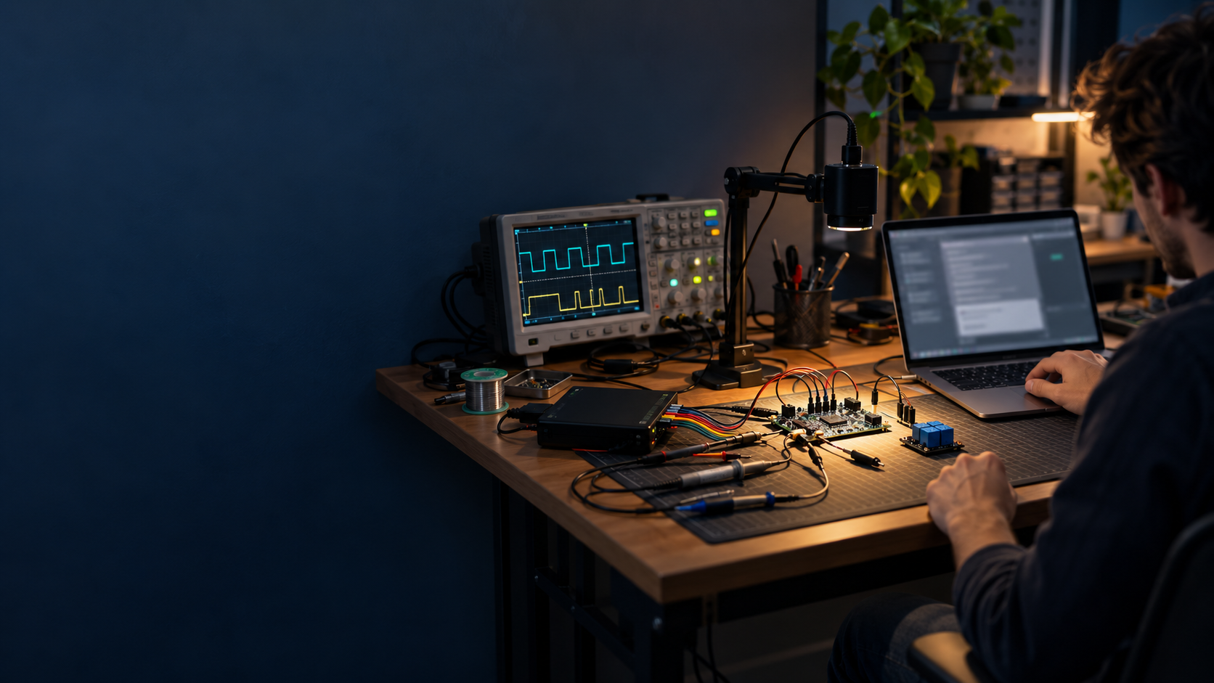
One engineer,
one board
An AI partner for
investigating hardware
behavior.
“Why does it fail
after restart?”
Concept illustration
7
Notes:
Another use case is an engineer developing a board alone. The board may connect to a debugger, logic analyzer or oscilloscope, with a camera observing it and a relay board controlling part of the setup. Nilo could connect those tools to an AI agent so the engineer can ask a hardware question and work through the investigation with assistance. Debuggers, broader oscilloscope support and relay controls depend on future integrations.
Use case source: user-provided solo embedded development example. Visual: AI-generated concept illustration using the built-in image generation tool. Prompt: modest individual electronics workbench with prototype board, debug adapter, logic analyzer, oscilloscope, relay module and camera; engineer on right; dark blue-gray negative space left; natural warm desk lighting; no brands or readable text. This is not a photograph of a Nilo deployment.

Slide 8
A board investigation
1
Observe startup
Use the camera and device logs.
2
Measure behavior
Capture the signals around the failure.
3
Connect the evidence
Compare measurements with code and documentation.
4
Repeat the test
Apply an agreed change and check the result.
Envisioned workflow with the relevant plugins
8
Notes:
The investigation starts with an observation: what happens when the board restarts? The agent can help gather camera images and device logs, then use supported measurement tools to examine the signals around the failure. It can compare that evidence with source code and reference documentation, suggest a next check, and help repeat the test after an agreed change. Planned flashing and relay integrations could add firmware updates and controlled power cycles.
This is an envisioned complete workflow, not a claim that the current PoC controls every illustrated device. Source: user-supplied vision and plugin roadmap.

Slide 9
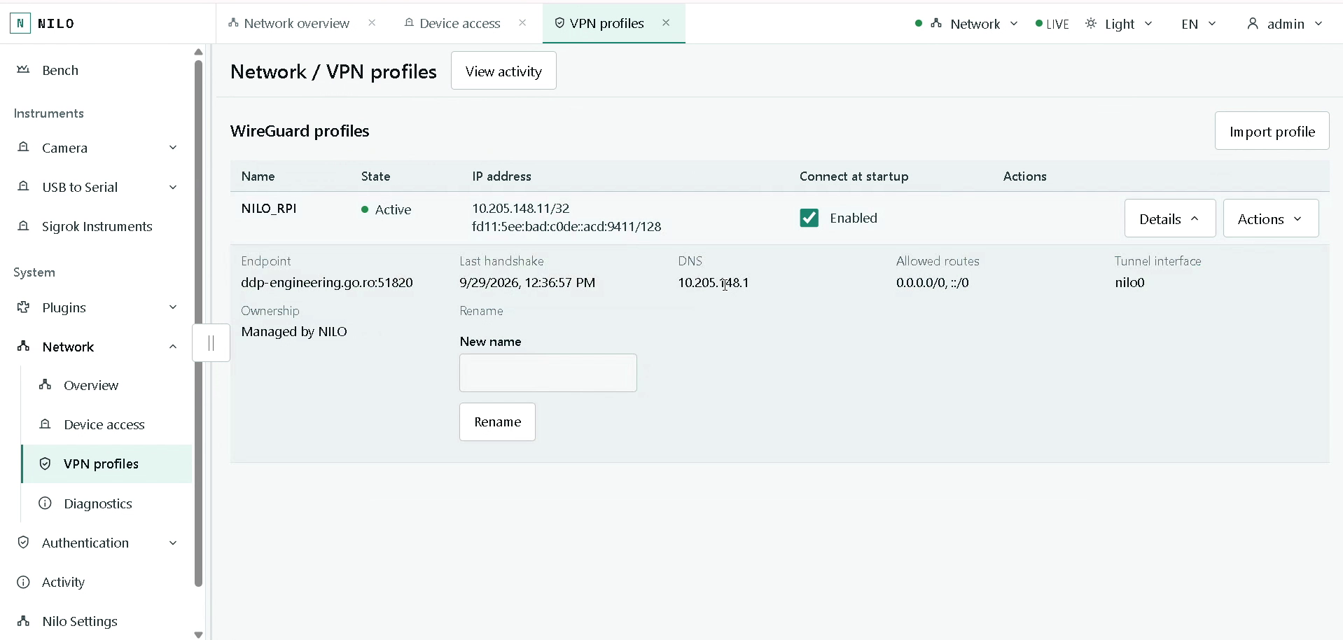
Remote bench access
The bench stays
near the hardware.
People and AI agents
can work from elsewhere
through a VPN.
Runs on a Raspberry Pi
or a Linux PC.
Smart, configurable routing
connects selected bench devices.
9
Notes:
The bench can stay where the hardware is, while a person or agent works elsewhere through the configured VPN connection. Nilo also acts as a configurable network gateway: it manages multiple interfaces and can route selected traffic, translate addresses and carry access through VPN tunnels. It runs on Linux single-board computers such as Raspberry Pi and on Linux PCs. Each appliance has its own permanent identity.
Sources: D:/ProjectsDDP/2026_Networked_Intelligent_Lab_Orchestrator/.agentic/context/project.md; D:/ProjectsDDP/2026_Networked_Intelligent_Lab_Orchestrator/06_SoftwareDocu/Network_Operations.md. Remote access depends on the configured routes, permissions and VPN connection. The screenshot shows the VPN workspace, not proof that every downstream device is reachable. Image: D:/ProjectsDDP/2026_Networked_Intelligent_Lab_Orchestrator/09_Others/Nilo_preview1.mp4, frame at 03:47.

Slide 10
People set the boundaries
Administrators choose
tools and permissions.
Engineers define the task and review findings.
Agents work through the access they receive.
Activity records help trace what happened.
10
Notes:
The people using the bench define its boundaries. An administrator chooses which integrations and access to enable. An engineer defines the work and reviews the findings. Agent credentials carry specific access, and operation policies can require approval. The activity history provides a record to inspect afterwards. The collaboration is designed around people remaining responsible for the physical setup and consequential decisions.
Sources: D:/ProjectsDDP/2026_Networked_Intelligent_Lab_Orchestrator/.agentic/context/project.md; D:/ProjectsDDP/2026_Networked_Intelligent_Lab_Orchestrator/07_Delivery/NILO_CLI_and_Authentication.md. The existing roles are Administrator, Operator and Viewer. Token scopes intersect with the owner’s role, and operation policy is a separate decision.

Slide 11
A growing set of capabilities
Proof of concept
In development
Planned expansion
Camera views and captures
Device communication
Recording device signals
Networking and access
Industrial and vehicle
communication plugins
Modbus and CAN
Relay board control
Loading software onto boards
More hardware tools
Each plugin adds another way to observe or operate the bench.
11
Notes:
Nilo is a work in progress. The proof of concept already includes camera, serial and digital capture tools along with networking and access management. Industrial and vehicle communication are the next area of expansion, including Modbus and CAN. Modbus implementation is actively developing in this checkout and is not presented as a released product. Further plans include relay boards, for example Arduino-based devices over USB or serial, and flashers for ESP32 and STM32 families, followed by more debugging and measurement integrations. No delivery dates are promised here.
Sources for current PoC: D:/ProjectsDDP/2026_Networked_Intelligent_Lab_Orchestrator/.agentic/context/project.md; D:/ProjectsDDP/2026_Networked_Intelligent_Lab_Orchestrator/06_SoftwareDocu/Camera_Integration.md. Roadmap source: user-supplied planned capabilities, September 2026.

Slide 12
Nilo
A shared workspace for people,
AI agents and real equipment
Which bench task should
Nilo assist with first?
Proof of concept
Notes:
The longer-term aim is to make hardware work something an AI agent can help carry out, through tools connected to Nilo. The best next test is a real bench workflow with a clear question and observable result. That might be one repeated release check or one board investigation. The proof of concept will grow through these workflows and the integrations they require. Which bench task would you want it to assist with first?
Source: user-supplied product direction.

