Slide 1
Convolution & implementation
Chapter 3
References:
J. H. McClellan, R. W. Schafer and M. A. Yoder, Signal Processing First, Pearson Education, Inc. 2003, Chapter 5.
S. K. Mitra, Digital Signal Processing – A Computer-Based Approach, McGraw-Hill International Edition, 4th Ed., 2011, Chapter 4.

Slide 2
3.1 DSP systems
A DSP system transforms signals into new signals or different signal representations
Mathematically
T, in this case, works on discrete-time signals, hence it is a discrete-time system
y[n] = T{x[n]}
e.g. y[n] = 2*x[n]
Output signal
Input signal
System or Operator

Slide 3
Different kinds of DSP systems
Depend on the way a DSP system handles the input data, it can be classified into different categories. Common ones:
Linear or non-linear
Time invariant or time variant
Many DSP systems are linear and time invariant, due to the ease of handling
Many real-life systems are non-linear; but in normal situation, they can be approximated as linear

Slide 4

Linear DSP systems
For a DSP system, if
$$y_{1}\left[n\right]=T\left\{x_{1}\left[n\right]\right\}; y_{2}\left[n\right]=T\left\{x_{2}\left[n\right]\right\}$$
the system is linear if and only if
$$T\left\{x_{1}\left[n\right]+x_{2}\left[n\right]\right\}=$$
$T\left\{x_{1}\left[n\right]\right\}+T\left\{x_{2}\left[n\right]\right\}=y_{1}\left[n\right]+y_{2}\left[n\right]$
and
$T\left\{{ax}_{1}\left[n\right]\right\}=aT\left\{x_{1}\left[n\right]\right\}=ay_{1}\left[n\right]$
$T\left\{{ax}_{2}\left[n\right]\right\}=aT\left\{x_{2}\left[n\right]\right\}=ay_{2}\left[n\right]$
where ‘a’ is an arbitrary constant

Slide 5
Linear DSP systems
For example: an amplifier
Non-linear system example: taking square
10(x₁[n] + x₂[n]) =
10x₁[n] +10x₂[n]
x₁[n] + x₂[n]
*10
ax[n]
10(ax[n]) =
a(10x[n])
Linear
(x₁[n] + x₂[n])² =
(x₁[n])² + (x₂[n])² +
2x₁[n]x₂[n]
x₁[n] + x₂[n]
(.)²
Non-linear

Slide 6
Time invariance DSP systems
If y[n] = T{x[n]}, the system T is said to be time-invariant if for all n_{o} the input sequence x with a delay n_{o} will generate the same output with delay n_{o,} i.e. y[n-n_{o}] = T{x[n-n_{o}]}
Counter-example: a compressor
x[n]
y[n] = x[2n]
0
n
y[n]
0
n

Slide 7
Time invariance DSP systems
If x[n] is delayed by 3 units,
x[n-3]
x x x
n
0
x[2n-3]
x x
n
0
y[n-3]
x x x
n
0
Original y[n]
0
n

Slide 8
3.2 Linear convolution
Consider a linear time-invariant (LTI) system with two sample inputs at different times
y[n]
x[n]
LTI
System
e.g. y[n] = x[n]*2
0
4
n
0
4
n
Due to time-invariance
y[0] = x[0]*2
y[4] = x[4]*2

Slide 9
16
y[n]
x[n]
LTI System
h[n]
8
8
4
4
4
2
0
n
n
0
4
0
0
4
0
Assume for every sample of x, the system will give the output x.h, hence
h[n] is also called impulse response, since it is exactly the response of the system if an impulse is input
y[n] = x[0]h[n]
y[n] = x[0]h[n]
y[n] = x[4]h[n-4]
y[n] = x[0]h[n] + x[4]h[n-4]

Slide 10
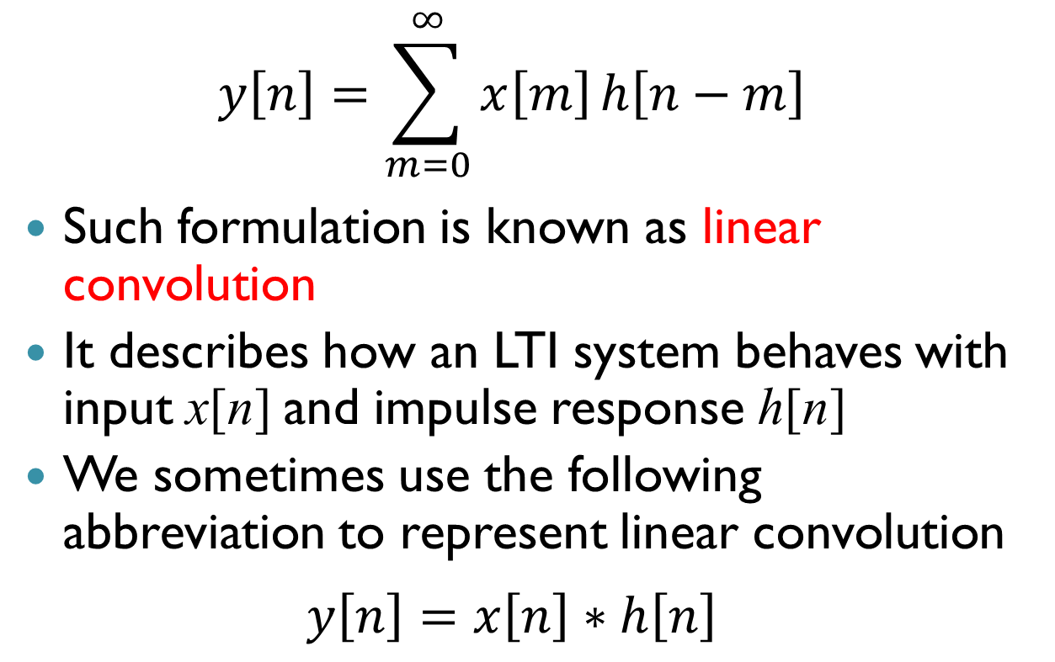
Linear convolution
$$y\left[n\right]=\sum_{m=0}^{∞}{x\left[m\right]}h\left[n−m\right]$$
Such formulation is known as linear convolution
It describes how an LTI system behaves with input x[n] and impulse response h[n]
We sometimes use the following abbreviation to represent linear convolution
$$y\left[n\right]=x\left[n\right]∗h\left[n\right]$$

Slide 11
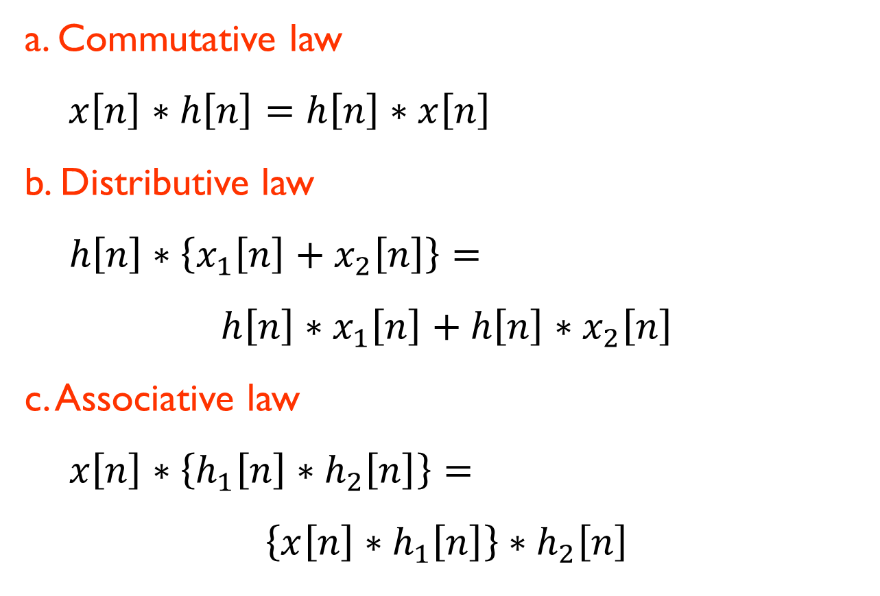
Properties of linear convolution
a. Commutative law
$x\left[n\right]∗h\left[n\right]=h\left[n\right]∗x\left[n\right]$
b. Distributive law
$h\left[n\right]∗\left\{x_{1}\left[n\right]+x_{2}\left[n\right]\right\}=$
$$h\left[n\right]∗x_{1}\left[n\right]+h\left[n\right]∗x_{2}\left[n\right]$$
c. Associative law
$x\left[n\right]∗\left\{h_{1}\left[n\right]∗h_{2}\left[n\right]\right\}=$
$$\left\{x\left[n\right]∗h_{1}\left[n\right]\right\}∗h_{2}\left[n\right]$$

Slide 12
Response of impulse chain
x[n]
LTI System
h[n]
y[n]
2
1
n
0
n
0
0
If the impulse response h has a length of p and the input x has a length of q, the output of a LTI system will have a length of p+q-1

Slide 13
Finite impulse response filter
We often use the following structure to describe the operation of an LTI system
Such structure is named as Finite Impulse Response (FIR) Filter – means that the response of any input impulse is finite
delay
x[n]
...
D
D
D
multiplier
y[n]
+
+
+
adder

Slide 14
Finite impulse response filter
n = 0
n = 1
n = 2
n = 3
n = 4
x[n]
D
D
h[0] = 1
h[1] = 1
h[2] = 1
y[n]
+
+
0
n

Slide 15
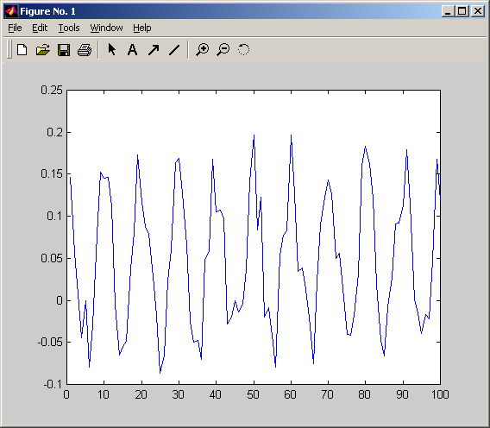
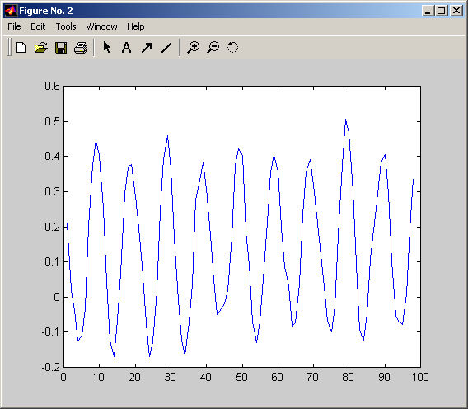
By adjusting h[0], h[1] and h[2], which are the so-called FIR filter coefficients, we can modify the input signal to our desire
The above example of h[n] is indeed an average filter (which is a kind of low pass filter)
⇒ That is, it can smooth out the sharp change in the signal
D
D
h[0] = 1
h[1] = 1
h[2] = 1
+
+
3-tap average filter

Slide 16
Exercise
Given that an LTI system has an impulse response h[n] = [3 2 1] and the input is x[n] = [1 3 2 2]. Determine the output of the system y[n].
x[n]
2 2 3 1
D
D
h[0]
=3
h[1]
=2
h[2]
=1
+
+

Slide 17
Solution
x[n]
2 2 3 1
D
D
h[0]
=3
h[1]
=2
h[2]
=1
h[n] = [3 2 1] x[n] = [1 3 2 2]
y[n] = x[n] * h[n]
n=0 y[0] = x[0]×h[0] = 1×3 = 3
n=1 y[1] = x[1]×h[0] + x[0]×h[1] = 3×3 + 1×2 = 11
n=2 y[2] = x[2]×h[0] + x[1]×h[1] + x[0]×h[2]
= 2×3 + 3×2 + 1×1 = 13
n=3 y[3] = x[3]×h[0] + x[2]×h[1] + x[1]×h[2]
= 2×3 + 2×2 + 3×1 = 13
n=4 y[4] = x[3]×h[1] + x[2]×h[2]
= 2×2 + 2×1 = 6
n=5 y[5] = x[3]×h[2]
= 2×1 = 2
+
+

Slide 18
LTI Systems in Frequency Domain
The operation of LTI systems can be simply explained in frequency domain
Assume that
It can be shown that
Also known as the convolution property of the Fourier transform

Slide 19
Time | Frequency
Convolution | Multiplication
Also known as the transfer function of the system
LTI
System
1
0
0
0
Input
Ideal low pass filter
Output

Slide 20
Proof

Slide 21
Proof (cont)
Let k = n – m hence n = k + m
n = 0 to ∞ ⇒ k = -m to ∞
Since h[k] = 0 if k < 0, hence

Slide 22
Cascaded LTI Systems
LTI
System
LTI
System
1
1
0
0
0
0
Input
Output

Slide 23
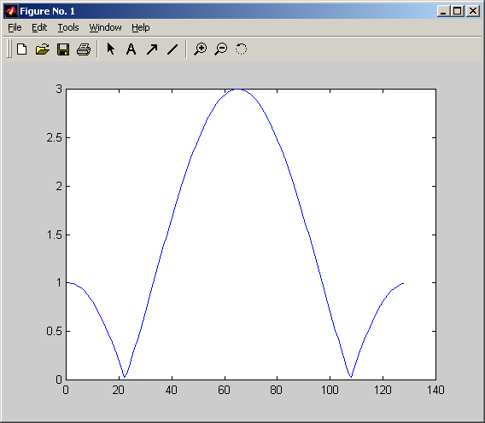
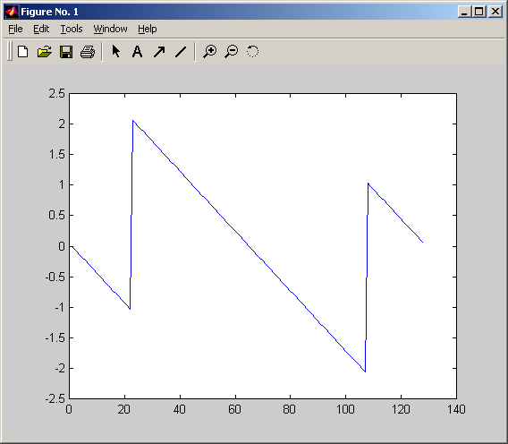
Frequency Response of LTI Systems
magnitude
D
D
h[0]
h[1]
h[2]
+
+
-π
0
π
phase
0
-π
0
π

Slide 24
Frequency Response of LTI Systems
We are interested in the bandwidth of the LTI system
The bandwidth is defined by
-π
0
π
Bandwidth ~ 0.3π

Slide 25
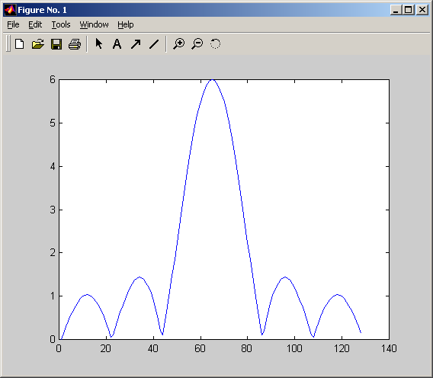
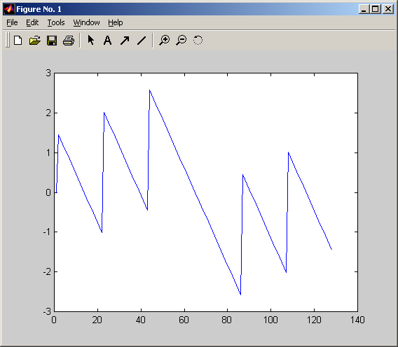
Frequency Response of LTI Systems
We can modify the shape of the frequency response by
Modifying the filter coefficients,
Modifying the number of taps, or
Both
Bandwidth ~ 0.15π

Slide 26
3.3 Implementation of linear convolution
Direct computing a linear convolution can be time consuming particularly if the impulse response is long
Based on the convolution property of the Fourier transform, we can implement linear convolutions using FFT – hence much faster
However, cannot directly apply FFT to the original data sequence and the impulse response

Slide 27


x[n]
*
h[n]
Length-N
Length-N
FFT
FFT
X[k]
$$×$$
H[k]
Length-N
Length-N
✗
What’s wrong?
$$=$$
Y[k]
Inverse FFT
y[n]
Length-N
Length-N

Slide 28




$\tilde{x}$[n]
*
$\tilde{h}$[n]
 |  |  |  |  |  | 0 | 0 | 0 | 0 | 0
 |  |  |  |  |  | 0 | 0 | 0 | 0 | 0
Length-2N-1
Length-2N-1
FFT
FFT
$\tilde{X}$[k]
$$×$$
$\tilde{H}$[k]
Length-2N-1
Length-2N-1
✓
$$=$$
Y[k]
Inverse FFT
y[n]
Length-2N-1
Length-2N-1

Slide 29
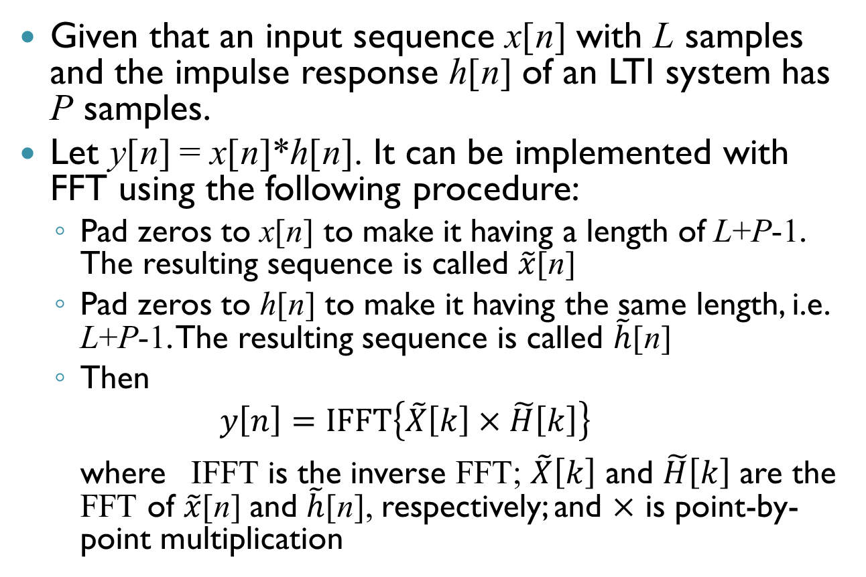
Implementation of linear convolution using FFT
Given that an input sequence x[n] with L samples and the impulse response h[n] of an LTI system has P samples.
Let y[n] = x[n]*h[n]. It can be implemented with FFT using the following procedure:
Pad zeros to x[n] to make it having a length of L+P-1. The resulting sequence is called $\tilde{x}$[n]
Pad zeros to h[n] to make it having the same length, i.e. L+P-1. The resulting sequence is called $\tilde{h}$[n]
Then
$$y\left[n\right]=IFFT\left\{\tilde{X}\left[k\right]×\tilde{H}\left[k\right]\right\}$$
where IFFT is the inverse FFT; $\tilde{X}\left[k\right]$ and $\tilde{H}\left[k\right]$ are the FFT of $\tilde{x}$[n] and $\tilde{h}$[n], respectively; and $×$ is point-by-point multiplication

Slide 30
How much it save?
Assume both x[n] and h[n] are real numbers, direct computation of linear convolution requires
LxP multiplications and (L-1)x(P-1) additions

Slide 31
How much it save?
Using FFT approach
3 FFTs (2 forward + 1 inverse):
3x((L+P-1)/2)log₂(L+P-1) complex multiplications; and
3(L+P-1)log₂(L+P-1) complex additions
Plus L+P-1 complex multiplications
Here it is assumed that L+P-1 is a power of 2

Slide 32
How much it save?
Assume one complex multiplication needs 4 real multiplications and 2 real additions
One complex addition needs 2 real additions
Assume L = 513, P = 512. Hence L+P-1 = 1024
Direct linear convolution:
262,656 real multiplications + 261,632 real additions
Using FFT:
65,536 real multiplications + 94,208 real additions, i.e. 25% and 35% of the direct approach

Slide 33
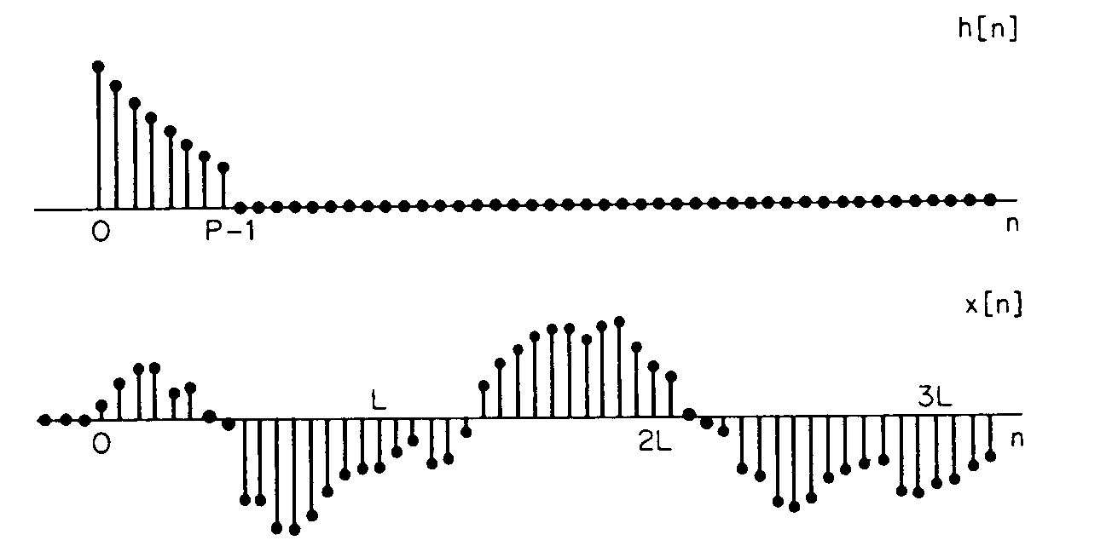
Convolution by sectioning
For an LTI system, it is often that a long data sequence is sent to the system to perform convolution with a short impulse response, e.g.,
Here x[n] is a very long input sequence while h[n] is a P-point system impulse response

Slide 34
Convolution by sectioning
Although using the FFT to compute linear convolution can reduce the computational complexity, it requires to wait until all data are received before we can start the FFT computation. It causes some delay
For the case that the input sequence is very long, the delay will be unacceptable
In fact, we can segment the input sequence into sections and perform the FFTs section by section using the Overlap and Add approach

Slide 35
Overlap and add method
Recall the previous example, the input sequence can be considered as a sum of shifted finite-length segments of length L
Hence the linear convolution of x[n] and h[n] can be expressed as
Adding the convolution result of all sections

Slide 36
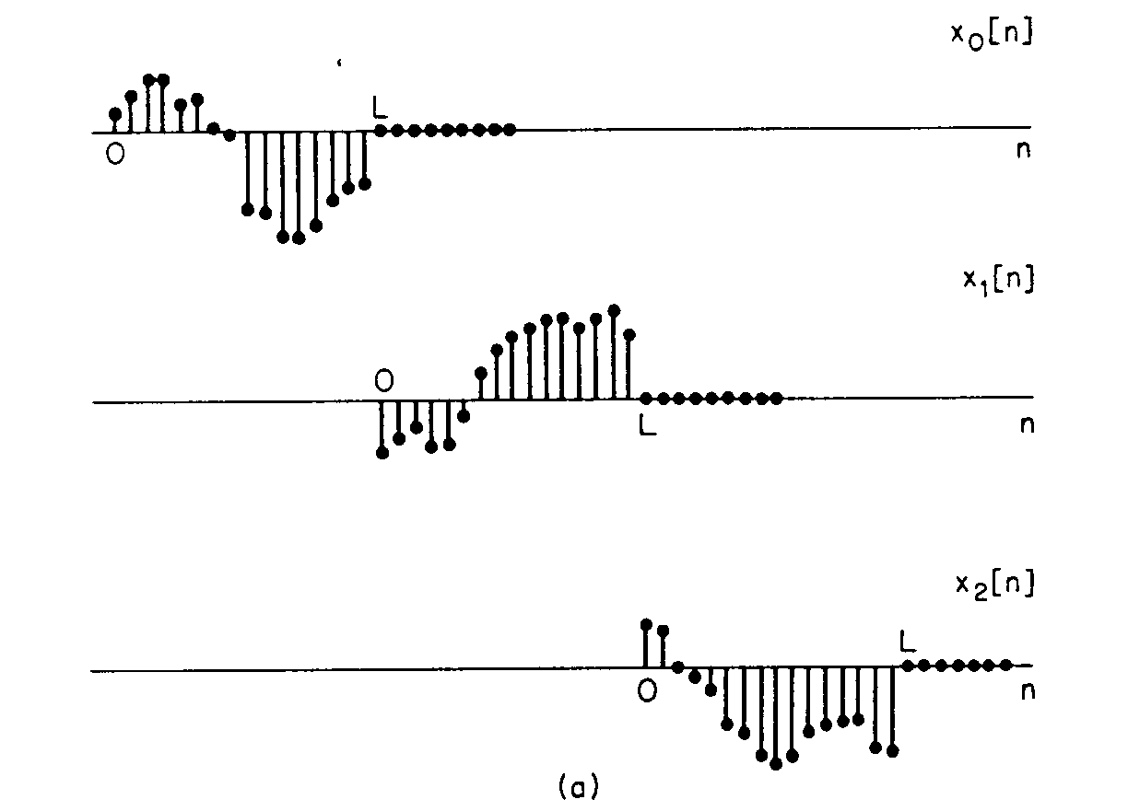
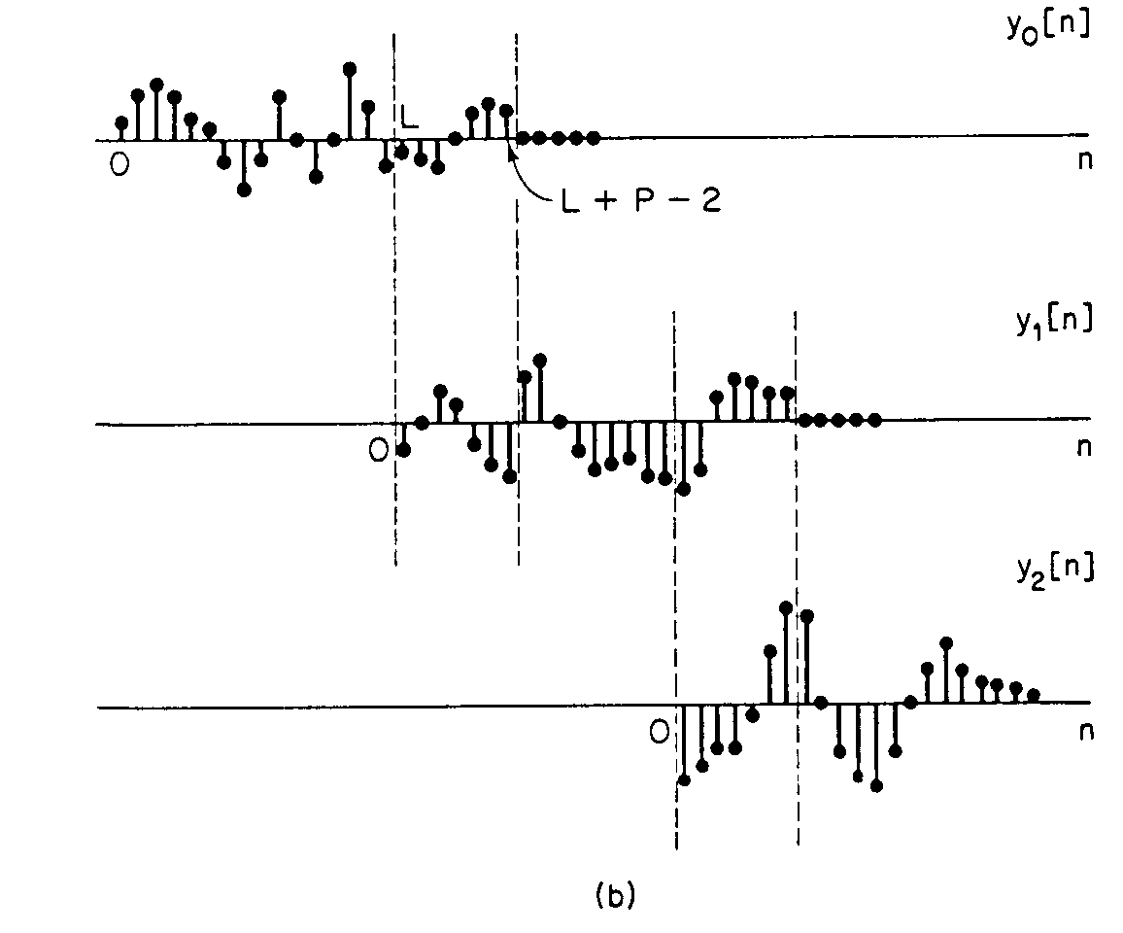
x[n] is segmented into 3 sections
The linear convolution of a length-L sequence with a length-P impulse response would have a length of L+P-1
Hence there are P-1 samples overlap between two sections
Overlap and add approach allows one to start the convolution computation using FFT once one section of data are available
Hence reduce the delay
Convolution result of 3 sections are added together

