Slide 1
FIR Filter Design
Chapter 5
References:
J. H. McClellan, R. W. Schafer and M. A. Yoder, Signal Processing First, Pearson Education, Inc. 2003, Chapter 5 and 6.
S. K. Mitra, Digital Signal Processing – A Computer-Based Approach, McGraw-Hill International Edition, 4th Ed., 2011, Chapter 8 and 10.

Slide 2
5.1 What are digital filters?
In general, a filter is a system that removes the unwanted components in our input
In the context of DSP, a digital filter is a discrete-time system that removes the unwanted components in the input signal
Here, we are particularly interested in the digital filters that will remove the unwanted frequencies in the input signal
Can be further classified as
Low-pass
High-pass
Band-pass

Slide 3
FIR Filters
If the impulse response of an LTI system is of a finite duration, the system is said to be a finite impulse response (FIR) system
If an FIR system is used for filtering purpose, it is called an FIR filter
An FIR filter is characterized by linear convolution in time domain
where N is the filter length and h is its impulse response and can be described in z-domain as

Slide 4



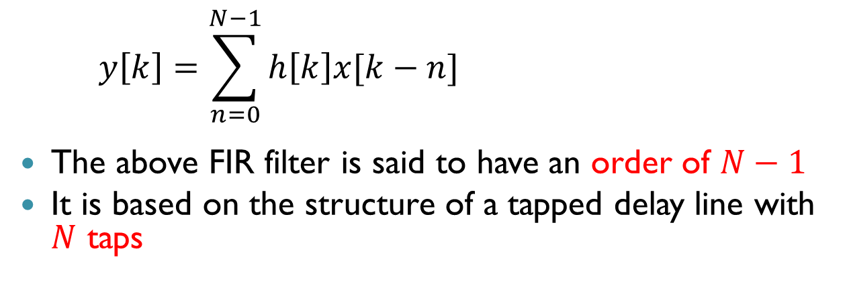



Order and Taps
Z⁻¹
Z⁻¹
$$⋯$$
Z⁻¹
$h[0]$
$h[1$]
$h[N−2]$
$h[N−1]$
+
$$⋯$$
+
+
$$y\left[k\right]=\sum_{n=0}^{N−1}{h\left[k\right]x[k−n]}$$
The above FIR filter is said to have an order of $N−1$
It is based on the structure of a tapped delay line with $N$ taps

Slide 5
Characteristics of FIR filters
Stable – The behavior of an FIR filter usually will not change much due to the imperfection in the implementation
Linear phase response – An FIR filter can be easily designed to have the linear phase characteristics. Hence minimum distortion
Hardware cost – The hardware cost of an FIR filter is linearly proportional to the order of the filter (i.e. number of taps). One more tap → one more set of delay element, multiplier and adder
Delay – Input data need to go thru all the taps of an FIR filter before the output is obtained, which introduces system delay. Again, the amount of system delay is linearly proportional to the order of the filter, i.e. one more tap → one more clock cycle delay

Slide 6
Design stages for FIR filters
Start
Obtain performance specifications
Calculate filter coefficients
Re-calculate
Re-specify
Re-structure
Re-design
Simulate with FIR structure
Finite wordlength effects analysis
Actual hardware/software implementation + testing
Stop

Slide 7
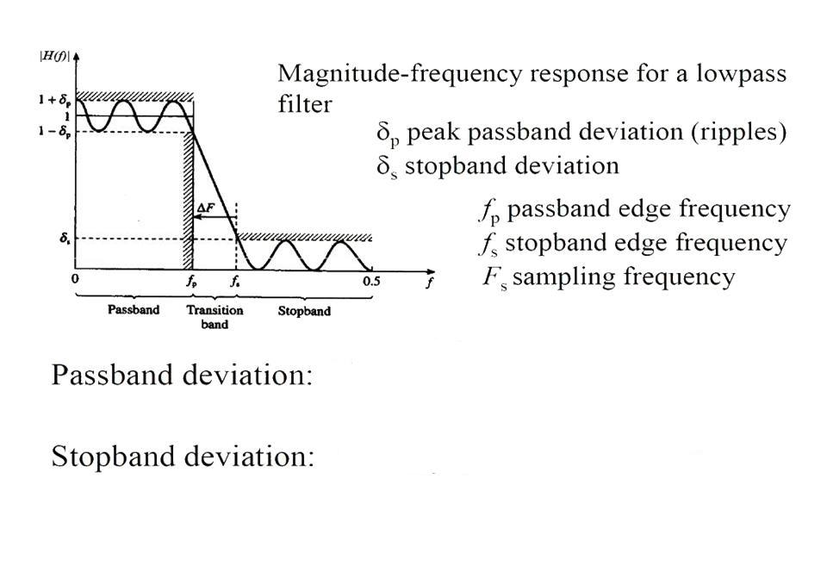
FIR filter specifications
20log(1+δ_{p})
(in dB)
20log(δ_{s})
(in dB)

Slide 8
Design method - Windowing
Design objective: obtain values of h[n] such that the resulting FIR filter meets the design specifications
Magnitude response
Linear phase property, etc.
For the windowing design method, we start with the ideal magnitude response H_{D}(ω). Its impulse response h_{D}[n] can be obtained by the inverse Fourier transform

Slide 9
Window method
For instance, if a low pass filter is to be designed, we consider its ideal magnitude response
1
• • •
• • •
(frequency)
h_{D}[n]
n
(time)

Slide 10
Window method (cont)
The ideal impulse response is given by:
Unfortunately, the above ideal impulse response cannot be implemented by an FIR filter since it goes to infinite
An obvious solution is to truncate h_{D}[n] by

Slide 11
Frequency response of the truncated impulse response
Does the truncated impulse response have the ideal frequency response H_{D}(ω)? See the following example:
Small M ⇒ big ripple, long transition width
Large M ⇒ the ripple becomes smaller when far away from the cutoff frequency, but becomes large when close to it (Gibb’s phenomenon), short transition width
ω T_{s}

Slide 12
Ripples in the magnitude response
No matter how large M is (as long as it is finite), the truncation will always introduce ripples into the magnitude response
It can be explained as follows:
Truncation is just equivalent to multiplying a rectangular window w to h_{D}[n]: Let

Slide 13
Ripples in the magnitude response (cont)
Convolution integral in frequency domain

Slide 14
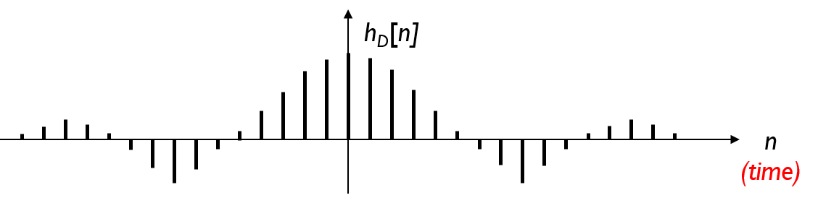

Truncation of ideal low pass filter
Time Domain
Frequency Domain
$$×$$
1
*
=
Rectangular
=

Slide 15
Ripples in the magnitude response (cont)
Assume W (ω) is a unit impulse at 0. The convolution of H_{D}(ω) and W (ω) is just H_{D}(ω)
1
-ω_{p}
0
ω_{p}
ω
1
-ω_{p}
0
ω_{p}
ω

Slide 16
Ripples in the magnitude response (cont)
But W (ω) is not a unit impulse but a sinc function. The convolution of H_{D}(ω) and W(ω) is not H_{D}(ω)
The ripples in the sinc function lead to the ripples in the final magnitude response
-ω_{p}
0
ω_{p}
ω

Slide 17
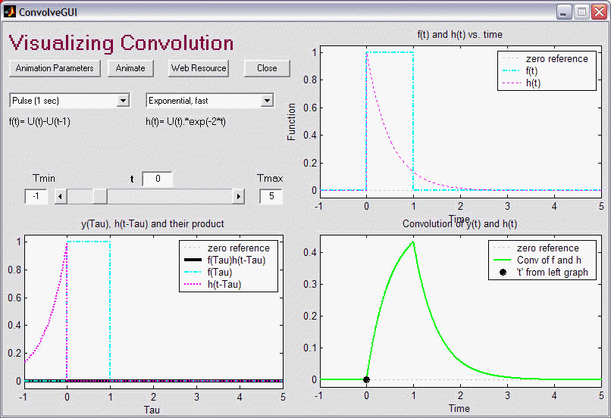
Convolution Integral
http://lpsa.swarthmore.edu/Convolution/ConvolveGUI.html

Slide 18
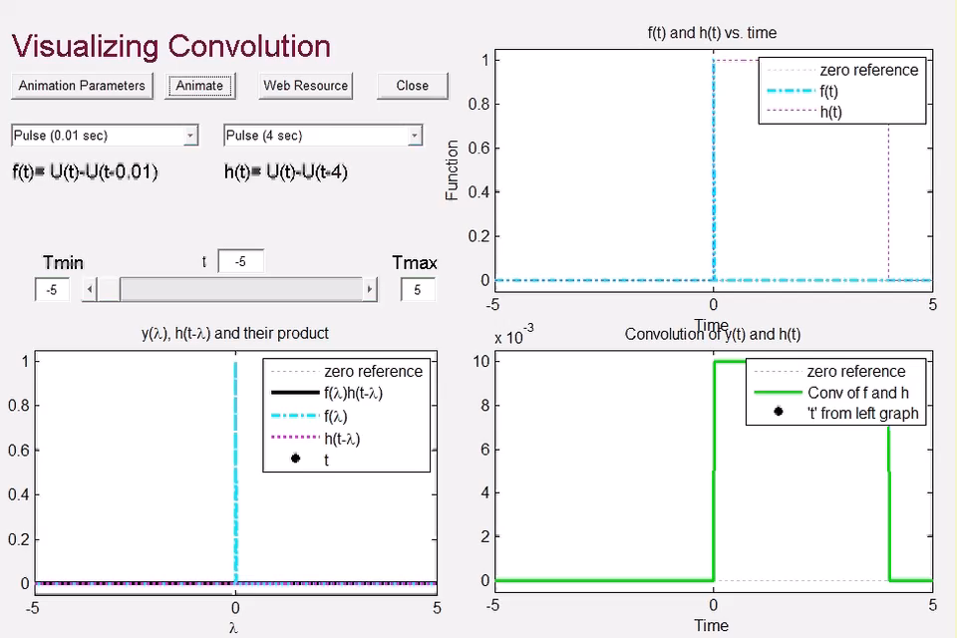
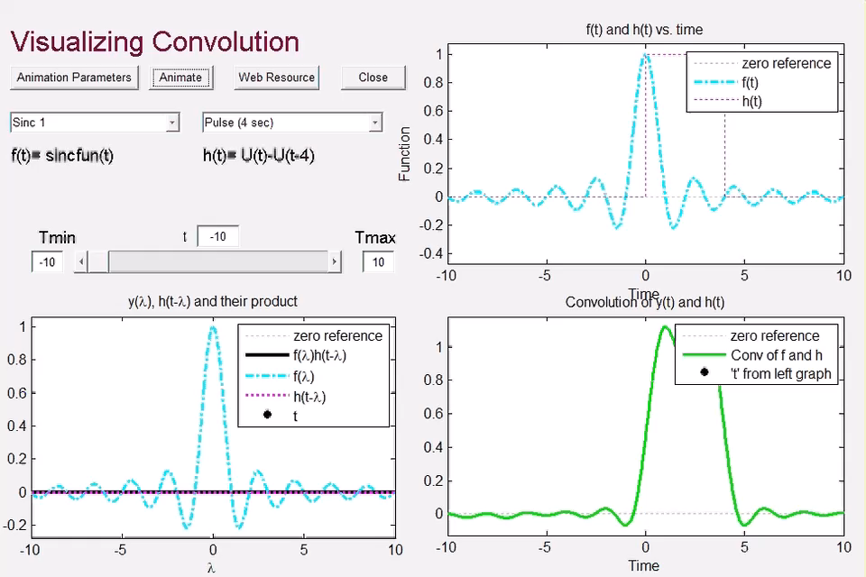
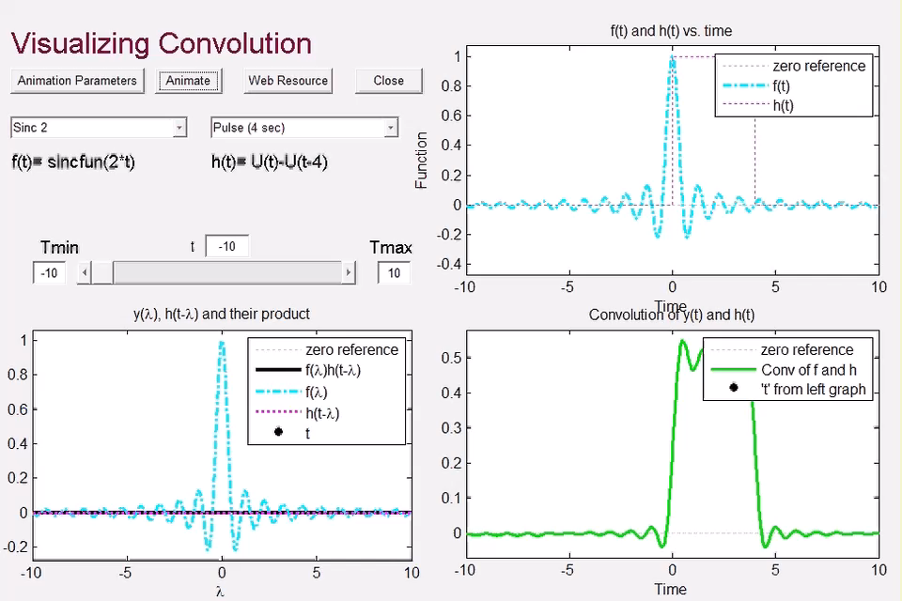

Slide 19
To eliminate ripples …
It is now clear that ripples come from the spectral response of the window function
The closer W (ω) is to a unit impulse, the closer H_{T}(ω) is to the ideal H_{D}(ω)
Can we design a window function with its spectrum response without ripples?
Yes, it depends on the shape of the window function in the time domain

Slide 20
To eliminate ripple … (cont)
Time Domain
Frequency Domain
$$×$$
1
*
=
Rectangular
=

Slide 21
To eliminate ripple … (cont)
Time Domain
Frequency Domain
$$×$$
*
=
Hamming
=

Slide 22
Popular windows
The Triangular window
The Hamming window
The Blackman window

Slide 23
Popular windows (cont)
The envelopes of various digital windows
Frequency Spectrum
w_{i}(n)
Rectangular
1
Hamming
Triangular
-1
0
Blackman
Hamming, Blackman and Triangular windows have no or very small ripples in their spectrum
Rectangular
Hamming
Triangular
Blackman
π
ωT_{s}
-π
0

Slide 24
Popular windows (cont)
The magnitude response of an ideal low-pass digital filter truncated by using various windows with M = 5
Hamming window gives the narrowest transition band (or smallest smearing or leakage)
Prefer in general applications
Rectangular
1
Hamming
Note the passband frequency of H_{D}(ω) is at the middle of the transition band
Triangular
Blackman
ωT_{s}
0

Slide 25
Determine the filter order
The transition width of a digital filter is closely related to the filter order
A higher filter order (longer length) is required for a sharp transition
Different window has different relationship between transition width and filter length
E.g., rectangular window:
where ΔF is the transition width which is defined as ΔF = f_{p} - f_{s}
f_{p} = normalized frequency of the passband edge
f_{s} = normalized frequency of the stopband edge

Slide 26
Recall filter specifications
δ_{p} = passband deviation (e.g. ≤ 0.01, i.e. 20log(1+0.01) ≈ 0.1 dB )
δ_{s} = stopband deviation (e.g. ≤ 0.001, i.e. 20log(0+0.001) = -60 dB )
f_{p} = passband edge frequency (e.g. 1600/8000 = 0.2, F_{s} = 8000)
f_{s} = stopband edge frequency = (e.g. 2240/8000 = 0.28, F_{s} = 8000)
ΔF = Transition Width = (f_{s} – f_{p}) (e.g. 0.28-0.2 = 0.08)
|H_{T}(f)|
1+δ_{p}
1
1-δ_{p}
Stopband Attenuation
= -20log(δ_{s}/(1- δ_{p})
≈ -20log(δ_{s})
ΔF
δ_{s}
f
0
f_{p}
f_{s}
0.5
Passband
Transition band
Stopband

Slide 27
Important properties for windows
Window name | Transition width (normalized) | Passband ripple (dB) | Stopband attenuation (dB)
Rectangular | 0.9/2M | 0.7416 | 21
Hanning | 3.1/2M | 0.0546 | 44
Hamming | 3.3/2M | 0.0194 | 53
Blackman | 5.5/2M | 0.0017 | 75

Slide 28
Design procedure
Specify the desired ideal frequency response, H_{D}(ω)
Obtain the impulse response, h_{D}[n], of the desired filter by evaluating the inverse Fourier transform of H_{D}(ω)
Select a suitable window function w[n] based on the specifications
The values of the actual FIR coefficients, h[n] are obtained by :
h[n] = h_{D}[n]w[n]

Slide 29
5.2 Design Example
Using the window method, obtain the coefficients of an FIR low-pass filter to meet the specifications below:
passband edge frequency = 1.5 kHz ± 20 Hz
passband ripple < 0.05 dB
transition width ≤ 0.5 kHz
stopband attenuation > 50 dB
sampling frequency = 8 kHz

Slide 30
Design example (cont)
From the table on p.26, it is known that both the Hamming and Blackman window will satisfy the stopband attenuation requirement
For simplicity, the Hamming window is used
ΔF = 0.5/8 = 0.0625;
2M = 3.3 / ΔF = 52.8 ⇒ M is selected as 26
ω_{p}T_{s} = 2π1500/8000 = 2π(0.1875)

Slide 31
Design example (cont)
The ideal low-pass filter coefficients :
The Hamming window coefficients :

Slide 32
Design example (cont)
The final FIR filter
Note that the filter is non-causal, i.e. having coefficients at negative time
Need to shift by 26 samples such that h[n] starts at n = 0
From the shift property of the Fourier transform, shifting h[n] will only add a phase shift to H(ω) but will not change its magnitude

Slide 33
Design example (cont)
The resulting FIR filter and its FFT (zero-padded to 512 points):
Shifted 26 samples
0Hz
1500Hz
8000Hz

Slide 34
Design example (cont)
1.0019
0.9981
δ_{p} = passband deviation
= 0.0019 ⇒ 20log(1+0.0019) ≈ 0.016 dB (Spec: < 0.05 dB)
✗
✓
f_{p} = 80/512*8000 Hz
= 1250 Hz (Spec: 1500 Hz)

Slide 35
Design example (cont)
0.0025
f_{s} = 113.3/512*8000 Hz
= 1770 Hz
δ_{s} = stopband deviation
= 0.0025 ⇒ 20log(0.0025)
≈ -52 dB
Stopband attenuation = -20log(δ_{s}/(1- δ_{p})
≈ 52 dB (Spec: >50 dB)
✗
Transition width
= f_{s} - f_{p}
= 520 Hz (Spec: < 500 Hz)
✓

Slide 36
Design example (cont)
Two specifications cannot be met
Reason 1: Approximation made in M – lead to error in transition width
Reason 2: f_{p} of H_{D}(ω) is not the f_{p} of H_{T}(ω)
For Hamming window,
f_{p} of H_{D}(ω) always locates at the middle of the transition band

Slide 37
Design example (cont)
Approximate 3.3 / ΔF as the next even number larger than 3.3 / ΔF , i.e. 54 in this case. Hence, M can be set as 54/2 = 27
f_{p(ideal)} of H_{D}(ω) can be set as
f_{p (ideal)} = f_{p} + (transition width) / 2
For this example,
f_{p (ideal)} = 1500 + 500 / 2
= 1750 Hz

Slide 38
Design example (cont)
1.0019
δ_{p} = passband deviation
= 0.0019 ⇒ 20log(1+0.0019) ≈ 0.016 dB (Spec: < 0.05 dB)
M = 27
✓
0.9981
✓
f_{p} = 97/512*8000 Hz
= 1515 Hz (Spec: 1500 Hz ± 20 Hz)

Slide 39
Design example (cont)
f_{s} = 128.8/512*8000 Hz
= 2012 Hz
Transition width
= f_{s} - f_{p}
= 2012 – 1515
= 497 Hz
✓
✓
Stopband attenuation = -20log(δ_{s}/(1- δ_{p})
≈ 52 dB (Spec: >50 dB)

Slide 40
5.3 Designing high-pass and band-pass FIR filters
The procedure of designing a high-pass FIR filter is nearly the same as for low-pass filters
The only difference – starting with an ideal high-pass filter:
Specify the desired ideal high-pass frequency response, H_{HPD}(ω)
Obtain the impulse response, h_{HPD}[n], of the desired filter by evaluating the inverse Fourier transform of H_{HPD}(ω)
Select a suitable window function w[n] based on the specifications
The values of the actual FIR coefficients, h[n] are obtained by : h_{HP}[n] = h_{HPD}[n]w[n]

Slide 41
From low-pass to high-pass
An ideal high-pass filter can be designed from an ideal low-pass filter
Given that an ideal low-pass filter having a magnitude response H_{LPD}(ω) and the passband frequency at f_{p}. The magnitude response of an ideal high-pass filter H_{HPD}(ω) having the same passband frequency can be obtained by
1
• • •
• • •

Slide 42
Impulse response of ideal high-pass filter
1
0
n

Slide 43
Designing band-pass FIR filters
A band-pass filter has two transition bands – one on the lower frequency side and one on the higher frequency side
If both transition bands have the same specifications, a band-pass FIR filter can be designed using the same approach, but starting with an ideal band-pass filter
Specify the desired ideal band-pass frequency response, H_{BPD}(ω)
Obtain the impulse response, h_{BPD}[n], of the desired filter by evaluating the inverse Fourier transform of H_{BPD}(ω)
Select a suitable window function w[n] based on the specifications
The values of the actual FIR coefficients, h[n] are obtained by : h_{BP}[n] = h_{BPD}[n]w[n]

Slide 44
From low pass to band pass
An ideal band-pass filter can be constructed from two ideal low-pass filters
1
• • •
• • •
-
(frequency)
1
• • •
• • •
=
(frequency)
1
• • •
• • •
(frequency)

Slide 45
Impulse response of ideal band-pass filter

Slide 46
Limitations of the windowing method
This method is applicable only when H_{D}(ω) can be put into a closed form mathematical expression
Hence we can derive h_{D}[n] using the inverse Fourier transform
If not, a different approach, namely the frequency sampling method, should be used
Numerically compute the inverse discrete Fourier transform of a sampled H_{D}(ω)
The use of windows offers very little design flexibility
Ripples of passband and stopband must be the same
Passband frequency of H_{D}(ω) must be at the middle of the transition band
No way to clearly specify the final passband and stopband frequency
No way to clearly specify the transition width of H(ω) in the design

Slide 47
Limitations of the windowing method (cont)
Need human effort to manually adjust the design for achieving the specifications
Current approaches add an automatic optimization method to search for the best design parameters – the optimal method

Slide 48
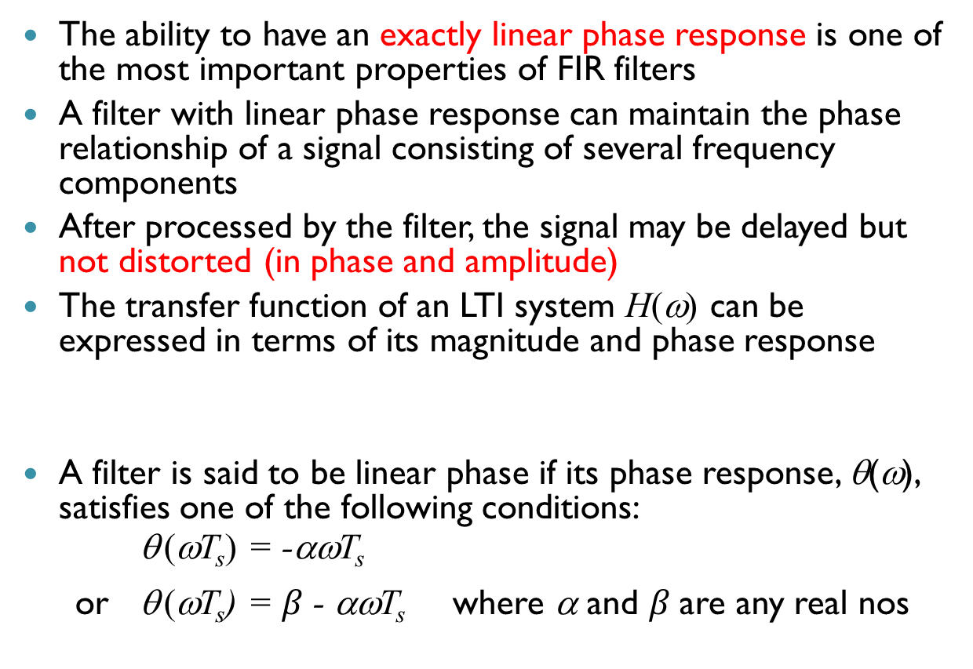
5.4 Linear Phase Response and Its Implications
The ability to have an exactly linear phase response is one of the most important properties of FIR filters
A filter with linear phase response can maintain the phase relationship of a signal consisting of several frequency components
After processed by the filter, the signal may be delayed but not distorted (in phase and amplitude)
The transfer function of an LTI system H(ω) can be expressed in terms of its magnitude and phase response
A filter is said to be linear phase if its phase response, θ(ω), satisfies one of the following conditions:
θ (ωT_{s}) = -αωT_{s}
or θ (ωT_{s}) = $β$ - αωT_{s} where α and $β$are any real nos

Slide 49
Linear phase response
Assume a signal x[n] has two components x₁[n] and x₂[n]
Assume a filter h₁[n] has a unit magnitude response, i.e. |H₁(ωT_{s})| = 1, and linear phase response, e.g. θ₁ (ωT_{s}) = -2ωT_{s}, thus
Both components will have the same delay, hence no distortion

Slide 50
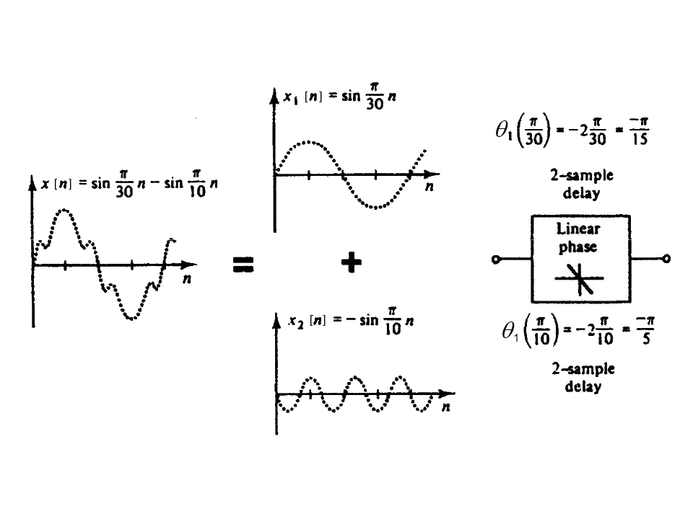

Effect of linear phase: E.g. $θ_{1}\left(\hat{ω}\right)=−2\hat{ω}$

Slide 51
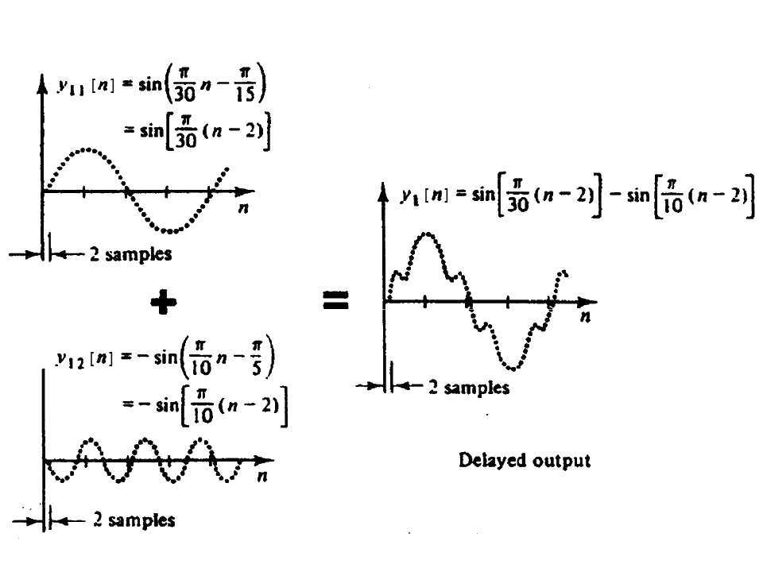
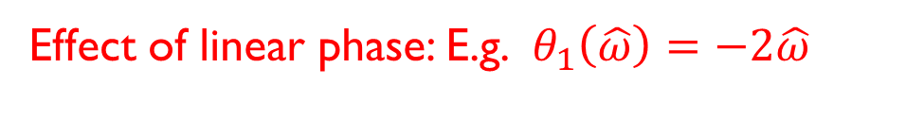
Effect of linear phase: E.g. $θ_{1}\left(\hat{ω}\right)=−2\hat{ω}$
Output is delayed but not distorted

Slide 52
Non-linear phase response
Now, assume another filter h₂[n] which also has a unit magnitude response, i.e. |H₂(ωT_{s})| = 1, but a non-linear phase response, e.g.
θ ₂(ωT_{s}) = −(150/π)(ωT_{s})² + 3 ωT_{s},
hence

Slide 53
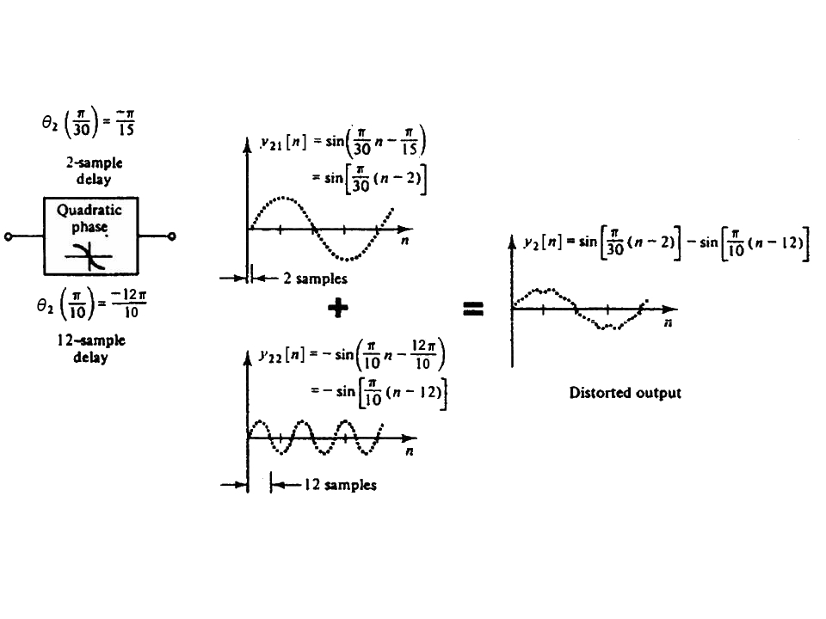
Effect of non-linear phase: E.g. $θ_{2}\left(\hat{ω}\right)=−\left(\frac{150}{π}\right){\hat{ω}}^{2}+3\hat{ω}$
Different delays to different frequencies: output distorted

Slide 54
Conditions for Linear Phase
The necessary and sufficient condition for an FIR filter to have a linear phase response is that its impulse response, h[n], must be symmetrical or anti-symmetrical.
Also desirable that the filter should have real (not complex numbers) coefficients h[n] in time domain
That is
h[n] = h[N-1-n] or
h[n] = -h[N-1-n]
where N is the length of the filter

Slide 55
Example
Consider a symmetrical filter with N = 7
We have h[0] = h[6]
h[1] = h[5]
h[2] = h[4]
h[3]
Note that all h[n] are real number
The Fourier Transform of the filter becomes
1
2
3
4
5
6

Slide 56
Example (cont)

Slide 57
Example (cont)
A(ωT_{s})
The term A(ωT_{s}) are real numbers (not imaginary) but can be positive or negative
We may consider
Then the phase is
which are both linear phase according to our definition

Slide 58
Four types of linear phase filters
There are four types of linear phase filters, as illustrated in the following examples
Centre of symmetry
(N odd, positive symmetry)
3
9
11
n
N = 13 (odd)
0
1
2
4
5
6
7
8
10
12
1
Centre of symmetry
(N even, positive symmetry)
1
2
9
10
n
N = 12 (even)
0
3
4
5
6
7
8
11
Centre of symmetry
(N odd, negative symmetry)
5
6
7
8
n
N = 9 (odd)
0
1
2
3
4
Centre of symmetry
(N even, negative symmetry)
5
6
7
8
9
n
N = 10 (even)
0
1
2
3
4

