Slide 1
fourier Analysis – theory and implementation
Chapter 2
References:
J. H. McClellan, R. W. Schafer and M. A. Yoder, Signal Processing First, Pearson Education, Inc. 2003, Chapter 3, 4 and 13.
S. K. Mitra, Digital Signal Processing – A Computer-Based Approach, McGraw-Hill International Edition, 4th Ed., 2011, Chapter 3, 5 and 11.

Slide 2
2.1 Fourier analysis
We are interested in signal representation in the frequency domain (or the spectrum) since it can give us information that sometimes cannot be seen in the time domain
Signals in the frequency domain can usually be obtained by making use of the Fourier Analysis
Many applications:
Equalizer for audio signals
Frequency division multiplexing for communications
Image and video compression
Speech and image enhancement
etc.

Slide 3
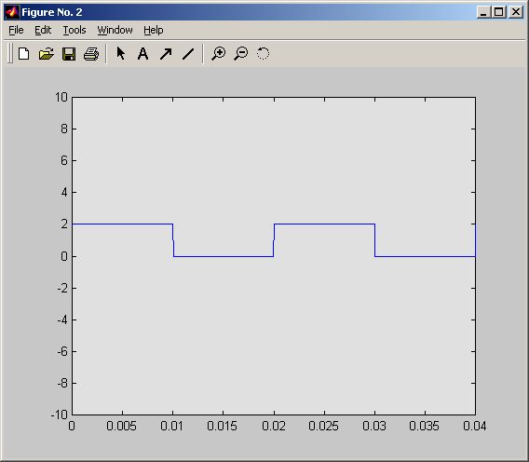
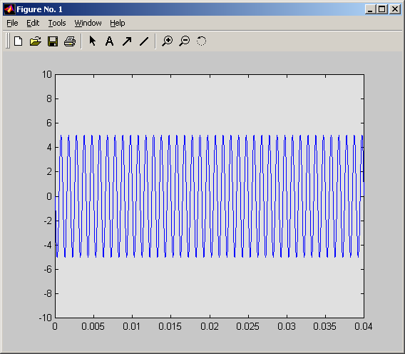
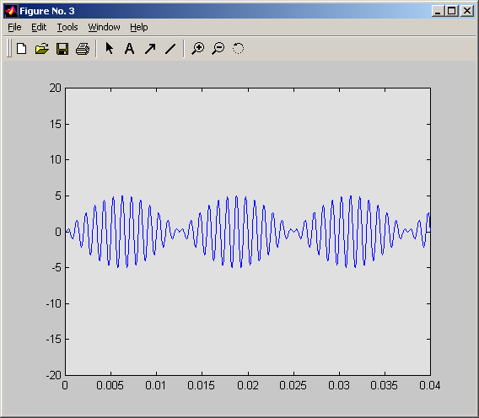
Fourier series
Fourier first showed that any periodic waveform can be synthesized by a sum of sinusoids that are harmonically related
Periodic signal:
Signals that repeat itself within a fixed period

Slide 4
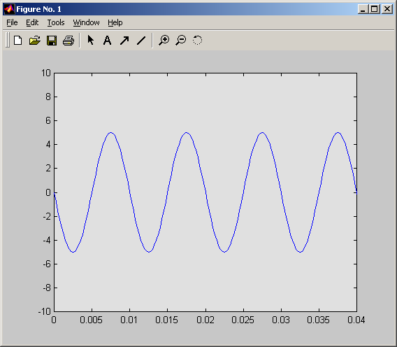
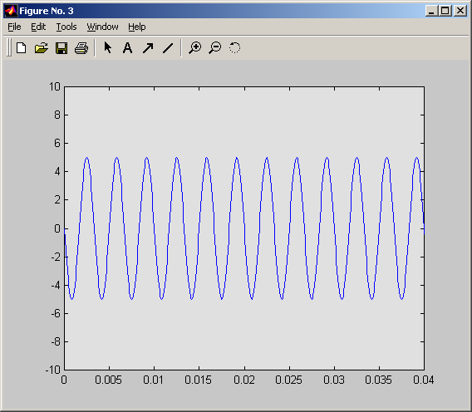
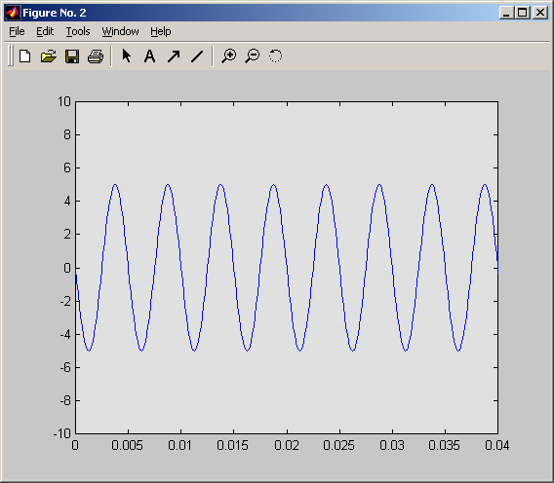
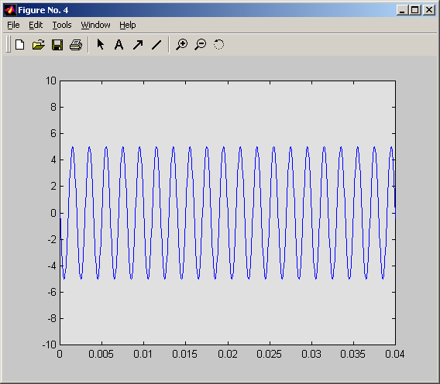
Fourier series
Harmonically related sinusoids:
Sinusoids with frequencies that are multiple of a fundamental frequency
f_{o} = 100Hz (fundamental
frequency or 1st harmonic)
f = 300Hz = 3*f_{o} (3rd harmonic)
f = 200Hz = 2*f_{o} (2nd harmonic)
f = 500Hz = 5*f_{o} (5th harmonic)

Slide 5
Fourier series
Any continuous-time periodic waveform can be represented by the Fourier series as follows:
Summation operator: Take the sum of the following function for k = 1, 2, …, ∞
An infinite series
The bias of x or dc of x (dc here stands for signals that will not change in time, just like direct current in electric circuit, as opposed to alternating current (ac))

Slide 6
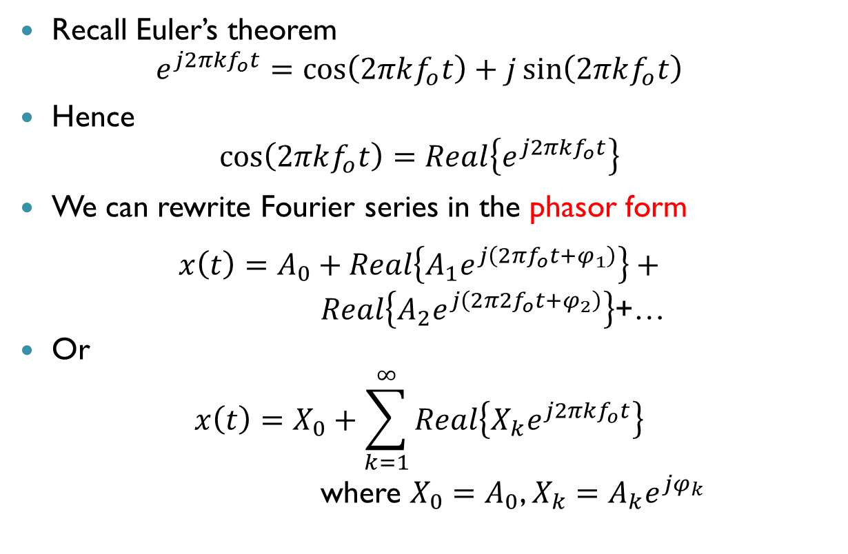
Phasor representation of Fourier series
Recall Euler’s theorem
$$e^{j2πkf_{o}t}=\cos\left(2πkf_{o}t\right)+j\sin\left(2πkf_{o}t\right)$$
Hence
$$\cos\left(2πkf_{o}t\right)=Real\left\{e^{j2πkf_{o}t}\right\}$$
We can rewrite Fourier series in the phasor form
$$x\left(t\right)=A_{0}+Real\left\{A_{1}e^{j\left(2πf_{o}t+φ_{1}\right)}\right\}+$$
$Real\left\{A_{2}e^{j\left(2π2f_{o}t+φ_{2}\right)}\right\}$+…
Or
$$x\left(t\right)=X_{0}+\sum_{k=1}^{∞}{Real\left\{X_{k}e^{j2πkf_{o}t}\right\}}$$
where $X_{0}=A_{0}$, $X_{k}=A_{k}e^{jφ_{k}}$
See the proof in Appendix A

Slide 7
Fourier series
{X_{o}, X₁, X₂, …, X∞} are the Fourier series coefficients
Each coefficient controls the amplitude of the corresponding harmonic required to construct a signal
Some signals need less harmonics, some signals need more
For example, to 100% synthesize a square wave, basically need infinite number of harmonics
The fact is even if you have ∞ number of harmonics, you still cannot obtain a 100% square wave. It is due to the Gibbs phenomenon

Slide 8
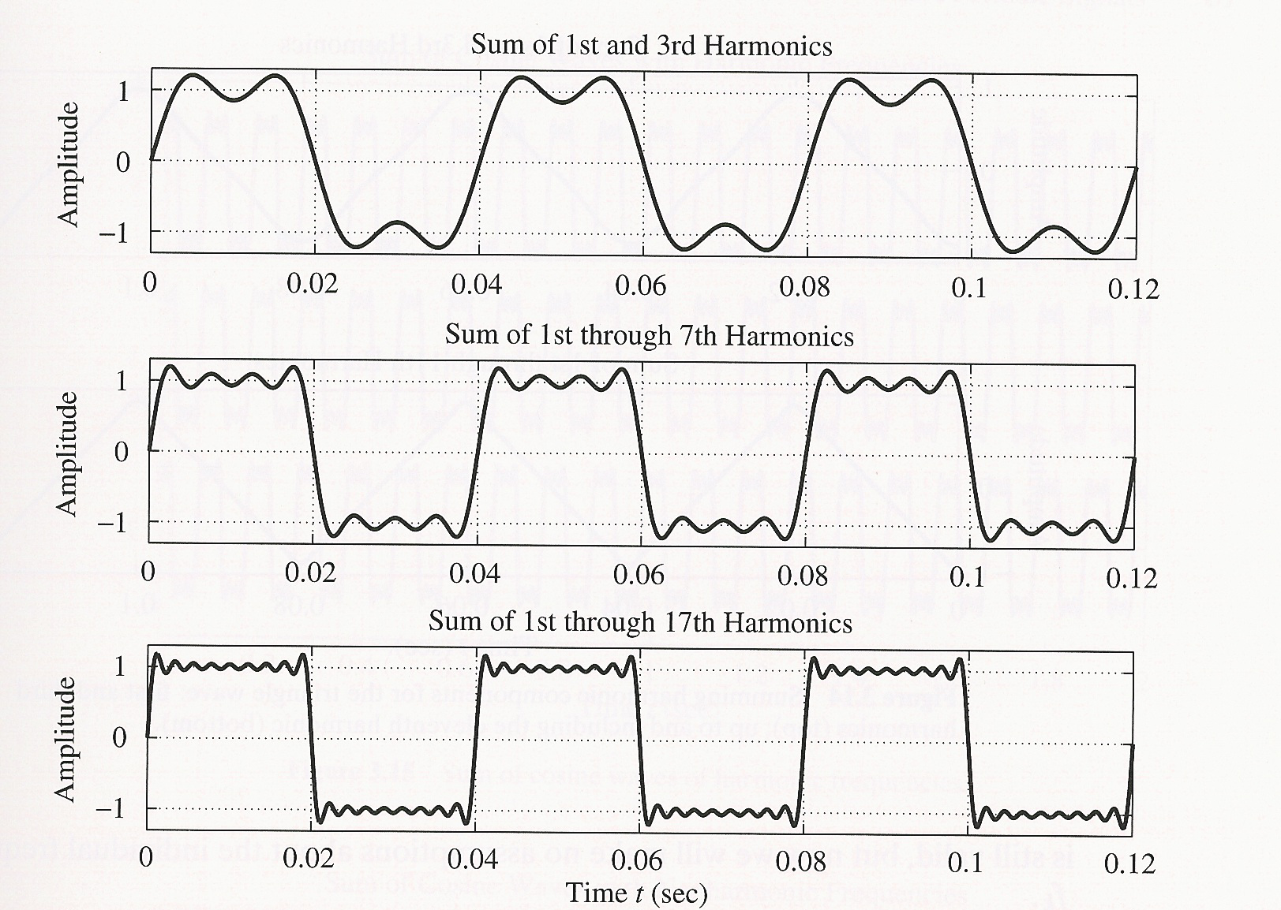
Gibbs phenomenon

Slide 9
Fourier series analysis
Given a periodic signal, how do we know its Fourier series coefficients X_{k}?
By Fourier series analysis,
where
See the proof in Appendix B

Slide 10
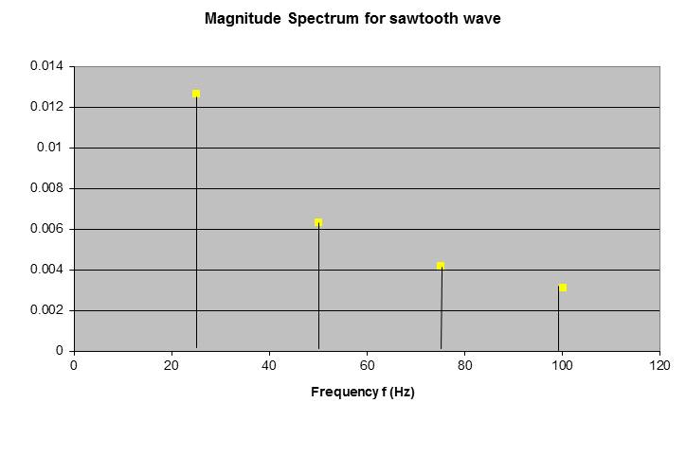

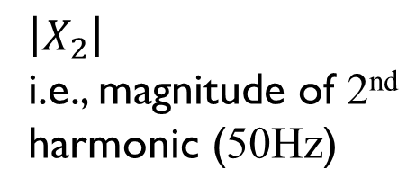
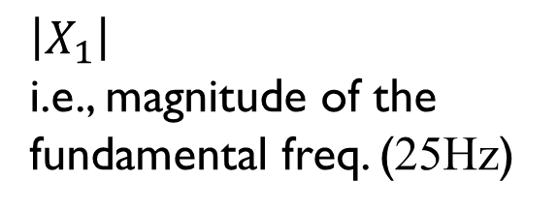

Frequency response
The Fourier series coefficients are also referred to as the frequency response (or spectrum) of a periodic signal
$$\left|X_{2}\right|$$
i.e., magnitude of 2nd harmonic (50Hz)
T₀/2
-T₀/2
T₀
$$\left|X_{3}\right|$$
$$\left|X_{4}\right|$$
(40 msec)
$$\left|X_{1}\right|$$
i.e., magnitude of the fundamental freq. (25Hz)
Assume f₀ = 1/T₀ = 25Hz

Slide 11
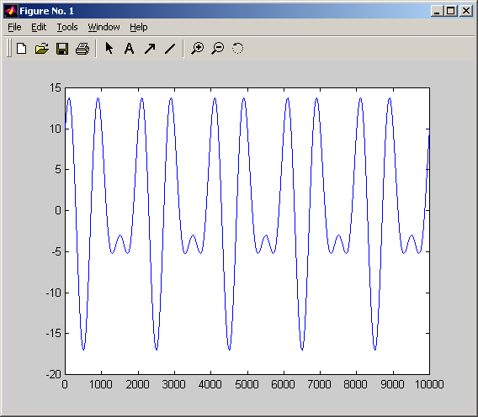
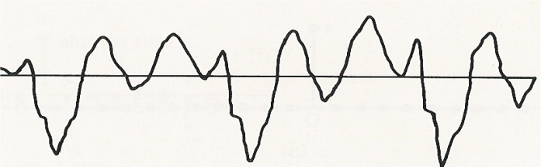
2.2 The Fourier transform
Fourier series analysis helps us to find the spectrum of periodic signals
Most signals are not periodic
Speech, audio, etc.
Need another tool to find the spectrum of non-periodic (aperiodic) signals
⇒ The Fourier Transform

Slide 12

The Fourier transform of continuous-time signals
Let x(t) be an aperiodic continuous-time signal, the spectrum of x(t) is given by the Fourier transform as follows:
Or if we know the spectrum X(ω), we can reconstruct the signal by means of the inverse Fourier transform :
$$x\left(t\right)=\frac{1}{2π}\int_{−∞}^{∞}{X(ω)e^{jωt}}dω where ω=2πf$$
No longer discrete, it is continuous in frequency domain
Frequency, now any real number

Slide 13
Spectrum of aperiodic signals
Time Domain
Frequency Domain
x(t)
X[k]
Fourier series
0
t
-B 0 B
k
Periodic
Discrete
x(t)
Fourier transform
X(ω)
0
t
-B 0 B
ω
Aperiodic
Continuous

Slide 14
The Fourier transform of discrete-time signals
Let x(t) be an aperiodic continuous-time signal, x[n] is the samples of x(t) such that:
The spectrum of x[n] is given by the Fourier transform as follows:
x[n] = x(nT_{s})
Normalized radian frequency
or

Slide 15
Periodic spectrum of discrete-time signals
It is interesting to note that discrete aperiodic signals have periodic spectrum
It is because
1

Slide 16
Periodic spectrum of discrete-time signals
-2π
0
2π

Slide 17
Relationship with the spectrum of continuous-time signals
If x(t) has a spectrum of X(ω) and x[n] = x(nT_{s}) has a spectrum of X_{p}(ωT_{s}), it can be shown that

Slide 18

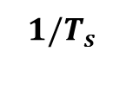
The Fourier transform
Time Domain
Frequency Domain
x(t)
X(ω)
1
0
t
-B 0 B
ω
Ideal low pass filter
x[n] = x(nT_{s})
$1/T_{s}$
n
-2π/T_{s} 0 2π/T_{s}
We can always get back the original continuous signal $x\left(t\right)$ from the sampled signal $x\left[n\right]$ by using an ideal low pass frequency filter

Slide 19
Time Domain
Frequency Domain
x(t)
X(ω)
1
0
t
-B 0 B
ω
See the aliasing effect of reducing the sampling rate
x[n]
n
0 | |←T_{s}
-2π /T_{s} 0 2π/T_{s}
x[n]
n
0 | |←T_{s}
-2π/T_{s} 0 2π/T_{s}

Slide 20
Time Domain
Frequency Domain
x(t)
X(ω)
1
0
t
-B 0 B
ω
See the aliasing effect of reducing the sampling rate
x[n]
n
0 | |←T_{s}
-2π/T_{s} 0 2π/T_{s}
x’(t)
X’(ω)
0
t
-B 0 B
ω

Slide 21
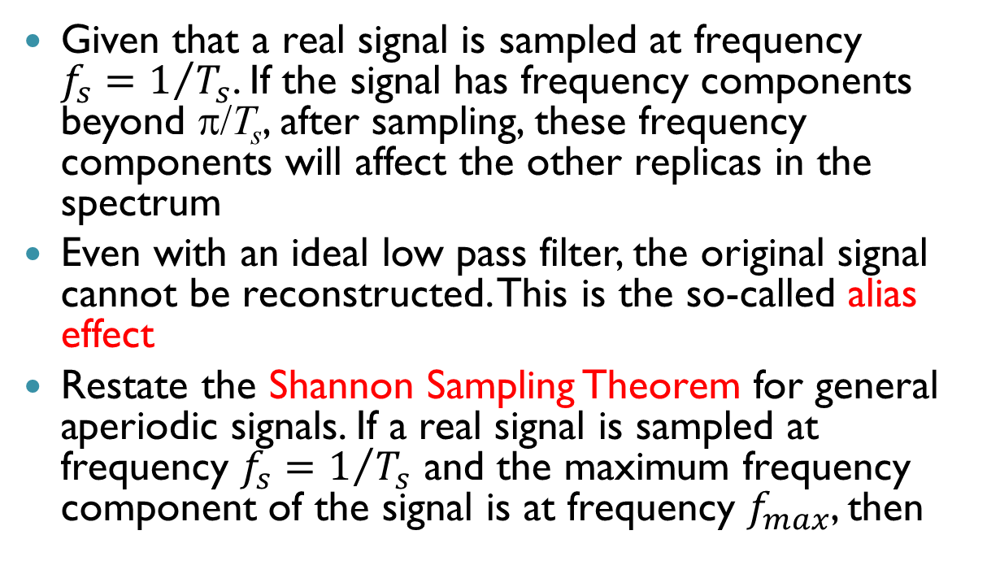
Shannon sampling theorem
Given that a real signal is sampled at frequency $f_{s}=1/{T_{s}}$. If the signal has frequency components beyond π/T_{s}, after sampling, these frequency components will affect the other replicas in the spectrum
Even with an ideal low pass filter, the original signal cannot be reconstructed. This is the so-called alias effect
Restate the Shannon Sampling Theorem for general aperiodic signals. If a real signal is sampled at frequency $f_{s}=1/{T_{s}}$ and the maximum frequency component of the signal is at frequency $f_{max}$, then

Slide 22
Shannon sampling theorem
A continuous-time real aperiodic signal x(t) with frequencies no higher than f_{max} can be reconstructed exactly from its samples x[n] = x(nT_{s}) if the samples are taken at a rate f_{s} = 1/T_{s} that is greater than 2f_{max}
Nyquist Rate

Slide 23
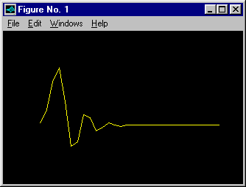
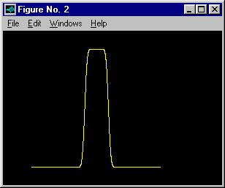
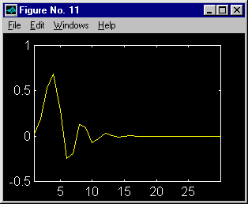
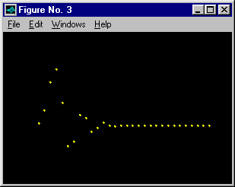
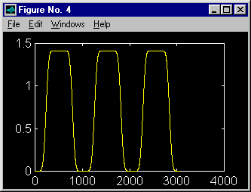
Real example
Time Domain
Frequency Domain
Resulted signal
Ideal low pass filter and inverse Fourier transform

Slide 24
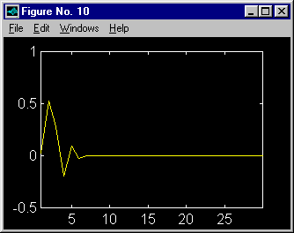
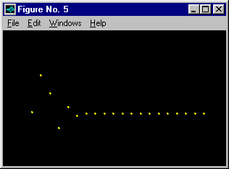
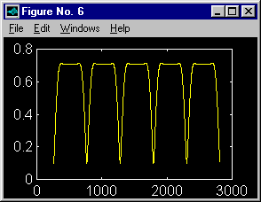
Real example
Time Domain
Frequency Domain
Resulted signal
Ideal low pass filter and inverse Fourier transform

Slide 25
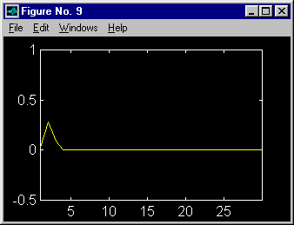
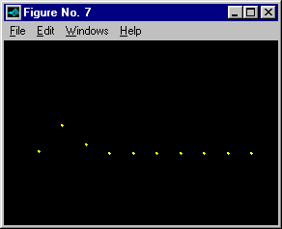
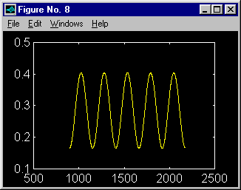
Real example
Time Domain
Frequency Domain
Resulted signal
Ideal low pass filter and inverse Fourier transform

Slide 26
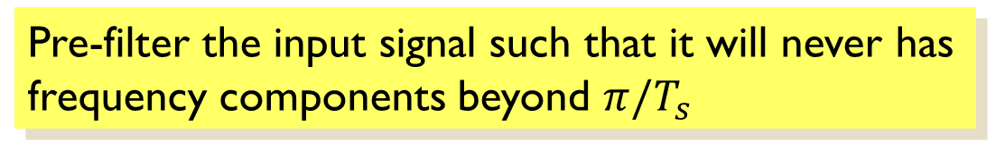
How to solve the aliasing problem?
Increase the sampling rate such that f_{s} ≥ 2f_{max}
Use anti-aliasing filter first
Pre-filter the input signal such that it will never has frequency components beyond $π/T_{s}$
Pre-filter
Digital Signal Processor
Post-filter
A/D
D/A

Slide 27
Time Domain
Frequency Domain
x(t)
X(ω)
1
0
t
-B 0 B
ω
X(ω)
Anti-aliasing
filter
1
-π/T_{s} 0 π/T_{s}
x[n]
0 | |←T_{s}
n
-2π/T_{s} 0 2π/T_{s}

Slide 28
With anti-aliasing filter
Without anti-aliasing filter
Ideal low pass filter
Ideal low pass filter
X’(ω)
X’(ω)
ω
ω
Look better

Slide 29

Hear the effect
Original
44.1kHz
sampling
8kHz
sampling
with aliasing
8kHz
sampling
with anti-aliasing filter

Slide 30
2.3 Discrete Fourier transform
Spectrum of aperiodic discrete-time signals is periodic and continuous
Difficult to be handled by computer
Since the spectrum is periodic, there’s no point to keep all periods – one period is enough
Computer cannot handle continuous data, we can only keep some samples of the spectrum
Interesting enough, such requirements lead to a very simple way to find the spectrum of signals
⇒ Discrete Fourier Transform

Slide 31
Discrete Fourier transform
Recall the Fourier transform of an aperiodic discrete sequence
Assume x[n] is an aperiodic sequence with N samples, i.e. {x[n] : n = 0,1, ..., N-1}

Slide 32
Discrete Fourier transform
If we are now interested only in N equally spaced frequencies of 1 period of the Fourier spectrum, i.e.
If N = 13
k = 0
k = 4
-2π
0
2π/N
2π

Slide 33
Discrete Fourier transform
Now if we want to compute the value of these N frequencies,
for k = 0,1,…, N-1
Discrete Fourier Transform

Slide 34
Discrete Fourier transform
Discrete Fourier Transform (DFT) is exactly the output of the Fourier Transform of an aperiodic sequence at some particular frequencies
Inherently DFT is periodic since X[k+N] = X[k], although we always only consider one period of X[k]
1

Slide 35
Inverse DFT
If we know X[k], we can reconstruct back the signal x[n] via the inverse discrete Fourier transform
for n = 0,1,…, N-1
Inverse Discrete Fourier Transform

Slide 36
Inverse DFT
It can be proven as follows:
See the proof in Appendix C

Slide 37
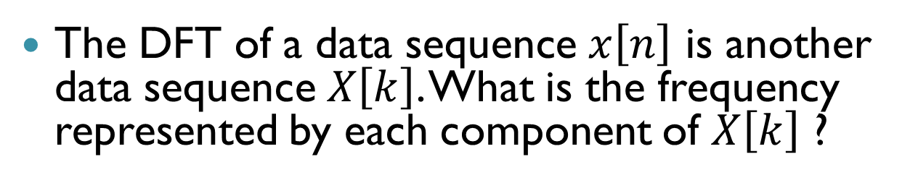
Frequency representation of DFT
The DFT of a data sequence $x\left[n\right]$ is another data sequence $X\left[k\right]$. What is the frequency represented by each component of $X\left[k\right]$ ?
If N = 13
k = 0
k = 4
-2π
0
2π

Slide 38
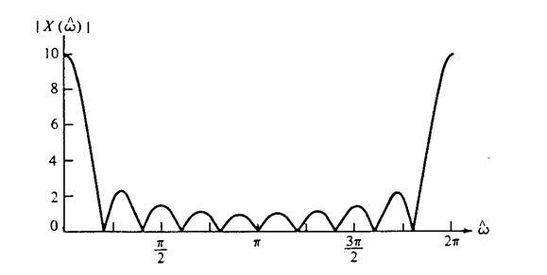
Frequency resolution of DFT
Although DFT gives exact frequency response of a signal, sometimes it may not give the desired spectrum
Fourier
Transform
One period of
x[n]
n
0
9
10
X[k] if N = 10
So different from
N = 10
DFT
k

Slide 39
Frequency resolution of DFT
Need improved resolution
Achieve by padding zeros to the end of x[n] to make N bigger
x[n]
Pad 40 zeros
n
0
9
50
49
x[n] = {1 1 1 1 1 1 1 1 1 1 0 0 0 0 … 0}
40 zeros

Slide 40
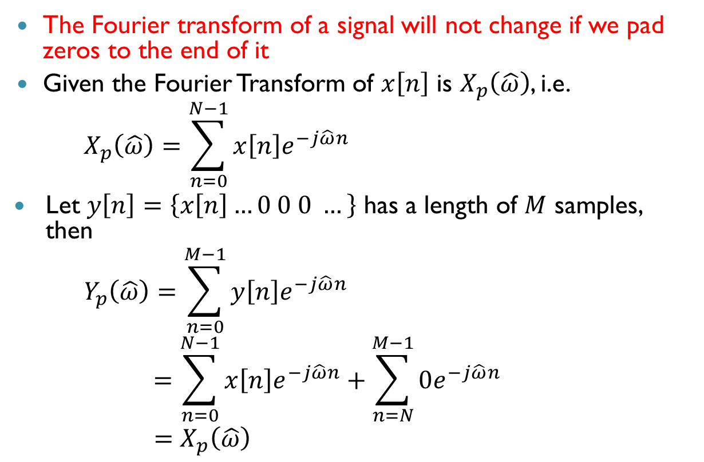
Frequency resolution of DFT
The Fourier transform of a signal will not change if we pad zeros to the end of it
Given the Fourier Transform of $x\left[n\right]$ is $X_{p}\left(\hat{ω}\right)$, i.e.
$$X_{p}\left(\hat{ω}\right)=\sum_{n=0}^{N−1}{x\left[n\right]e^{−j\hat{ω}n}}$$
Let $y\left[n\right]=\left\{x\left[n\right]…0 0 0 …\right\}$ has a length of $M$ samples, then
$$Y_{p}\left(\hat{ω}\right)=\sum_{n=0}^{M−1}{y\left[n\right]e^{−j\hat{ω}n}}$$
$$=\sum_{n=0}^{N−1}{x\left[n\right]e^{−j\hat{ω}n}}+\sum_{n=N}^{M−1}{0e^{−j\hat{ω}n}}$$
$$=X_{p}\left(\hat{ω}\right)$$
0

Slide 41
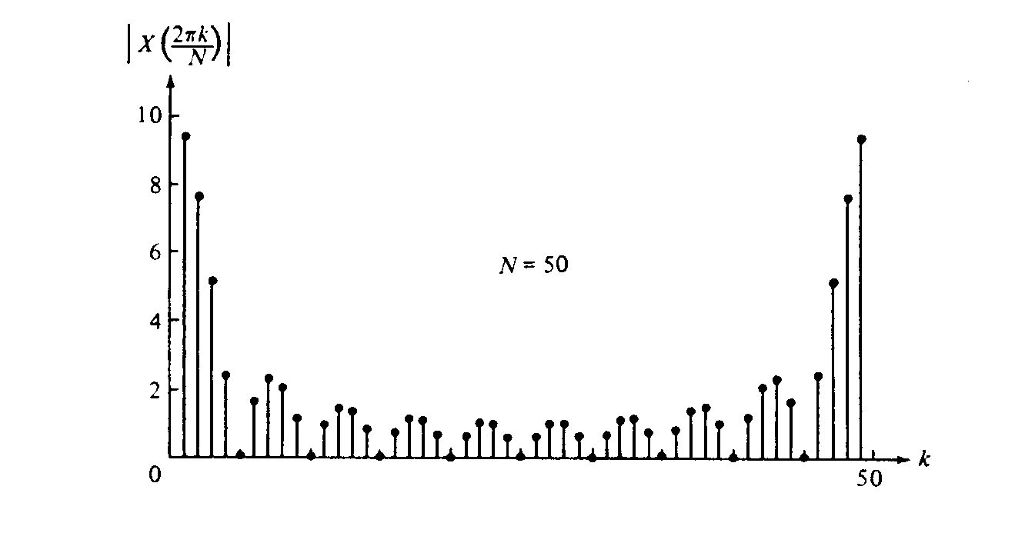
DFT of zero padded sequence
N = 50

Slide 42
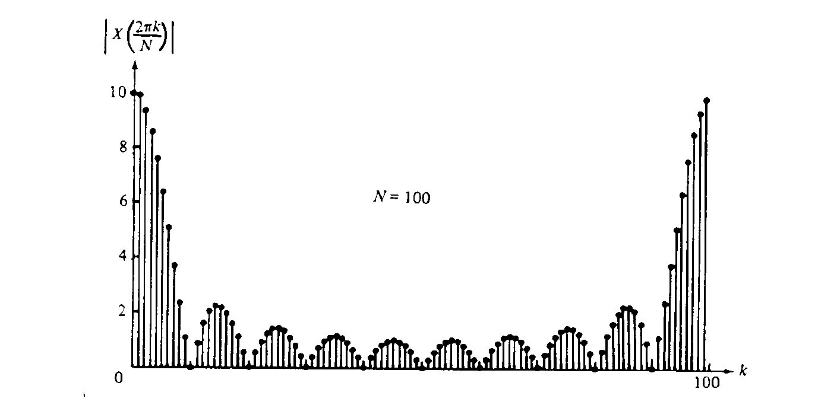
DFT of zero padded sequence
N = 100

Slide 43
Summary
Periodic signal
Fourier Series
Analysis
Discrete spectrum

Slide 44
Summary
Non-Periodic continuous
signal
Fourier
transform
Continuous spectrum
0

Slide 45
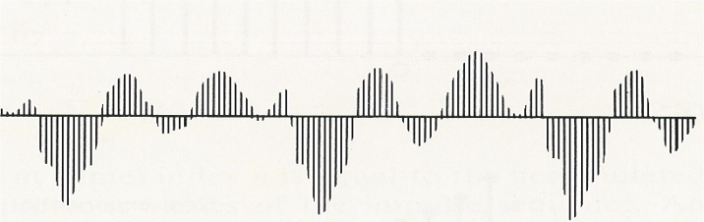
Summary
Non-Periodic discrete
signal
Fourier
transform
Continuous periodic
spectrum
-2π
0
2π

Slide 46
Summary
Non-Periodic discrete
signal
Discrete Fourier
transform
Determine only N samples of one period of the Continuous periodic spectrum
-2π
0
2π

Slide 47
Properties of DFT
Recall the formulation of DFT,
Linear property
If X₁[k] is the DFT of x₁[n] and X₂[k] is the DFT of x₂[n], then

Slide 48
Properties of DFT
Circulant property (periodicity):
If X[k] is the DFT of x[n] with N samples,
Shift property:
Given that X[k] is the DFT of x[n]. If y[n] is a shifted version of x[n] such that y[n] = x[n-m], then
-N
0
N

Slide 49
Properties of DFT
Symmetry properties:
If x[n] is real (none of x[n] contains imaginary number) and if X[k] can be written as
then
X_{r}[k]
k
Even symmetry
-2N
-N
0
N
2N
X_{i}(k)
Odd symmetry
k
-2N
-N
0
N
2N

Slide 50
Properties of DFT
Symmetry properties:
If x[n] is real and even symmetry (an even function), i.e. x[n] = x[N-n], then
If x[n] is real and odd symmetry (an odd function), i.e. x[n] = -x[N-n], and x[0] = x[N/2] = 0 (if N is even), then
and
and

Slide 51
2.4 Fast Fourier Transform
A Historical Perspective
The Cooley and Tukey Fast Fourier Transform (FFT) algorithm is a turning point to the computation of DFT
Before that, DFT was never practical except running by some very expensive computers
FFT gives nearly a factor of 1000 improvement in the computation speed over the traditional approach in most computing environments

Slide 52
Principal discoveries of DFT computation
Researcher(s) Date Feature
Cooley & Tukey 1965 Any 2^{n} composite integer
I.J. Good 1958 Any integer with relatively prime factors
L.H. Thomas 1948 Any integer with relatively prime factors
Danielson 1942 2^{n}
K. Stumpff 1939 2^{n}k, 3^{n}k
C. Runge 1903 2^{n}k
J.D. Everett 1860 12
A. Smith 1846 4, 8, 16, 32
F. Carlini 1828 12
C.F. Gauss 1805 Any composite integer
Fourier proposed Fourier series in 1807 !

Slide 53
Basic principle
The basic principle of FFT is “divide and conquer”
⇒ To break down a big problem to a number of smaller problems and tackle them individually
Need to satisfy the following criterion

Slide 54
Basic principle
Smaller
Problems
Smaller
Problem
Big Problem
Smaller
Problem
Apply Divide and Conquer iteratively
Overhead

Slide 55
Operation of FFT
Length-N/4 DFTs
Length-N/2
DFT
Length-N DFT
Length-N/2
DFT
Overhead
For each round, the size of the problem is divided by 2

Slide 56
Mathematical Derivation
Recall the DFT of x[n], for n = 0, 1,…,N-1
Separate the summation into two groups
for k = 0, 1,…,N-1
for k = 0, 1,…,N-1

Slide 57
Example
If DFT of x[n] is
We separate it into two groups with odd and even n

Slide 58
Mathematical Derivation
for k = 0, 1,…,N-1

Slide 59
Mathematical Derivation
Since
for k = 0, 1,…,N-1
Note that G[k] = G[k+N/2]; H[k] = H[k+N/2]
Overhead
Length-N/2 DFT of data with even n
Length-N/2 DFT of data with odd n

Slide 60
Example: N = 8
G[0]
x[0]
N/2 = 4 point DFT
X[0]
G[1]
W₈⁰
x[2]
X[1]
G[2]
W₈¹
X[2]
x[4]
G[3]
W₈²
x[6]
X[3]
W₈³
H[0]
X[4]
x[1]
N/2 = 4 point DFT
H[1]
W₈⁴
x[3]
X[5]
H[2]
W₈⁵
x[5]
X[6]
H[3]
W₈⁶
x[7]
X[7]
W₈⁷

Slide 61
How much it saves?
Assume x[n] has N data and each data is a complex number
For each k, it needs N complex multiplications and N-1 complex additions
In overall, it needs N² complex multiplications and N(N-1) complex additions
for k = 0, 1,…,N-1

Slide 62
How much it saves?
FFT converts an N-point DFT to 2 N/2-points DFTs
for k = 0, 1,…,N-1
(N/2)² complex multiplications
N/2(N/2-1) complex additions
N complex multiplications

Slide 63
Computational complexity
N
DFT
1-stage FFT
4
16x/12+
12x/8+
8
64x/56+
40x/32+
16
256x/240+
144x/128+
32
1,024x/992+
544x/512+
64
4,096x/4,032+
2,112x/2,048+
128
16,384x/16,256+
8,320x/8,192+
256
65,536x/65,280+
33,024x/32,768+
512
262,144x/261,632+
131,584x/131,072+
1024
1,048,576x/1,047,552+
525,312x/524,288+

Slide 64
Computational complexity
Obviously
We can re-apply the same approach to the decomposed N/2 problems

Slide 65
Example: Apply to G[k] and H[k]
x[0]
N/4 = 2 point DFT
X[0]
W₄⁰
W₈⁰
x[4]
X[1]
W₄¹
W₈¹
x[2]
X[2]
N/4 = 2 point DFT
W₄²
W₈²
x[6]
X[3]
W₄³
W₈³
x[1]
N/4 = 2 point DFT
X[4]
W₄⁰
W₈⁴
x[5]
W₄¹
X[5]
W₈⁵
x[3]
N/4 = 2 point DFT
X[6]
W₄²
W₈⁶
x[7]
X[7]
W₄³
W₈⁷

Slide 66
Further decomposition
The complexity is further reduced
The above decomposition is recursively performed until a length-2 DFT is computed
A length-2 DFT can be implemented as a butterfly as follows:
x[0]
X[0]
x[1]
X[1]

Slide 67
Final “butterfly” structure
x[0]
X[0]
W₄⁰
W₈⁰
x[4]
X[1]
-1
W₄¹
W₈¹
x[2]
X[2]
W₄²
W₈²
x[6]
X[3]
-1
W₄³
W₈³
x[1]
X[4]
W₄⁰
W₈⁴
x[5]
X[5]
-1
W₄¹
W₈⁵
x[3]
X[6]
W₄²
W₈⁶
x[7]
X[7]
-1
W₄³
W₈⁷

Slide 68
Further simplification
The complexity can be further reduced. For every butterfly, it can be converted as follows:
1
-1
Since

Slide 69
Further simplified structure
x[0]
X[0]
x[4]
W₂⁰
X[1]
-1
x[2]
W₄⁰
X[2]
-1
W₂⁰
W₄¹
X[3]
x[6]
-1
-1
x[1]
W₈⁰
X[4]
W₂⁰
-1
x[5]
W₈¹
X[5]
-1
W₄⁰
-1
x[3]
W₈²
X[6]
W₂⁰
-1
-1
x[7]
W₄¹
W₈³
X[7]
-1
-1
-1
FFT
Total complex multiplication: 5
Total complex addition: 24
DFT
Total complex multiplication: 64
Total complex addition: 56

Slide 70
Relationship between input and output indices
From the length-8 DIT FFT flowgraph, it is seen that the input and output are not in-order
The input data needs to shuffle before performing the DIT-FFT
The input and output indices of DIT-FFT follow a bit-reversal relationship
For example: Length-8 DIT-FFT
Input: x[0] – 000 => Output: X[0] – 000
x[4] – 100 => X[1] – 001
: ;
x[3] – 011 => X[6] – 110
Also apply to other sequence lengths

Slide 71
Remarks
FFT of the form above is called decimation-in-time (DIT) FFT (or Cooley and Tukey FFT)
In general, the complexity of DIT FFT is
(N/2)log₂N complex multiplications (W⁰ is considered as multiplication in this expression)
Nlog₂ N complex additions
DIT FFT requires N to be a power of 2
If N is not a power of 2, need zero padding to let N be a power of 2 before FFT
More than a hundred of FFT algorithms after DIT FFT for different applications

Slide 72
Appendix A – Proof of the Fourier series in complex number form

Slide 73
Appendix A – Proof of the Fourier series in complex number form
where
(Q.E.D.)

Slide 74
Appendix B – Proof of the Fourier series analysis
From Appendix A
Hence

Slide 75
Appendix B – Proof of the Fourier series analysis
Also from Appendix A
(Q.E.D.)

Slide 76
Appendix B – Proof of the Fourier series analysis
A₀
0
That is,
(Q.E.D.)

Slide 77
Appendix C – Proof of the formulation in inverse DFT
It is known from the geometric series that,
Hence
So if m ≠ n,
If m = n,
(Q.E.D.)

