Slide 1
Introduction to Infinite Impulse Response filters
Chapter 6
References:
J. H. McClellan, R. W. Schafer and M. A. Yoder, Signal Processing First, Pearson Education, Inc. 2003, Chapter 8.
S. K. Mitra, Digital Signal Processing – A Computer-Based Approach, McGraw-Hill International Edition, 4th Ed., 2011, Chapter 8 and 9.

Slide 2
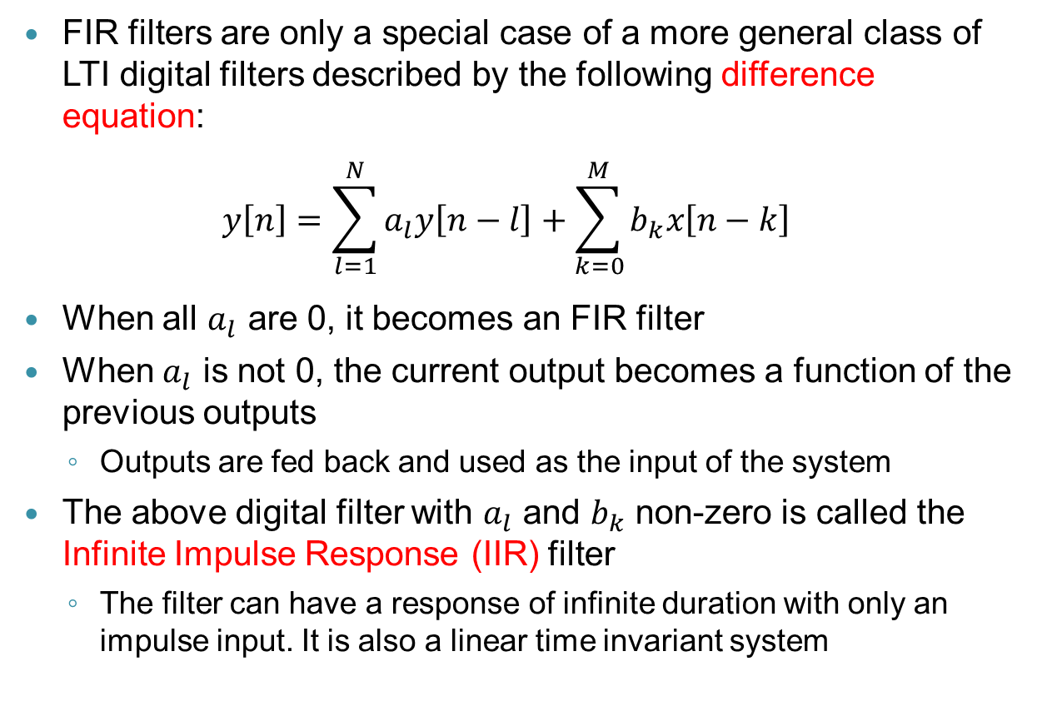
6.1 General IIR Difference Equation
FIR filters are only a special case of a more general class of LTI digital filters described by the following difference equation:
$$y\left[n\right]=\sum_{l=1}^{N}{a_{l}y\left[n−l\right]}+\sum_{k=0}^{M}{b_{k}x\left[n−k\right]}$$
When all $a_{l}$ are 0, it becomes an FIR filter
When $a_{l}$ is not 0, the current output becomes a function of the previous outputs
Outputs are fed back and used as the input of the system
The above digital filter with $a_{l}$ and $b_{k}$ non-zero is called the Infinite Impulse Response (IIR) filter
The filter can have a response of infinite duration with only an impulse input. It is also a linear time invariant system

Slide 3
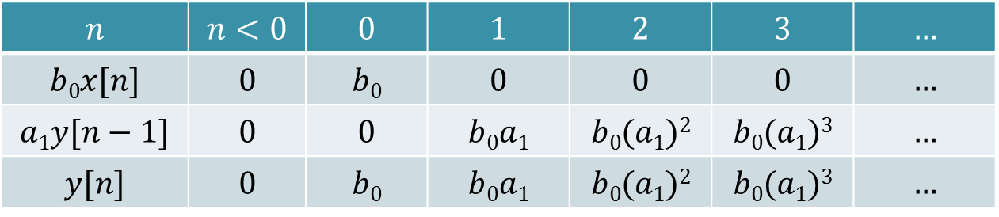
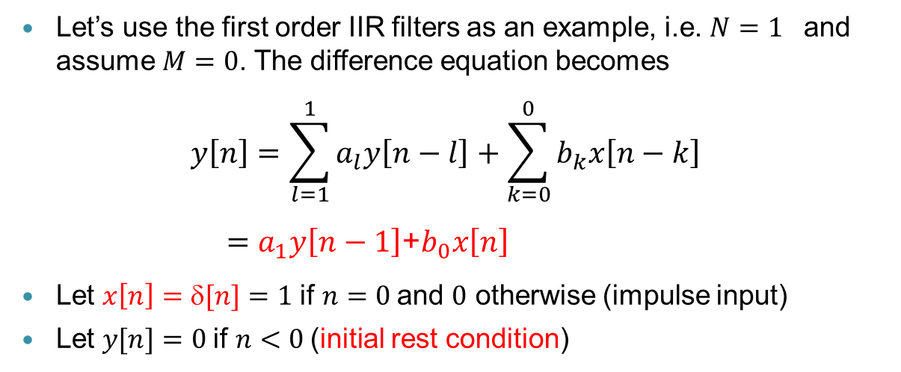
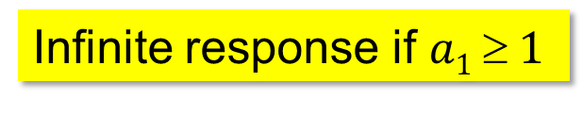
First order IIR filters
Let’s use the first order IIR filters as an example, i.e. $N=1$ and assume $M=0$. The difference equation becomes
$$y\left[n\right]=\sum_{l=1}^{1}{a_{l}y\left[n−l\right]}+\sum_{k=0}^{0}{b_{k}x\left[n−k\right]}$$
$=a_{1}y\left[n−1\right]$+$b_{0}x\left[n\right]$
Let $x\left[n\right]=δ[n]=1$if $n=0$and $0$ otherwise (impulse input)
Let $y[n]=0$if $n<0$(initial rest condition)
$$n$$ | $$n<0$$ | $$0$$ | $$1$$ | $$2$$ | $$3$$ | $$…$$
$$b0x[n]$$ | $$0$$ | $$b0$$ | $$0$$ | $$0$$ | $$0$$ | $$…$$
$$a1y[n−1]$$ | $$0$$ | $$0$$ | $$b0a1$$ | $$b0(a1)2$$ | $$b0(a1)3$$ | $$…$$
$$y[n]$$ | $$0$$ | $$b0$$ | $$b0a1$$ | $$b0(a1)2$$ | $$b0(a1)3$$ | $$…$$
Infinite response if $a1  1$

Slide 4
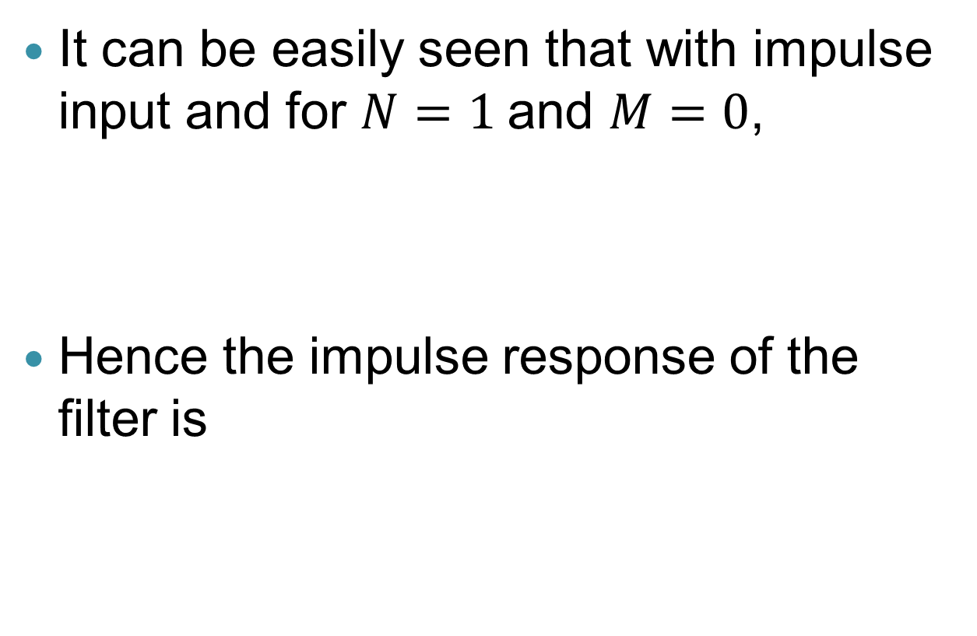
Impulse response of IIR filters
It can be easily seen that with impulse input and for $N=1$and $M=0$,
Hence the impulse response of the filter is
Step function

Slide 5
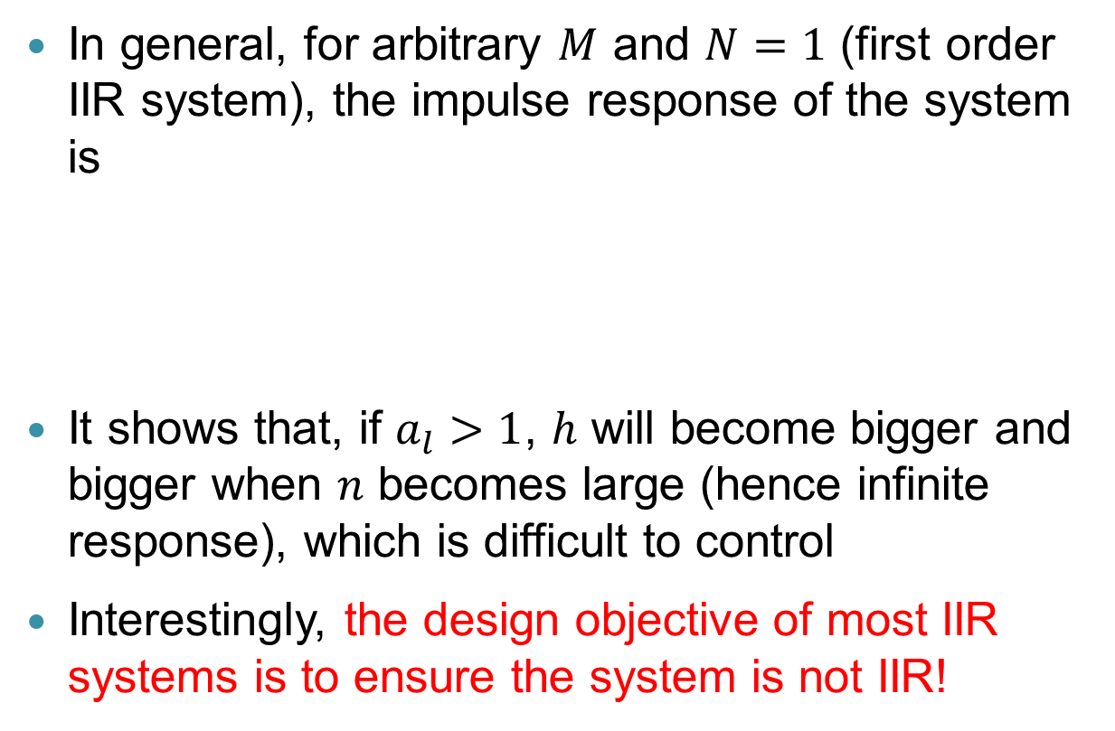
Impulse response of IIR filters (cont)
In general, for arbitrary $M$ and $N=1$ (first order IIR system), the impulse response of the system is
It shows that, if $a_{l}>1$, $h$ will become bigger and bigger when $n$ becomes large (hence infinite response), which is difficult to control
Interestingly, the design objective of most IIR systems is to ensure the system is not IIR!

Slide 6
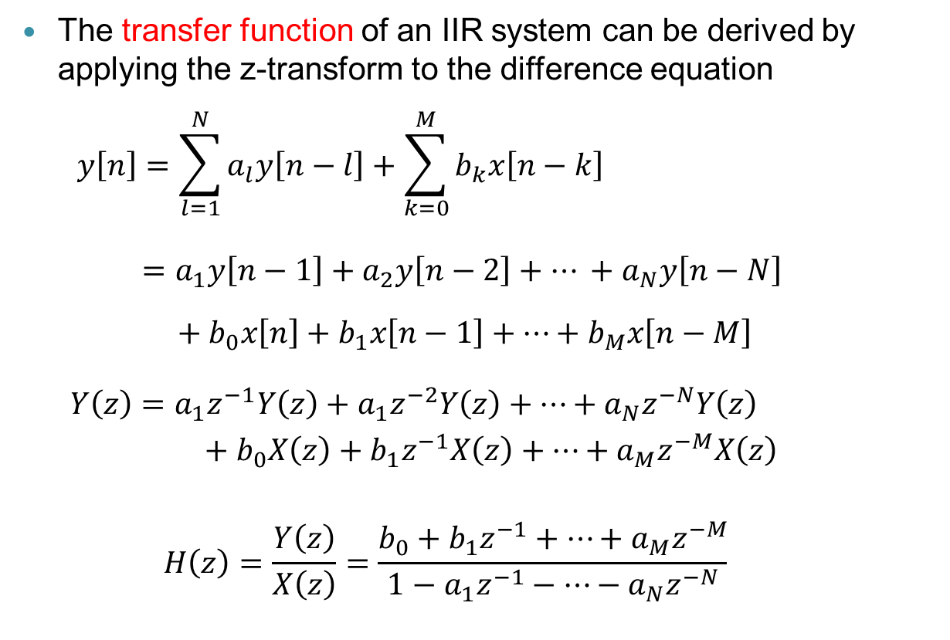
6.2 Transfer Function IIR Filters
The transfer function of an IIR system can be derived by applying the z-transform to the difference equation
$$y\left[n\right]=\sum_{l=1}^{N}{a_{l}y\left[n−l\right]}+\sum_{k=0}^{M}{b_{k}x\left[n−k\right]}$$
$$=a_{1}y\left[n−1\right]+a_{2}y\left[n−2\right]+… +a_{N}y\left[n−N\right]$$
$+ b_{0}x\left[n\right]+b_{1}x\left[n−1\right]+…+b_{M}x\left[n−M\right]$
$$Y\left(z\right)=a_{1}z^{−1}Y\left(z\right)+a_{1}z^{−2}Y\left(z\right)+…+a_{N}z^{−N}Y\left(z\right)$$
$$+ b_{0}X\left(z\right)+b_{1}z^{−1}X\left(z\right)+…+a_{M}z^{−M}X\left(z\right)$$
$$H\left(z\right)=\frac{Y\left(z\right)}{X\left(z\right)}=\frac{b_{0}+b_{1}z^{−1}+…+a_{M}z^{−M}}{1−a_{1}z^{−1}−…−a_{N}z^{−N}}$$

Slide 7
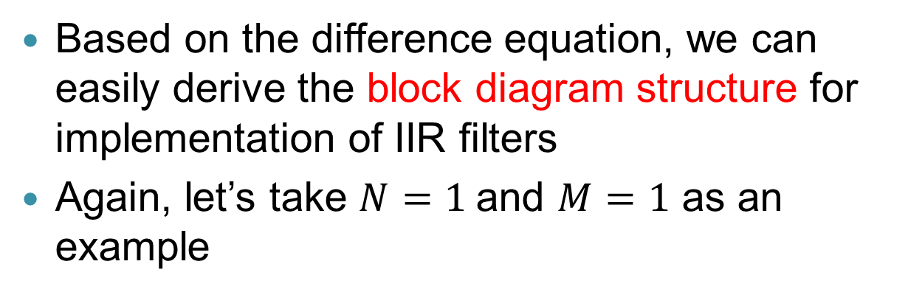
Block diagram structure
Based on the difference equation, we can easily derive the block diagram structure for implementation of IIR filters
Again, let’s take $N=1$and $M=1$ as an example
x[n]
+
+
y[n]
b₀
Z⁻¹
Z⁻¹
b₁
a₁
x[n-1]
y[n-1]
Direct Form I structure

Slide 8
Block diagram structure (cont)
x[n]
+
+
y[n]
b₀
Z⁻¹
Z⁻¹
b₁
a₁
x[n-1]
y[n-1]
Feed-forward Part
B(z)
Feedback Part
Direct Form I structure

Slide 9
Block diagram structure (cont)
x[n]
+
+
y[n]
b₀
Z⁻¹
Z⁻¹
a₁
b₁
Feedback Part
Feed-forward Part
B(z)
Direct Form II structure

Slide 10
Block diagram structure (cont)
The two delay elements can be combined
x[n]
+
+
y[n]
b₀
Z⁻¹
a₁
b₁
Feedback Part
Feed-forward Part
B(z)
Direct Form II structure

Slide 11
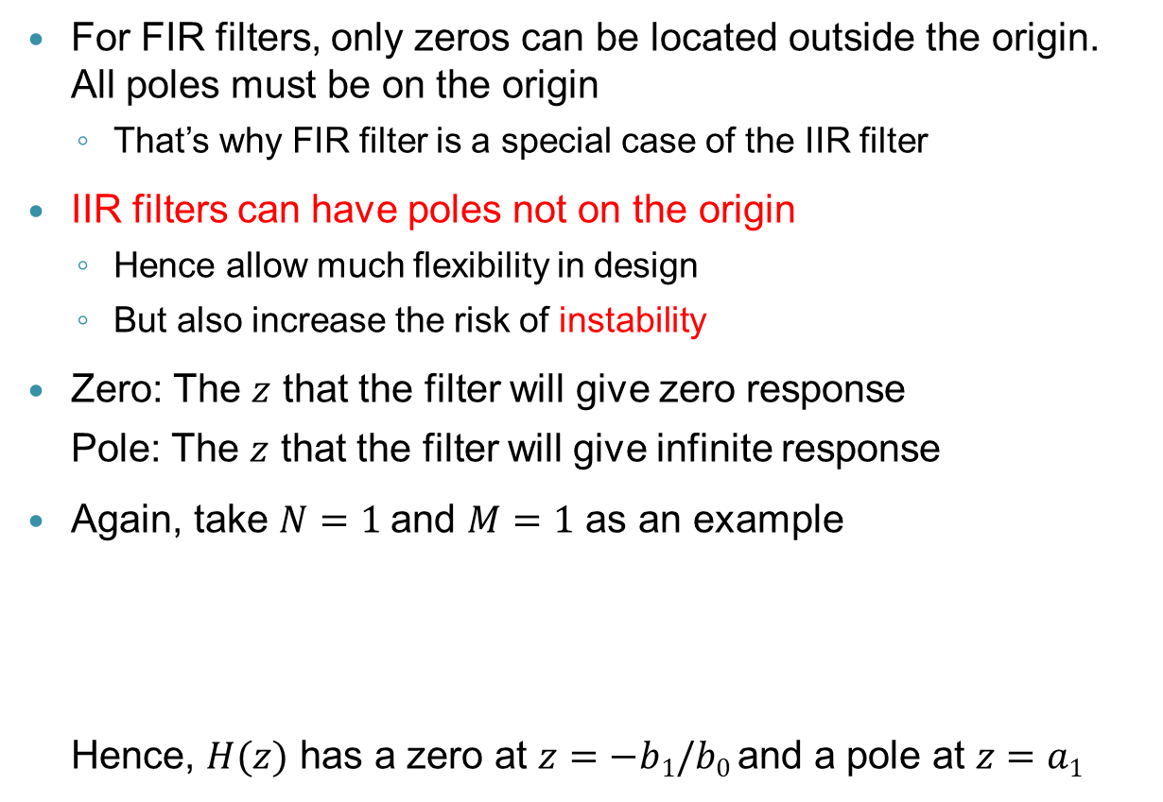
Poles and zeros
For FIR filters, only zeros can be located outside the origin. All poles must be on the origin
That’s why FIR filter is a special case of the IIR filter
IIR filters can have poles not on the origin
Hence allow much flexibility in design
But also increase the risk of instability
Zero: The $z$ that the filter will give zero response
Pole: The $z$ that the filter will give infinite response
Again, take $N=1$and $M=1$ as an example
Hence, $H(z)$ has a zero at $z=−b1/b0$and a pole at $z=a1$

Slide 12
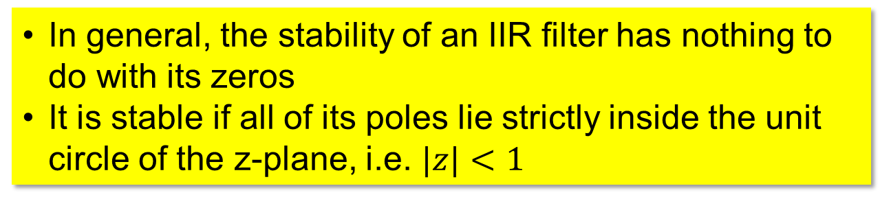
Pole location and stability
The location of the poles of an IIR filter has a direct consequence to its stability
Recall for a 1st order IIR filter
Die out
Unbounded
In general, the stability of an IIR filter has nothing to do with its zeros
It is stable if all of its poles lie strictly inside the unit circle of the z-plane, i.e. $|z|<1$

Slide 13
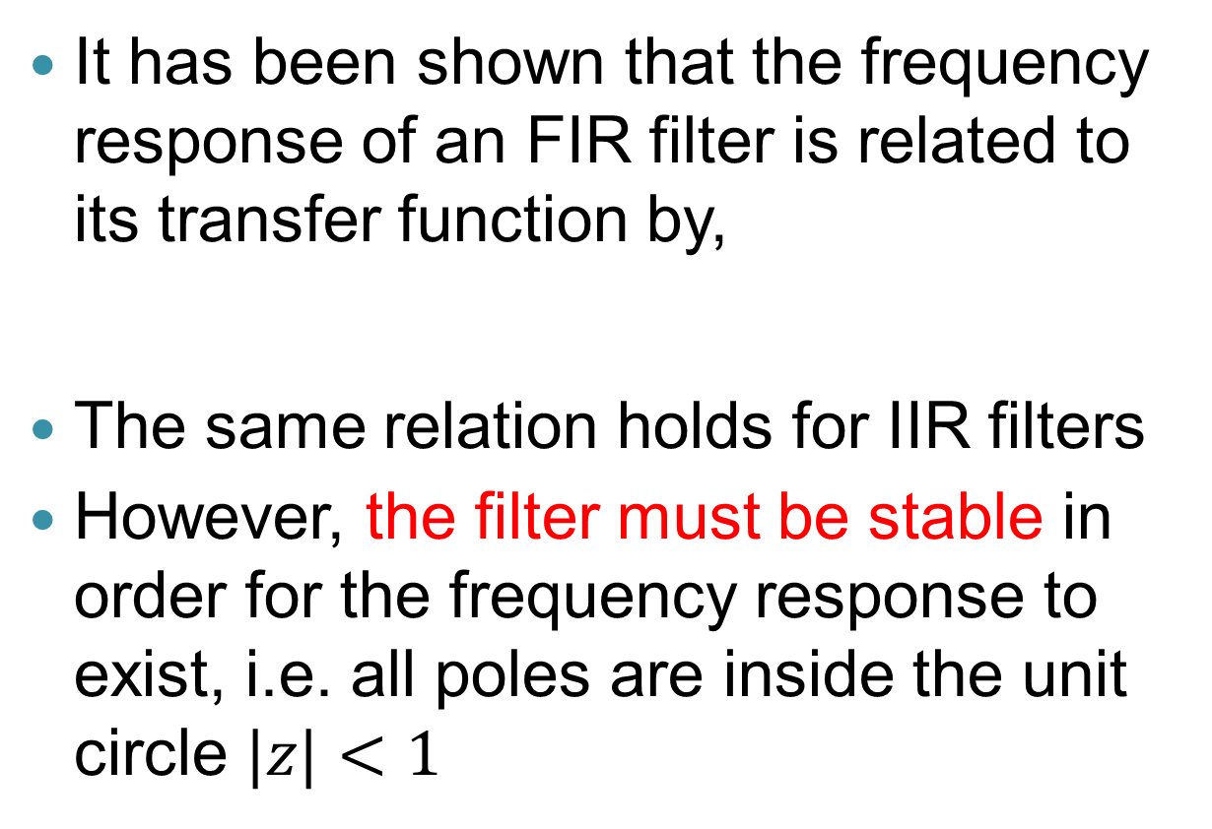
6.3 Frequency Response of IIR Filters
It has been shown that the frequency response of an FIR filter is related to its transfer function by,
The same relation holds for IIR filters
However, the filter must be stable in order for the frequency response to exist, i.e. all poles are inside the unit circle $|z|<1$

Slide 14
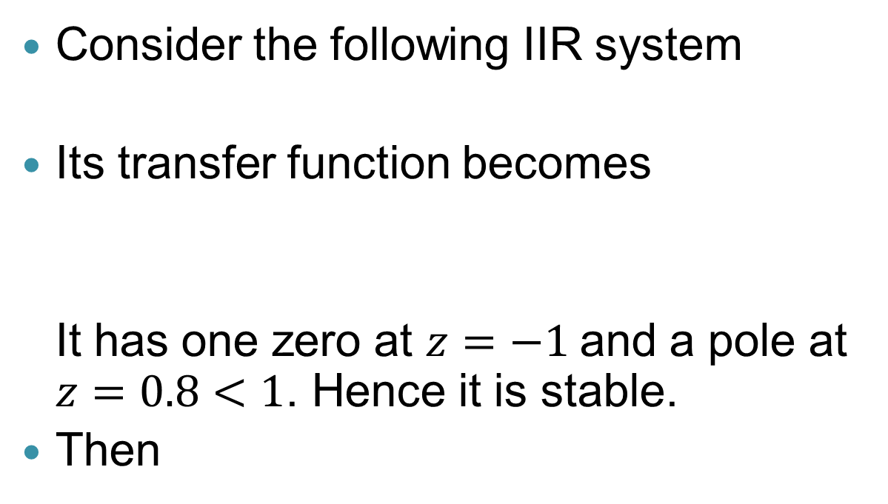
Example 1
Consider the following IIR system
Its transfer function becomes
It has one zero at $z=−1$and a pole at $z=0.8<1$. Hence it is stable.
Then

Slide 15
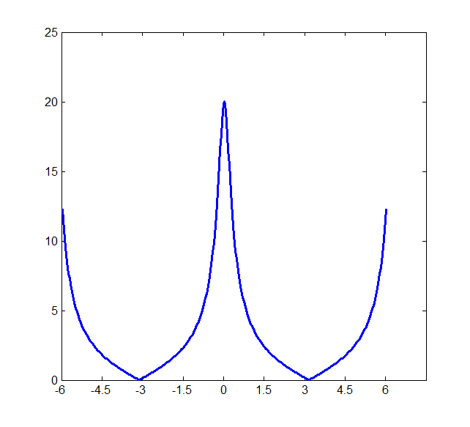
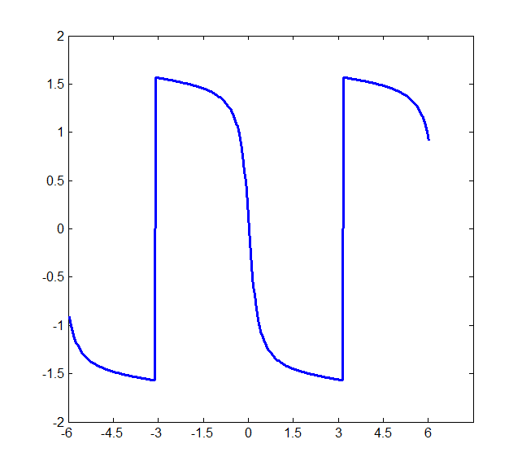
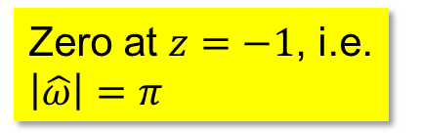
Example 1 (cont)
Magnitude response
Phase response
Zero at $z=−1$, i.e. $\left|\hat{ω}\right|=π$
Non-linear phase

Slide 16
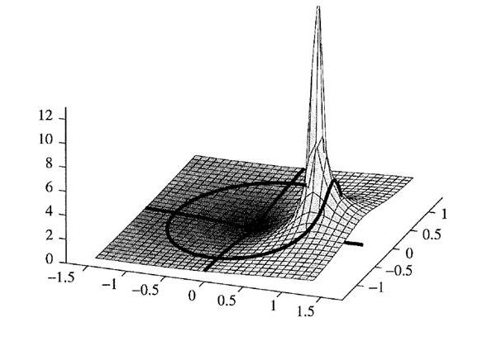

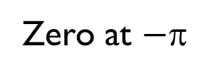
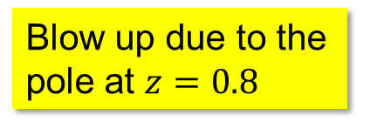
Example 1 (cont)
The effect of the pole at $z=0.8$can be visualized using a 3-D plot
Blow up due to the pole at $z=0.8$
z plane
Zero at $−$
O
Imaginary axis
Real axis

Slide 17
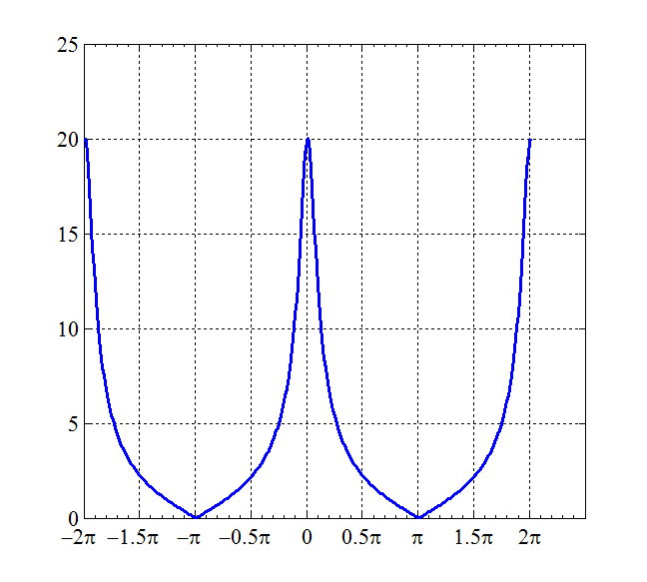
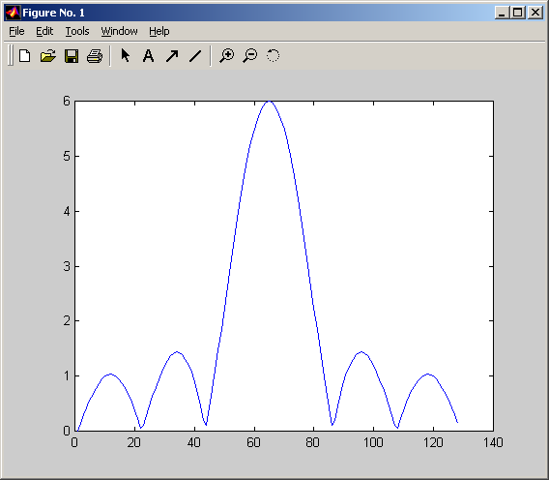
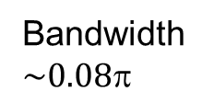

Comparison with FIR filters
The IIR filter in the example is a low-pass filter
Let’s compare it with the magnitude response of the running average FIR filter as shown on p.29 of the course notes z-transform
Bandwidth $\sim 0.08π$
Bandwidth $\sim 0.15π$

Slide 18
Comparison with FIR filters (cont)
Comparing with FIR filters, IIR filters can always achieve filters of same (or narrower) passband bandwidth with less number of taps
Due to the feedback part which recursively processes the output
Less number of taps means less storage and less computation, which are the advantage of IIR filters
x[n]
+
+
y[n]
b₀
Z⁻¹
Z⁻¹
b₁
a₁
x[n-1]
y[n-1]

Slide 19
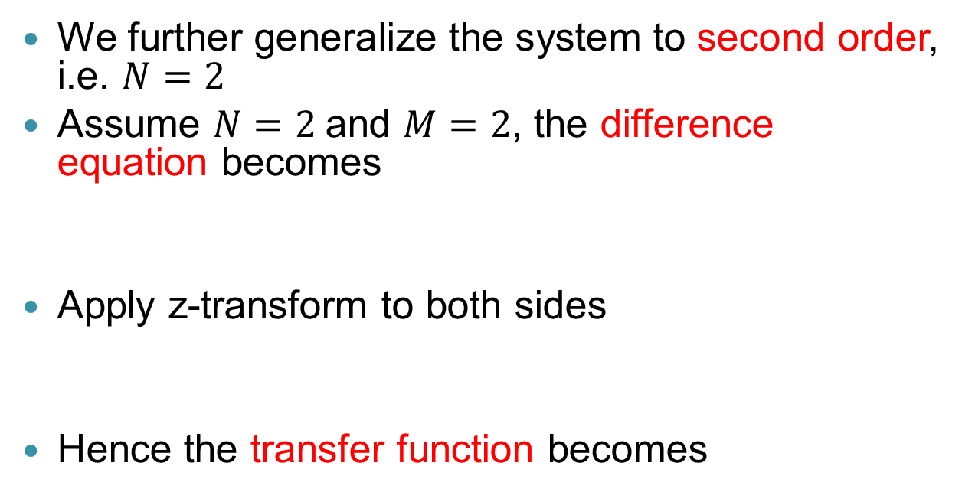
6.4 Second Order IIR Filters
We further generalize the system to second order, i.e. $N=2$
Assume $N=2$and $M=2$, the difference equation becomes
Apply z-transform to both sides
Hence the transfer function becomes

Slide 20
Block diagram structure
Similarly, we can derive the block diagram structure based on the difference equation:
x[n]
+
+
b₀
y[n]
Z⁻¹
Z⁻¹
b₁
a₁
x[n-1]
y[n-1]
Z⁻¹
Z⁻¹
b₂
a₂
x[n-2]
y[n-2]
Direct Form I structure

Slide 21
Block diagram structure (cont)
We can also reverse the structure to implement a second order IIR filter in direct form II
x[n]
+
+
y[n]
b₀
Z⁻¹
a₁
b₁
Z⁻¹
a₂
b₂
Direct Form II structure

Slide 22
Poles and zeros
The poles and zeros of a second order transfer function can be obtained using the traditional factorization technique for quadratic equations

Slide 23
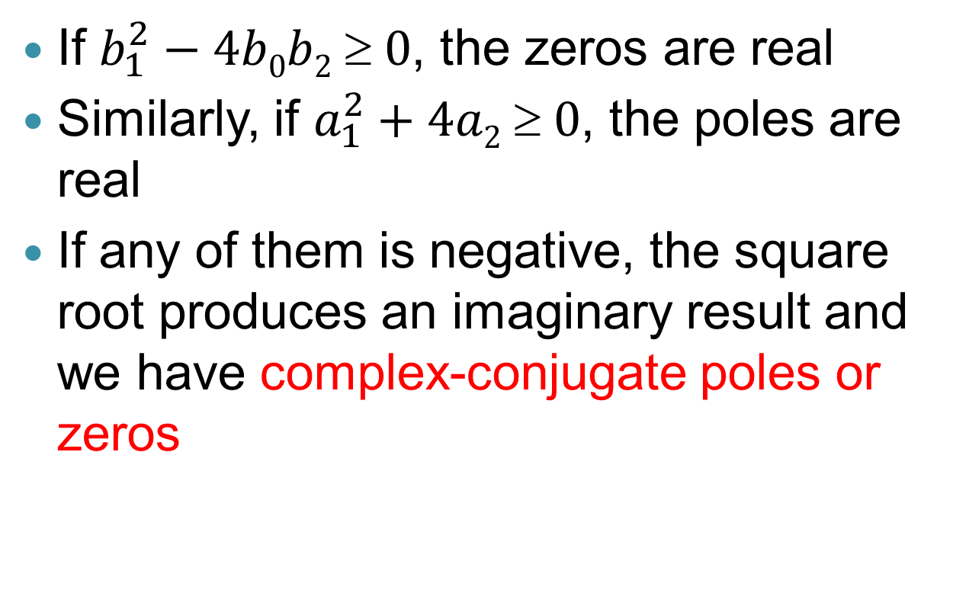
Pole and zeros (cont)
If $b_{1}^{2}−4b0b2  0$, the zeros are real
Similarly, if $a_{1}^{2}+4a2  0$, the poles are real
If any of them is negative, the square root produces an imaginary result and we have complex-conjugate poles or zeros

Slide 24
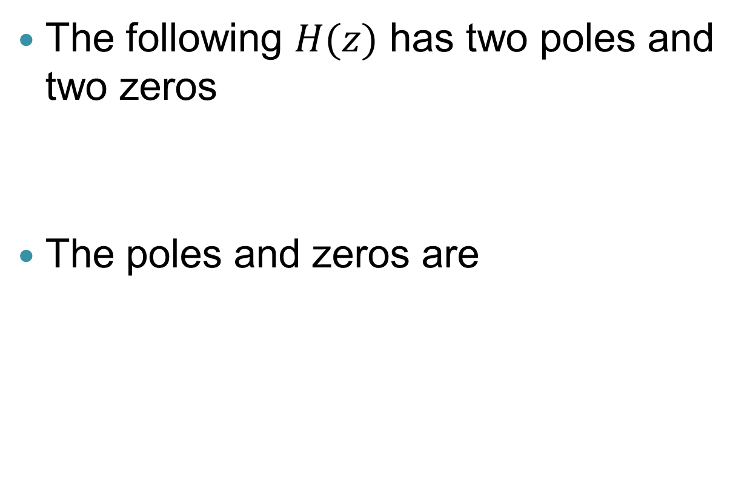
Example 2
The following $H(z)$ has two poles and two zeros
The poles and zeros are

Slide 25
Example 2 (cont)
For this example, the poles are on the unit circle. Can be unstable for most of the input signals
1
×
0.5
Imaginary part
0
-0.5
-1
×
-1
-0.5
0
0.5
1
Real part
For all second order IIR filters with real coefficients, their poles and zeros are either real or complex conjugate pairs

Slide 26
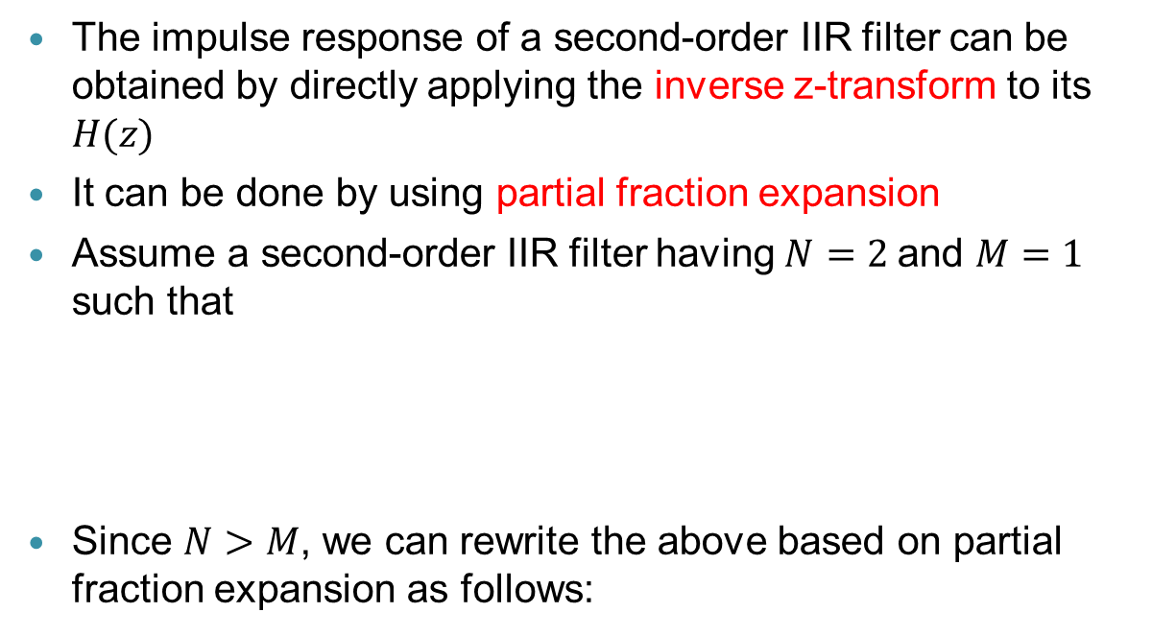
Impulse response of a second-order IIR filter
The impulse response of a second-order IIR filter can be obtained by directly applying the inverse z-transform to its $H(z)$
It can be done by using partial fraction expansion
Assume a second-order IIR filter having $N=2$and $M=1$ such that
Since $N>M$, we can rewrite the above based on partial fraction expansion as follows:

Slide 27
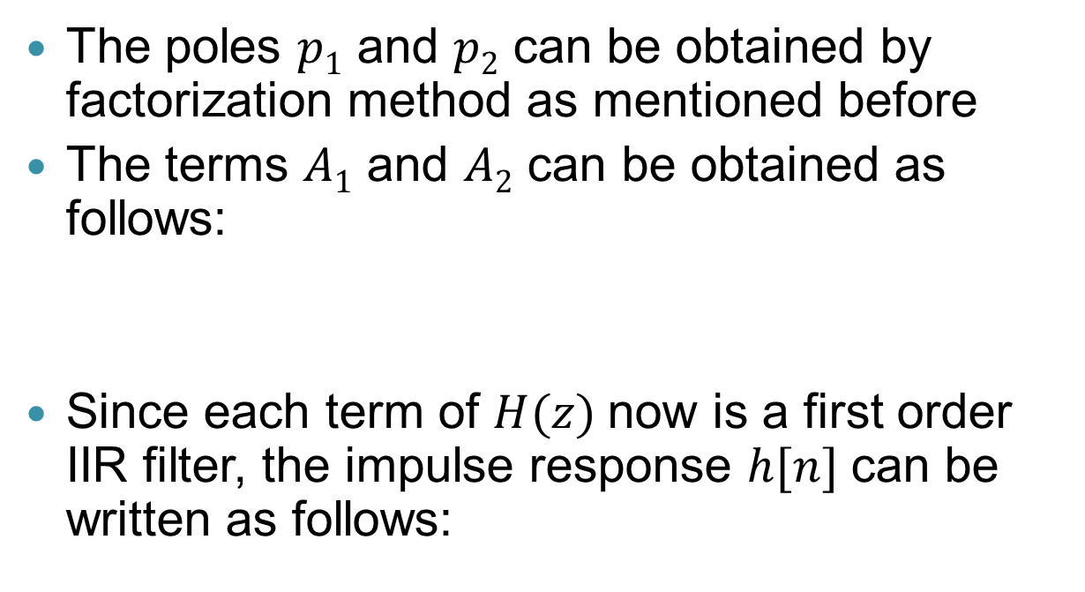
Impulse response of a second-order IIR filter (cont)
The poles $p1$ and $p2$ can be obtained by factorization method as mentioned before
The terms $A1$ and $A2$ can be obtained as follows:
Since each term of $H(z)$now is a first order IIR filter, the impulse response $h[n]$can be written as follows:

Slide 28
Example 3
Let the transfer function of a second-order IIR filter be
We wish to write
We know that

Slide 29
Example 3 (cont)
Hence

Slide 30

Example 4
Let the transfer function of a second-order IIR filter be
We wish to write the above to
But
As $A1$ and $A2$ are both constants, the numerator can only have terms up to $z^{−1}$ but not $z^{−2}$

Slide 31
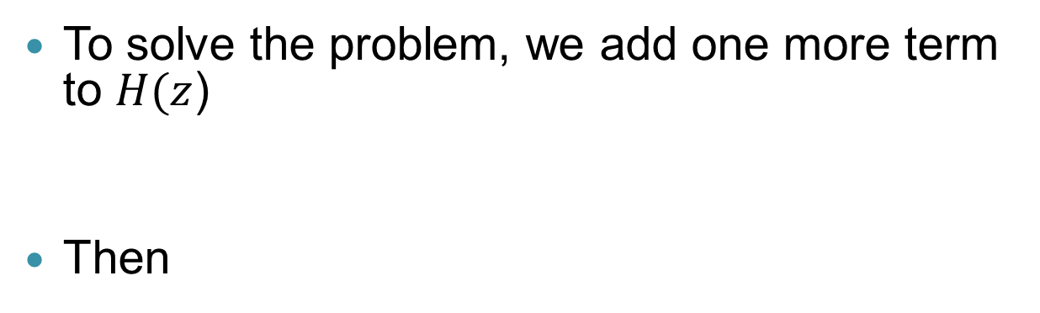
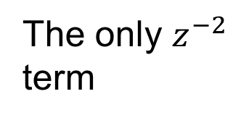
Example 4 (cont)
To solve the problem, we add one more term to $H(z$)
Then
The only $z^{−2}$ term

Slide 32
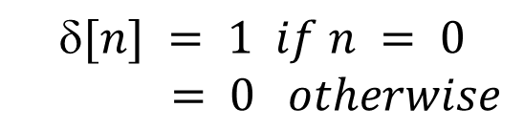
Example 4 (cont)
So we have
$$[n] = 1 if n = 0$$
$$= 0 otherwise$$

Slide 33
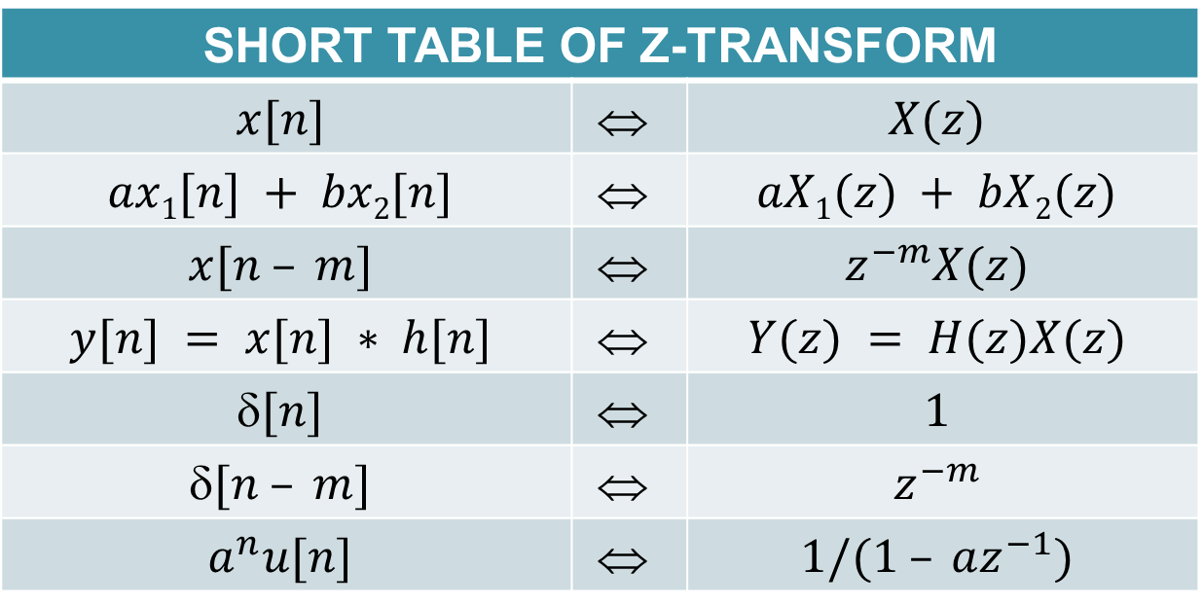
Short table of Z-transform
SHORT TABLE OF Z-TRANSFORM
$$x[n]$$ | $$$$ | $$X(z)$$
$$ax1[n] + bx2[n]$$ | $$$$ | $$aX1(z) + bX2(z)$$
$$x[n – m]$$ | $$$$ | $$z^{−m}X(z)$$
$$y[n] = x[n] ∗ h[n]$$ | $$$$ | $$Y(z) = H(z)X(z)$$
$$[n]$$ | $$$$ | $$1$$
$$[n – m]$$ | $$$$ | $$z^{−m}$$
$$a^{n}u[n]$$ | $$$$ | $$1/(1 – az^{−1})$$

Slide 34
Frequency response of second-order IIR filters
Similar to the first order case, the frequency response of a stable system is related to its Z-transform by,
Hence if
The magnitude response of the filter becomes
⇒

Slide 35
Example 5
Consider a second-order IIR filter with transfer function
Hence
⇒

Slide 36
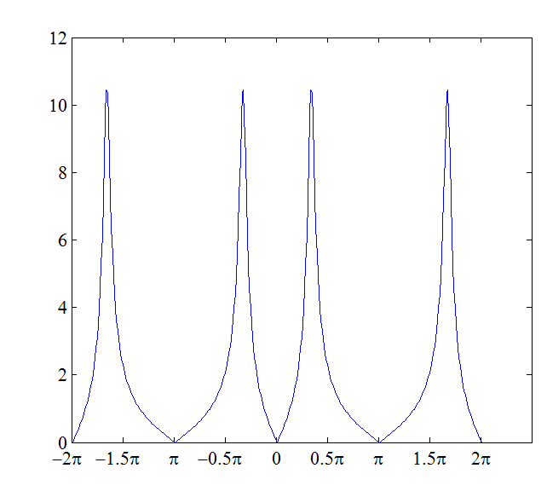
Example 5 (cont)
One can easily plot the magnitude response using Matlab

Slide 37

Example 5 (cont)
The shape of the magnitude response can be easily explained by the position of its poles and zeros
Position of zeros: $z=1$and $z=−1$
Position of poles: $z = 0.9e^{jπ/3}$and $0.9e^{−jπ/3}$

Slide 38

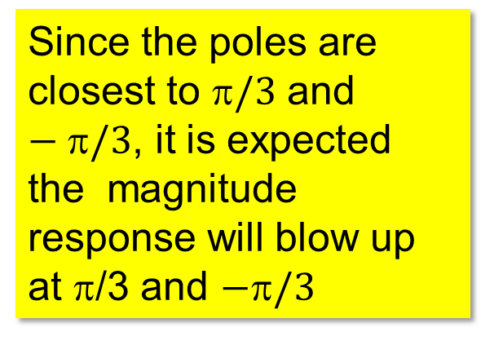
Example 5 (cont)
Since the poles are closest to $/3$ and $−/3$, it is expected the magnitude response will blow up at π/3 and $−/3$
1
×
0.5
Imaginary part
0
-0.5
×
-1
-1
-0.5
0
0.5
1
Real part
It forms a very narrowband bandpass filter at around $/3$

Slide 39
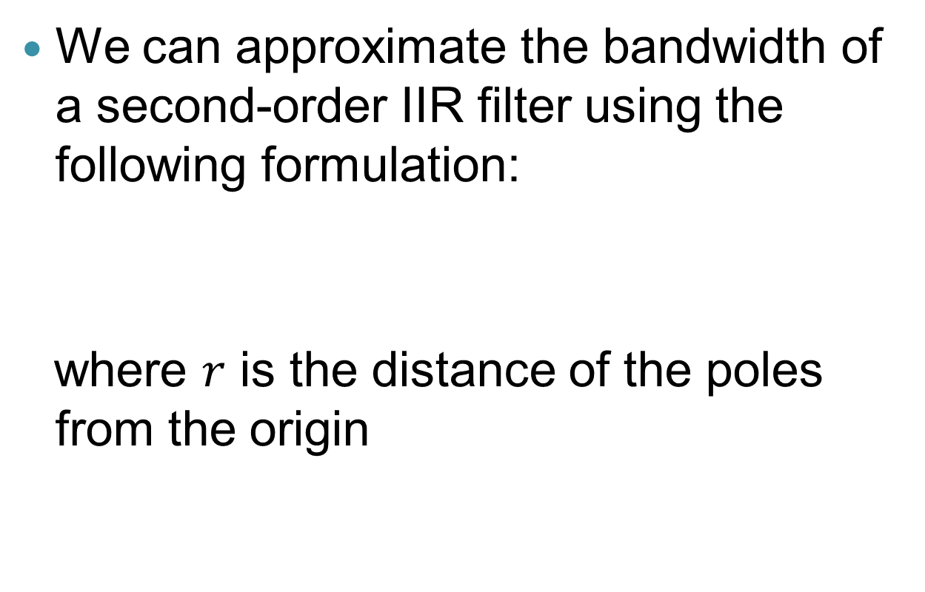
Example 6
We can approximate the bandwidth of a second-order IIR filter using the following formulation:
where $r$ is the distance of the poles from the origin

Slide 40




Example 6 (cont)
An IIR filter has the following poles / zeros
1
0.5
×
Imaginary part
$$\frac{π}{6}$$
$$r=0.8$$
0
$$r=0.8$$
$$−\frac{π}{6}$$
-0.5
×
-1
-1
-0.5
0
0.5
1
Real part

Slide 41
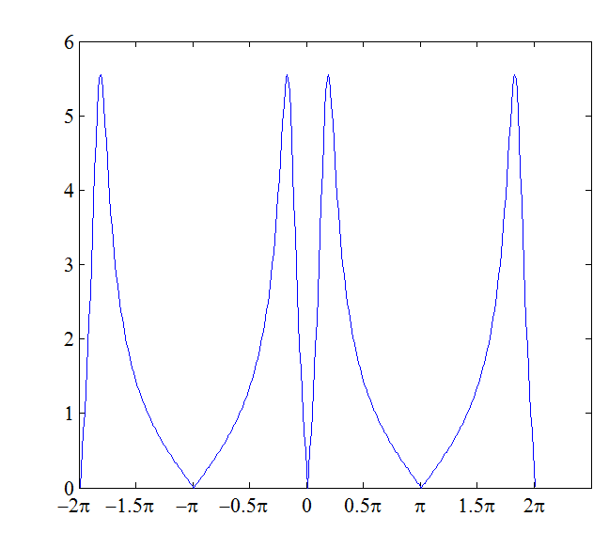

Example 6 (cont)
The magnitude response of the IIR filter is plotted as follows:
Bandwidth
$$=\frac{\left|H_{max}\right|}{√2}≈0.14π$$
-π/6
π/6

Slide 42
Final remarks
To design more sophisticated IIR filters (flat passband and stopband, sharp transition edge, etc), more poles and zeros are needed ⇒ hence higher order and more difficult
Rather than making the design from scratch, usually we start with an analogue filter (e.g. Butterworth, Chebyshev, Elliptic) that meets the specifications. Then transform it to the form of an IIR filter using the techniques such as bilinear transformation, impulse invariance, etc.
It is possible since the structure of analogue filters is close to the IIR filters

Slide 43
Final remarks (cont)
Advantage of IIR filters over FIR filters
IIR filters can give a similar performance as FIR filters with less taps
Less storage, less computation, and perhaps shorter delay
Common problems
Difficult to design IIR filters with linear phase
Stability is a problem when working in adverse environment (due to finite word length effect, noise in the system, etc.)

