Slide 1
EIE4413 Digital Signal Processing
Dr Daniel Lun
Department of Electronic and Information Engineering
The Hong Kong Polytechnic University
Office: DE637 Tel: 27666255
Email: enpklun@polyu.edu.hk
https://staff.eie.polyu.edu.hk/enpklun/
Course material can be found in the Blackboard

Slide 2
Topics
Introduction
Fourier analysis – theory and implementation
Convolution and implementation
The Z transform and digital filter realization
FIR and IIR filter designs
Statistical signal processing and applications

Slide 3
Subject learning outcomes
Upon completion of the subject, students will be able to:
Understand the basic concepts of Fourier analysis of digital signals and apply them to practical problems.
Design and realize simple digital filters for practical applications.
Understand the importance of random signal processing in DSP, and its application in statistical measures, prediction and data modelling.
Design and simulate simple DSP systems.

Slide 4
Assessment plan
Examination (60%)
Continuous assessment (40%)
>10 short exercises (in-class exercises) (5%)
2 assignments (5%): to prepare for the test and exam
3 lab reports (10%): and 3 demos too
2 tests (20%)

Slide 5
References
Textbooks:
S.K. Mitra, Digital Signal Processing, 3rd Edition, McGraw-Hill Education (Asia), 2009.
J.G. Proakis and D.G. Manolakis, Digital Signal Processing: Principles, Algorithms and Applications, 4th Edition, Pearson International Edition, 2007.
E.C. Ifeacher and B.W. Jervis, Digital Signal Processing - A Practical Approach, Prentice Hall (Pearson Education), 2002.
Plus other reference materials given by the subject lecturer

Slide 6
Introduction
Chapter 1

Slide 7
Why “Digital Signal Processing”?
What are signals?
“Something” that carry information
“Something” ⇒ pattern of variations of physical quantity that can be manipulated, stored, or transmitted by physical process
e.g. Speech signals, audio signals, image signals, video signals, radar signals, etc.
Human beings use different kind of signals to convey information
They are the basis of all information systems
Need thorough study of their manipulation, storage, and transmission

Slide 8



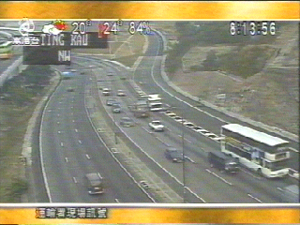

Examples of signals
Image
Speech
Audio
Video
Multimedia

Slide 9
Why “Processing”?
The original form of signals may not suit the needs of conveying information
E.g. speech signals
Volume too low, too noisy, not enough intelligibility, etc.
E.g. image signals
Too blur, too dark, not colorful enough, etc.
It is often that we have no way to inform the signal sources to change their signals
Desirable if they can be processed after received

Slide 10
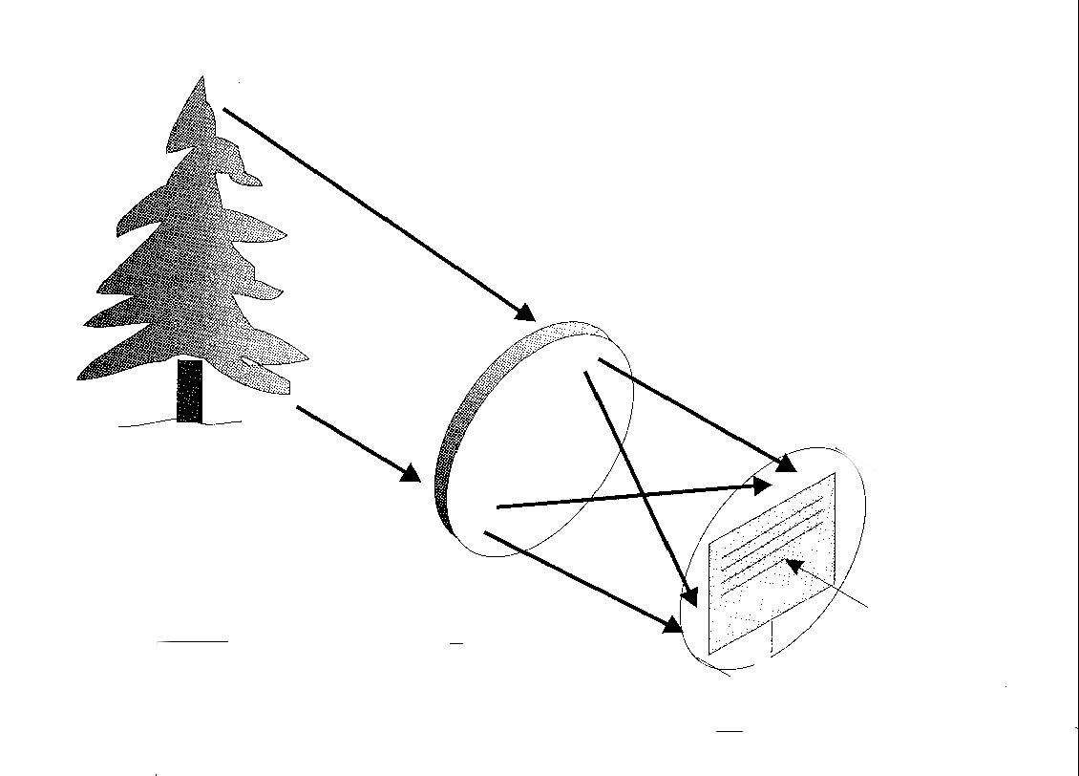
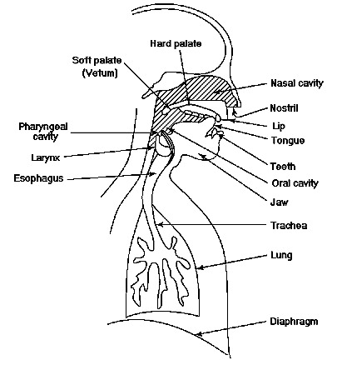

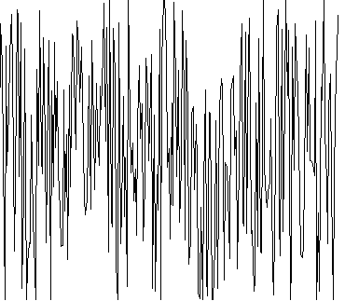
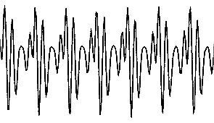
Why “Digital”?
Signals can change to other physical form, e.g. electricity
Light
Object
wave
CCD
Lens
mic
Facilitate manipulation, storage, and transmission using electrical equipment
change of voltage
change of voltage

Slide 11
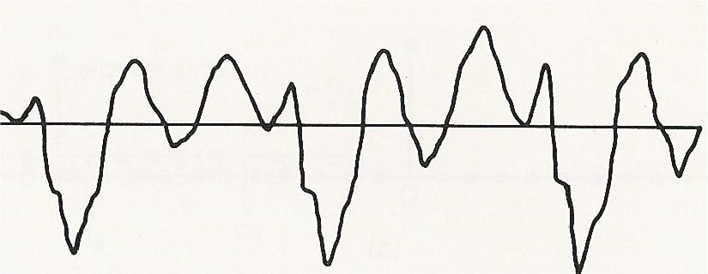
Why “Digital”?
After conversion, many signals become voltage changing with time, e.g. speech
For every time instant, signal is found
Hence continuous-time signal (or analogue signal)
Most natural signals, such as speech, audio, etc. are continuous-time signals
voltage
time

Slide 12
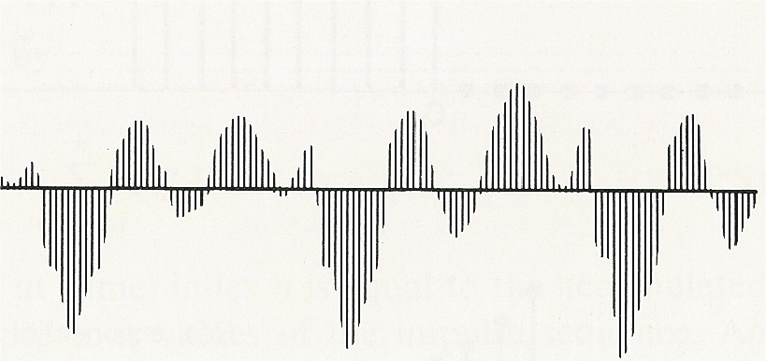
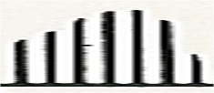
Why “Digital”?
With the advance of computer technology, we want to process signals by computer
Computer can only handle data, but not continuous signals
Need sampling
⇒ extract signal at some time instants
⇒ Discrete-time signals
voltage
4.2v
4v
time
2v
Signal is found only at some instants
Discrete-time signal

Slide 13
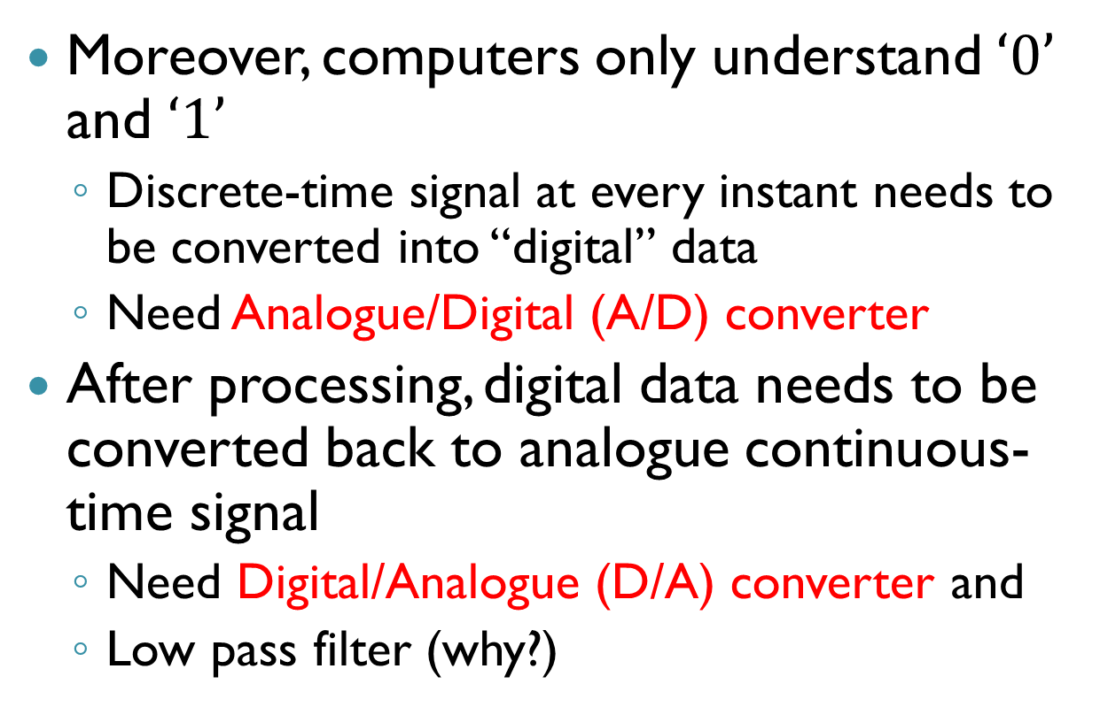
Why “Digital”?
Moreover, computers only understand $‘0’$ and $‘1’$
Discrete-time signal at every instant needs to be converted into “digital” data
Need Analogue/Digital (A/D) converter
After processing, digital data needs to be converted back to analogue continuous-time signal
Need Digital/Analogue (D/A) converter and
Low pass filter (why?)

Slide 14
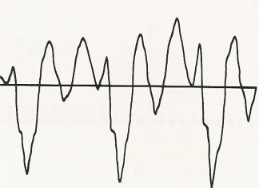
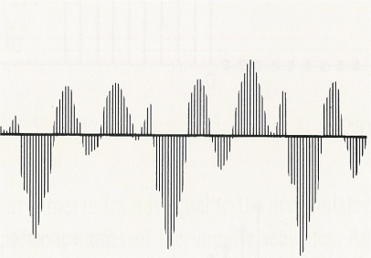
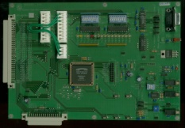


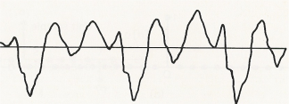
Typical DSP system
Sound card with sampler
(or A/D converter)
Mic
speaker
D/A converter and low pass filter
Processed signal

Slide 15
Then why NOT analogue signal processing?
DSP has a few important advantages over directly processing analogue signals
Perfect reproducibility
No drift in performance with temperature or age
Suitable for VLSI implementation
VLSI favors digital systems
Greater flexibility
DSP systems can be programmed and reprogrammed to perform a variety of functions, without modifying the hardware
Superior performance
New methods are found for processing signals in discrete domain but hardly in analogue domain

Slide 16
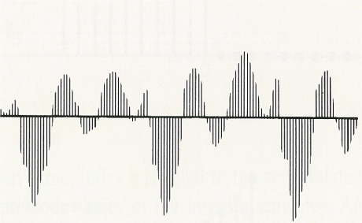
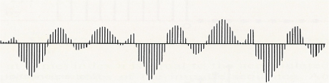
Typical steps to construct a DSP system
Prepare all the required hardware
Generate digital data for processing at the computer input
Convert digital data from the computer output to analogue signal
Develop signal processing algorithm
Express input and output in mathematical form
Using mathematics to figure out the solution to the problem
Realize the signal processing algorithm
Translate the algorithm into computer program
Execute the program with the computer
Input
Output

Slide 17
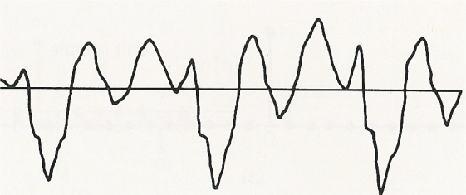
Example – To amplify a signal
Start with an analogue signal x(t) …
We use () to indicate that x is continuous
t = 100.23
x(t)
t = 0
t = 70.5
x: a symbol represents this signal
t: a real number variable
x(t) is defined for all value of t, hence continuous
e.g. x(0) = 0; x(70.5) = -90.5; x(100.23) = 80

Slide 18
Example – To amplify a signal
The sampler converts x(t) to become a discrete-time signal x[n]
We use [] to indicate that x is discrete
n = 100
x[n]
n = 0
n = 70
x: a symbol represents this signal
n: an integer variable
x[n] is defined only at some instants of time, since n is integer
e.g. x[0] = 0; x[70] = -90.5; x[100] = 80

Slide 19

Example – To amplify a signal
x(t)
x[n] = x(nT_{s})
x[n]
x[0] = x(0)
x[1] = x(T_{s})
x[2] = x(2T_{s})
x[3] = x(3T_{s})
: :
T_{s} – Sampling period

Slide 20
Example – To amplify a signal
Input
(256 samples)
Output
(256 samples)
Our task: Output = Input x 2
1. Develop signal processing algorithm
Input – x[n]; Output – y[n]
y[n] = x[n] × 2 for all n (algorithm)
2. Realize the signal processing algorithm
main()
{ int n, x[256], y[256]; x = zeros(1,256);
for (n=0; n<256; n++) y = zeros(1,256);
// Get data and store in x % Get data and store in x
y[n] = x[n]*2; y = x*2;
}
C Program
Matlab Program

Slide 21
Summary
Digital signal processing has many advantages over directly processing a signal in analogue form
Digital signal processing needs special hardware such as sampler, A/D, D/A converter and low pass filter for its implementation
Mathematic derivation and programming are equally important when constructing a DSP system

Slide 22
Summary
All of the above are based on an important theorem, namely the Shannon sampling theorem,
Analogue signals can be reconstructed from their discrete-time counterpart without significant error if certain criteria are fulfilled
To understand the Shannon sampling theorem, we need to first understand the frequency response of signals

