Slide 1
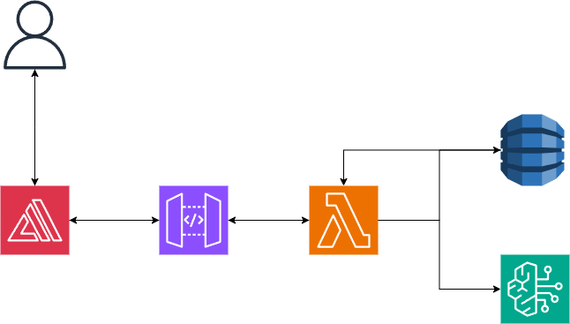
User
AWS Dynamodb
AWS API gateway
AWS amplify
AWS lambda
AWS Bedrock

