Slide 1

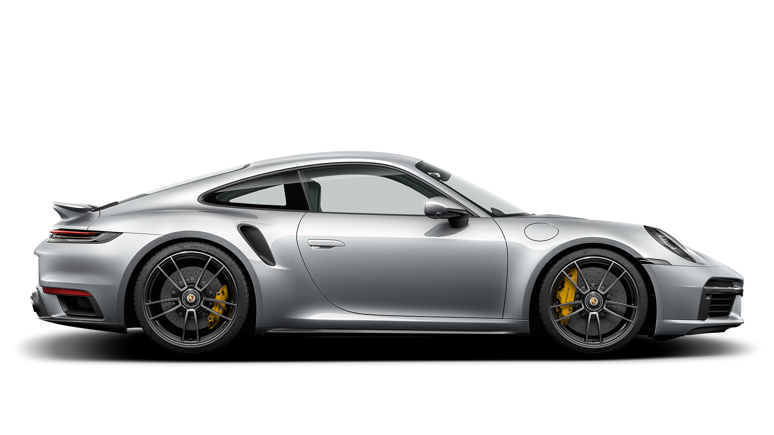


Slide 2
Performance
Porsche 911 Turbo S Engine and Transmission: It is powered by a 2981 cc engine which is available with a Automatic transmission.
The 911 Turbo S
The price of the 2024 Porsche 911 Turbo / Turbo S starts at $198,850 and goes up to $244,850 depending on the trim and options. To unlock the entirety of the 3.7-liter six-cylinder's 640 horsepower, you'll need to spring for the Turbo S model.
Design
The seat backrests have quilted seat centres and backrests in leather.
Comfort
Porsche 911 Turbo S is a masterpiece of luxury and technology. The seats are made of high-quality leather and provide excellent support and comfort, even during spirited driving.

Slide 3
205 mph
Top track speed
2,6s
0-60 mph
640HP
MAXIMUM POWER
Performance
Porsche 911 Turbo S Engine and Transmission: It is powered by a 2981 cc engine which is available with a Automatic transmission.
Turbo S
Design
The seat backrests have quilted seat centres and backrests in leather.
Comfort
Porsche 911 Turbo S is a masterpiece of luxury and technology. The seats are made of high-quality leather and provide excellent support and comfort, even during spirited driving.

Slide 4
640HP
MAXIMUM POWER
2,6s
0-60 mph
205 mph
Top track speed
PORSCHE 911

Slide 5
PORSCHE 911
The most perfect sportscar

