Slide 1
Jenkins, fuego, lava in Continuous integration

Slide 2

Jenkins
Jenkins, fuego, lava in Continuous integration
An extensible automation server
Jenkins can be used as
- a simple CI server
- a continuous delivery hub for any project
Frédéric Marec

Slide 3
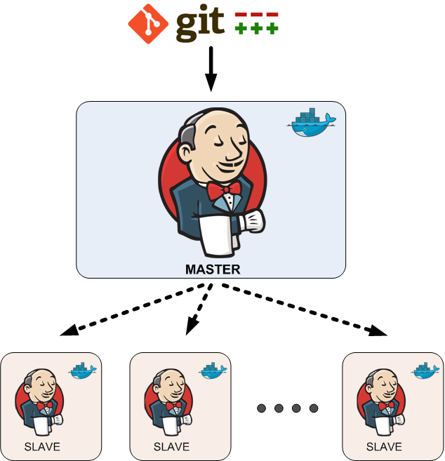
Current architecture
Jenkins, fuego, lava in Continuous integration
Master: Jenkins v2.94
Slaves:
- opensuse 42.3
- opensuse tumbleweed
- ubuntu 16.04
- fedora 25
- debian 9
- raspbian 9.1
Frédéric Marec

Slide 4
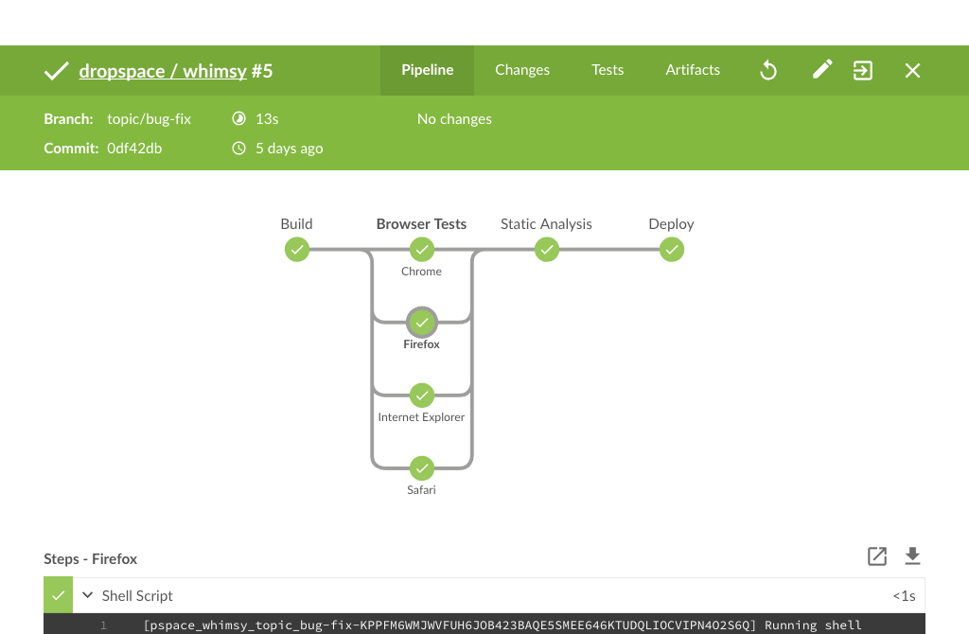
Jenkins Blue Ocean
Jenkins, fuego, lava in Continuous integration
Designed for Jenkins Pipeline :
- allowing for fast and intuitive comprehension of pipeline’s status
- pinpoint precision when intervention is needed and/or issues arise
- Native integration for branch and pull requests
Frédéric Marec

Slide 5
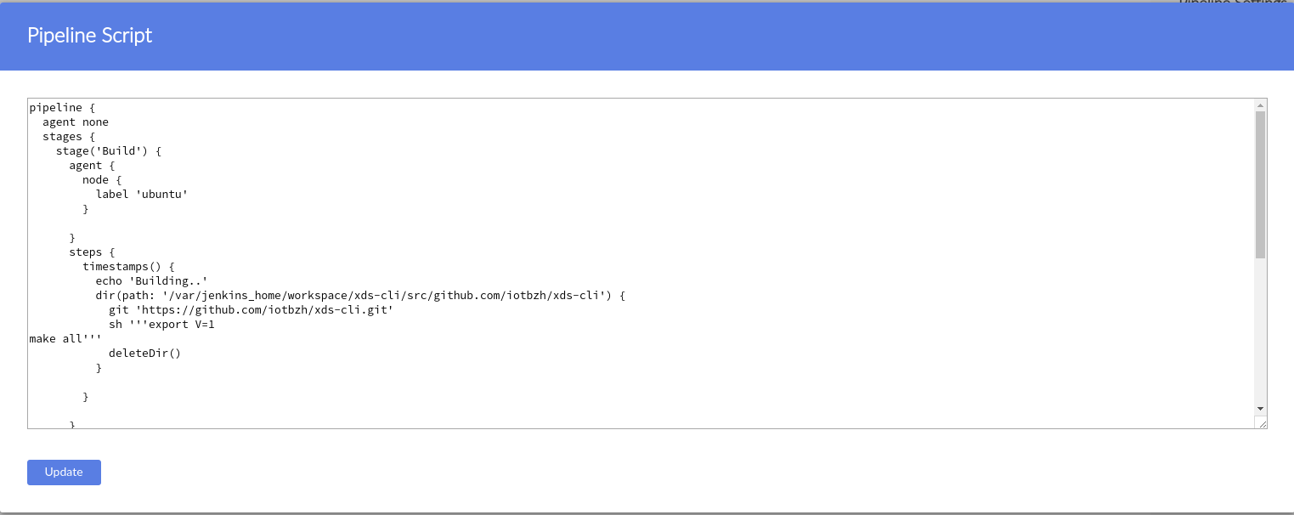
Jenkinsfile
Jenkins, fuego, lava in Continuous integration
Blue ocean plugin has a pipeline editor (intuitive and visual process to create a Pipeline)
Pipeline script use groovy syntax:
https://jenkins.io/doc/book/pipeline/syntax/
Frédéric Marec

Slide 6

Fuego
Jenkins, fuego, lava in Continuous integration
Fuego is a test framework specifically designed for embedded Linux testing.
Fuego is that it consists of a host/target script engine, with a Jenkins front-end, and over 50 pre-packaged tests, installed in a docker container.
Frédéric Marec

Slide 7
Kernelci
Jenkins, fuego, lava in Continuous integration
kernelci.org is a community based, open source distributed test automation system focused on upstream Linux kernel development.
Their goal is to unify all upstream Linux kernel testing efforts in order to provide a single place where to store, view, compare and track these results.
It is their mission to detect, bisect, report and fix regressions on upstream Kernel trees before they even reach «mainline».
Frédéric Marec

Slide 8
Lava
Jenkins, fuego, lava in Continuous integration
LAVA is the Linaro Automation and Validation Architecture
LAVA is a continuous integration system for deploying operating systems onto physical and virtual hardware for running tests
Tests can be simple boot testing, bootloader testing and system level testing, although extra hardware may be required for some system tests
Frédéric Marec

